Slide 1
Dictionaries and Sets
Module 6

Slide 2
Introduction
Dictionaries: Data structures that hold data or information in key-value order.
Known as associative arrays in other languages.
Indexed using key which are usually strings.
Two kinds:
dict: Default, unordered.
OrderedDict: Stores in order of insertion.
Set: Collection of unordered and unique data items.
Able to use for mathematical operations, such as union and intersection.
Union: Given two sets, A and B, union is set of everything in A and B.
Intersection: Given two sets A and B, intersection is set of everything common in both A and B.

Slide 3
Lesson 6.1: Working with Dictionaries (1 of 2)
Can create two ways:
With curly brackets: dictionary = {}
With dict() function: dictionary = dict()
Snippet 6.5 shows example of how to create a dictionary.
state and city are the keys.
NY and New York are the values.

Slide 4
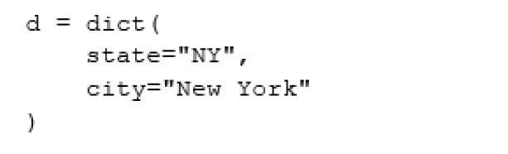
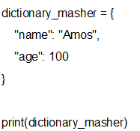
Lesson 6.1.1: Adding Data to a Dictionary (1 of 3)
Snippet 6.6 shows how to add data using both curly brackets and dict() function.
With dict() function, values are assigned to keys using =
With brackets, separate keys from values using colon.
{‘name’: ‘Amos’, ‘age’: 100}

Slide 5
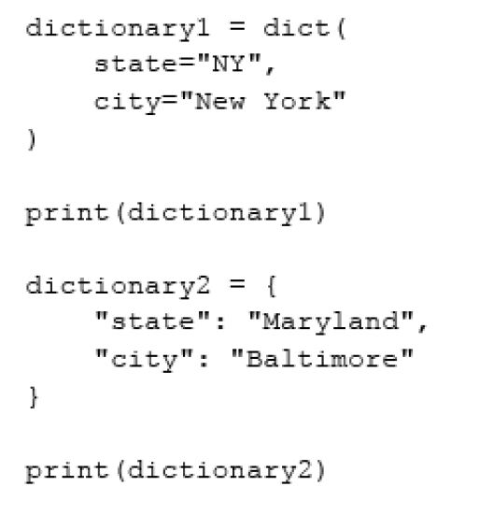
Lesson 6.1.1: Adding Data to a Dictionary (2 of 3)
Snippet 6.6

Slide 6
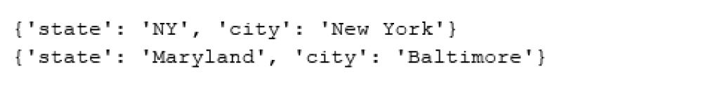
Lesson 6.1.1: Adding Data to a Dictionary (3 of 3)
Snippet 6.7

Slide 7
Lesson 6.1.2: Reading Data from a Dictionary
Access value via keys.
Example: dictionary['state']
If key does not exist, will get KeyError
Access using get() function.
Example: dictionary.get('state’)
If key doesn’t exist, None is returned.

Slide 8
Lesson 6.1.3: Iterating through Dictionaries
Simplest way is to use for loop.
Example: for item in dictionary
By default, iterates through keys.
Can specify returning keys or values using keys() or values() methods.
Example, to return values: for item in dictionary.values()
Use items() method to iterate through both keys and values.

Slide 9
Lesson 6.1.4: Checking for the Existence of Particular Keys (1 of 2)
Use in keyword.
Returns Boolean.
True if key exists, otherwise False.
Snippet 6.44 shows example.

Slide 10
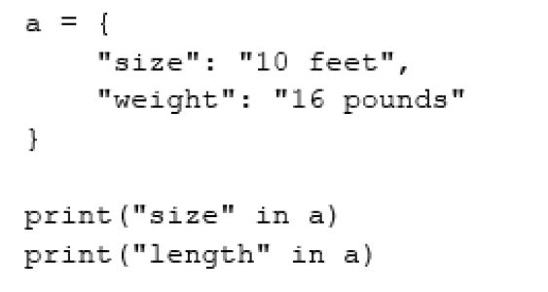
Lesson 6.1.4: Checking for the Existence of Particular Keys (2 of 2)
Snippet 6.44

Slide 11
Lesson 6.2.1: dict.update()
Inserts new key-value pairs or updates existing.
Syntax: dictionary.update({"key_name": "Value1"})

Slide 12
Lesson 6.2.2: dict.clear() and dict.pop()
clear() method removes all keys.
del keyword removes only one key-value pair.
Syntax: del dictionary["key_name"]
pop() method removes key-value pair and returns the value.
Syntax: variable_name = dictionary.pop("key_name“)

Slide 13
Lesson 6.2.3: dict.copy() (1 of 2)
Creates shallow copy of dictionary.
Shallow copy is separate entity.
Deep copy refers to same object.
Make with = operator.
Example of copy() shown in Snippet 6.54.

Slide 14
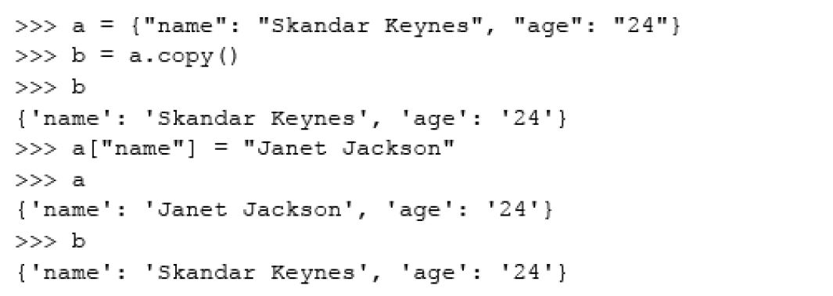
Lesson 6.2.3: dict.copy() (2 of 2)
Snippet 6.54

Slide 15
Lesson 6.2.4: dict.popitem()
Pops and returns random item from dictionary.
Item will no longer exist in dictionary.

Slide 16

Lesson 6.2.5: dict.setdefault()
Takes two arguments: key to be searched and value.
If key exists, value is returned.
Dictionary left untouched.
Value argument discarded.
If key doesn’t exist, it is inserted with given value.
If no value argument passed, None is inserted.

Slide 17
Lesson 6.2.6: dict.fromkeys() (1 of 2)
Creates dictionary from iterable of keys with value provided.
If not value provided, values set to None.
Snippet 6.60 shows example.

Slide 18
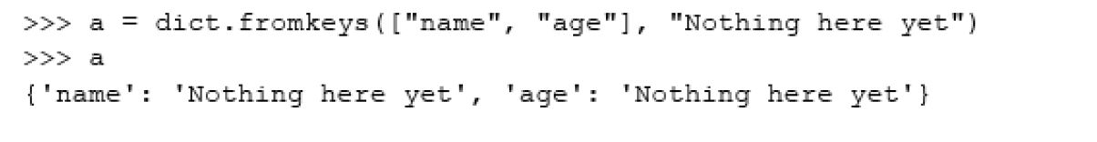
Lesson 6.2.6: dict.fromkeys() (2 of 2)
Snippet 6.60

Slide 19
Lesson 6.3: Ordered Dictionaries
Dictionaries that maintain insertion order of keys.
Create instance of OrderedDict class.
Need to import OrderedDict class from collections.
from collections import OrderedDict
When checking for equality order of key is considered.

Slide 20
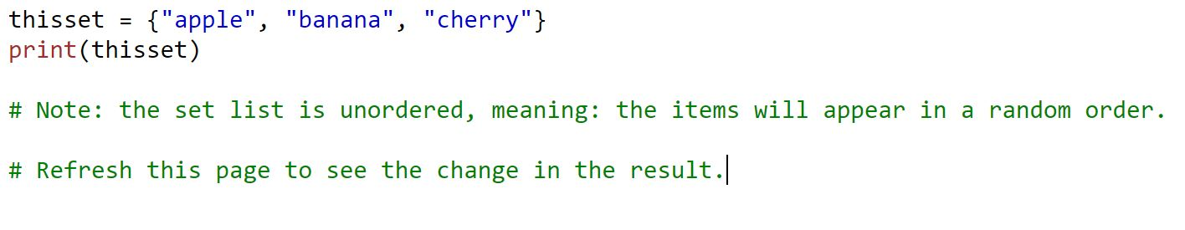
Lesson 6.4: The Basics of Sets
Set is collection of data items that are unordered and unique.
Sets are written with curly brackets
{‘cherry’, ‘apple’, ‘banana’}

Slide 21
Lesson 6.4: The basics of Creating Sets
Set is collection of data items that are unordered, unchangeable, and unique
But you can remove and add items
Create two ways:
set() function
Example: a = set([1,2,3])
Curly bracket notation
Example: c = {'a', 'b', 'c'}
{‘cherry’, ‘apple’, ‘banana’}

Slide 22
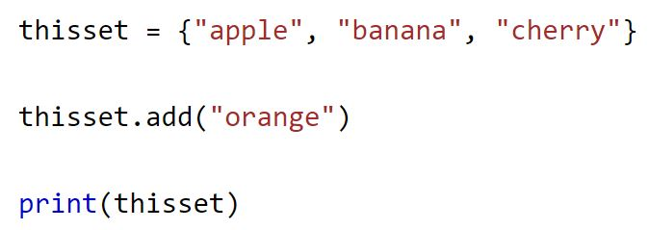
Lesson 6.4.2: Adding Data to a Set
set.add()
Adds data to set.
Example: set_a.add(4)
If adding duplicate value, set will not change.
set.update()
Adds data to set using iterables.
Example: set_a.update([3,4,5,6])
{‘cherry’, ‘orange’, ‘apple’, ‘banana’}

Slide 23
Lesson 6.4.3: Reading Data from a Set (1 of 2)
Sets do not support indices.
Iterate through set using for loop.
Example shown in Snippet 6.87.
set.pop()
Removes and returns item from beginning of set.

Slide 24

Lesson 6.4.3: Reading Data from a Set (2 of 2)
Snippet 6.87

Slide 25
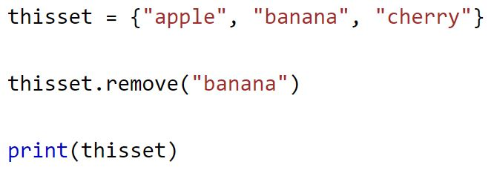
Lesson 6.4.4: Removing Data from a Set
set.pop()
set.remove(value)
Removes passed value without returning it.
If value doesn’t exist, KeyError raised.
set.discard(value)
Removes passed value without returning it.
If value doesn’t exist, no error raised.
set.clear()
Removes all data from set.
{‘cherry’, ‘apple’}

Slide 26
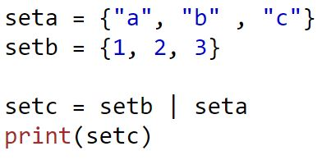
Lesson 6.5.1: Union
Union of two sets is set of all elements in both sets.
Will always exclude any duplicates
Use union() method.
set_a.union(set_b) count(item)
Use | operator.
set_a | set_b
{1,2,3,”b”, “c”, “a”}

Slide 27
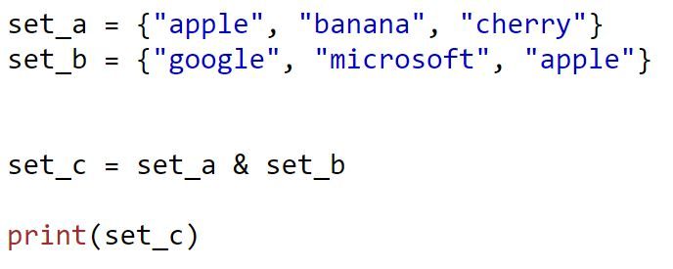
Lesson 6.5.2: Intersection
Intersection of sets is set of all elements that appear in all sets.
Use intersection() method.
set_a.intersection(set_b) count(item)
Use & operator.
set_a & set_b
{“apple”}

Slide 28
Lesson 6.5.3: Difference
Difference between two sets is what is in one set and not the other.
Use difference() method.
set_a.difference(set_b) count(item)
Symmetric difference: set of everything that is not in intersection.
set_a.symmetric_difference(set_b)

Slide 29
Lesson 6.5.4: Subsets
issubset(): Checks whether all of one set’s elements exist in another set.
set_b.issubset(set_a)
issuperset(): Checks whether set has every element of another set.
set_a.issuperset(set_b) count(item)

Slide 30
Lesson 6.5.5: Equality
== operator: Checks whether two sets are equivalent.
set_a == set_bIssu
!= operator: Checks whether two sets are not equivalent.
set_a != set_bIssu)

Slide 31
Lesson 6.5.6: Update Methods
difference_update()
Removes all values of other set from set that is called on.
set_a.difference_update(set_b)
intersection_update()
Updates set that is call on with intersection of itself and passed set.
set_a.intersection_update(set_b) c
symmetric_difference_update()
Updates set that is call on with symmetric difference of itself and passed set.
set_a.symmetric_difference_update(set_b) ount(item)

Slide 32
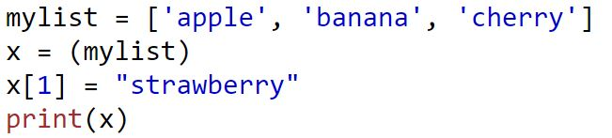
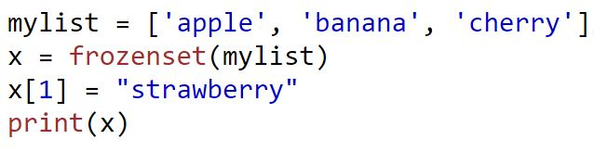
Lesson 6.6: Frozen Sets
Just like sets only immutable.
To create, use frozenset() function.
Example: a = frozenset([1,2,3])
[‘apple’, ‘strawberry’, ‘cherry’]
TypeError: ‘frozenset’ object does not support item assignment

