Slide 1

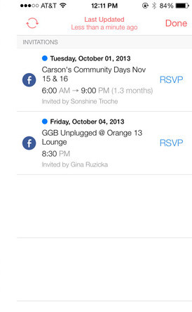





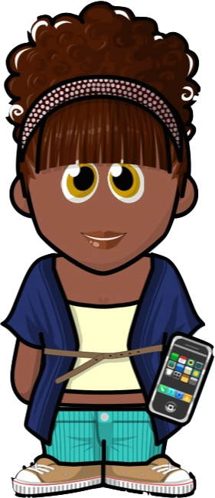
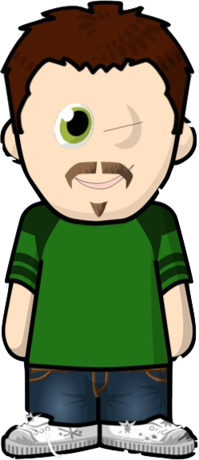

TODAY TOMORROW LATER
MY EVENTS
Angelhack Spring 2014
Google Campus
June 14 –June 15
Lord of the Rings Movie Premiere
Leicester Square
June 14 9pm
Meet with Snoop Dog
NYC – Doggie Bar
July 4th 8:30pm
FRIENDS

Slide 2
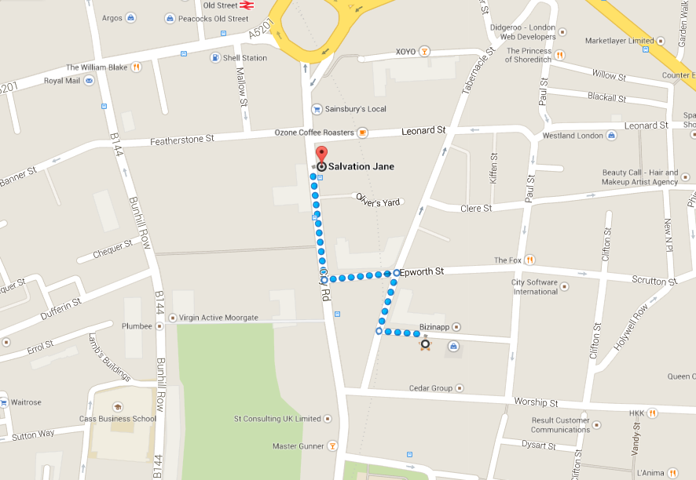
ANGELHACK SPRING 2014
From : June 14th 9am
To: June 15th 6pm
Google Campus
4 Bonhill street
London EC2A 4BX
FRIENDS
Attendees
Linda
Yemi
Adam

Slide 4



Linda
“Bringing coffee!”
Will arrive at 2:17pm

Slide 5


AngelHack Spring 2014
June 14th 9am
June 15th 6pm

Slide 6
AngelHack Spring 2014
Google Campus 4 Bonhill street London EC2A 4BX

