Slide 1

Assignment 3:
Machine Learning Model for Customer Churn
Nicholas Feng Schaefer

Slide 2
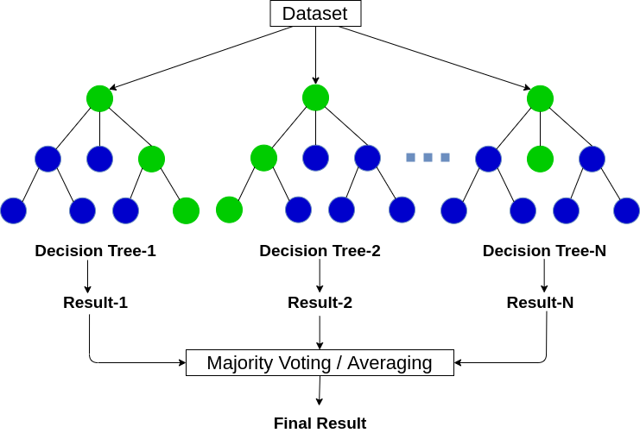
Task 1
Random Forest Model

Slide 3
Task 1: Random Forest Model
Random forest with 1000 trees:
  Estimated error rate: 20.25%
  Accuracy rate: 79.75%
From a random forest with 200 trees:
  Estimated error rate: 20.33%
  Accuracy rate: 79.67%
Slight increase in accuracy (0.08%)

Slide 4
Task 1: Random Forest Model
Top 5 important characteristics in determining customer churn (in order):
  Total Charges
  Monthly Charges
  Tenure
  Contract
  Payment Method

Slide 5
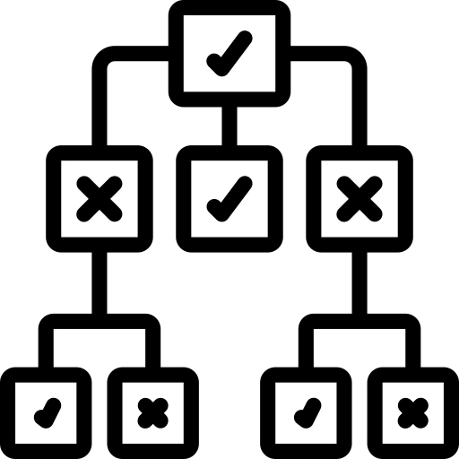
Task 2
Decision Tree

Slide 6
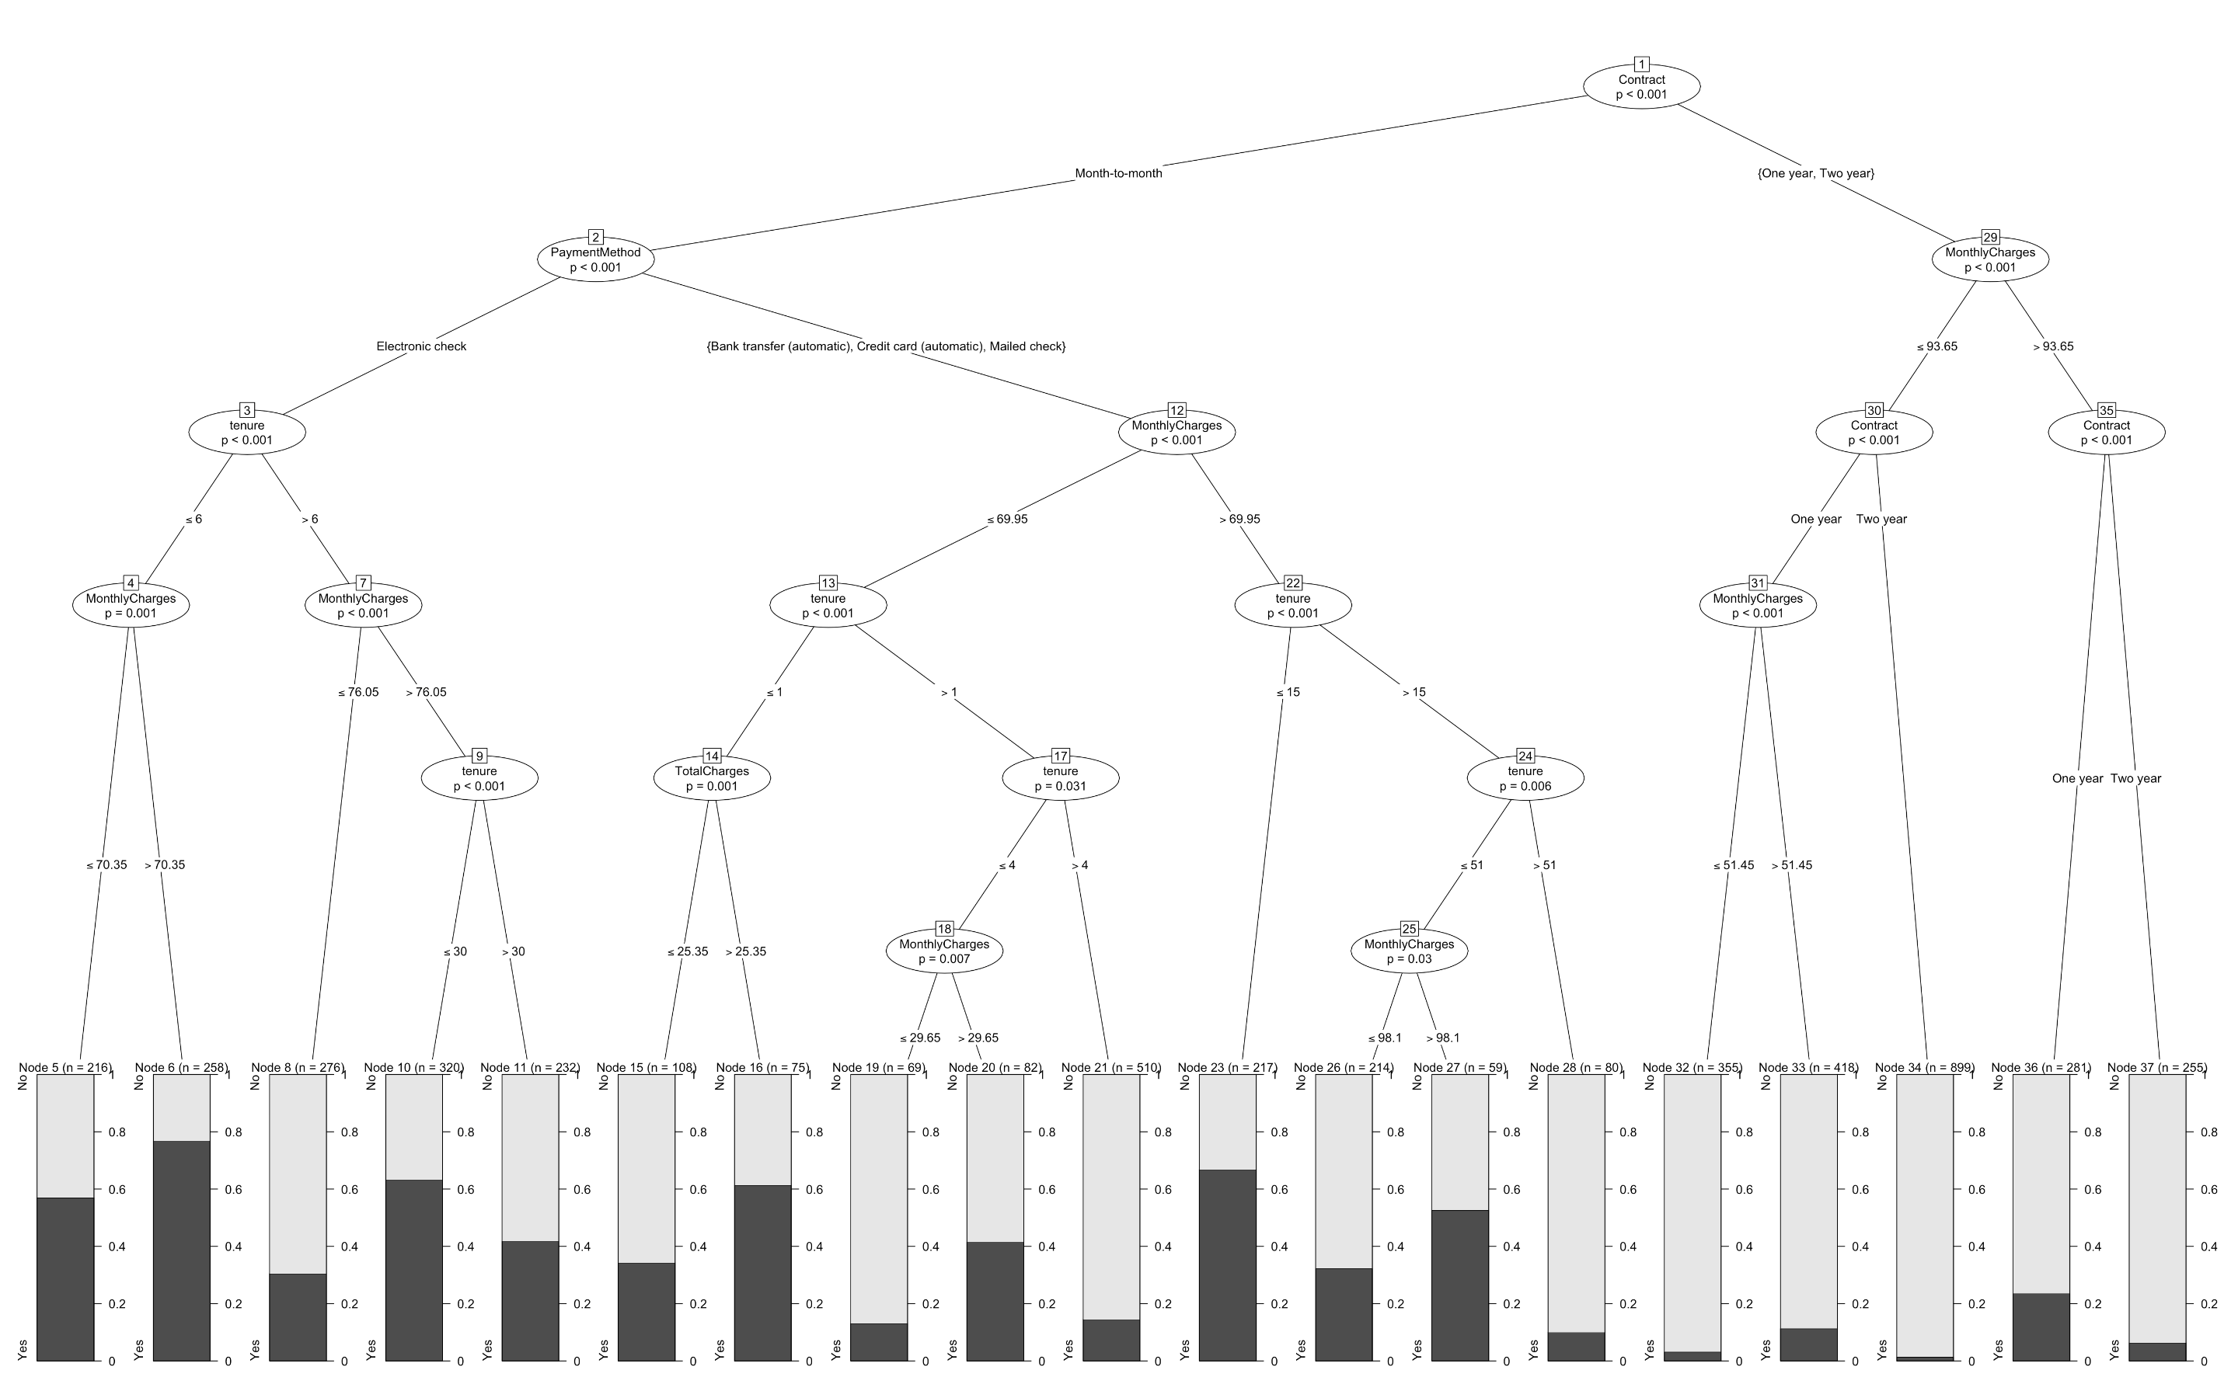

Slide 7
Task 2: Decision Tree
The decision tree using the 5 most important characteristics in determining customer churn has 19 segments in total
Which 3 segments are most like to churn (in order)?
  ~ 78% Probability to churn:
  Contract (Month-to-Month) -> Payment Method (Electronic Cash) -> Tenure (<= 6 months) -> Monthly Charges (> $70.35)
  ~ 65% Probability to churn:
  Contract (Month-to-Month) -> Payment Method (Bank Transfer, Credit Card, or Check) -> Monthly Charges (> $69.95) -> Tenure (<= 15 months)

Slide 8
Task 2: Decision Tree
  ~ 62% Probability to churn:
  Contract (Month-to-Month) -> Payment Method (Electronic Cash) -> Tenure (> 6 months) -> Monthly Charges (> $76.05) -> Tenure (<= 30 months)
  Lowest customer churn rate (~ 2-3% Probability to churn):
  Contract (One or Two Years) -> Monthly Charges (<= $93.65) -> Contract (Two Years)
  Marketing Advice:
      Incentivize customers to sign longer-term contracts instead of month-to-month ones
      Lower monthly charges
      Customers who have been with the company for longer are less likely to churn

