Slide 1


sensing of rainfall using opportunistic data from Satellite communication terminals
www.opensenseaction.eu
2023

Slide 2
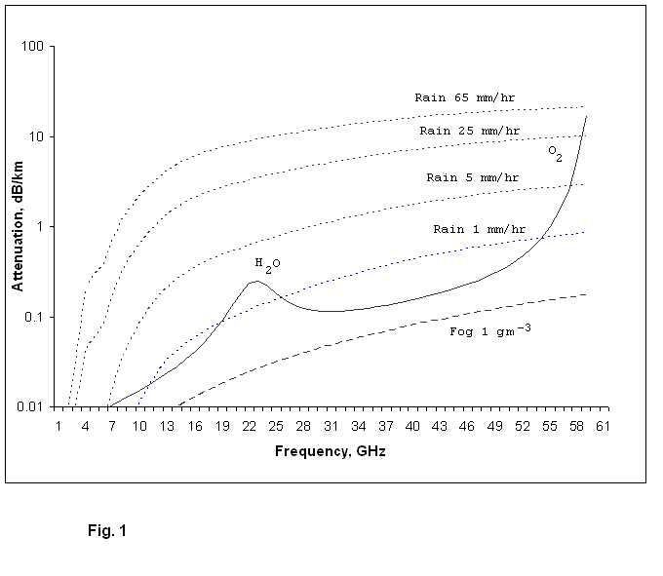
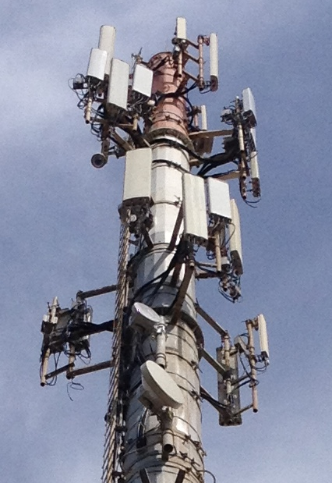
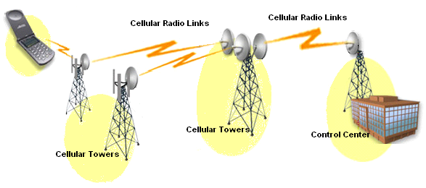
CML: high resolution, low cost environmental monitoring
Measurements from EXISTING wireless networks can be used for environmental monitoring.
2004-5
Source: ITU

Slide 3
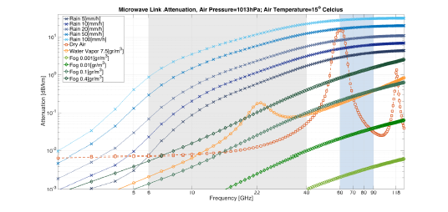
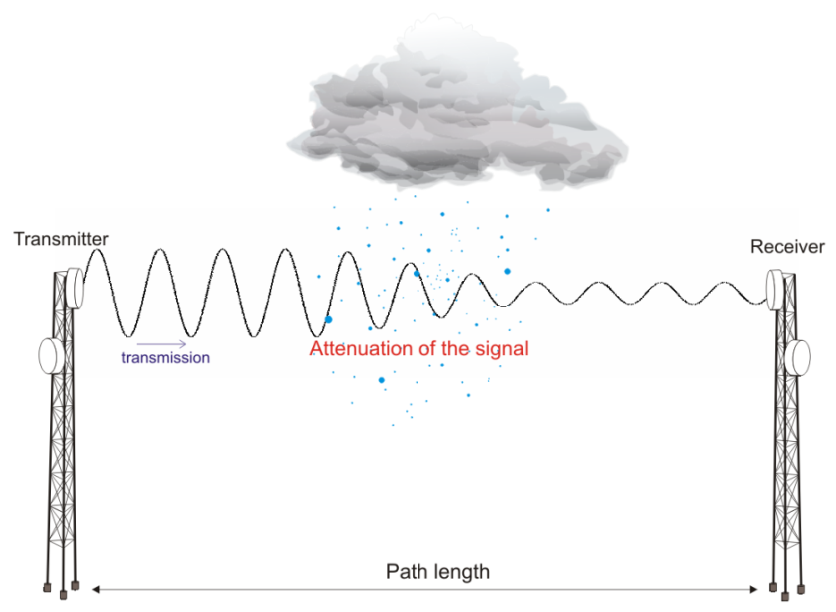
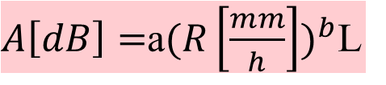

The simplified (opportunistic) Sensor:
Given its frequency and length L, any commercial microwave link (CML) can serve as a virtual rain gauge
$A\left[dB\right]=$a${(R\left[\frac{mm}{h}\right])}^{b}$L
$$A=TSL−RSL$$
K-band
E-band

Slide 4
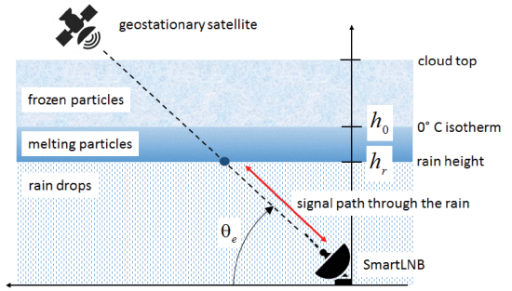
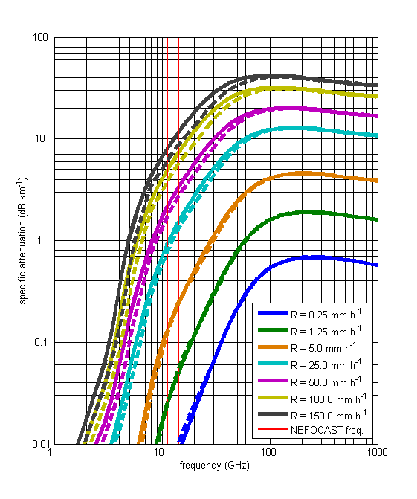

From near ground CMLs to Satellite links
Power Law :
r – Rain Rate [mm/h]
α and β are coefficients depending on frequency and on the climatic zone of the receiver location
FROM: Giannetti, Filippo, et al. "Real-time rain rate evaluation via satellite downlink signal attenuation measurement." Sensors 17.8 (2017): 1864.

Slide 5
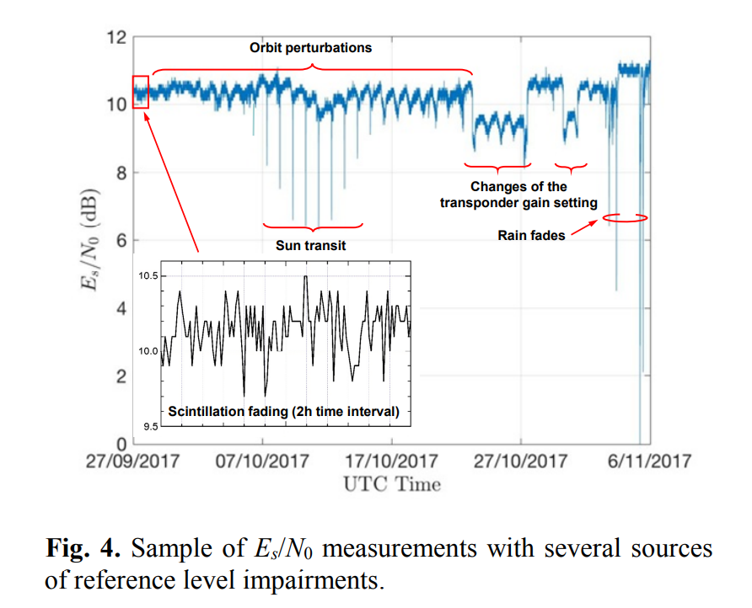
Satellite signal impairments

Slide 6
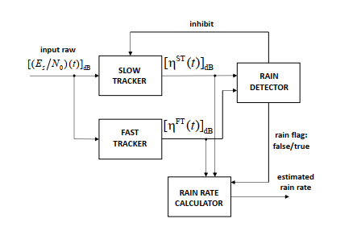
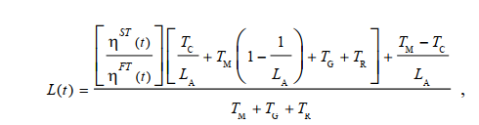

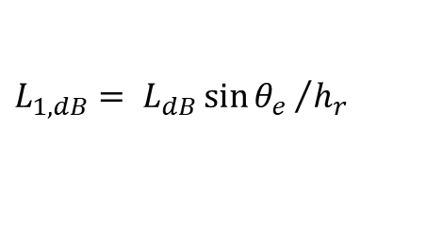
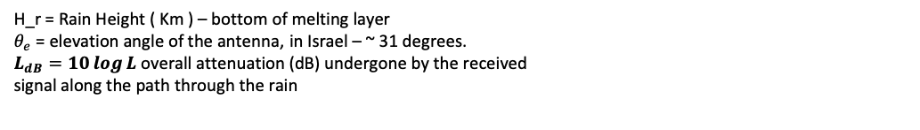
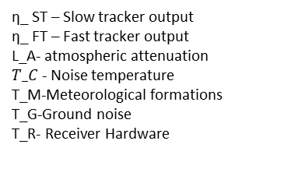

Implementation of Rainfall Estimation Algorithm
Algorithm based on an article by Giannetti [1].
The article develops a satellite signal tracking system and rainfall estimation method once a rain event was found
For optimal rain detection the system uses Kalman Filter to track fast and slow changes in signal attenuation levels, once the absolute difference between the trackers is above a threshold, it is consider that rain event was detected and the rainfall estimation calculated using the power law
Rain Rate Estimation :
α and β are coefficients depending on frequency and on the climatic zone of the receiver location. Based on Giannetti et al, we took α=~28 and β =~0.8.
H_r – rain high
H_0^c - height of the 0 ◦C isotherm
Dh = 400 m

Slide 7
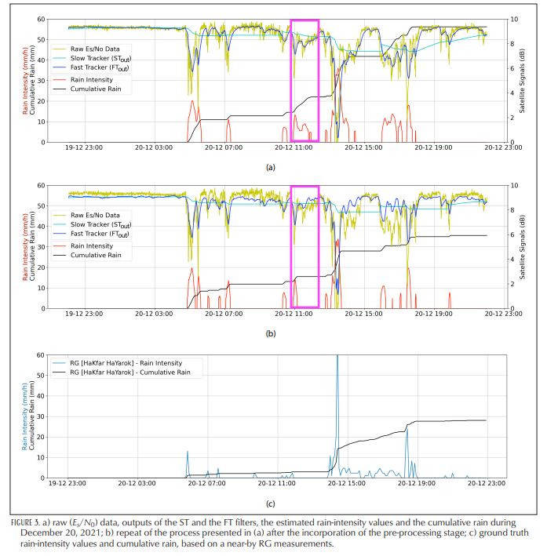
Expected results

Slide 8
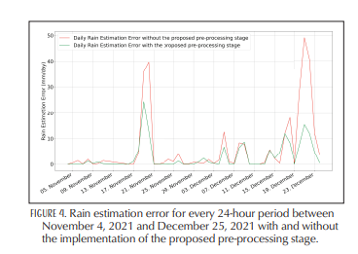
Expected results

Slide 9
Sources:
[1] Giannetti, F., Moretti, M., Reggiannini, R., Petrolino, A., Bacci, G., Adirosi, E., ... & Ortolani, A. (2018, June). The potential of SmartLNB networks for rainfall estimation. In 2018 IEEE Statistical Signal Processing Workshop (SSP) (pp. 120-124). IEEE.
[2] Giannetti, F.; Reggiannini, R.; Moretti, M.; Adirosi, E.; Baldini, L.; Facheris, L.; Antonini, A.; Melani, S.; Bacci, G.; Petrolino, A.; Vaccaro, A. Real-Time Rain Rate Evaluation via Satellite Downlink Signal Attenuation Measurement. Sensors 2017, 17, 1864. https://doi.org/10.3390/s17081864
[3] Ostrometzky, J., Raich, R., Bao, L., Hansryd, J., & Messer, H. (2017). The wet-antenna effect—A factor to be considered in future communication networks. IEEE Transactions on Antennas and Propagation, 66(1), 315-322.
[4] Ostrometzky, J., & Messer, H. (2017). Dynamic determination of the baseline level in microwave links for rain monitoring from minimum attenuation values. IEEE Journal of Selected Topics in Applied Earth Observations and Remote Sensing, 11(1), 24-33

