Slide 1
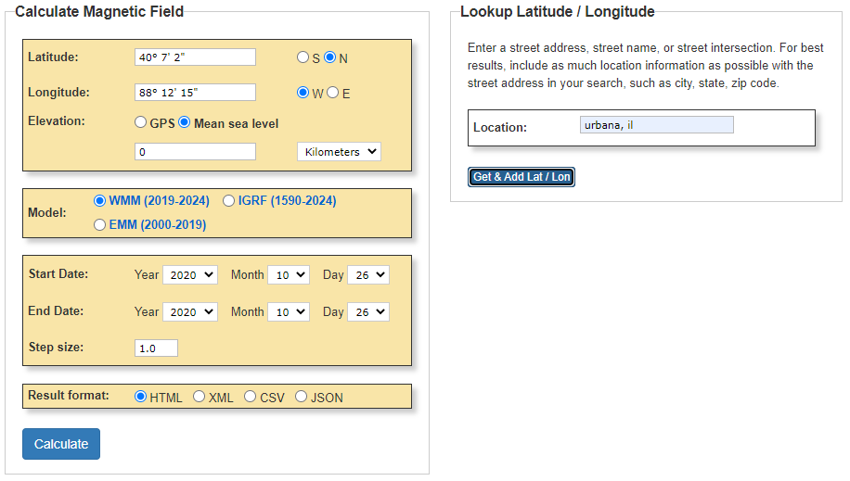
Step 1: Go to https://www.ngdc.noaa.gov/geomag/calculators/magcalc.shtml#igrfwmm
Step 2: Enter your location
Step 3: Click on this button
(Doing this will enter your longitude and latitude on the form for you).
Step 4: Click on the Calculate button

Slide 2
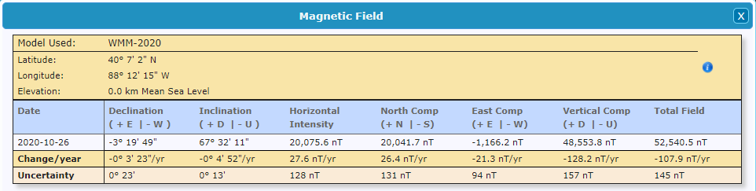
Step 5: This calculated number tells you the downward component of the Earth’s magnetic field at your location in units of nano-Tesla (nT). Since you want the upward component in units of micro-Tesla (μT), you need to divide by -1000 to get B_{Ez}.
In this example B_{Ez} = 48553.8/(-1000) = -48.55 μT.
Your B_{Ez} value will probably be negative if you are in the northern hemisphere, and it will probably have a magnitude similar to the number shown. If you get something ten times bigger or smaller then you should make sure you didn’t make a mistake.

Slide 3
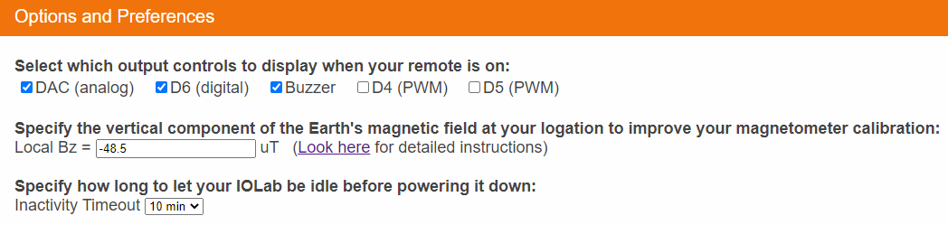
Step 6: Put the B_{Ez} value that you found as described on the previous few pages into the Local Bz box on the Options and Preference panel.
Step 7: Restart your IOLab application and calibrate the magnetometer. Your new value of B_{Ez} will be used in the calibration.

