Slide 1


Google Girl Hackathon Final Presentation
March 19, 2017
Group “睡什么睡起来coding”

Slide 2
Agenda
Product
Introduction
Highlight
Impact
Technical Details
Classifying algorithm
Ranking prediction
Demo

Slide 3
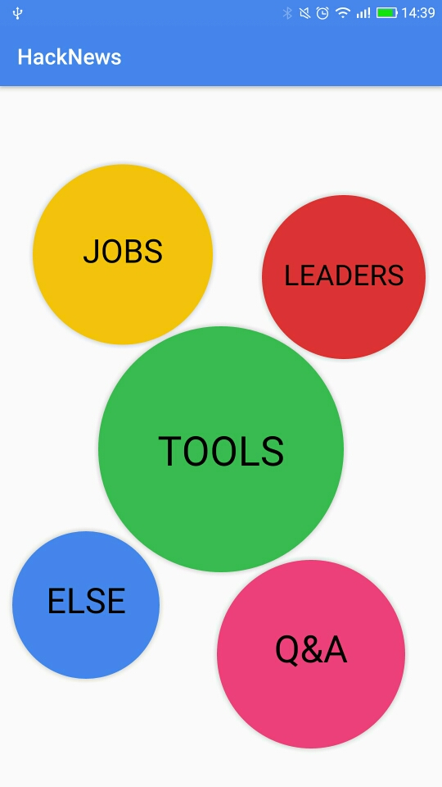
is an Android APP that displays data on current articles and predictive trends.
HackHot allows users to identify the type of latest article being read by other users.
The various sizes of circle is determined by the Ranking we calculated for each type.
Product
Impact
Technical Details
Demo

Slide 4
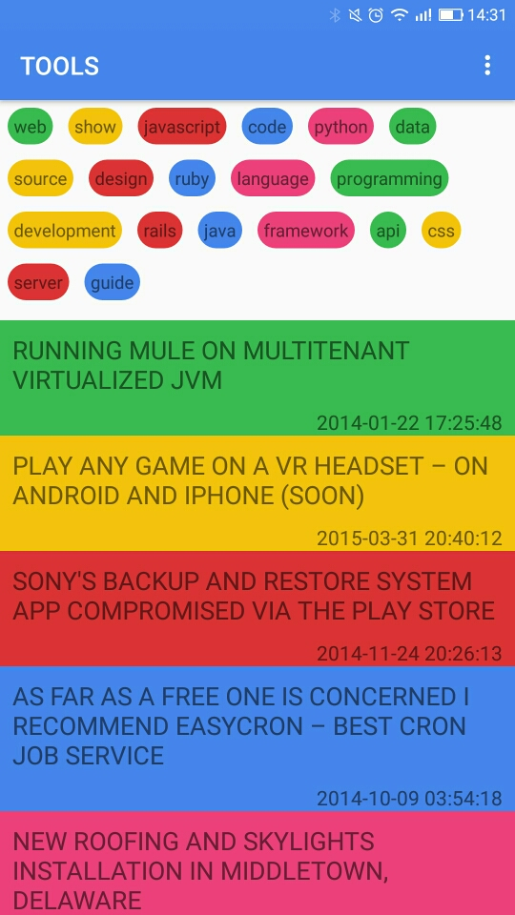
is an Android APP that displays data on current articles and predictive trends.
Users can see the list of articles and keywords that are being classified into the types.
Product
Impact
Technical Details
Demo

Slide 5
is an Android APP that displays data on current articles and predictive trends.
Users are able to see the Ranking of different type.
User can see the trend prediction of that specific type inside individual tab.
Product
Impact
Technical Details
Demo

Slide 6
We believe is able to make impact to the following parties.
Ads Provider
Information Provider
Reader/ Information consumer
Product
Impact
Technical Details
Demo

Slide 7
There are three technical processes in producing the information on
Data cleaning
Identify the data required, remove unnecessary data and transform into useful format
Classifying data
Parse texts and classify them using LDA, an unsupervised learning algorithm
Regression
Run regression on number of stories, comments and score to produce a Ranking
Product
Impact
Technical Details
Demo

Slide 8

We have used LDA to classify data into 5 types.
Parse title and text from story corpus and extract key information about the story.
Key words are used to classify the articles.
Through trial and error, we have found that K = 5 is the most optimum result.
Product
Impact
Technical Details
Demo

Slide 9
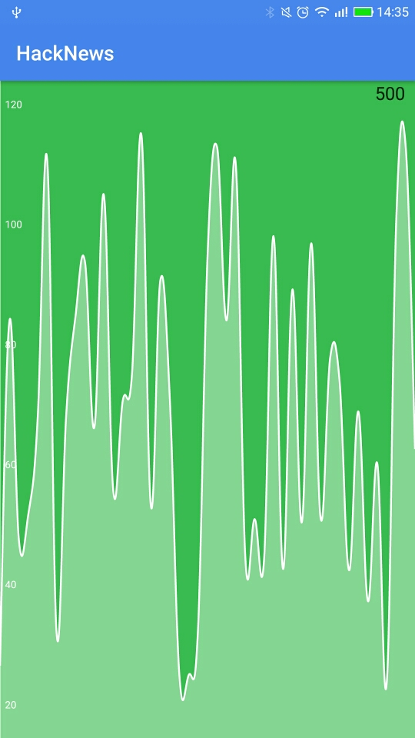
We have made our data more meaningful by computing Ranking.
Aggregate statistics of story corpus.
Aim to find a correlationship between time, number of comments, number of stories and score of the article.
Regression is used to produce predictive data
Product
Impact
Technical Details
Demo

Slide 10

Demo
Product
Impact
Technical Details
Demo

