Slide 1

Rewind &
Amplify
Predicting how hidden defects change
quantum measurement patterns
A Qiskit model tested on IBM hardware.
Exploratory extension: laser diagnostics.
Qubits / Florida Gulf Coast University
Florida Qiskit Hackathon finals / FAU / 14 November 2026
01
Notes:
0:00–0:15
We are Qubits from Florida Gulf Coast University. We model how hidden defects change quantum measurement patterns, then test a method for querying that model on IBM hardware. Laser diagnosis is a separate research extension.
PRESENTER CUE: Nicholas introduces the problem. First nine slides cover the original quantum computation.
SOURCES: Original project README and docs/REPORT.md. Event: https://entangledsolutionsgroup.com/Qiskit-Fall-Fest-2026/. Conceptual cover generated with OpenAI image generation.

Slide 2
Hidden defects can change the state before readout
State estimates depend on the dynamics and readout model
During qubit evolution
When interpreting the readout
A coupled defect can exchange energy
or change the qubit’s frequency.
Repeated measurements estimate
probabilities, not a full state in one shot.
The intended state can evolve
differently from the ideal circuit.
Readout errors and hidden dynamics
can otherwise receive the wrong explanation.
Potential value: better calibration and more trustworthy state estimates
State estimation needs appropriate measurements and a validated noise model. This project has not diagnosed a physical defect.
02
Notes:
0:15–1:00
Why analyze defects? A hidden two-level system can exchange energy with a qubit or shift its frequency. Then the state evolves differently from the ideal circuit. We infer quantum behavior from repeated preparations and measurements. One readout does not reveal an arbitrary full quantum state. If our analysis ignores hidden dynamics or detector errors, we can assign the wrong cause to the observed statistics. Defect analysis can inform calibration, operating frequencies and device selection, helping preserve useful computation and interpret state estimates. Our project tests a modeling approach to that analysis. It has not diagnosed an unknown physical defect or performed complete state tomography.
PRESENTER CUE: Nicholas distinguishes physical state evolution from inference about that state. The QRSM models possible causes of the record.
SOURCES: Schlor et al., PRL123190502 (2019): https://www.nist.gov/publications/correlating-decoherence-transmon-qubits-low-frequency-noise-single-fluctuators. Keith et al., PRA98042318 (2018): https://www.nist.gov/publications/joint-quantum-state-and-measurement-tomography-incomplete-measurements. These support the physical context and measurement-inference limitations, not validation of our surrogate. Local mechanism: original prior_work/hidden_defects/README.md and qrsm_grover/model.py.

Slide 3
A click is one recorded measurement outcome
1 = click
0 = no click
The output qubit reads 1
in one model time step.
A single click does not
identify a defect.
Time step | 1 | 2 | 3 | 4
One example record | 0 | 0 | 1 | 0
The emitter and hidden qubit carry memory between steps
Optical interpretation: a detector fires. On IBM, superconducting qubits represent this model.
03
Notes:
1:00–1:35
A click means the model output reads one in a time step. Zero means no click. This example reads zero, zero, one, zero: a click at step three. Our query selects that step alone and allows any earlier history. Optically, the bit represents a detector firing. On IBM, a superconducting qubit represents that output. The emitter and hidden qubit carry memory to the next step. This repeating model is a quantum recurrent state machine, or QRSM.
PRESENTER CUE: Trace the four columns left to right. Say “a recorded one,” before using “click” again.
SOURCES: rewindandamplify-main/qrsm_grover/model.py: QRSM.dynamic, QRSM.purified, history_to_string. Original deck circuit slide and docs/TEAM_GUIDE.md. Example0010 is illustrative chronological notation, not a Qiskit endian-formatted counts key.

Slide 4
The QRSM connects each bit to a hidden-state model
Does an emitter alone explain the record, or does a hidden partner help?
Updates the modeled state
Scores a physical explanation
Each observed 0 or 1 updates the
conditional state of the emitter
and its hidden partner.
Candidate coupling and noise settings
assign a probability to the record
and predict the next readout.
A fresh synthetic test: detector dead time changes the inferred coupling
True coupling | Dead time ignored | Dead time modeled
0.65 | 0.069 | 0.706
Other fitted parameters remained biased. Classical sequence models also use history. IBM used known models.
04
Notes:
1:35–2:35
The QRSM connects each observation to a physical hidden-state model. Each bit conditions the emitter and possible defect state, contributes to the record likelihood, and changes the next prediction. Across records, classical fitting compares coupling and noise settings. A fresh synthetic test shows why this matters. Ignoring detector dead time pushed inferred coupling from a true 0.65 to 0.069. Modeling the blind detector bin moved it to 0.706 and improved prediction on unused records. Other parameters stayed biased. A detector error can otherwise receive a false physical explanation. Classical hidden-state models also capture history, so the quantum structure must earn its value. Our IBM experiment uses a prepared zero state and known model settings. Grover then queries that model; it does not identify an arbitrary unknown state.
PRESENTER CUE: Nicholas explains the QRSM itself before any acceleration claim. Distinguish updating the state within a model from estimating the model parameters across many records.
SOURCES: qrsm_grover/model.py kraus, record_log_probability and branches. Fresh inference: qrsm_photon_poc/followup/README.md and inference_results/fixed_411101_dead1_fit0.json, fixed_411101_dead1_fit1.json. Coupling rounded0.069 and0.706 versus truth0.65. Held-out log-score improvement0.4584nats/24-bin record, conditional95%interval0.3978–0.5210. Other parameters biased/boundary. Independent score review in followup/independent_review.json. Conditional trajectories are established prior work: Murch etal., Nature502211(2013), https://arxiv.org/abs/1305.7270.

Slide 5
Hidden memory changes what follows a click
Given a click at step 3, how likely is another click later?
Probability of a later click
At step 6
10.10%
without hidden defect
4.67%
with hidden defect
Exact model predictions. We compare known model alternatives. No unknown physical defect was diagnosed.
05
Notes:
2:35–3:20
This is the useful prediction. Given a click at step three, how likely is another at steps four, five and six? With no hidden defect, the click resets the modeled emitter. With a coupled hidden qubit, memory survives and changes what follows. At step six, the two models predict about ten percent and five percent. Comparing these predictions with data can help evaluate a candidate mechanism. Here the model alternatives are deliberately specified. These curves show exact model behavior, not discovery of an unknown physical defect. They also explain why the history matters beyond an overall click count.
PRESENTER CUE: The audience should understand the two curves before hearing how Grover obtains the samples.
SOURCES: research-validation/original_after_click_verification.json. Direct reproduction of qrsm_grover/queries.py exact_after_click and results/e5_inside_loop/noiseless.json. Conditional probabilities given step3=1, not stationary optical g2. Coupling phi=.45,zeta=.3 versus no hidden defect, theta=.6,gamma=.2.

Slide 6
Rare conditions waste ordinary samples
3.95%
Quantum query scaling
1 / p
of ideal runs have the selected click
About 25 runs per matching sample
ordinary rejection
1 / √p
ideal coherent model calls
p = probability of the selected event
Today, a classical conditional sampler
wins this small problem
A possible benefit needs larger quantum memory and sufficiently accurate reversible circuits.
06
Notes:
3:20–4:05
The selected click occurs in 3.95 percent of ideal runs. Ordinary rejection needs about 25 runs for one match, with cost growing as one over its probability. Amplitude amplification reduces coherent model calls to order one over the square root of that probability. That is the quantum rationale, not a wall-clock speedup. Our strongest classical baseline directly samples conditional answers without rejection and wins at this small size. The possible future opportunity is a hidden quantum memory that becomes expensive to represent classically, provided the reversible quantum circuit stays accurate. That crossover remains unproven.
PRESENTER CUE: Dan explains the fair classical comparison and why this remains quantum-computing research.
SOURCES: ExactP from summary_plain.json. Classical backward sampler: docs/REPORT.md section5 and qrsm_grover/classical.py. Amplitude amplification https://arxiv.org/abs/quant-ph/0005055. Quantum inference precedent https://arxiv.org/abs/1402.7359. Cost includes calls to preparation and its inverse, with additional oracle/reflection gates.

Slide 7
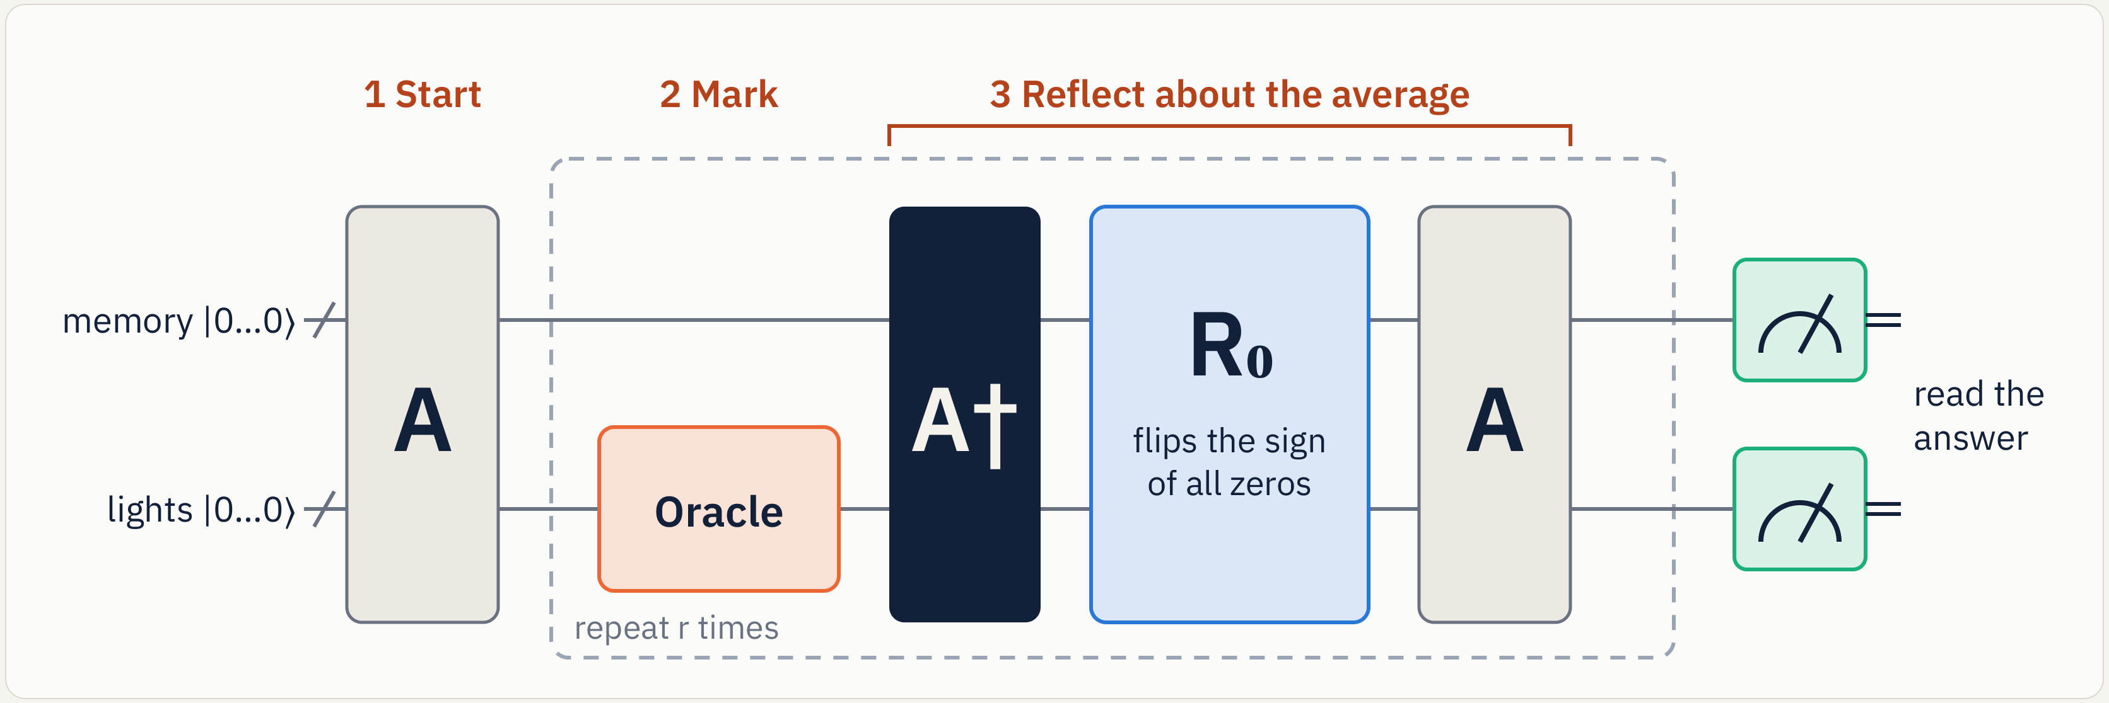
A reversible model makes amplification possible
3 Reflect about the prepared state
records |0…0⟩
Save the history
Steer the model
Amplify locally
Check the answer
Fresh qubits
replace resets
Classical tuning
of a supported event
Fewer gates
with approximation
Event rate and
conditional accuracy
Qiskit circuit construction, Aer verification, IBM compilation and archived device counts.
07
Notes:
4:05–5:00
Grover must run the model backward, but a reset discards information. We replace each reset with a fresh output qubit and defer measurement. A prepares the histories. The oracle marks the selected condition. A dagger reverses the preparation. A reflection followed by preparation changes interference so matching histories become more likely. We then reduce hardware cost. Steering is classical tuning of a supported event. Local reflection checks fewer qubits but introduces approximation. We verify both event rate and conditional accuracy. Qiskit builds the circuits, Aer checks the exact model, and compiled circuits run on IBM. Amplification is established. Our contribution is this recurrent-model construction and its tested adaptations.
PRESENTER CUE: Dan explains A and A dagger. Nicholas explains the implementation changes and verification. Technical model circuit is in backup.
SOURCES: rewindandamplify-main/qrsm_grover/model.py, amplify.py, queries.py and tests. Steering helpers are in amplify.py. Original circuit figure fig_circuit_grover.png with corrected prepared-state terminology. Prior amplification and Bayesian-network inference: Brassard et al. and Low, Yoder, Chuang 2014. Before-event QRSM and during-event contributions documented in original README.

Slide 8
More matching answers with fewer gates
Actual IBM Kingston run. Same steering, one amplification round.
Raw matching-event rate
40 vs 85
two-qubit gates
local / full
0.055 / 0.069
conditional-history error*
local / full
Cost matters: fewer executed gates per accepted answer in this pair
4,096 shots each. *Corrected TVD, lower is closer. Layouts differ. Gate accounting excludes other costs.
08
Notes:
5:00–6:00
On IBM Kingston, local reflection returned the selected event in 86.06 percent of raw shots, versus 78.49 percent for full reflection. Both use steering and one round. They compiled to 40 and 85 two-qubit gates. Gates consume scarce device operations and introduce errors. In this pair, the shorter circuit returns more accepted answers per executed gate. That is limited operation accounting, not dollar savings or a classical speedup. Conditional accuracy matters too. Corrected total variation distance is 0.055 versus 0.069, where lower is closer to the right distribution. Different physical placements confound the comparison. An archived repeat supports the pattern but does not isolate its cause. Reliable qubits are valuable because accurate answers require both a workable circuit and trustworthy measurements.
PRESENTER CUE: Dillon presents the result and cost limitation. Mention the repeat, with details available in backup.
SOURCES: research-validation/hardware_verification.json. First raw counts3525/4096 and3215/4096. Same steering and r=1. Corrected conditional-history TVD .055 versus.069. Two-qubit gate executions per raw accepted event:40/(3525/4096)=46.48 versus85/(3215/4096)=108.29. This excludes calibration, readout, compilation, duration and distribution-bias costs. No monetary savings or causal attribution. Job dbmfqlt8ft8s738uplmg,5Nov2026.

Slide 9
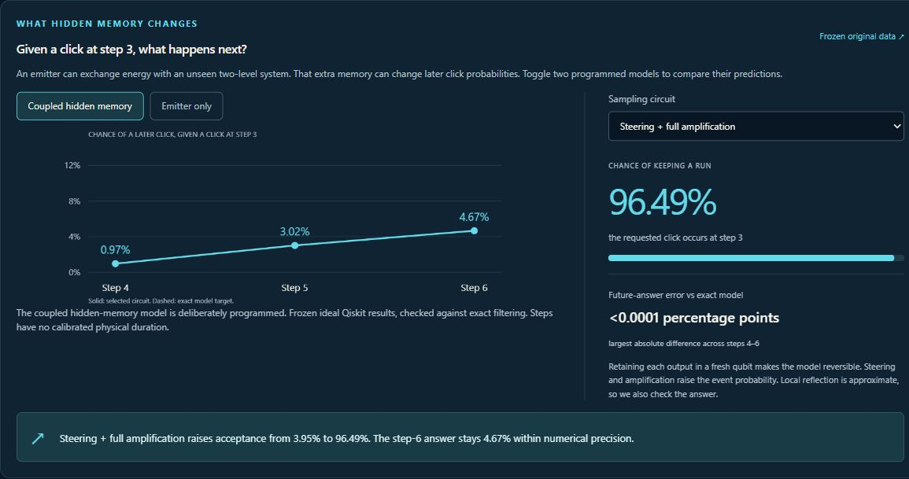
The query returns a prediction about the next clicks
Live local demonstration of the original model. Static screenshot remains available if switching fails.
09
Notes:
6:00–6:45
In the app, we select a click at step three. Switching from plain sampling to full amplification raises acceptance while preserving the predicted future probabilities. Now switch the hidden-memory model to an emitter alone. The step-six probability changes from about five percent to ten percent. That is the answer we wanted: how a candidate hidden interaction changes later observations. These are saved, verified model calculations. The separate IBM data measure circuits representing those models. Neither is a live laser measurement, and amplification does not increase photons from a real source.
PRESENTER CUE: Timofey demonstrates for 45 seconds: 0–8 explain the QRSM role, 8–15 define the selected click, 15–27 choose Steering + full, 27–38 switch to Emitter only, 38–45 explain the diagnosis boundary and return to slides. Pre-open Focus view and the original QRSM chapter. Do not troubleshoot during the talk.
SOURCES: laser-diagnostics-app original-core section and research-validation/original_after_click_verification.json. Original source queries.py and e5_inside_loop/noiseless.json. This demonstration is distinct from the separate two-bin cavity model.

Slide 10
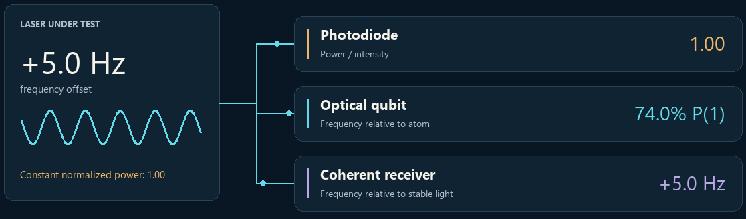
Laser diagnostics could protect chip exposures
Exposure light affects the pattern printed on a wafer
Research question: does an atomic reference add useful information?
Illustrative +5 Hz response. Our 698 nm lab surrogate needs a separate sensing design for lithography sources.
10
Notes:
6:45–7:25
Chipmaking exposes a pattern on a wafer using light. Changes in energy, wavelength or bandwidth can alter that pattern. Cymer and imec measured this connection, and conventional source monitors already exist. Our separate question is whether an atomic reference adds useful information alongside those instruments. A photodiode measures power. A coherent receiver compares optical references. An atom compares the laser with an atomic transition. Earlier diagnosis could reduce wasted exposures or downtime, but we have measured neither benefit. This 698 nanometer lab surrogate needs a separate design for lithography sources.
PRESENTER CUE: Nicholas states the pragmatic chipmaking connection. This is a proposed diagnostic addition, not evidence of finding a light-source defect.
SOURCES: Cymer/imec2014 controlled source and wafer experiments: https://www.cymer.com/wp-content/uploads/2018/12/Cymer_SPIE_AdvancedLithography_2014.pdf. Atomic precedent Bishof etal2013 https://arxiv.org/abs/1303.6741. Illustration instantaneouspulse+5Hz, benchmarkfinitepulse±.5Hz. DUV193nm,CO2drive,EUV13.5nm distinctions in backup.

Slide 11
The classical reference leads with unknown onset
Detection within 32 s of a ±0.5 Hz step. Its start time is hidden.
Atomic addition
+6.67 points
95% interval
+3.96 to +9.38 points
C + C still leads
Full-record false alarms: 5.42% / 5.16% / 4.06% (C / C + Q / C + C)
128 s records. 1,920 per class. Unseen sessions. Nominal 5% alarm target. Total apparatus costs differ.
11
Notes:
7:25–8:10
The test hides when frequency changes and holds out simulated sessions. Can the monitor respond within 32 seconds? The conventional receiver detects 51.35 percent. Adding the atomic channel reaches 58.02 percent, a 6.67 point gain. A second independent conventional reference reaches 97.97 percent. False alarms below refer to the entire 128 second record, not each instant. We include missed events in the delay calculation. Degraded atomic coherence can reverse the benefit, and shared-path drift still mimics the source. These controls sharpen our conclusion: an atomic reference can add information in this model, but the conventional addition performs best. Apparatus resources are not fully matched.
PRESENTER CUE: Dillon explains the unknown onset and 32 second horizon before the percentages. Do not quote the earlier 86% known-time result here.
SOURCES: laser_sensor_viability/followup/main/results.json, unseen_nominal_sessions. Detection within32s C.5135416667,CQ.5802083333,CC.9796875. Full-recordFAR .0541666667,.0515625,.040625. Eight independent calibration pipelines,96held-out sessions,1920null and1920source records. Paired hierarchical bootstrap gain6.67pp[3.96,9.38]. Assumed698nm,64atoms,1scycle and975msdeadtime. Distinct task from the earlier known-midpoint benchmark.

Slide 12
The evidence changes our next experiment
Drive-amplitude monitoring
Phase inspection model
3.71% timely detection
0.00637 vs 0.00791 rad
6.84% false source alarms
Hybrid / coherent phase error
This budget gives
no useful prompt warning
A conditional precision benefit
merits a calibrated optical test
Revise the operating point
before a sensor prototype.
20,000 incident photons
81% overall efficiency
Separate simulations. Drive: +20% field step, 32-bin detection horizon, 96-bin alarm record. No wafer result.
12
Notes:
8:10–8:50
In simulation, a 20 percent drive step gives only 3.71 percent detections within 32 bins and 6.84 percent false alarms per 96-bin stable record. Most amplitude-estimation gain comes from its prior, so this regime needs redesign. A separate phase simulation is promising: a charged hybrid reduces error from 0.00791 to 0.00637 radians at matched incident photons and ideal preparation. Loss and preparation time matter. Next, test a calibrated optical target with an independent reference. Computing also needs accurate answers at competitive total cost. Neither path has demonstrated a wafer benefit.
PRESENTER CUE: Nicholas states the negative amplitude result and the conditional phase opportunity. Save prior-control and ambiguity details for backups 25–26.
SOURCES: RESEARCH_RESULTS.md. Drive: qrsm_photon_poc/drive_diagnostics_followup/main/results.json and prior_only_estimation_control.json, independent reviews. Phase: quantum_lithography_poc/phase_inspection_followup/results.json high_efficiency/equal_sample_photons/global.20,000mean photons before object, both modes charged,T=.9,D=.9,p=1,10%coherent/90%NOON. RMSE hybrid.00637086 versus coherent.007908rad. Global phase prior over2pi, assumed known phase reference. No fabricated sample or industrial process test.

Slide 13
Our contribution and what we learned
A queryable recurrent quantum model
Reversible construction and hardware adaptations,
with exact-model checks and archived IBM results
Controls changed our conclusions. Accuracy and total cost both matter.
Nicholas Taylor
Timofey Yudintsev
QRSM research, Grover fusion, experiments
Research, keyword-search idea
Dan Izquierdo
Dillon Satria Sitepu
Experimentation
Formatting and revising
QRSM model predates the event. Known amplification methods. AI assistance: Claude and Codex / OpenAI.
13
Notes:
8:50–9:20
Our contribution is a queryable recurrent quantum model with tested hardware adaptations. Controls changed our conclusions: accuracy and total cost both matter. The documented team roles are here. The QRSM predates the event, and amplification is established prior work. We used Claude for the original work and Codex with OpenAI models for the extensions. We now have a tested computing question and clearer optical experiments to pursue. Thank you.
PRESENTER CUE: Nicholas closes. Slides 14 onward are Q&A only. The planned 9:20 finish leaves 40 seconds for handoffs or pauses. Rehearse to confirm the actual time.
SOURCES: Original README sections PriorworkandAIhelp and Team. User confirmed the documented roles. New finals assistance includes research reconstruction, simulation implementation, tests, source review, app and presentation authoring. Prior amplification Brassardetal2000 and quantum inference Lowetal2014. Project repository https://github.com/Nicholas55555/rewindandamplify.

Slide 14
Hardware evidence and ablations
Circuit | Raw hits | Corrected hits | 2-qubit gates | TVD*
Plain sampling | 6.05% | 5.98% | 13 | 0.071
Steering only | 21.36% | 21.43% | 13 | 0.090
Steer + full, 1 round | 78.49% | 79.29% | 85 | 0.069
Steer + local, 1 round | 86.06% | 87.36% | 40 | 0.055
Full, unsteered, 3 rounds | 58.52% | 58.95% | 213 | 0.263
Repeat: local 87.26% raw, full 78.61% raw
4,096 shots/circuit in each job. *Readout-corrected conditional-history TVD. Layouts differ.
14
Notes:
Backup
The complete set prevents the closer local-versus-full comparison from being confused with the older 87-versus 59 percent headline, which changed several factors at once. Raw rates, corrected rates, gate costs and conditional-distribution errors are separate quantities. Two nearby archived jobs are a repeat, not validation across many devices or days. The local ideal reflection already introduces conditional-history error before hardware noise.
PRESENTER CUE:
SOURCES: FINALS_EVIDENCE.md and research-validation/hardware_verification.json. First job dbmfqlt8ft8s738uplmg. Repeat dbmfv758ft8s738upsdg. Repeat raw selected counts local3574/4096 and full3220/4096. Correction assumes independent single-qubit readout flips and clips estimates. Classical baselines are faster at this size.

Slide 15
Three optical bins expose the circuit cost
All three bins must click. Full reflection preserves the retained model.
Choi cutoff | Qubits | Whole-query CX | Accepted rate¹ | State error*
0.03 | 15 | 10,189 | 0.12783% | 0.02604
0.003 | 18 | 19,864 | 0.12755% | 0.01094
Implementation error < 6.3 × 10⁻¹³
Exact classical recursion already answers these small queries efficiently
¹After one round. *Trace distance versus the cavity-2 model. No three-bin noise, routing or physical sensor test.
15
Notes:
Backup
The optical extension now retains three flags and all environments before reversal. Both approximations pass every history-branch and conditional-state circuit check. The tighter approximation improves the selected-state error but nearly doubles gate count. It does not establish physical cavity convergence. The original untruncated-in-Choi cavity-two triple-click probability is 0.0147042 percent, while the retained laws differ. Exact classical recursion answers the last-click or all-click query with only three channel applications. A separate one-bin noise test reaches conditional-state error about 0.806 or 0.848 at the largest chosen gate noise, even though recorded acceptance increases. Those one-bin values are not the noise performance of this three-bin circuit.
PRESENTER CUE:
SOURCES: qrsm_photon_poc/multibin_followup/README.md, main/ideal_0p03.json, main/ideal_0p003.json, main/validation.json and branch NPZ archives. Whole all-click query includes preparation, oracle, inverse, full reflection and replay. Genericu,cx costs exclude routing. Separate cavity cutoff audit in qrsm_photon_poc/followup/dynamics_results.json.

Slide 16
Sensor assumptions and resource accounting
Model element | Assumed setting
Compatible laboratory wavelength | 698 nm, narrow-line optical drive
Atomic ensemble | 64 independent, unentangled atoms
Interrogation | 2.5 ms pulse + 20 ms dark time + 2.5 ms pulse
Record and acquisition gap | 128 s record, 975 ms dead time per cycle
Relaxation and readout | T₂ = 200 ms, T₁ = 100 s; 2% / 4% readout errors
Time and task match. Total apparatus resources do not.
Photon allocation is assumed bookkeeping. Reference lasers, cooling, trapping and readout costs remain uncounted.
16
Notes:
Backup
The atomic response follows finite driven Bloch rotations with T1/T2 damping, preparation error, asymmetric readout error and binomial projection noise. Optical intensity changes the Rabi frequency and induces an assumed light shift during pulses. Conventional receivers include source-photon shot noise, electronics and reference drift. All methods see the same underlying source task and duration. The photon allocation is a declared assumption: atomic coupling and beam geometry are not specified from a real apparatus, and reference lasers plus atomic support optics are not included in a full cost comparison. Therefore this is not a resource-matched quantum advantage test.
PRESENTER CUE:
SOURCES: laser_sensor_viability/results.json config and resource_ledger supply the unchanged physical model. New task: followup/README.md, protocol.json and main/results.json. Unknown source onset48–96s, eight independently trained/calibrated pipelines, held-out sessions. Whole-record alarm calibration, misses and prealarms charged32sin restricted delay. Bishof etal., PRL111093604, https://arxiv.org/abs/1303.6741 is physical precedent, not chosen device specifications.

Slide 17
Calibration failures can reverse the conclusion
Scenario | C detection / false alarm | C + Q | C + C
Unseen nominal sessions | 51.4% / 5.4% | 58.0% / 5.2% | 98.0% / 4.1%
Shorter atomic coherence | 52.8% / 6.0% | 47.3% / 6.1% | 98.1% / 5.0%
Primary-reference step | 44.0% / 91.5% | 45.6% / 84.5% | 97.7% / 4.8%
Shared-path step | 45.6% / 91.1% | 48.2% / 94.1% | 56.1% / 100.0%
Shared-path drift is indistinguishable from source drift here
Each cell: detection within 32 s / false alarms per 128 s record. 1,920 null and source records per scenario.
17
Notes:
Backup
These are the new unknown-onset results. Each cell gives timely detection followed by full-record false alarms. The target is source-frequency change, so a sensor/reference/path change can trigger a false source diagnosis. Shorter atomic coherence makes the fused channel worse than C alone. A separate agreement veto reduces the primary-reference failure but sacrifices sensitivity and still exceeds the nominal alarm target. Shared-path drift is structurally indistinguishable from source motion in this measurement model. Hierarchical pipeline/session intervals quantify finite simulation variation, not physical model error or calibrated universal coverage. None of the older known-midpoint rates belong in this table.
PRESENTER CUE:
SOURCES: laser_sensor_viability/followup/main/results.json and README.md. New primary-reference CQFAR84.53%, common-path94.11%. Agreement rule15.57% and68.23%, respectively. Nominal CQgain6.67pp, shortcoherence−5.42pp. Eight pipelines and96test sessions per scenario.

Slide 18
Detector dead time can distort inferred coupling
Fresh synthetic records. True coupling = 0.65. Same data for both fits.
Physical model | Fitted coupling | Held-out score relative to HMM*
Dead time ignored | 0.069 | −0.4506 nats / record
Blind-bin dynamics included | 0.706 | +0.0078 nats / record
Modeling dead time improves prediction by 0.4584 nats / record
Corrected parameters still show bias and a dephasing boundary
*24-bin records. Corrected model versus HMM interval spans zero. Synthetic inference, not physical defect diagnosis.
18
Notes:
Backup
After a click, the next recorded bit is forced to zero while the underlying system evolves unconditionally. Ignoring that readout process misattributes detector correlation to the hidden interaction. Including it improves held-out log likelihood by 0.4584 nats per 24-bin record, with paired conditional 95%interval 0.3978–0.5210. The fitted coupling moves closer to the known synthetic value, but dephasing reaches its upper bound and efficiency remains biased. A trained HMM captures the detector correlation too: the corrected physical model’s advantage over it is unresolved. Other physical parameters and the family remain known. This fresh result replaces the earlier truth-informed candidate-count example in the current deck.
PRESENTER CUE:
SOURCES: qrsm_photon_poc/followup/README.md, inference_results/fixed_411101_dead1_fit0.json, fixed_411101_dead1_fit1.json, parameter_validation_v2/ and independent_review.json. The HMM difference interval for the corrected model is−.0067to+.0222nats/record.

Slide 19
Where the quantum component enters
Layer | What it does | Evidence today
Sensor physics | Atomic state responds to sampled laser | Classical Bloch simulation
Diagnostic inference | Combines measured or simulated records | Classical statistical estimator
Rare-history query | Amplifies a condition in a coherent model | Qiskit simulation + IBM surrogate
A sensing benefit does not establish a computing speedup
The current sensor benchmark is not compiled into the IBM circuit or the small optical queries.
19
Notes:
Backup
A sensor can use quantum dynamics while a classical computer processes its readouts. The Ramsey benchmark is simulated classically and uses classical inference. The quantum-computing component is the separate recurrent-model rare-history query. Connecting a calibrated realistic sensor model to coherent preparation and an oracle is further work. No end-to-end quantum advantage has been demonstrated.
PRESENTER CUE:
SOURCES: LASER_DIAGNOSTICS_ROADMAP.md, laser_sensor_viability documentation, qrsm_photon_poc/README.md and FINALS_EVIDENCE.md.

Slide 20
The transfer to lithography needs its own test
Signal | Physical role | Current model
193 nm excimer light | DUV exposure source | Not represented
CO₂ drive laser | Creates a tin plasma for EUV | Not represented
13.5 nm EUV | Plasma emission used for exposure | Not represented
698 nm laboratory laser | Compatible narrow-line atomic probe | Synthetic surrogate
Conventional source diagnostics already exist
Proposed value: test complementary information on synchronized observations, then assess a specific source.
20
Notes:
Backup
The distinction matters. A CO2 drive laser heats tin to create plasma, which emits EUV. Monitoring the drive is different from measuring EUV. A narrow-line 698 nm atomic benchmark does not automatically transfer to either of those signals or to a 193 nm broadband pulsed excimer source. Existing conventional monitoring measures relevant source quantities. Cymer and imec reported controlled wafer experiments correlating light-source changes with critical-dimension behavior. That motivates source metrology, not a quantitative yield claim for our sensor. Atomic laser-noise metrology is also established prior work, including Bishof and colleagues in 2013.
PRESENTER CUE:
SOURCES: ASML: https://www.asml.com/en/technology/lithography-principles/light-and-lasers and https://www.asml.com/en/products/euv-lithography-systems. Cymer/imec2014: https://www.cymer.com/wp-content/uploads/2018/12/Cymer_SPIE_AdvancedLithography_2014.pdf. Bishof etal.: https://arxiv.org/abs/1303.6741.

Slide 21
The continued query also ran on IBM
Model and circuit | Accepted / 4,096 | Click at step 6* | 2-qubit gates
Hidden defect, plain | 290 | 12.07% | 34
Hidden defect, steer + local | 3354 | 6.89% | 65
No defect, plain | 503 | 13.72% | 18
No defect, steer + local | 3748 | 10.57% | 29
Exact targets: 4.67% with defect; 10.10% without
*Raw conditional rate given step-3 click. Separate, longer circuits than the main 86.06% result.
21
Notes:
Backup
These circuits amplify the step-three click and then continue the original machine through step six. The hidden-defect circuit retained 290 plainshots and 3354 steeredlocalshots, while the no-defect circuit retained 503 and 3748. More accepted shots improve counting precision but hardware bias remains. In particular, the amplified hidden-defect step-six rate 6.887 percent exceeds the exact 4.667 percent. Layouts, widths and depths differ. The table is raw data, with the repeat and readout-corrected values available in the evidence. It is a test of deliberately programmed model alternatives, not discovery of unknown hardware or laser defects.
PRESENTER CUE:
SOURCES: research-validation/original_after_click_verification.json hardware_jobs[0]. Archived raw_plain.json jobdbmfqlt8ft8s738uplmg. Reproduced circuit conditional probabilities and independent raw-count extraction. No significance claim, hidden-state tomography or physical optical timing.

Slide 22
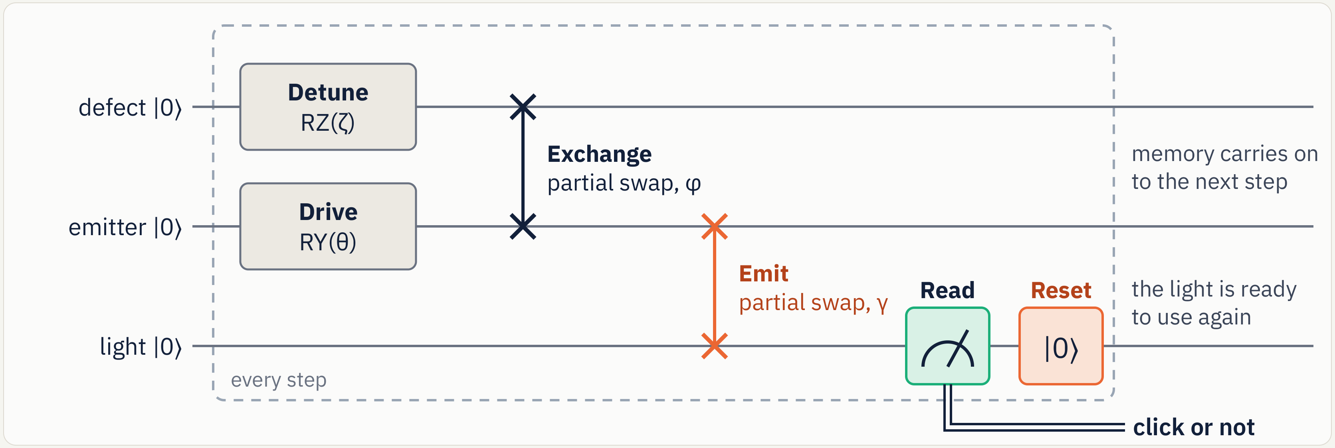
One step of the recurrent quantum model
Dynamic version: measure and reset the output
Purified version retains a fresh output for each step and defers measurement, preserving the click statistics.
22
Notes:
Backup
The emitter rotates under a drive. A hidden qubit rotates under its detuning and exchanges excitation with the emitter. The emitter then exchanges with a fresh output qubit. The dynamic implementation measures and resets that output each step. The purified implementation retains it, so the environment and history required for reversal remain in the circuit. This trades extra qubits for reversibility. Model steps are dimensionless. The optical labels describe a model interpretation. These IBM circuits did not measure photon arrivals.
PRESENTER CUE:
SOURCES: Original fig_circuit_hybrid.png, qrsm_grover/model.py and tests. QRSM defaults theta=.6,gamma=.2,phi=(.45,),zeta=(.3,).

Slide 23
Judging rubric and evidence map
Criterion | Weight | Where the talk addresses it
Problem and impact | 15% | 1–5, 8, 10, 12: purpose, measurement, cost
Quantum rationale | 20% | 4, 6–7, 15, 27: model, scaling, limits
Technical Qiskit implementation | 20% | 7–9, 14–15, 21–22, 27: circuit evidence
Results and evaluation | 10% | 4–5, 8, 11–12, 17–18, 25–29
Innovation | 10% | 7, 13, 24: contribution versus prior work
Presentation | 15% | 13 main slides, planned 9:20 including demo
Q&A and teamwork | 10% | 13–29: roles, lessons, evidence backups
Hardware bonus: highest applicable tier, up to +5. Evidence supports evaluation, not a guaranteed score.
23
Notes:
Backup
This map follows the supplied Qiskit Fall Fest judging rubric. Exceptional performance asks for a specific stakeholder and realistic impact, a defensible quantum rationale that considers classical alternatives and hardware scale, reproducible Qiskit implementation, rigorous comparisons, a clear contribution relative to reused ideas, accessible delivery within the time limit, and shared understanding. The hardware bonus is a separate highest-tier item, not an additive sum of all tier values. We do not predict a judge score.
PRESENTER CUE:
SOURCES: User-supplied Qiskit_Fall_Fest_Judging_Rubric.xlsx, extracted by root. FINALS_RUBRIC.md.

Slide 24
Contribution, prior work and AI assistance
Origin | What belongs there
Established prior work | Amplitude amplification and amplified conditional inference
Before the event | QRSM idea, physics-shaped model and exact filter
Original hackathon work | Qiskit realization, Grover fusion, steering, local reflection, experiments
Finals extension | Independent model audits, laser diagnostics and optical feasibility studies
AI assistance | Original: Claude. Finals: Codex with OpenAI models
A sensing benefit and a computing speedup are separate claims
Atomic laser-noise spectroscopy also predates this project. No new atomic sensing principle is claimed.
24
Notes:
Backup
The original README documents the team research timeline and Claude assistance. The team set the original direction and questions and reviewed the work. This finals revision uses Codex and OpenAI models to assist research review, reproduction, simulations, tests, application and presentation. Do not imply that every generated analysis has already received manual team verification. Amplitude amplification and Bayesian quantum inference are prior art. Atomic laser-noise spectroscopy is also prior art. The separate optical and sensing extensions test scoped feasibility questions and do not establish an end-to-end quantum computing advantage.
PRESENTER CUE:
SOURCES: Original README PriorworkandAIhelp and Team. Brassardetal https://arxiv.org/abs/quant-ph/0005055. Lowetal https://arxiv.org/abs/1402.7359. Bishofetal https://arxiv.org/abs/1303.6741.

Slide 25
Drive amplitude: a useful negative result
Same 96-bin records. Unknown +20% field step. Detection within 32 bins.
Detector | Timely detection | Stable-record false alarms
Physical QRSM | 3.71% | 6.84%
Classical HMM | 3.13% | 5.27%
Count baseline | 1.76% | 1.95%
Prior-only RMSE 0.1136 → observed-data RMSE 0.1125
Most of the apparent estimation gain came from the prior
Post-holdout prior control is descriptive. 512 records per case; 6,656 total. No physical time or photon-budget calibration.
25
Notes:
Backup
The field-amplitude proxy is the drive parameter, not an incident-photon flux. A20 percent field step would correspond to 44 percent intensity under fixed coupling. This low-count regime yields poor timely detection alongside substantial full-record false alarms. The physical filter, fitted HMM and count detector share the same bits; these are not independent engineered optical receivers. The post-holdout prior-only control exposes a weak constant-estimate comparison: for this step, using observations only slightly improves the prior estimate, and for the four other source-changing cases it makes estimation worse. Afterpulsing produces 10.55 percent false source alarms. The model needs a better operating regime and calibrated detector dynamics before a practical monitor claim.
PRESENTER CUE:
SOURCES: qrsm_photon_poc/drive_diagnostics_followup/README.md; main/results.json, prior_only_estimation_control.json, independent_review.json, prior_only_independent_review.json. Four separately calibrated pipelines,13cases,128records per pipeline/case,96bins/cavity4. Stable FAR35/512 and step timely19/512 for physical QRSM. Prior-only MSE minus observed-data MSE .00025149, paired interval [.00007878,.00044596] for this step, a small conditional effect. Prior supplement is post-holdout descriptive, not another confirmatory test.

Slide 26
Phase inspection: benefit depends on the budget
Two illuminated sample modes. All incident photons are charged before loss.
Protocol at 81% efficiency | Full 2π phase RMSE | Wrong π branch
Coherent reference | 0.00791 rad | 0 / 2,000 trials
Pure two-photon NOON | 2.22674 rad | 50.4%
10% coherent + 90% NOON | 0.00637 rad | 0 / 2,000 trials
20,000 mean incident photons; ideal preparation in this comparison
1% preparation: matched dose takes 100× longer for pure NOON
Synthetic phase task, known reference and loss. Hybrid pilots are charged. Zero observed branch errors is not a guarantee.
26
Notes:
Backup
A doubled fringe has a pi ambiguity. Pure NOON performs well locally around a shared calibrated working point, but fails to identify the full phase globally. A charged coherent pilot resolves that ambiguity in the tested hybrid. Both sample modes illuminate the object; the resource is 20,000 mean photons before object transmission, including reference-arm photons. The high-efficiency case has 90 percent object transmission and 90 percent detection, with ideal preparation. Lower transmission removes the precision benefit. At one-percent preparation, matching dose requires 100 times longer for pure NOON; at fixed clock time its precision is worse. Ideal number-resolving detection, a known phase reference and the declared classical protocol bound this result. It is not superiority over all classical designs or a measured feature-size benefit.
PRESENTER CUE:
SOURCES: quantum_lithography_poc/phase_inspection_followup/README.md and results.json high_efficiency/equal_sample_photons. Pure NOON modulo-pi RMSE .0062646rad, full2piRMSE2.226739rad. Hybrid.00637086rad, coherent.007908rad,2000outcomes per protocol in each cohort. Zero errors gives95%Wilson upper bound.1917%. Global phases reused across methods; outcomes independently drawn. Separate equal-clock and equal-dose budgets.

Slide 27
The full spatial query is costly to construct
49 exposure cells, capped photon counts and a reversible weighted threshold
Constructed bound | Qubits | Generic CX upper bound | Dose-1.5 event probability
Floor weights | 389 | 3,382,108 | 0.00423713
Ceiling weights | 389 | 2,874,028 | 0.00422695
196 count qubits + 23 score qubits + 170 extra clean ancillas
Both circuit files round-trip. Classical evaluation is already tractable.
Constructive, unoptimized bounds. No full-state simulation, routing, hardware execution or physical optical claim.
27
Notes:
Backup
This is an actual constructed reversible 49-cell oracle, not an extrapolation from three cells. Four count qubits per cell encode a capped Poisson law,23 bits accumulate the weighted score, and 170 extra clean ancillas support explicit reversible gates. Both 389 qubit circuits pass QPY serialization and independent structural, arithmetic and uncomputation checks. The CX values are constructive generic decomposition upper bounds, including preparation and one complete amplification round; they are not a routed device compilation. Rounding and capped-tail bounds bracket the original event, with relative bracket width 0.2406 percent at dose 1.5 and 0.3526 percent at dose 1.8. Classical dynamic programming already solves this independent-cell distribution efficiently. Construction alone establishes neither computational advantage nor physical lithography feasibility.
PRESENTER CUE:
SOURCES: finals-lithography/full_spatial_circuit/README.md, results.json, process_bounds.py, independent_review.json. Floor and ceiling clean circuits389qubits; CX bounds3,382,108/2,874,028 and U5,050,537/4,288,741. Dose1.5 original event bracket [.004226948015,.004237128599]; conservative conditionalTVbound.00482. Cap15 value change usesPoisson tailN>=16, encoded cap probabilityusesN>=15. Check row direction against event interval: floor weights admit an upper event; ceiling weights give a lower event.

Slide 28
Exposure: contrast trades against dose and loss
Phenomenological two-photon resist; fixed threshold and 20 evaluated guard cells
Illumination | Best mean cell accuracy | Incident photons | All 20 cells correct
Two-photon NOON | 95.16% | 14.88 million | 36.76%
Phase-cycled coherent | 78.28% | 6.81 million | 0.73%
10% duty coherent | 83.29% | 0.845 million | 2.52%
Quantum contrast helps this chosen response; it is not dose advantage
Loss, blur and linear background can erase the pattern benefit
Each row uses its own best tested dose. All phase-cycle exposures charged. Higher classical peak intensity is allowed.
28
Notes:
Backup
The response combines declared linear and two-photon activation coefficients, loss, phase jitter, finite pixel collection and post-activation blur. Activations are rare Poisson events, not direct photon probabilities. The NOON pattern has stronger mean contrast and higher best guard-cell accuracy under the nominal assumptions, but requires more incident photons at its best tested dose. The duty-cycle comparator concentrates equal average photons into ten-percent active time, giving higher peak intensity. It is one explicit classical competitor, not an optimum over all illumination. Loss, blur, linear leakage, background and low preparation success degrade the result. The 20 guard cells exclude boundary cells. This is a sensitivity study of an assumed resist, not a prediction for an available material or fabricated feature.
PRESENTER CUE:
SOURCES: quantum_lithography_poc/exposure_followup/README.md and results.json finite_nominal. Table optimizes each method over tested doses, so it is not a single equal-dose operating point. G1/G2 supplement verifies spatial conservation and harmonic/per-photon accounting. 540,000Poisson realizations. Wavelength800nm, ±30degree modes, second harmonic400nm; period is not linewidth. Independent or fast phase jitter/mean-rate approximation excludes slow correlated phase drift.

Slide 29
Model accuracy is part of the resource budget
Cavity truncation changes conditional predictions, even with exact circuit execution
Cavity levels | Default drive error* | Higher-drive error*
2 | 2.7643 percentage points | 7.0829 percentage points
4 | 0.0494 percentage points | 0.1118 percentage points
5 | 0.00281 percentage points | 0.01102 percentage points
Controlled records improve some model comparisons; ambiguity remains
Classical filtering remains the baseline. More physics costs more qubits.
*Largest tested after-click probability error versus cavity level 6. Finite truncation study, not universal convergence.
29
Notes:
Backup
The original optical circuit uses only two cavity levels. Comparing its conditional predictions with a six-level reference reveals errors of several percentage points, especially under stronger drive. Increasing the cutoff reduces the discrepancy in these cases, but raises state and circuit costs. Six fresh joint-inference cases fit five parameters with source and detector controls. Fixed settings do not resolve performance versus an HMM; controlled settings give small held-out gains under shared known physics. Fixed-drive detuning sign remains structurally ambiguous. Controlled settings break that exact symmetry but do not establish reliable finite-data sign identification. Local curvature intervals fail near boundaries and are not global uncertainty guarantees. Thermal, multimode and non-Markovian effects remain future model families.
PRESENTER CUE:
SOURCES: qrsm_photon_poc/followup/README.md, dynamics_results.json, inference_results/, parameter_validation_v2/ and independent_review.json. Max after-click error over tested later lags versus cavity dimension6. Master equation independently checked with QuTiP; trajectory statistics tested separately. Controlled model-HMM logscore gains .0574[.0158,.1014] and .0972[.0448,.1495]nats/24-binrecord under conditional bootstrap. This does not establish physical defect identification or a quantum computational speedup.

