Slide 1

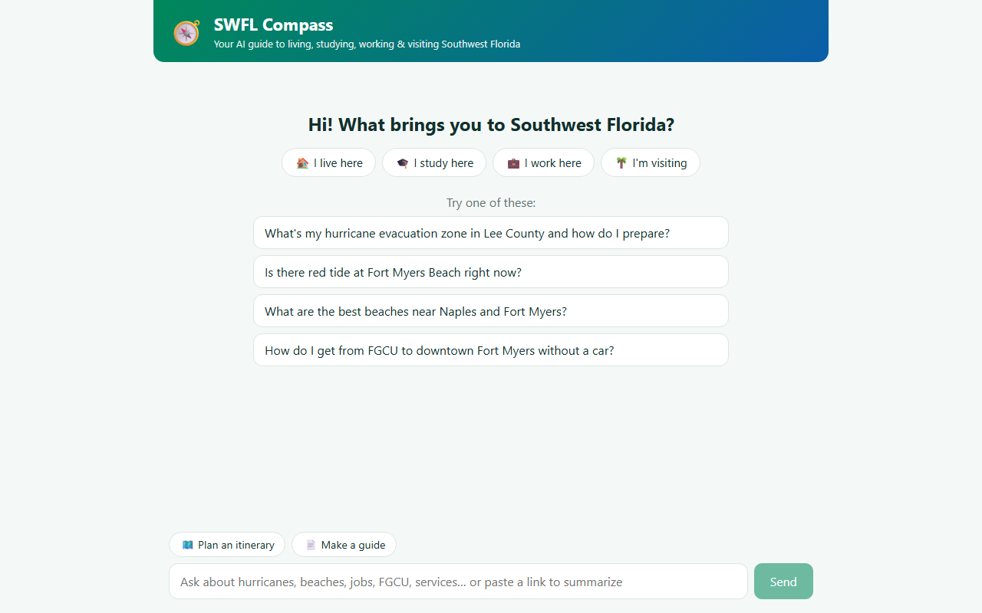
SWFL Compass
An agentic AI guide for everyone who lives, studies, works in, or visits Southwest Florida
FGCU AI Day H{AI}ckathon · Challenge: AI for SWFL
November 2, 2026
Notes:
Hi, we built SWFL Compass: one place to ask anything about life in Southwest Florida and get a researched, sourced answer, real places on a map, and a plan you can take with you.

Slide 2




Answers about SWFL are scattered across dozens of sites
Today you have to know where to look
Residents
Students
County emergency management
NWS + FWC red tide reports
LeeTran / CAT transit
CareerSource, FGCU, FSW
Tourism boards, reviews, maps
Evacuation zones, red tide, flooding, utility help
Getting around without a car, housing, campus resources
Workers
Visitors
…and much of it is time-sensitive.
Job training, hiring industries, childcare support
Beaches, wildlife, food, staying safe in storm season
Notes:
Four audiences, one region. The information exists, but it's spread over county sites, state agencies, transit, schools and tourism boards, and things like storms and red tide change daily.

Slide 3
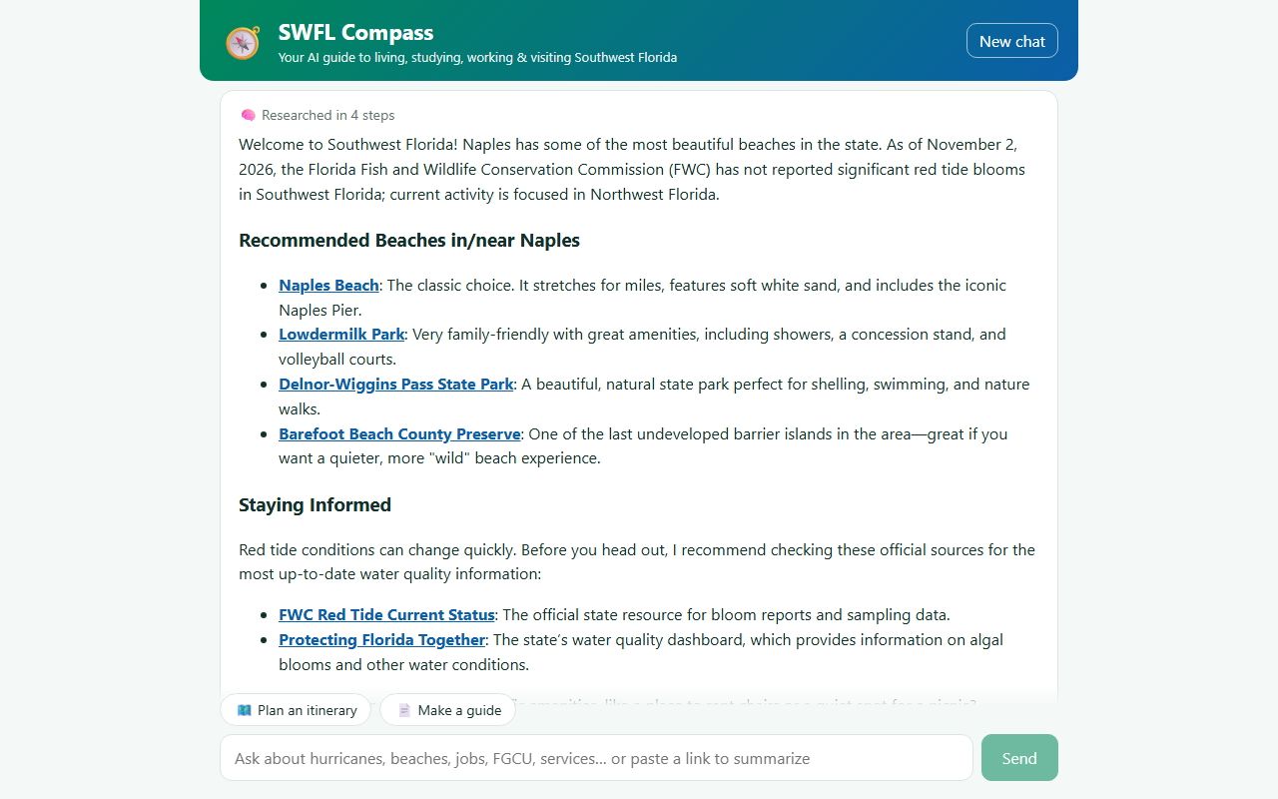





One question in, a researched answer out
Researches live
Searches the web, reads official pages, streams each step
Shows real places
Verified Google Maps places, pinned on a map
Points to resources
Only links it actually read, plus one-click summaries
Keeps the conversation going
Suggests follow-up questions tailored to you
Makes a plan
Itineraries and guides to download or print
Notes:
Ask in plain language. The agent decides what to search, reads the pages, checks places on Google Maps and writes a sourced answer, then hands you resources, follow-up questions and, if you want, a full plan.

Slide 4
Live demo
In 60 seconds
1
Pick who you are
2
Ask a question
3
Watch the agent research
4
Answer + map + resources
5
Summarize a source
6
Build a 2-day itinerary
Notes:
Click play. A visitor asks about Naples beaches and red tide. You can see each agent step live, then the sourced answer, map pins from Google Places, resources with a one-click summary of the FWC red tide page, and finally a two-day Naples itinerary built from the form.

Slide 5
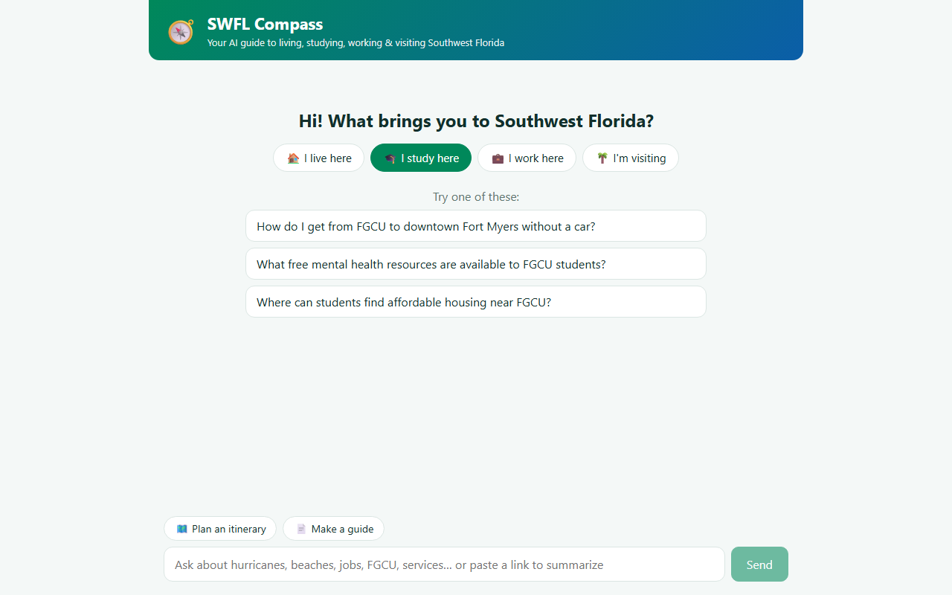
Tailored to who you are
Residents
Hurricane zones, red tide, utility help
Students
Transit, housing, campus wellness
Workers
Training, hiring industries, childcare
Visitors
Beaches, wildlife, food, safety
The persona also tunes the agent’s advice, not just the suggestions.
Pick “I study here” and the starter questions change
Notes:
Users start by saying who they are. That changes the starter questions and is passed to the agent so advice fits a resident, student, worker or visitor.

Slide 6
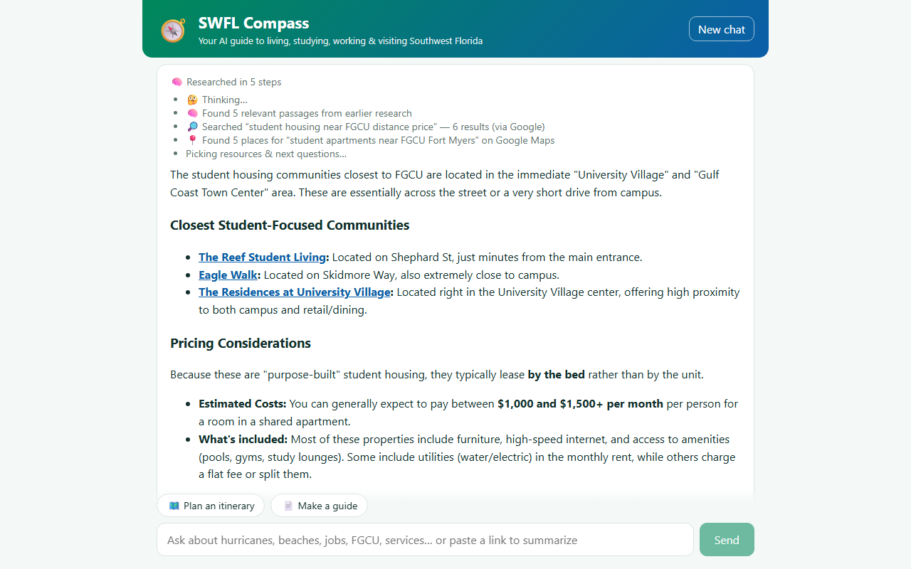
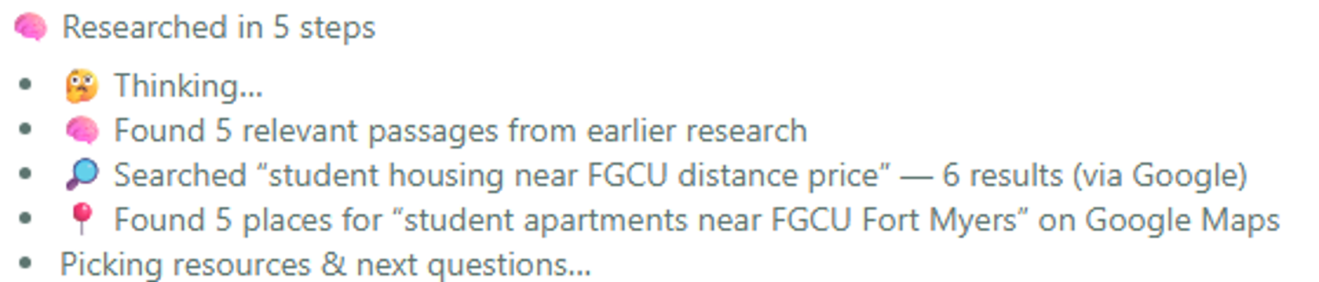
Watch the agent research in real time
ZOOM: THE AGENT’S OWN STEPS
Recall
Found 5 relevant passages from earlier in the chat
Web search
SearXNG first, Google grounding when it comes back empty
Google Places
Real apartments near FGCU with addresses and ratings
Notes:
Every tool call streams to the UI. This is a follow-up question: the agent first pulled five passages from its own memory of the chat, searched the web once more, then checked student apartments on Google Maps.

Slide 7
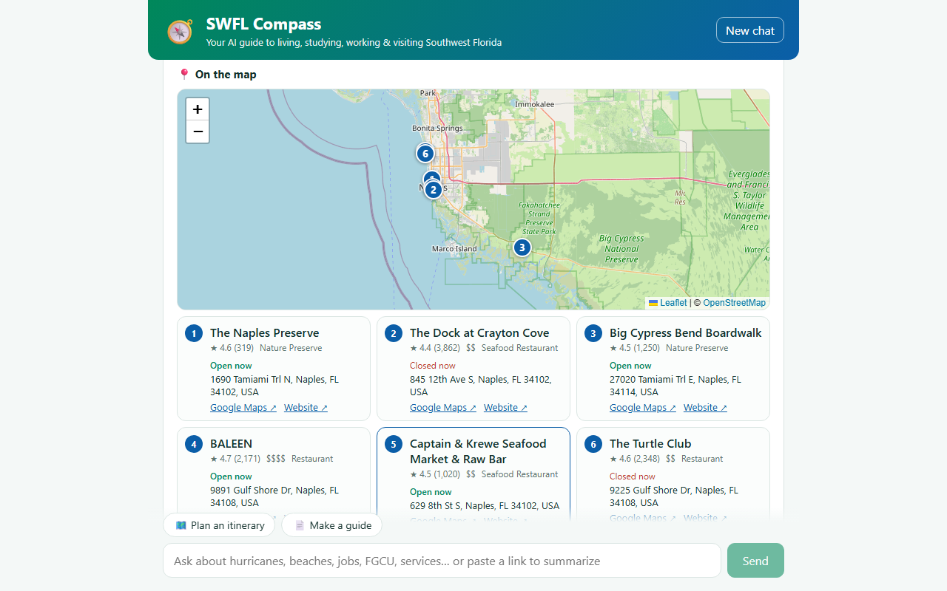
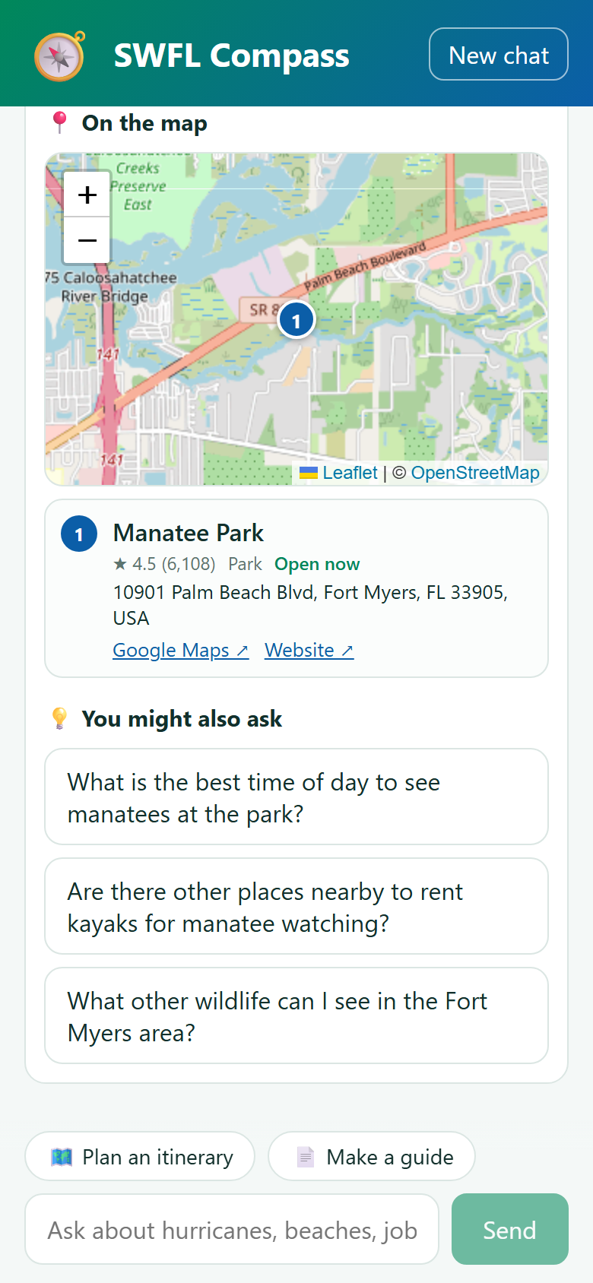
Real places, verified on Google Maps
★ 4.6 (319)
Google rating + review count
Open now
Live open/closed status
Maps ↗ Website ↗
Official links, never guessed
Numbered pins match the place cards · click a card to zoom the map
Notes:
The find_places tool calls the Google Places API, so addresses, ratings and open-now status are real. Places the answer mentions are pinned on an OpenStreetMap map, on desktop and on phones.

Slide 8
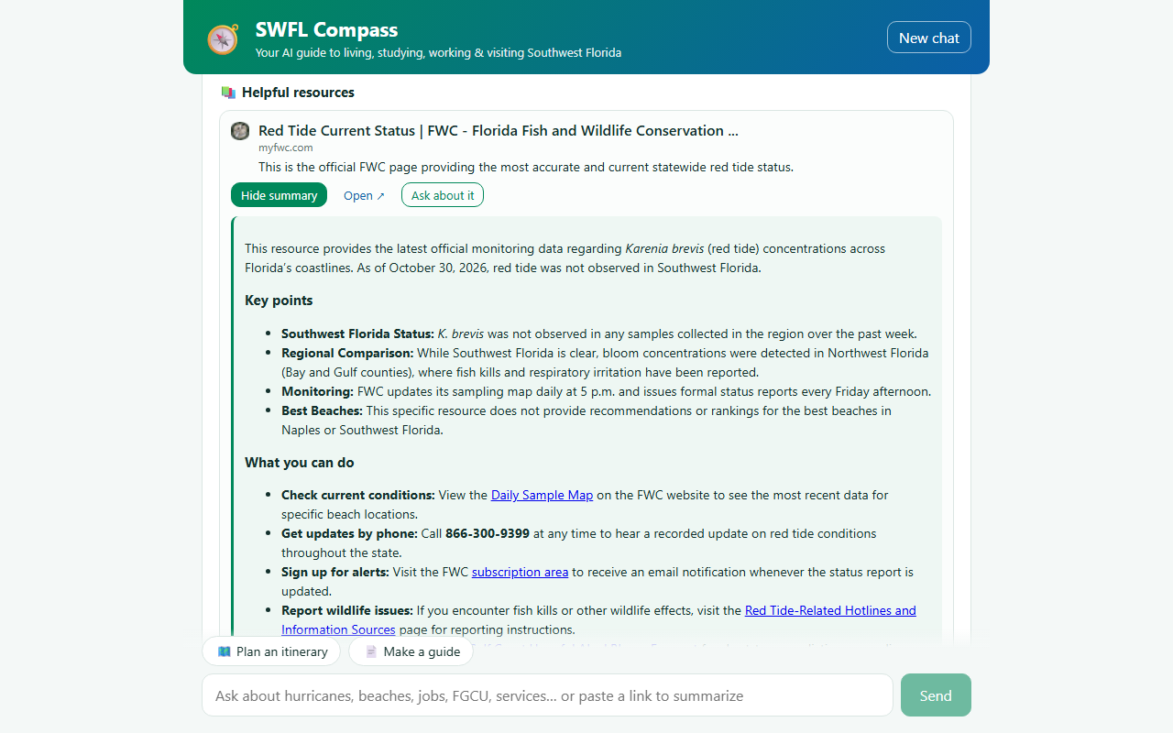

Resources you can trust, summarized in one click
Links only from pages it read
Resources are picked by index from what the agent actually saw: no invented URLs
Summarize any resource
Key points + what you can do: phone numbers, schedules, sign-ups
Official sources first
.gov, FWC, NWS and county sites; reminds you to verify time-sensitive info
Notes:
Resources come only from pages the agent read. One click summarizes any of them; here the FWC red tide page becomes key points plus actions, including FWC's phone line and update schedule.

Slide 9
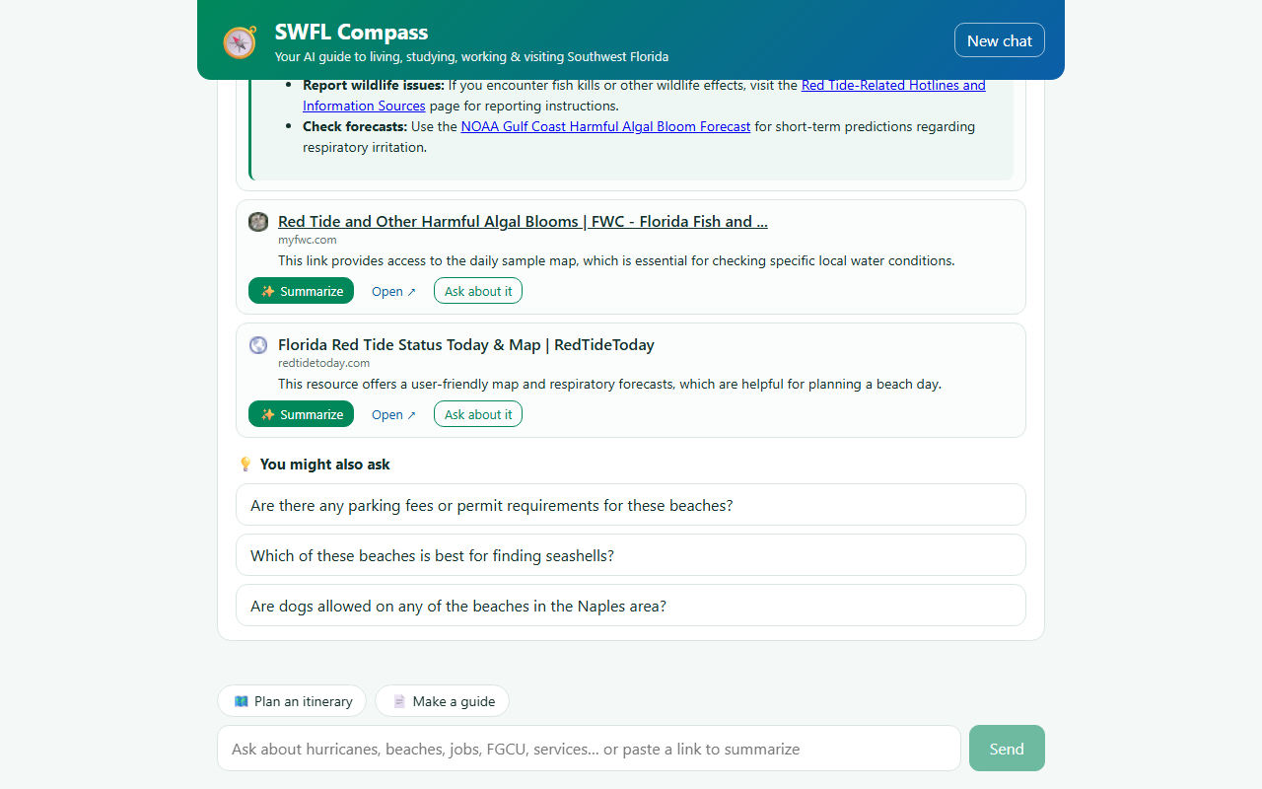
Follow-ups that remember what it learned
PER-CHAT RAG MEMORY
Pages & results read
full text, not truncated
Chunk + embed
Gemini embedding-001
Chat’s vector store
in-memory, per session
Three follow-ups written in your voice, one click to ask
Top passages → next turn
auto-retrieved every question
Notes:
After each answer it suggests what you'd ask next. Everything the agent reads is chunked, embedded with Gemini and kept in that chat's vector store, so follow-ups, itineraries and guides build on earlier research instead of starting over.

Slide 10
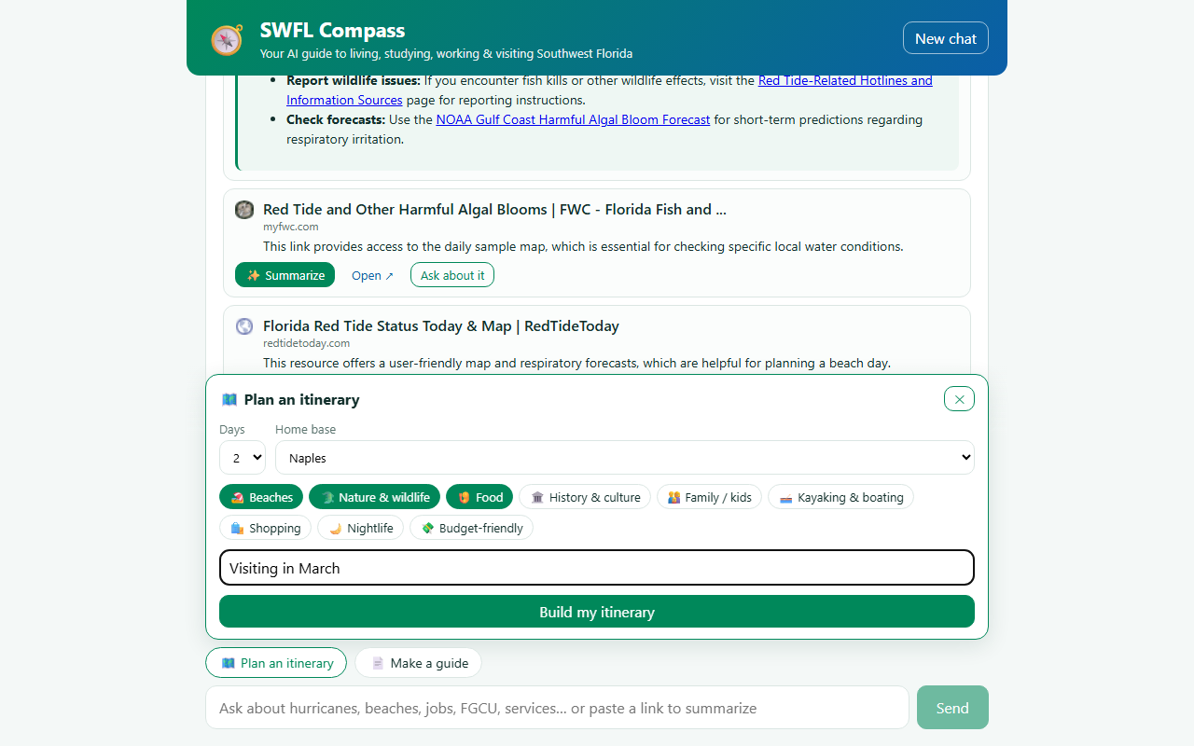
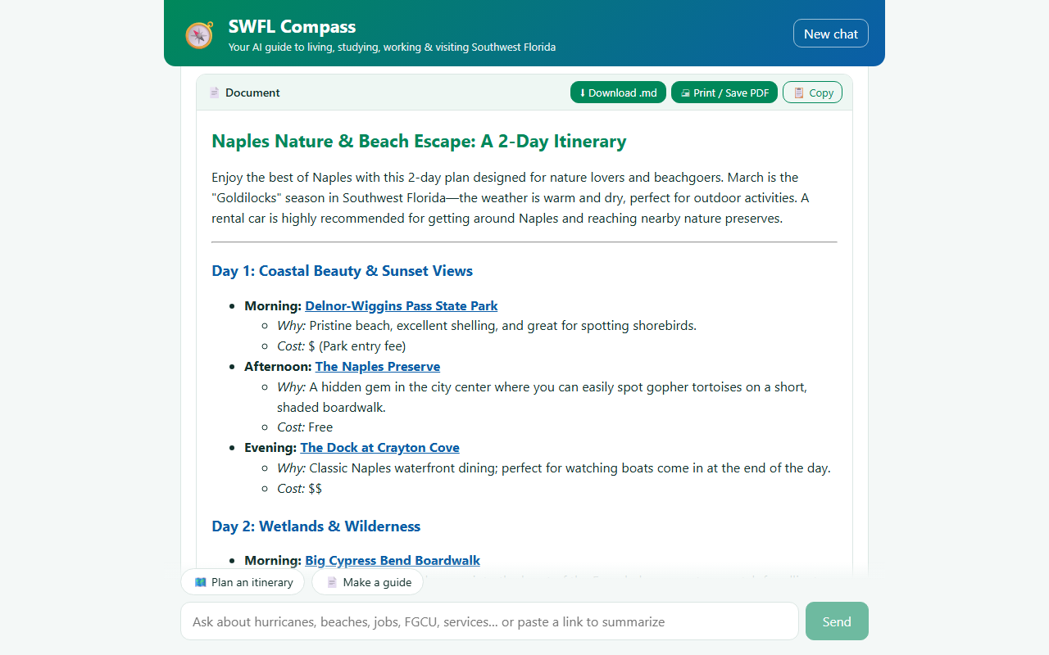
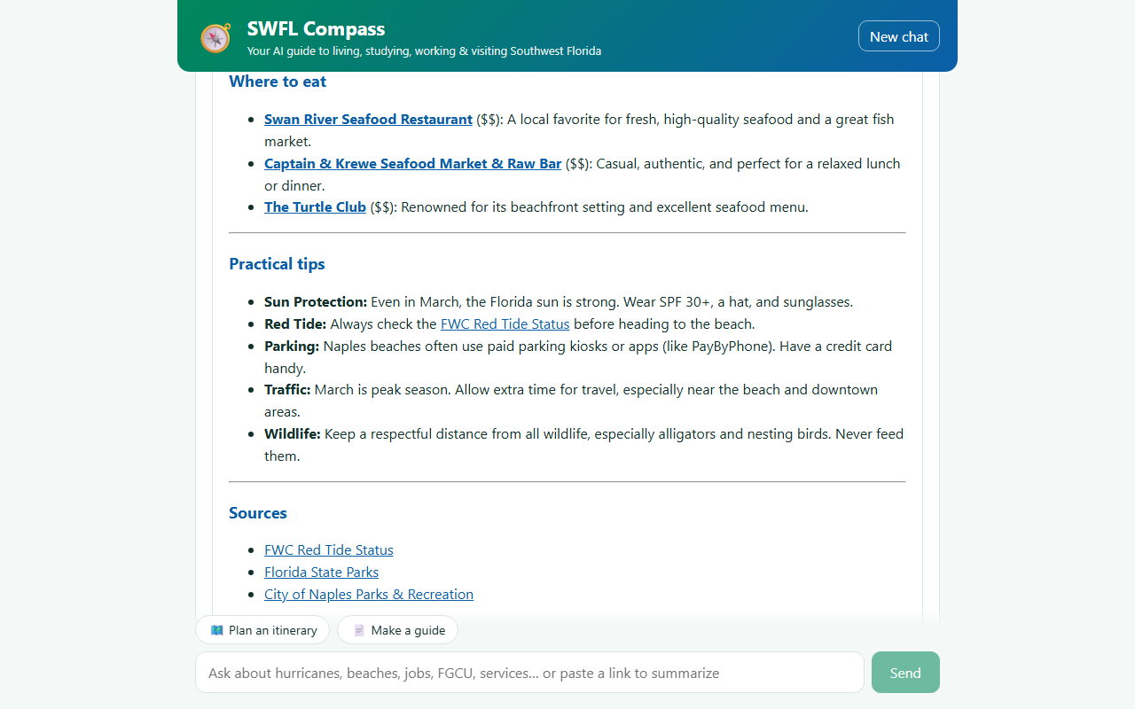
Plan a whole trip from one form
1 · Choose days, home base, interests
Morning / afternoon / evening, cost, Maps link for every stop
2 · The agent researches and writes the plan
Notes:
The itinerary builder takes days, a home base, interests and notes like 'visiting in March'. The agent runs a longer research loop and writes a day-by-day plan in the chat.

Slide 11
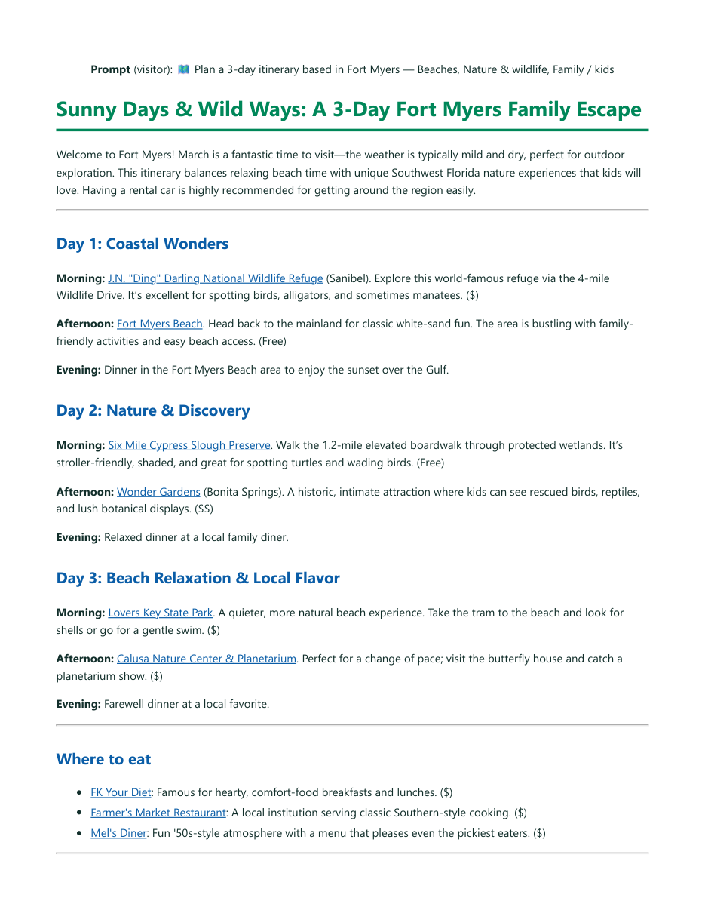
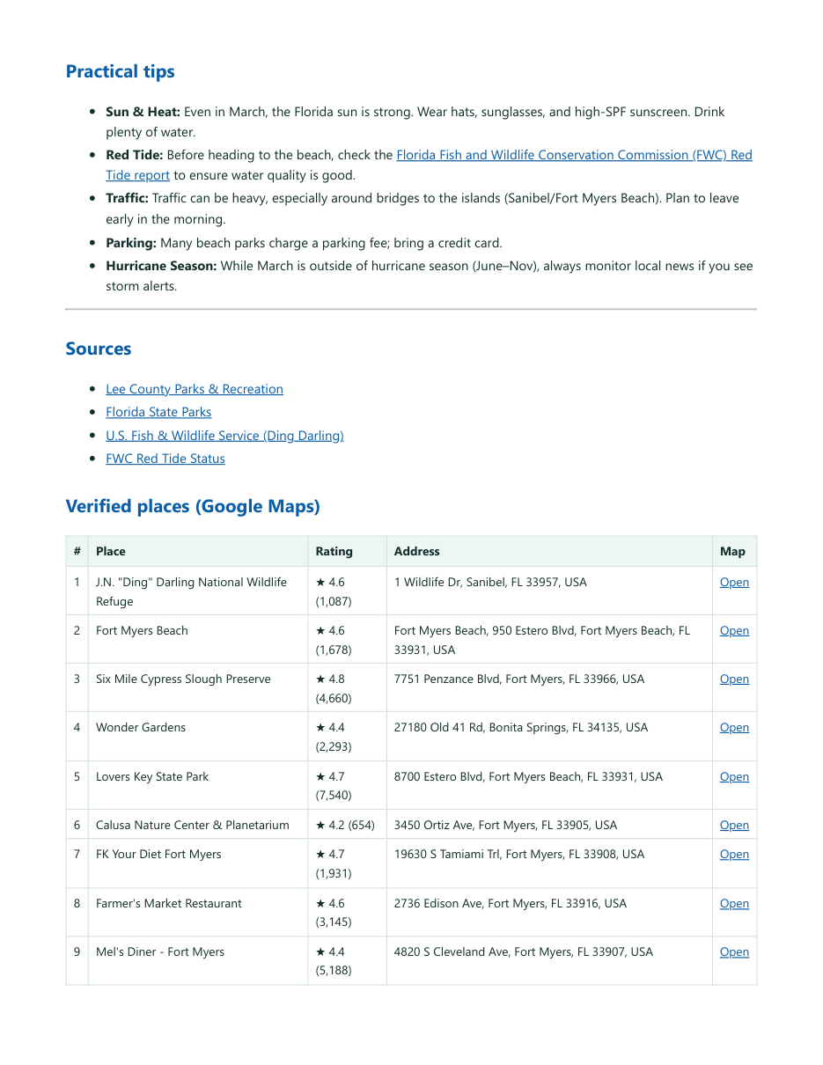
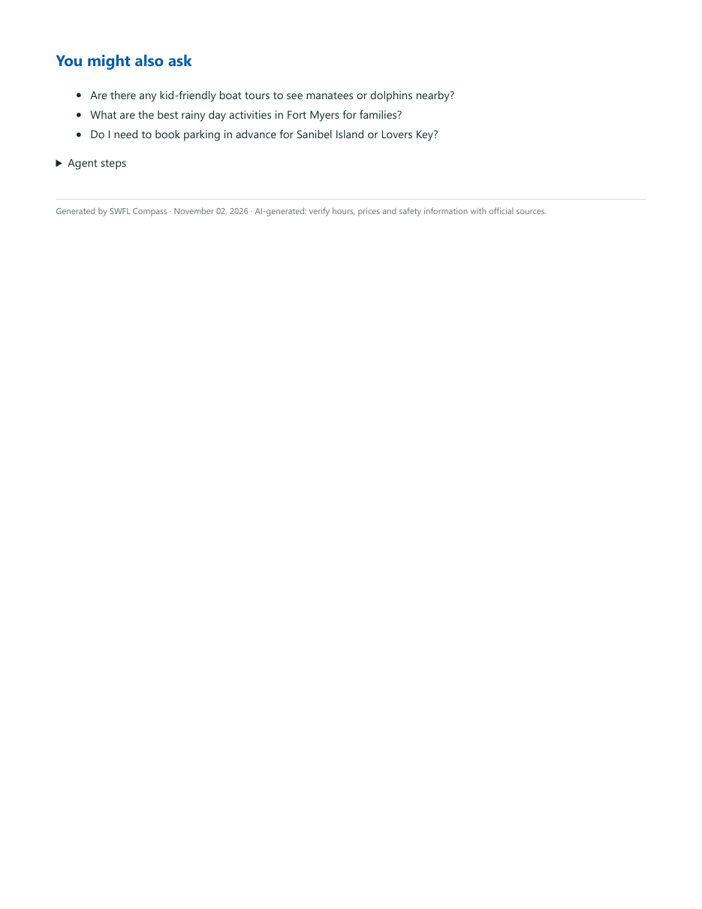
The output: a 3-day family itinerary, ready to print
3
days, each with morning, afternoon and evening
9
places checked on Google Maps, with ratings, addresses and links
1 click
to download Markdown or print to PDF
Unedited output: docs/samples/itinerary-3-day-fort-myers-family.pdf
Notes:
This is a real, unedited export. Prompt: three days in Fort Myers with two kids in March. Ding Darling, Six Mile Cypress, Lovers Key, Calusa Nature Center, family restaurants, practical tips, sources, and a table of nine Google-verified places.

Slide 12
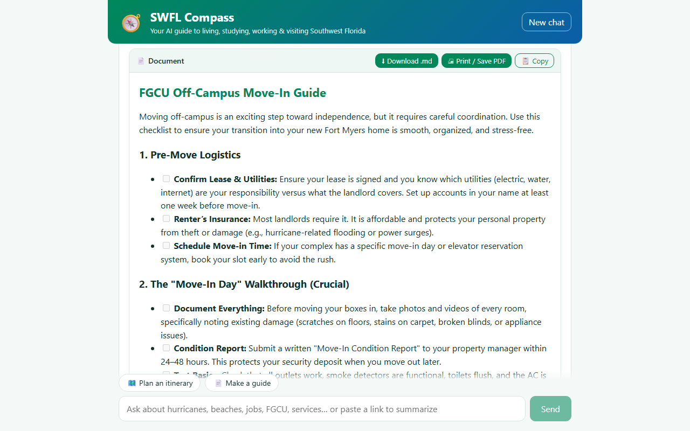
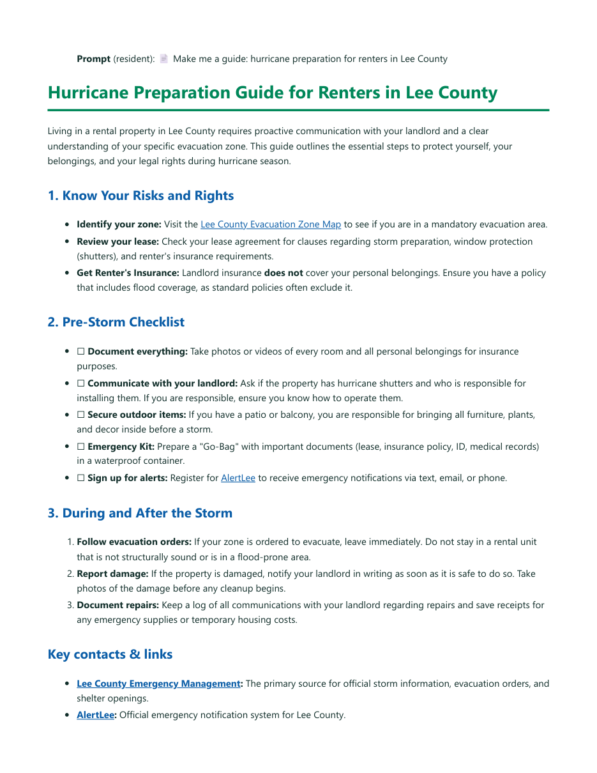
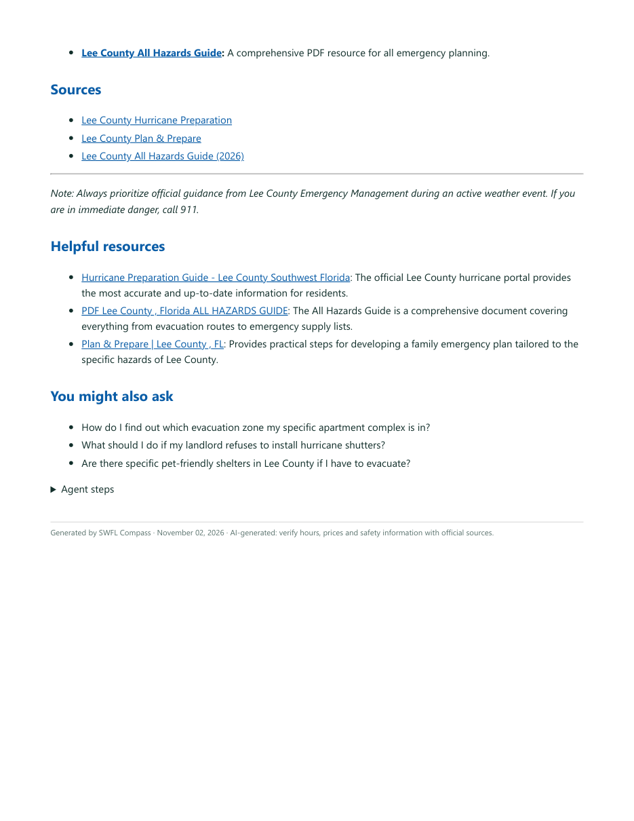
Guides for any topic, with checklists
In the app: “FGCU off-campus move-in” guide with checkboxes
Exported PDF: “Hurricane prep for Lee County renters”
Notes:
Guides work for any topic, or turn the current conversation into a guide. Left, a move-in checklist for FGCU students generated in the app; right, the exported PDF of a hurricane-prep guide for Lee County renters with AlertLee and the county's All Hazards Guide.

Slide 13
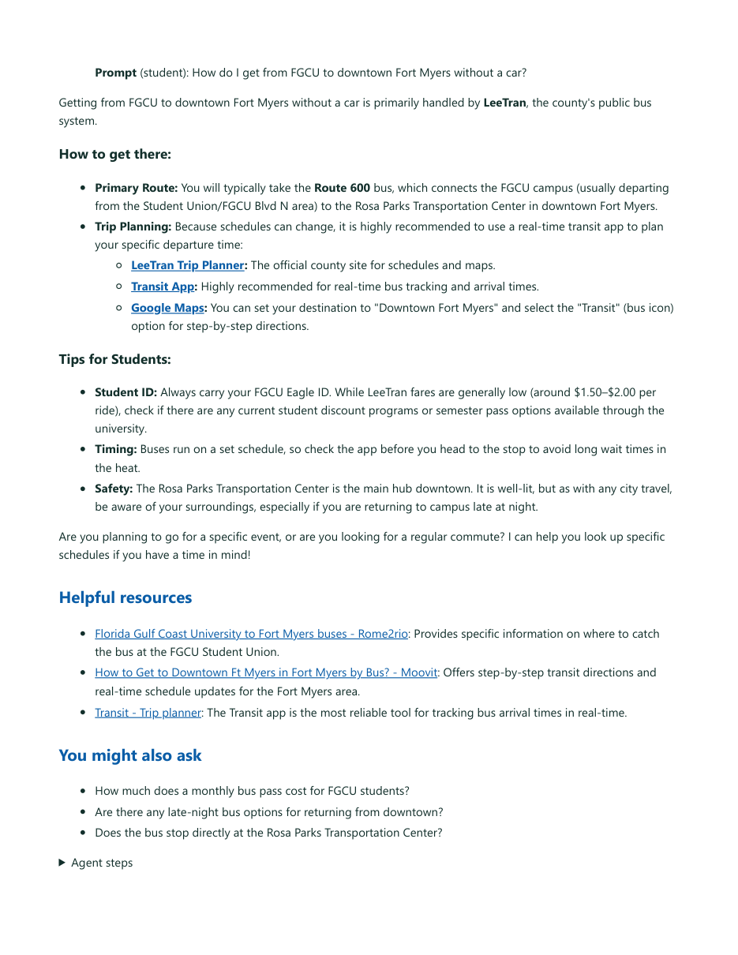
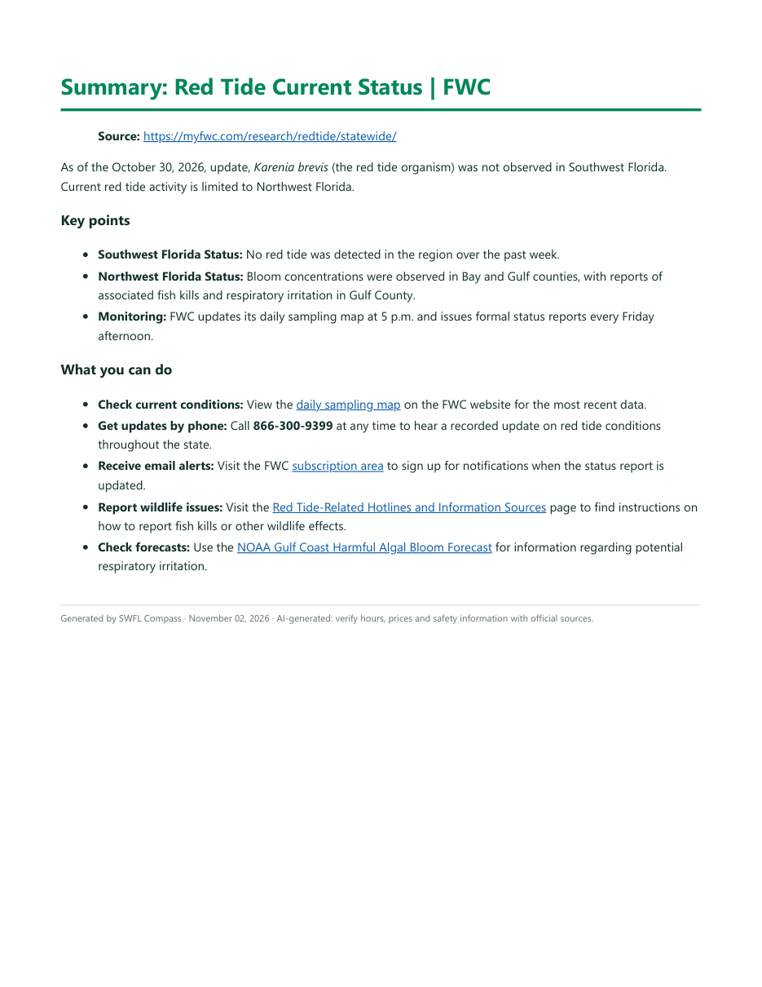
Every output leaves the app with you
🗺️ Itinerary
📄 Guide
💬 Chat answer
✨ Resource summary
⬇ Download .md 🖨 Print / Save PDF 📋 Copy · all four are real exports in docs/samples/
Notes:
Itineraries, guides, chat answers and resource summaries all export: Markdown download, print or save as PDF, or copy. All four of these are real, unedited outputs in the repo.

Slide 14
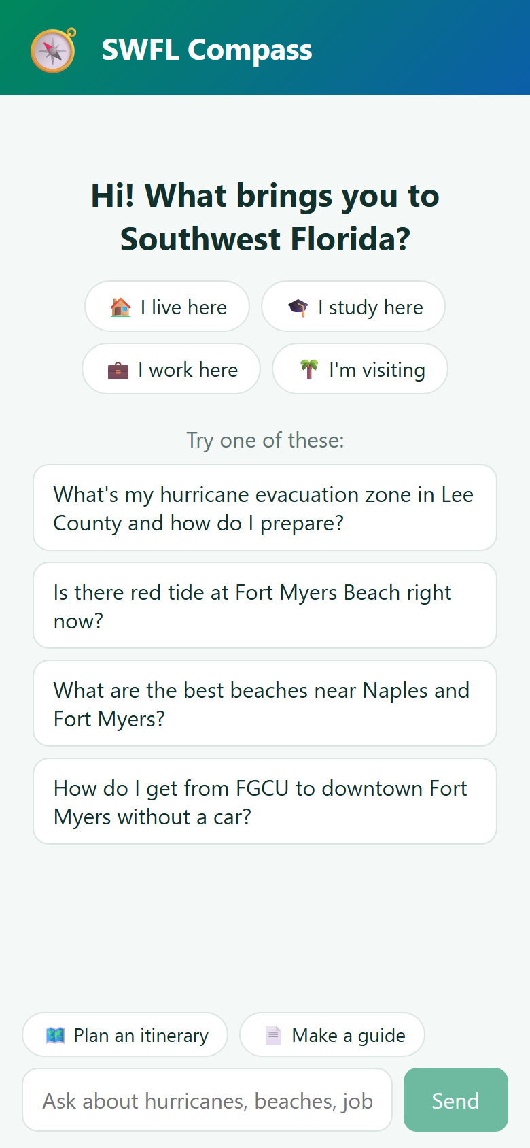
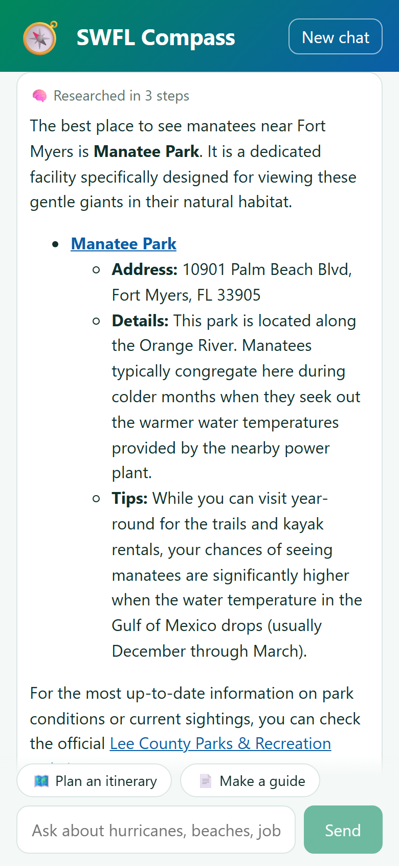

Built for phones: where people need it
On the beach or in the car
Same features on a phone: research, map, resources, documents
When it matters most
Storm-season questions get official sources and verify-first reminders
Pick who you are
Researched answer
Places on the map
Notes:
Most people will ask from a phone: on the beach, in the car, during storm season. Everything works at phone width.

Slide 15
How it works: an agent with four tools
web_search
Self-hosted SearXNG · Google grounding fallback
FastAPI agent
React UI
Gemini 3.1 Flash-Lite function-calling loop. Streams every step (SSE)
read_page
Personas, live steps, map, documents
Scraper + PDF · Gemini url_context for blocked sites
find_places
Google Places API (New) · verified places
Answer + resources + follow-ups, chosen only from what the agent actually saw
recall (RAG)
Per-chat vector store · Gemini embeddings
Notes:
The React front end streams from a FastAPI backend. Gemini runs a tool loop: SearXNG web search we host ourselves, a page reader, Google Places for verified locations, and a per-chat vector store so follow-ups and documents build on earlier research.

Slide 16



Built to hold up on demo day
Cheap and fast
Search that survives venue Wi-Fi
Gemini 3.1 Flash-Lite first, automatic fallback to other models when one is overloaded
Our own SearXNG in Docker with public DNS and short engine timeouts; Google grounding if it comes back empty
Never a dead end
Self-contained
Retries empty model replies, reads blocked sites through Gemini, answers from gathered research if a step fails
Pinned search image saved in the repo folder, one-click start.bat, keys in a local .env
Notes:
Real-world problems we hit today and fixed: model overload, search engines timing out on the venue network, sites that block scrapers. Every one has a fallback, so the user always gets an answer.

Slide 17


What's next for SWFL Compass
Spanish and Haitian Creole
Hurricane mode
Text and voice access
Local partners
Serve more of SWFL's communities in their own language
Live NWS alerts, evacuation zone lookup by address, shelter map
Ask by SMS or phone when the internet is down after a storm
County 311, FGCU and transit data feeds as trusted sources
Notes:
Where we'd take it: more languages for SWFL's communities, a dedicated hurricane mode, SMS and voice for when the internet is down after a storm, and partnerships with local data sources.

Slide 18

Thank you: questions?
github.com/Nicholas55555/swfl-compass
AI tools & APIs used
Google Gemini API (3.1 Flash-Lite, function calling, url_context, Search grounding)
Gemini Embeddings (gemini-embedding-001)
Google Maps Places API (New)
SearXNG (self-hosted) · OpenStreetMap + Leaflet
Claude Code (development assistant)
Works on phones too
Notes:
Thanks! The code, this deck and the demo video are on GitHub. Happy to take questions.

