Slide 1
CS-254 Algorithms Selection Sort
Dr. Terry Mason

Slide 2
Sorting Introduction
Sorting is the process of re-arranging data items in ascending or descending order.
There are many different sorting algorithms, each with its own properties. We will look at these algorithms:
selection sort
insertion sort
quick sort
merge sort
heap sort

Slide 3
Sorting Why so many algorithms?
You may wonder why there are so many different sorting algorithms.
One reason is algorithmic approaches as different algorithms were proposed as researchers tried to find better algorithms.
We still study many of these algorithms, including the slower ones, because in some cases even the algorithms that are slower on average may be better for certain inputs.
For example, insertion sort is very good when the array is almost sorted.

Slide 4
Quadratic Sorting Algorithms
The first class of sorting algorithms we will study are called quadratic sorting algorithms because in the worst case their performance is O(n²), where n is the size of the array.
Note that for our discussion of sorting algorithms we will sort an array of integers in ascending order (from smallest to largest), however all algorithms can be reversed to sort in descending order.
Further, we can modify our sorting algorithms to be generic which would allow us to sort any data type that overloads the "<" operator or implements Comparable.
The name of our array will be data with indices from 0..n-1 and values data[0], data[1], …, data[n-1].

Slide 5
Selection Sort
Selection sort is a simple quadratic sorting algorithm where the basic idea is to always select the smallest element in the unsorted part of the array and move it to the front of the array.
Selection sort algorithm:
for each array index i
Find the smallest element in the part of the array that is not sorted.
Save the location of the smallest element. Let this location be k.
Swap data[k] and data[i].
This can be done by using a temporary variable to store one of the elements.

Slide 6
Selection Sort Example
[0]
[1]
[2]
[3]
[4]
[5]
[6]
[7]
[8]
[9]
[10]
Unsorted array
5
10
3
4
7
5
1
6
8
2
9
Pass 1. Min=1.
5
10
3
4
7
5
1
6
8
2
9
Move 1 to index 0.
After pass 1.
1
10
3
4
7
5
5
6
8
2
9
Pass 2. Min=2.
1
10
3
4
7
5
5
6
8
2
9
After pass 2.
1
2
3
4
7
5
5
6
8
10
9

Slide 7
Selection Sort Example (2)
[0]
[1]
[2]
[3]
[4]
[5]
[6]
[7]
[8]
[9]
[10]
After pass 3.
1
2
3
4
7
5
5
6
8
10
9
After pass 4.
1
2
3
4
7
5
5
6
8
10
9
After pass 5.
1
2
3
4
5
7
5
6
8
10
9
After pass 6.
1
2
3
4
5
5
7
6
8
10
9
After pass 7.
1
2
3
4
5
5
6
7
8
10
9
After pass 8.
1
2
3
4
5
5
6
7
8
10
9

Slide 8
Selection Sort Example (3)
[0]
[1]
[2]
[3]
[4]
[5]
[6]
[7]
[8]
[9]
[10]
After pass 9.
1
2
3
4
5
5
6
7
8
10
9
After pass 10.
1
2
3
4
5
5
6
7
8
9
10
After pass 11.
1
2
3
4
5
5
6
7
8
9
10

Slide 9
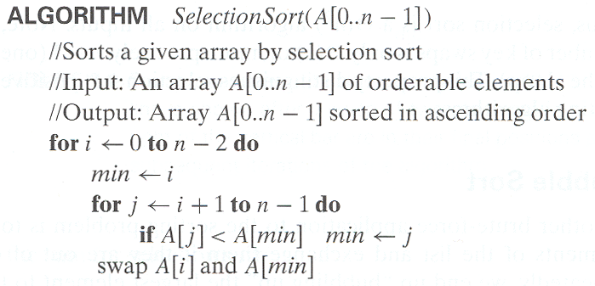
Analysis of Selection Sort

Slide 10
Sorting Analysis
To analyze all the sorting methods, we will compare them on two factors:
1) # of element movements (swaps)
2) # of comparisons (< operator)

Slide 11
Selection Sort Analysis
Selection sort analysis (simplified):
Swaps Comparisons
Best case n-1 n*(n-1)/2
Worst case n-1 n*(n-1)/2
Thus, selection sort performs n-1 swaps and n*(n-1)/2 comparisons regardless of the input array and is O(n²).

