Slide 1
Decrease-and-Conquer
Reduce problem instance to smaller instance of the same problem
Solve smaller instance
Extend solution of smaller instance to obtain solution to original instance
Can be implemented either top-down or bottom-up
Also referred to as inductive or incremental approach

Slide 2
3 Types of Decrease and Conquer
Decrease by a constant (usually by 1):
insertion sort
algorithms for generating permutations, subsets
Decrease by a constant factor (usually by half)
binary search and bisection method
exponentiation by squaring
Variable-size decrease
Euclid’s algorithm
selection by partition

Slide 3
Brute Force
A straightforward approach, usually based directly on the problem’s statement and definitions of the concepts involved
Often easiest solution to apply.
Use force of computer or computing.
Strategy applies to variety of problems.
Stop analyzing and Do It!

Slide 4
Brute Force
A straightforward approach, usually based directly on the problem’s statement and definitions of the concepts involved
Examples:
Searching for a key of a given value in a list
Selection Sort
Bubble Sort
String Matching
Graph Searching (Breadth and Depth First Searches)

Slide 5
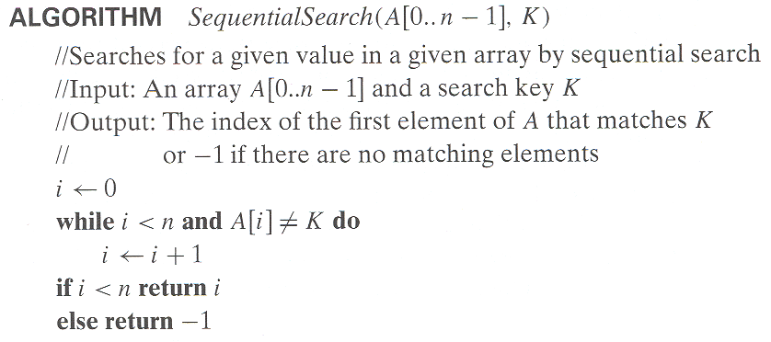
Brute Force Example: Sequential search
Worst case
Best case
Average case

Slide 6
Divide and Conquer: Binary search (recursive)
Worst case
Best case
Average case

Slide 7
Insertion Sort
To sort array A[0..n-1], sort A[0..n-2] recursively and
then insert A[n-1] in its proper place among the sorted
A[0..n-2]
Usually implemented bottom up (nonrecursively)
Example: Sort 6, 4, 1, 8, 5 6 | 4 1 8 5
4 6 | 1 8 5
1 4 6 | 8 5
1 4 6 8 | 5
1 4 5 6 8

Slide 8
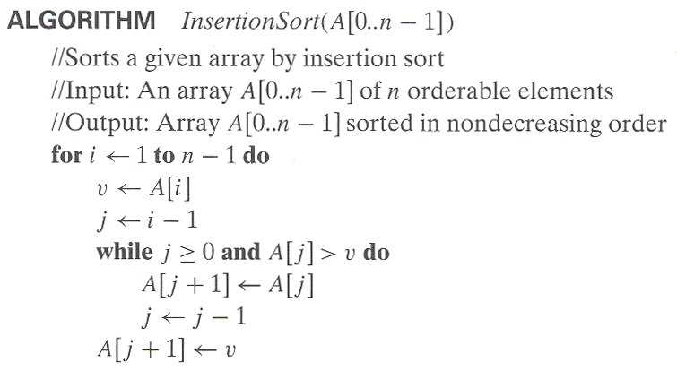
Pseudocode of Insertion Sort

Slide 9
Analysis of Insertion Sort
Time efficiency
C_{worst}(n) = n(n-1)/2 ∈ Θ(n²)
C_{avg}(n) ≈ n²/4 ∈ Θ(n²)
C_{best}(n) = n - 1 ∈ Θ(n) (also fast on almost sorted arrays)
Space efficiency: in-place
Stability: yes
Best elementary sorting algorithm overall
Binary insertion sort – What does this mean?

Slide 10
Decrease-by-Constant-Factor Algorithms
In this variation of decrease-and-conquer, instance size is reduced by the same factor (typically, 2)
Examples:
binary search and the method of bisection
exponentiation by squaring
multiplication à la russe (Russian peasant method)

Slide 11
Binary Search
Very efficient algorithm for searching in sorted array:
K
vs
A[0] . . . A[m] . . . A[n-1]
If K = A[m], stop (successful search); otherwise, continue
searching by the same method in A[0..m-1] if K < A[m]
and in A[m+1..n-1] if K > A[m]
l ← 0; r ← n-1
while l ≤ r do
m ← ⎣(l+r)/2⎦
if K = A[m] return m
else if K < A[m] r ← m-1
else l ← m+1
return -1

Slide 12
Analysis of Binary Search
Time efficiency
worst-case recurrence: C_{w} (n) = 1 + C_{w}( ⎣n/2⎦ ), C_{w} (1) = 1 solution: C_{w}(n) = ⎡log₂(n+1)⎤ This is VERY fast: e.g., C_{w}(10⁶) = 20
Optimal for searching a sorted array
Limitations: must be a sorted array (not linked list)
Has a continuous counterpart called bisection method for solving equations in one unknown f(x) = 0 (see Sec. 12.4)

Slide 13
Fake-Coin Puzzle (simpler version)
There are n identically looking coins one of which is fake. There is a balance scale but there are no weights; the scale can tell whether two sets of coins weigh the same and, if not, which of the two sets is heavier (but not by how much). Design an efficient algorithm for detecting the fake coin. Assume that the fake coin is known to be lighter than the genuine ones.
How solve this?

Slide 14
Fake-Coin Puzzle (simpler version)
There are n identically looking coins one of which is fake. There is a balance scale but there are no weights; the scale can tell whether two sets of coins weigh the same and, if not, which of the two sets is heavier (but not by how much). Design an efficient algorithm for detecting the fake coin. Assume that the fake coin is known to be lighter than the genuine ones.
https://www.businessinsider.com/answers-to-15-google-interview-questions-that-will-make-you-feel-stupid-2009-11#you-have-eight-balls-all-of-the-same-size-12

Slide 15
Variable-Size-Decrease Algorithms
In the variable-size-decrease variation of decrease-and-conquer, instance size reduction varies from one iteration to another
Examples:
Euclid’s algorithm for greatest common divisor
partition-based algorithm for selection problem
interpolation search
some algorithms on binary search trees
Nim and Nim-like games

Slide 16
Euclid’s Algorithm
Euclid’s algorithm is based on repeated application of equality
gcd(m, n) = gcd(n, m mod n)
Ex.: gcd(80,44) = gcd(44,36) = gcd(36, 12) = gcd(12,0) = 12
One can prove that the size, measured by the second number,
decreases at least by half after two consecutive iterations.
Hence, T(n) ∈ O(log n)

Slide 17
Selection Problem
Find the k-th smallest element in a list of n numbers
k = 1 or k = n
median: k = ⎡n/2⎤
Example: 4, 1, 10, 9, 7, 12, 8, 2, 15 median = ?
The median is used in statistics as a measure of an average
value of a sample. In fact, it is a better (more robust) indicator
than the mean, which is used for the same purpose.

Slide 18
Algorithms for the Selection Problem
The sorting-based algorithm: Sort and return the k-th element Efficiency (if sorted by mergesort): Θ(nlog n)
A faster algorithm is based on the array partitioning:
Assuming that the array is indexed from 0 to n-1 and s is a split position obtained by the array partitioning:
If s = k-1, the problem is solved;
if s > k-1, look for the k-th smallest element in the left part; if s < k-1, look for the (k-s)-th smallest element in the right part.
Note: The algorithm can simply continue until s = k-1.
s
all are ≤ A[s]
all are ≥ A[s]

Slide 19
Two Partitioning Algorithms
There are two principal ways to partition an array:
One-directional scan (Lomuto’s partitioning algorithm)
Two-directional scan (Hoare’s partitioning algorithm)

Slide 20
Lomuto’s Partitioning Algorithm
Scans the array left to right maintaining the array’s partition into three contiguous sections: < p, ≥ p, and unknown, where p is the value of the first element (the partition’s pivot).
On each iteration the unknown section is decreased by one element until it’s empty and a partition is achieved by exchanging the pivot with the element in the split position s.

Slide 21
Tracing Lomuto’s Partioning Algorithm
s | i
4 | 1 | 10 | 8 | 7 | 12 | 9 | 2 | 15
 | s | i
4 | 1 | 10 | 8 | 7 | 12 | 9 | 2 | 15
 | s |  |  |  |  |  | i
4 | 1 | 10 | 8 | 7 | 12 | 9 | 2 | 15
 |  | s |  |  |  |  |  | i
4 | 1 | 2 | 8 | 7 | 12 | 9 | 10 | 15
 |  | s
4 | 1 | 2 | 8 | 7 | 12 | 9 | 10 | 15
2 | 1 | 4 | 8 | 7 | 12 | 9 | 10 | 15

Slide 22
Tracing Quickselect (Partition-based Algorithm)
Find the median of 4, 1, 10, 9, 7, 12, 8, 2, 15
Here: n = 9, k = ⎡9/2⎤ = 5, k -1=4
0 | 1 | 2 | 3 | 4 | 5 | 6 | 7 | 8
4 | 1 | 10 | 8 | 7 | 12 | 9 | 2 | 15
2 | 1 | 4 | 8 | 7 | 12 | 9 | 10 | 15
 |  |  | 8 | 7 | 12 | 9 | 10 | 15
 |  |  | 7 | 8 | 12 | 9 | 10 | 15
after 1st partitioning: s=2<k-1=4
after 2nd partitioning: s=4=k-1
The median is A[4]= 8

Slide 23
Efficiency of Quickselect
Average case (average split in the middle):
C(n) = C(n/2)+(n+1) C(n) ∈ Θ(n)
Worst case (degenerate split): C(n) ∈ Θ(n²)
A more sophisticated choice of the pivot leads to a complicated algorithm with Θ(n) worst-case efficiency.

Slide 24
Binary Search Tree Algorithms
Several algorithms on BST requires recursive processing of just one of its subtrees, e.g.,
Searching
Insertion of a new key
Finding the smallest (or the largest) key
k
<k
>k

Slide 25
Searching in Binary Search Tree
Algorithm BTS(x, v)
//Searches for node with key equal to v in BST rooted at node x
if x = NIL return -1
else if v = K(x) return x
else if v < K(x) return BTS(left(x), v)
else return BTS(right(x), v)
Efficiency
worst case: C(n) = n
average case: C(n) ≈ 2ln n ≈ 1.39log₂ n

