Slide 1
Solving Tridiagonal System
( By LU decomposition and backward substitution )
Course: CS 4MN3
Student: Imam Abdukerim
Professor: Dr. Sanzheng Qiao
Date: February 27, 2009

Slide 2
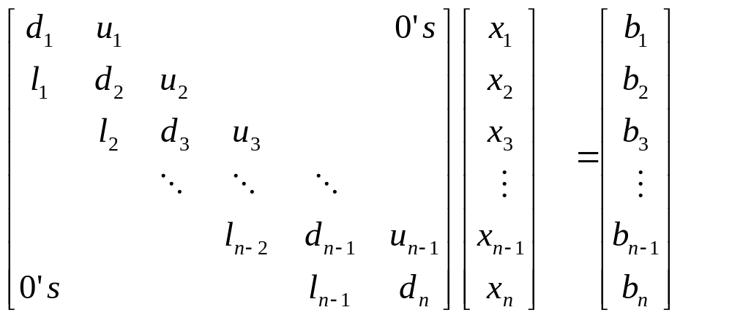
Tridiagonal System
u = [u1, u2, …, un-1]
d = [d1, d2, …, dn-1, dn]
l = [l1, l2, …, ln-1]

Slide 3
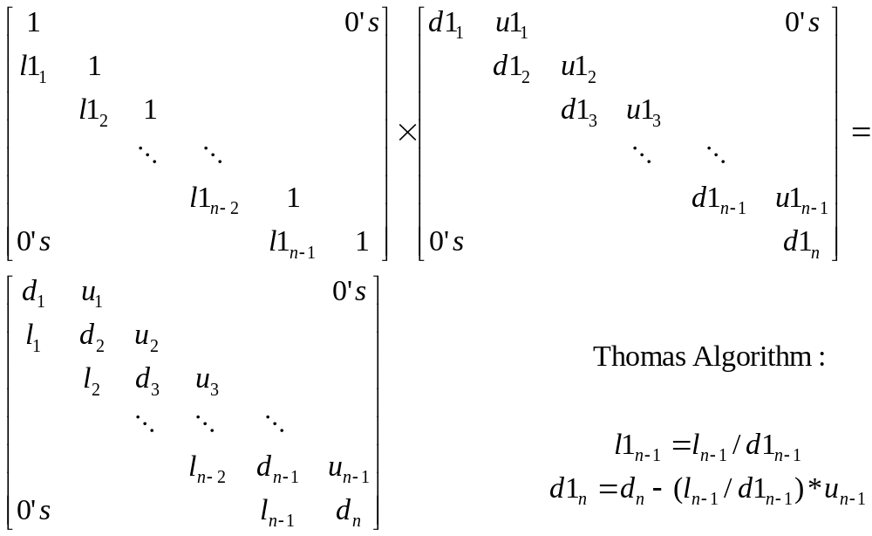
LU decomposition of
Tridiagonal Matrix

Slide 4
LU decomposition of
Tridiagonal Matrix (Matlab Code)
  function [u1,d1,l1] = decomt(u,d,l)
  n = length(d); % get the length of the diagonal
  % initialize the output vectors
  u1=u;
  d1=d;
  l1=l;
  %Perform LU decomposition
  d1(1)=d(1);
  for i=2:n
  l1(i-1) = l(i-1)/d1(i-1); % Update the lover triangle vector
  d1(i) = d(i) - (l(i-1)/d1(i-1))*u(i-1); %Update the diaginal
  end
  Complexity: O(n)

Slide 5
LU decomposition of
Tridiagonal Matrix (Testing)
u = [23 43 22 3 77];
d = [3 34 55 18 13 56];
l = [1,2,3,4,5];
>>[u,d,l] = decomt(u,d,l)
u = 23 43 22 3 77
d = 3.0000 26.3333 51.7342 16.7242 12.2825 24.6545
l = 0.3333 0.0759 0.0580 0.2392 0.4071
(Construct L and U using decomposed vectors)
L = diag(l,-1)+eye(6);
U = diag(d)+diag(u,+1);
L =
1.0000 0 0 0 0 0
0.3333 1.0000 0 0 0 0
0 0.0759 1.0000 0 0 0
0 0 0.0580 1.0000 0 0
0 0 0 0.2392 1.0000 0
0 0 0 0 0.4071 1.0000
U =
3.0000 23.0000 0 0 0 0
0 26.3333 43.0000 0 0 0
0 0 51.7342 22.0000 0 0
0 0 0 16.7242 3.0000 0
0 0 0 0 12.2825 77.0000
0 0 0 0 0 24.6545
(Construct triangular matrix by multiplying L and U)
>>L*U
ans =
3.0000 23.0000 0 0 0 0
1.0000 34.0000 43.0000 0 0 0
0 2.0000 55.0000 22.0000 0 0
0 0 3.0000 18.0000 3.0000 0
0 0 0 4.0000 13.0000 77.0000
0 0 0 0 5.0000 56.0000

Slide 6
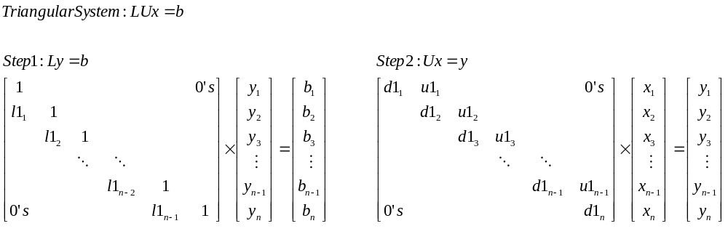
Solving Tridiagonal System

Slide 7
Solving Tridiagonal System
(Matlab Code - Ditailed)
function [x] = solvet(u,d,l,b)
n = length(d);
x = (1:n);
y = (1:n);
%Solve Tridiagonal system LUx=b;
% Step 1 : Solve Ly=b for y
y(1) = b(1);
for i=2:n
y(i) = b(i) - l(i-1)*y(i-1);
end
% Step 2 : Solve Ux=y for x
x(n) = y(n)/d(n);
for i=(n-1):-1:1
x(i) = (y(i)-u(i)*x(i+1))/d(i);
End

Slide 8
Solving Tridiagonal System
(Testing)
(Using solvet() function)
u = 23 43 22 3 77
d = 3.0000 26.3333 51.7342 16.7242 12.2825 24.6545
l = 0.3333 0.0759 0.0580 0.2392 0.4071
b = 45 43 33 67 89 76
>> solvet(u,d,l,b)
y = 45.0000 28.0000 30.8734 65.2097 73.4036 46.1186
x = -11.9303 3.5127 -1.5000 4.9307 -5.7506 1.8706
ans = -11.9303 3.5127 -1.5000 4.9307 -5.7506 1.8706
(Using Matlab standard function)
M =
3.0000 23.0000 0 0 0 0
1.0000 34.0000 43.0000 0 0 0
0 2.0000 55.0000 22.0000 0 0
0 0 3.0000 18.0000 3.0000 0
0 0 0 4.0000 13.0000 77.0000
0 0 0 0 5.0000 56.0000
b = 45 43 33 67 89 76
>> M\b1
ans =
-11.9303
3.5127
-1.5000
4.9307
-5.7506
1.8706

Slide 9
Solving Tridiagonal System
(Matlab Code – overwrite b)
function [b] = solvet(u,d,l,b)
n = length(d);
%Solve Tridiagonal system LUx=b;
% Step 1 : Solve Ly=b for y (overwrite b)
for i=2:n
b(i) = b(i) - l(i-1)*b(i-1);
end
% Step 2 : Solve Ux=y for x (overwrite b)
b(n) = b(n)/d(n);
for i=(n-1):-1:1
b(i) = (b(i)-u(i)*b(i+1))/d(i);
End

Slide 10
Question(s)?

