Slide 1
CCPs’ Curves Boostrapping:
Stand-Alone Calibration Vs. Spread Calibration
07/04/2017

Slide 2
Introduction
The following slides aim to compare two different boostrap processes that can be followed in order to obtain smooth CCPs curves.
The analysis takes as example Euribor_6M curves boostrapped for the most relevant CCPs, namely: LCH, CME and EUX.
The necessity to calibrate different curves to price instruments cleared in different central counterparties is driven by the market itself which is showing relevant basis between analogous instruments cleared in different CCPs.
We compare a typical stand-alone curve to a spread curve, where the objective is to bootstrap the zero rate spread with respect to a backbone curve, which for sake of market relevance is the EUR6M_LCH (the internal production curve).
Nicholas Bertocchi, Quantitative Structuring

Slide 3
Available Data and Basic Requirements
Market quotes swap basis spread LCH/CME, LCH/EUX
CME and EUX implied swap quotes can be easily retrived:
SWAPxY_CCP = SWAPxY_LCH + BASISxY_LCH/CCP
Our target is to obtain curves with these characteristics:
1) Convergence from EUR6M_CCP to EUR6M_LCH
when CCPs’ basis tends to 0.
2) Smoothness and monotonicity in interpolated forward rates;
3) Basis dominance always respected;
4) Basis equal to 0 before a threshold (e.g. after Euribor_6M fixing, each residual 6M maturity swap is composed of a single deterministic payment; it is straightforward to impose that CCPs’ basis must converge to 0 at 6M).
.
Nicholas Bertocchi, Quantitative Structuring

Slide 4
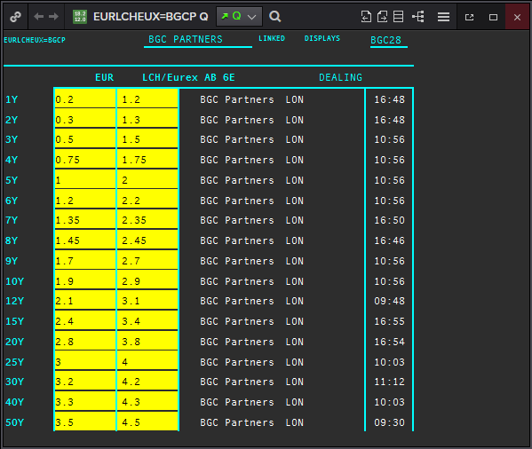
Basis extrapolation:
Warning 1: Market quotes start with 1Y: how to estimate basis before 1Y?
Warning 2: How we can estimate forward basis for FRAs?
Figure 1: LCH/EUREX Swap 6M strip Market Basis (Source: Thomson Reuters).
Nicholas Bertocchi, Quantitative Structuring

Slide 5
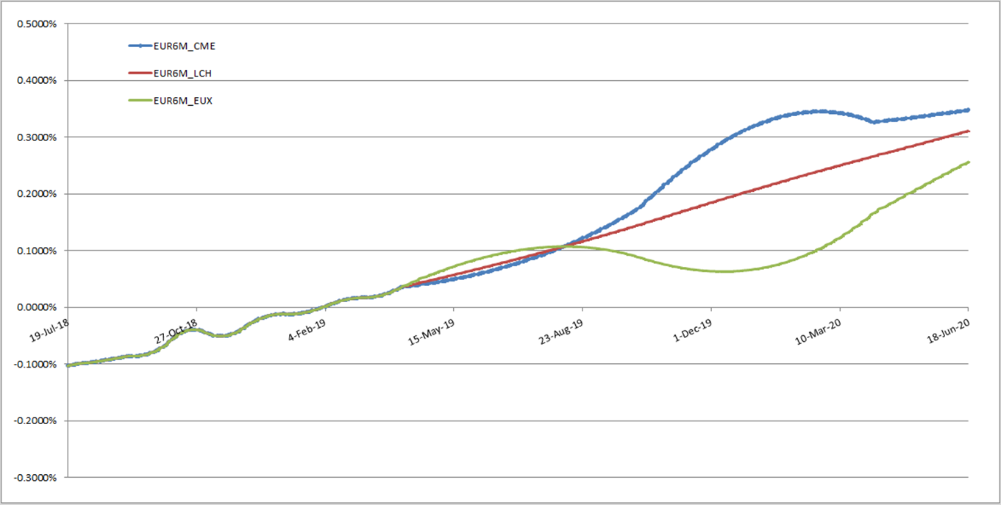
Short-end instruments for stand-alone curves
As usual, bootstrapping stand-alone curves requires careful estimation of short-end instruments. For examples, using EUR6M instruments (no basis!) up to 24Mx30M FRA + basis-adjusted SWAPS from 3Y onwards gives oscillatory behavior.
Figure 2: EUR6M_CCP instantaneous forwards obtained without estimating interpolated basis lead to strange shape oscillation.
Nicholas Bertocchi, Quantitative Structuring

Slide 6
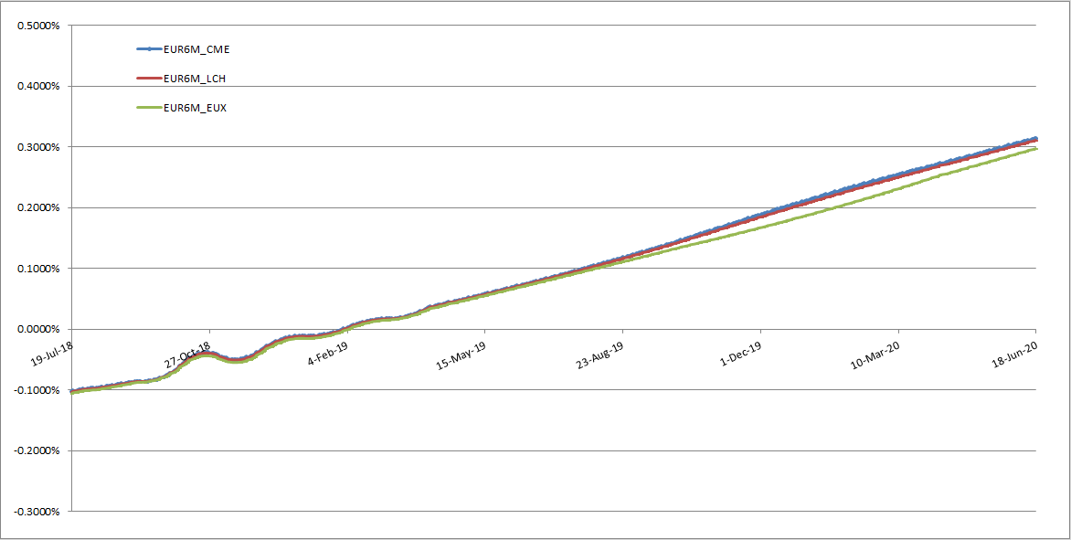
Short-end instruments for stand-alone curves
As a rough workaround we can estimate forward basis from spot market quotes for curve section 6M -> 3Y and add them to FRAs.
Interpolated basis ensure a smooth shape without oscillations at FRA-SWAP joint.
Figure 3: Introducing interpolated basis in section (6M,3Y) leads to smoother instantaneous forwards.
Nicholas Bertocchi, Quantitative Structuring

Slide 7
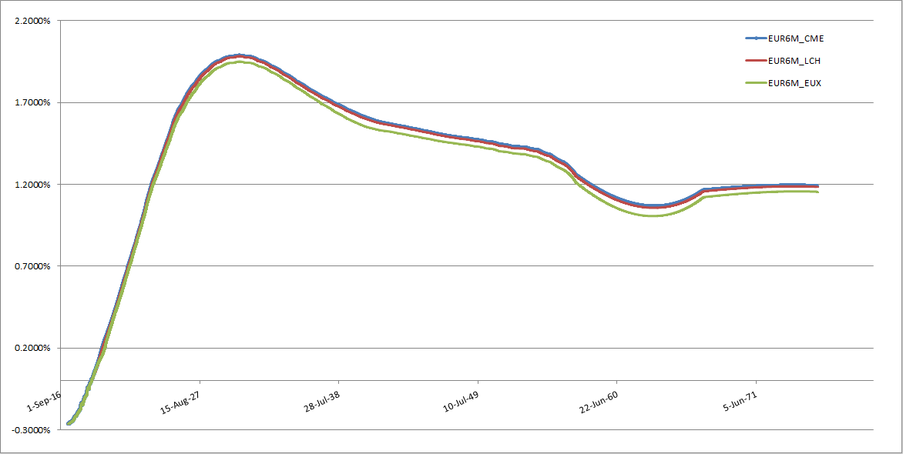
Stand-alone curves
Smoothness on the mid-long part is satisfied using a constrained cubic interpolator.
Figure 4: EUR6M_CCP curves obtained through stand-alone calibration, using interpolated basis in section (6M,3Y) and market basis in section (3Y,60Y) (60Y flat extrapolated from 50Y).
Nicholas Bertocchi, Quantitative Structuring

Slide 8
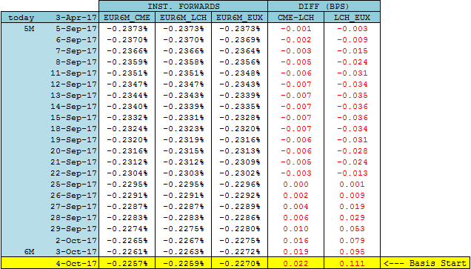
Stand-alone curves
Cubic interpolation introduces non-locality:
Basis dominance is not respected: instantaneous forward differences between CCPs curves change sign on the very short-end.
Basis in section (SpotDate;6M) are not equal to 0.
Figure 5: Daily forwards comparison between EUR6M_CCP curves. Basis dominance is respected if CME-LCH and LCH-EUX differences are always positive while we expect no differences before 6-months.
Nicholas Bertocchi, Quantitative Structuring

Slide 9
Spread Curve Calibration
Spread Calibration builds interest rate term structures adding a spread to a backbone curve¹.
Most logical backbone curve is the EUR6M_LCH curve.
The spread curve calibration basket only contains market basis quotes².
Basis in section (6M,3Y) is implied by the spread interpolation algorithm.
To guarantee a 0 basis up to 6M we can simply include in the calibration a 6M deposit equal to the corresponing one in the backbone curve.
By construction, the spread calibrator ensures the convergence to the backbone curve in case of basis tending to 0.
¹MX at present only supports zero-rate spread curves
²MX at present only supports outright swap quotes
Nicholas Bertocchi, Quantitative Structuring

Slide 10
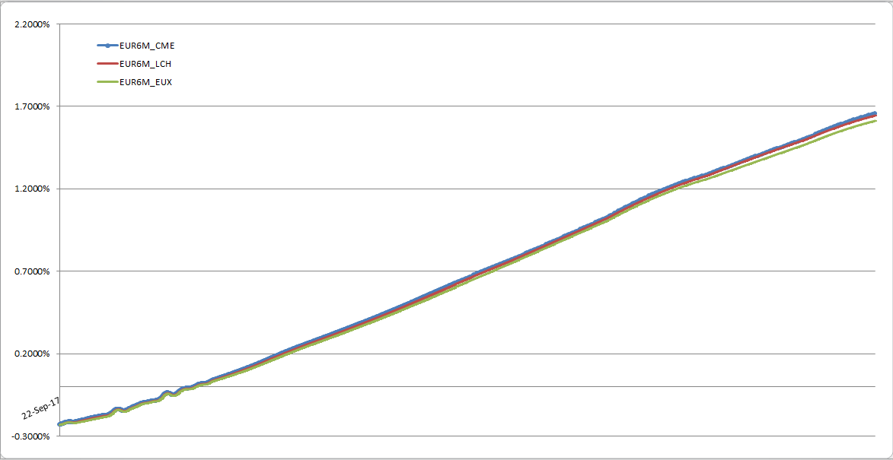
Spread Curve
smooth shape without oscillations at FRA-SWAP joint
Figure 6: Instantaneous forwards obtained by means of a Spread Calibration.
Nicholas Bertocchi, Quantitative Structuring

Slide 11
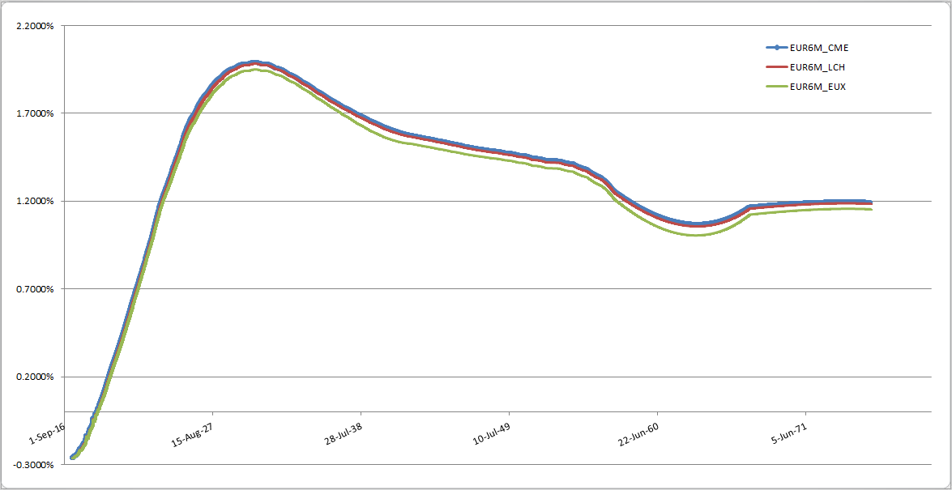
Spread Curve
Smoothness on the mid-long part is satisfied using a constrained cubic interpolator.
Figure 7: Instantaneous forwards obtained by means of a Spread Calibration.
Nicholas Bertocchi, Quantitative Structuring

Slide 12
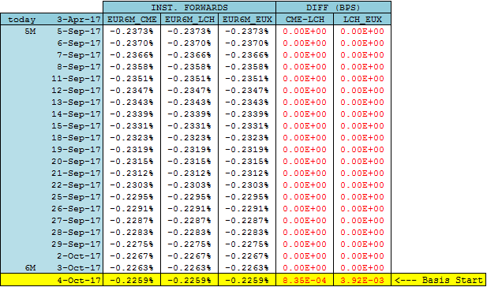
Spread Curve
Basis dominance ensured
Zero Basis in section (SpotDate;6M) ensured.
Figure 8: Daily forwards comparison between EUR6M_CCP curves. Spread calibration leads to almost the same curves till 6 months.
Nicholas Bertocchi, Quantitative Structuring

Slide 13

Conclusions
Requirements | Stand-Alone Calibration | Spread Calibration
Avoid creation of (unhedgable) fake quotes
Convergence from EUR6M_CCP to EUR6M_LCH when CCPs’ basis tend to 0
Smoothness and monotonicity in interpolated forward rates
Basis dominance
Zero basis before a threshold
Nicholas Bertocchi, Quantitative Structuring

