Slide 1
CCPs’ Curves Boostrapping:
Stand-Alone Calibration Vs. Spread Calibration
06/04/2017

Slide 2
Introduction
The following slides aim to compare two different boostrap processes that can be followed in order to obtain smooth CCPs curves.
The analysis takes as example Euribor_6M curves boostrapped for the most relevant CCPs, namely: LCH, CME and EUX.
The necessity to calibrate different curves to price instruments cleared in different central counterparties is driven by the market itself which is showing relevant basis between analogous instruments cleared in different CCPs.
We compare the standard stand-alone calibration, where input market quotes are outright instruments, to a spread calibration, where the objective is to bootstrap the zero rate spread with respect to a backbone curve, which for sake of simplicity is the EUR6M_LCH (the internal production curve).
Nicholas Bertocchi, Quantitative Structuring

Slide 3
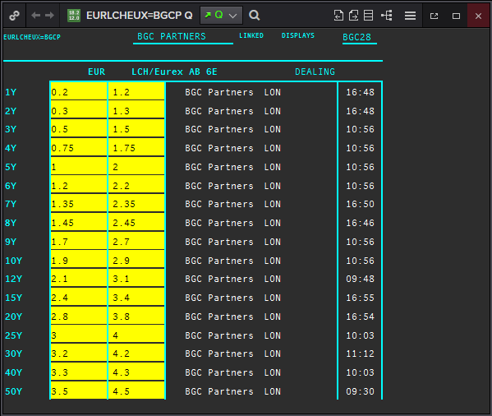
Figure 1: LCH/EUREX Swap 6M strip Market Basis (Source: Thomson Reuters).
Nicholas Bertocchi, Quantitative Structuring

Slide 4
Stand-Alone Calibration
Before starting the EUR6M_CME and EUR6M_EUX calibration we need to retrive the relative market quotes and we can easily do it adding the market basis to the native LCH quotes:
SWAPxY_CCP = SWAPxY_LCH + BASISxY_LCH/CCP
Since CCPs’ quoted basis start from 1Y tenor we face the problem to estimate properly the basis up to 1Y.
Furthermore another problem is how to manage basis before 3Y since the quoted values refer to par swap rates and the internal calibration basket is composed by FRAs up to 3Y. This situation leads to the necessity to find a way to retrive forward basis in order to add the correct value to forward instruments.
We can bypass this problems just using basis from 3Y and above, interpolating them to obtain the corresponding basis for interpolated swaps.
Nicholas Bertocchi, Quantitative Structuring

Slide 5
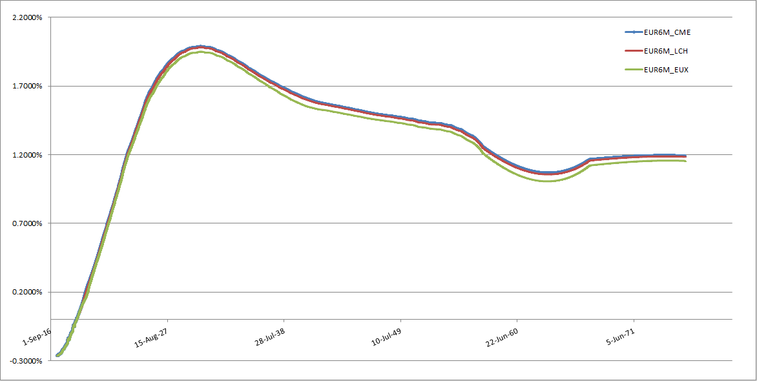
CCPs curves obtained throught this methodoloy show a smooth shape and seem to ensure the market basis dominance: EUR6M_CME > EUR6M_LCH > EUR6M_EUX. However, the apparent good result is driven by the short tenors’ small basis which produce almost monotone instantaneous forwards.
Figure 2: EUR6M_CCP curves obtained through stand-alone calibration and using basis from 3Y up to 60Y (60Y flat extrapolated from 50Y) .
Nicholas Bertocchi, Quantitative Structuring

Slide 6
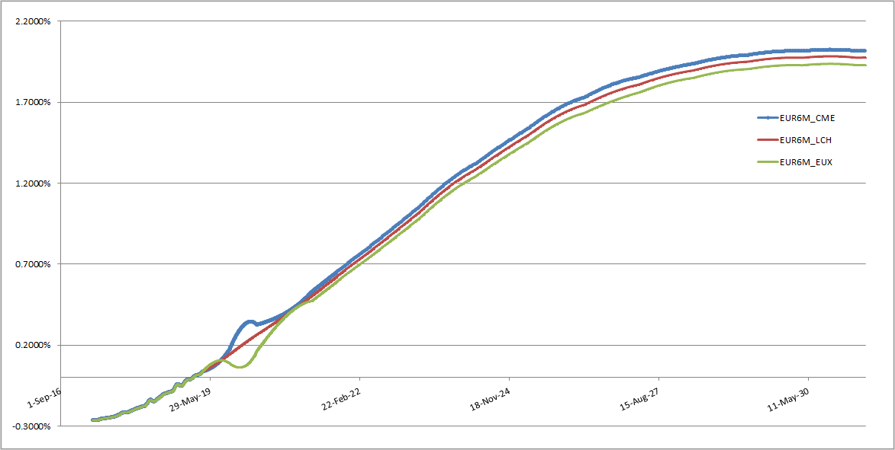
However, if basis become larger, the resulting forwards are no longer monotone in the section where basis start to be introduced.
Figure 3: Instantaneous forwards’ obtained introducing larger basis starting from 3Y until 60Y (60Y flat extrapolated from 50Y).
Nicholas Bertocchi, Quantitative Structuring

Slide 7
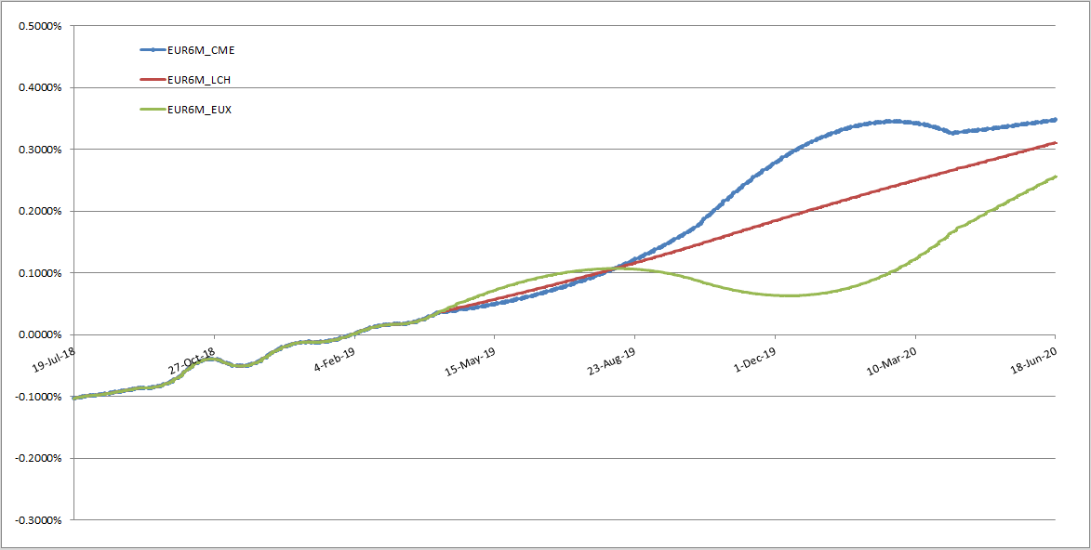
Furthermore, also the basis dominance is not respected anymore leading to incoherent curves’ sections.
Figure 4: EUR6M_CME forwards lower than EUR6M_LCH and EUR6M_EUX forwards from May 19 to September 19
Nicholas Bertocchi, Quantitative Structuring

Slide 8
Possible solutions:
Our target is to obtain curves with this characteristics:
1) Convergence from EUR6M_CCP to EUR6M_LCH
when CCPs’ basis tend to 0.
2) Smoothness and monotonicity in forward rates;
3) Basis dominance always respected;
4) Basis equal to 0 before 6-months.
Since, after Euribor6M fixing, an hypothetical 6-months maturity swap is composed of a single deterministic payment, it is straightforward to impose that CCPs’ basis must be equal to 0 up to 6M.
We can try to estimate forward basis for tenor 6M -> 3Y and add them to FRAs market quotes. This introduce degrees of freedom in calibration but can avoid strange oscillation as the ones shown in previous examples.
Nicholas Bertocchi, Quantitative Structuring

Slide 9
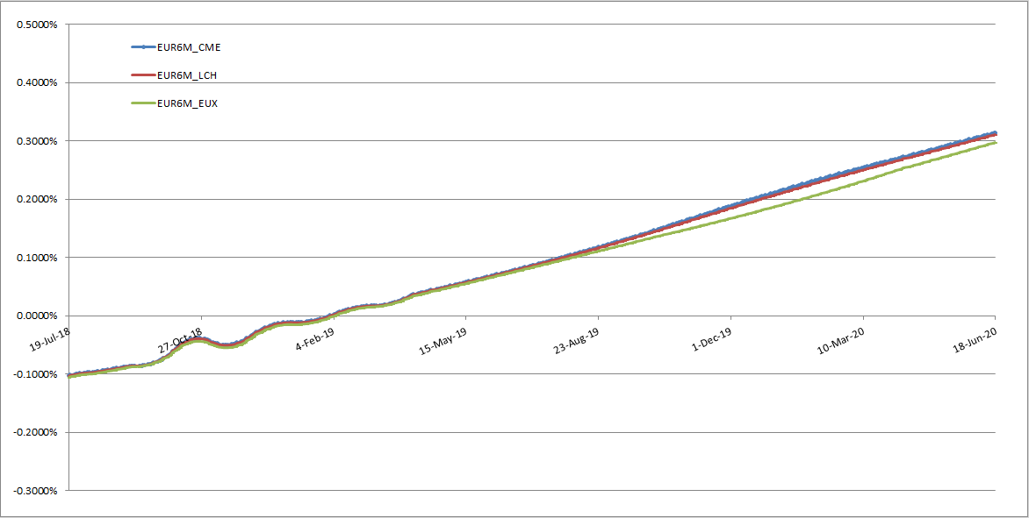
Introducing interpolated basis from 6M to 3Y and using a cubic interpolator (Kruger in our examples) we reach requirements 1) and 2).
Figure 5: Introducing interpolated basis from 6M produces smoother instantaneous forwards avoiding strange shape oscillation.
Nicholas Bertocchi, Quantitative Structuring

Slide 10
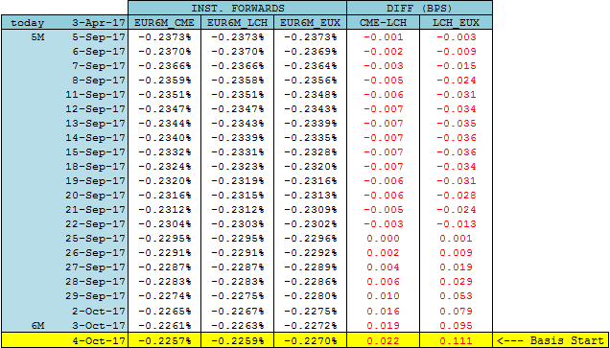
However, 3) And 4) are not satisfied. Since curves’ differences change sign, basis dominance is in not respected. Furthemore, basis in section (SpotDate;6M) are not equal to 0. This is due to cubic interpolation, which is necessary to obtain smooth forwards but introduce non-locality.
Figure 6: Daily forwards comparison between EUR6M_CCP curves. Basis dominance is respected if CME-LCH and LCH-EUX differences are always positive while we expect no differences before 6-months.
Nicholas Bertocchi, Quantitative Structuring

Slide 11
Spread Calibration
The other approach analyzed is the Spread Calibration. This process build interest rate term structures as Spread over a Backbone curve, where for Spread we mean Zero Rate Spread, which is the only methodology available and reproducible in Murex.
The most logical choice for the backbone curve is the one bootstrapped with LCH cleared instruments, which are the native quotations of the market.
The calibration basket is reduced to the only instruments which have a corresponding basis quoted on market. We don’t have to interpolate and we don’t have to retrive forward basis for the curves’ section covered by FRAs; this part is fully delegated to the boostrap algorithm.
To guarantee a 0 basis up to 6M we can simply include in the calibration a 6-months maturity deposit without basis.
By construction, the spread calibration ensures the convergence to the backbone curve in case of basis tending to 0.
Nicholas Bertocchi, Quantitative Structuring

Slide 12
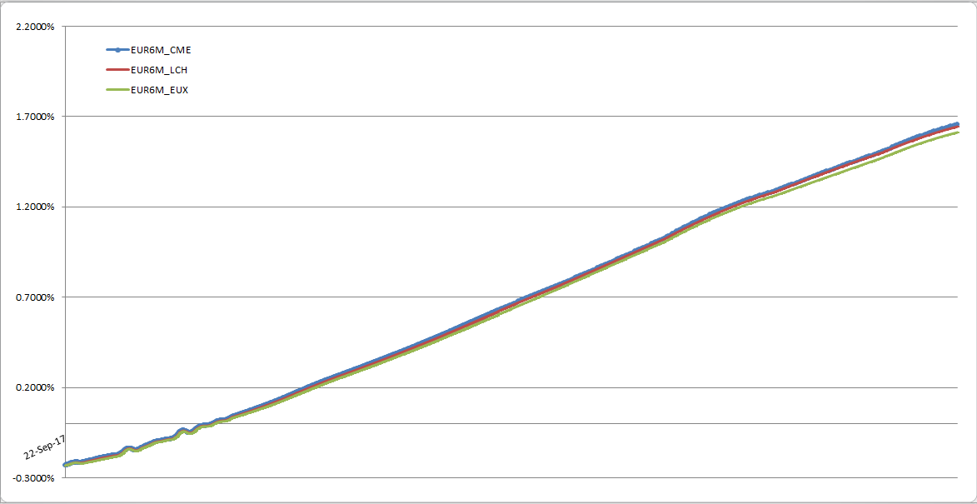
As visible, 1) and 2) are satisfied; instantaneous forwards are smooth due to the cubic interpolator and convergence is ensured by construction.
Figure 7: Instantaneous forwards obtained by means of a Spread Calibration.
Nicholas Bertocchi, Quantitative Structuring

Slide 13
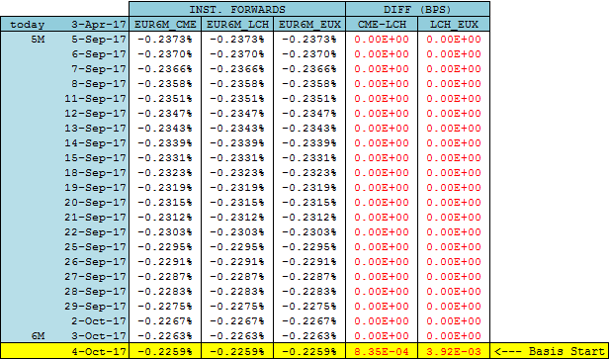
Also 3) and 4) are perfectly satisfied; basis domincance is always respected and 0 basis in section (SpotDate;6M) is ensured.
Figure 8: Daily forwards comparison between EUR6M_CCP curves. Spread calibration leads to almost the same curves till 6 months.
Nicholas Bertocchi, Quantitative Structuring

Slide 14

Conslusions
Curves’ Requirements
1) Convergence from EUR6M_CCP to EUR6M_LCH when CCPs’ basis tend to 0;
2) Smoothness and monotonicity in forward rates;
3) Basis dominance always respected;
4) Basis equal to 0 before 6M.
Stand-Alone Calibration
Spread
Calibration
Nicholas Bertocchi, Quantitative Structuring

