Slide 1

Bike Share Analysis
Case Study Addressing Differences Between Casual and Member Riders

Slide 2
Scenario
I am a junior data analyst for a Chicago-based bike share company. The stakeholders believe the company’s future will rely on maximizing member annual riders. Our team is tasked with deciphering the differences between casual users and annual members.

Slide 3
Introduction to the company
The company was founded in 2016 and created a successful bike-share startup. The program has since grown to a fleet of 5,824 bicycles that are geotracked and show in a network of 692 stations across Chicago.

Slide 4
Business Task
Conduct data analysis into the relationships and trends between casual riders and annual members creating a marketing strategy to persuade casual riders to become members

Slide 5
Stakeholders To Consider
Lily Moreno: Our manager and director of marketing
Cyclistic executive team: Team in charge of approving our over all plan and approach to the issue.

Slide 6
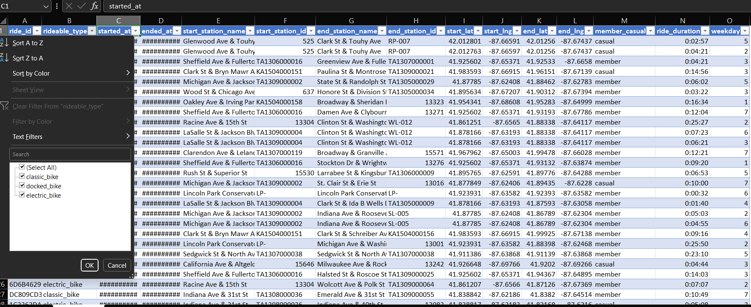
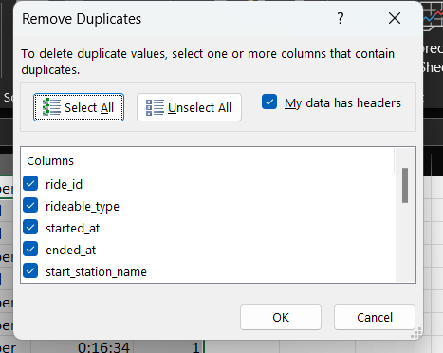
Microsoft Excel
Utilized the table function to observe the specific information placed within each column
Proceed to remove any duplicates from each excel column

Slide 7
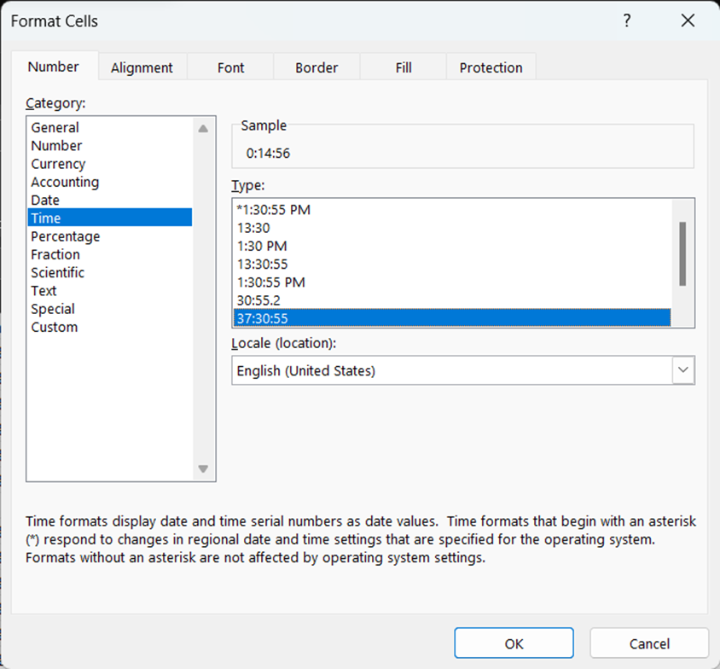
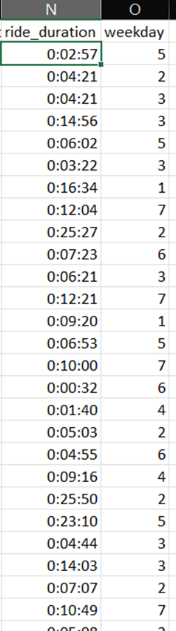
Microsoft Excel
Formatted the cells to fit within certain criteria used by the analytic team
Created two new columns within each sheet to show the duration of each bike trip and what day of the week each trip occurred

Slide 8
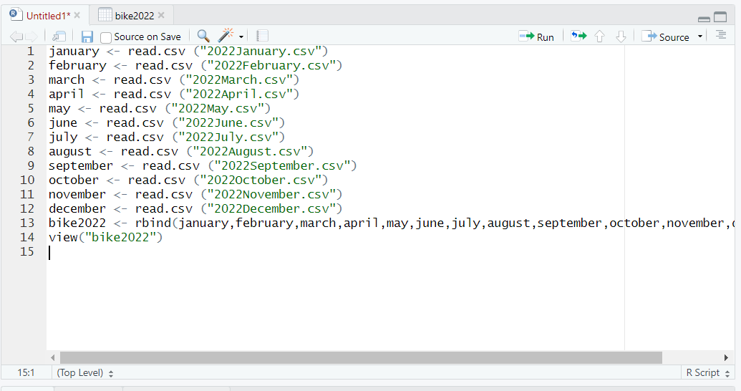
RStudio
After Cleaning and analyzing in Excel I input each month into Rstudio as a CSV file and combined them each into one data frame

Slide 9
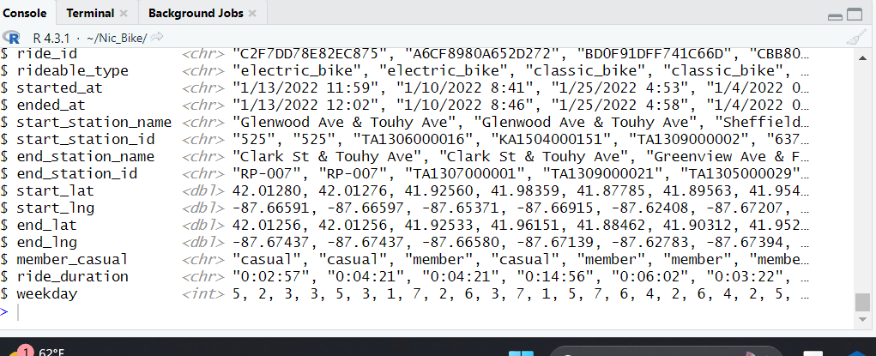
RStudio
Opened up the data frame to observe how the conversion remodeled my data types and realized new code input would have to be used.

Slide 10
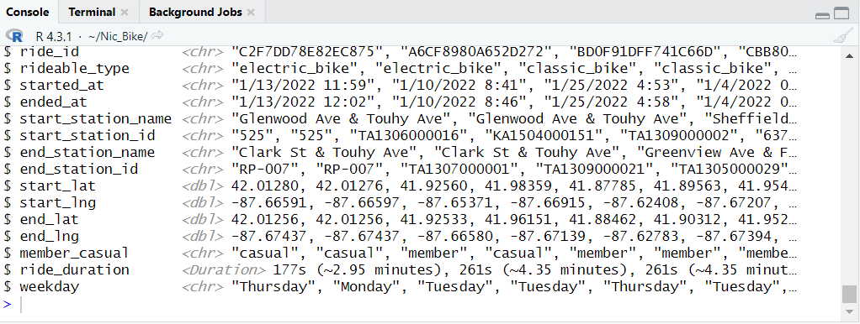
RStudio
Recoded the data to be used in a more accessible manner
Final form of data to be utilized for analysis

Slide 11
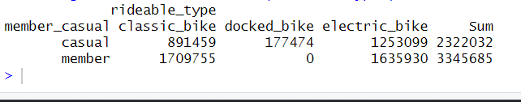
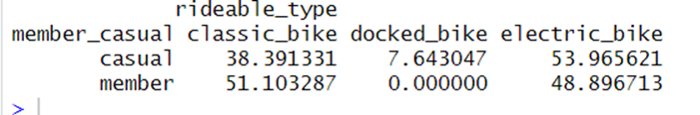
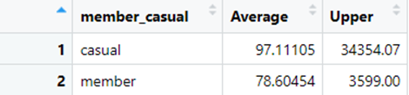
RStudio
Created tables to show the use of the differing bike types
Created a table to show the percentages of the use of bikes between casual and member users
Created a table to show the average and longest times for ride durations

Slide 12
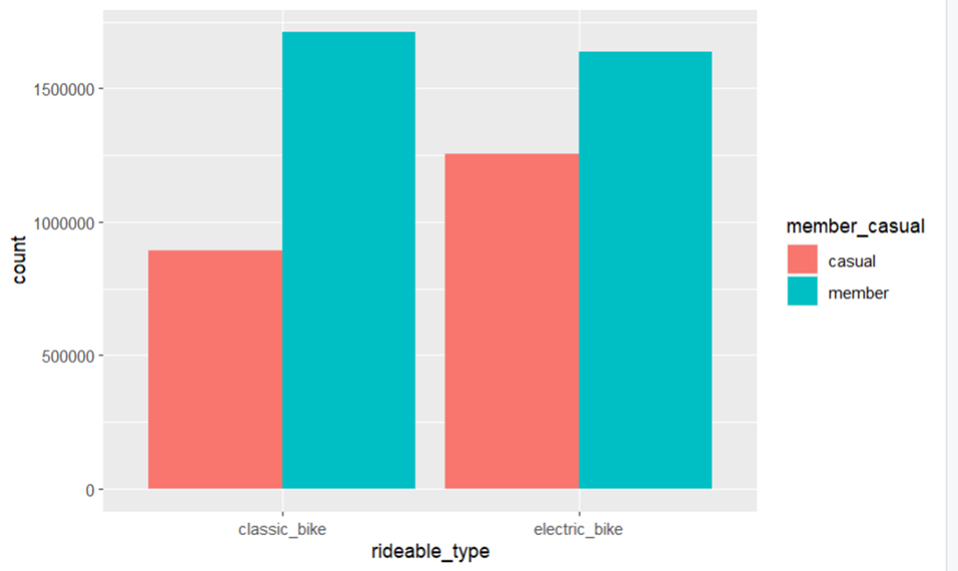
Visuals
Using RStudio to create a bar graph showing the differences in bike use between the two subjects

Slide 13
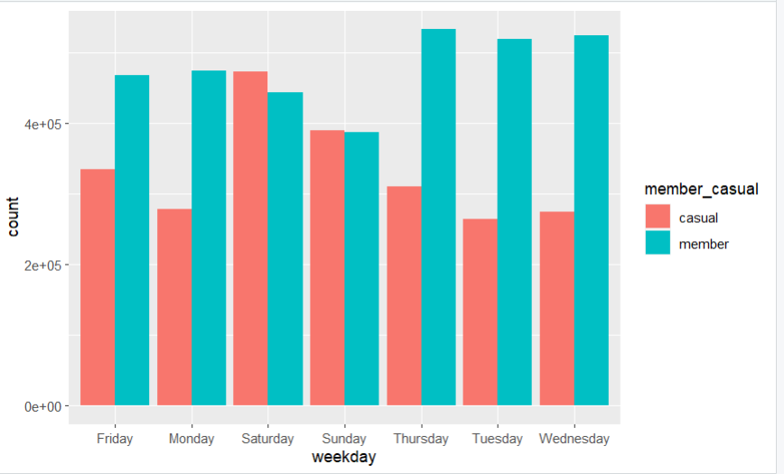
Visuals
This chart shows the differing bike use per day of the week

Slide 14
Conclusion
Comparing how bikes are utilized by both groups shows a correlation for how to attract more member
Demonstrating how the bikes are used by differing groups will allow to market to more member

