Slide 1
Summary of results

Slide 2
Mixer first with oscillator: top

Slide 3
Mixer first with oscillator: mixer

Slide 4
Mixer first with oscillator: oscillator

Slide 5
Mixer first with oscillator: baseband-amplifier

Slide 6
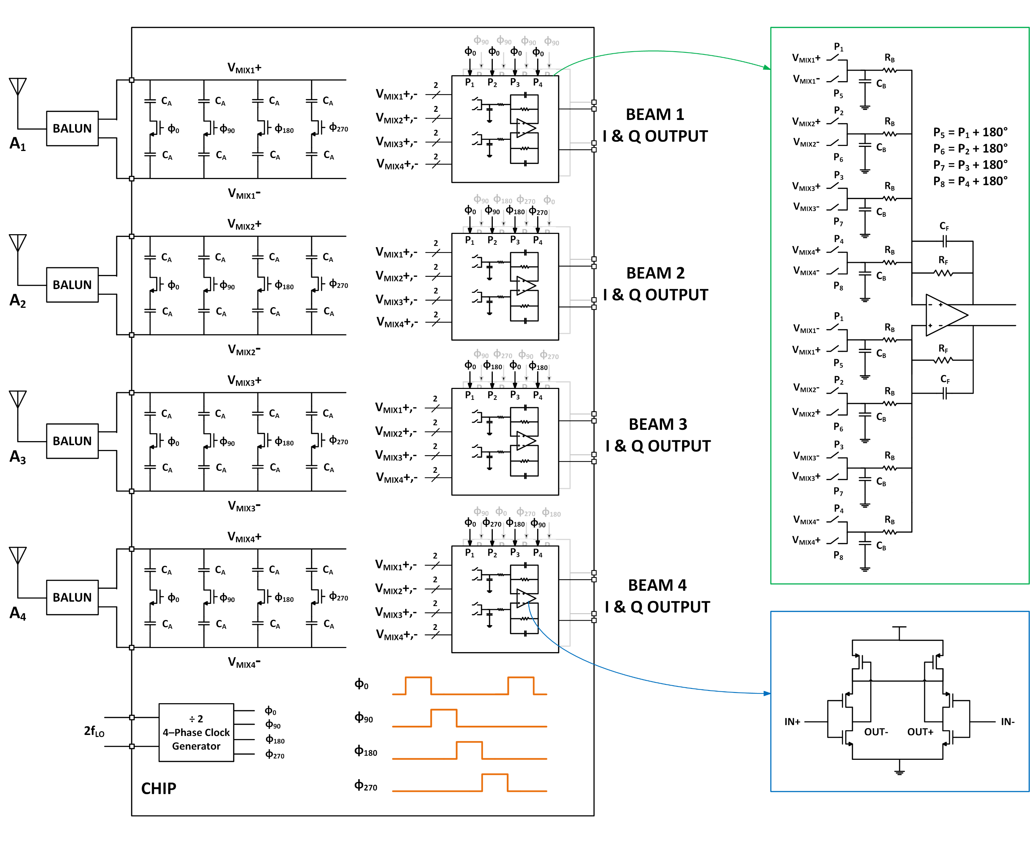
MIMO: top

Slide 7
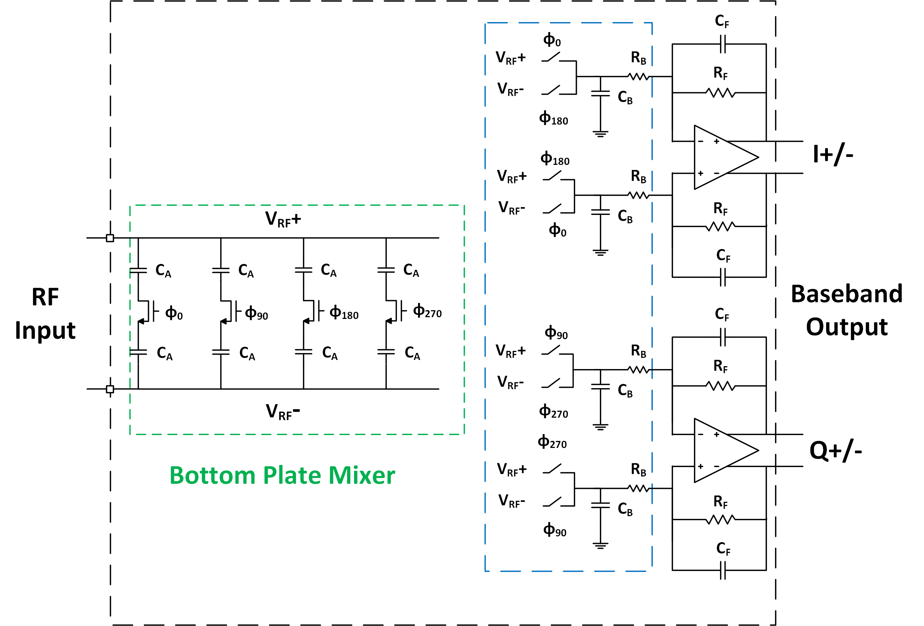
MIMO: Single phase (Mixer-first RX)

Slide 8
MIMO: Mixer

Slide 9
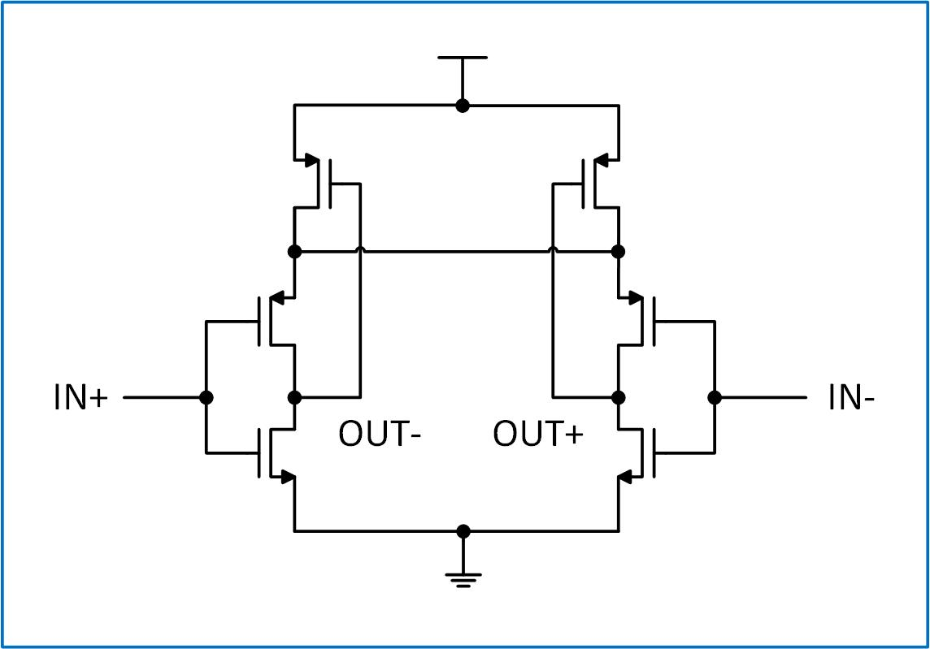
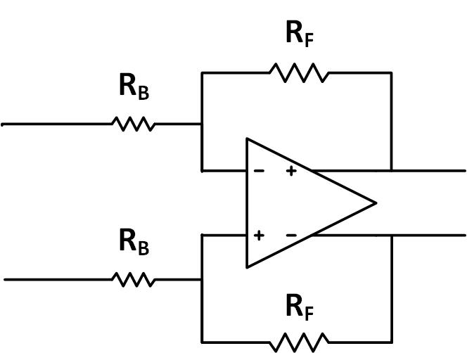
MIMO: TIA (transimpedance amplifier)

