Slide 1
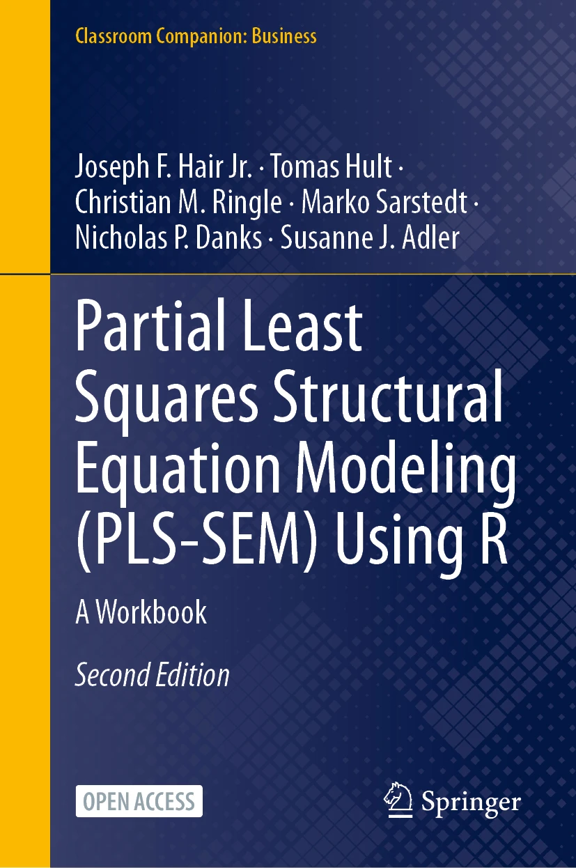
SEMINR WITH NICK DANKS
PLS-SEM with R
Companion to PLS-SEM Using R
Hair, Hult, Ringle, Sarstedt, Danks & Adler (2026)
Open access
PLS-SEM Using R · Hair, Hult, Ringle, Sarstedt, Danks & Adler
1 / 14
Notes:
Series intro card — reusable across all videos (~5 s).

Slide 2
THE CORPORATE REPUTATION MODEL · CHAPTER 8
COMP
CUSA
CUSL
LIKE
Satisfaction as the middleman — dashed paths are the direct effects in question
PLS-SEM Using R · Hair, Hult, Ringle, Sarstedt, Danks & Adler
2 / 14
Notes:
Shot 0:00 cold open — competence looked dead (0.006). It works through a middleman.

Slide 3
VIDEO 4 · CHAPTER 8
Mediation
Direct, indirect, and the Zhao typology
PLS-SEM Using R · Hair, Hult, Ringle, Sarstedt, Danks & Adler
3 / 14
Notes:
Shot 0:15 title card.

Slide 4
LEARNING OUTCOMES
By the end of this video
Distinguish direct, indirect, and total effects
1
Test specific indirect effects with specific_effect_significance()
2
Classify mediation with the Zhao, Lynch & Chen (2010) typology
3
Resolve the video-3 puzzle: why competence matters after all
4
PLS-SEM Using R · Hair, Hult, Ringle, Sarstedt, Danks & Adler
4 / 14
Notes:
Shot 0:30 — read the outcomes aloud.

Slide 5
DIRECT · INDIRECT · TOTAL
M
p1
p2
X
Y
p3 (direct)
indirect = p1 × p2 total = p3 + p1 × p2
The question is never just “is there mediation” — it's which kind.
PLS-SEM Using R · Hair, Hult, Ringle, Sarstedt, Danks & Adler
5 / 14
Notes:
Shot 1:00 concept — indirect effect is the PRODUCT of the two legs; total = direct + indirect.

Slide 6
THE ZHAO, LYNCH & CHEN (2010) TYPOLOGY
Indirect significant, direct significant, same sign → complementary mediation
1
Indirect significant, direct significant, opposite → competitive mediation
2
Indirect significant, direct not → indirect-only (full) mediation
3
Direct only → no mediation. Neither → no effect.
4
Two bootstrap questions replace the whole Baron–Kenny ritual.
PLS-SEM Using R · Hair, Hult, Ringle, Sarstedt, Danks & Adler
6 / 14
Notes:
Shot 3:00 — the Zhao decision logic. Two questions, five outcomes.

Slide 7
R HABIT 7 OF 10
7
Save artifacts, not screenshots
saveRDS(corp_rep_boot, "outputs/corp_rep_boot.rds")
Bootstrapping is the expensive step. Save it once, readRDS() next session — never wait on 10,000 resamples twice.
Console screenshots are not reproducible; .rds files are.
PLS-SEM Using R · Hair, Hult, Ringle, Sarstedt, Danks & Adler
7 / 14
Notes:
Shot 5:00 habit banner #9 (45 s).

Slide 8
RESULTS · SPECIFIC INDIRECT EFFECTS · SEED 123
INDIRECT PATH | EFFECT | 2.5% CI | 97.5% CI | P
COMP → CUSA → CUSL | 0.082 | 0.018 | 0.151 | 0.006
LIKE → CUSA → CUSL | 0.214 | 0.146 | 0.286 | < .001
Both confidence intervals exclude zero — both indirect effects are real.
PLS-SEM Using R · Hair, Hult, Ringle, Sarstedt, Danks & Adler
8 / 14
Notes:
Shot 6:30 results — bootstrap the PRODUCT of the legs; both indirect paths significant.

Slide 9
RESULTS · DIRECT EFFECTS · SAME BOOTSTRAP
DIRECT PATH | EFFECT | 2.5% CI | 97.5% CI | P
COMP → CUSL | 0.009 | -0.092 | 0.120 | n.s.
LIKE → CUSL | 0.342 | 0.227 | 0.449 | < .001
COMP → CUSL spans zero, exactly as in video 3. LIKE → CUSL stays strong.
PLS-SEM Using R · Hair, Hult, Ringle, Sarstedt, Danks & Adler
9 / 14
Notes:
Shot 9:30 results — same bootstrap, the two direct legs. COMP -> CUSL is flat.

Slide 10
CLASSIFY · ZHAO, LYNCH & CHEN
COMP → CUSL
indirect-only
indirect ✓ · direct ✗
LIKE → CUSL
complementary
indirect ✓ · direct ✓ · same sign
Competence works entirely through satisfaction; likeability flows both ways.
PLS-SEM Using R · Hair, Hult, Ringle, Sarstedt, Danks & Adler
10 / 14
Notes:
Shot 11:30 — apply the typology: indirect-only vs complementary.

Slide 11
COMPETENCE MATTERS AFTER ALL
A flat direct path is not a dead predictor.
COMP → CUSA → CUSL carries 0.082 of real effect that the direct path never shows.
Managerially: competence is a satisfaction lever; likeability is a satisfaction lever and a loyalty lever.
PLS-SEM Using R · Hair, Hult, Ringle, Sarstedt, Danks & Adler
11 / 14
Notes:
Shot 13:30 — never delete a predictor because its direct path is flat.

Slide 12
RECAP · THE PROCEDURE
Test the indirect effects — specific_effect_significance(), bootstrap the product
1
Test the direct effects — same bootstrap, read the CIs
2
Classify — Zhao typology, then interpret both kinds
3
PLS-SEM Using R · Hair, Hult, Ringle, Sarstedt, Danks & Adler
12 / 14
Notes:
Shot 15:00 wrap part 1 — the three-step procedure.

Slide 13
RECAP · WHAT WE FOUND
COMP — indirect-only: 0.082 through CUSA, direct 0.009 n.s.
1
LIKE — complementary: 0.214 through CUSA + 0.342 direct
2
Rule — mediation analysis before you call any predictor dead
3
PLS-SEM Using R · Hair, Hult, Ringle, Sarstedt, Danks & Adler
13 / 14
Notes:
Shot 15:00 wrap part 2 — takeaways; next video: moderation.

Slide 14
RUN THIS YOURSELF
nicholasdanks.com/learn/mediation
Package: cran.r-project.org/package=seminr
Theory: Chapter 8, PLS-SEM Using R (open access)
Next video: Moderation — when strength depends on a third variable. Subscribe so you don't miss it
PLS-SEM Using R · Hair, Hult, Ringle, Sarstedt, Danks & Adler
14 / 14
Notes:
End card (~15 s) — Next video: Moderation — when strength depends on a third variable. Subscribe so you don't miss it

