Slide 1
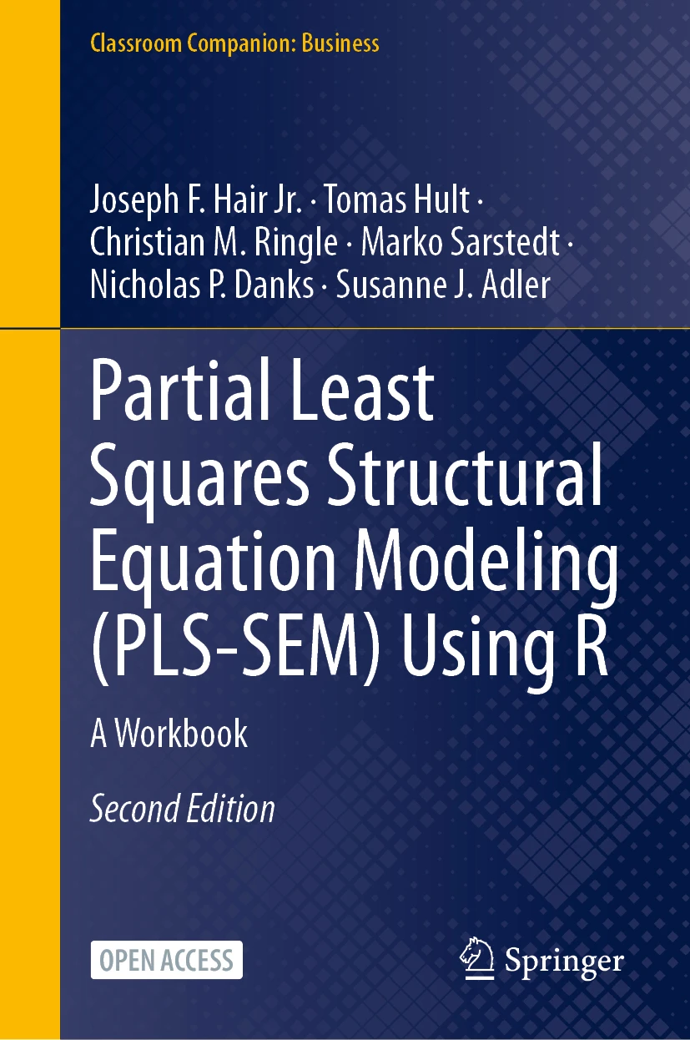
SEMINR WITH NICK DANKS
PLS-SEM with R
Companion to PLS-SEM Using R
Hair, Hult, Ringle, Sarstedt, Danks & Adler (2026)
Open access
PLS-SEM Using R · Hair, Hult, Ringle, Sarstedt, Danks & Adler
1 / 18
Notes:
Series intro card — reusable across all videos (~5 s).

Slide 2
SWITCHING COSTS AS A MODERATOR · CHAPTER 7
COMP
CUSA
CUSL
LIKE
SC
The moderator aims at the arrow, not the construct
PLS-SEM Using R · Hair, Hult, Ringle, Sarstedt, Danks & Adler
2 / 18
Notes:
Shot 0:00 cold open — does satisfaction drive loyalty equally for free and locked-in customers?

Slide 3
VIDEO 5 · CHAPTER 7
Moderation
Interaction terms, two-stage, simple slopes
PLS-SEM Using R · Hair, Hult, Ringle, Sarstedt, Danks & Adler
3 / 18
Notes:
Shot 0:15 title card.

Slide 4
LEARNING OUTCOMES
By the end of this video
Explain what a moderator does — change a relationship's strength
1
Specify interaction_term() and know why two-stage is the default
2
Test the interaction and judge its f² with the right benchmarks
3
Produce and read a simple-slopes plot
4
PLS-SEM Using R · Hair, Hult, Ringle, Sarstedt, Danks & Adler
4 / 18
Notes:
Shot 0:30 — read the outcomes aloud.

Slide 5
THREE WAYS TO BUILD THE INTERACTION TERM
Product-indicator — multiply all indicator pairs; reflective measures only
1
Orthogonalized — fixes collinearity, harder to interpret
2
Two-stage — construct scores from stage one; ANY measurement mode, best power
3
Default to two-stage — it even handles our single-item CUSA.
PLS-SEM Using R · Hair, Hult, Ringle, Sarstedt, Danks & Adler
6 / 18
Notes:
Shot 3:00 — product-indicator vs orthogonalized vs two-stage. Default: two-stage.

Slide 6
R HABIT 8 OF 10
8
Version control — even for “just an analysis”
One commit per working analysis step, from the RStudio Git pane. No branching strategy required.
What you actually need is yesterday's working version back when today's edit breaks something.
PLS-SEM Using R · Hair, Hult, Ringle, Sarstedt, Danks & Adler
7 / 18
Notes:
Shot 7:00 habit banner #10 (45 s) — show the Git pane, don't lecture.

Slide 7
RESULTS · BOOTSTRAPPED PATHS · SEED 123
PATH | ESTIMATE | 2.5% CI | 97.5% CI
CUSA → CUSL | 0.466 | 0.371 | 0.552
SC → CUSL | 0.069 | -0.039 | 0.176
CUSA×SC → CUSL | -0.071 | -0.136 | -0.009
LIKE → CUSL | 0.319 | 0.194 | 0.423
COMP → CUSL | -0.017 | -0.135 | 0.101
The interaction is negative and significant — higher switching costs weaken the satisfaction→loyalty link.
PLS-SEM Using R · Hair, Hult, Ringle, Sarstedt, Danks & Adler
8 / 18
Notes:
Shot 7:45 results — interaction -0.071, CI excludes zero. SC main effect n.s. but stays in.

Slide 8
SIMPLE SLOPES · SATISFACTION → LOYALTY
low SC slope ≈ 0.54
mean SC slope = 0.47
high SC slope ≈ 0.40
Always positive — satisfaction always helps. It just buys less loyalty when customers are locked in.
CUSL
satisfaction (CUSA)
PLS-SEM Using R · Hair, Hult, Ringle, Sarstedt, Danks & Adler
9 / 18
Notes:
Shot 10:45 — slope_analysis() live in RStudio; this slide is the stylized read.

Slide 9
INTERACTION EFFECT SIZE
F² OF CUSA×SC
0.014
looks tiny by Cohen's 0.02 / 0.15 / 0.35
KENNY (2018) FOR INTERACTIONS
0.005 / 0.01 / 0.025
0.014 = a solid medium effect
Interactions are systematically small — cite the right benchmark or a reviewer will do it for you.
PLS-SEM Using R · Hair, Hult, Ringle, Sarstedt, Danks & Adler
10 / 18
Notes:
Shot 13:15 — f² = 0.014: medium-to-large by Kenny's interaction benchmarks, not Cohen's.

Slide 10
LOCKED-IN CUSTOMERS: SATISFACTION BUYS LESS
High switching costs → loyalty is partly captive.
Satisfaction investments return less in contract-bound or ecosystem-locked segments.
Low switching costs → satisfaction is the main defense.
One interaction term, a segmentation insight.
PLS-SEM Using R · Hair, Hult, Ringle, Sarstedt, Danks & Adler
11 / 18
Notes:
Shot 14:45 — managerial read: captive loyalty vs earned loyalty.

Slide 11
THE OTHER KIND OF MODERATION
A continuous moderator → an interaction term (what we just did).
A categorical moderator → multigroup analysis (PLS-MGA).
Same question — does the relationship differ? — with a grouping variable instead of a scale.
The 2e covers both in this chapter. estimate_pls_mga() compares every path across two groups.
PLS-SEM Using R · Hair, Hult, Ringle, Sarstedt, Danks & Adler
12 / 18
Notes:
Shot 16:00 — the 2e teaches MGA in this (moderation) chapter: a moderator that is a GROUP is multigroup analysis.

Slide 12
RESULTS · PLS-MGA BY SERVICE TYPE
PATH | GROUP 1 | GROUP 2 | MGA P | VERDICT
COMP → CUSA | 0.224 | 0.130 | 0.258 | same
LIKE → CUSA | 0.358 | 0.460 | 0.785 | same
COMP → CUSL | 0.133 | -0.050 | 0.045 | group 1 ↑
LIKE → CUSL | 0.206 | 0.418 | 0.981 | group 2 ↑
CUSA → CUSL | 0.598 | 0.440 | 0.021 | group 1 ↑
Henseler one-sided p: significant when p < .05 (group 1 larger) or p > .95 (group 2 larger). 3 of 5 paths differ.
PLS-SEM Using R · Hair, Hult, Ringle, Sarstedt, Danks & Adler
13 / 18
Notes:
Shot 16:00 MGA results — servicetype 1 vs 2, core model, 1,000×2 bootstraps, seed 123. 3 of 5 paths differ.

Slide 13
WHAT THE POOLED MODEL HID
COMP → CUSL — 0.13 vs −0.05: competence buys loyalty only in group 1
1
LIKE → CUSL — 0.21 vs 0.42: likeability matters twice as much in group 2
2
CUSA → CUSL — 0.60 vs 0.44: satisfaction converts more in group 1
3
Caveat: establish measurement invariance (MICOM; Henseler, Ringle & Sarstedt 2016) before trusting these — otherwise path differences are noise.
PLS-SEM Using R · Hair, Hult, Ringle, Sarstedt, Danks & Adler
14 / 18
Notes:
Shot 16:00 MGA reading — the pooled model averaged away real differences; MICOM caveat.

Slide 14
RECAP · THE PROCEDURE
Specify — interaction_term(iv, moderator, method = two_stage)
1
Include the main effect — the moderator predicts the DV directly, significant or not
2
Bootstrap the interaction — CI must exclude zero
3
Categorical moderator? — MICOM, then estimate_pls_mga(), one-sided p
4
PLS-SEM Using R · Hair, Hult, Ringle, Sarstedt, Danks & Adler
15 / 18
Notes:
Shot 17:15 wrap part 1 — the procedure.

Slide 15
RECAP · WHAT WE FOUND
Interaction — −0.071, CI [−0.136, −0.009]: significant, negative
1
Slopes — 0.54 (low SC) → 0.40 (high SC), always positive
2
MGA — 3 of 5 loyalty paths differ by service type
3
PLS-SEM Using R · Hair, Hult, Ringle, Sarstedt, Danks & Adler
16 / 18
Notes:
Shot 17:15 wrap part 2 — what we found.

Slide 16
WHERE WE ARE
Done — reflective, formative, structural, mediation, moderation (+ MGA)
1
Next — higher-order constructs (MGA revisited alongside)
2
Then — prediction: PLSpredict & CVPAT
3
PLS-SEM Using R · Hair, Hult, Ringle, Sarstedt, Danks & Adler
17 / 18
Notes:
Wrap beat — five of seven topics done; the advanced pair remains.

Slide 17
RUN THIS YOURSELF
nicholasdanks.com/learn/moderation
Package: cran.r-project.org/package=seminr
Theory: Chapter 7, PLS-SEM Using R (open access)
Next video: Higher-order constructs — with a deeper multigroup treatment. Subscribe so you don't miss it
PLS-SEM Using R · Hair, Hult, Ringle, Sarstedt, Danks & Adler
18 / 18
Notes:
End card (~15 s) — Next video: Higher-order constructs — with a deeper multigroup treatment. Subscribe so you don't miss it

