Slide 1
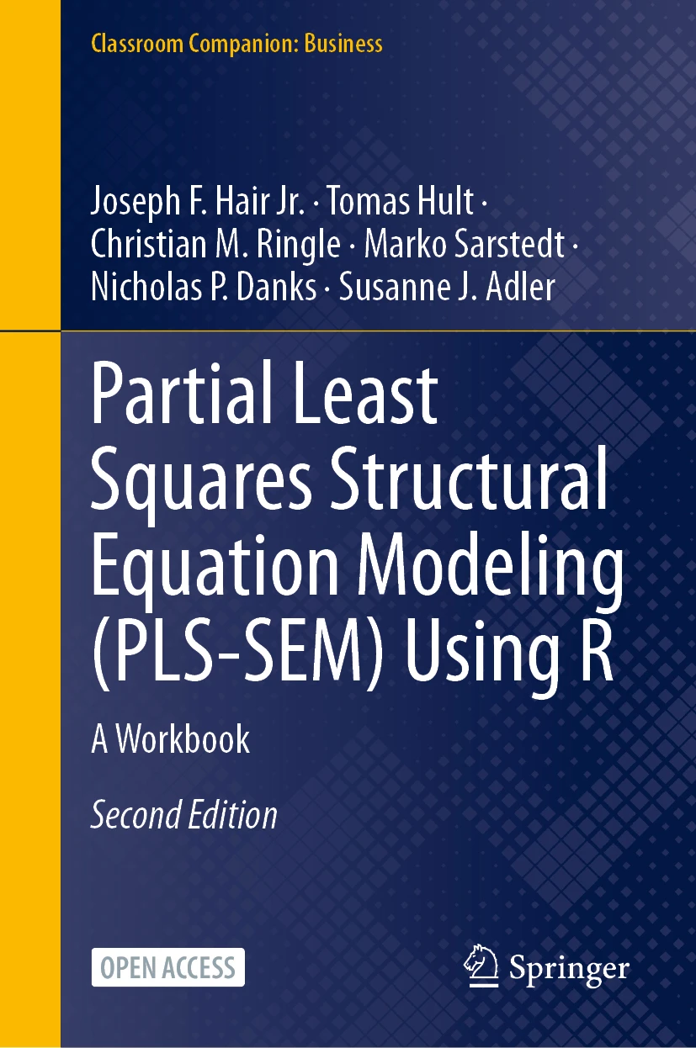
SEMINR WITH NICK DANKS
PLS-SEM with R
Companion to PLS-SEM Using R
Hair, Hult, Ringle, Sarstedt, Danks & Adler (2026)
Open access
PLS-SEM Using R · Hair, Hult, Ringle, Sarstedt, Danks & Adler
1 / 18
Notes:
Series intro card — reusable across all videos (~5 s).

Slide 2
THE CORPORATE REPUTATION MODEL · CHAPTER 4
COMP
CUSA
CUSL
LIKE
Four things every reviewer will check — in under 20 minutes
PLS-SEM Using R · Hair, Hult, Ringle, Sarstedt, Danks & Adler
2 / 18
Notes:
Shot 0:00 cold open. Narration: four things every reviewer will check, in SEMinR, in under 20 minutes.

Slide 3
VIDEO 1 · CHAPTER 4
Reflective Measurement
Four criteria every reviewer will check
PLS-SEM Using R · Hair, Hult, Ringle, Sarstedt, Danks & Adler
3 / 18
Notes:
Shot 0:15 title card + channel intro.

Slide 4
LEARNING OUTCOMES
By the end of this video
Specify a reflective measurement model in SEMinR
1
Estimate a PLS-SEM model and read the summary
2
Assess all four publication criteria: indicator reliability, internal consistency, convergent & discriminant validity
3
Bootstrap HTMT for an inferential test
4
PLS-SEM Using R · Hair, Hult, Ringle, Sarstedt, Danks & Adler
4 / 18
Notes:
Shot 0:30 — read the outcomes aloud as they appear.

Slide 5
SETUP · EVERYTHING IS ON CRAN
install.packages(c("seminr", "seminrExtras"))
SEMINR
2.5.0
SEMINREXTRAS
1.0.2
Data: corp_rep_data — 344 firms, bundled with seminr
PLS-SEM Using R · Hair, Hult, Ringle, Sarstedt, Danks & Adler
5 / 18
Notes:
Shot 1:00 setup. One install call; corp_rep_data, 344 firms.

Slide 6
R HABIT 1 OF 10
1
Use RStudio Projects, not setwd()
No absolute paths anywhere in this script. Your code should run from wherever the project folder lives — including someone else's machine.
PLS-SEM Using R · Hair, Hult, Ringle, Sarstedt, Danks & Adler
6 / 18
Notes:
Shot 1:00 habit banner #1 (15 s).

Slide 7
R HABIT 4 OF 10
4
Name objects for humans, not computers
The series convention is <study>_<role>:
corp_rep_mm · corp_rep_sm · corp_rep_pls_model · corp_rep_summary · corp_rep_boot
Related objects sort together; the script reads as a story.
PLS-SEM Using R · Hair, Hult, Ringle, Sarstedt, Danks & Adler
7 / 18
Notes:
Shot 2:00 habit banner #4 (30 s).

Slide 8
CRITERION 1 · INDICATOR RELIABILITY
loading ≥ 0.708 ⇒ loading² ≥ 0.50
0.40 – 0.708: delete only if it lifts rhoC or AVE above threshold — and never at the cost of content validity.
Below 0.40: drop it.
PLS-SEM Using R · Hair, Hult, Ringle, Sarstedt, Danks & Adler
8 / 18
Notes:
Shot 4:30 threshold card before running the loadings code.

Slide 9
RESULTS · INDICATOR RELIABILITY
ITEM | CONSTRUCT | LOADING | LOADING²
comp_1 | COMP | 0.858 | 0.736
comp_2 | COMP | 0.798 | 0.638
comp_3 | COMP | 0.818 | 0.669
like_1 | LIKE | 0.879 | 0.773
like_2 | LIKE | 0.870 | 0.757
like_3 | LIKE | 0.843 | 0.711
cusa | CUSA | 1.000 | 1.000
cusl_1 | CUSL | 0.833 | 0.694
cusl_2 | CUSL | 0.917 | 0.841
cusl_3 | CUSL | 0.843 | 0.710
Every loading² clears 0.50 — the lowest is cusl_1 at 0.69. Nothing to delete.
PLS-SEM Using R · Hair, Hult, Ringle, Sarstedt, Danks & Adler
9 / 18
Notes:
Shot 4:30 results — cut here after running corp_rep_summary$loadings^2.

Slide 10
CRITERIA 2 & 3 · RELIABILITY AND CONVERGENT VALIDITY
ALPHA · RHO_A · RHO_C
0.70 – 0.95
Report rhoA as the primary measure.
AVE
≥ 0.50
Convergent validity
Single-item constructs (CUSA) show 1.000 — nothing to assess.
PLS-SEM Using R · Hair, Hult, Ringle, Sarstedt, Danks & Adler
10 / 18
Notes:
Shots 6:30 / 8:30 thresholds for reliability + AVE.

Slide 11
RESULTS · RELIABILITY AND CONVERGENT VALIDITY
CONSTRUCT | ALPHA | RHO_A | RHO_C | AVE
COMP | 0.776 | 0.832 | 0.865 | 0.681
LIKE | 0.831 | 0.836 | 0.899 | 0.747
CUSA | 1.000 | 1.000 | 1.000 | 1.000
CUSL | 0.831 | 0.839 | 0.899 | 0.748
All rhoA in 0.70–0.95, all AVE ≥ 0.50. CUSA is single-item — its row is not interpretable.
PLS-SEM Using R · Hair, Hult, Ringle, Sarstedt, Danks & Adler
11 / 18
Notes:
Shots 6:30 / 8:30 results — corp_rep_summary$reliability. CUSA row dimmed (single item).

Slide 12
CRITERION 4 · DISCRIMINANT VALIDITY
HTMT
< 0.85
conceptually distinct constructs
HTMT
< 0.90
conceptually similar constructs
Stricter test: 90% bootstrap CI upper bound must not include 1
PLS-SEM Using R · Hair, Hult, Ringle, Sarstedt, Danks & Adler
12 / 18
Notes:
Shot 10:00 HTMT thresholds.

Slide 13
RESULTS · HTMT
 | COMP | LIKE | CUSA
LIKE | 0.780
CUSA | 0.465 | 0.577
CUSL | 0.532 | 0.737 | 0.755
Every pair below 0.85. The closest call: COMP–LIKE at 0.780.
PLS-SEM Using R · Hair, Hult, Ringle, Sarstedt, Danks & Adler
13 / 18
Notes:
Shot 10:00 results — corp_rep_summary$validity$htmt. Point at COMP-LIKE 0.780.

Slide 14
R HABIT 7 OF 10
7
Seed your bootstraps. Always.
set.seed(123) immediately before bootstrap_model().
A one-line insurance policy against “I can't reproduce your Table 3.” No exceptions.
PLS-SEM Using R · Hair, Hult, Ringle, Sarstedt, Danks & Adler
14 / 18
Notes:
Shot 13:00 habit banner #7 (45 s) — zoom on set.seed.

Slide 15
RESULTS · BOOTSTRAPPED HTMT · 1,000 SAMPLES · SEED 123
RELATIONSHIP | HTMT | 5% CI | 95% CI
COMP → LIKE | 0.780 | 0.709 | 0.842
COMP → CUSA | 0.465 | 0.373 | 0.552
COMP → CUSL | 0.532 | 0.445 | 0.629
LIKE → CUSA | 0.577 | 0.504 | 0.642
LIKE → CUSL | 0.737 | 0.669 | 0.803
CUSA → CUSL | 0.755 | 0.697 | 0.808
No upper bound comes near 1 — the largest is 0.842. Discriminant validity holds inferentially.
PLS-SEM Using R · Hair, Hult, Ringle, Sarstedt, Danks & Adler
15 / 18
Notes:
Shot 13:00 results — bootstrapped_HTMT, nboot 1000, seed 123, alpha 0.10.

Slide 16
CONGRUENCE TEST · FRANKE, SARSTEDT & DANKS (2021)
RELATIONSHIP | CONGRUENCE | 5% CI | 95% CI
COMP → LIKE | 0.961 | 0.937 | 0.978
COMP → CUSA | 0.841 | 0.776 | 0.895
COMP → CUSL | 0.893 | 0.847 | 0.928
LIKE → CUSA | 0.875 | 0.819 | 0.921
LIKE → CUSL | 0.940 | 0.911 | 0.962
CUSA → CUSL | 0.961 | 0.941 | 0.975
Every CI upper bound stays below 1 — even the tightest pairs remain empirically distinct.
PLS-SEM Using R · Hair, Hult, Ringle, Sarstedt, Danks & Adler
16 / 18
Notes:
Shot 15:00 results — congruence_test() from seminrExtras. Franke, Sarstedt & Danks (2021).

Slide 17
RECAP
The four criteria
Indicator reliability — loadings ≥ 0.708
1
Internal consistency — rho_A in 0.70 – 0.95
2
Convergent validity — AVE ≥ 0.50
3
Discriminant validity — HTMT < 0.85, CI excludes 1
4
PLS-SEM Using R · Hair, Hult, Ringle, Sarstedt, Danks & Adler
17 / 18
Notes:
Shot 16:30 wrap — recap the four criteria, point to the companion page and Chapter 4.

Slide 18
RUN THIS YOURSELF
nicholasdanks.com/learn/reflective
Package: cran.r-project.org/package=seminr
Theory: Chapter 4, PLS-SEM Using R (open access)
Next video: Formative measurement — subscribe so you don't miss it
PLS-SEM Using R · Hair, Hult, Ringle, Sarstedt, Danks & Adler
18 / 18
Notes:
End card (~15 s), reusable — swap the 'next video' line per episode.

