Slide 1
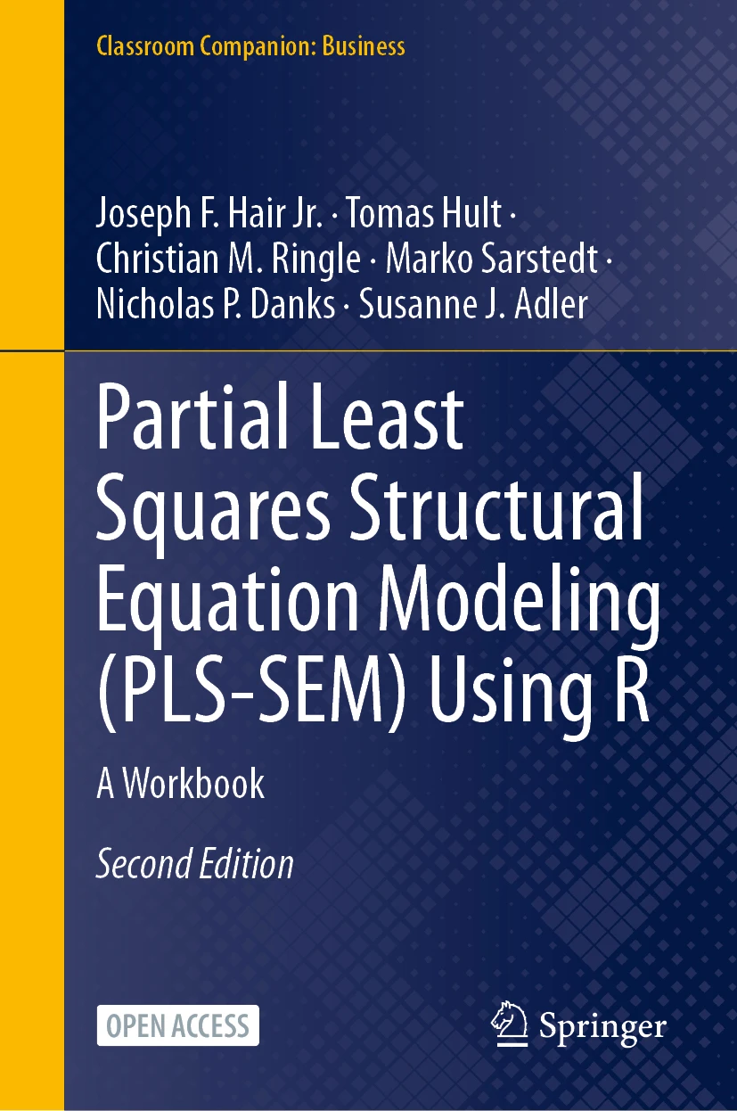
SEMINR WITH NICK DANKS
PLS-SEM with R
Companion to PLS-SEM Using R
Hair, Hult, Ringle, Sarstedt, Danks & Adler (2026)
Open access
PLS-SEM Using R · Hair, Hult, Ringle, Sarstedt, Danks & Adler
1 / 20
Notes:
Series intro card — reusable across all videos (~5 s).

Slide 2
THE EXTENDED CORPORATE REPUTATION MODEL · CHAPTER 6
QUAL
COMP
CUSA
PERF
CSOR
LIKE
CUSL
ATTR
Measurement is settled — now the paths themselves
PLS-SEM Using R · Hair, Hult, Ringle, Sarstedt, Danks & Adler
2 / 20
Notes:
Shot 0:00 cold open. Narration: do the paths hold up — and can the model predict? Five steps, under 20 min.

Slide 3
VIDEO 3 · CHAPTER 6
The Structural Model
Testing the theory
PLS-SEM Using R · Hair, Hult, Ringle, Sarstedt, Danks & Adler
3 / 20
Notes:
Shot 0:15 title card.

Slide 4
LEARNING OUTCOMES
By the end of this video
Assess the five structural criteria: collinearity, paths, R², f², predictive power
1
Bootstrap path coefficients and read the confidence intervals
2
Distinguish explanatory power (R²) from predictive power (PLSpredict)
3
4
Conduct predictive model evaluation and comparison.
PLS-SEM Using R · Hair, Hult, Ringle, Sarstedt, Danks & Adler
4 / 20
Notes:
Shot 0:30 — read the outcomes aloud.

Slide 5
THE FIVE-STEP PROCEDURE
Collinearity — VIF among each construct's predictors
1
Significance & relevance — bootstrapped path coefficients
2
Explanatory power — R² of the endogenous constructs
3
Effect sizes — f² per path
4
5
Predictive power — PLSpredict, LM benchmark
PLS-SEM Using R · Hair, Hult, Ringle, Sarstedt, Danks & Adler
5 / 20
Notes:
Shot 2:30 — the five steps, in order. Explanation first, prediction fifth.

Slide 6
STEP 1 · COLLINEARITY AMONG PREDICTORS
VIF IDEALLY
< 3
start paying attention above this
VIF PROBLEM AT
≥ 5
unstable paths, possible sign flips
Path coefficients are regression coefficients — check the predictors of every endogenous construct.
PLS-SEM Using R · Hair, Hult, Ringle, Sarstedt, Danks & Adler
6 / 20
Notes:
Shot 3:00 threshold card — same VIF logic as video 2, one level up.

Slide 7
RESULTS · PREDICTOR VIFS
PREDICTING | PREDICTOR | VIF | VERDICT
COMP / LIKE | QUAL | 3.49 | acceptable — note it
COMP / LIKE | PERF | 2.89 | fine
COMP / LIKE | CSOR · ATTR | 2.08 · 2.12 | fine
CUSA | COMP · LIKE | 1.69 | fine
CUSL | COMP · LIKE · CUSA | 1.41 – 1.95 | fine
Only QUAL at 3.49 sits above 3 — below the ceiling of 5, so report and proceed.
PLS-SEM Using R · Hair, Hult, Ringle, Sarstedt, Danks & Adler
7 / 20
Notes:
Shot 3:00 results — vif_antecedents. QUAL at 3.49 is the one to mention in a paper.

Slide 8
RESULTS · BOOTSTRAPPED PATHS · 1,000 SAMPLES · SEED 123
PATH | ESTIMATE | 2.5% CI | 97.5% CI
QUAL → COMP | 0.430 | 0.301 | 0.559
QUAL → LIKE | 0.380 | 0.261 | 0.522
PERF → COMP | 0.295 | 0.165 | 0.417
PERF → LIKE | 0.117 | -0.013 | 0.261
CSOR → COMP | 0.059 | -0.040 | 0.171
CSOR → LIKE | 0.178 | 0.063 | 0.290
ATTR → COMP | 0.086 | -0.018 | 0.184
ATTR → LIKE | 0.167 | 0.036 | 0.284
COMP → CUSA | 0.146 | 0.015 | 0.274
COMP → CUSL | 0.006 | -0.096 | 0.114
LIKE → CUSA | 0.436 | 0.320 | 0.554
LIKE → CUSL | 0.344 | 0.235 | 0.449
CUSA → CUSL | 0.505 | 0.420 | 0.587
Nine of thirteen significant. Amber CIs include zero — including COMP → CUSL at 0.006.
PLS-SEM Using R · Hair, Hult, Ringle, Sarstedt, Danks & Adler
8 / 20
Notes:
Shot 5:00 results — 13 paths, 4 n.s. Hold COMP->CUSL for the headline at 16:00.

Slide 9
STEP 2 · TOTAL EFFECTS
DRIVER → CUSL | TOTAL EFFECT | 95% CI
QUAL | 0.248 | [0.174, 0.340]
PERF | 0.089 | [0.005, 0.176]
CSOR | 0.105 | [0.038, 0.172]
ATTR | 0.101 | [0.028, 0.173]
COMP | 0.079 | [-0.046, 0.208]
LIKE | 0.564 | [0.439, 0.679]
None of the four drivers has a direct arrow to loyalty — yet each carries a significant total effect through COMP/LIKE → CUSA → CUSL. Total = direct + indirect; COMP's stays flat — the video-4 puzzle.
PLS-SEM Using R · Hair, Hult, Ringle, Sarstedt, Danks & Adler
9 / 20

Slide 10
R HABIT 5 OF 10
5
Never share the R Output directly
R plots and figures are generally low grade and statistical in nature.
Rather hand craft and convert to tables in docx or ppt.
Use bolding, fonts, accents, underline to draw focus
PLS-SEM Using R · Hair, Hult, Ringle, Sarstedt, Danks & Adler
10 / 20
Notes:
Shot 5:00 habit banner #3 (30 s).

Slide 11
STEP 3 · EXPLANATORY POWER (R²)
COMP
0.631
LIKE
0.558
CUSA
0.292
CUSL
0.562
Substantial for a behavioral model — except CUSA, predicted by only two constructs.
Interpret R² against your field's norms, not arbitrary cutoffs.
PLS-SEM Using R · Hair, Hult, Ringle, Sarstedt, Danks & Adler
11 / 20
Notes:
Shot 8:30 — R² from the top of the paths table. Judge against field norms, not cutoffs.

Slide 12
STEP 4 · EFFECT SIZES (F²)
PATH | F² | READING
CUSA → CUSL | 0.403 | large
LIKE → CUSA | 0.159 | medium
QUAL → COMP | 0.144 | close to medium
LIKE → CUSL | 0.138 | close to medium
QUAL → LIKE | 0.094 | small–medium
PERF → COMP | 0.076 | small–medium
COMP → CUSA | 0.018 | below small
Thresholds 0.02 / 0.15 / 0.35 (Cohen). Report f² next to every path — significance says whether, f² says how much.
PLS-SEM Using R · Hair, Hult, Ringle, Sarstedt, Danks & Adler
12 / 20
Notes:
Shot 10:30 — f²: how much R² drops if the predictor is deleted. 0.02/0.15/0.35.

Slide 13
STEP 5 · PREDICTIVE POWER (PLSPREDICT)
R² is explanation inside your sample.
Prediction is performance on data the model never saw.
RMSE(PLS) < RMSE(LM) — beats the naive benchmark
PLS-SEM Using R · Hair, Hult, Ringle, Sarstedt, Danks & Adler
13 / 20
Notes:
Shot 12:30 concept — R² is in-sample explanation; prediction is out-of-sample. 10x10 CV, seeded.

Slide 14
RESULTS · OUT-OF-SAMPLE PREDICTION · CUSL INDICATORS
INDICATOR | RMSE PLS | RMSE LM
cusl_1 | 1.196 | 1.212
cusl_2 | 1.240 | 1.266
cusl_3 | 1.311 | 1.339
PLS beats the LM benchmark on every loyalty indicator (and 9 of 10 overall);
medium-to-high predictive power.
PLS-SEM Using R · Hair, Hult, Ringle, Sarstedt, Danks & Adler
14 / 20
Notes:
Shot 12:30 results — CUSL indicators; PLS beats LM on 9/10 indicators overall.

Slide 15
STEP 5 · CVPAT — IS THE PREDICTION GAP SIGNIFICANT?
BENCHMARK (OVERALL) | PLS LOSS | BENCH. | DIFF | P
vs LM · linear model | 1.418 | 1.477 | −0.060 | <.001
vs IA · indicator avg | 1.418 | 2.290 | −0.873 | <.001
A t-test on average out-of-sample loss: PLS predicts significantly better than both the linear-model and indicator-average benchmarks (seed 123, 2,000 boots). assess_cvpat() · seminrExtras.
PLS-SEM Using R · Hair, Hult, Ringle, Sarstedt, Danks & Adler
15 / 20

Slide 16
STEP 6 · PREDICTIVE MODEL COMPARISON
BIC WEIGHT · MODEL 1
0.90
parsimonious model wins — 0.01 / 0.08 for the richer models
+4 DIRECT PATHS
p = .36
CVPAT: the extra driver→outcome paths add no predictive value
Three nested models. Extra paths raise in-sample fit but not out-of-sample prediction. BIC backs Model 1 (0.90 weight); CVPAT confirms the additions buy nothing (p = .36). Keep it parsimonious — and cite a test.
PLS-SEM Using R · Hair, Hult, Ringle, Sarstedt, Danks & Adler
16 / 20

Slide 17
THE HEADLINE FINDING
COMP → CUSL
0.006
p = 0.84 — nothing
LIKE → CUSL
0.344
p < 0.001
Customers stay because they like you — not because they think you're competent.
Is competence really irrelevant? That's a mediation question → video 4.
PLS-SEM Using R · Hair, Hult, Ringle, Sarstedt, Danks & Adler
17 / 20
Notes:
Shot 16:00 — competence does nothing for loyalty directly; likeability carries it. Tease mediation.

Slide 18
R HABIT 6 OF 10
6
End every script with sessionInfo()
One line. It records R and package versions, so when seminr updates in 2027 anyone can still reproduce today's exact output.
The difference between “my code worked in 2026” and “my code works forever.”
PLS-SEM Using R · Hair, Hult, Ringle, Sarstedt, Danks & Adler
18 / 20
Notes:
Shot 17:00 habit banner #8 (45 s).

Slide 19
RECAP
The five steps
Collinearity — VIF < 3 (ceiling 5)
1
Paths — bootstrap CIs, seed first
2
R² — judge against field norms
3
f² — 0.02 / 0.15 / 0.35
4
5
Prediction — Model comparison, beat the LM benchmark
PLS-SEM Using R · Hair, Hult, Ringle, Sarstedt, Danks & Adler
19 / 20
Notes:
Shot 17:45 wrap — five-step recap; next video: mediation.

Slide 20
RUN THIS YOURSELF
nicholasdanks.com/learn/structural
Package: cran.r-project.org/package=seminr
Theory: Chapter 6, PLS-SEM Using R (open access)
Next video: Mediation — why competence matters after all. Subscribe so you don't miss it
PLS-SEM Using R · Hair, Hult, Ringle, Sarstedt, Danks & Adler
20 / 20
Notes:
End card (~15 s) — Next video: Mediation — why competence matters after all. Subscribe so you don't miss it

