Slide 1
OOP345
Week 1

Slide 2
How the course works?
Every lecture class starts with a quiz
It is expected of you to read the lecture notes ahead of time and come to class with questions (Lectures are to help you comprehend the text Not for me to teach you, learning is self-driven)
Workshops are broken down into 3 parts
In-lab (due by the end of class)
At-home (due within 4 days of the in-labs due date)
Reflection a.k.a. What did you learn during the workshop? (due with the at-home part)

Slide 3
My Goal:
Your success
Helping you with your projects, and comprehending difficult concepts of c++
For you to feel confident in your programming abilities
What I need from you
Attendance, on time with the chapters read
Effort, this is cited as one of the most difficult course in CPA/CPD

Slide 4

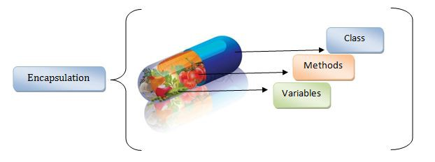
Review 3 oOP fundimentals
Encapsulation:

Slide 5
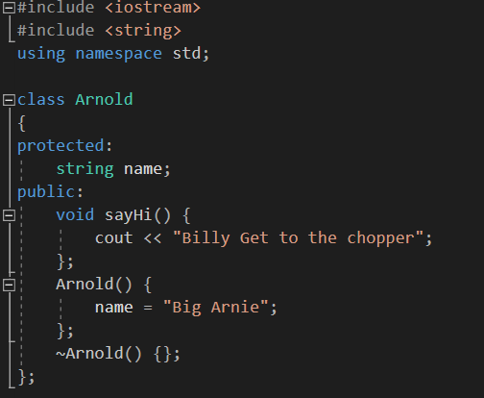
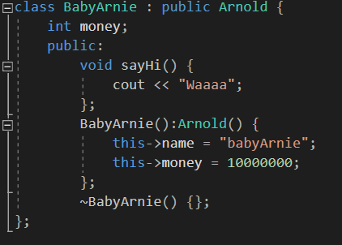


Inheritance

Slide 6
Polymorphism

Slide 7
Types
Fundamental – bool, int, char etc
Built-in – reflect the capabilities of the hardware facilities directly and efficiently
User-Defined (Classes, structs etc)
Concrete types – defined and has values
Abstract types – not defined and purpose is unknown by itself

Slide 8
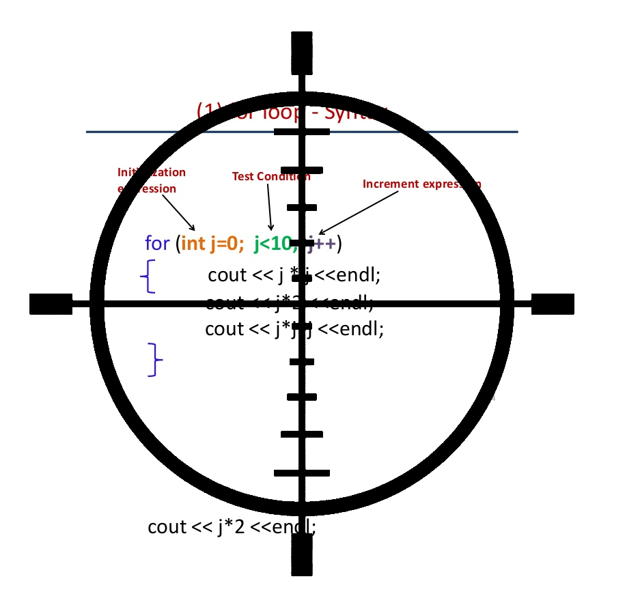
Scope
Local
Class
Namespace
Global
Shadowing
External (extern)
Static

Slide 9

When will your program break?
Compile time
Link Time
Run Time
Static vs dynamic What’s the difference?

Slide 10
Mutability
None – modifiable & no side-effects
const – unmodifiable & no side-effects
volatile – modifiable & some side-effects (needs memory location updated on every value change)
const volatile – unmodifiable & some side-effects

Slide 11
Type Defining
Create a new typedef so you can make variables of that type easier.
typedef const string myNewTypeName; //creating the new type
myNewTypeName teacherName = “Nathan, you can’t touch this!”;
teacherName = “A new name”; //causes an error because teacherName is

Slide 12

Namespace
Is a named scope
Items exist in each named scope
If a int money = 5; in namespace A, then you can have another variable called int money = 6; in another namespace.
There are complications when you include both namespaces into another module (2 variables that share a common name) e.g. cout<<money;
You must specify what namespace that variable is associated with cout<<A::money<<B::money;
You’ve been using this for the std namespace std::cout<<“You can call std in this fashion”;

Slide 13


Storage
Duration
Automatic – Lasts length of scope
static - lasts lifetime of program
dynamic - created using “new” deallocated using “delete”
thread - lasts lifetime of thread

Slide 14
Stages of compliation
Pre-Processing Stage – groups header and source files into a translation unit (single piece of code that we’ll compile)
Compilation Stage – Takes the translation unit and converts it into a binary file for the computer.
Linking Stage – Takes all binary files and creates a relocatable file (makes all your files into a single file)
Loader – Loader takes your Relocatable file and copies it into memory to run.

Slide 15
Compilers
Linux GCC | Windows CL
This gets rid of any pesky warning messages #define _CRT_SECURE_NO_WARNINGS

Slide 16

Arguments (args.)
Arguments are passed into your program from command line
int argc, char *argv[] //variables that capture your args.
argc stands for argument count. Holds how many arguments are being passed (default is 1)
argv is an array that holds strings as each argument argv[0] is your program’s file name
Your program returns control to the computer after return 0; //you can change 0 to a number if you want to give a different error

Slide 17
Fundamentals you should know
Pass by Reference, Pass by Value
Object pointer vs dereferenced Object
Rule of 3 for classes
Copy constructor e.g. newClass A; newClass B(A);
Assignment operator e.g. newClass A; newClass B; B = A;
Destructor ~A

Slide 18

Guards
Guards help protect against duplicate class definitions
#pragma once
OR
#ifndef _NAME_OF_GUARD
#define _NAME_OF_GUARD
//code here
//end of code
#endif

