Slide 1

Multiple Inheritance & Bitwise
Week 12 – OOP345

Slide 2
Multiple Inheritance
Some times when coding or seeing real world examples, objects may derive from more than one source.
Ex. Omnivores (carnivores, herbivores), Child (Mother, Father)
When using multiple inheritance we define it in the inheritor class with a coma separated class name list
Ex. class Ominvore: public Carnivore, public Herbavore{ …}
//Remember to add the class descriptor(public) to each. You’ll get compiler errors otherwise

Slide 3
Constructors
When working with multiple inheritance make sure to include any calls to base derived constructors in your classes
Omnivore::Omnivore(char * name, char * FavMeat, char *FavPlant): Carnivore(name, FavMeat), Herbivore(name, FavPlant){ … } //calls derived 2 arg constructors
Stipulation: If you do not supply any constructors, the compile looks for a default constructor, if no constructor exists, then the compile will have an error.
If both the derived classes (herb.. and carn..) have the same function (eg char* getName(); ) we have to specify which to use, even if they’re virtual
If both the derived classes (herb.. and carn..) inherit from the same base class (e.g. Creature) they create their own versions of that class
Creature
Creature
Carnavore
Herbavore
Omnivore

Slide 4
Constructors cont.
With the previous example there are issues with that model (e.g. Carnivore::getName(); ). We fix them by making the derived classes’ base class virtual
Carnivore():virtual public Creature{} Omnivore():virtual public Creature{}
This allows us to call our inheritor class’s functions as intended.
E.g. Omnivore _om(“Racoon”, “Pizza”, “Salad” ; _om.getName(); //returns “Racoon”
In order for us to use this we also have to change our created class’s constructor to now have a base constructor
Omnivore::Omnivore(char * name, char * FavMeat, char *FavPlant): Creature(name), Carnivore(name, FavMeat), Herbivore(name, FavPlant){ … } //calls derived 2 arg constructors
Creature
Carnavore
Herbavore
Inheritance looks like this now →
Omnivore

Slide 5


Slide 6
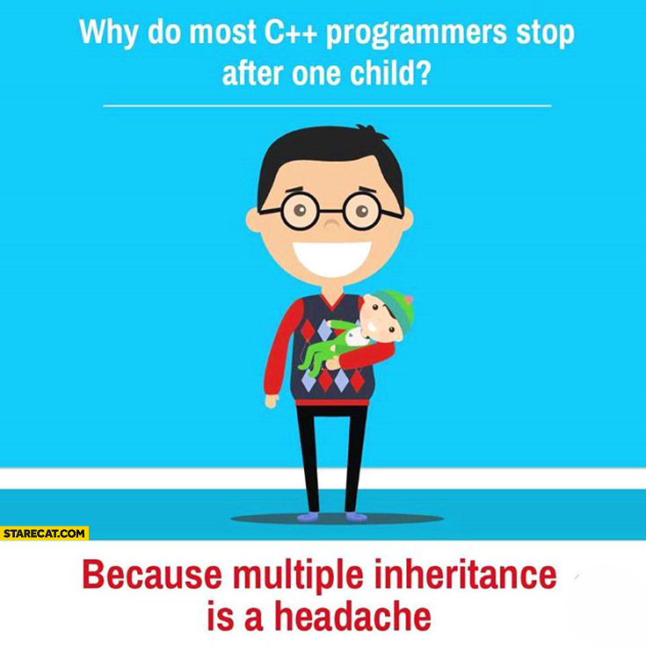
Multiple inheritance Example
Let’s look at the code and change it up.
What happens when we pass different names to the constructors?
What happens when we add virtual?
https://ict.senecacollege.ca/~oop345/pages/content/mult_.html

Slide 7
Bitwise operations
Bitwise operations work on variables on a bit Level, checking/ changing the 1&0’s.
We’ll cover:
Flipping bits
Bit Shifting
And, or, xor

Slide 8
Bitwise cont. (Flipping Bits)
Let’s say we have a couple variables:
char x = 23; // 00010111
char y = 6; // 00000110
We’ll start by using the bit-wise negation “~”
If we do ~x we flip all the bits to they’re opposite version.
Ei. 00010111 becomes 11101000 which in decimal is 232
Interesting tricks: if you have a signed number e.g. -6 if we flip the bits we get it’s positive version with one less, 5
If we have an unsigned variable, the negated version is the maximum size of the variable minus the current value.
E.g. unsigned char x = 6; ~x is 11111001 which is 249 in dec 249+6 = 255 this is the max size of an unsigned char

Slide 9
Bitwise Cont. (Bit shifting)
The << and >> operators move you bits x spots over, where x is the right hand operand.
E.g. char y = 6; // 00000110 ( y << 3 ); //returns prvalue of 00110000 (equals 48 in decimal)
In the example above we move the string of bits to the left cutting off 3 left bits and padding with 3 0’s to the right
Lets see the next example: E.g. char y = 6; // 00000110 ( y >> 3 );
We are left with 00000000. we’ve taken 00000|110 the 3 bits to the right and chopped them off, padding the left side with 3 new 0 bits 000|00000
We can use bit shifting for multiplying/dividing by powers of 2. 6*(2^3)=48

Slide 10
Bitwise (And & )
And looks for all the matching bits and gives the result of both.
If 0 and 0 = 0.
If 1 and 0 = 0.
If 1 and 1= 1.
char x = 23; // 00010111
char y = 6; // 00000110
(x&y); //returns 6 00000110
We can use & for masking only part of a variable. (e.g. Checking bits 4-6)
We can also use it for testing ODD or Even
bool odd = (bool)(y&1); (checks if the last bit is 1)

Slide 11
Bitwise (OR | )
And looks for all the bits that are 1 and gives result of 1.
If 0 or 0 = 0.
If 1 or 0 = 1.
If 1 or 1= 1.
char x = 23; // 00010111
char y = 6; // 00000110
(x|y); //returns 23 00010111
We can use it for Turning on certain bits.

Slide 12
Bitwise (xOR ^ ) (aka “Exclusive OR”)
And looks for all the bits that are different and gives result of 1 for different bits.
If 0 xor 0 = 0.
If 1 xor 0 = 0.
If 1 xor 1= 1.
char x = 23; // 00010111
char y = 6; // 00000110
(x^y); //returns 17 00010001
We can use it for flipping certain bits.

