Slide 1
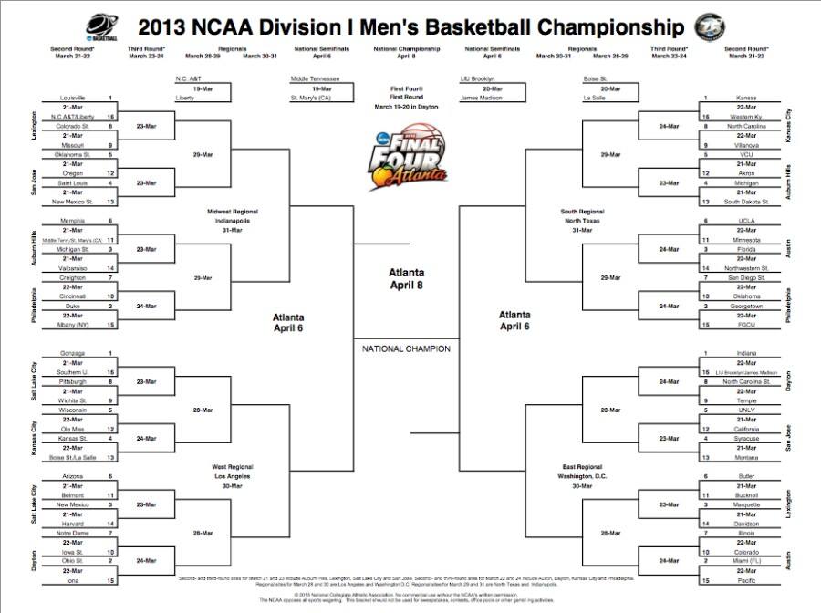
Variable 2-42 RIGHT
Louisville
Louisville
Kansas
Kansas
Colorado St.
Louisville
Michigan
North Carolina
Oklahoma St.
VCU
Saint Louis
Saint Louis
Louisville
Florida
Michigan
Michigan
Saint Mary
Michigan St.
Louisville
Florida
Minnesota
Michigan St.
Florida
Creighton
Duke
Florida
San Diego State
Duke
Duke
Indiana
Georgetown
Georgetown
Gonzaga
Gonzaga
Indiana
Indiana
Pittsburgh
Gonzaga
Indiana
North Carolina St.
Wisconsin
UNLV
Wisconsin
Indiana
Syracuse
Kansas St.
Syracuse
Arizona
Gonzaga
Indiana
Butler
Arizona
Marquette
New Mexico
Marquette
Iowa St.
Ohio St.
Miami
Illinois
Ohio St.
Ohio St.
Miami
Miami

Slide 2
Variable 3-41 RIGHT
Louisville
Louisville
Kansas
Kansas
Missouri
Louisville
Michigan
North Carolina
Oklahoma St.
VCU
Saint Louis
Saint Louis
Louisville
Florida
Michigan
Michigan
Memphis
Michigan St.
Louisville
Florida
UCLA
Michigan St.
Florida
Creighton
Duke
Florida
San Diego State
Duke
Duke
Louisville
Georgetown
Georgetown
Gonzaga
Gonzaga
Indiana
Indiana
Wichita St.
Gonzaga
Indiana
North Carolina St.
Wisconsin
UNLV
Wisconsin
Florida
Syracuse
Kansas St.
Syracuse
Arizona
Gonzaga
Indiana
Butler
Arizona
Marquette
New Mexico
Marquette
Notre Dame
Ohio St.
Miami
Illinois
Ohio St.
Ohio St.
Miami
Miami

Slide 3
Variable 4-41 RIGHT
Louisville
Louisville
Kansas
Kansas
Colorado St.
Louisville
Kansas
North Carolina
Oregon
VCU
New Mexico
New Mexico
Louisville
Kansas
Michigan
Michigan
Memphis
Memphis
Louisville
Florida
UCLA
Michigan St.
Florida
Creighton
Memphis
Florida
San Diego State
Duke
Duke
Louisville
Georgetown
Georgetown
Gonzaga
Gonzaga
Indiana
Indiana
Wichita St.
Gonzaga
Syracuse
North Carolina St.
Ole Miss
UNLV
Ole Miss
Kansas
Syracuse
Kansas St.
Syracuse
Arizona
Gonzaga
Syracuse
Bucknell
New Mexico
Marquette
New Mexico
Marquette
Notre Dame
Ohio St.
Miami
Illinois
Ohio St.
Ohio St.
Miami
Miami

Slide 4
Variable 5-39 RIGHT
Louisville
Colorado St.
Kansas
Kansas
Colorado St.
Colorado St.
Michigan
North Carolina
Oklahoma St.
VCU
Saint Louis
Oklahoma St.
Colorado St.
Michigan
Michigan
Michigan
Saint Mary
Michigan St.
Gonzaga
Florida
Minnesota
Michigan St.
Florida
Creighton
Michigan St.
Florida
Oklahoma
Duke
Duke
Michigan
Oklahoma
Georgetown
Gonzaga
Gonzaga
Indiana
Indiana
Pittsburgh
Gonzaga
Indiana
North Carolina St.
Ole Miss
California
Kansas State
Michigan
Syracuse
Kansas St.
Syracuse
Arizona
Gonzaga
Marquette
Butler
Arizona
Marquette
New Mexico
Marquette
Iowa State
Arizona
Marquette
Illinois
Ohio St.
Ohio St.
Illinois
Miami

Slide 5
Variable 6-35 RIGHT
Louisville
Louisville
Kansas
Kansas
Missouri
Louisville
Kansas
North Carolina
Oregon
VCU
Saint Louis
Saint Louis
Louisville
Georgetown
Michigan
Michigan
Memphis
Michigan St.
Wisconsin
Florida
UCLA
Michigan St.
Florida
Cincinnati
Michigan St.
Georgetown
San Diego State
Duke
Cincinnati
Wisconsin
Georgetown
Georgetown
Gonzaga
Gonzaga
Indiana
Indiana
Pittsburgh
Wisconsin
Syracuse
Temple
Wisconsin
UNLV
Wisconsin
Georgetown
Syracuse
Kansas St.
Syracuse
Arizona
Wisconsin
Colorado
Butler
Arizona
Marquette
New Mexico
Marquette
Notre Dame
Ohio St.
Colorado
Colorado
Ohio St.
Ohio St.
Colorado
Miami

Slide 6
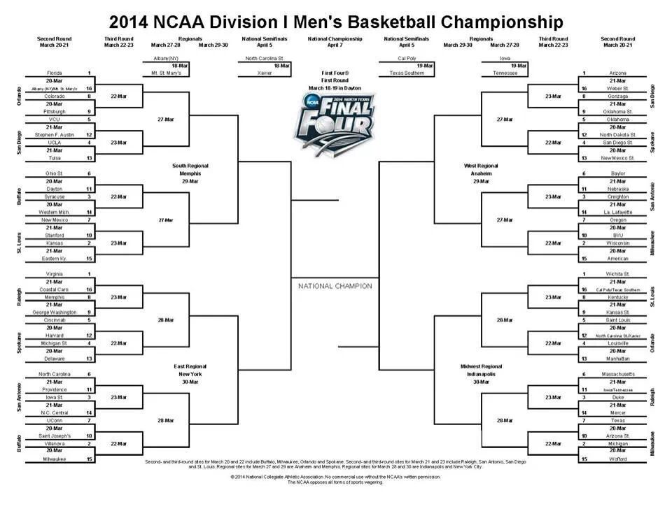
Variable 2-40 RIGHT
Florida
Florida
Arizona
Arizona
Pittsburgh
Florida
Arizona
Gonzaga
VCU
Oklahoma
UCLA
UCLA
Florida
Arizona
Oklahoma
San Diego St.
Ohio State
Syracuse
Creighton
Baylor
Florida
Syracuse
Creighton
New Mexico
Kansas
Wisconsin
Oregon
Kansas
Kansas
Wisconsin
Wisconsin
Virginia
Louisville
Virginia
Wichita St.
Wichita St.
Memphis
Virginia
Louisville
Kentucky
Cincinnati
Saint Louis
Michigan State
Louisville
Louisville
Louisville
Michigan State
North Carolina
Virginia
Louisville
Tennessee
Iowa St
Tennessee
Iowa St
Duke
UConn
Villanova
Michigan
Texas
Villanova
Villanova
Michigan
Michigan

Slide 7
Variable 3-42 RIGHT
Florida
Florida
Arizona
Arizona
Pittsburgh
Florida
Arizona
Gonzaga
VCU
Oklahoma
UCLA
UCLA
Florida
Arizona
San Diego St.
San Diego St.
Ohio State
Syracuse
Creighton
Baylor
Florida
Syracuse
Creighton
New Mexico
Syracuse
Wisconsin
Oregon
Kansas
Kansas
Wisconsin
Wisconsin
Virginia
Louisville
Virginia
Wichita St.
Wichita St.
Memphis
Virginia
Louisville
Kentucky
Cincinnati
Saint Louis
Michigan State
Louisville
Louisville
Louisville
Michigan State
North Carolina
UConn
Louisville
Tennessee
Iowa St
Duke
Iowa St
Duke
UConn
UConn
Duke
Texas
Villanova
UConn
Michigan
Michigan

Slide 8
Variable 4-42 RIGHT
Florida
Florida
Arizona
Arizona
Pittsburgh
Florida
Arizona
Gonzaga
SFA
Oklahoma
UCLA
SFA
Florida
Arizona
San Diego St.
San Diego St.
Dayton
Syracuse
Creighton
Baylor
Florida
Syracuse
Creighton
New Mexico
Syracuse
Wisconsin
Oregon
Kansas
New Mexico
Wisconsin
Wisconsin
Virginia
Florida
Virginia
Wichita St.
Wichita St.
George Washington
Virginia
Wichita St.
Kentucky
Cincinnati
Saint Louis
Michigan State
Wichita St.
Louisville
Louisville
Michigan State
North Carolina
UConn
Wichita St.
Mass.
Iowa St
Duke
Iowa St
Duke
UConn
UConn
Michigan
Texas
Villanova
UConn
Michigan
Michigan

Slide 9
Variable 5-35 RIGHT
Florida
Pittsburgh
Arizona
Arizona
Pittsburgh
Pittsburgh
Arizona
Oklahoma St.
SFA
Oklahoma
UCLA
UCLA
Kansas
Creighton
Oklahoma
San Diego St.
Dayton
Syracuse
Creighton
Baylor
Kansas
Syracuse
Creighton
New Mexico
Kansas
Creighton
Oregon
Kansas
Kansas
Wisconsin
Wisconsin
Virginia
Michigan
Virginia
Kentucky
Wichita St.
Memphis
Michigan St.
Kentucky
Kentucky
NC St.
Michigan St.
Michigan St.
Michigan
NC St.
Louisville
Providence
Michigan St.
Michigan
Duke
Tennessee
Providence
Iowa St
Duke
Saint Joseph
Providence
Michigan
Texas
Villanova
Villanova
Michigan
Michigan

Slide 10
Variable 6-40 RIGHT
Florida
Florida
Arizona
Arizona
Colorado
Florida
Arizona
Gonzaga
VCU
Oklahoma
UCLA
VCU
Ohio State
Arizona
San Diego St.
San Diego St.
Ohio State
Ohio State
Baylor
Baylor
Ohio State
Syracuse
Creighton
Stanford
Ohio State
Wisconsin
Oregon
Kansas
Kansas
Wisconsin
Wisconsin
Ohio State
Virginia
Virginia
Kentucky
Wichita St.
Memphis
Virginia
Louisville
Kentucky
Cincinnati
Saint Louis
Cincinnati
Arizona
Louisville
Louisville
Delaware
North Carolina
UConn
Louisville
Tennessee
North Carolina
Tennessee
Iowa St
Duke
UConn
UConn
Tennessee
Arizona St.
Villanova
UConn
Arizona St.
Michigan

Slide 11
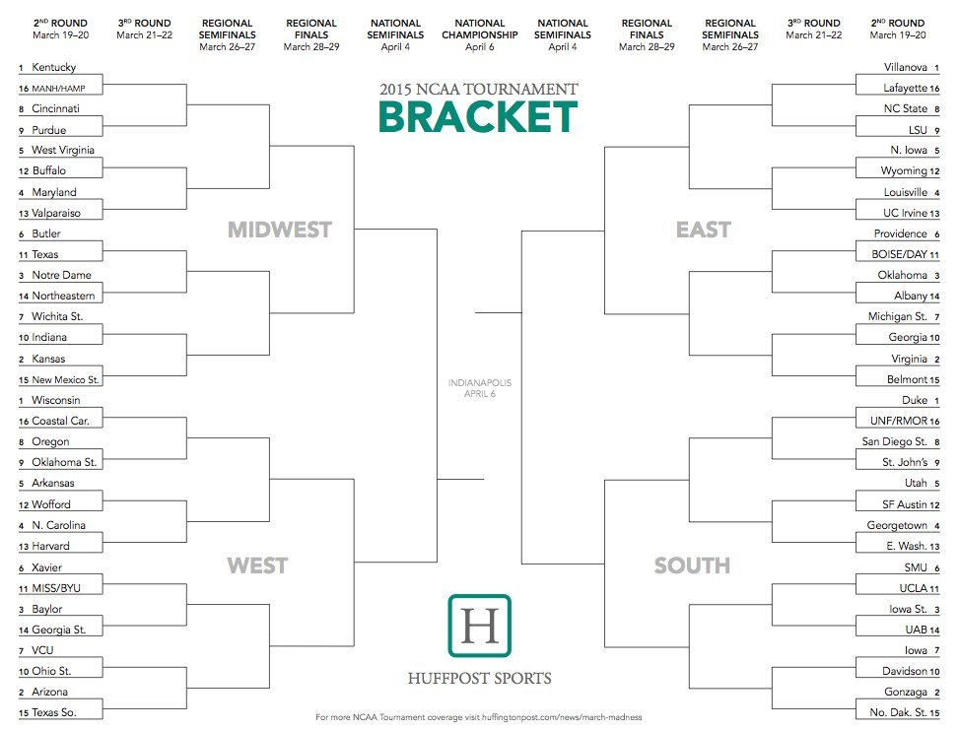
Variable 2-46 RIGHT
Kentucky
Villanova
Kentucky
Villanova
Purdue
Kentucky
Villanova
NC State
West Virginia
N. Iowa
West Virginia
N. Iowa
Maryland
Kentucky
Villanova
Louisville
Butler
Providence
Notre Dame
Oklahoma
Notre Dame
Duke
Oklahoma
Wichita St.
Notre Dame
Virginia
Michigan St.
Kansas
Virginia
Kansas
Virginia
Wisconsin
Kentucky
Duke
Wisconsin
Duke
Oregon
Wisconsin
Duke
St. John’s
Arkansas
Kentucky
Utah
North Carolina
Utah
North Carolina
Georgetown
Xavier
Wisconsin
Duke
SMU
Baylor
Iowa St
Baylor
Iowa St
Ohio St.
Arizona
Gonzaga
Iowa
Arizona
Gonzaga
Arizona
Gonzaga

Slide 12
Variable 3-49 RIGHT
Kentucky
Villanova
Kentucky
Villanova
Cincinnati
Kentucky
Villanova
LSU
West Virginia
N. Iowa
West Virginia
Louisville
Maryland
Kentucky
Villanova
Louisville
Butler
Providence
Notre Dame
Oklahoma
Notre Dame
Duke
Oklahoma
Wichita St.
Notre Dame
Virginia
Michigan St.
Kansas
Duke
Virginia
Kansas
Virginia
Wisconsin
Duke
Wisconsin
Duke
Oregon
Wisconsin
Duke
San Diego St.
Arkansas
Kentucky
Utah
North Carolina
Utah
North Carolina
Georgetown
Xavier
Wisconsin
Duke
SMU
Baylor
Iowa St
Baylor
Iowa St
Ohio St.
Arizona
Gonzaga
Iowa
Arizona
Gonzaga
Arizona
Gonzaga

Slide 13
Variable 4-45 RIGHT
Kentucky
Villanova
Kentucky
Villanova
Cincinnati
Kentucky
Villanova
NC State
West Virginia
N. Iowa
Maryland
N. Iowa
Maryland
Kentucky
Villanova
Louisville
Butler
Dayton
Notre Dame
Dayton
Notre Dame
Duke
Oklahoma
Wichita St.
Notre Dame
Virginia
Michigan St.
Wichita St.
Virginia
Kansas
Virginia
Wisconsin
Kentucky
Duke
Wisconsin
Duke
Oregon
Wisconsin
Duke
San Diego St.
Arkansas
Kentucky
Utah
Arkansas
Utah
North Carolina
E. Wash
Xavier
Wisconsin
Duke
SMU
Georgia St.
SMU
Georgia St.
Iowa St
VCU
Arizona
Gonzaga
Davidson
Arizona
Gonzaga
Arizona
Gonzaga

Slide 14
Variable 5-44 RIGHT
Kentucky
Villanova
Kentucky
Villanova
Purdue
Kentucky
Villanova
NC State
West Virginia
N. Iowa
West Virginia
N. Iowa
Maryland
Notre Dame
Villanova
Louisville
Texas
Providence
Notre Dame
Providence
Notre Dame
Duke
Oklahoma
Indiana
Notre Dame
Michigan St.
Michigan St.
Indiana
Michigan St.
Kansas
Virginia
Wisconsin
Wisconsin
Duke
Wisconsin
Duke
Oregon
Wisconsin
Duke
St. John’s
Arkansas
Wisconsin
Utah
North Carolina
Georgetown
North Carolina
Georgetown
Xavier
Wisconsin
Duke
UCLA
Baylor
Iowa St
Baylor
Iowa St
Ohio St.
Baylor
Gonzaga
Iowa
Arizona
Gonzaga
Arizona
Gonzaga

Slide 15
Variable 6-44 RIGHT
Kentucky
Villanova
Kentucky
LSU
Cincinnati
Kentucky
Louisville
LSU
West Virginia
N. Iowa
Maryland
Louisville
Maryland
Kentucky
Virginia
Louisville
Butler
Providence
Butler
Oklahoma
Notre Dame
Duke
Oklahoma
Wichita St.
Kansas
Virginia
Georgia
Kansas
Duke
Virginia
Kansas
Virginia
Wisconsin
Duke
Wisconsin
Duke
Oklahoma St.
Wisconsin
Duke
San Diego St.
Arkansas
Kentucky
Utah
North Carolina
Utah
North Carolina
Georgetown
Xavier
Wisconsin
Duke
UCLA
Baylor
Iowa St
Baylor
Iowa St
Ohio St.
Arizona
Iowa
Iowa
Arizona
Iowa
Arizona
Gonzaga

Slide 16
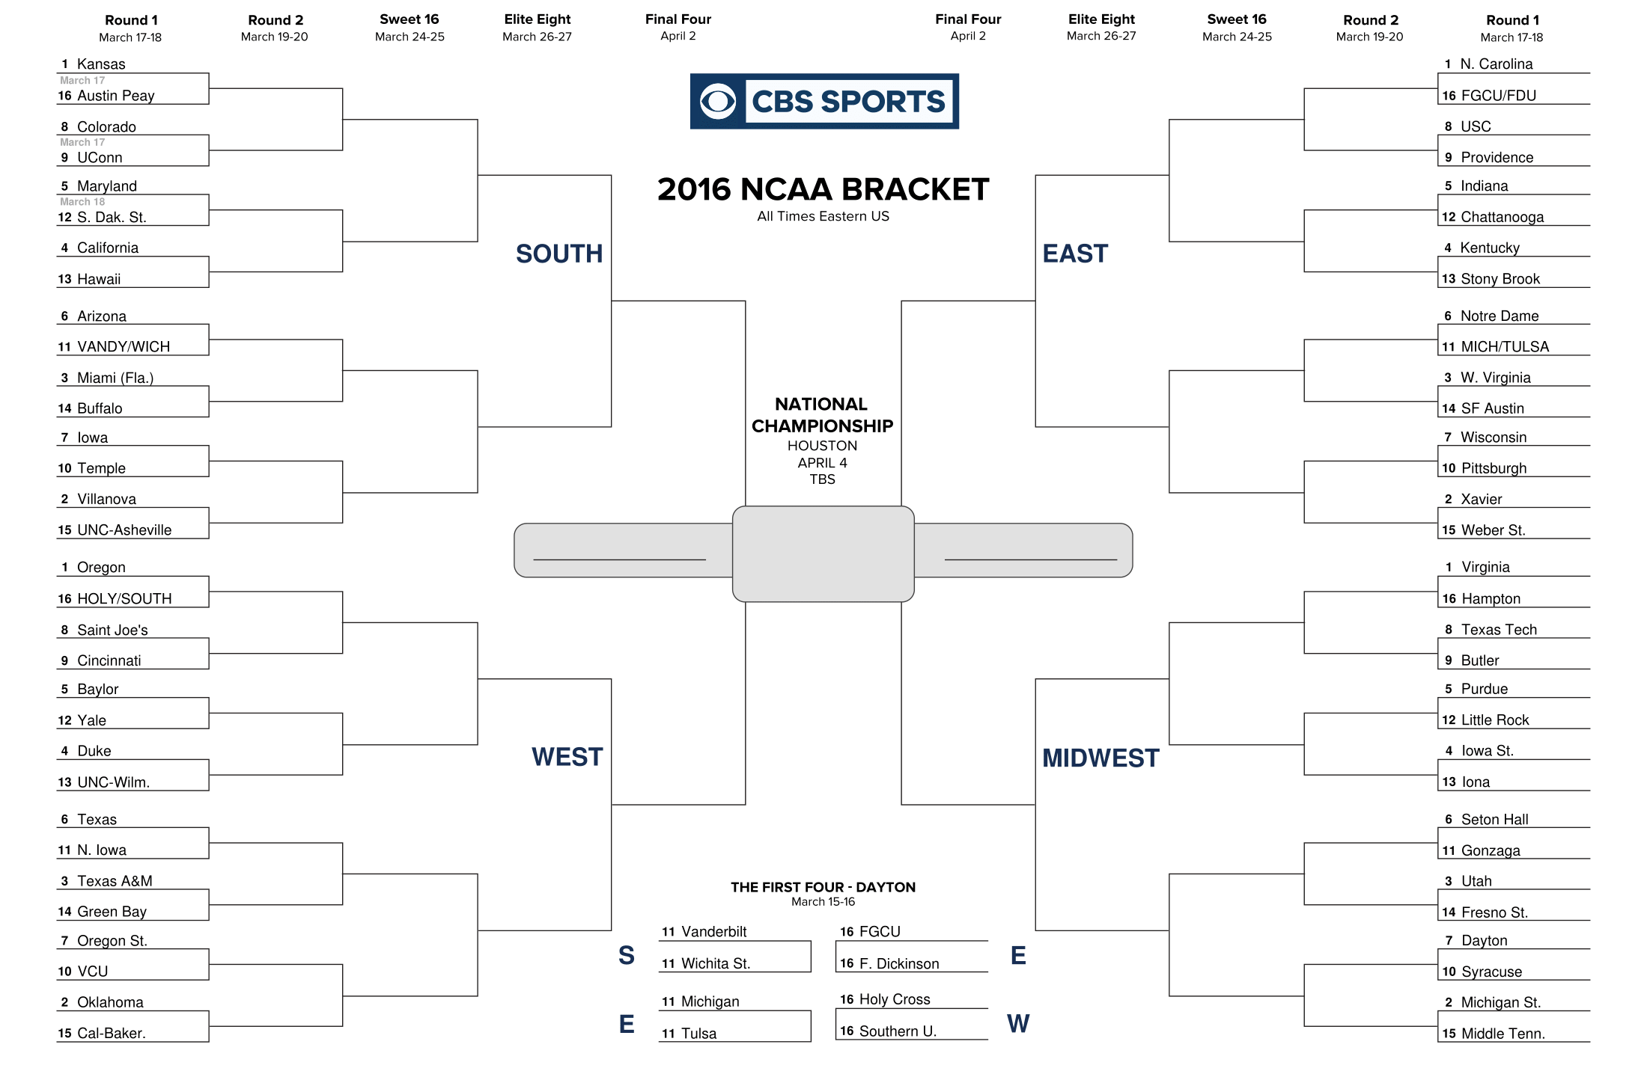
Variable 2-47 RIGHT
North Carolina
Kansas
North Carolina
Kansas
North Carolina
USC
UConn
Kansas
Maryland
Indiana
California
Villanova
North Carolina
Kentucky
California
Kentucky
WICH
Notre Dame
Miami
West Virginia
Miami
West Virginia
Iowa
Villanova
West Virginia
Pittsburgh
Villanova
Villanova
North Carolina
Xavier
Villanova
Villanova
Xavier
Oregon
Virginia
Oregon
Virginia
Saint Joe’s
Oregon
Virginia
Butler
Baylor
Purdue
Duke
Duke
Purdue
Iowa St.
Texas
Oklahoma
Virginia
Gonzaga
Texas A&M
Gonzaga
Texas A&M
Utah
VCU
Oklahoma
Michigan St.
Syracuse
Oklahoma
Michigan St.
Oklahoma
Michigan St.

Slide 17
Variable 3-48 RIGHT
North Carolina
Kansas
North Carolina
Kansas
North Carolina
USC
UConn
Kansas
Maryland
Indiana
Maryland
Villanova
North Carolina
Kentucky
California
Kentucky
Wich
Notre Dame
Miami
West Virginia
Miami
West Virginia
Iowa
Villanova
Xavier
Wisconsin
Villanova
Villanova
North Carolina
Xavier
Villanova
Villanova
Xavier
Oregon
Virginia
Oregon
Virginia
Saint Joe’s
Duke
Virginia
Butler
Baylor
Purdue
Duke
Duke
Iowa St.
Iowa St.
Northern Iowa
Oklahoma
Virginia
Gonzaga
Texas A&M
Gonzaga
Texas A&M
Utah
VCU
Oklahoma
Michigan St.
Syracuse
Oklahoma
Michigan St.
Oklahoma
Michigan St.

Slide 18
Variable 4-50 RIGHT
North Carolina
Kansas
North Carolina
Kansas
North Carolina
Providence
UConn
Kansas
Maryland
Indiana
Maryland
Villanova
North Carolina
Indiana
Hawaii
Kentucky
Arizona
Notre Dame
Miami
West Virginia
Miami
West Virginia
Iowa
Villanova
Xavier
Wisconsin
Villanova
Villanova
North Carolina
Xavier
Villanova
Villanova
Xavier
Oregon
Virginia
Oregon
Virginia
Saint Joe’s
Oregon
Virginia
Butler
Yale
Little Rock
Duke
Duke
Iowa St.
Iowa St.
Northern Iowa
Oregon
Virginia
Gonzaga
Texas A&M
Utah
Texas A&M
Utah
VCU
Oklahoma
Michigan St.
Dayton
Oklahoma
Michigan St.
Oklahoma
Michigan St.

Slide 19
Variable 5-45 RIGHT
North Carolina
Kansas
North Carolina
Kansas
North Carolina
USC
UConn
Kansas
Maryland
Indiana
Maryland
Villanova
North Carolina
Kentucky
California
Kentucky
WICH
Notre Dame
Miami
West Virginia
Miami
West Virginia
Iowa
Villanova
West Virginia
Pittsburgh
Villanova
Villanova
North Carolina
Xavier
Villanova
Xavier
Oregon
North Carolina
Virginia
Oregon
Virginia
Saint Joe’s
Duke
Virginia
Butler
Baylor
Purdue
Duke
Duke
Purdue
Iowa St.
Texas
Oklahoma
Virginia
Gonzaga
Texas A&M
Gonzaga
Texas A&M
Utah
VCU
Oklahoma
Michigan St.
Dayton
Oklahoma
Michigan St.
Oklahoma
Michigan St.

Slide 20
Variable 6-37 RIGHT
North Carolina
Kansas
Providence
Kansas
Providence
Providence
Colorado
Kansas
Maryland
Indiana
California
Villanova
Wisconsin
Kentucky
California
Kentucky
Arizona
Michigan
Miami
West Virginia
Miami
West Virginia
Iowa
Villanova
Wisconsin
Wisconsin
Villanova
Villanova
Wisconsin
Villanova
Syracuse
Xavier
Oregon
Syracuse
Virginia
Cincinnati
Virginia
Cincinnati
Duke
Virginia
Texas Tech
Baylor
Purdue
Duke
Duke
Iowa St.
Iowa St.
Texas
Oklahoma
Syracuse
Seton Hall
Texas A&M
Seton Hall
Texas A&M
Utah
VCU
Oklahoma
Syracuse
Syracuse
Oklahoma
Syracuse
Oklahoma
Michigan St.

Slide 21
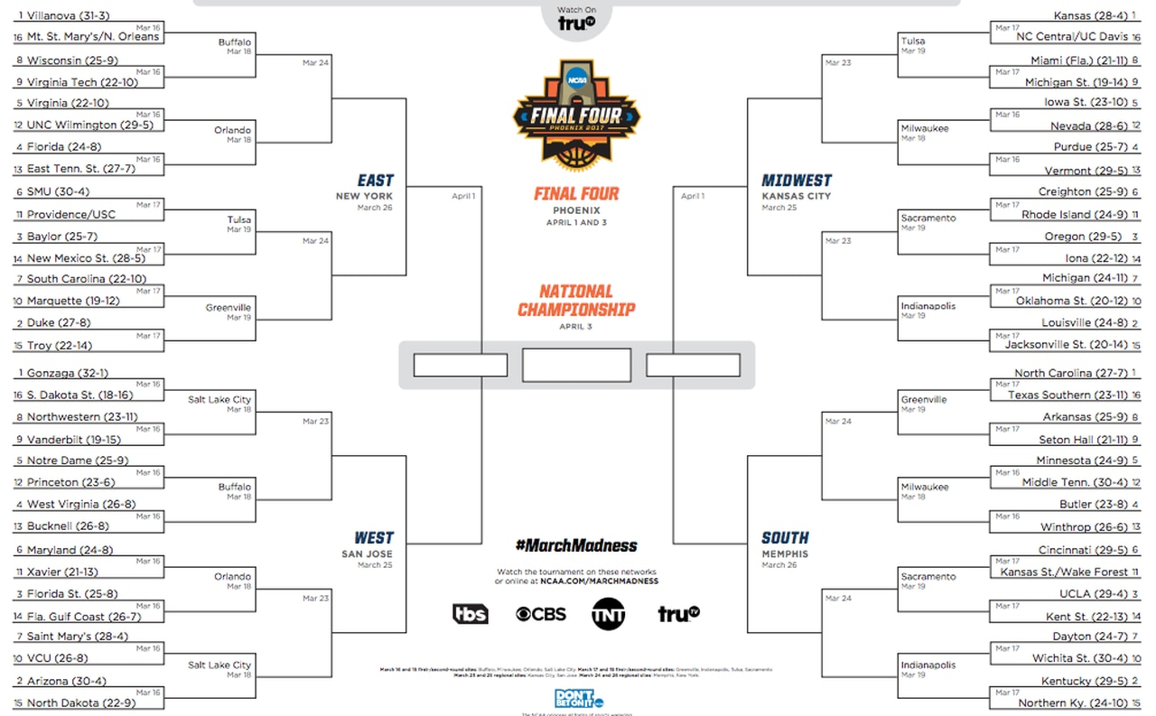
Villanova
Variable 2-43 RIGHT
Kansas
Villanova
Kansas
Wisconsin
Villanova
Kansas
Miami(Fla.)
Virginia
Iowa St.
Florida
Iowa St.
Florida
Villanova
Kansas
Purdue
SMU
Creighton
SMU
Oregon
Baylor
Oregon
Marquette
Duke
Louisville
Michigan
Duke
Louisville
Duke
Louisville
Gonzaga
Gonzaga
North Carolina
North Carolina
Gonzaga
Gonzaga
North Carolina
Vanderbilt
Gonzaga
North Carolina
Arkansas
Notre Dame
Minnesota
West Virginia
Butler
West Virginia
Butler
Xavier
Gonzaga
North Carolina
Cincinnati
Florida St.
UCLA
Florida St.
UCLA
Saint Mary’s
Saint Mary’s
Kentucky
Wichita St.
Saint Mary’s
Kentucky
Arizona
Kentucky

Slide 22
Villanova
Variable 3-48 RIGHT
Kansas
Villanova
Kansas
Wisconsin
Villanova
Kansas
Miami(Fla.)
Virginia
Iowa St.
Florida
Purdue
Florida
Villanova
Oregon
Purdue
SMU
Creighton
SMU
Oregon
Baylor
Oregon
South Carolina
Duke
Oregon
Michigan
Duke
Michigan
Duke
Louisville
Gonzaga
Gonzaga
North Carolina
North Carolina
Gonzaga
Gonzaga
North Carolina
Vanderbilt
Gonzaga
North Carolina
Arkansas
Notre Dame
Minnesota
West Virginia
Butler
West Virginia
Butler
Xavier
Gonzaga
North Carolina
Cincinnati
Florida St.
UCLA
Florida St.
UCLA
Saint Mary’s
Saint Mary’s
Kentucky
Wichita St.
Saint Mary’s
Kentucky
Arizona
Kentucky

Slide 23
Villanova
Variable 4-40 RIGHT
Kansas
Villanova
Kansas
Wisconsin
Villanova
Kansas
Miami(Fla.)
UNC Wilmington
Nevada
UNC Wilmington
Vermont
Florida
Villanova
Oregon
Vermont
SMU
Creighton
SMU
Oregon
New Mexico St.
Oregon
South Carolina
SMU
Oregon
Michigan
Duke
Michigan
Duke
Louisville
Gonzaga
Gonzaga
Oregon
North Carolina
Gonzaga
Gonzaga
North Carolina
Northwestern
Gonzaga
North Carolina
Arkansas
Notre Dame
Middle Tenn.
West Virginia
Middle Tenn.
West Virginia
Winthrop
Maryland
Gonzaga
North Carolina
Cincinnati
Florida St.
UCLA
Florida St.
UCLA
Saint Mary’s
Arizona
Kentucky
Wichita St.
Arizona
Kentucky
Arizona
Kentucky

Slide 24
Villanova
Variable 5-40 RIGHT
Kansas
Villanova
Kansas
Wisconsin
Villanova
Kansas
Miami(Fla.)
UNC Wilmington
Iowa St.
Florida
Iowa St.
Florida
Villanova
Oklahoma St.
Purdue
SMU
Rhode Island
Baylor
Oregon
Baylor
Oregon
Marquette
Baylor
Oklahoma St.
Oklahoma St.
Duke
Oklahoma St.
Duke
Louisville
Villanova
Oklahoma St.
Oklahoma St.
North Carolina
Gonzaga
Gonzaga
North Carolina
Northwestern
Notre Dame
North Carolina
Arkansas
Notre Dame
Middle Tenn.
Notre Dame
Butler
West Virginia
Butler
Xavier
Saint Mary’s
North Carolina
Cincinnati
Xavier
UCLA
Florida St.
UCLA
Saint Mary’s
Saint Mary’s
UCLA
Wichita St.
Saint Mary’s
Kentucky
Arizona
Kentucky

Slide 25
Villanova
Variable 6-43 RIGHT
Kansas
Villanova
Miami(Fla.)
Wisconsin
Florida
Miami(Fla.)
Miami(Fla.)
Virginia
Iowa St.
Florida
Purdue
Florida
Florida
Michigan
Purdue
USC
Creighton
Baylor
Creighton
Baylor
Oregon
South Carolina
South Carolina
Michigan
Michigan
South Carolina
Michigan
Duke
Louisville
Gonzaga
Gonzaga
Kentucky
North Carolina
Gonzaga
Gonzaga
North Carolina
Vanderbilt
Gonzaga
Minnesota
Seton Hall
Notre Dame
Minnesota
West Virginia
Minnesota
West Virginia
Butler
Xavier
Gonzaga
Kentucky
Kansas St.
Xavier
Kansas St.
Florida St.
UCLA
Saint Mary’s
Arizona
Kentucky
Wichita St.
Arizona
Kentucky
Arizona
Kentucky

Slide 26
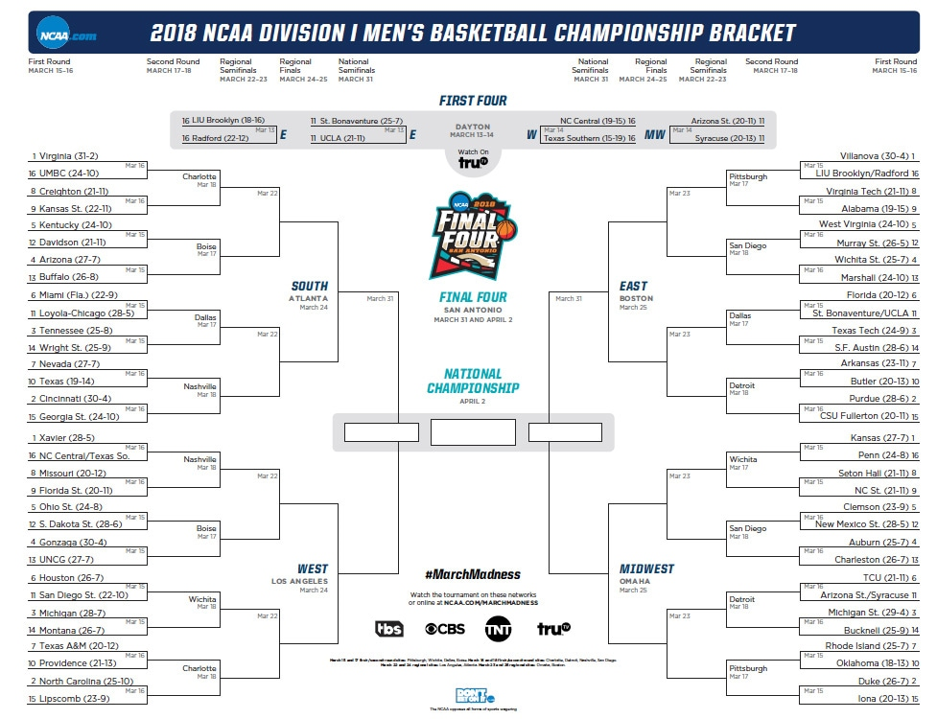
Variable 2-39 RIGHT
Virginia
Villanova
Virginia
Villanova
Creighton
Virginia
Villanova
Virginia Tech
Kentucky
West Virginia
Kentucky
Villanova
West Virginia
Arizona
Virginia
Wichita St.
Miami(Fla.)
Florida
Tennessee
Florida
Tennessee
Texas Tech
Nevada
Cincinnati
Purdue
Butler
Cincinnati
Purdue
Cincinnati
Virginia
Villanova
Villanova
Purdue
Xavier
Kansas
Xavier
Kansas
Florida St.
Xavier
Kansas
Seton Hall
Ohio St.
Clemson
Gonzaga
Clemson
Gonzaga
Auburn
Houston
North Carolina
Duke
TCU
Michigan
Michigan St.
Michigan
Michigan St.
Texas A&M
North Carolina
Duke
Oklahoma
North Carolina
Duke
North Carolina
Duke

Slide 27
Variable 3-48 RIGHT
Virginia
Villanova
Virginia
Villanova
Kansas St.
Virginia
Villanova
Virginia Tech
Kentucky
West Virginia
Kentucky
Villanova
West Virginia
Arizona
Virginia
Marshall
Loyal-Chicago
Florida
Tennessee
Texas Tech
Tennessee
Texas Tech
Nevada
Cincinnati
Purdue
Butler
Cincinnati
Purdue
Cincinnati
Michigan
Villanova
Villanova
Purdue
Xavier
Kansas
Xavier
Kansas
Florida St.
Gonzaga
Kansas
Seton Hall
Ohio St.
Clemson
Gonzaga
Clemson
Gonzaga
Auburn
Houston
Michigan
Duke
Syracuse
Michigan
Michigan St.
Michigan
Michigan St.
Texas A&M
Michigan
Duke
Rhode Island
North Carolina
Duke
North Carolina
Duke

Slide 28
Variable 4-39 RIGHT
Virginia
Villanova
Virginia
Villanova
Kansas St.
Virginia
Villanova
Virginia Tech
Kentucky
West Virginia
Arizona
West Virginia
Arizona
Cincinnati
Villanova
Wichita St.
Loyal-Chicago
St. Bonaventure
Loyal-Chicago
S.F. Austin
Tennessee
S.F. Austin
Nevada
Cincinnati
Purdue
Arkansas
Cincinnati
Purdue
Cincinnati
Michigan
Villanova
Villanova
Purdue
Xavier
Kansas
Xavier
Kansas
Florida St.
Gonzaga
Kansas
Seton Hall
S. Dakota St.
New Mexico St.
Gonzaga
New Mexico St.
Gonzaga
Charleston
Houston
Michigan
Kansas
Syracuse
Michigan
Michigan St.
Michigan
Michigan St.
Texas A&M
Michigan
Michigan St.
Rhode Island
North Carolina
Duke
North Carolina
Duke

Slide 29
Variable 5-37 RIGHT
Virginia
Villanova
Virginia
Villanova
Creighton
Virginia
Villanova
Virginia Tech
Davidson
West Virginia
Arizona
Villanova
West Virginia
Arizona
Virginia
Wichita St.
Miami(Fla.)
Florida
Tennessee
Florida
Tennessee
Texas Tech
Nevada
Tennessee
Purdue
Butler
Nevada
Purdue
Cincinnati
N. Carolina
Villanova
Villanova
Purdue
Xavier
Kansas
Xavier
Kansas
Florida St.
Xavier
Kansas
Seton Hall
Ohio St.
Clemson
Ohio St.
Clemson
Gonzaga
Auburn
Houston
North Carolina
Duke
TCU
Michigan
TCU
Michigan
Michigan St.
Texas A&M
North Carolina
Duke
Oklahoma
North Carolina
Duke
North Carolina
Duke

Slide 30
Variable 6-36 RIGHT
Virginia
Villanova
Virginia
Villanova
Kansas St.
Virginia
Villanova
Alabama
Kentucky
West Virginia
Kentucky
Marshall
Arizona
Virginia
Florida
Marshall
Miami(Fla.)
Florida
Tennessee
Florida
Tennessee
Texas Tech
Texas
Texas
Florida
Butler
Texas
Purdue
Cincinnati
Virginia
Duke
Duke
Purdue
Xavier
Kansas
Missouri
Kansas
Missouri
Ohio St.
Kansas
Seton Hall
Ohio St.
Clemson
Ohio St.
Clemson
Gonzaga
Auburn
San Diego St.
Michigan
Duke
Syracuse
Michigan
Syracuse
Michigan
Michigan St.
Providence
Michigan
Duke
Oklahoma
Providence
Duke
North Carolina
Duke

Slide 31
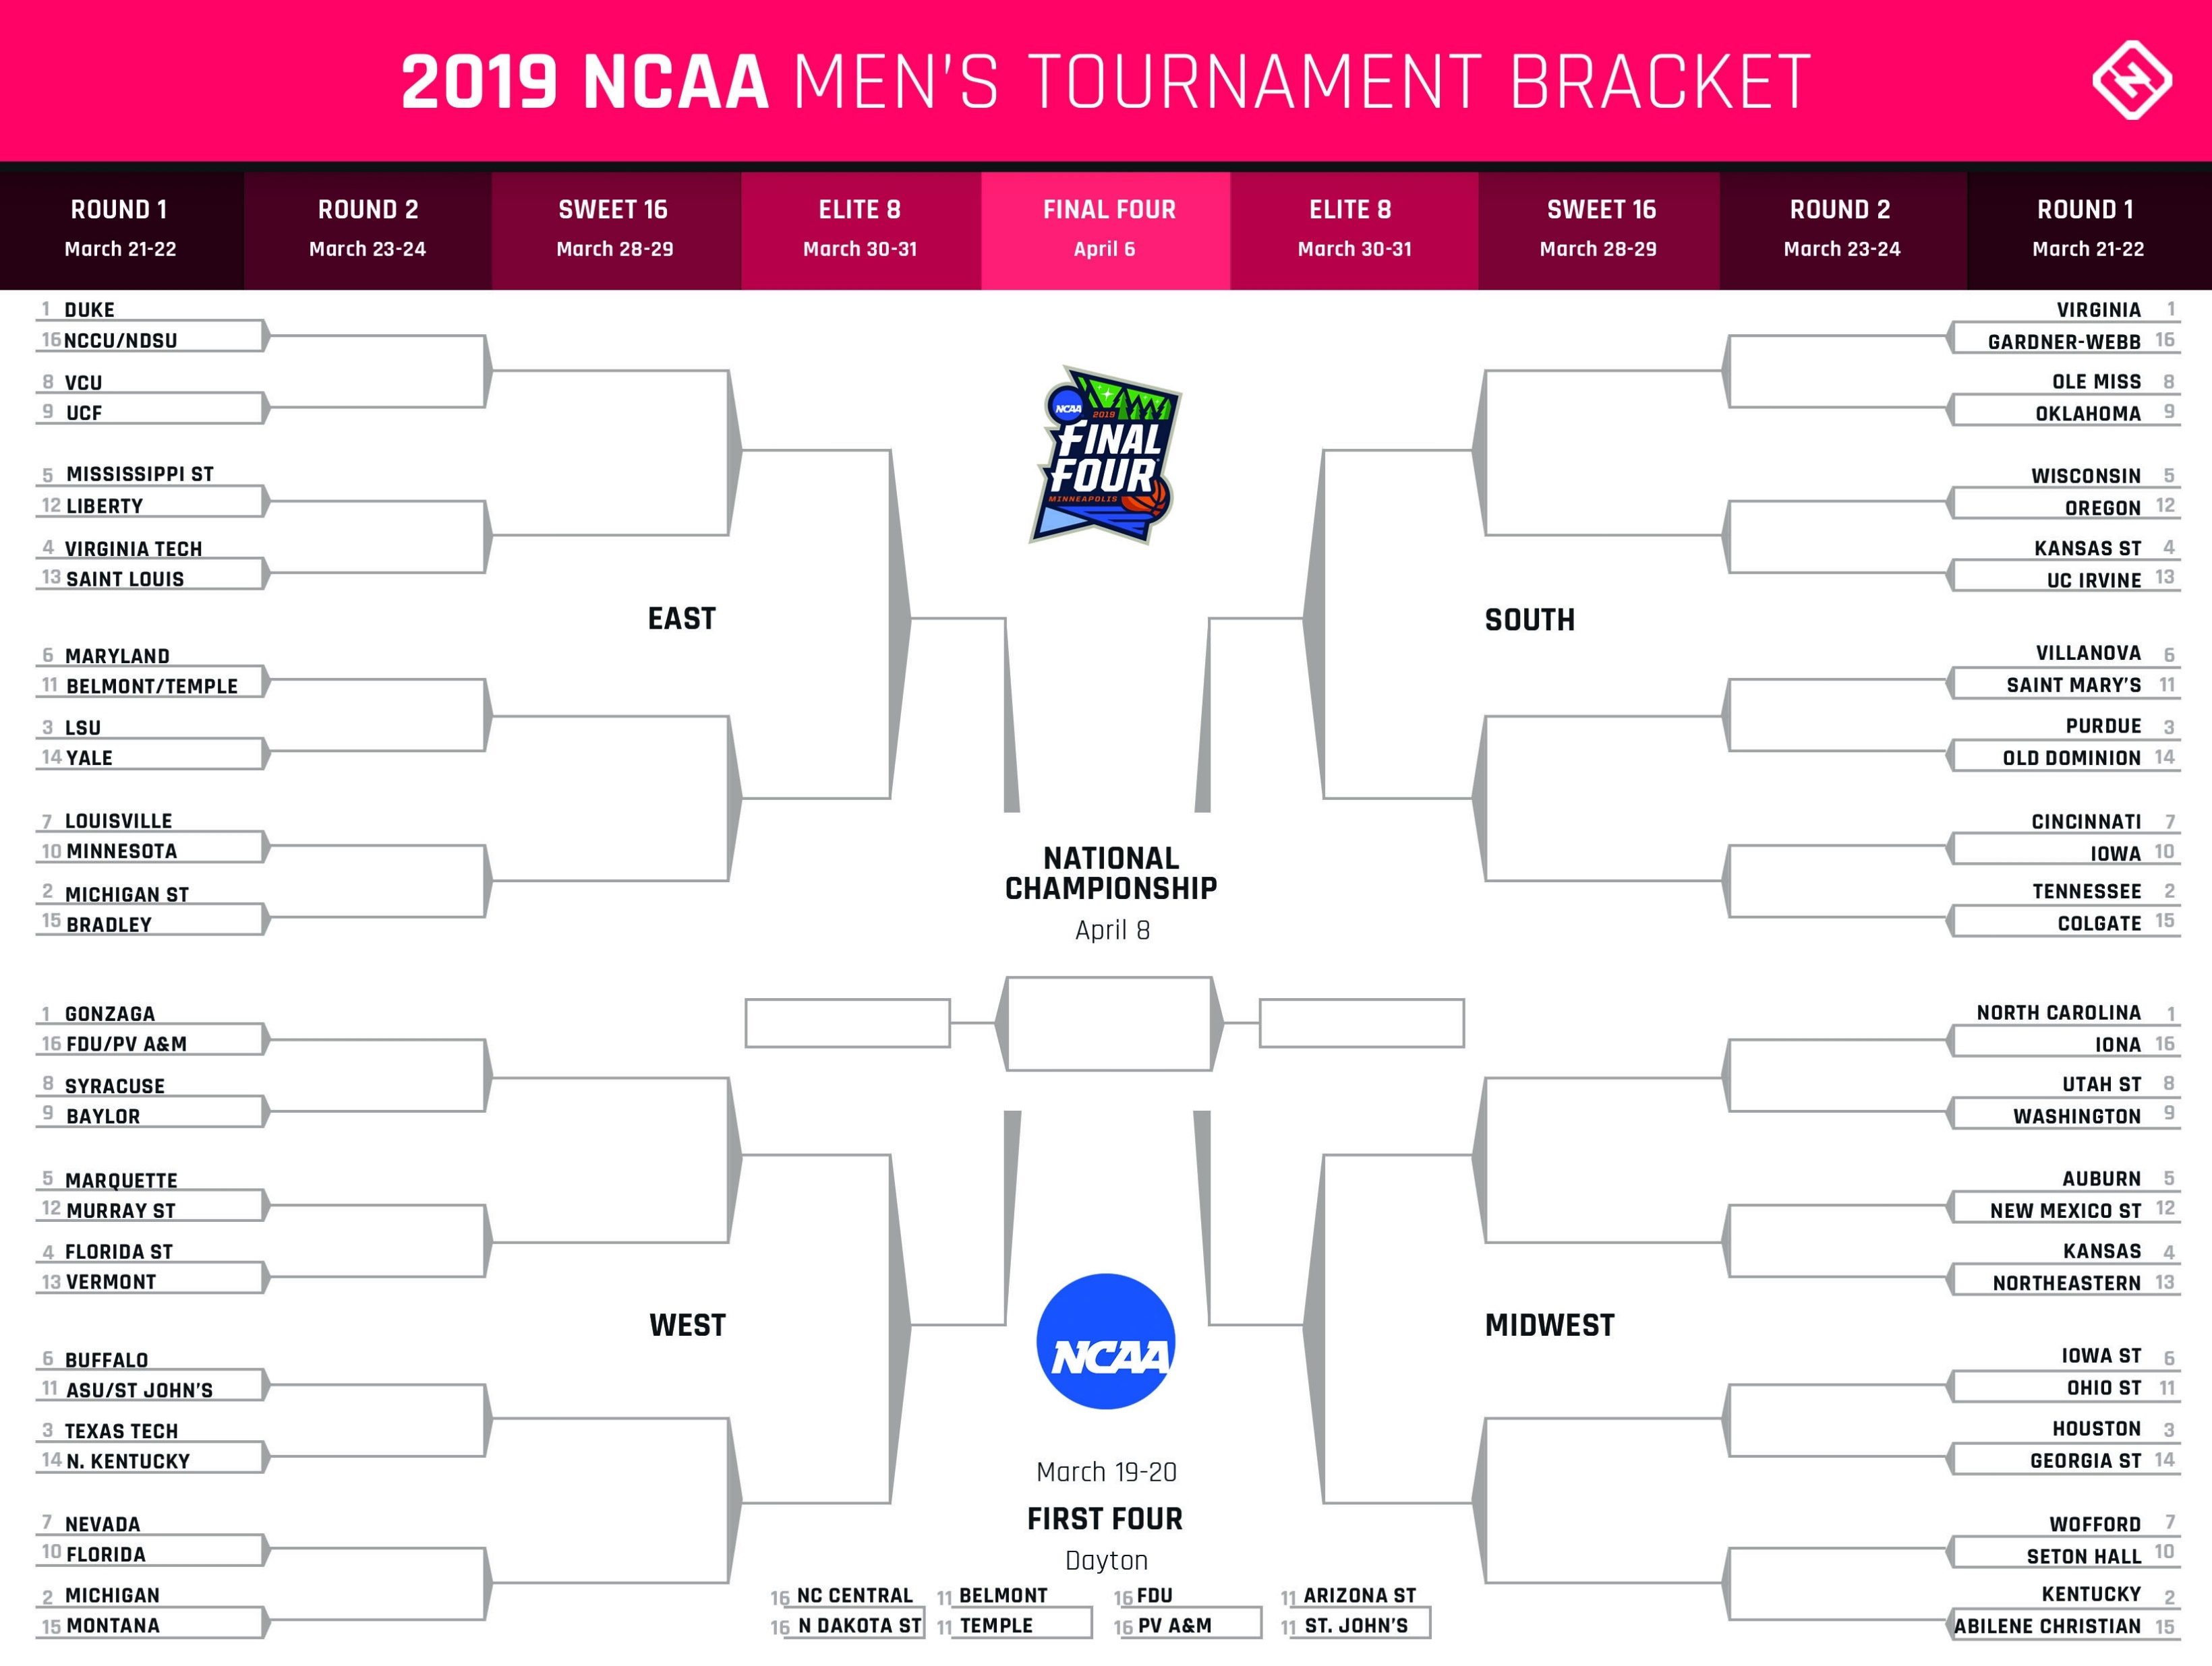
Variable 2-46 RIGHT
Duke
Virginia
Duke
Virginia
UCF
Duke
Virginia
Oklahoma
Mississippi St.
Wisconsin
Virginia Tech
Virginia
Kansas St.
Virginia Tech
Duke
Kansas St.
Maryland
LSU
Saint Mary’s
Purdue
LSU
Purdue
Louisville
Michigan St.
Purdue
Cincinnati
Michigan St.
Tennessee
Michigan St.
Tennessee
Gonzaga
Gonzaga
Gonzaga
Virginia
North Carolina
Gonzaga
North Carolina
Syracuse
Gonzaga
North Carolina
Utah St.
Marquette
Auburn
Florida St.
Auburn
Florida St.
Kansas
Buffalo
Gonzaga
North Carolina
Iowa St.
Texas Tech
Houston
Texas Tech
Houston
Florida
Texas Tech
Kentucky
Wofford
Michigan
Michigan
Kentucky
Kentucky

Slide 32
Variable 3-51 RIGHT
Duke
Virginia
Duke
Virginia
VCU
Duke
Virginia
Oklahoma
Mississippi St.
Oregon
Virginia Tech
Virginia Tech
Virginia
Oregon
Duke
Kansas St.
Maryland
LSU
Villanova
Purdue
LSU
Purdue
Louisville
Michigan St.
Purdue
Cincinnati
Michigan St.
Tennessee
Michigan St.
Tennessee
Gonzaga
Gonzaga
Gonzaga
Virginia
North Carolina
Gonzaga
North Carolina
Syracuse
Gonzaga
Auburn
Washington
Murray St.
Auburn
Florida St.
Auburn
Florida St.
Kansas
Buffalo
Gonzaga
Auburn
Iowa St.
Texas Tech
Houston
Texas Tech
Houston
Florida
Texas Tech
Houston
Wofford
Michigan
Michigan
Kentucky
Kentucky

Slide 33
Variable 4-43 RIGHT
Duke
Virginia
Duke
Virginia
VCU
Duke
Virginia
Ole Miss
Liberty
Oregon
Liberty
Virginia
UC Irvine
Virginia Tech
Duke
UC Irvine
Belmont
LSU
Villanova
Purdue
LSU
Purdue
Minnesota
Michigan St.
Tennessee
Cincinnati
Michigan St.
Tennessee
Michigan St.
Tennessee
Gonzaga
Gonzaga
Virginia
Virginia
North Carolina
Gonzaga
North Carolina
Syracuse
Gonzaga
Auburn
Utah St.
Murray St.
Auburn
Florida St.
Auburn
Florida St.
Kansas
Buffalo
Gonzaga
Houston
Iowa St.
Buffalo
Houston
Texas Tech
Houston
Nevada
Buffalo
Houston
Wofford
Michigan
Michigan
Wofford
Kentucky

Slide 34
Variable 5-48 RIGHT
Duke
Virginia
Duke
Virginia
UCF
Duke
Virginia
Ole Miss
Mississippi St.
Oregon
Virginia Tech
Virginia Tech
Virginia
Kansas St.
Duke
Kansas St.
Maryland
LSU
Villanova
Purdue
LSU
Purdue
Louisville
LSU
Purdue
Iowa
Michigan St.
Tennessee
Michigan St.
Tennessee
Gonzaga
Duke
Virginia
Virginia
North Carolina
Gonzaga
North Carolina
Baylor
Gonzaga
Auburn
Utah St.
Marquette
Auburn
Florida St.
Auburn
Florida St.
Kansas
Buffalo
Gonzaga
Auburn
Iowa St.
Texas Tech
Iowa St.
Texas Tech
Houston
Florida
Michigan
Iowa St.
Wofford
Michigan
Michigan
Kentucky
Kentucky

Slide 35
Variable 6-38 RIGHT
Duke
Virginia
Duke
Virginia
VCU
Duke
Wisconsin
Oklahoma
Mississippi St.
Wisconsin
Virginia Tech
Virginia Tech
Wisconsin
Duke
Wisconsin
Kansas St.
Maryland
Saint Mary’s
Maryland
Purdue
LSU
Purdue
Minnesota
Michigan St.
Purdue
Cincinnati
Michigan St.
Tennessee
Michigan St.
Tennessee
Gonzaga
Michigan
Michigan
Wisconsin
North Carolina
Gonzaga
North Carolina
Syracuse
Gonzaga
Kansas
Washington
Marquette
Auburn
Florida St.
Florida St.
Kansas
Kansas
Buffalo
Ohio St.
Texas Tech
Michigan
Kentucky
Ohio St.
Texas Tech
Houston
Florida
Michigan
Kentucky
Seton Hall
Michigan
Michigan
Kentucky
Kentucky

Slide 36
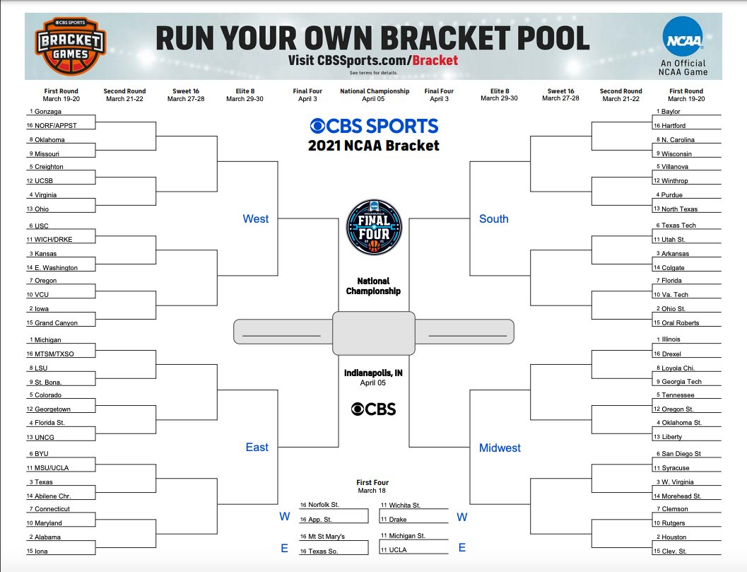
Variable 2-40 RIGHT
Gonzaga
Baylor
Gonzaga
Baylor
Oklahoma
Gonzaga
Baylor
Wisconsin
Creighton
Villanova
Virginia
Gonzaga
Baylor
Villanova
Virginia
Purdue
USC
Texas Tech
USC
Texas Tech
Kansas
Arkansas
Oregon
Iowa
Ohio St.
Florida
Iowa
Ohio St.
Iowa
Gonzaga
Gonzaga
Houston
Ohio St.
Michigan
Illinois
Michigan
Illinois
LSU
Michigan
Illinois
Loyola Chi.
Colorado
Tennessee
Florida St.
Tennessee
Oklahoma St.
Florida St.
BYU
Michigan
Houston
San Diego St.
Texas
San Diego St.
Texas
West Virginia
Connecticut
Alabama
Houston
Rutgers
Alabama
Houston
Alabama
Houston

Slide 37
Variable 3-38 RIGHT
Gonzaga
Baylor
Gonzaga
Baylor
Oklahoma
Gonzaga
Baylor
Wisconsin
Creighton
Villanova
Creighton
Gonzaga
Baylor
Purdue
Virginia
Purdue
USC
Texas Tech
Kansas
Arkansas
Kansas
Arkansas
VCU
Iowa
Ohio St.
Florida
Iowa
Ohio St.
Iowa
Gonzaga
Gonzaga
Houston
Ohio St.
Michigan
Illinois
Michigan
Illinois
LSU
Michigan
Illinois
Loyola Chi.
Colorado
Tennessee
Colorado
Oklahoma St.
Florida St.
Oklahoma St.
BYU
Alabama
Houston
San Diego St.
Texas
West Virginia
Texas
West Virginia
Connecticut
Alabama
Houston
Rutgers
Alabama
Houston
Alabama
Houston

Slide 38
Variable 4-31 RIGHT
Gonzaga
Baylor
Gonzaga
Baylor
Missouri
Gonzaga
Baylor
N. Carolina
UCSB
Winthrop
UCSB
Gonzaga
Arkansas
Winthrop
Virginia
Purdue
Drake
Arkansas
Utah St.
Drake
Kansas
Arkansas
Oregon
Drake
Arkansas
Va. Tech
Iowa
Ohio St.
Iowa
Gonzaga
Houston
Houston
Ohio St.
Michigan
Illinois
Michigan
Illinois
LSU
Colorado
Illinois
Loyola Chi.
Colorado
Tennessee
Colorado
Oklahoma St.
UNCG
Oklahoma St.
BYU
Alabama
Houston
San Diego St.
Abilene Chr.
San Diego St.
Abilene Chr.
Morehead St.
Maryland
Alabama
Houston
Clemson
Alabama
Houston
Alabama
Houston

Slide 39
Variable 5-34 RIGHT
Gonzaga
Baylor
Gonzaga
Baylor
Missouri
Gonzaga
Baylor
Wisconsin
Creighton
Villanova
Virginia
Gonzaga
Ohio St.
Villanova
Virginia
Purdue
USC
Texas Tech
USC
Texas Tech
Kansas
Arkansas
Oregon
Iowa
Ohio St.
Florida
Iowa
Ohio St.
Iowa
Gonzaga
Houston
Houston
Ohio St.
Michigan
Illinois
LSU
Illinois
LSU
LSU
Illinois
Georgia Tech.
Colorado
Tennessee
Florida St.
Oklahoma St.
Florida St.
Oklahoma St.
BYU
LSU
Houston
Syracuse
Texas
West Virginia
Texas
Connecticut
West Virginia
Connecticut
Houston
Clemson
Connecticut
Houston
Alabama
Houston

Slide 40
Variable 6-28 RIGHT
Gonzaga
Baylor
Gonzaga
Wisconsin
Oklahoma
Gonzaga
Wisconsin
Wisconsin
Creighton
Villanova
Creighton
Purdue
Virginia
Kansas
Wisconsin
Purdue
USC
Texas Tech
Kansas
Arkansas
Kansas
Arkansas
VCU
Kansas
Arkansas
Florida
VCU
Florida
Iowa
Alabama
Alabama
Wisconsin
Ohio St.
Michigan
Illinois
Michigan
Georgia Tech.
St. Bona.
Georgetown
Oklahoma St.
Georgia Tech.
Georgetown
Tennessee
Georgetown
Oklahoma St.
Florida St.
Oklahoma St.
BYU
Alabama
Rutgers
Syracuse
BYU
West Virginia
Texas
West Virginia
Maryland
Alabama
Rutgers
Rutgers
Alabama
Rutgers
Alabama
Houston

Slide 41
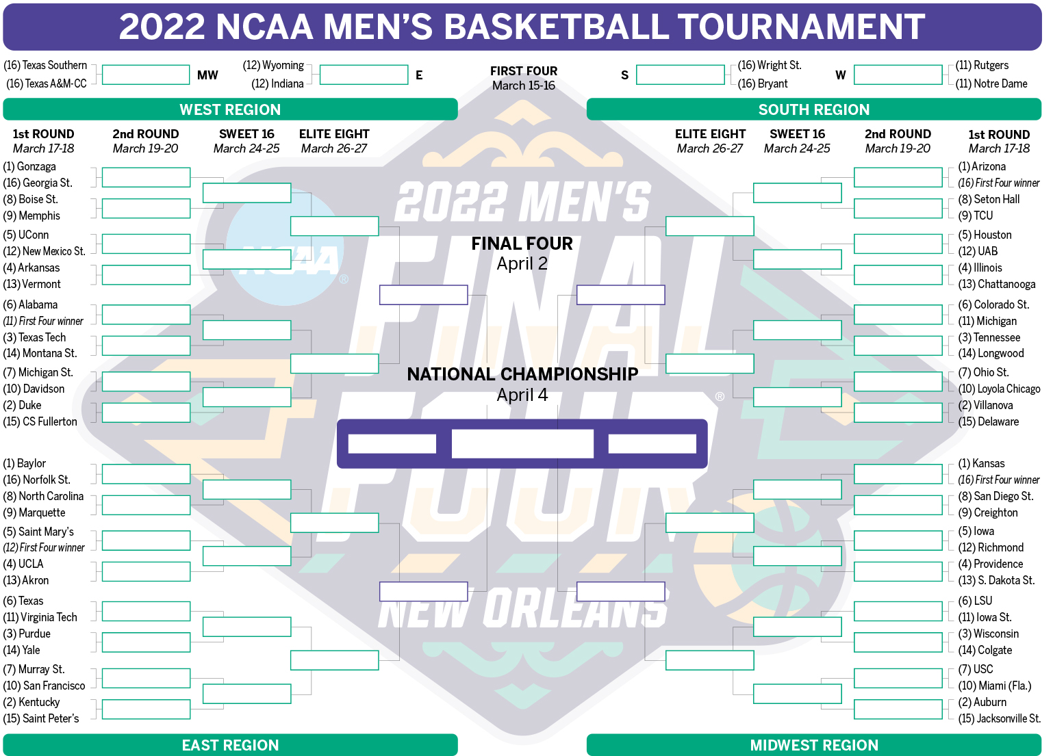
Variable 2-41 RIGHT
Gonzaga
Gonzaga
Arizona
Arizona
Memphis
TCU
Gonzaga
Houston
UConn
Houston
Arkansas
Houston
Arkansas
Illinois
Gonzaga
Houston
Alabama
Tennessee
Michigan
Texas Tech
Texas Tech
Tennessee
Duke
Villanova
Michigan St.
Ohio St.
Duke
Duke
Villanova
Villanova
Gonzaga
Gonzaga
Kansas
Baylor
Kansas
Baylor
Kansas
North Carolina
San Diego St.
Baylor
Kansas
Saint Mary’s
Iowa
UCLA
Iowa
UCLA
Providence
Baylor
Kansas
Texas
LSU
Purdue
LSU
Purdue
Wisconsin
Purdue
Auburn
San Francisco
Miami(Fla.)
Kentucky
Auburn
Kentucky
Auburn

Slide 42
Variable 3-45 RIGHT
Gonzaga
Gonzaga
Arizona
Arizona
Memphis
TCU
Gonzaga
Houston
UConn
Houston
Arkansas
Houston
Illinois
Arkansas
Duke
Houston
Notre Dame
Tennessee
Michigan
Texas Tech
Texas Tech
Tennessee
Duke
Villanova
Michigan St.
Ohio St.
Duke
Duke
Villanova
Villanova
Duke
Kansas
Kansas
Baylor
Kansas
Baylor
Kansas
North Carolina
Creighton
Baylor
Kansas
Saint Mary’s
Iowa
UCLA
Iowa
UCLA
Providence
Baylor
Kansas
Virginia Tech
LSU
Purdue
LSU
Purdue
Wisconsin
Purdue
Auburn
Murray St.
Miami(Fla.)
Kentucky
Auburn
Kentucky
Auburn

Slide 43
Variable 4-38 RIGHT
Gonzaga
Gonzaga
Arizona
Boise St.
Arizona
Seton Hall
Gonzaga
Arizona
New Mexico St.
Houston
Arkansas
Houston
Arkansas
Chattanooga
Duke
Arizona
Notre Dame
Tennessee
Colorado St.
Texas Tech
Texas Tech
Tennessee
Duke
Villanova
Davidson
Loyola Chicago
Duke
Duke
Villanova
Villanova
Duke
Kansas
Kansas
Baylor
Kansas
North Carolina
Kansas
North Carolina
San Diego St.
North Carolina
Kansas
Saint Mary’s
Iowa
UCLA
S. Dakota St.
UCLA
S. Dakota St.
Murray St.
Kansas
Virginia Tech
LSU
Purdue
Wisconsin
Purdue
Wisconsin
Murray St.
Auburn
Murray St.
USC
Murray St.
Auburn
Kentucky
Auburn

Slide 44
Variable 5-43 RIGHT
Gonzaga
Gonzaga
Arizona
Arizona
Memphis
TCU
Gonzaga
Houston
UConn
Houston
UConn
Houston
Arkansas
Illinois
Duke
Houston
Alabama
Alabama
Michigan
Texas Tech
Michigan
Tennessee
Duke
Villanova
Davidson
Ohio St.
Duke
Duke
Villanova
Villanova
Duke
Duke
Kansas
Baylor
Kansas
Baylor
Kansas
North Carolina
Creighton
Baylor
Kansas
Saint Mary’s
Iowa
UCLA
Iowa
UCLA
Providence
Kentucky
Kansas
Texas
LSU
Purdue
Wisconsin
Purdue
Wisconsin
Kentucky
Miami(Fla.)
San Francisco
Miami(Fla.)
Kentucky
Miami(Fla.)
Kentucky
Auburn

Slide 45
Variable 6-34 RIGHT
Gonzaga
Gonzaga
Arizona
TCU
Memphis
TCU
Gonzaga
TCU
UConn
Houston
Arkansas
Illinois
Arkansas
Illinois
Texas Tech
Tennessee
Alabama
Tennessee
Michigan
Texas Tech
Texas Tech
Tennessee
Texas Tech
Tennessee
Michigan St.
Loyola Chicago
Duke
Duke
Villanova
Villanova
Texas Tech
Iowa St.
Iowa St.
Baylor
Kansas
North Carolina
Creighton
North Carolina
Creighton
Saint Mary’s
Creighton
Saint Mary’s
Iowa
Saint Mary’s
Iowa
UCLA
Providence
Saint Mary’s
Iowa St.
Texas
Texas
Iowa St.
Iowa St.
Purdue
Wisconsin
Texas
Iowa St.
San Francisco
Miami(Fla.)
San Francisco
Miami(Fla.)
Kentucky
Auburn

Slide 46
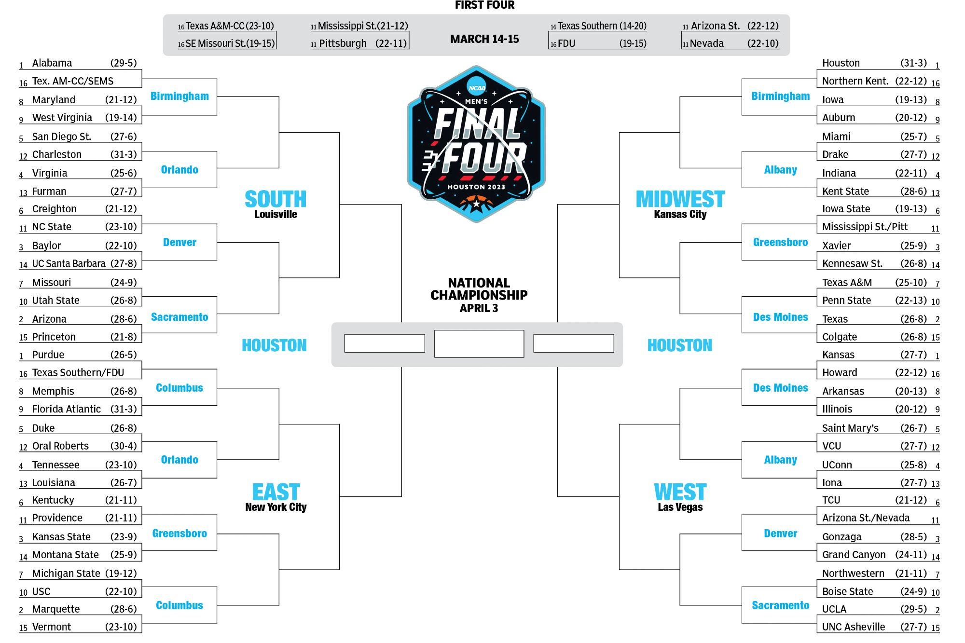
Variable 2-40 RIGHT
Alabama
Houston
Alabama
Houston
West Virginia
Alabama
Houston
Auburn
San Diego St.
Miami
San Diego St.
Houston
Miami
Virginia
Alabama
Indiana
Creighton
Iowa State
Creighton
Xavier
Baylor
Xavier
Utah State
Arizona
Texas
Texas A&M
Arizona
Texas
Arizona
Alabama
UConn
UConn
Texas
Purdue
Kansas
Purdue
Kansas
Memphis
Purdue
UConn
Arkansas
Duke
Saint Mary’s
Tennessee
UConn
Tennessee
UConn
Kentucky
Purdue
UConn
TCU
Kentucky
Gonzaga
Kansas State
Gonzaga
Michigan St.
Marquette
UCLA
Northwestern
Marquette
UCLA
Marquette
UCLA

Slide 47
Variable 3-50 RIGHT
Alabama
Houston
Alabama
Houston
Maryland
San Diego St.
Houston
Auburn
San Diego St.
Miami
San Diego St.
Houston
Miami
Virginia
San Diego St.
Indiana
Creighton
Pittsburgh
Creighton
Xavier
Baylor
Xavier
Missouri
Creighton
Texas
Penn State
Arizona
Texas
Arizona
San Diego St.
UConn
UConn
Texas
Purdue
Kansas
Purdue
Kansas
Florida Atlantic
Tennessee
UConn
Arkansas
Duke
Saint Mary’s
Tennessee
UConn
Tennessee
UConn
Kentucky
Marquette
UConn
TCU
Kansas State
Gonzaga
Kansas State
Gonzaga
Michigan St.
Marquette
UCLA
Northwestern
Marquette
UCLA
Marquette
UCLA

Slide 48
Variable 4-40 RIGHT
Alabama
Houston
Alabama
Houston
Maryland
San Diego St.
Houston
Auburn
San Diego St.
Miami
San Diego St.
Houston
Miami
Virginia
San Diego St.
Kent State
Creighton
Pittsburgh
UCSB
Xavier
UCSB
Xavier
Utah State
Arizona
Texas
Texas A&M
Arizona
Texas
Arizona
Florida Atlantic
Florida Atlantic
Houston
Texas
Purdue
Kansas
Florida Atlantic
Kansas
Florida Atlantic
Florida Atlantic
UConn
Arkansas
Oral Roberts
Saint Mary’s
Oral Roberts
UConn
Tennessee
UConn
Kentucky
Florida Atlantic
UConn
Arizona St.
Kansas State
Gonzaga
Kansas State
Gonzaga
USC
Marquette
Gonzaga
Boise St.
Marquette
UCLA
Marquette
UCLA

Slide 49
Variable 5-39 RIGHT
Alabama
Houston
West Virginia
Houston
West Virginia
West Virginia
Houston
Iowa
San Diego St.
Miami
San Diego St.
Houston
Miami
Furman
Baylor
Indiana
Creighton
Pittsburgh
Baylor
Xavier
Baylor
Xavier
Missouri
Baylor
Penn State
Penn State
Missouri
Penn State
Arizona
Baylor
UConn
UConn
Texas
Purdue
Kansas
Purdue
Kansas
Memphis
Purdue
UConn
Arkansas
Duke
Saint Mary’s
Duke
UConn
Tennessee
UConn
Kentucky
Purdue
UConn
TCU
Kentucky
Gonzaga
Kansas State
Gonzaga
Michigan St.
Marquette
Gonzaga
Northwestern
Marquette
UCLA
Marquette
UCLA

Slide 50
Variable 6-36 RIGHT
Alabama
Houston
Alabama
Auburn
Maryland
San Diego St.
Auburn
Auburn
San Diego St.
Miami
San Diego St.
Indiana
Virginia
San Diego St.
Texas
Indiana
Creighton
Iowa State
Creighton
Iowa State
Baylor
Xavier
Utah State
Creighton
Texas
Texas A&M
Arizona
Texas
Arizona
San Diego St.
San Diego St.
UCLA
Texas
Purdue
Kansas
Purdue
Kansas
Memphis
Tennessee
Kansas
Arkansas
Duke
Saint Mary’s
Tennessee
Saint Mary’s
Tennessee
UConn
Kentucky
Tennessee
UCLA
TCU
Kansas State
TCU
Kansas State
Gonzaga
Michigan St.
Marquette
UCLA
Northwestern
Marquette
UCLA
Marquette
UCLA

