Slide 1
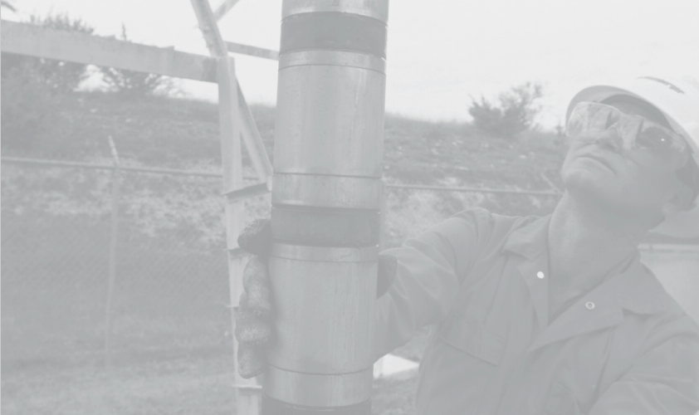
Wellbore Cement Bond Log Reader
Nick Fry
June 2021
Class Salmon – PDX Code Guild

Slide 2
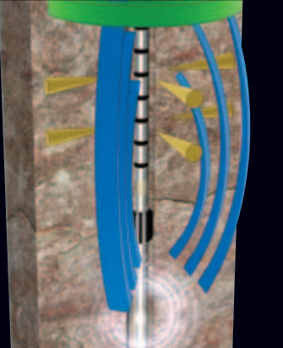
Problem
Geothermal wells are subjected to cyclic thermal loads
Cyclic thermal loads can cause well integrity problems for any high pressure, high temperature well
Poor cement bonding to the casing and rock formation wall can result in wall material failures
The drilling industry uses sonic logs to test the cement bonding before putting a well into production
Interpreting then generating a report can be time consuming with excel

Slide 3





Solution
Quickly select a well
Visualize it without a tedious excel spreadsheet
Annotate a problem spot in the cement bond log
Automatically generate a formatted report
Provide statistics on the well log just by selecting a depth range

