Slide 1
Gross Domestic Product and Life Expectancy Over Time
United States of America, Chile, Zimbabwe, Germany, Mexico, China
Codecademy Training Exercise
Nicholas Fry

Slide 2
GDP and LEABY
GDP stands for Gross Domestic Product. GDP is a monetary measure of the market value of all final goods and services produced in a time period.
The GDP values in this project are in current US dollars.
LEABY stands for life expectancy by year

Slide 3
Goals
This project explores the relationship between life expectancy and gross domestic product of several countries over time.
These values may have externalities that act upon them.
In conclusion, an exploration of the most rapidly growing GDP, found in China, is speculated upon.

Slide 4
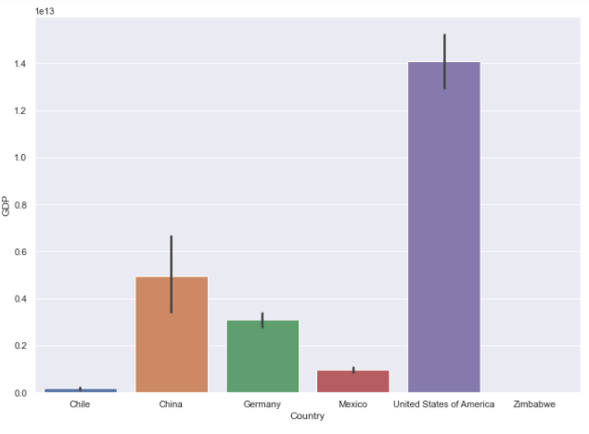
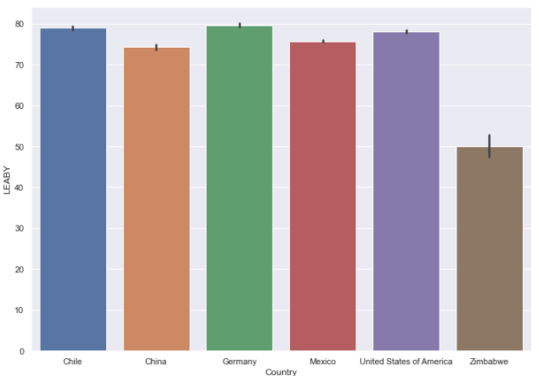
GDP and LEABY
The two charts do not appear similar. The United States has a disproportionately high GDP, while having an average LEABY.

Slide 5
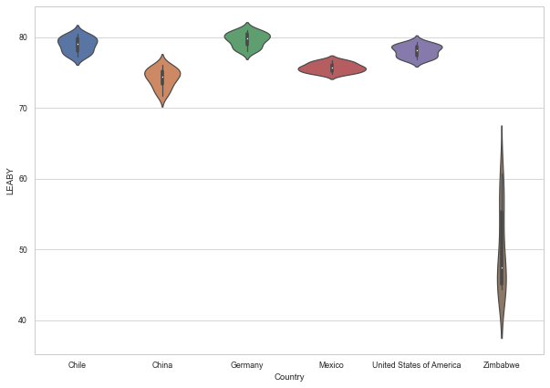
Violin Plot of Life Expectancies over time
Zimbabwe has a wider range of life expectancies than the other countries, indicating an abnormal condition for the country. Zimbabwe.

Slide 6
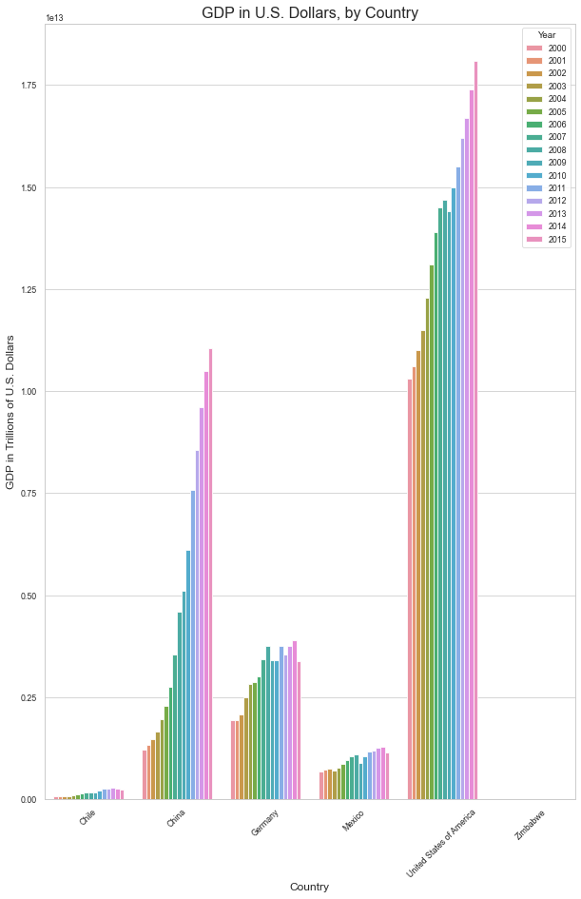
GDP in Dollars, by country, over years

Slide 7
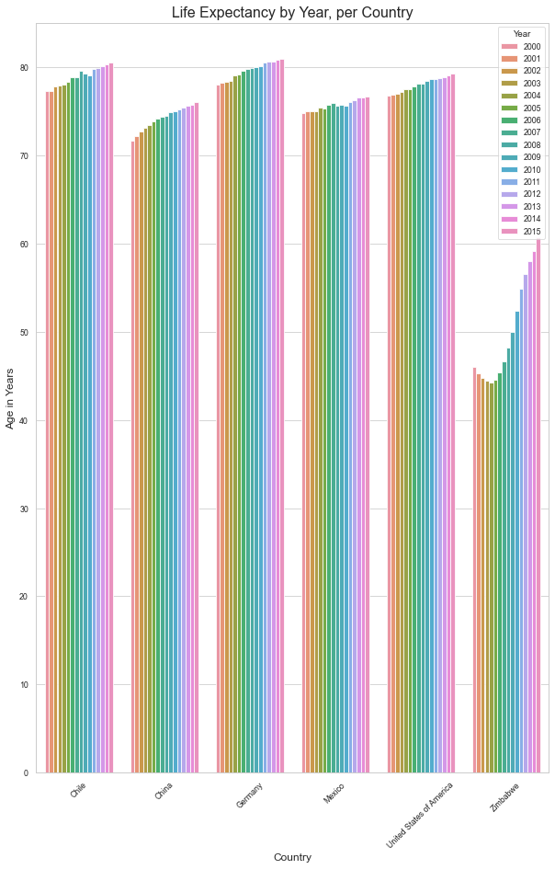
Life Expectancy over time

Slide 8
LEABY and GDP Analysis
What are your first impressions looking at the visualized data?
- Which countries' bars changes the most?
- What years are there the biggest changes in the data?
- Which country has had the least change in GDP over time?
- How do countries compare to one another?
- Now that you can see the both bar charts, what do you think about the relationship between GDP and life expectancy?
- Can you think of any reasons that the data looks like this for particular countries?
The developing country of Zimbabwe has the greatest change in life expectancy over the years. It appears the most rapid increases in life expectancy took place between 2007 and 2015 in this dataset. The least change in GDP was in Zimbabwe, meaning their life expectancy rose but the GDP stagnated. Countries are far different from one another in terms of GDP. GDP and life expectancy generally have a positive correlation with each other, but this is not always the case, such as in Zimbabwe. The countries with the lower and stagnating GDP probably have externalities to deal with. Speculation would not be helpful in this forum.

Slide 9
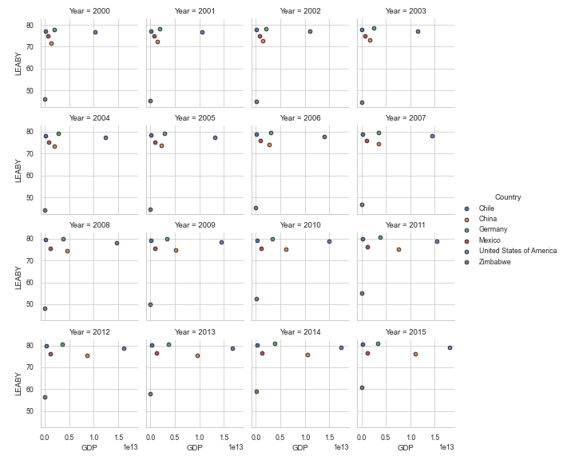
Facet Grids of GDP and LEABY

Slide 10
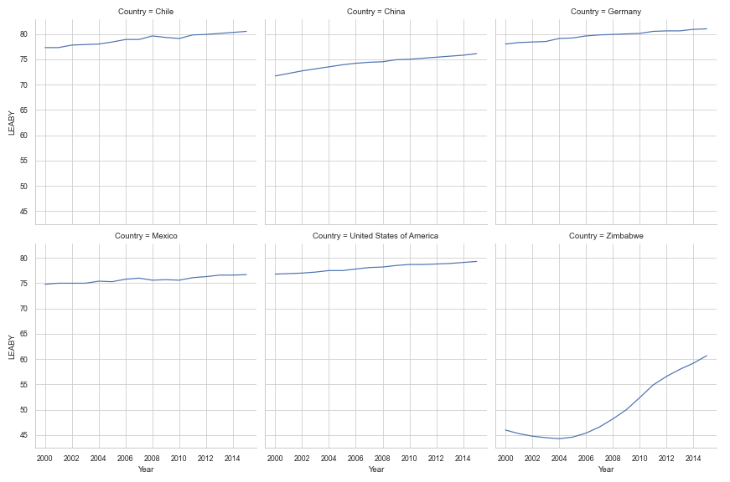
Line plots of life expectancy by country
I cannot tell the difference in slope through visuals on any country but Zimbabwe. Zimbabwe changes a lot. The slope for the year 2010 in Zimbabwe appears to have the largest positive value. The least change in life expectancy seems to be Mexico, but I cannot be sure without knowing the slopes. Sure. There are reasons that this would be different for different coutries.

Slide 11
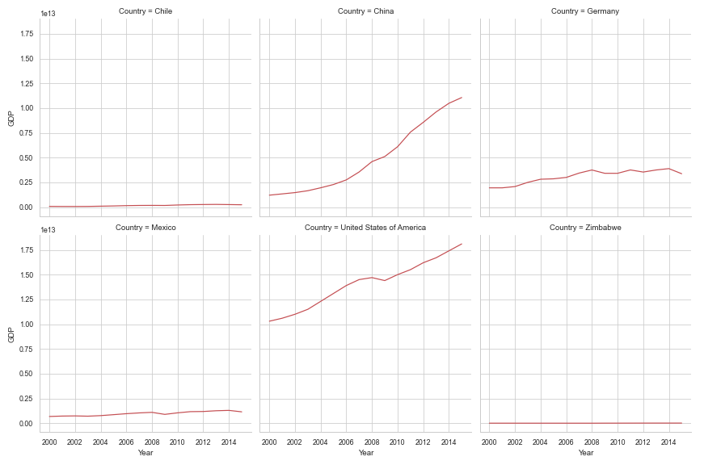
Line Plots of GDP by country

Slide 12
Analysis – China GDP
What happened in China in the past 10 years that increased the GDP so drastically?
The Chinese government provides central planning structure that accumulates manufacturing capacity and intervenes when the privatized industrial sector is not coordinated with national GDP growth models. Privatization took place in the 1990s, and manufacturing accumulation became a central policy after that. Since the manufacturing capacity has matured, the Chinese economy has diversified into other specialties and is now nascently joining "developed" status. https://www.macrobusiness.com.au/2019/10/how-did-china-develop-so-fast/
They still have vast human rights infractions and do not support high labor standards. Inequality, social and economic, is high in China.

Slide 13
Thanks for reading!

