Slide 1
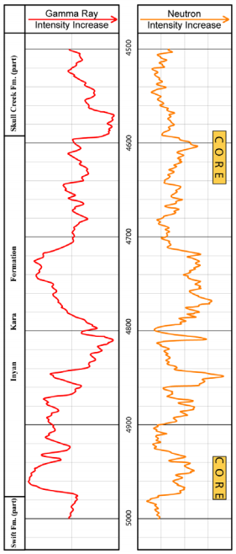
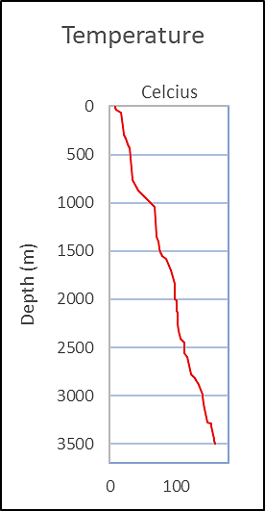
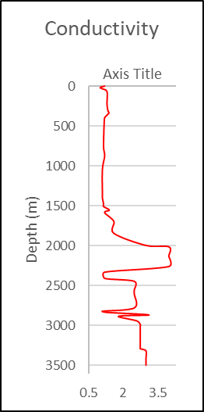

ERATHEM
SYSTEM
ROCK UNIT
AGE
SEQUENCE
LITHOLOGY
SERIES
GROUP
FORMATION
65.5
HELL CREEK
SKULL CREEK
FOX HILL
MONTANA
Upper
PIERRE
CRETACEOUS
NIOBRARA
CARLILE
INYAN KARA FORMATION
MESOZOIC
COLORADO
GREENHORN
BELL FOURCHE
99.6
MOWRY
Lower
DAKOTA
NEW CASTLE
SKULL CREEK
145.5
INYAN KARA
JURASSIC
SKULL CREEK
201.6

Slide 2
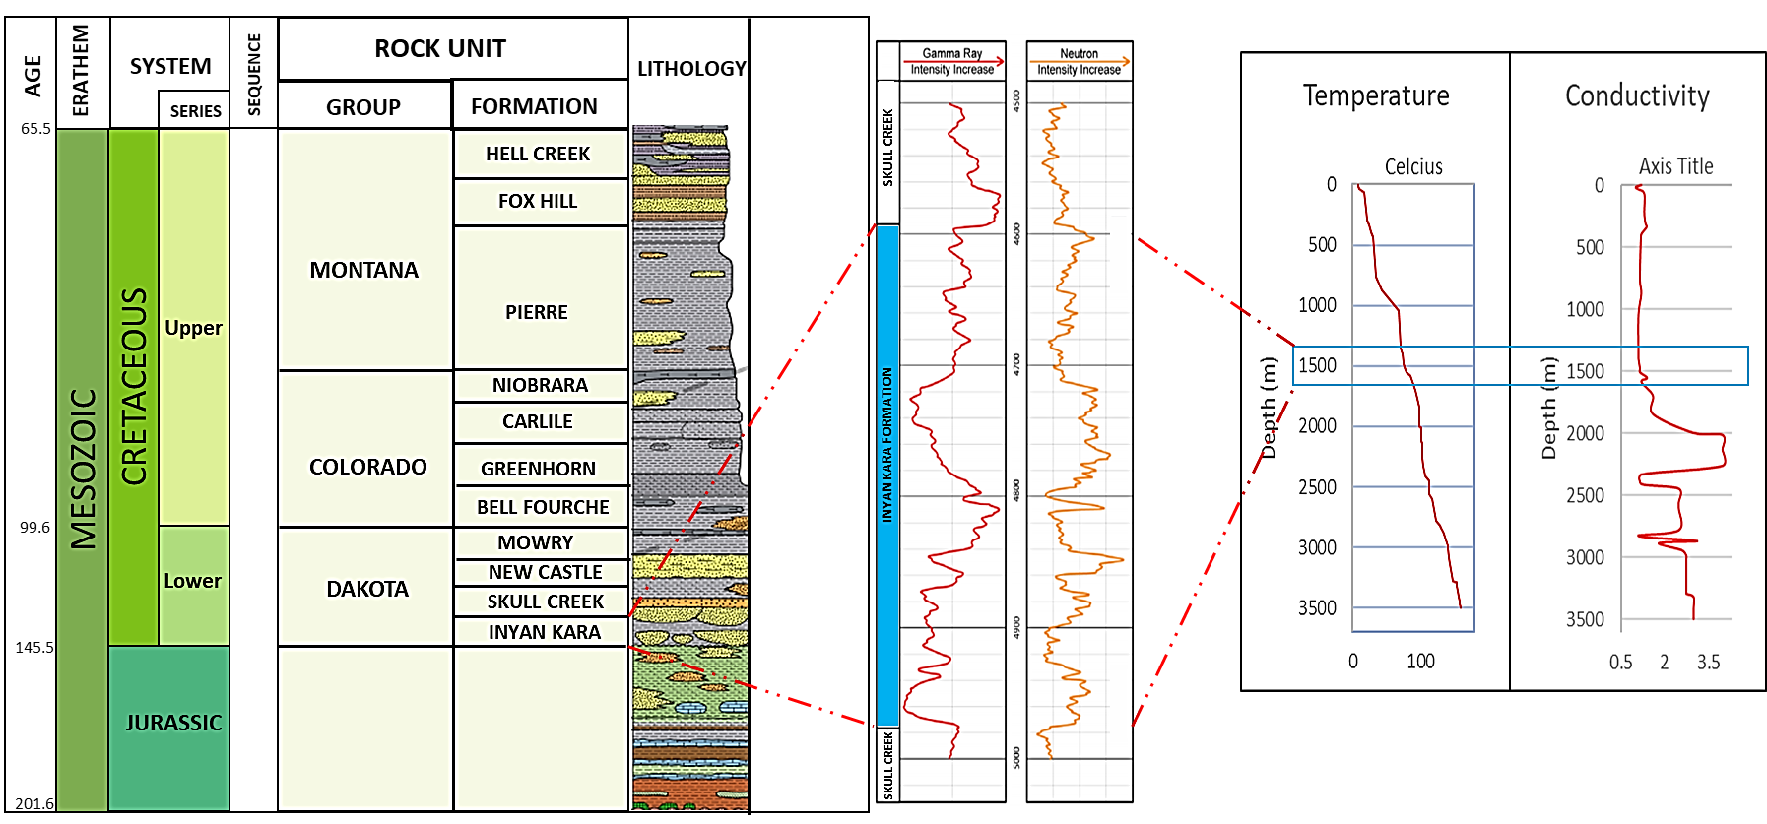

Slide 3
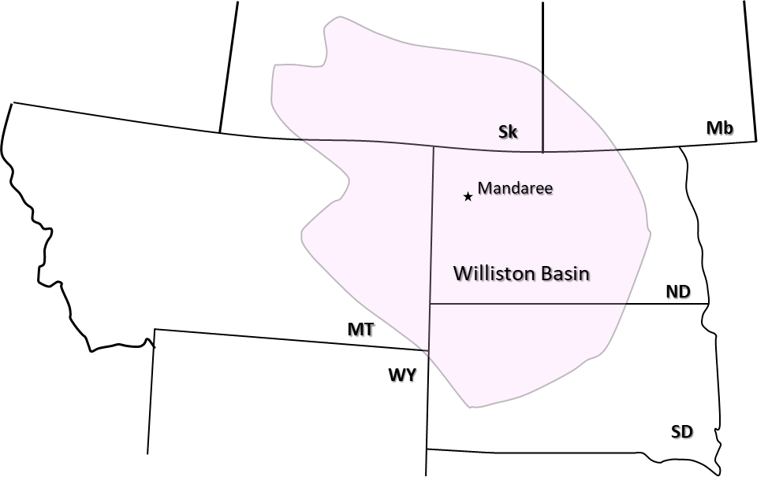
Sk
Mb
Mandaree
Williston Basin
ND
MT
WY
SD

Slide 4
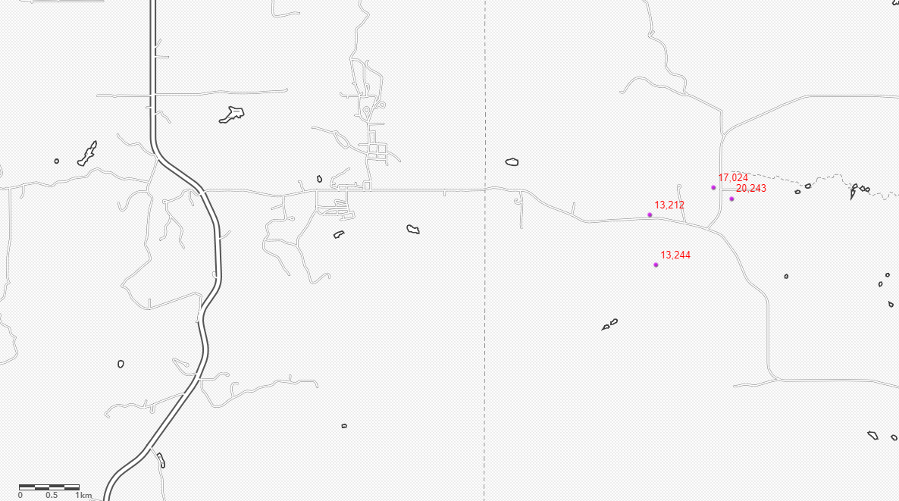
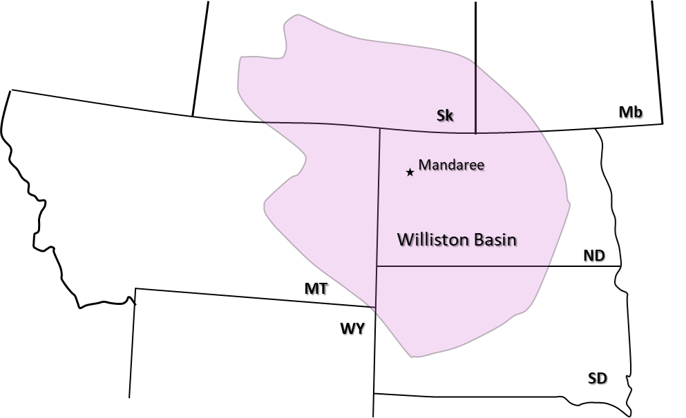
18128
Proposed wells
A’
15580
Mandaree
8095
A

Slide 5
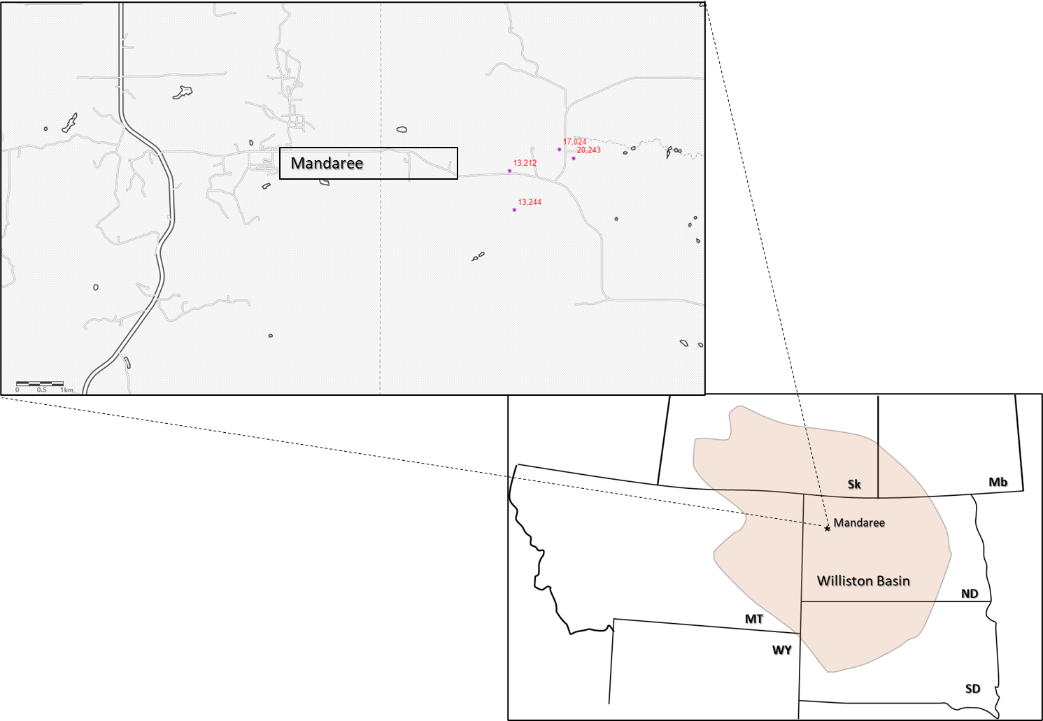

Slide 6
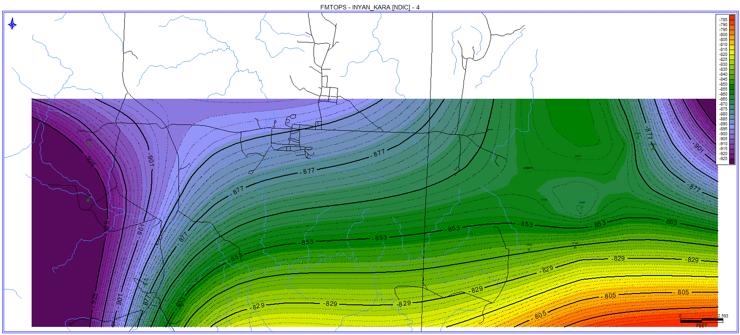
Mandaree
Proposed Wells

Slide 7
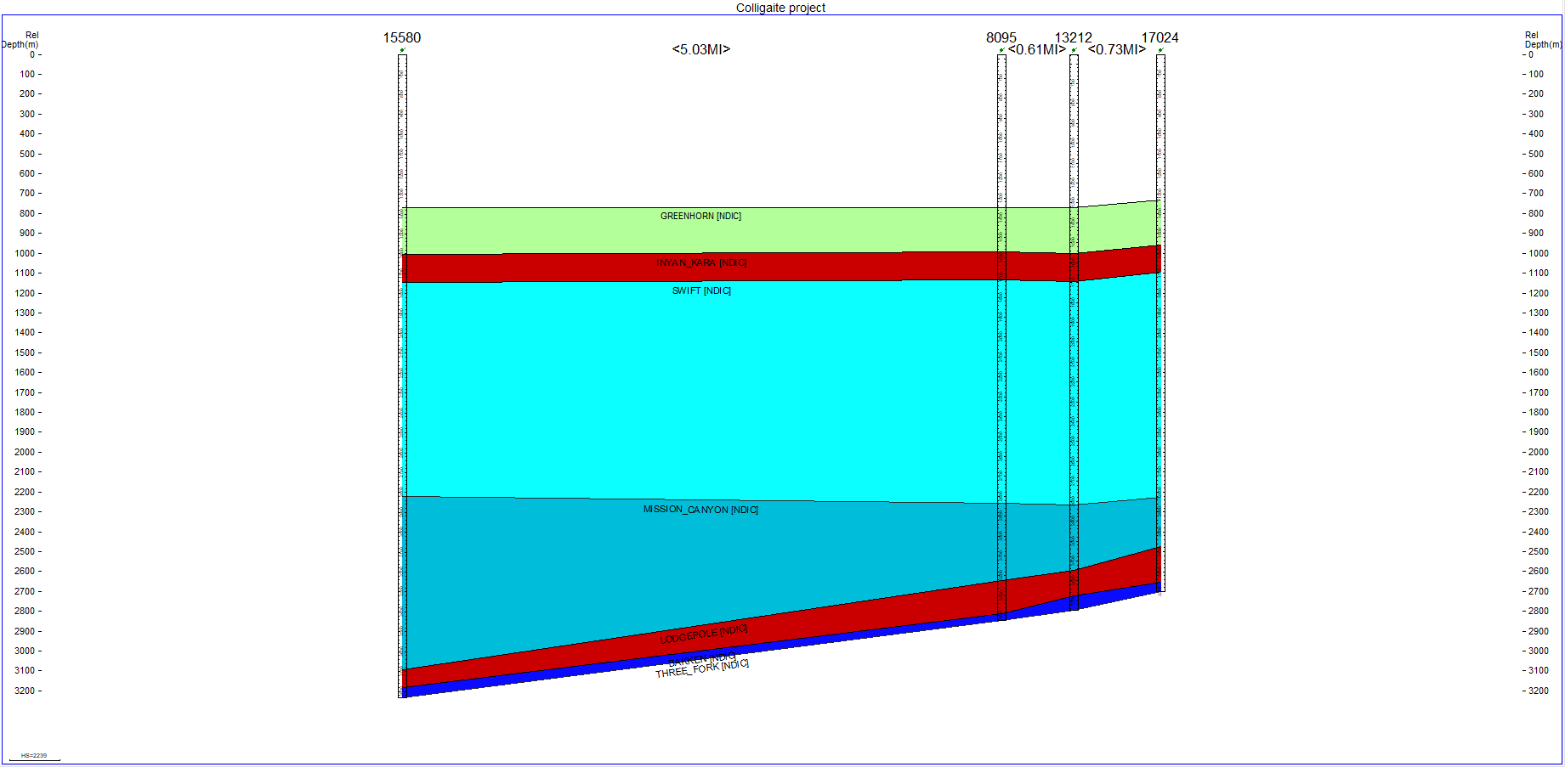
A
A’
< 8,095 m >
< 981.7 m >
< 1174 m >

Slide 8
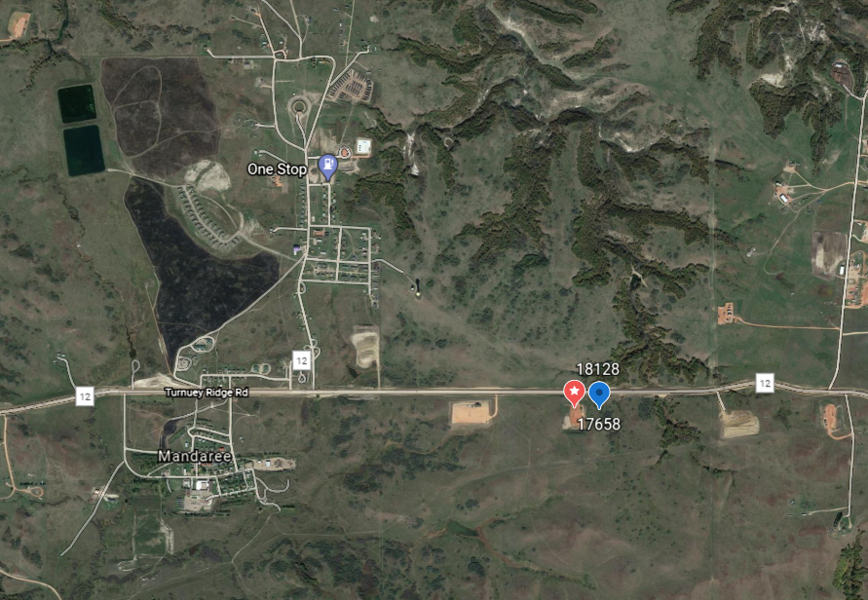
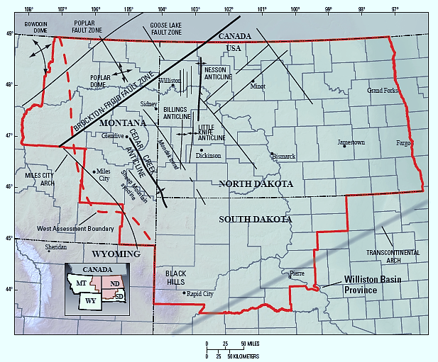
Proposed Area

Slide 9
