Slide 1
Thermalize
SPE Europe GEOENERGY Hackathon!

Slide 2

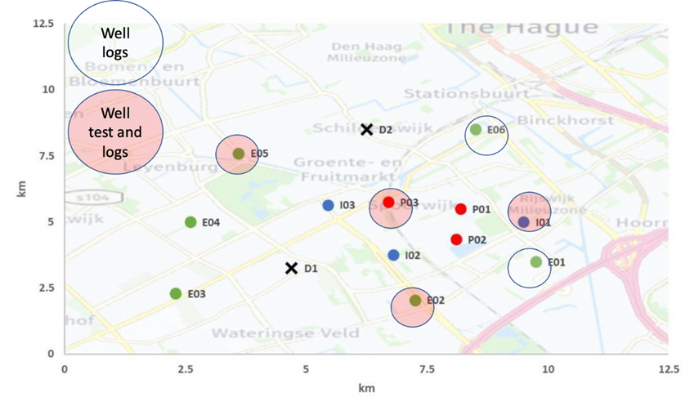
The Exploration

Slide 3
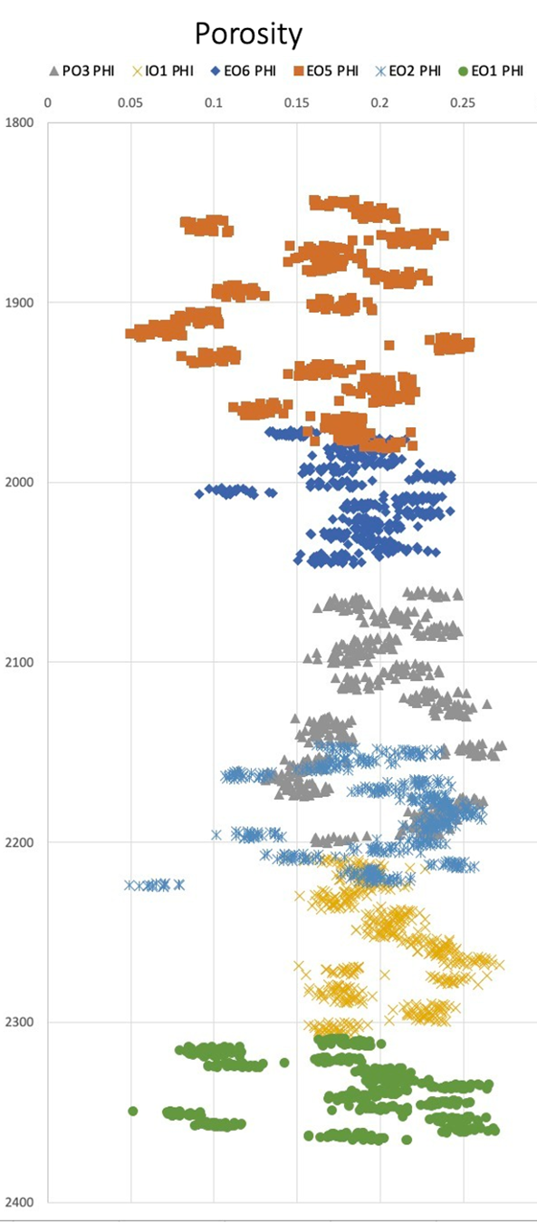

The Exploration

Slide 4
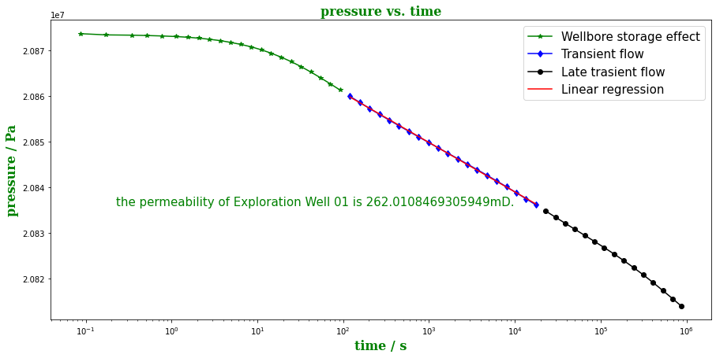
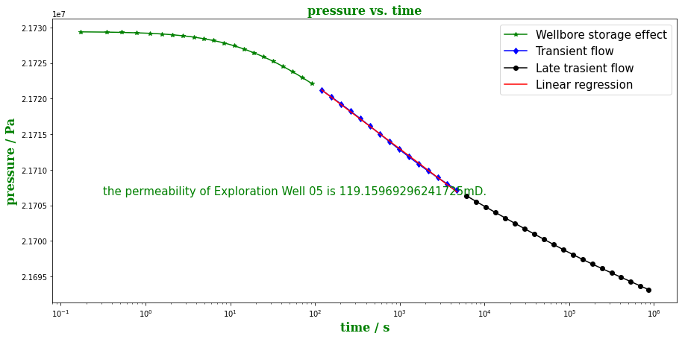
The Exploration

Slide 5
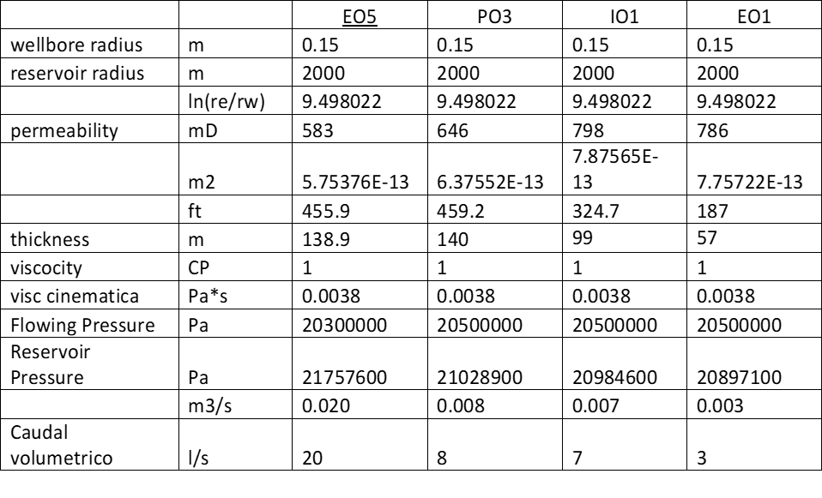
The Exploration

Slide 6
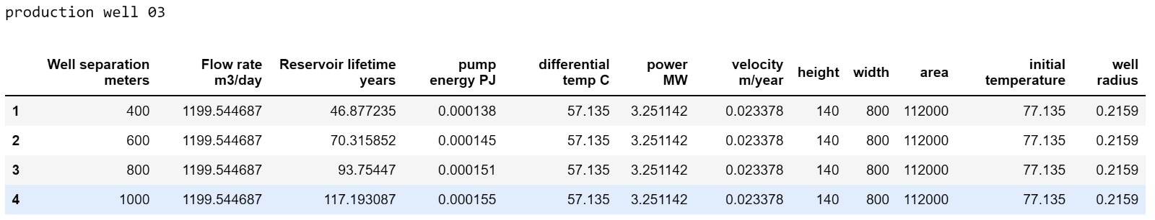
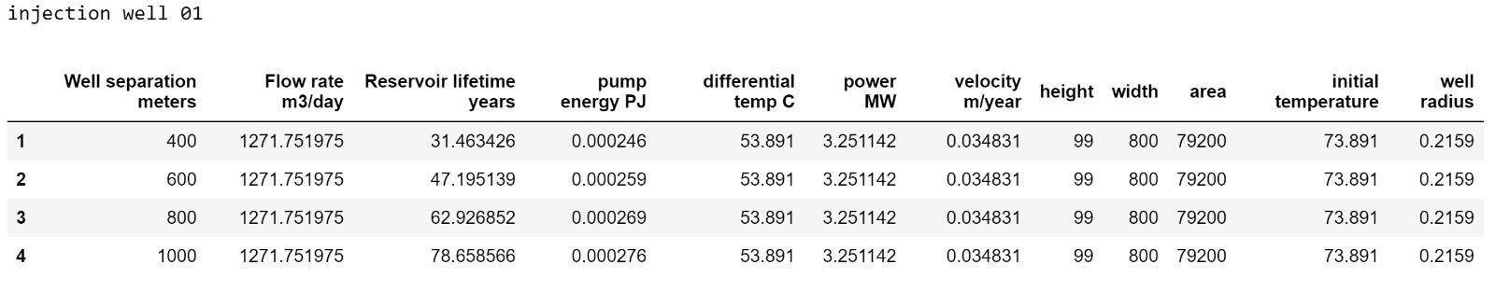
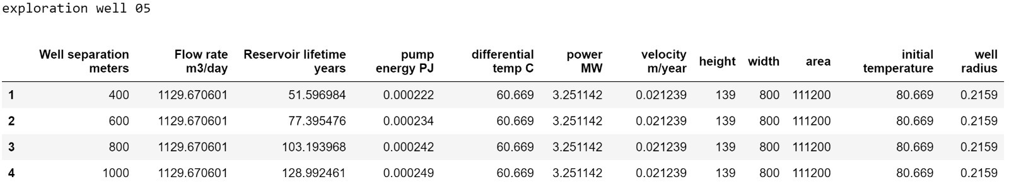
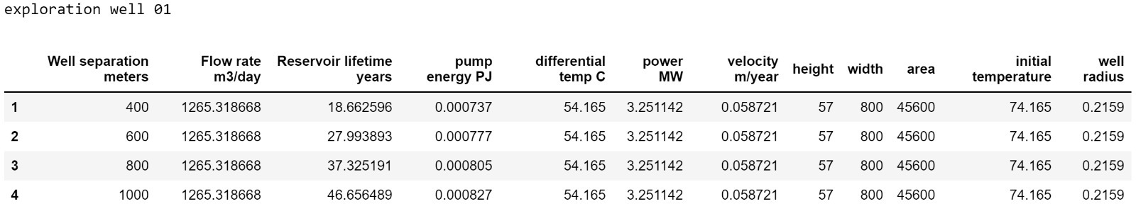
The experimentation

Slide 7
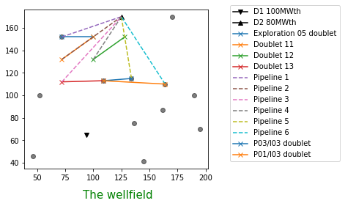
The Configuration

Slide 8
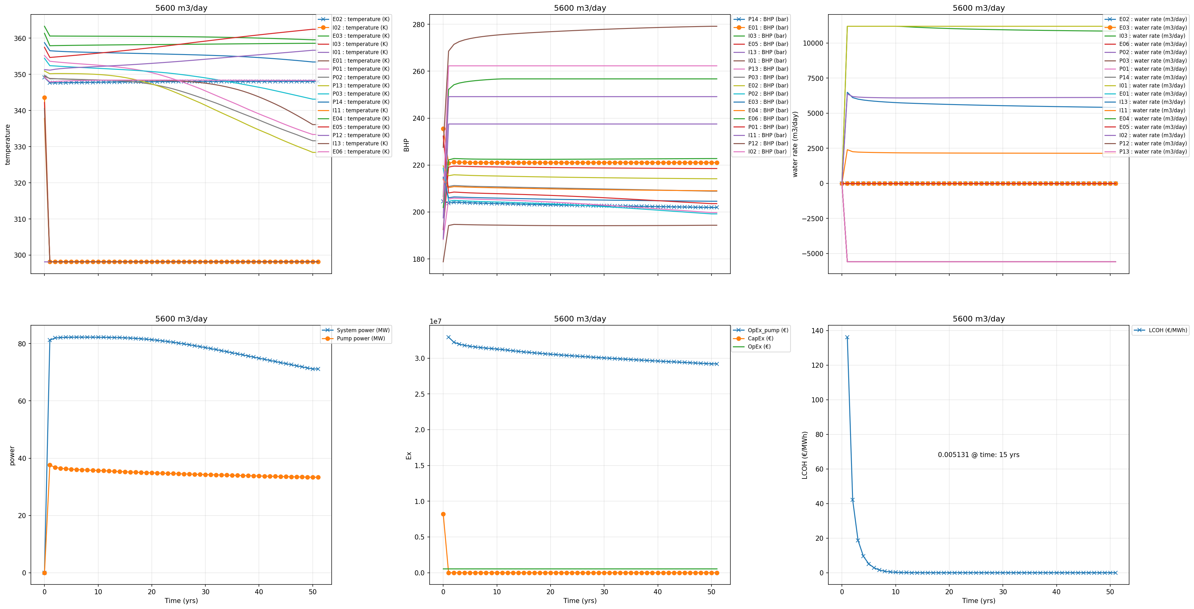

The RESULTS – 5600M3/day

Slide 9
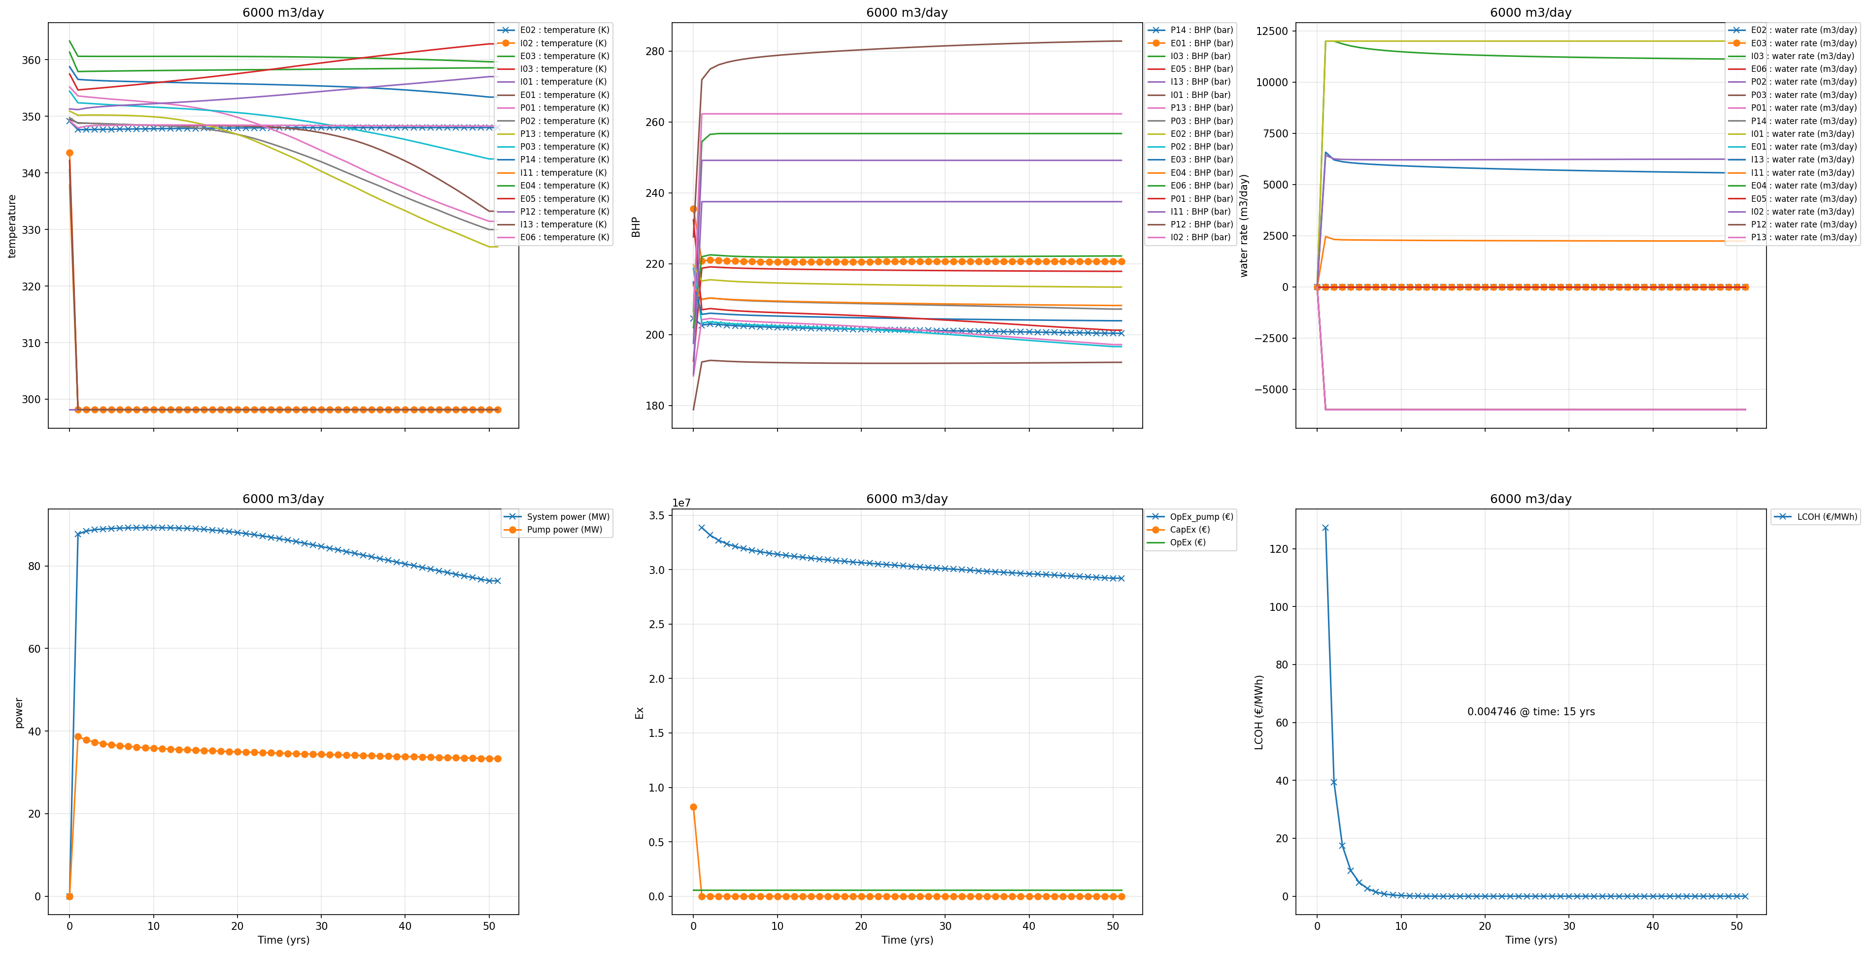
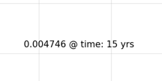
The RESULTS – 6000M3/day

Slide 10
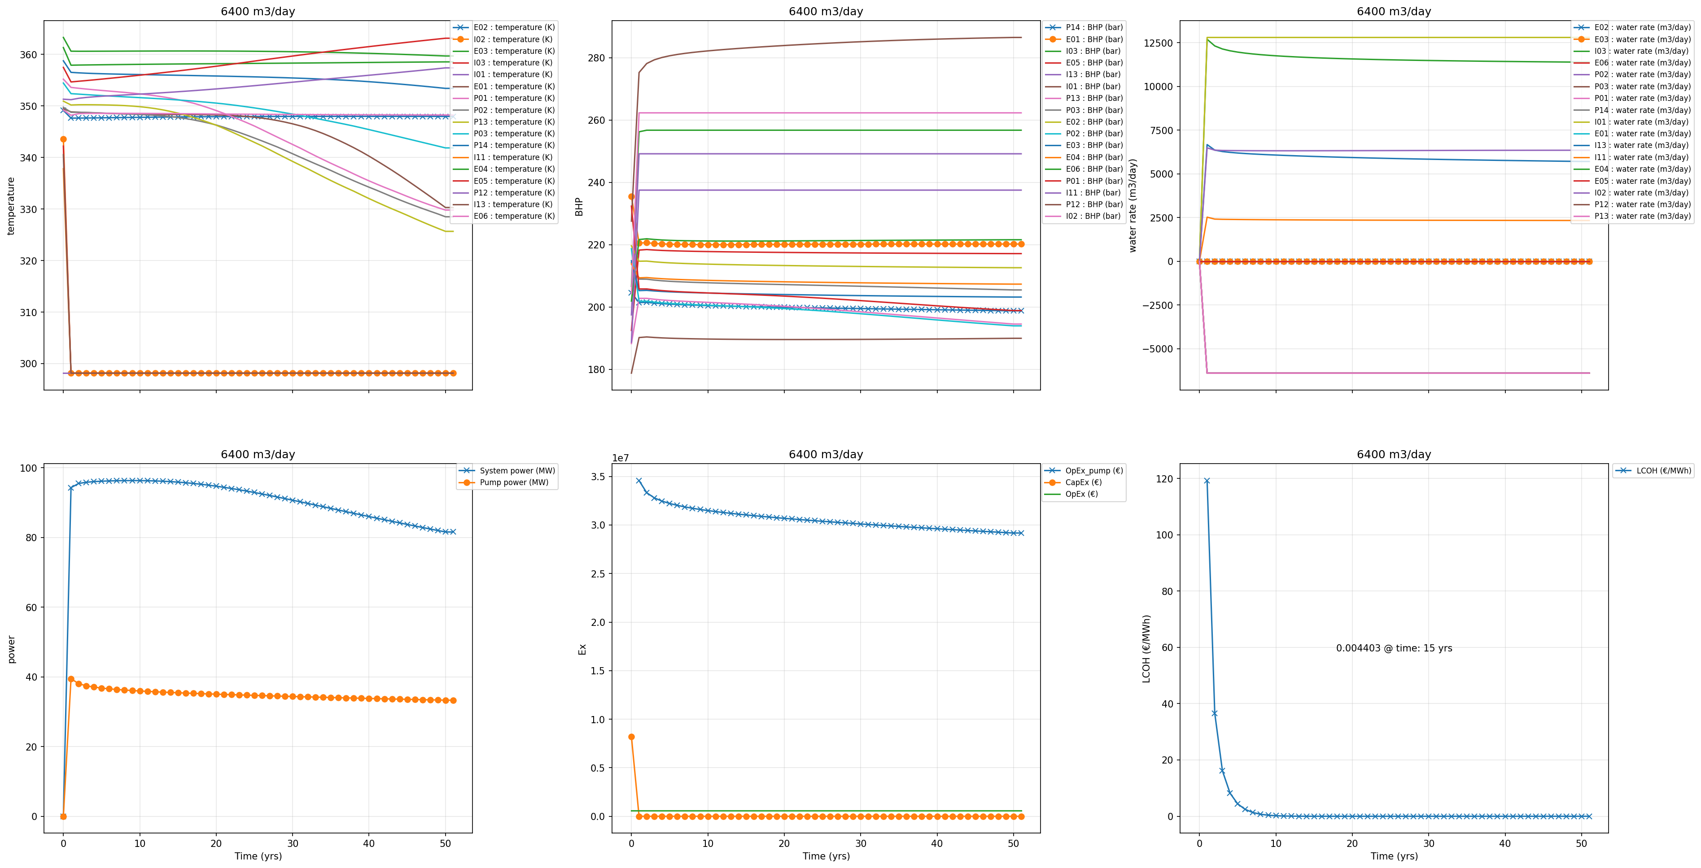
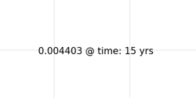
The RESULTS – 6400M3/day

Slide 11
Conclusions
We configured 6 doublets consisting of 6 production wells and 3 injection wells. Two production wells were already in existence and one injection well was already in existence. Based on the initial production, drilling no additional makeup wells, we initially overproduce at 6000M3/day to meet the thermal demand for more than 40 years at less that €0.005 LCOH after 15 years.
We learned interesting new workflows, programming skills, and hope to work more with darts in the future, given our own geologic models.

