Slide 1

Tim Berners-Lee
The Creator of HTML and essentially the World Wide Web as we know it! He also created the first web browser and the HTTP protocol we use to pull web pages today. He is the founder and chair of the World Wide Web Consortium that oversees the continued improvement of the web.

Slide 2

Håkon Wium Lie
The creator of CSS! Originally integrated into the Arena web browser, this was the first occurrence of CSS. Created Acid benchmark tests to score web browsers’ support for common web standards.

Slide 3

Vitaly Friedman
Founder of and author for Smashing Magazine, one of the largest magazines for online design. A strong supporter of function UX and design that accommodates everyone.

Slide 4

John Resig
The creator of the most popular JavaScript libraires, Jquery. He has shaped how we use JavaScript for our modern day Web. He is now the Chief Software Architect at Kahn Academy!

Slide 5

Lea Verou
One of the few W3C Technical Architect Group members responsible for reviewing proposals for new technology that would change the way we use the Web, as well as an expert for the W3C CSS Working Group.

Slide 6
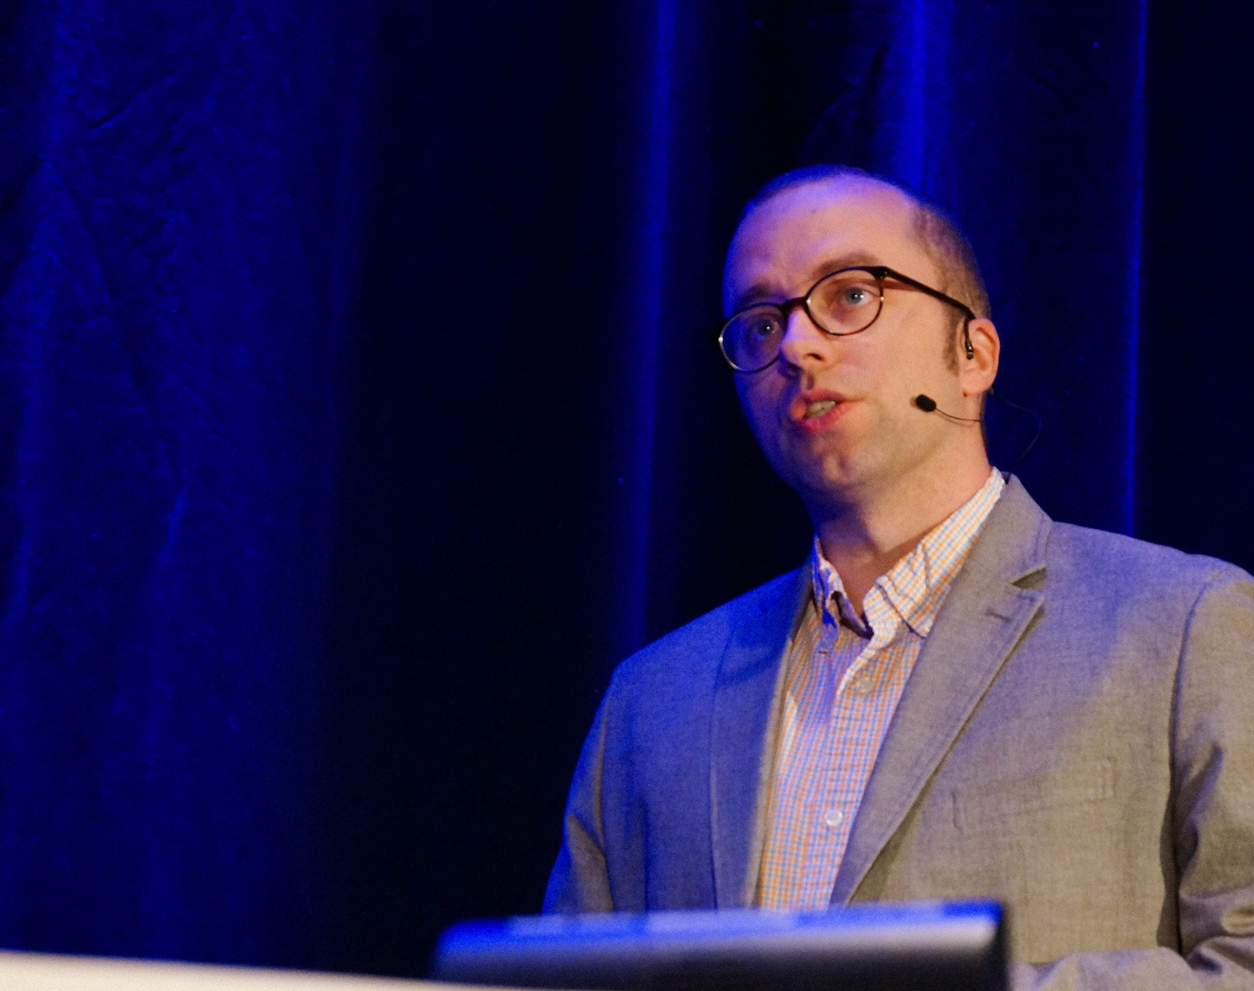
Ethan Marcotte
The father of responsive design! He has written books on responsive design principles and has done work for several well known companies with a focus on performance and accessibility for everyone.

Slide 7

Brendan Eich
The creator of the JavaScript language and cofounder of Mozilla! Most recently he is the founder of Brave Software, which is responsible for the newer Brave browser.

