Slide 1
Case Study 1: Predicting Employee Attrition at Frito Lay
Presented on Behalf of DDS Analytics by Nicholas Jones

Slide 2
Predicting Attrition (Qualitative Analysis)/Base Model Understanding
Goal of Model:
To predict costly company employee turnover via “Attrition”
Where Yes = Attrition on upcoming matrices
Missing employees that will leave is more costly than vice versa
Missing employee cost is around 50-200% of that employee's annual salary
Sensitivity = Predicted value of no attrition (did not leave) / actual no attrition
Specificity = Predicted value of yes attrition (leave) / actual yes attrition
Model needs to capture both 60% Specificity and 60% Sensitivity to suffice
Took out constant (output) variables/ place holders

Slide 3
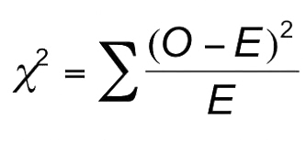
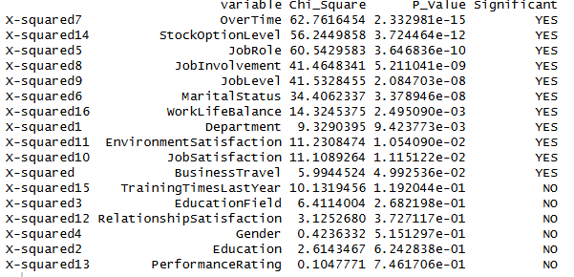
Scanning for Variables With Significant Relationship to Attrition
Chi_Square for categorical variables (independently ran each variable)
O = observed, E = Expected
Lower P-Value the more the significance
Higher Chi Square = Higher (X^2 = (O-E)^2/E))
Where x^2 = Chi Square

Slide 4
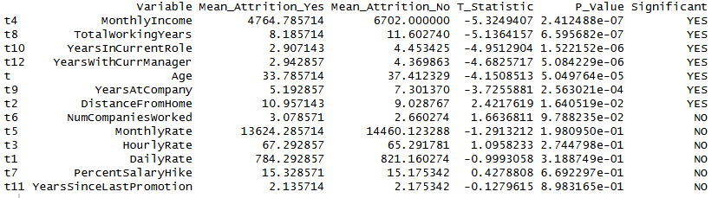
Scanning for Variables With Significant Relationship to Attrition
Same idea as categorical but for numerical values
Looking for statistically significant features in relation to attrition
T-test for numerical variables (Individual Tests)
Null Hypothesis = Same mean is just as likely to predict those who leave as those who will stay (not significant relationship)
Alternative Hypothesis = Same mean is not just as likely to predict those who will leave to those who will stay (likely is significant relationship)
The latter Hypothesis represents significance and thus will likely have a lower P-value

Slide 5
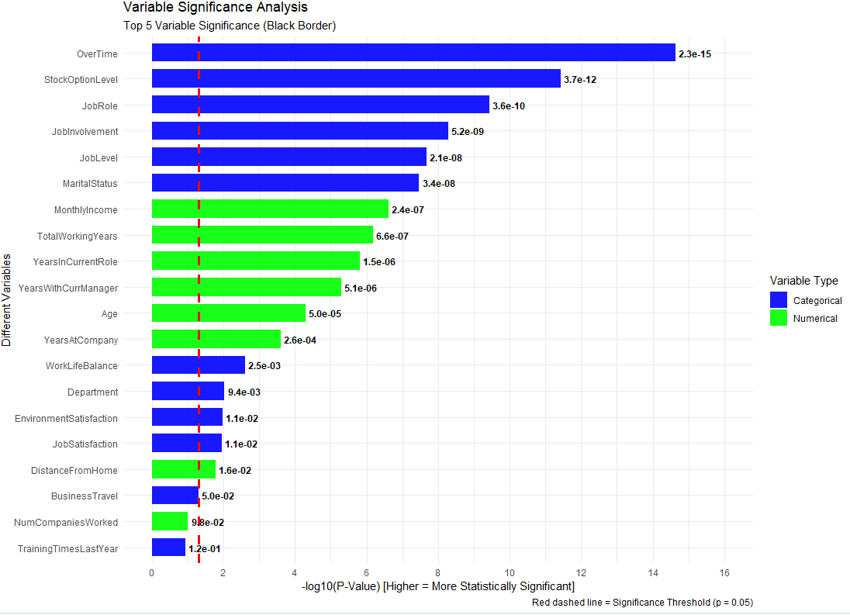
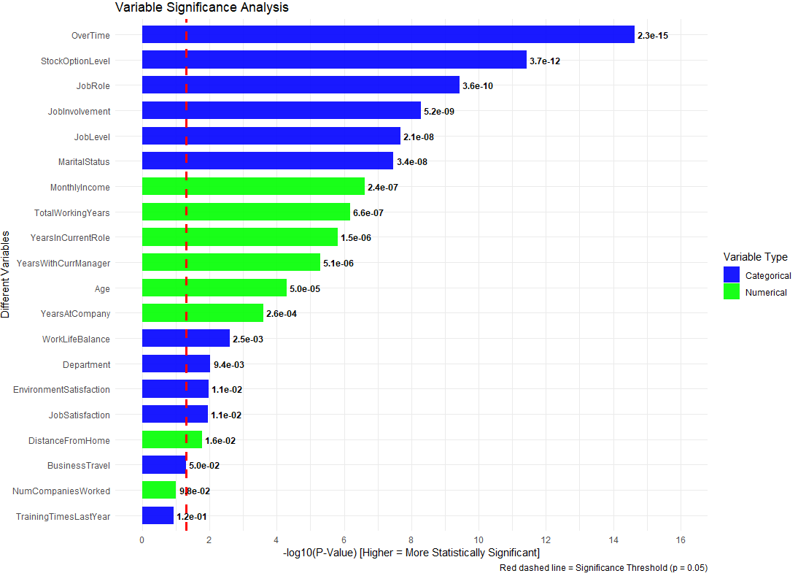

Slide 6
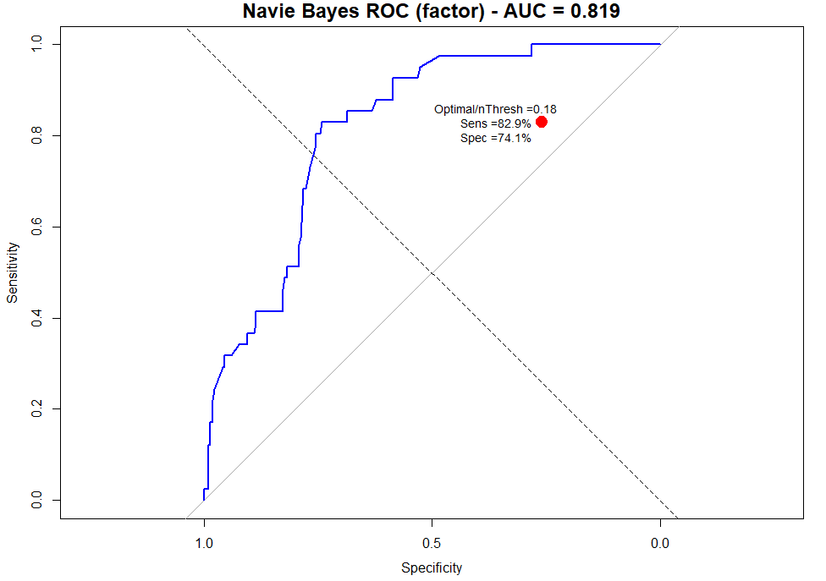
AUC and Threshold ((ROC Curve) NB)
Original Threshold = .5
Optimal Threshold = .18
Captures more “At Risk” Individuals than original threshold model

Slide 7




Final Naïve Bayes Model
Top matrix = model after threshold fitting
Bottom matrix = model before threshold fitting
Threshold fitting allowed for more “Yes” predictions and Specificity rating at the sacrifice of “No” predictions and Sensitivity rating
This better accomplishes our cost savings goal

Slide 8
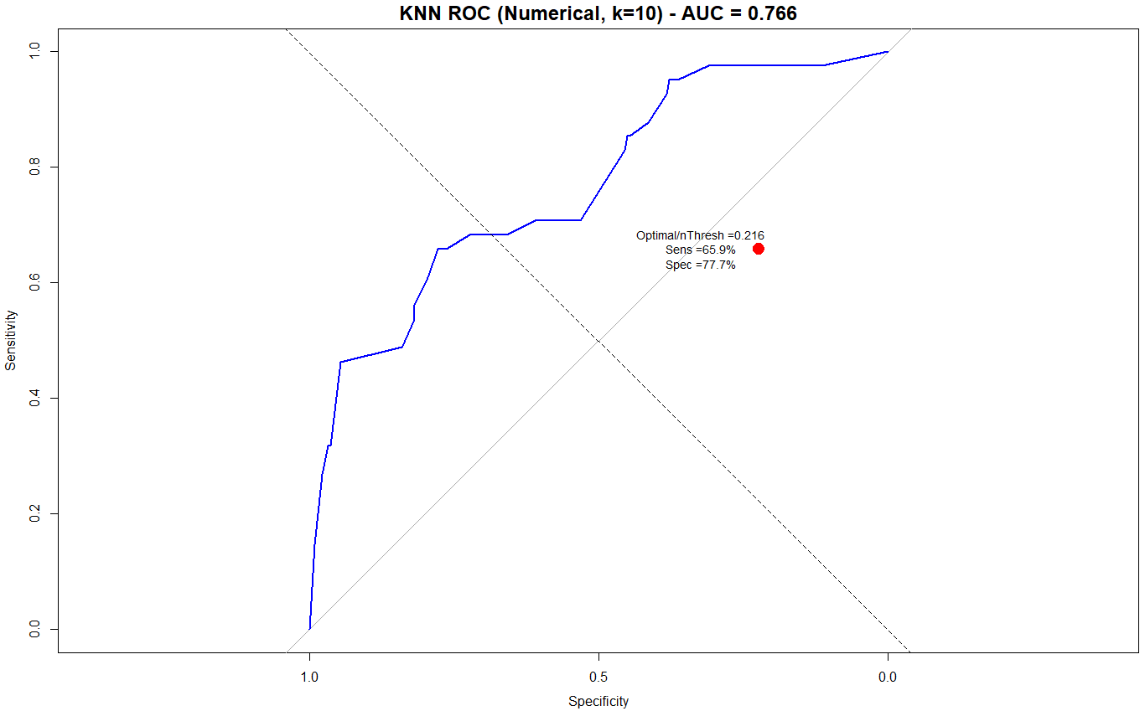
AUC and Threshold ((ROC Curve) KNN)
Original Threshold = .5
Optimal Threshold = .216

Slide 9


Final KNN Model
Top matrix = model after threshold fitting
Bottom matrix = model before threshold fitting
Specificity and Sensitivity are flipped on top matrix
More Yeses captured due to threshold
Not Apples to Apples with NB model, as variable selection was modified

Slide 10
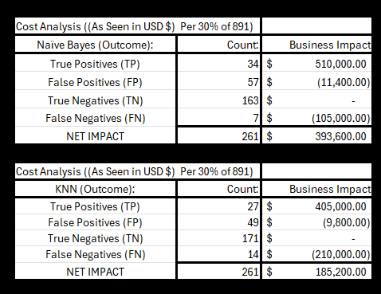
Total Predicted Cost and Savings W/ Model(s)
TP = Predicted Yes and was true
FP = Predicted Yes and was wrong
TN = Predicted No and was true
FN = Predicted No and was wrong

Slide 11
Thank you
Nicholas Jones
nickjones@smu.edu

Slide 12
Citations
https://www.google.com/url?sa=i&url=https%3A%2F%2Fwww.graphpad.com%2Fquickcalcs%2Fchisquared1%2F&psig=AOvVaw004NiwFAIis6PPezlJ0_Dc&ust=1761345749210000&source=images&cd=vfe&opi=89978449&ved=0CBkQjhxqFwoTCNCMp7Cyu5ADFQAAAAAdAAAAABAE
https://mgrworkforce.com/employers/employee-retention-costs/#:~:text=The%20Society%20for%20Human%20Resource%20Management%20(SHRM),training%2C%20reduced%20productivity%2C%20et%20cetera%2C%20were%20considered

Slide 13
Areas for Improvement
Still time to better feature fit the model to achieve the coveted %60, %60 threshold that would deem a model successful
I need to do a deeper dive on covariance between variables
Breaking down the qualitative reasoning behind specificity (getting the people who leave right) and each qualitative reasoning and interaction with each variable will provide much guidance in the future model
When it come to the real presentation: I will need to visualize my findings more instead of given raw numbers
The KNN-Model may present its own difficulties, but I want to have a good understanding of the feature relationship before running said model
Sort of Using the NB Model as Trial and Error
Likely need to present less models for real presentation to present in time
Specific money saved vs. lost cost analysis needed on final version
Checking the precision in the variable tests is likely a part of the answer

Slide 14
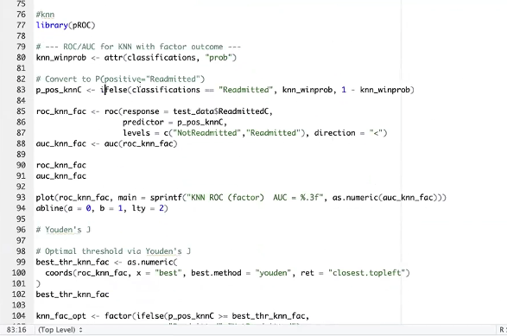
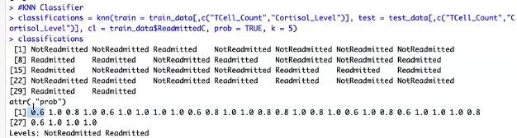
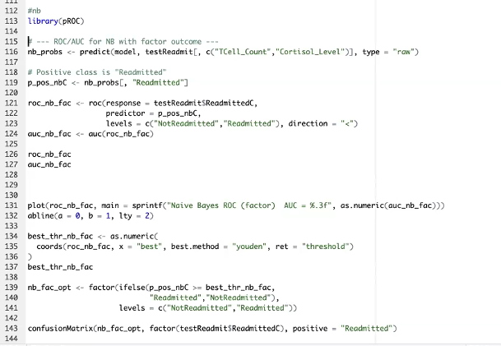
AUC and Thresholding (ROC Curve)

Slide 15
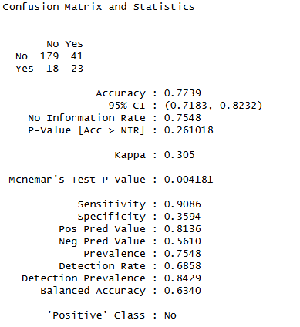
Second NB Model
Testing all significant variables together
Lower Specificity and Lower Accuracy than original model
Possible overfitting?
Too many variables?
Still too many predicted yesses
Actual
Predicted

Slide 16
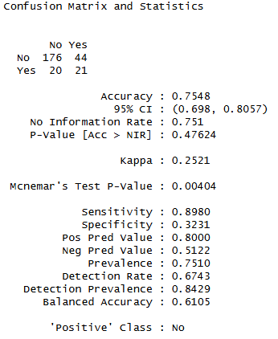
Adding More Highly Statistically Significant Variables
Trying to capture more actual yesses
-05 decimal places for the P-value
Just testing the waters with the Significance only thesis
More analysis between variable relationships needed
Model did not perform well
Now is predicting too many Yeses
Actual
Predicted

Slide 17
Base Model Understanding
Sensitivity = Predicted value of no attrition (did not leave) / actual no attrition
Specificity = Predicted value of yes attrition (leave) / actual yes attrition
Model needs to capture both 60% Specificity and 60% Sensitivity to suffice

Slide 18
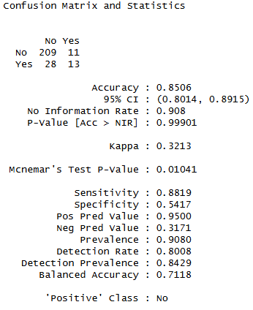
Top 5 Most Statistically-Significant Variables
Limited Dataset: less variables may perform better?
All most significant variables were categorical variables (out of 5)
Close to our 60% Specificity and 60% Sensitivity goal
Less variables seems to equal less statistical noise
Not predicting enough Yeses, thus low specificity still
Actual
Predicted

