Slide 1



OpenSurf
➢ human-friendly surf analysis
in the palm of your hand
Nicholas Dibello-Hitta, Nolan Lee,
Jorge Perez, Alan Shami, Andrew Snell

Slide 2
Legal Disclaimers
Data Usage Disclaimer for SurfForecast.com
This project utilizes data web scraped from SurfForecast.com for educational and non-commercial purposes only.
The data has been used in accordance with the website's terms and conditions:
"You may print off one copy, and may download extracts, of any page(s) from our site for your personal reference."
All rights to the data remain with SurfForecast.com, and no commercial use is intended.
For further information, please refer to their Terms and Conditions: https://www.surf-forecast.com/pages/terms
Data Usage Disclaimer for Pysurfline
This project utilizes data scraped from the Pysurfline API for educational and non-commercial purposes only.
Pysurfline is not affiliated with Surfline/WaveTrak, Inc (aka Surfline.com) in any way, shape, or form.

Slide 3
Introduction
Project: Predicting the quality of surf based on data from the National Oceanic and Atmospheric Administration (NOAA).
Goal: Provide a user-friendly interface between raw NOAA data and human-readable surf reports using AI techniques discussed throughout CS450.
Significance:
Surf conditions are infamously difficult to predict accurately with simple data analysis and hand-written algorithms.
The complexity of modern surf reports can be overwhelming and confusing for general audiences when attempting to interpret.

Slide 4

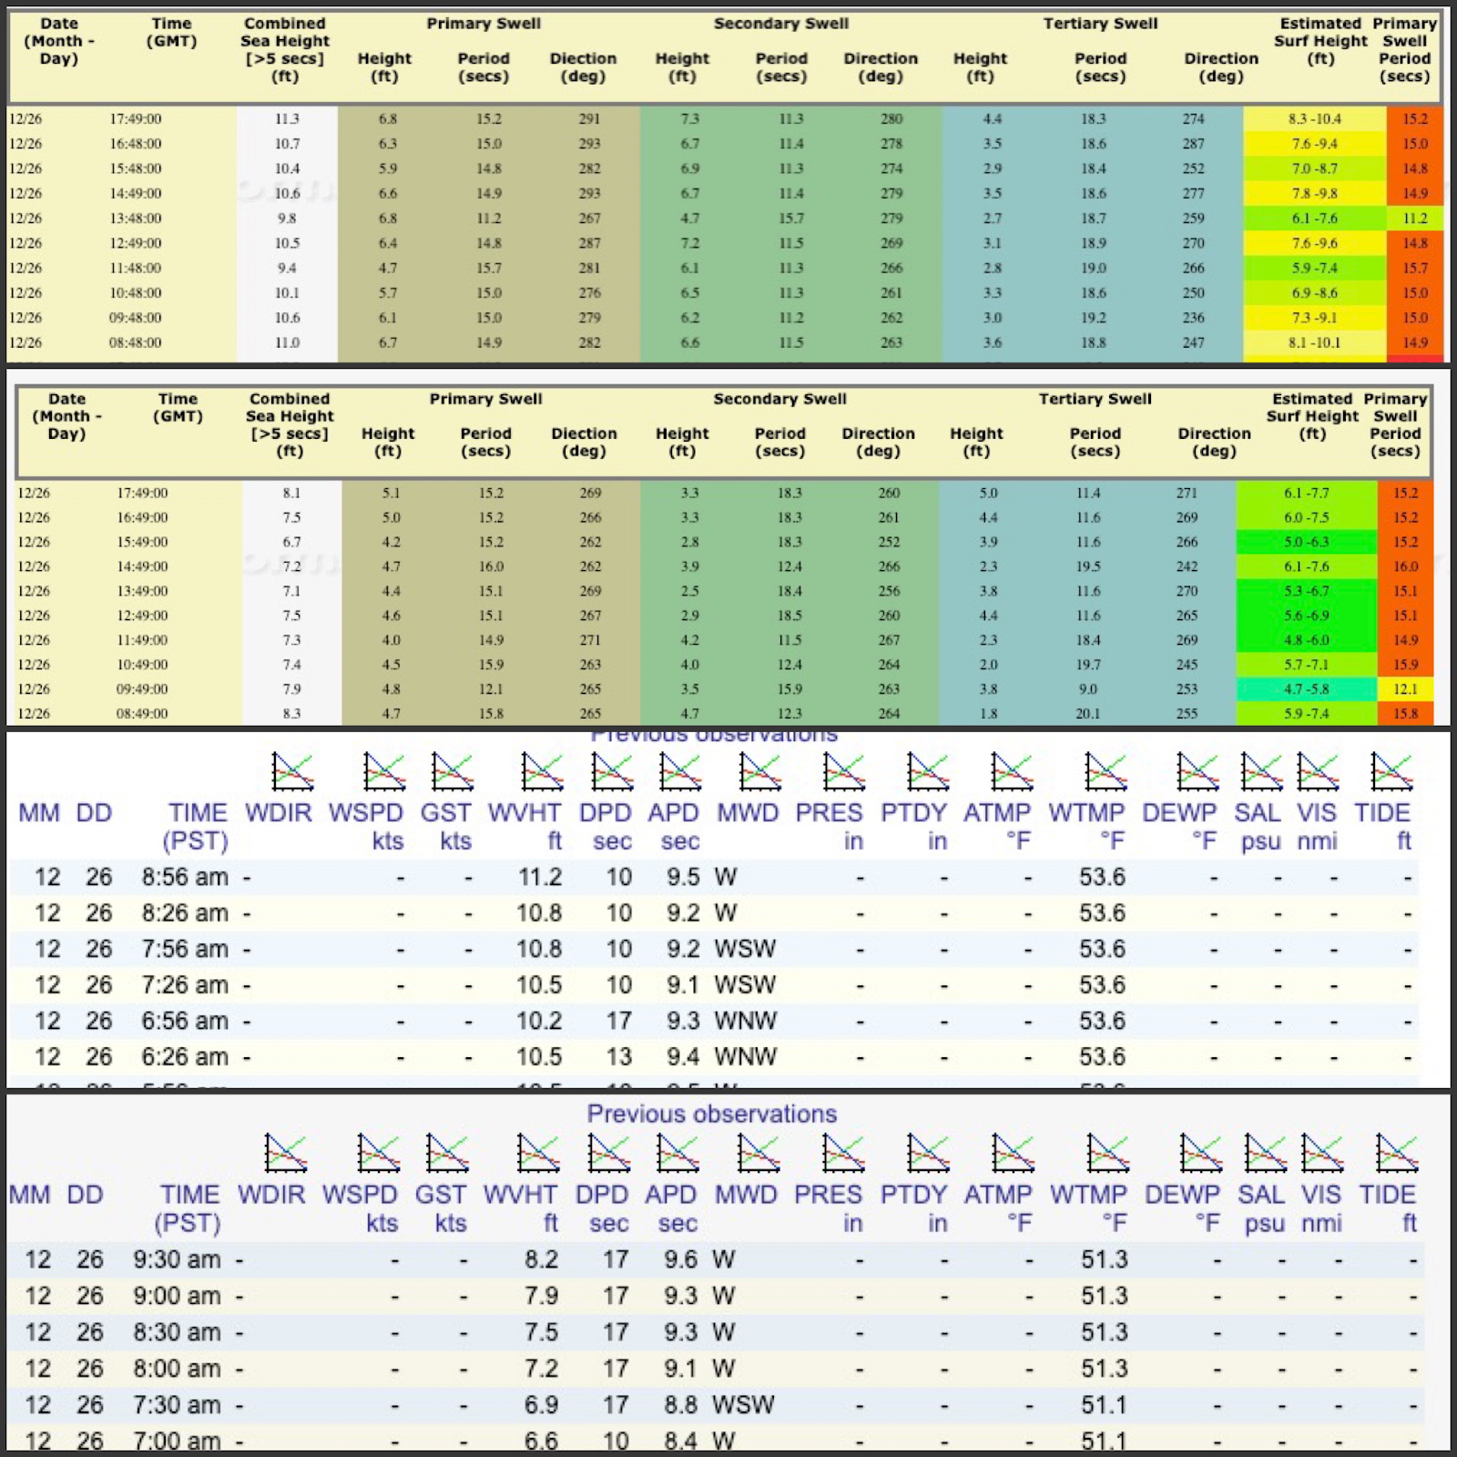

Slide 5
Data Preprocessing I
Arguably the most aching part of this project, as we did not know if this was even possible at first.
Not only is swell and wind data extremely difficult to access legally, it’s even more difficult to have a computer program make sense of that input.
Data accessed from SurfForecast.com, Pysufline, and RealWaterSports.com.
It took weeks of test trials: scraping, cleaning, processing, organizing, and storing/accessing, and each read and write to the database costs money ☹
In the end, we effectively simulated years of surf data for a single beach using two weeks worth of data from thousands of beaches across the pacific coast.

Slide 6
Data Preprocessing II
Using BeautifulSoup, Pandas, Selenium, MapBox, and Python, various data preprocessing programs were developed.
Storage was accomplished using Google’s Firebase.
Feature Engineering was used to make use and better sense of the data regarding wind/swell direction.
Compiling testing and training data:
One set created from surforecast.com containing a quality rating (judged by a qualified surf reporter), the other set from the corresponding raw surf data (NOAA, Meo), lacking any human analysis or quality report.

Slide 7

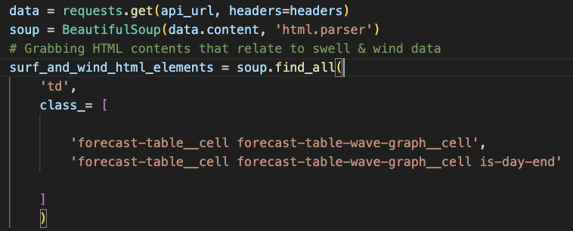
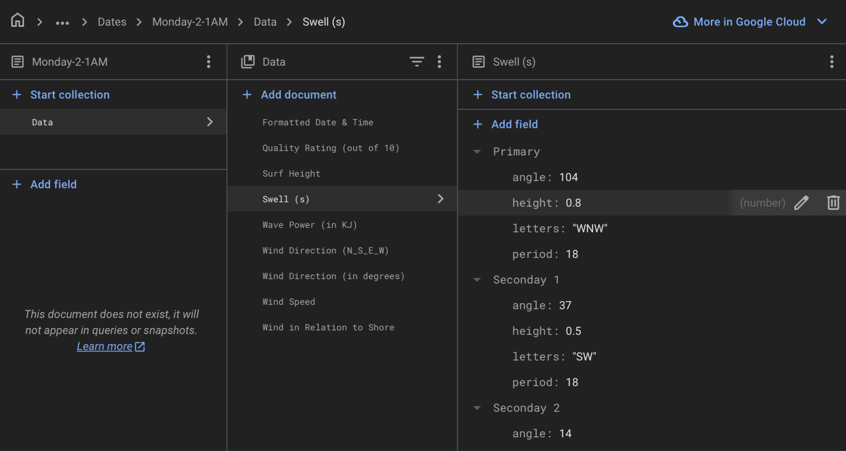
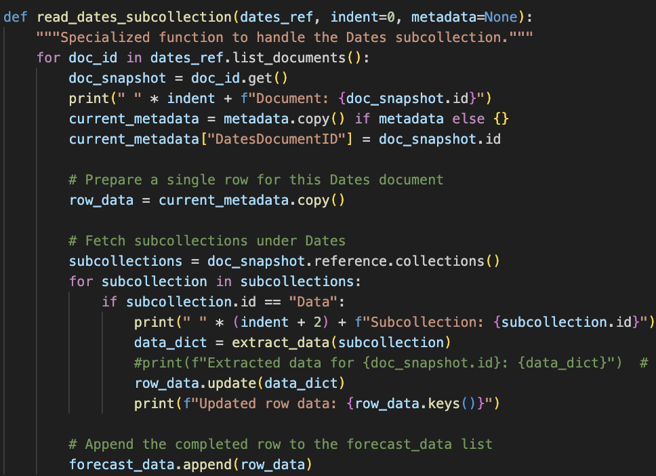
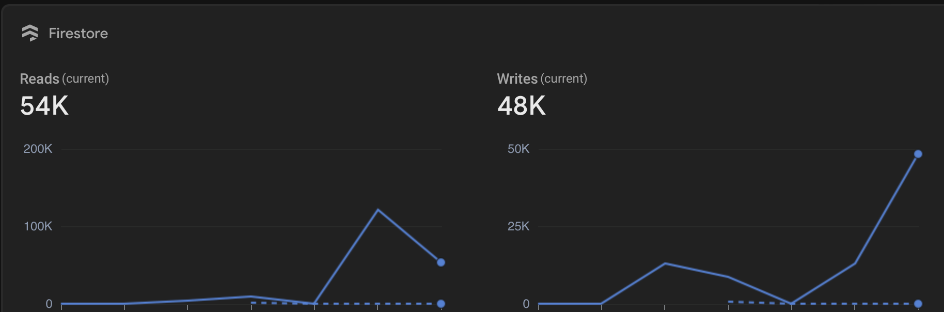
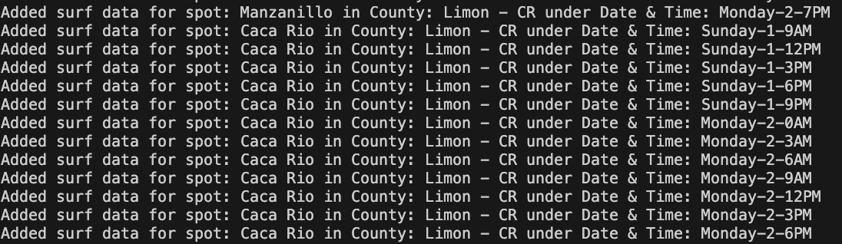

Slide 8
Data and Methodology
Time Frame: 26/11/24-30/11/24
Geographic Scope:
Sample Size:
Weather Data:
Preprocessing: Pandas
Model Used: sklearn RandomForestRegressor and GridSearchCV

Slide 9
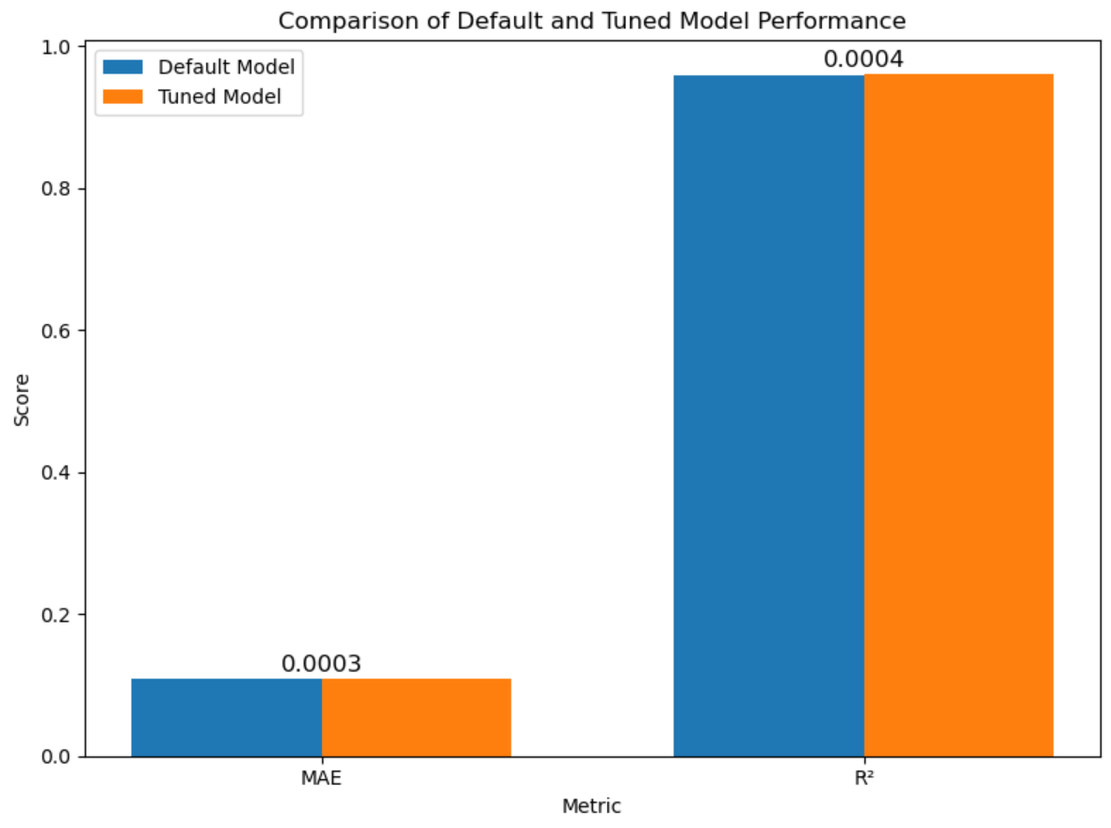
Experimental Results
Performance Metrics: Visualization of Results:
Default Model Performance:
MAE: 0.1083
R²: 0.9591
Tuned Model Performance:
MAE: 0.1080
R²: 0.9596
Performance Improvement After Hyperparameter Tuning:
MAE Improvement: 0.0003
R² Improvement: 0.0004

Slide 10
Discussion
Interpretation:
most improvements were made with feature engineering, increased data surges, and data diversity (as for the the spot location variation).
Though some improvements were made with hyper parameter tuning, processing data further ultimately led to better results”
Challenges:
The hardest part was getting good data, the model worked great.

Slide 11
Conclusion
Summary and Reflection:
This project could support tourism-related businesses. By integrating safety-related data pertaining to wave height or rip current forecasts, this system could contribute to reduce risks for swimmers and surfers. This model could also be applied to activities beyond surfing. This data could lead to other environmental prediction algorithms, like flood or wildfire analysis.

Slide 12
Appendices
Glossary:
Code Snippet: import pandas as pd
# First, we need to remove all of the unnecessary features, since i picked all beach breaks on the pacific west coast, we are treating
# this as one surf break, no need to include directions relative to the shore line nor location/date/times.
# Load the dataset
file_path = 'waves_fileV4b.csv'
data = pd.read_csv(file_path)

Slide 13
Appendices
SurfForecast.com information for San Diego
Sample data: DocumentID,DatesDocumentID,timestamp,name,County,Name,data,Surf Height: Size,Surf Height: Direction,Surf Height: Period,Surf Height: Angle,Seconday 1 -> height,Seconday 1 -> letters,Seconday 1 -> period,Seconday 1 -> angle,Primary -> height,Primary -> letters,Primary -> period,Primary -> angle,Seconday 2 -> height,Seconday 2 -> letters,Seconday 2 -> period,Seconday 2 -> angle,Seconday 3 -> height,Seconday 3 -> letters,Seconday 3 -> period,Seconday 3 -> angle,Star Rating,Wave Power,Wind Direction (NSEW),Wind Direction (Angle),Primary Wind Speed,Wind Direction (Human Relation)
Klamath Rivermouth,Tuesday-26-10PM,26 November 2024: 7:10PM,Del Norte County,Del Norte County,Klamath Rivermouth,"['Tuesday', 'November', 26, 2024, '10PM']",0.9,WNW,7.0,103.0,0.5,W,13,101.0,0.9,WNW,7,103.0,0.3,WNW,20,108.0,,,,,1,86,ENE,254.0,10.0,off
Klamath Rivermouth,Tuesday-26-1PM,26 November 2024: 7:10PM,Del Norte County,Del Norte County,Klamath Rivermouth,"['Tuesday', 'November', 26, 2024, '1PM']",0.8,WSW,7.0,67.0,0.6,WNW,8,108.0,0.8,WSW,7,67.0,0.4,WNW,14,104.0,,,,,1,61,WNW,112.0,5.0,glass

