Slide 1



OpenSurf
➢ human-friendly surf analysis
in the palm of your hand
Nicholas Dibello-Hitta, Nolan Lee,
Jorge Perez, Alan Shami, Andrew Snell

Slide 2
Disclaimer
Data Usage Disclaimer for SurfForecast.com
This project utilizes data web scraped from SurfForecast.com for educational and non-commercial purposes only.
The data has been used in accordance with the website's terms and conditions:
"You may print off one copy, and may download extracts, of any page(s) from our site for your personal reference."
All rights to the data remain with SurfForecast.com, and no commercial use is intended.
For further information, please refer to their Terms and Conditions: https://www.surf-forecast.com/pages/terms

Slide 3
Introduction
Project: Predicting the Quality of Surf based on general NOAA data.
Goal: Provide a user-friendly interface between raw NOAA data and human-readable surf reports using AI techniques discussed throughout CS450 to predict real-time surf conditions.
Significance:
Surf conditions are extremely difficult to predict accurately with general data analysis and algorithms.
As humans, it is tough to fully understand the complexity of reports

Slide 4
Data and Methodology
Time Frame: 26/11/24-30/11/24
Geographic Scope:
Sample Size:
Weather Data:
Preprocessing:
Model Used: sklearn, *add why*

Slide 5
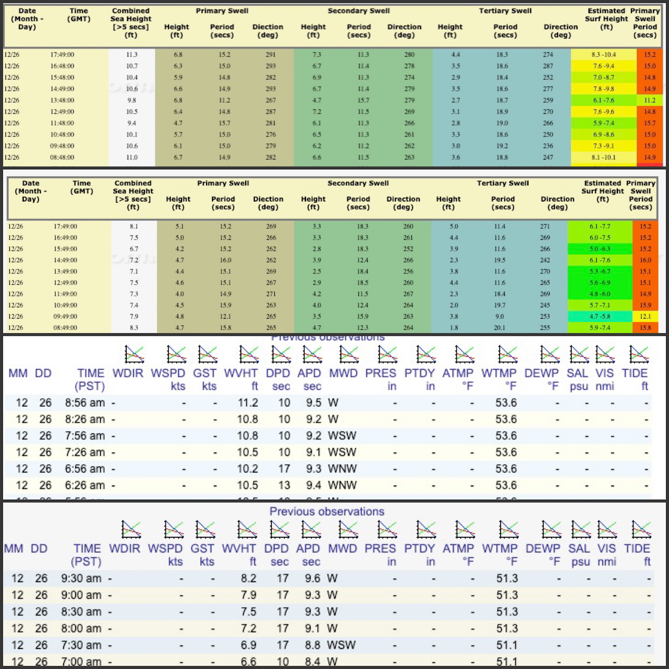
Raw Data

Slide 6
Experimental Results
Performance Metrics:
Visualization of Results:

Slide 7
Discussion
Interpretation:
Challenges:

Slide 8
Conclusion
Summary and Reflection:
This project could support tourism-related businesses. By integrating safety-related data pertaining to wave height or rip current forecasts, this system could contribute to reduce risks for swimmers and surfers. This model could also be applied to activities beyond surfing. This data could lead to other environmental prediction algorithms, like flood or wildfire analysis.

Slide 9
Appendices
Glossary:
Code Snippet: import pandas as pd
# First, we need to remove all of the unnecessary features, since i picked all beach breaks on the pacific west coast, we are treating
# this as one surf break, no need to include directions relative to the shore line nor location/date/times.
# Load the dataset
file_path = 'waves_fileV4b.csv'
data = pd.read_csv(file_path)

Slide 10
Appendices
SurfForecast.com information for San Diego
Sample data: DocumentID,DatesDocumentID,timestamp,name,County,Name,data,Surf Height: Size,Surf Height: Direction,Surf Height: Period,Surf Height: Angle,Seconday 1 -> height,Seconday 1 -> letters,Seconday 1 -> period,Seconday 1 -> angle,Primary -> height,Primary -> letters,Primary -> period,Primary -> angle,Seconday 2 -> height,Seconday 2 -> letters,Seconday 2 -> period,Seconday 2 -> angle,Seconday 3 -> height,Seconday 3 -> letters,Seconday 3 -> period,Seconday 3 -> angle,Star Rating,Wave Power,Wind Direction (NSEW),Wind Direction (Angle),Primary Wind Speed,Wind Direction (Human Relation)
Klamath Rivermouth,Tuesday-26-10PM,26 November 2024: 7:10PM,Del Norte County,Del Norte County,Klamath Rivermouth,"['Tuesday', 'November', 26, 2024, '10PM']",0.9,WNW,7.0,103.0,0.5,W,13,101.0,0.9,WNW,7,103.0,0.3,WNW,20,108.0,,,,,1,86,ENE,254.0,10.0,off
Klamath Rivermouth,Tuesday-26-1PM,26 November 2024: 7:10PM,Del Norte County,Del Norte County,Klamath Rivermouth,"['Tuesday', 'November', 26, 2024, '1PM']",0.8,WSW,7.0,67.0,0.6,WNW,8,108.0,0.8,WSW,7,67.0,0.4,WNW,14,104.0,,,,,1,61,WNW,112.0,5.0,glass

