Slide 1
EDES 301 <Epic Audio Analyzer> Proposal
<2/23/2026>
<Nicholas Melendez>

Slide 2
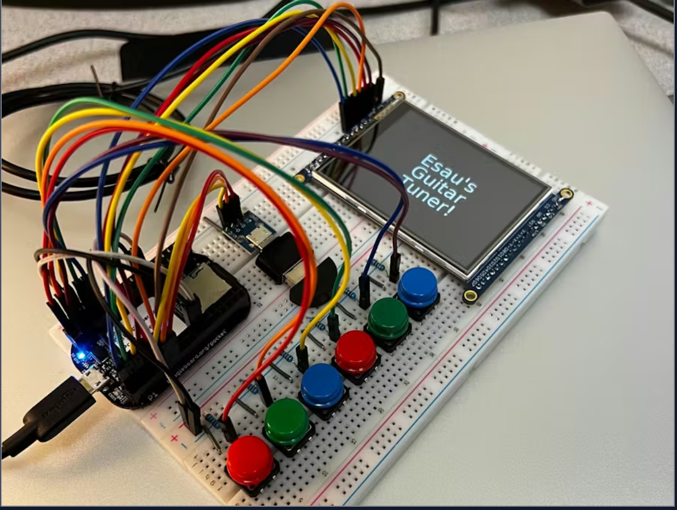
Background Information
My goal is to create an embedded system which can listen to audio, analyze it, and output the general pitch of the sound, along with its frequency, and if the note is in tune or not, through display.
My Idea came from this project:
PocketBeagle Guitar Tuner - Hackster.io The project is a guitar tunner which is able to listen to notes and determine if the guitar is in tune or not. I though I could make something similar but apply it to many sounds and not just guitar
I’ve grown interest in this project because up until now, music and sound has always fascinated me. As a trumpet player, I’ve never thought about
analyzing sound, but I found musical tuners to be pretty cool because I never knew how they worked. In my concurrent music theory for non music majors class,
We covered how a Fourier transform can be used to analyze sounds in the time domain and how they can determine the overall pitch composition of sounds,
and so through this project, I would like to attempt to create my own sound analyzer.

Slide 3
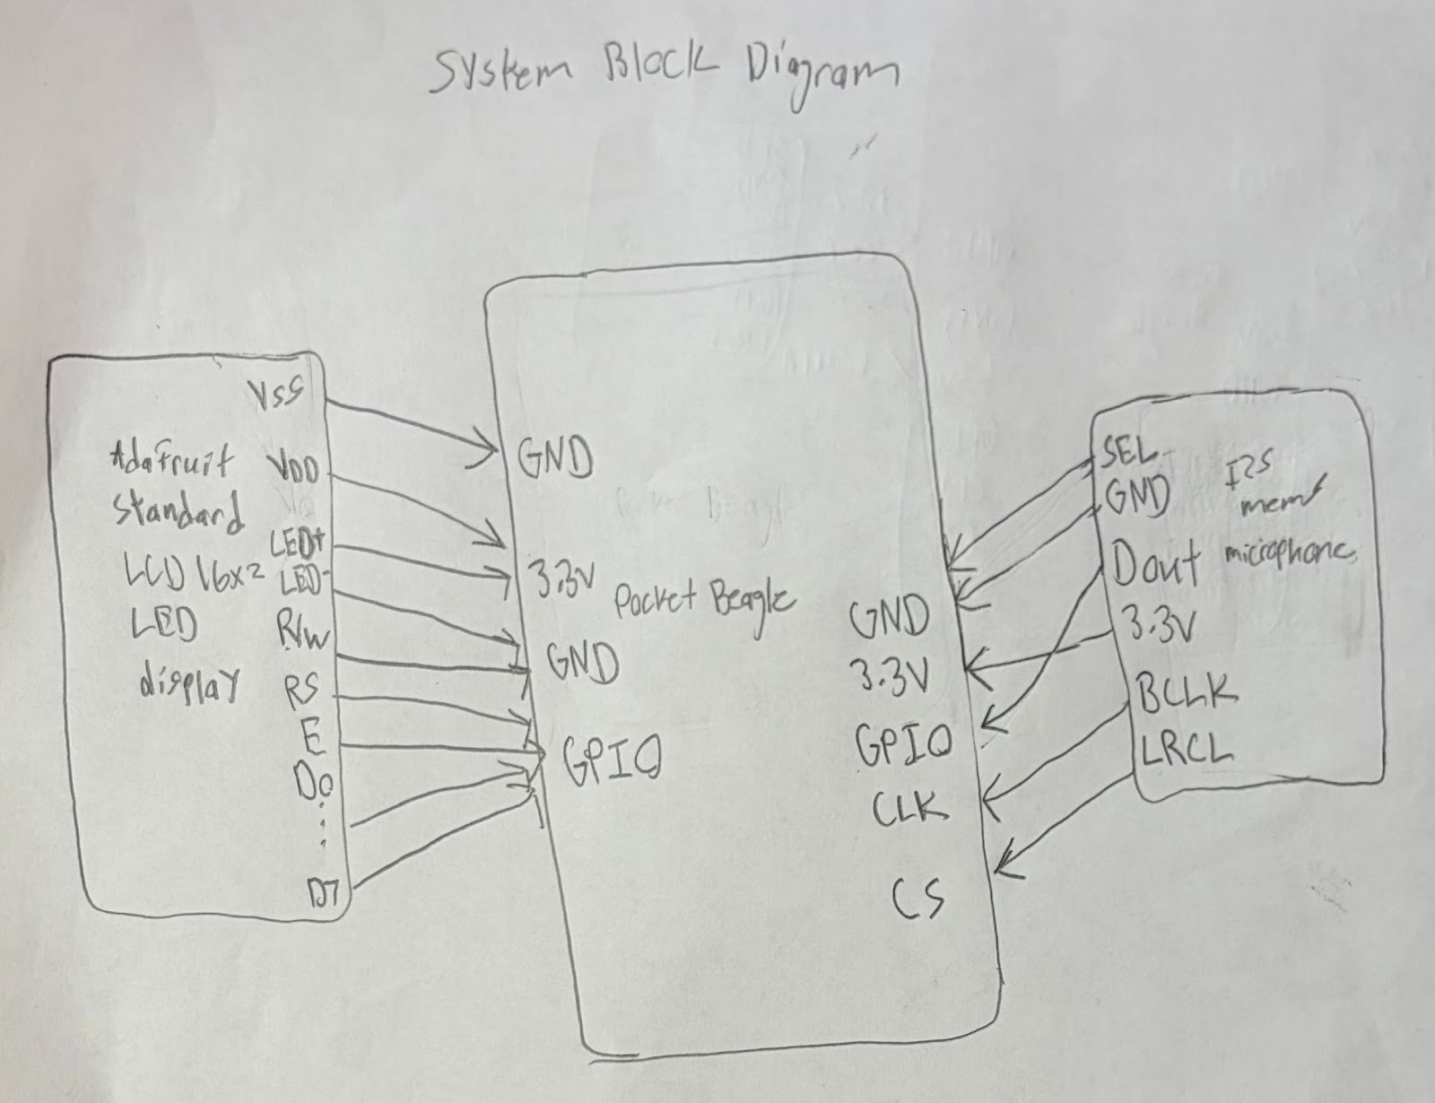
System Block Diagram

Slide 4
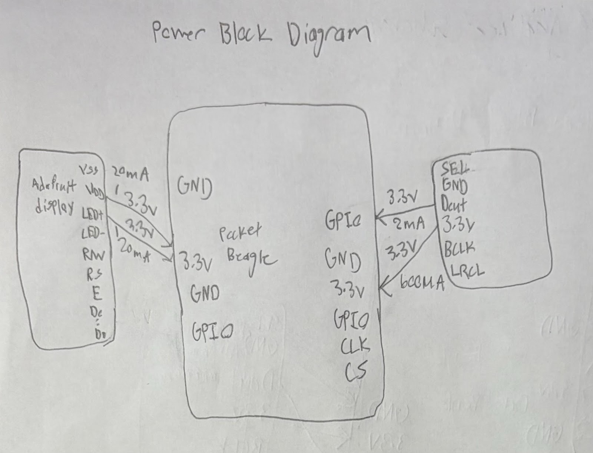
Power Block Diagram

Slide 5
Components / Budget
Component | EDES301 to Buy? | Cost
SPH0645LM4H SiSonic™ MEMS Omnidirectional Microphones Audio Evaluation Board - 3421 Adafruit Industries LLC | Development Boards, Kits, Programmers | DigiKey | Yes | $15.09 (include shiping +tax)
Character Display (16x2) white on blue (from parts list) Standard LCD 16x2 + extras [white on blue] : Adafruit Industries, Unique & fun DIY electronics and kits | Yes | $17.52 (cheapest shipping + tax)

