Slide 1
Text Mining Reviews for NICHOLAS V.
Wine Classification NIKOLOV
ILLINOIS STATE UNIVERSITY

Slide 2
WHAT IS WINE? (yes, really)

Slide 3
WHAT IS WINE? (yes, really)
“The alcoholic fermented juice of fresh grapes used as a beverage”
Notes:
* the alcoholic fermented juice of fresh grapes used as a beverage -- Merriam Webster

Slide 4
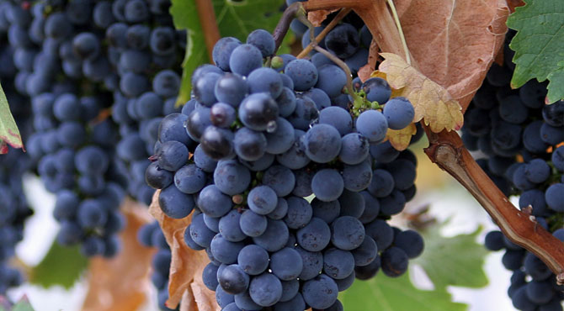
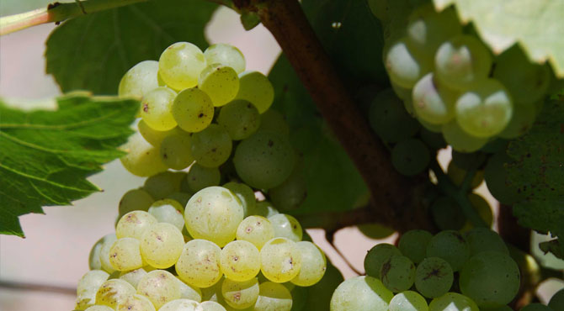
WHAT IS WINE? (yes, really)
“The alcoholic fermented juice of fresh grapes used as a beverage”
Classifications based on grape (Europe vs. World)
CABERNET SAVIGNON
CHARDONNAY
Notes:
the alcoholic fermented juice of fresh grapes used as a beverage -- Merriam Webster
Europe classifies wines based on region. Rest of world TYPICALLY categorizes by grape
Cab image from healthbenefitstimes.com

Slide 5
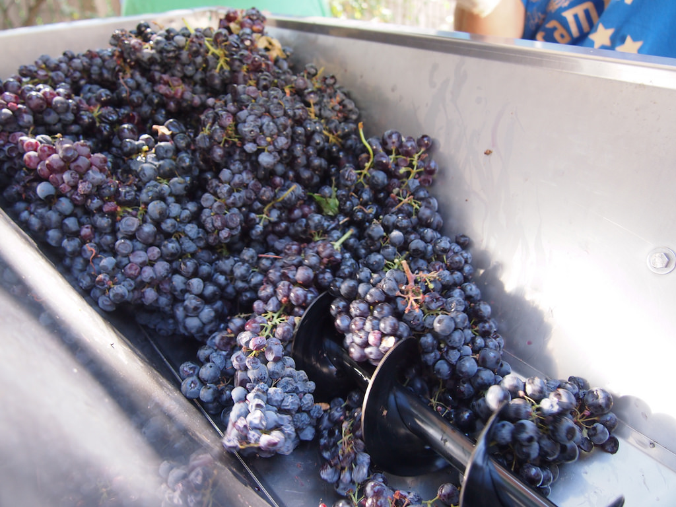
WHAT IS WINE? (yes, really)
“The alcoholic fermented juice of fresh grapes used as a beverage”
Classifications based on grape (Europe vs. World)
How wine is made
Notes:
the alcoholic fermented juice of fresh grapes used as a beverage -- Merriam Webster
Europe classifies wines based on region. Rest of world TYPICALLY categorizes by grape
Cab image from healthbenefitstimes.com
Wine is made in a multistep process: Grapes are harvested, pressed (releasing the juices), then sealed in airtight containers (typically barrels)

Slide 6
DATA PREPROCESSING
Feature Selection
Country | Description | Points | Price | Province | Region_1 | Region_2 | Winery | Variety
US | Tart and… | 87 | 14 | Oregon | Williamette | Williamette | Rainstorm | Pinot Gris
France | This soft… | 86 | 15 | Burgundy | MÃ¢con-Milly Lamartine |  | Vignerons des Terres SecrÃ¨tes | Chardonnay
Spain | Blackberry… | 87 | 15 | Northern Spain | Navarra |  | Tandem | Tempranillo-Merlot
Notes:
the alcoholic fermented juice of fresh grapes used as a beverage -- Merriam Webster
Europe classifies wines based on region. Rest of world TYPICALLY categorizes by grape
Cab image from healthbenefitstimes.com
Wine is made in a multistep process: Grapes are harvested, pressed (releasing the juices), then sealed in airtight containers (typically barrels)

Slide 7
DATA PREPROCESSING
Feature Selection
Wine Variety | Observations
Cabernet Sauvignon | 7067
Chardonnay | 6377
Malbec | 503
Merlot | 2190
Pinot Gris | 787
Pinot Noir | 9008
Riesling | 1598
Zinfandel | 2554
Notes:
the alcoholic fermented juice of fresh grapes used as a beverage -- Merriam Webster
Europe classifies wines based on region. Rest of world TYPICALLY categorizes by grape
Cab image from healthbenefitstimes.com
Wine is made in a multistep process: Grapes are harvested, pressed (releasing the juices), then sealed in airtight containers (typically barrels)

Slide 8
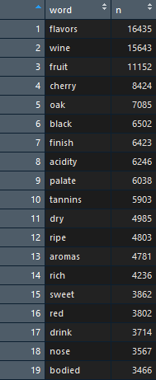
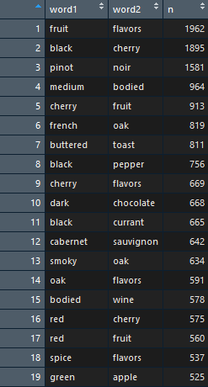
DATA PREPROCESSING
Feature Selection
Character Vector Text Mining (ngram tokenization)
Notes:
the alcoholic fermented juice of fresh grapes used as a beverage -- Merriam Webster
Europe classifies wines based on region. Rest of world TYPICALLY categorizes by grape
Cab image from healthbenefitstimes.com
Wine is made in a multistep process: Grapes are harvested, pressed (releasing the juices), then sealed in airtight containers (typically barrels)

Slide 9
DATA PREPROCESSING
Feature Selection
Character Vector Text Mining (ngram tokenization)
Notes:
the alcoholic fermented juice of fresh grapes used as a beverage -- Merriam Webster
Europe classifies wines based on region. Rest of world TYPICALLY categorizes by grape
Cab image from healthbenefitstimes.com
Wine is made in a multistep process: Grapes are harvested, pressed (releasing the juices), then sealed in airtight containers (typically barrels)

Slide 10
DATA PREPROCESSING
Feature Selection
Character Vector Text Mining (ngram tokenization)
Dummy Variable Creation
Notes:
the alcoholic fermented juice of fresh grapes used as a beverage -- Merriam Webster
Europe classifies wines based on region. Rest of world TYPICALLY categorizes by grape
Cab image from healthbenefitstimes.com
Wine is made in a multistep process: Grapes are harvested, pressed (releasing the juices), then sealed in airtight containers (typically barrels)
H2O’s Deep Learning is based on a multi-layer feedforward artificial neural network that is trained with stochastic gradient descent using back-propagation.
H2O Deep Learning has implemented the method of Gedeon, and returns relative variable importances in descending order of importance.

Slide 11
DATA PREPROCESSING
Feature Selection
Character Vector Text Mining (ngram tokenization)
Dummy Variable Creation
Training/Test Split
Notes:
the alcoholic fermented juice of fresh grapes used as a beverage -- Merriam Webster
Europe classifies wines based on region. Rest of world TYPICALLY categorizes by grape
Cab image from healthbenefitstimes.com
Wine is made in a multistep process: Grapes are harvested, pressed (releasing the juices), then sealed in airtight containers (typically barrels)
H2O’s Deep Learning is based on a multi-layer feedforward artificial neural network that is trained with stochastic gradient descent using back-propagation.
H2O Deep Learning has implemented the method of Gedeon, and returns relative variable importances in descending order of importance.

Slide 12
MODEL DEVELOPMENT
First model – Random Forest
Notes:
the alcoholic fermented juice of fresh grapes used as a beverage -- Merriam Webster
Europe classifies wines based on region. Rest of world TYPICALLY categorizes by grape
Cab image from healthbenefitstimes.com
Wine is made in a multistep process: Grapes are harvested, pressed (releasing the juices), then sealed in airtight containers (typically barrels)
H2O’s Deep Learning is based on a multi-layer feedforward artificial neural network that is trained with stochastic gradient descent using back-propagation.
H2O Deep Learning has implemented the method of Gedeon, and returns relative variable importances in descending order of importance.

Slide 13
MODEL DEVELOPMENT
First model – Random Forest
Initial goal of 67% achieved
1-gram tokenization
Notes:
the alcoholic fermented juice of fresh grapes used as a beverage -- Merriam Webster
Europe classifies wines based on region. Rest of world TYPICALLY categorizes by grape
Cab image from healthbenefitstimes.com
Wine is made in a multistep process: Grapes are harvested, pressed (releasing the juices), then sealed in airtight containers (typically barrels)
H2O’s Deep Learning is based on a multi-layer feedforward artificial neural network that is trained with stochastic gradient descent using back-propagation.
H2O Deep Learning has implemented the method of Gedeon, and returns relative variable importances in descending order of importance.

Slide 14
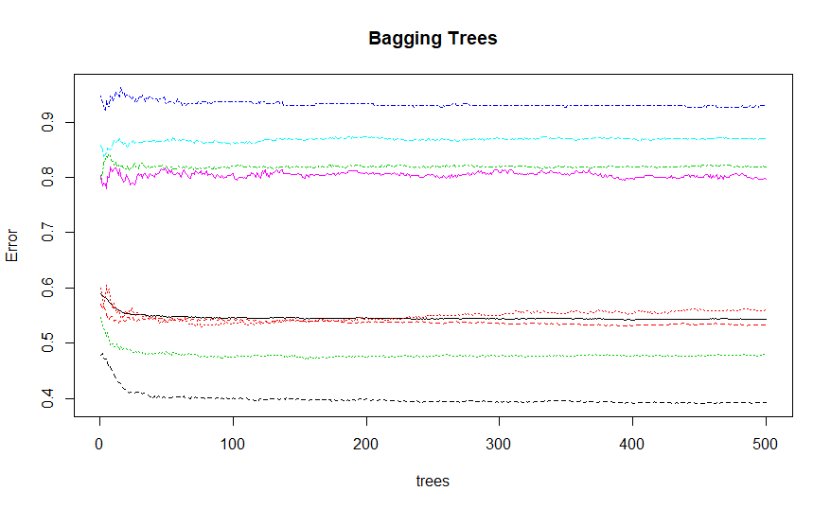
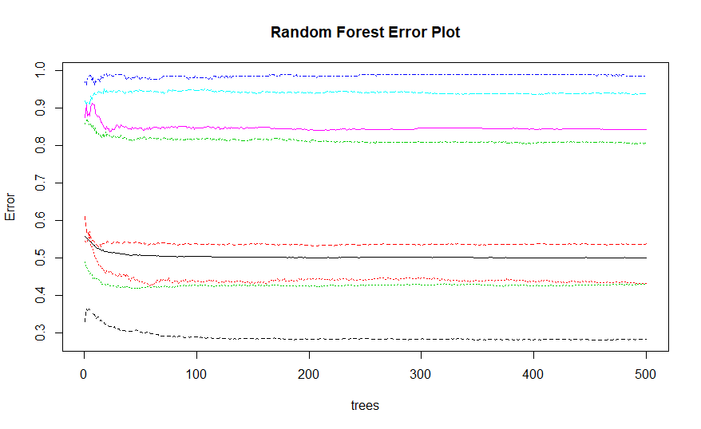
MODEL DEVELOPMENT
First model – Random Forest/Bagging
Initial goal of 67% achieved
1-gram tokenization
Limitations – larger models
Notes:
the alcoholic fermented juice of fresh grapes used as a beverage -- Merriam Webster
Europe classifies wines based on region. Rest of world TYPICALLY categorizes by grape
Cab image from healthbenefitstimes.com
Wine is made in a multistep process: Grapes are harvested, pressed (releasing the juices), then sealed in airtight containers (typically barrels)
H2O’s Deep Learning is based on a multi-layer feedforward artificial neural network that is trained with stochastic gradient descent using back-propagation.
H2O Deep Learning has implemented the method of Gedeon, and returns relative variable importances in descending order of importance.

Slide 15
MODEL DEVELOPMENT
First model – Random Forest/Bagging
Initial goal of 67% achieved
1-gram tokenization
Limitations – larger models
Wine Variety | Class Error
Cabernet Sauvignon | 53.17%
Chardonnay | 47.83%
Malbec | 93.01%
Merlot | 86.93%
Pinot Gris | 79.61%
Pinot Noir | 39.30%
Riesling | 56.00%
Zinfandel | 81.88%
Notes:
the alcoholic fermented juice of fresh grapes used as a beverage -- Merriam Webster
Europe classifies wines based on region. Rest of world TYPICALLY categorizes by grape
Cab image from healthbenefitstimes.com
Wine is made in a multistep process: Grapes are harvested, pressed (releasing the juices), then sealed in airtight containers (typically barrels)
H2O’s Deep Learning is based on a multi-layer feedforward artificial neural network that is trained with stochastic gradient descent using back-propagation.
H2O Deep Learning has implemented the method of Gedeon, and returns relative variable importances in descending order of importance.

Slide 16
MODEL DEVELOPMENT
First model – Random Forest/Bagging
Initial goal of 67% achieved
1-gram tokenization
Limitations – larger models
Wine Variety | Class Error
Cabernet Sauvignon | 53.17%
Chardonnay | 47.83%
Malbec | 93.01%
Merlot | 86.93%
Pinot Gris | 79.61%
Pinot Noir | 39.30%
Riesling | 56.00%
Zinfandel | 81.88%
Vs. Random Guessing
>70% Error
Notes:
the alcoholic fermented juice of fresh grapes used as a beverage -- Merriam Webster
Europe classifies wines based on region. Rest of world TYPICALLY categorizes by grape
Cab image from healthbenefitstimes.com
Wine is made in a multistep process: Grapes are harvested, pressed (releasing the juices), then sealed in airtight containers (typically barrels)
H2O’s Deep Learning is based on a multi-layer feedforward artificial neural network that is trained with stochastic gradient descent using back-propagation.
H2O Deep Learning has implemented the method of Gedeon, and returns relative variable importances in descending order of importance.

Slide 17
MODEL DEVELOPMENT
First model – Random Forest/Bagging
Initial goal of 67% achieved
1-gram tokenization
Limitations
Second Model – Artificial Neural Network
Notes:
the alcoholic fermented juice of fresh grapes used as a beverage -- Merriam Webster
Europe classifies wines based on region. Rest of world TYPICALLY categorizes by grape
Cab image from healthbenefitstimes.com
Wine is made in a multistep process: Grapes are harvested, pressed (releasing the juices), then sealed in airtight containers (typically barrels)
H2O’s Deep Learning is based on a multi-layer feedforward artificial neural network that is trained with stochastic gradient descent using back-propagation.
H2O Deep Learning has implemented the method of Gedeon, and returns relative variable importances in descending order of importance.

Slide 18
MODEL DEVELOPMENT
First model – Random Forest/Bagging
Initial goal of 67% achieved
1-gram tokenization
Limitations
Second Model – Artificial Neural Network
Initial difficulty with high class error
Notes:
the alcoholic fermented juice of fresh grapes used as a beverage -- Merriam Webster
Europe classifies wines based on region. Rest of world TYPICALLY categorizes by grape
Cab image from healthbenefitstimes.com
Wine is made in a multistep process: Grapes are harvested, pressed (releasing the juices), then sealed in airtight containers (typically barrels)
H2O’s Deep Learning is based on a multi-layer feedforward artificial neural network that is trained with stochastic gradient descent using back-propagation.
H2O Deep Learning has implemented the method of Gedeon, and returns relative variable importances in descending order of importance.

Slide 19
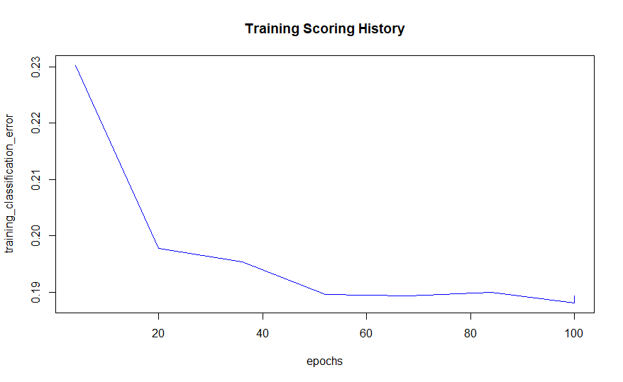
MODEL DEVELOPMENT
First model – Random Forest/Bagging
Initial goal of 67% achieved
1-gram tokenization
Limitations
Second Model – Artificial Neural Network
Initial difficulty with high class error
Implementing 2 and 3-gram tokenization
Notes:
the alcoholic fermented juice of fresh grapes used as a beverage -- Merriam Webster
Europe classifies wines based on region. Rest of world TYPICALLY categorizes by grape
Cab image from healthbenefitstimes.com
Wine is made in a multistep process: Grapes are harvested, pressed (releasing the juices), then sealed in airtight containers (typically barrels)
H2O’s Deep Learning is based on a multi-layer feedforward artificial neural network that is trained with stochastic gradient descent using back-propagation.
H2O Deep Learning has implemented the method of Gedeon, and returns relative variable importances in descending order of importance.

Slide 20
MODEL DEVELOPMENT
First model – Random Forest/Bagging
Initial goal of 67% achieved
1-gram tokenization
Limitations
Second Model – Artificial Neural Network
Initial difficulty with high class error
Implementing 2 and 3-gram tokenization
Validated on test data – 78-78.5% accuracy
Notes:
the alcoholic fermented juice of fresh grapes used as a beverage -- Merriam Webster
Europe classifies wines based on region. Rest of world TYPICALLY categorizes by grape
Cab image from healthbenefitstimes.com
Wine is made in a multistep process: Grapes are harvested, pressed (releasing the juices), then sealed in airtight containers (typically barrels)
H2O’s Deep Learning is based on a multi-layer feedforward artificial neural network that is trained with stochastic gradient descent using back-propagation.
H2O Deep Learning has implemented the method of Gedeon, and returns relative variable importances in descending order of importance.

Slide 21
FINAL MODEL
Artificial Neural Network
Notes:
the alcoholic fermented juice of fresh grapes used as a beverage -- Merriam Webster
Europe classifies wines based on region. Rest of world TYPICALLY categorizes by grape
Cab image from healthbenefitstimes.com
Wine is made in a multistep process: Grapes are harvested, pressed (releasing the juices), then sealed in airtight containers (typically barrels)
H2O’s Deep Learning is based on a multi-layer feedforward artificial neural network that is trained with stochastic gradient descent using back-propagation.
H2O Deep Learning has implemented the method of Gedeon, and returns relative variable importances in descending order of importance.

Slide 22
FINAL MODEL
Feedforward Artificial Neural Network
Two hidden layers with 12 and 10 neurons respectively
Notes:
the alcoholic fermented juice of fresh grapes used as a beverage -- Merriam Webster
Europe classifies wines based on region. Rest of world TYPICALLY categorizes by grape
Cab image from healthbenefitstimes.com
Wine is made in a multistep process: Grapes are harvested, pressed (releasing the juices), then sealed in airtight containers (typically barrels)
H2O’s Deep Learning is based on a multi-layer feedforward artificial neural network that is trained with stochastic gradient descent using back-propagation.
H2O Deep Learning has implemented the method of Gedeon, and returns relative variable importances in descending order of importance.

Slide 23
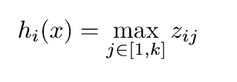

FINAL MODEL
Feedforward Artificial Neural Network
Two hidden layers with 12 and 10 neurons respectively
Maxout activation
Notes:
the alcoholic fermented juice of fresh grapes used as a beverage -- Merriam Webster
Europe classifies wines based on region. Rest of world TYPICALLY categorizes by grape
Cab image from healthbenefitstimes.com
Wine is made in a multistep process: Grapes are harvested, pressed (releasing the juices), then sealed in airtight containers (typically barrels)
H2O’s Deep Learning is based on a multi-layer feedforward artificial neural network that is trained with stochastic gradient descent using back-propagation.
H2O Deep Learning has implemented the method of Gedeon, and returns relative variable importances in descending order of importance.

Slide 24

FINAL MODEL
Feedforward Artificial Neural Network
Two hidden layers with 12 and 10 neurons respectively
Maxout activation
Cross entropy loss
Notes:
the alcoholic fermented juice of fresh grapes used as a beverage -- Merriam Webster
Europe classifies wines based on region. Rest of world TYPICALLY categorizes by grape
Cab image from healthbenefitstimes.com
Wine is made in a multistep process: Grapes are harvested, pressed (releasing the juices), then sealed in airtight containers (typically barrels)
H2O’s Deep Learning is based on a multi-layer feedforward artificial neural network that is trained with stochastic gradient descent using back-propagation.
H2O Deep Learning has implemented the method of Gedeon, and returns relative variable importances in descending order of importance.

Slide 25
FINAL MODEL
Feedforward Artificial Neural Network
Two hidden layers with 12 and 10 neurons respectively
Maxout activation
Cross entropy loss
20 epochs
Notes:
the alcoholic fermented juice of fresh grapes used as a beverage -- Merriam Webster
Europe classifies wines based on region. Rest of world TYPICALLY categorizes by grape
Cab image from healthbenefitstimes.com
Wine is made in a multistep process: Grapes are harvested, pressed (releasing the juices), then sealed in airtight containers (typically barrels)
H2O’s Deep Learning is based on a multi-layer feedforward artificial neural network that is trained with stochastic gradient descent using back-propagation.
H2O Deep Learning has implemented the method of Gedeon, and returns relative variable importances in descending order of importance.

Slide 26
FINAL MODEL
Feedforward Artificial Neural Network
Two hidden layers with 12 and 10 neurons respectively
Maxout activation
Cross entropy loss
20 epochs
Wine Variety | Class Error
Cabernet Sauvignon | 30.18% (-22.99%)
Chardonnay | 13.75% (-34.08%)
Malbec | 17.02% (-75.99%)
Merlot | 33.74% (-53.19%)
Pinot Gris | 27.5% (-52.11%)
Pinot Noir | 19.30% (-20%)
Riesling | 13.50% (-42.5%)
Zinfandel | 32.65% (-49.23%)
Notes:
the alcoholic fermented juice of fresh grapes used as a beverage -- Merriam Webster
Europe classifies wines based on region. Rest of world TYPICALLY categorizes by grape
Cab image from healthbenefitstimes.com
Wine is made in a multistep process: Grapes are harvested, pressed (releasing the juices), then sealed in airtight containers (typically barrels)
H2O’s Deep Learning is based on a multi-layer feedforward artificial neural network that is trained with stochastic gradient descent using back-propagation.
H2O Deep Learning has implemented the method of Gedeon, and returns relative variable importances in descending order of importance.

Slide 27
FUTURE IMPROVEMENTS
More Implemented Tokens (I.e. more variables)
Notes:
the alcoholic fermented juice of fresh grapes used as a beverage -- Merriam Webster
Europe classifies wines based on region. Rest of world TYPICALLY categorizes by grape
Cab image from healthbenefitstimes.com
Wine is made in a multistep process: Grapes are harvested, pressed (releasing the juices), then sealed in airtight containers (typically barrels)
H2O’s Deep Learning is based on a multi-layer feedforward artificial neural network that is trained with stochastic gradient descent using back-propagation.
H2O Deep Learning has implemented the method of Gedeon, and returns relative variable importances in descending order of importance.

Slide 28
FUTURE IMPROVEMENTS
More Implemented Tokens (I.e. more variables)
Higher Tokens (e.g. 4-gram)
Notes:
the alcoholic fermented juice of fresh grapes used as a beverage -- Merriam Webster
Europe classifies wines based on region. Rest of world TYPICALLY categorizes by grape
Cab image from healthbenefitstimes.com
Wine is made in a multistep process: Grapes are harvested, pressed (releasing the juices), then sealed in airtight containers (typically barrels)
H2O’s Deep Learning is based on a multi-layer feedforward artificial neural network that is trained with stochastic gradient descent using back-propagation.
H2O Deep Learning has implemented the method of Gedeon, and returns relative variable importances in descending order of importance.

Slide 29
FUTURE IMPROVEMENTS
More Implemented Tokens (I.e. more variables)
Higher Tokens (e.g. 4-gram)
Binary Classification
Notes:
the alcoholic fermented juice of fresh grapes used as a beverage -- Merriam Webster
Europe classifies wines based on region. Rest of world TYPICALLY categorizes by grape
Cab image from healthbenefitstimes.com
Wine is made in a multistep process: Grapes are harvested, pressed (releasing the juices), then sealed in airtight containers (typically barrels)
H2O’s Deep Learning is based on a multi-layer feedforward artificial neural network that is trained with stochastic gradient descent using back-propagation.
H2O Deep Learning has implemented the method of Gedeon, and returns relative variable importances in descending order of importance.

Slide 30
FUTURE IMPROVEMENTS
More Implemented Tokens (I.e. more variables)
Higher Tokens (e.g. 4-gram)
Binary Classification
Implement Winery Variable
Notes:
the alcoholic fermented juice of fresh grapes used as a beverage -- Merriam Webster
Europe classifies wines based on region. Rest of world TYPICALLY categorizes by grape
Cab image from healthbenefitstimes.com
Wine is made in a multistep process: Grapes are harvested, pressed (releasing the juices), then sealed in airtight containers (typically barrels)
H2O’s Deep Learning is based on a multi-layer feedforward artificial neural network that is trained with stochastic gradient descent using back-propagation.
H2O Deep Learning has implemented the method of Gedeon, and returns relative variable importances in descending order of importance.

Slide 31
FUTURE IMPROVEMENTS
More Implemented Tokens (I.e. more variables)
Higher Tokens (e.g. 4-gram)
Binary Classification
Implement Winery Variable
Incorporate Additional Classes (I.e. more wines to predict)
Notes:
the alcoholic fermented juice of fresh grapes used as a beverage -- Merriam Webster
Europe classifies wines based on region. Rest of world TYPICALLY categorizes by grape
Cab image from healthbenefitstimes.com
Wine is made in a multistep process: Grapes are harvested, pressed (releasing the juices), then sealed in airtight containers (typically barrels)
H2O’s Deep Learning is based on a multi-layer feedforward artificial neural network that is trained with stochastic gradient descent using back-propagation.
H2O Deep Learning has implemented the method of Gedeon, and returns relative variable importances in descending order of importance.

Slide 32
FUTURE IMPROVEMENTS
More Implemented Tokens (I.e. more variables)
Higher Tokens (e.g. 4-gram)
Binary Classification
Implement Winery Variable
Incorporate Additional Classes (I.e. more wines to predict)
Using Tensorflow for GPU Support and More Layer Control
Notes:
the alcoholic fermented juice of fresh grapes used as a beverage -- Merriam Webster
Europe classifies wines based on region. Rest of world TYPICALLY categorizes by grape
Cab image from healthbenefitstimes.com
Wine is made in a multistep process: Grapes are harvested, pressed (releasing the juices), then sealed in airtight containers (typically barrels)
H2O’s Deep Learning is based on a multi-layer feedforward artificial neural network that is trained with stochastic gradient descent using back-propagation.
H2O Deep Learning has implemented the method of Gedeon, and returns relative variable importances in descending order of importance.

Slide 33
REFERENCES
Goodfellow, I., Warde-Farley, D., Mirza, M., Courville, A. and Bengio, Y. (2013). Maxout Networks.
Goodfellow, I., Bengio, Y., Courville, A. (2016). Deep Learning. MIT Press.
Silge, J., & Robinson, D. (2017). Text mining with R. Beijing: O'Reilly.
Kuhn, M., & Johnson, K. (2013). Applied Predictive Modeling. Springer.
Eigel, K. (2018). How Wine is Made: From Grapes to Glass. Retrieved from https://winefolly.com/review/how-wine-is-made-in-pictures/
Notes:
the alcoholic fermented juice of fresh grapes used as a beverage -- Merriam Webster
Europe classifies wines based on region. Rest of world TYPICALLY categorizes by grape
Cab image from healthbenefitstimes.com
Wine is made in a multistep process: Grapes are harvested, pressed (releasing the juices), then sealed in airtight containers (typically barrels)
H2O’s Deep Learning is based on a multi-layer feedforward artificial neural network that is trained with stochastic gradient descent using back-propagation.
H2O Deep Learning has implemented the method of Gedeon, and returns relative variable importances in descending order of importance.

