Slide 1
Integrating R with SQL
Nicholas V. Nikolov

Slide 2
Outline of topics covered
Design of Database
  EER and ER Diagrams
  Relational mapping
Database connection through R and simple query
Simple model building using data from SQL query
Making a model prediction and writing into database

Slide 3
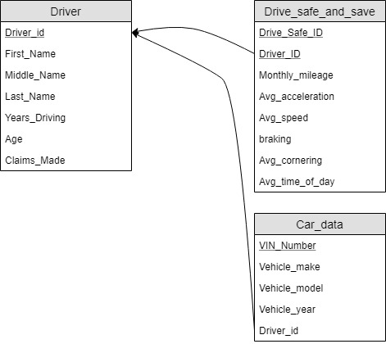
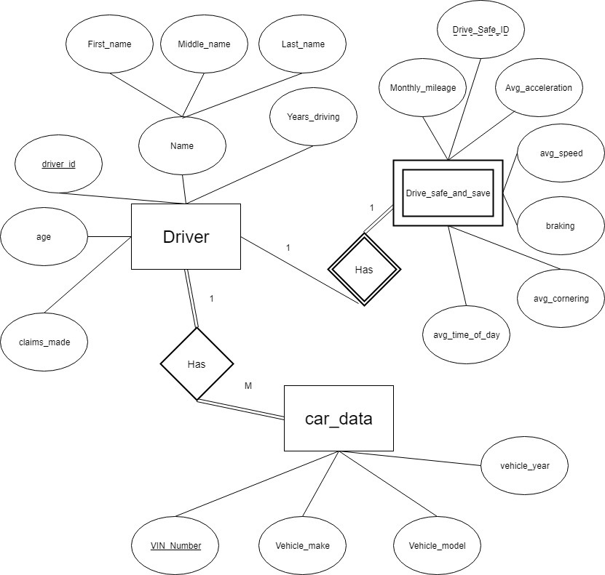
Database Design
Begin with simple enhanced entity relation diagram
Create relational mapping
This is a mock database based on State Farm’s
Drive Safe and Save program.

Slide 4
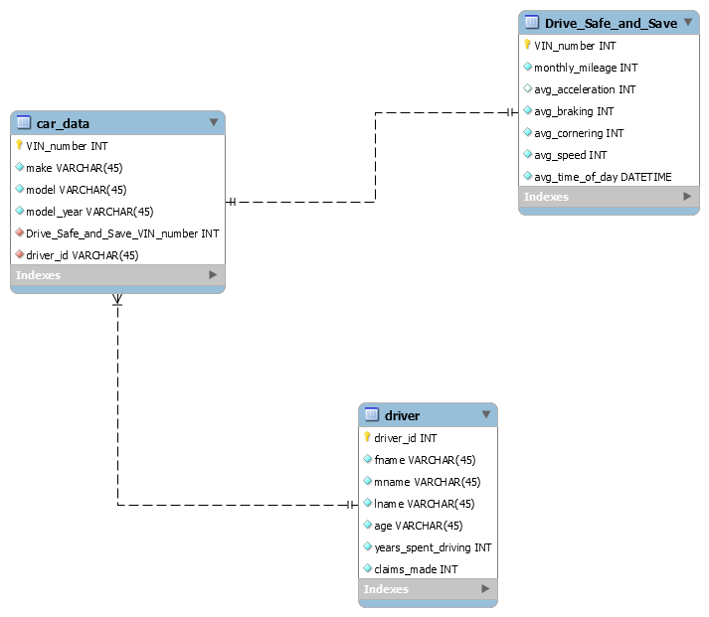
Database Design
Incorporated in MySQL is the relational diagram tool
This will serve as the basis of the database to be created

Slide 5
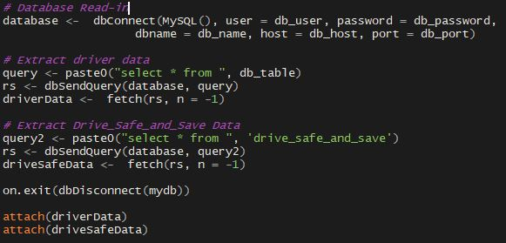
R Connection
Begin coding. Primary keys are VIN number and driver ID
Begin by connecting to Database

Slide 6
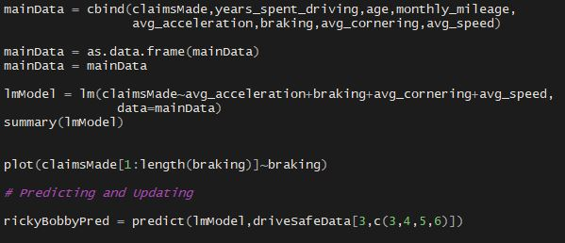
Simple Model
RStudio provides tools for statisticians to perform statistical analysis
We can connect to our database through this IDE
Once connected R allows us to write traditional queries
This includes writing statistical predictions into the database
Model Creation
Predicting Ricky Bobby’s Claims

Slide 7
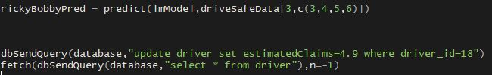
Prediction and write-in
RStudio provides tools for statisticians to perform statistical analysis
We can connect to our database through this IDE
Once connected R allows us to write traditional queries
This includes writing statistical predictions into the database
Predicting Ricky’s Claims
Query Update

Slide 8
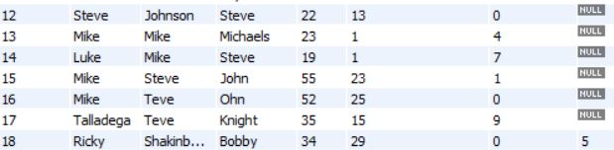
RStudio provides tools for statisticians to perform statistical analysis
We can connect to our database through this IDE
Once connected R allows us to write traditional queries
This includes writing statistical predictions into the database
Shake ‘n Bake

Slide 9
Future Applications
Automate SQL queries for dynamic models
Use function to paste predictions rather than manually entering them
Create vector of predictions rather than just one

