Slide 1
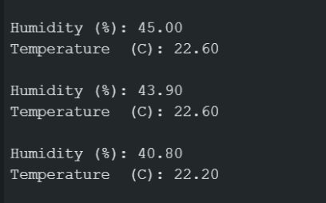
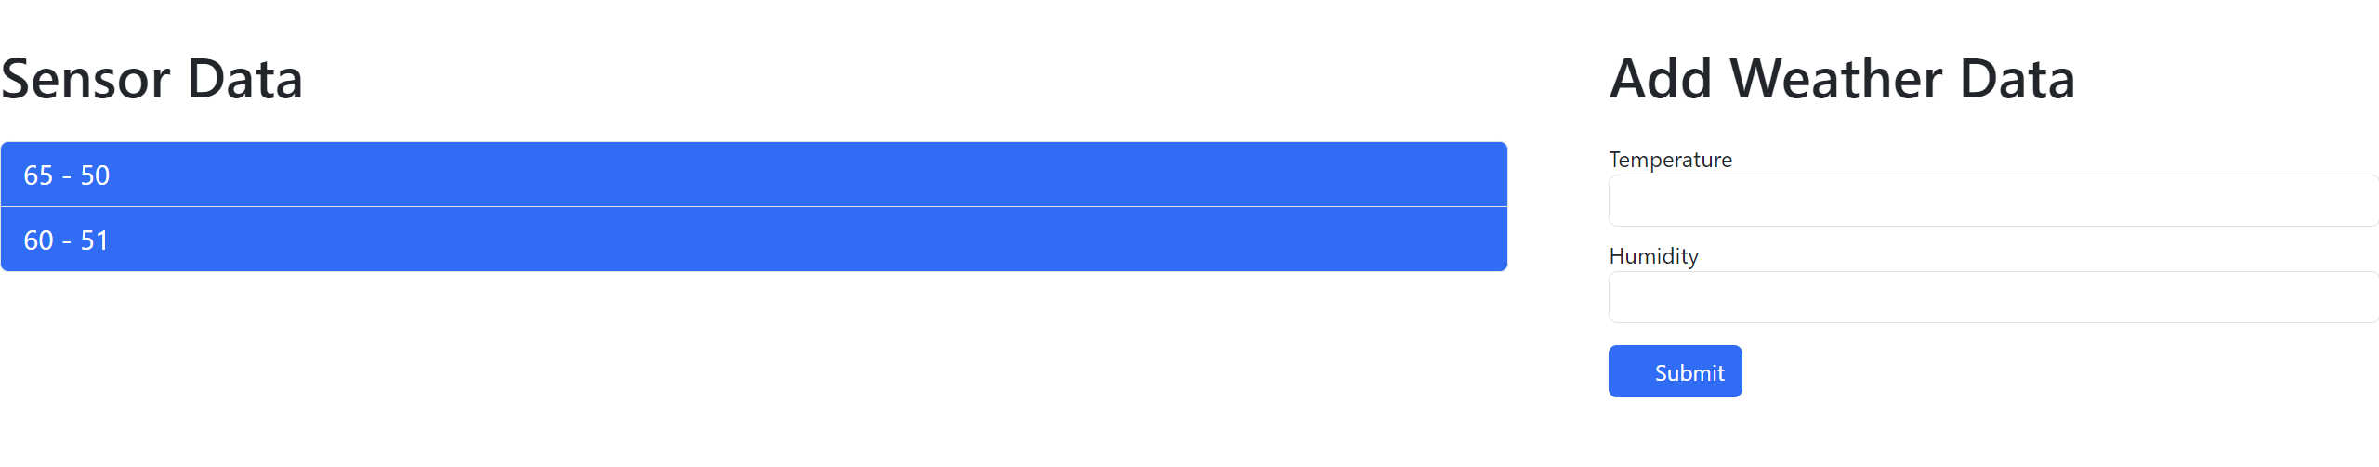
Arduino Weather Station Nick Rucinski
Main Goal:
-To build an IOT device that records the weather outside
-Display collected data to a dashboard.
Side Goals:
-Allow the dashboard to be viewed everywhere.
-Add a database to store the weather information
-Add more sensors
-Possibly a mobile app
Hardware:
-Arduino
-Temperature Sensor
-Raspberry Pi (Maybe)
Programming Languages:
-Arduino Language(C++)
-HTML + CSS
-Go (or JavaScript)
Interests:
-Hardware Control
-Web Technologies
-Databases
-Networking
-UI Design

