Slide 1
Efficient Attendance Monitoring Using
AI-Based Face Detection
Nicholas Marshall, Nivedita Prabhu, Frank Diabour, Matthew Willingham, Ayodeji Adeogun

Slide 2
Group Members
Nivedita Prabhu
Nicholas Marshall
Ayodeji Adeogun
Frank Diabour
Matthew Willingham
Computer Science, Mathematics, Software Engineering
Computer Science
Computer Science, Software Engineering
Computer Science
AI/ML, Prototyping
Computer Science
Software Engineering

Slide 3
OverVIEW
Introduction
Motivation
Usefulness/Impact
Project Implementation
Model Training and Image Augmentation
Data Collection
Database System
System Integration
Summary
Citations

Slide 4
Introduction
AI has transformed education, workplace management, and security. This paper proposes an AI-driven attendance system using computer vision and machine learning for real-time face recognition. A deep learning model detects faces, matches them with a database, and records attendance automatically.
Frank Diabour

Slide 5
Motivation
Why This Project?
Tracking attendance in large classrooms is challenging and error-prone. Professors struggle with accuracy, leading to misrepresentation. Traditional methods are slow, inefficient, and easily manipulated.
Replace with Name here

Slide 6
Usefulness/Impacts
1. Increased Accuracy & Integrity
Ensures students are correctly marked present or absent.
Prevents attendance fraud (e.g., students signing in for others).
2. Efficiency & Time-Saving
Eliminates manual roll calls
Allows professors to focus on teaching instead of attendance tracking.
3. Secure & Ethical Attendance Tracking
Use data in a way that safeguards student information.
Ensures fair and transparent attendance records.
Matthew Willingham

Slide 7
Project Implementation
Data Collection
Data Collection, images, student ID, converting images into trainable formats(JPEG,JNG, and others
Research
Model Training and Image Augmentation
Model Training and Image Augmentation
Database System [Store Attendance]
Storing and managing database of student records and attendance.
Schema will consist of database for attendance, database for the trained model, and a website to access attendance tracking and upload attendance images for scoring
System Integration [Model+Schema+UI]

Slide 8
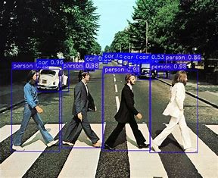
Data Collection
Data collection involves capturing and preparing images to ensure they are in the correct format for processing. This includes:
Collecting images from live video streams or uploaded photos.
Ensuring format compatibility, converting images from Apple’s format (such as HEIC) or other formats to standard ones like JPEG or PNG. Making sure the image format is standardized.
Labeling images with Student IDs, names, or other identifiers to create a structured dataset.
Main Image here
Matthew Willingham

Slide 9

Model Training and Image Augmentation
Models Considered: YOLO, ResNet, SSD
Model Selection Reasons: Lightweight, fast, smaller dataset Requirement.
Image Augmentation: tilt, grain, exposure, brightness and other filter helps increase the confidence rate. A script will be deployed to augment. This includes some variations( angles, Tilt, occlusion,etc)
Frank Diabour

Slide 10

Database System [Store Attendance]
Utilizes Yolov8, a deep learning model for real-time object detection in computer vision.
YOLOv8 detects faces in video for attendance tracking.
Faces identified are matched against a database (Excel, moving to MySQL).
Face angles: Front, Left-Side, Right-Side
Recognized faces are marked as attended.
Stores: First Name, Middle Name, Last Name, Email, R-Number, Course ID, Instructor Name, Instructor ID, Attendance.
Nivedita Prabhu

Slide 11
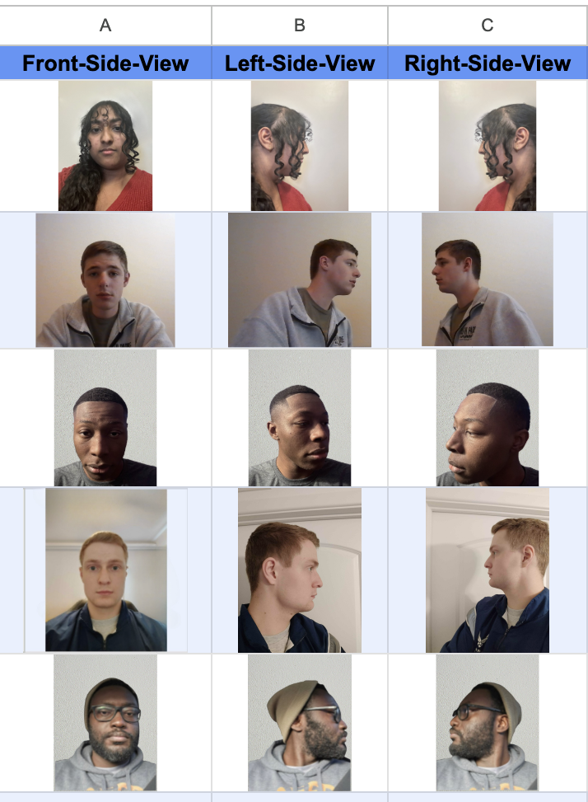
Face Views

Slide 12
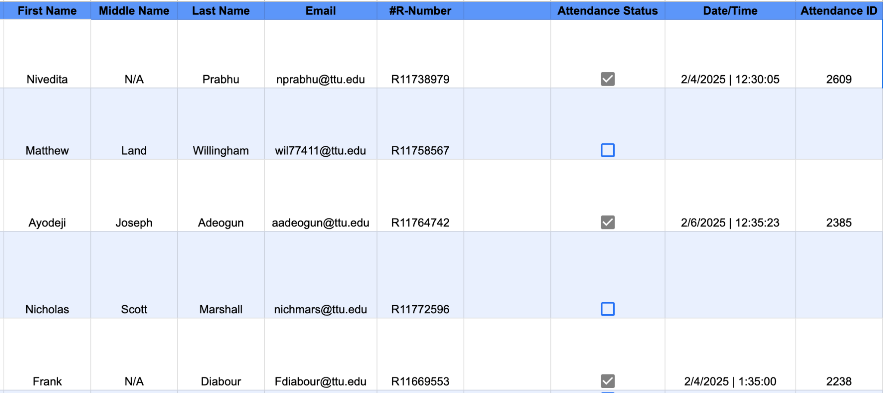
Database Example Table

Slide 13
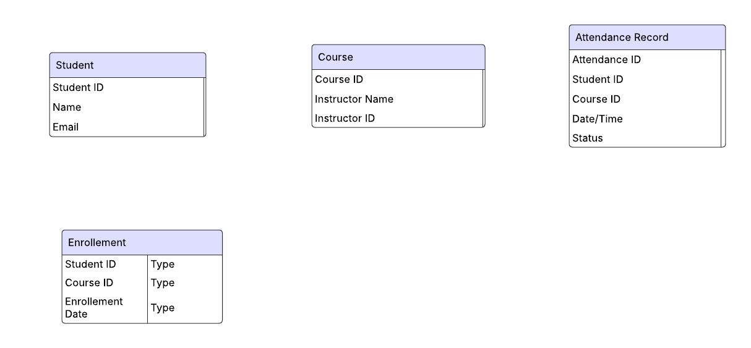
Er Diagram
Matthew Willingham

Slide 14
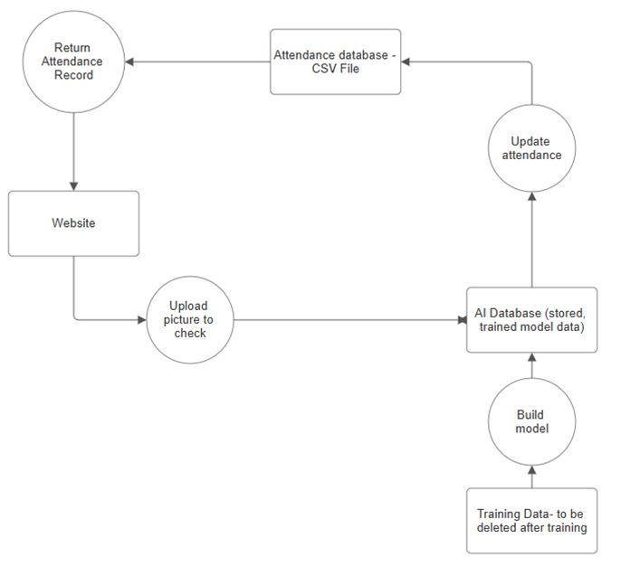
Schema
Overview here
Website - interact with attendance records and upload images to check
Attendance Database - see ER diagram
AI Database - holds trained data
Training data - will be used to train the model then be deleted
Nicholas Marshall

Slide 15
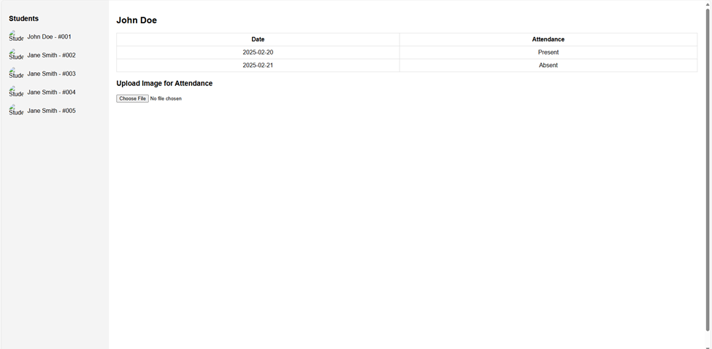
Website - UI
Nicholas Marshall

Slide 16
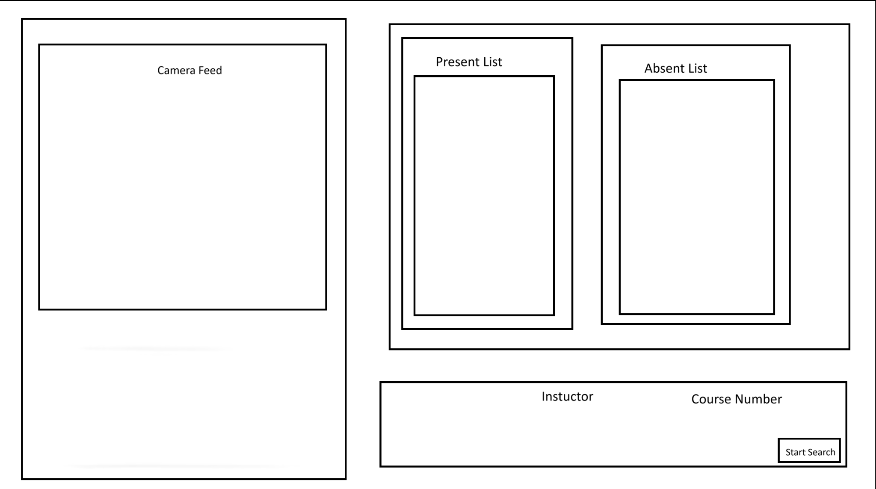
Software UI
Ayodeji Adeogun

Slide 17
Summary
Introduction
Motivation
Usefulness/Impact
Project Implementation
Model Training and Image Augmentation
Data Collection
Database System
System Integration
Frank Diabour

Slide 18
Citations
Ultralytics, “YoloV8 with Face Detection · Issue #4187 · ultralytics/ultralytics,” GitHub, 2024. https://github.com/ultralytics/ultralytics/issues/4187 (accessed Feb. 18, 2025).
Roboflow, “Difference Roboflow Model and Yolo8,” Roboflow, Nov. 21, 2023. https://discuss.roboflow.com/t/difference-roboflow-model-and-yolo8/3785 (accessed Feb. 18, 2025)

Slide 19
Thanks!
Q&A

