Slide 1

Steam Game Review
By: Nicholas Shin

Slide 2
Agenda
Executive Summary
Background and Research Question
Data source and understanding
Processing and Preparation Colab & RapidMiner
Modeling
Evaluation
Deployment
Summary and Lessons Learned

Slide 3
Executive Summary
This project analyzes different Steam game reviews to understand player sentiment and their reception of the game. We will be utilizing different tools such as Apify, Colab, RapidMiner, and OpenAI to process and interpret the data. The research found the reason for players' overall sentiment, whether that be issues with the games, lack of innovation, quality of life issues, or the positives such as the variety of characters, the contents and engaging gameplay. Understanding these key issues players have with each game, developers can make updates or adjustments to increase players' perception of the game and anyone who looks at the overall reviews. This can also bring in new players or have people playing in the long term. Also, by leveraging AI and data-driven insights, developers can improve game quality, address major criticisms, and optimize future game releases. This approach can also be done to analyze reviews on other platforms or track sentiment shifts over time, making it a valuable tool for the gaming industry.

Slide 4
Background/Research Question
Steam digit platform where you can buy, or sell games as a gaming market
What to people say about the game and how do they feel about it?
What are the possibilities we can use OpenAI for

Slide 5
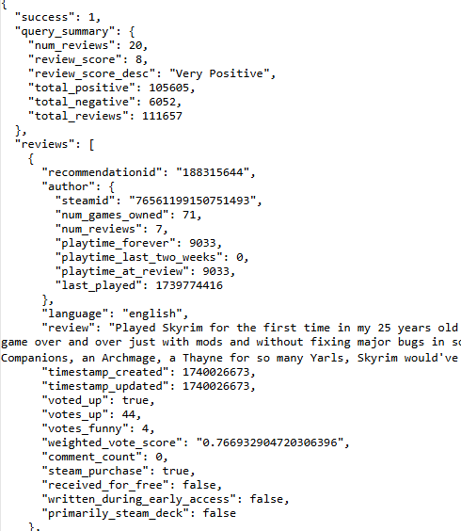
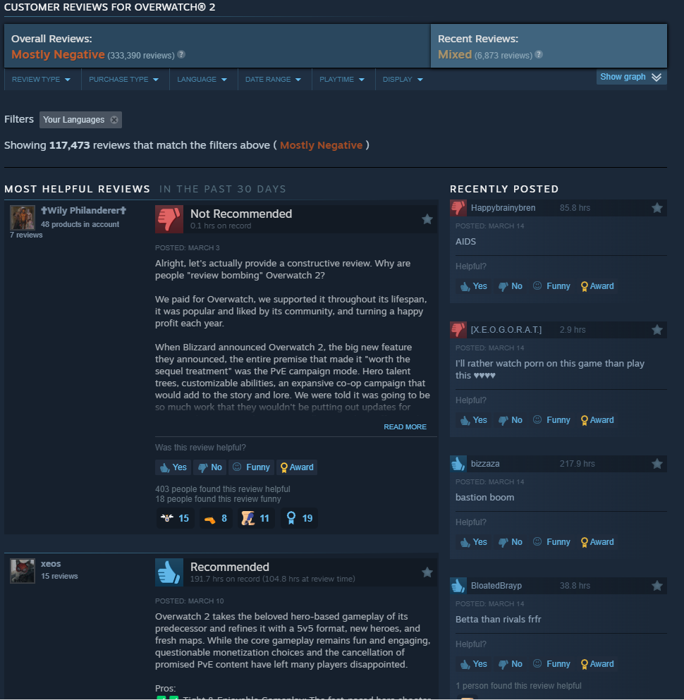
Data Source
Steam reviews from the store page
Raw data of comments
Used Apify
Attempted Colab
For each game, scraped around 6000-9000 reviews
Total 39500 scraped
Information scraped
Review
Thumb up or down
Date Posted

Slide 6
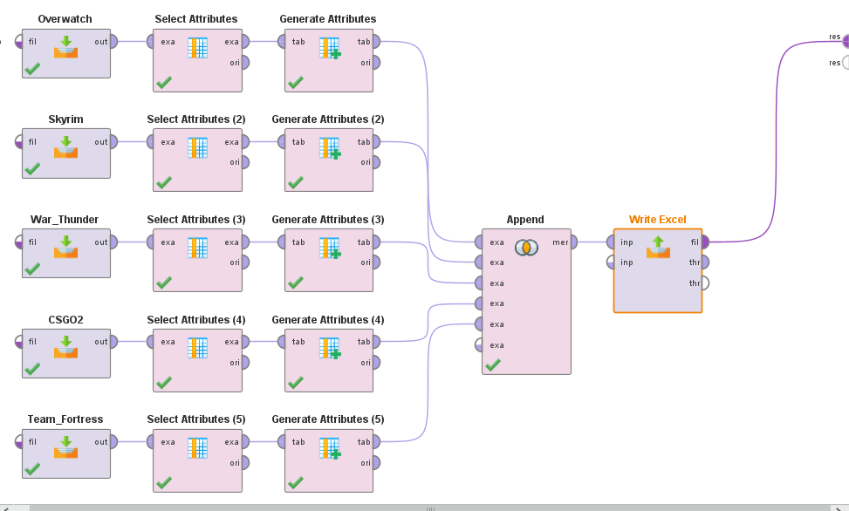
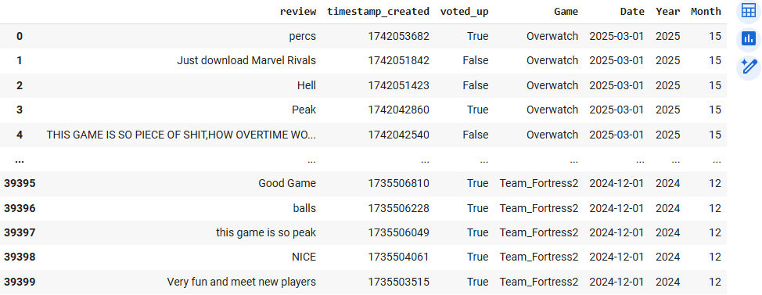
Data Preparation Using RapidMiner & Colab
Combine all different files into one
Select the column I need/want
Create a new column for game title
In Colab, Converted the timestamp to proper dates, and separated years and months

Slide 7
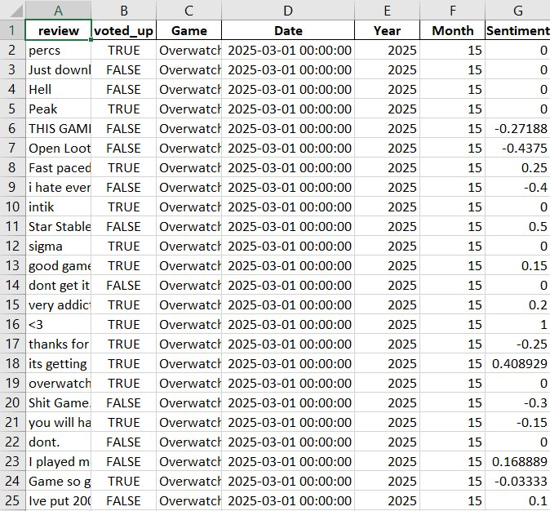
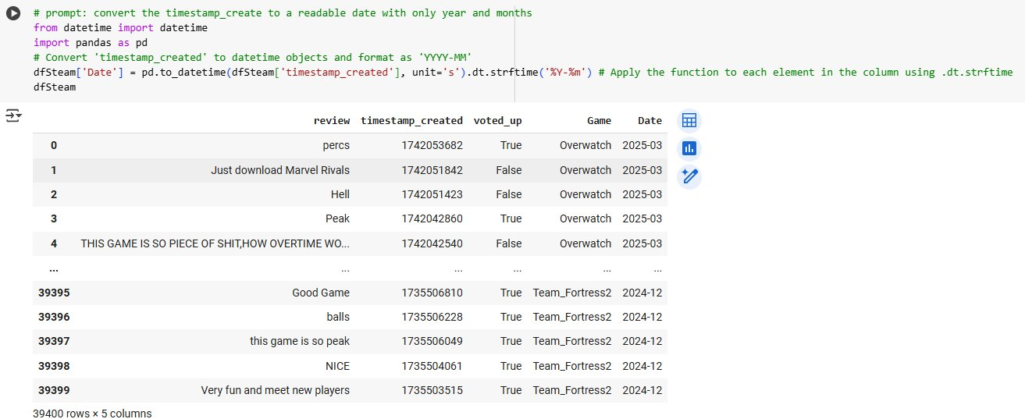
Beginning Data vs Ending Data

Slide 8
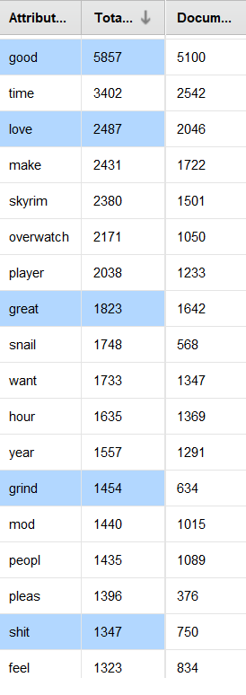
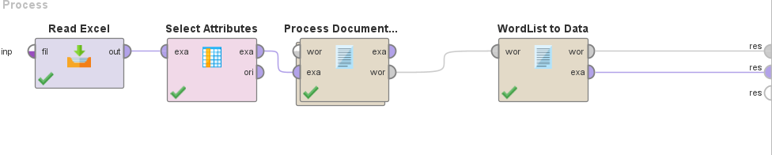
RapidMiner Term Occurrence
Term Occurrences of all games combined
Search for positive and negative words
Most common significant words
Good
Love
Great
Grind
Shit

Slide 9
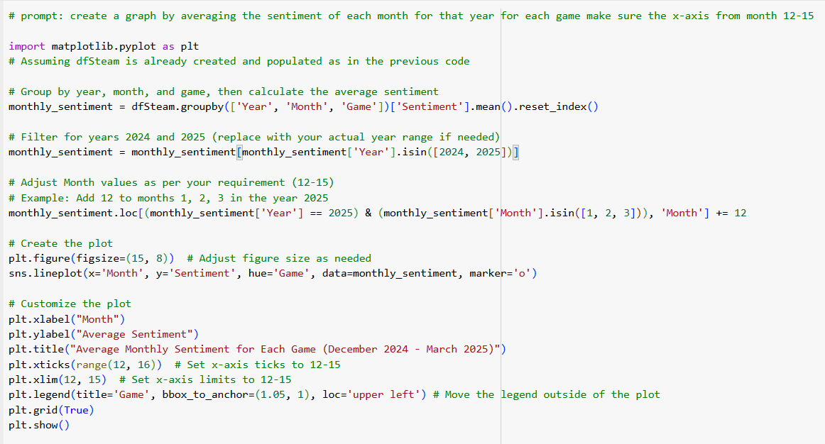
Modeling for Trend
Prompt: create a graph by averaging the sentiment of each month for that year for each game make sure the x-axis from month 12-15
Range is December 2024 – March 2025
Starting value is 12
Ending value is 15
Averages each month's sentiment and graphs it.

Slide 10
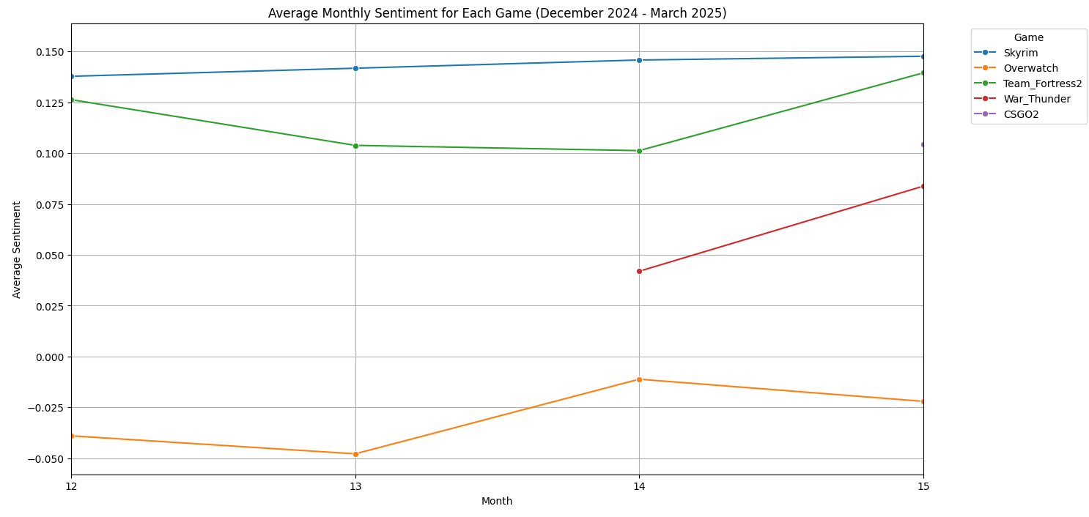
Trend of Sentiment
Starting December 2024, till March 2025
Average sentiment for each month
Some games have so many reviews that other months are not found
Skyrim V has continued positive sentiment
Overwatch 2 has the lowest sentiment
CSGO 2 so large, that it only have values in March

Slide 11
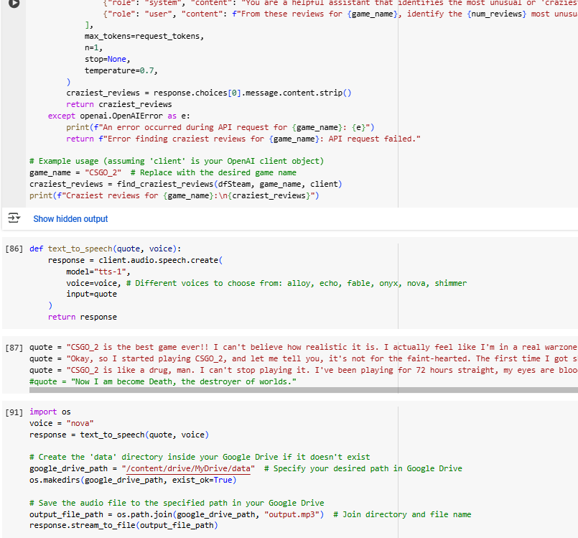

Modeling for Text-to-Speech
Prompt: Openai from the dataframe, find the most craziest reviews for any game

Slide 12

Craziest Review from OpenAI
Asked the OpenAI to find craziest review
Found the top 3 (From CSGO2)
Saved the audio to my drive
Used Nova to speak

Slide 13
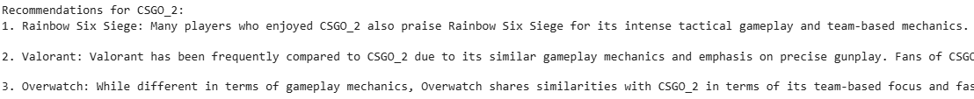
Fun OpenAI Use
Asked the OpenAI to make something fun and interesting with the data
Recommended certain games specifically those who played CSGO2

Slide 14
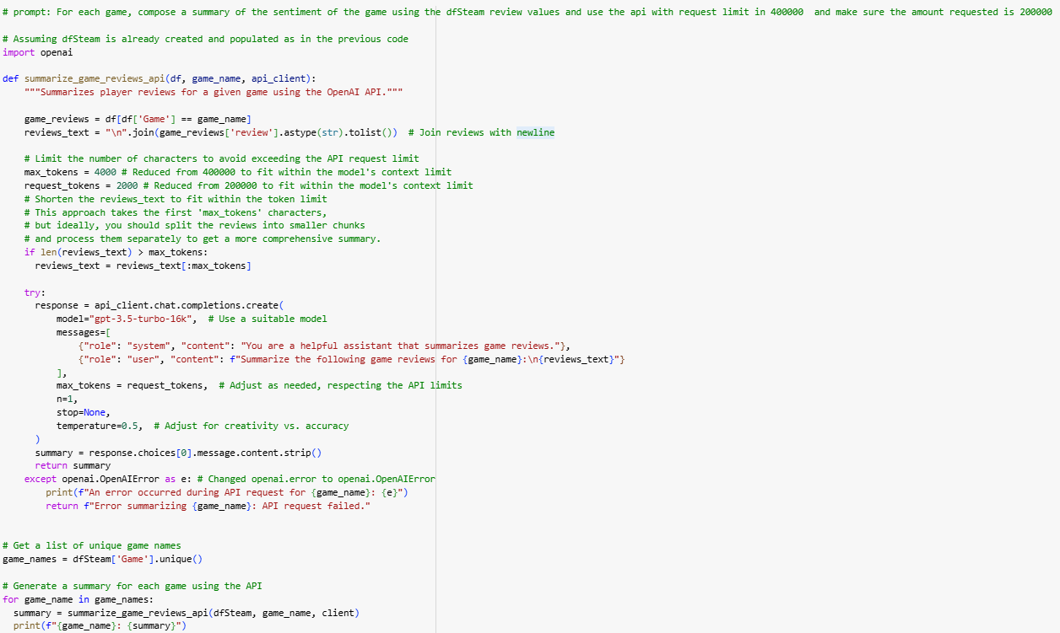
Modeling for Overall Opinions
Prompt: For each game, compose a summary of the sentiment of the game using the dfSteam review values and use the api with request limit in 400000 and make sure the amount requested is 200000

Slide 15
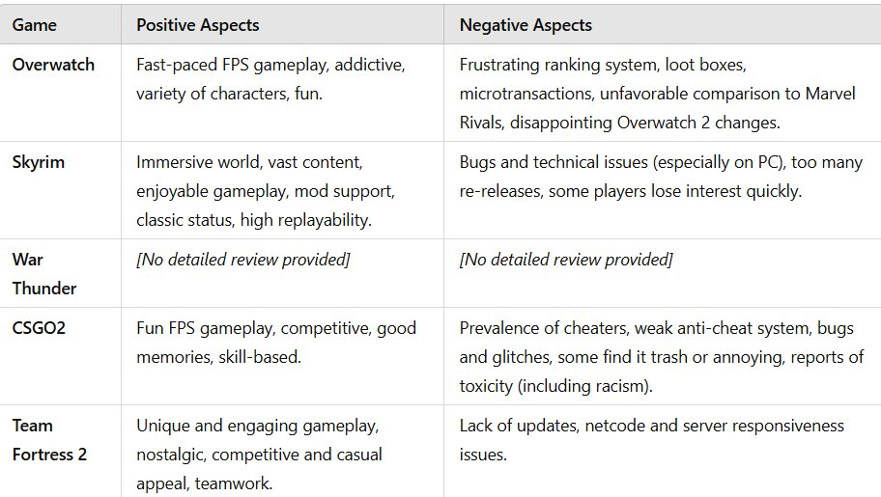
People Overall Opinions. OpenAI Analysis
Took in 200000 tokens (Maximum for each game)
Overall opinions for each game and what occurs the most
Fed the output of Colab into ChatGPT for clear table
War Thunder only said "War" for output (in Colab).

Slide 16
Deployment
What people want in a video to be fixed
If nothing is done, people are not going to change your opinions
If you want a successful game, listening to the people who play is significant

Slide 17
Summary
How to use OpenAI to assist in coding, and modeling
Colab is a powerful tool, that can scrape, prepare, and model data frames
There are many of minor fixes different programs can use to fix
Steam appreview does not work all the time
RapidMiner write Excel is weird sometimes
Colab has odd scraping behaviors

