Slide 1



Budget Data
View in Power BI
Last data refresh:
7/21/2022 11:10:44 AM UTC
Downloaded at:
8/19/2022 11:26:30 AM UTC

Slide 2
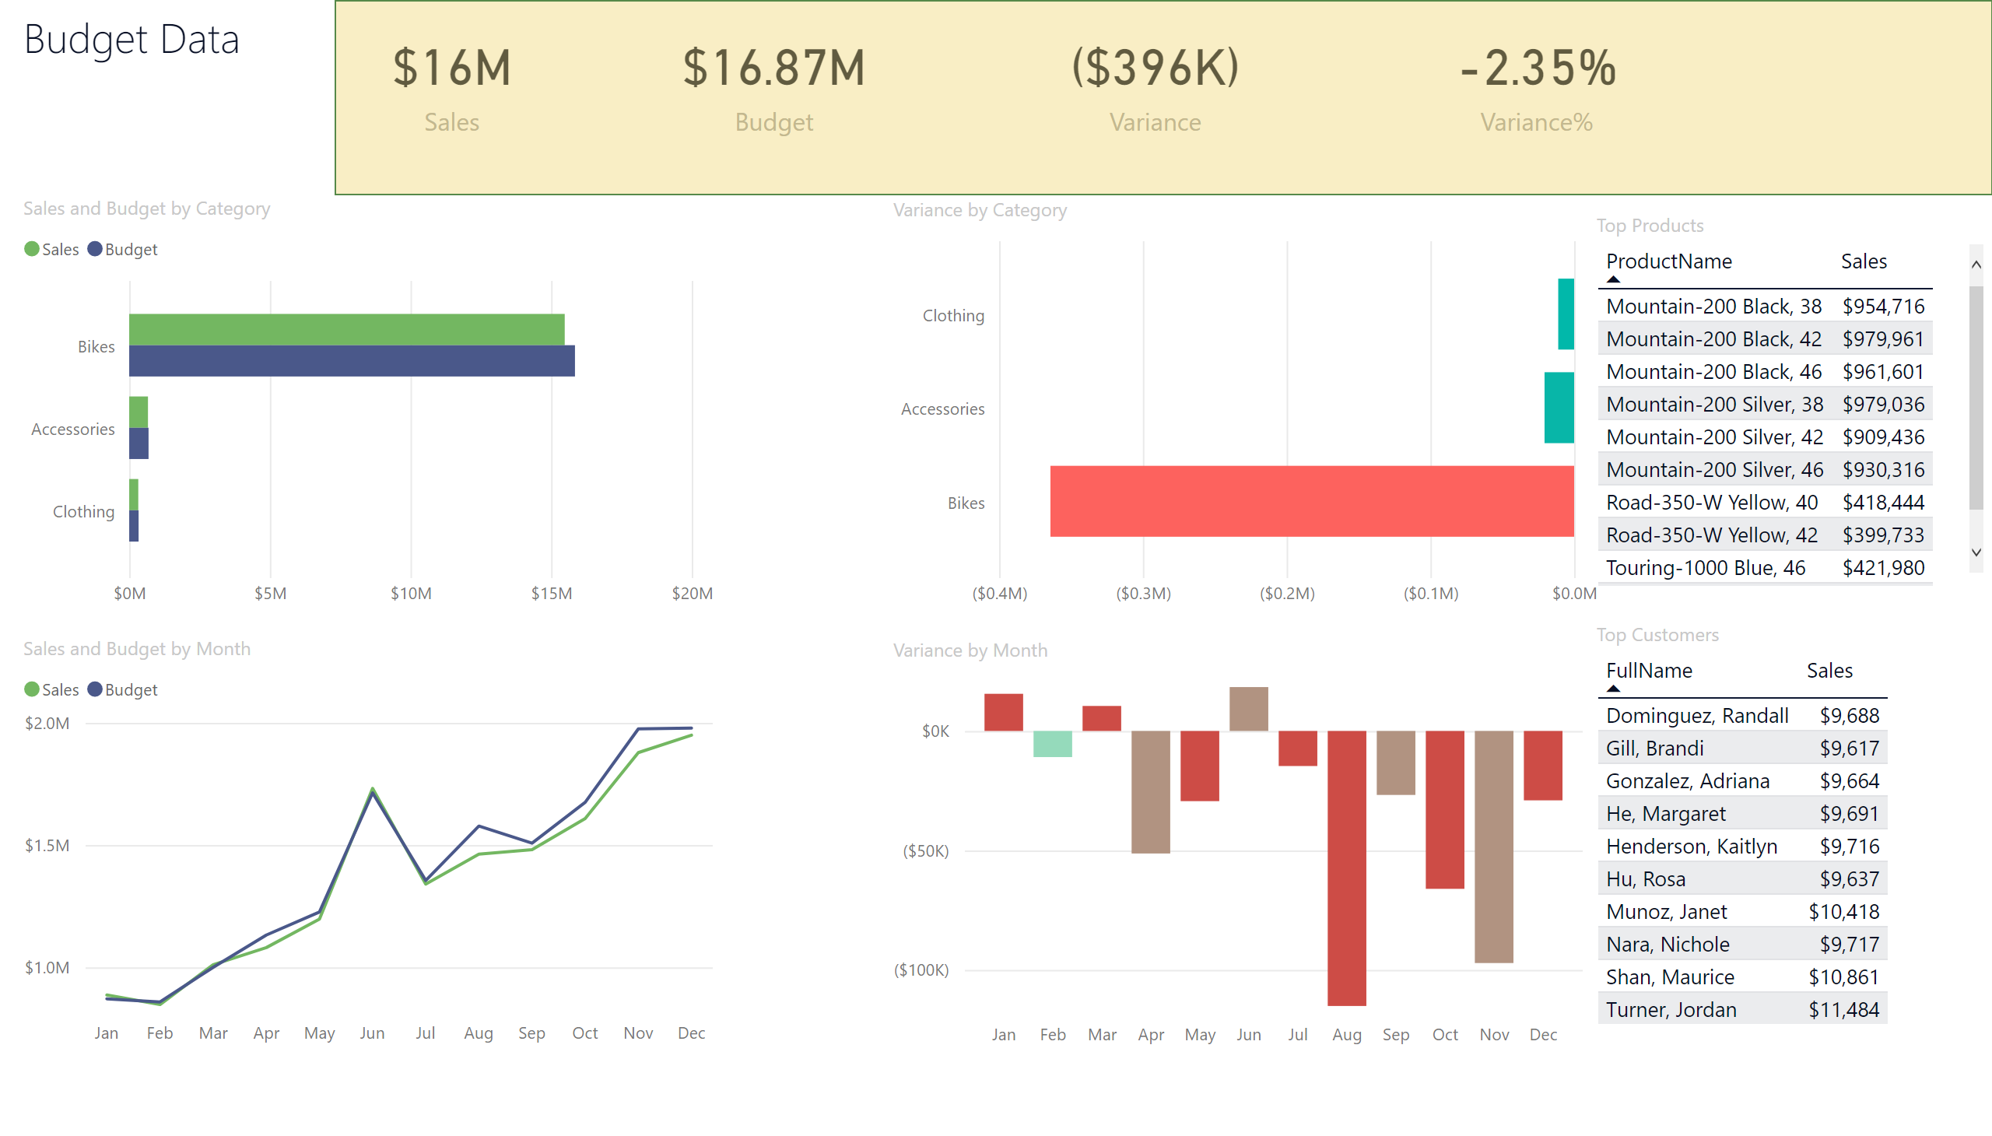
Page 2
Notes:
textbox
No alt text provided
card
No alt text provided
card
No alt text provided
card
No alt text provided
card
No alt text provided
shape
No alt text provided
clusteredBarChart
No alt text provided
clusteredBarChart
No alt text provided
lineChart
No alt text provided
columnChart
No alt text provided
Top Products
No alt text provided
Top Customers
No alt text provided

