Slide 1

{team 7}: {Gitaxian Probe}
{Raksha Rehal & Nicholas Tillo}

Slide 2
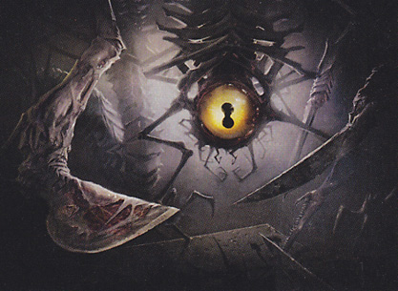
Summary
Our project is an exploration of the techniques of artificial intelligence and its ability to be used to optimize and analyze the trading card game Magic The Gathering. The goal is to optimize play and streamline feedback during games to allow new players to better understand correct lines of play.

Slide 3
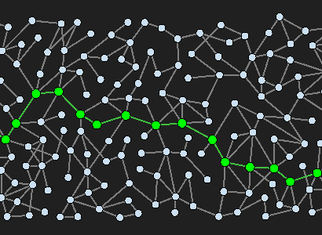
Planning – Optimal Play
What is the most optimal sequence of moves that will result in a winning outcome?
Incredibly Large Branching Factor
Requires a Step-By-Step approach.
Low depth limit.
Assumed Theoretical Control to be able to model multiplayer games.
Approach:
Take a snapshot of the game state.
Run planning algorithm using that snapshot.
For the next turn, repeat.

Slide 4
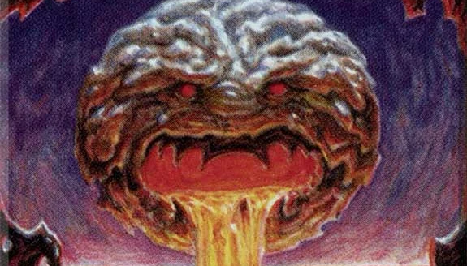
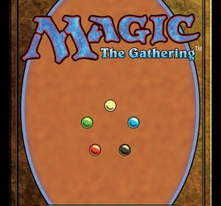
Probabilistic Inference – Probability To Win
From any given state, how likely am I to win?
Variables will be gathered from looking at previous tournament play games to find what states lead to wins.
Could be used as a heuristic for the planning algorithm.
Answers Key Questions:
What is the most important factor to winning.

Slide 5
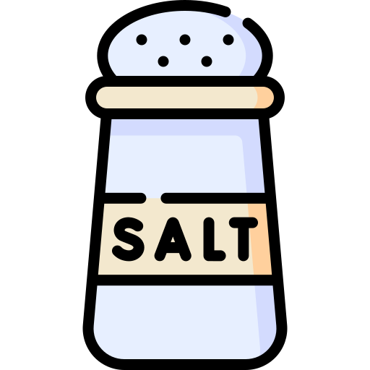
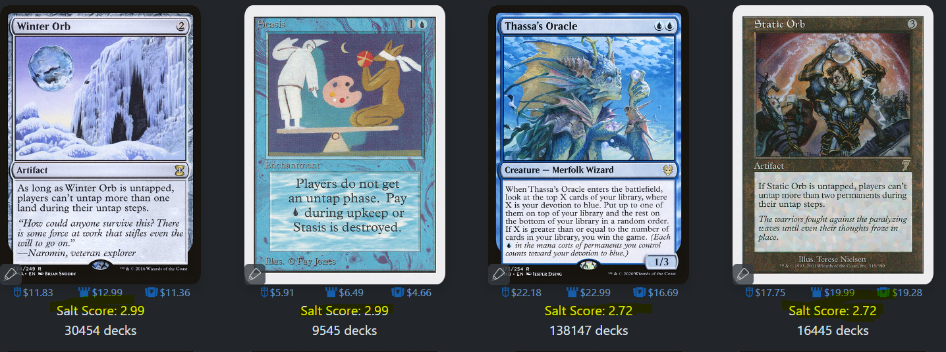
Deep Learning – Salt Score Analyzing
Using the variety of information stored on a MTG card, train a deep-learning model to estimate the "salt score" of MTG cards.
The community voted “How much do I hate playing against this card” value
Variables will be values on the card, mana cost, text on card, ETC
Approach:
Gather required resources, labelled dataset, and a testing dataset,
Use one of the python libraries to generate the model.
Run it against testing data to validate performance with new information

Slide 6
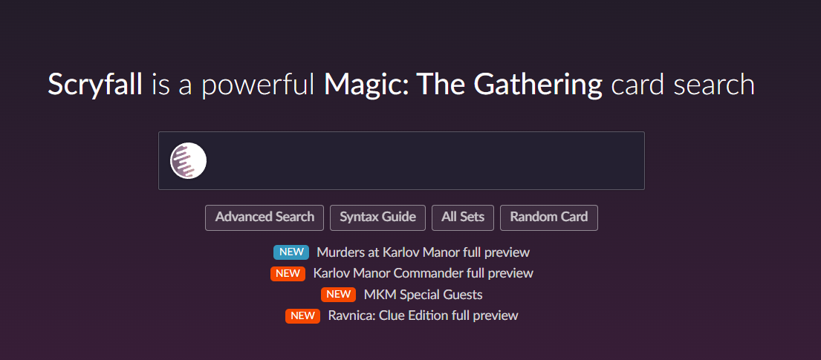
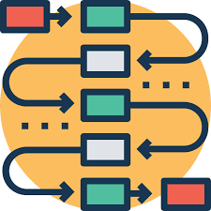
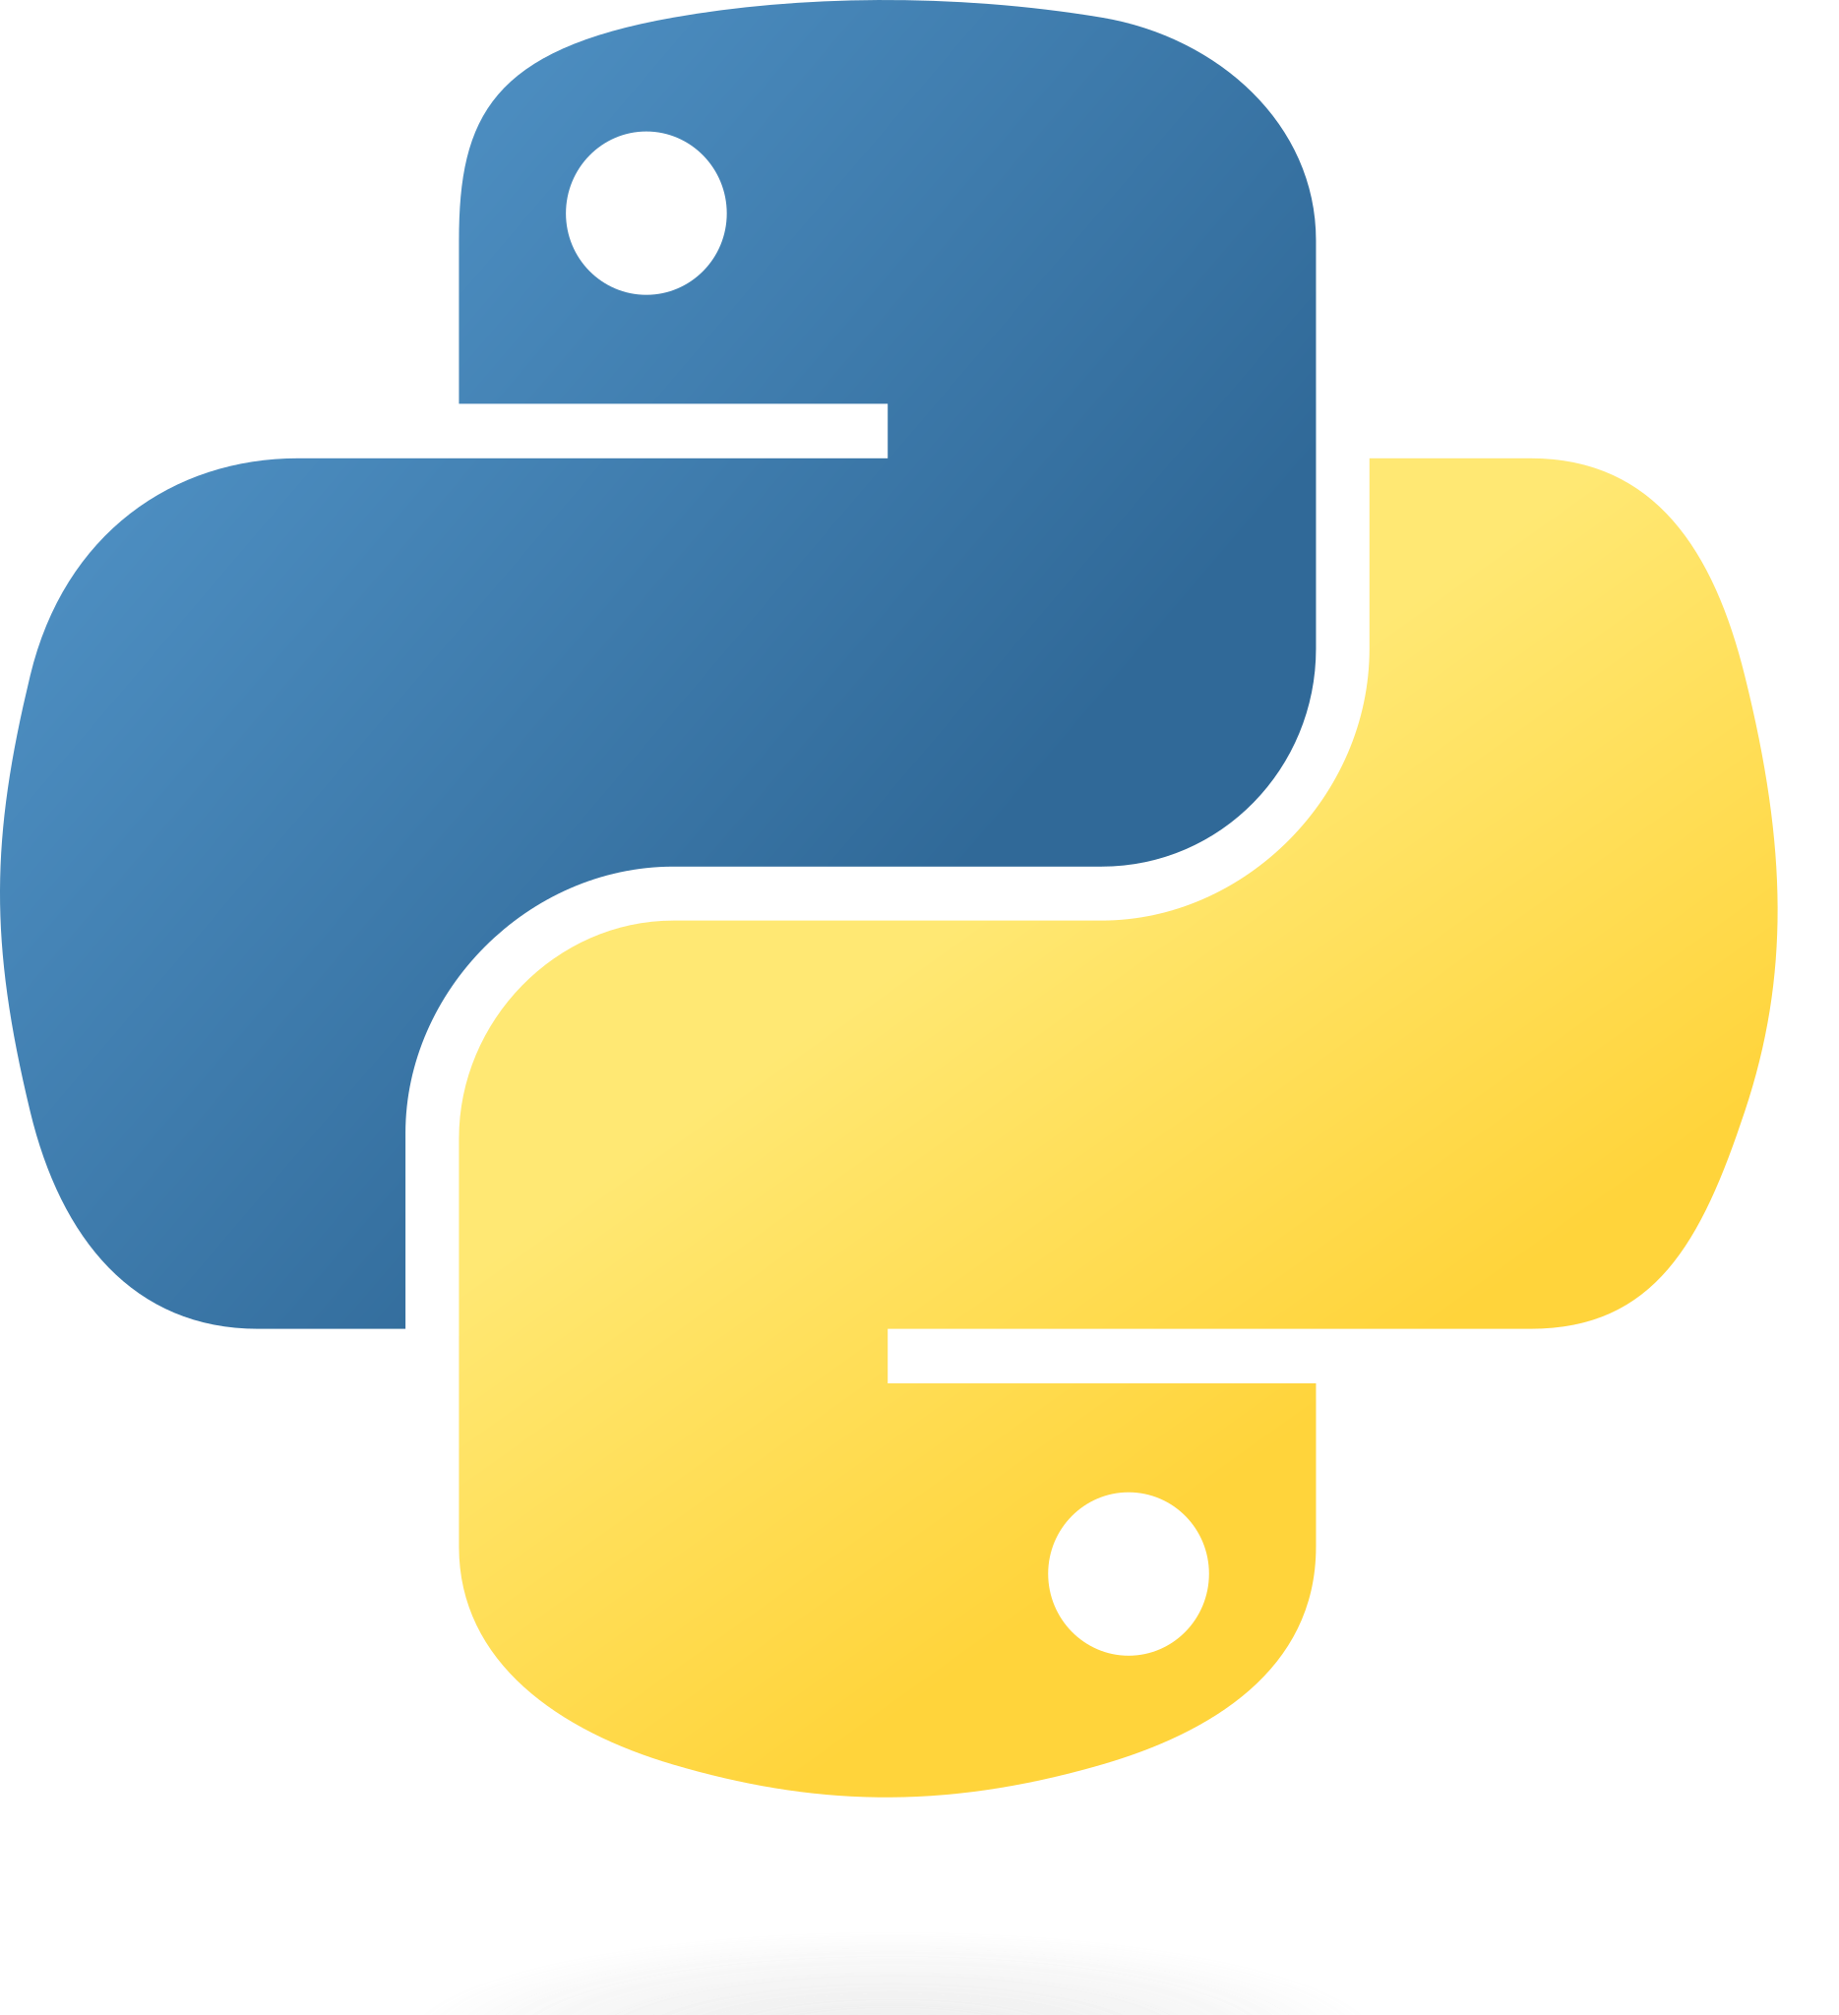
Planned Implementation
Python For Implementation
PDDL for Planning.
PyTorch, Keras, or TensorFlow for Deep learning
NumPy or PyMC3 for probabilistic networks.
Universally Required Python Libraries: NumPy,
Data required:
Card data will be gathered for free from the Scryfall website as separate JSON files per card, processed in python.

Slide 7
End

