Slide 1
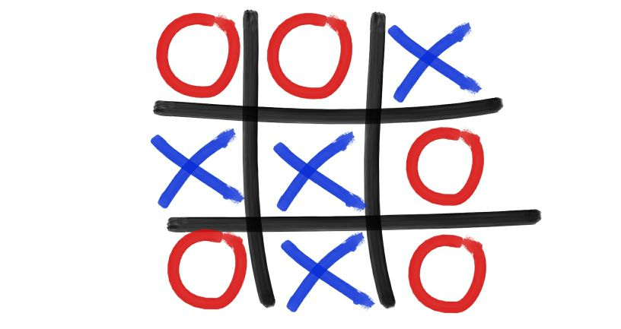
Tic Tac Toe AI
Pia Erbrath, Nicholas Walter 2017-12-11

Slide 2
Content
Problem/ Research Question
Approach
Tools
Results

Slide 3
Problem/ Research Question
Tic Tac Toe Game played by an AI
Can we teach an AI to play Tic Tac Toe?
Can the AI beat a human player?
How many practice games does the AI need?

Slide 4
Approach/ Literature
Q learning → reward/ punishment
Reinforcement-learning car
Keras plays Catch
Ultimate Tic Tac Toe

Slide 5



Tools
Tensorflow
  Keras as Interface
Python

Slide 6
Results
Very complicated logic
Time not sufficient
//insert human results
//insert iteration results (1000, 3000, 5000)

Slide 7
References
Keras plays Catch:
  https://edersantana.github.io/articles/keras_rl/
Reinforcement learning car:
  https://github.com/harvitronix/reinforcement-learning-car
Ultimate Tic Tac Toe:
  https://github.com/jjrob13/deep_ultimate_tic_tac_toe
Keras Documentation:
  https://keras.io/
Demystifying Deep Reinforcement Learning:
  https://www.intelnervana.com/demystifying-deep-reinforcement-learning/

