Slide 1
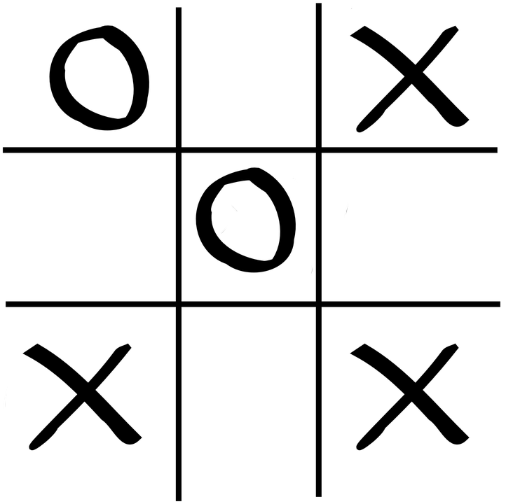
Tic Tac Toe AI

Slide 2
The problem
Tic Tac Toe
Create a learning AI that can play against another player

Slide 3
Learning Goals
Work with neural network
  Keras (interface to tensorflow) → Python
Implement reward/ punishment system for an AI
  Q learning
  e.g. Atari games AI

Slide 4
Research Questions
Can an AI play Tic Tac Toe?
How many iterations does the AI need to play “properly”?
Can an AI beat a human player?

Slide 5
Approach
Keras (Tensorflow)
Qlearning
  Reward/ Punishment

Slide 6
Progress
Rules
  8 game situations (e.g. win, two in a row, …)
Rewards
  -2000 for invalid move
  500 for win
  400 for blocking enemy win
  ...
Basic game framework
  Turn based
  Runs predefined number of iterations

Slide 7
Progress
Early implementation of “learning”
  At the moment, not taking rewards into consideration
  Learns on no feedback
Some statistics functionality
  Track player wins, draws and who begins

