Slide 1
Game of Life
Katarina Nitz & Nicholas Williar

Slide 2
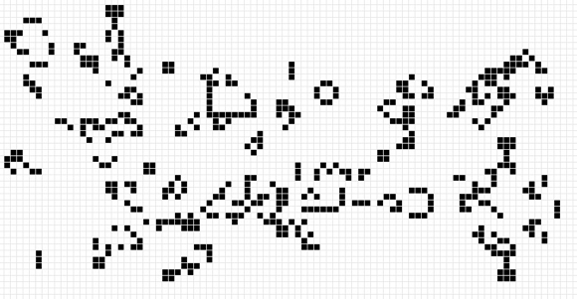
Game of Life - Introduction
The game of life is a zero-player game in which a starting grid-based pattern evolves over generations according to a set of known rules.

Slide 3
Game of Life - Rules
Birth: A dead cell with exactly three live neighbors becomes a live cell.
Survival: A live cell with two or three live neighbors stays alive.
Overcrowding / Loneliness: In all other cases, a cell dies or remains dead.

Slide 4
Model, View, Controller (MVC)
Model: start
View: start
Controller: start

Slide 5
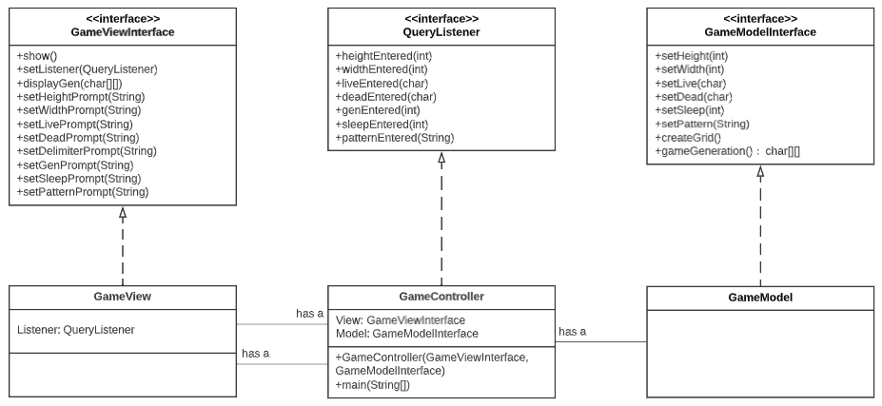
UML Diagram

Slide 6
Roles & Responsibilities
Katarina Nitz
Nicholas Williar
View Interface
View Code
Listener Code
Presentation
Final Paper
Model Interface
Model Code
Controller Code
Presentation
Final Paper

Slide 7
Project Roadmap
Plan
Finalize Code
Presentation
Code Outline
Draft Code
Test
Final Paper

Slide 8
Questions?

