Slide 1

Invest-In.Me An Open-Source AI Investing Tool
Nicholas Phomsopha
Meshal Saleh

Slide 2
What Is Invest-In.Me?
A platform that takes the guesswork out in investing in Stocks
Using neural networks and machine learning algorithms, we forecast a small window of stock prices a user wants to see and give them recommendations on what to do.
The end goal was to make a functional website where users can look and interact with graphs and see recommendations.

Slide 3
Who Are We Helping?
We are aiming to help the middle/poor class
Want to Bridge the gap between beginner and expert traders. Make powerful tools like ML prediction accessible to everybody.
We want to take most of the guesswork out of investing
Give them confidence as well as clear risk ratios so they can make the decision and a better investment for their future

Slide 4
How Did we Build this
We get the stock price data from yahoo finance, stock prices that go back at least one year, for training our model
We then Train a Machine learning model (LTSM,RNN) Time series for forecasting potential closing stock prices
Create graphs for the future prices and show when is the best time to sell or buy stocks

Slide 5
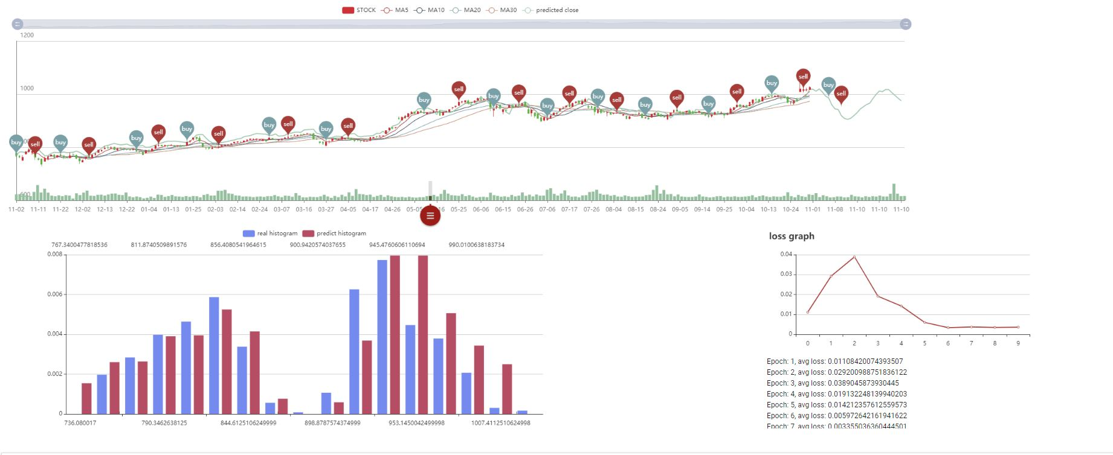
Final Result

Slide 6
What's Next
The Tool provided good predictions for a single stock so we can further increasing the testing to include more stocks
Use the model to simulate a more realistic growth of capital than many free tools by adding indicators as extra layer to train the model

