Slide 1
NGRX
After:
What is NGRX ?
What design pattern does ngRX uses ?
How will you develop an NGRX application ?
When will you use NGRX ?

Slide 2
What is NGRX
NGRX is a state management library. Which is uses to store information in your front-end. Making it globally available for all components. ngrx models itself off the flux pattern. Flux is an Architecture with a unidirectional flow of information consisting of dispatcher, stores and views.

Slide 3
Flow of Normal NGRX no Effects
Component
dispatch action
Action
{
Type,
Payload
}
Selector
Store
Updates state
Reducers

Slide 4
Using NGRX with Angular
To use Ngrx you need to use node package manager (npm). To install the following:
Npm i –S @ngrx/store @ngrx/store-devtools @ngrx/effects

Slide 5
Why should you use NGRX
Application are more consistent because state is immutable.
Redux gives us ways to debug or application
Easier to test since all of the information is store in one place.

Slide 6
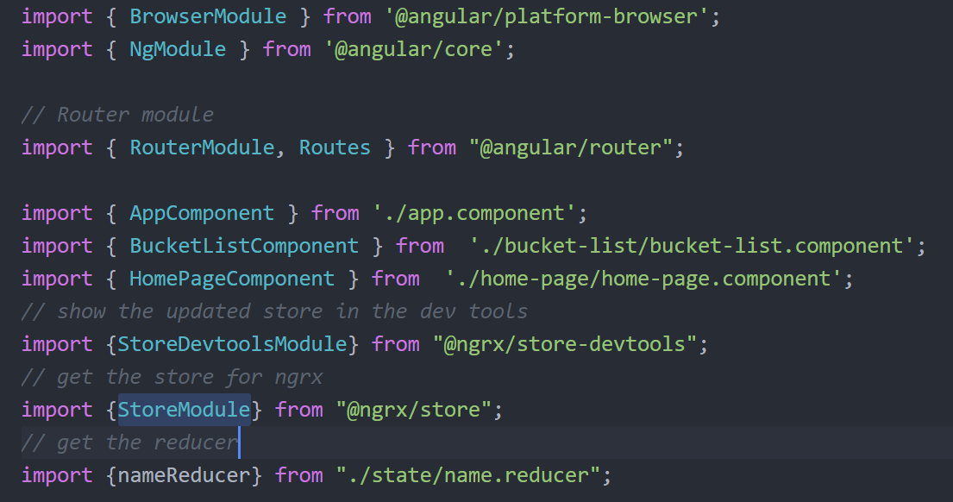
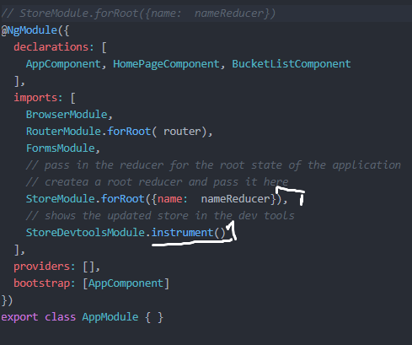
Setting Up NGXM from Modul
StoreModule (.forRoot , .forFeature)
StoreDevtoolsModule (instrument())

Slide 7
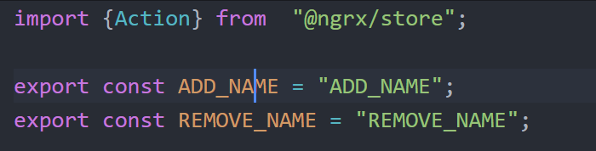
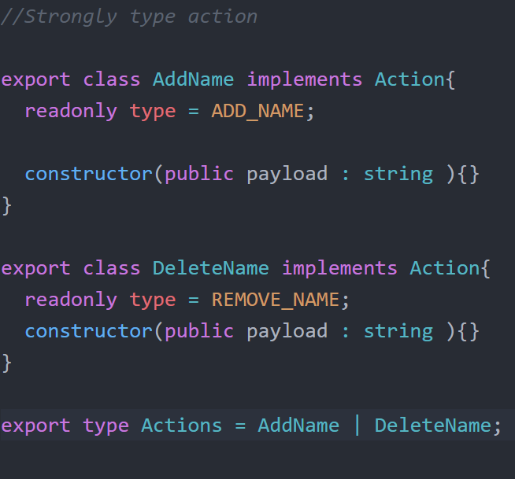
SetTing Up Actions

Slide 8

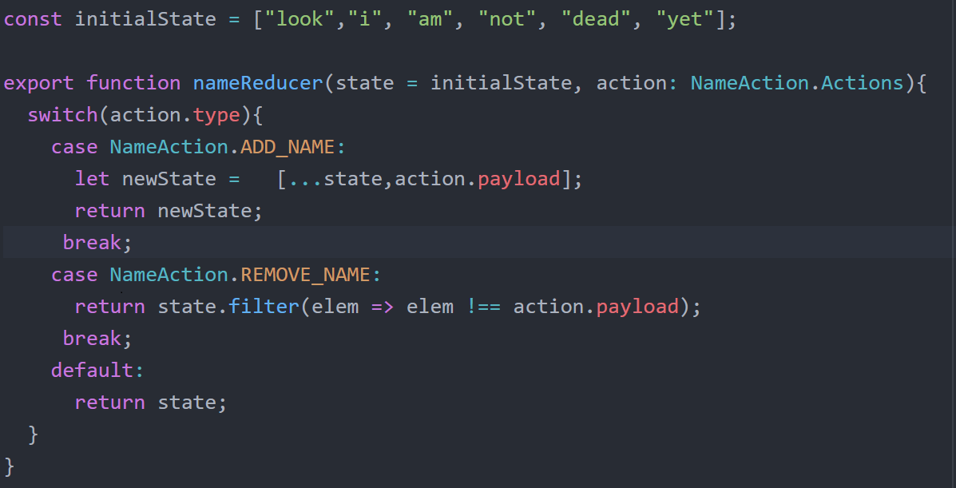
Setting up Reducer

Slide 9
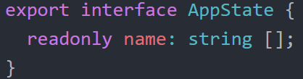
Global state
This gives a brief description of the ngrx store look likes.

Slide 10
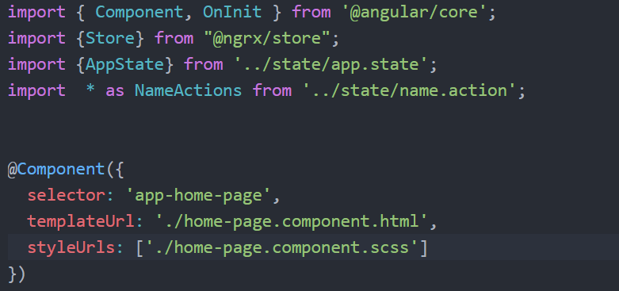
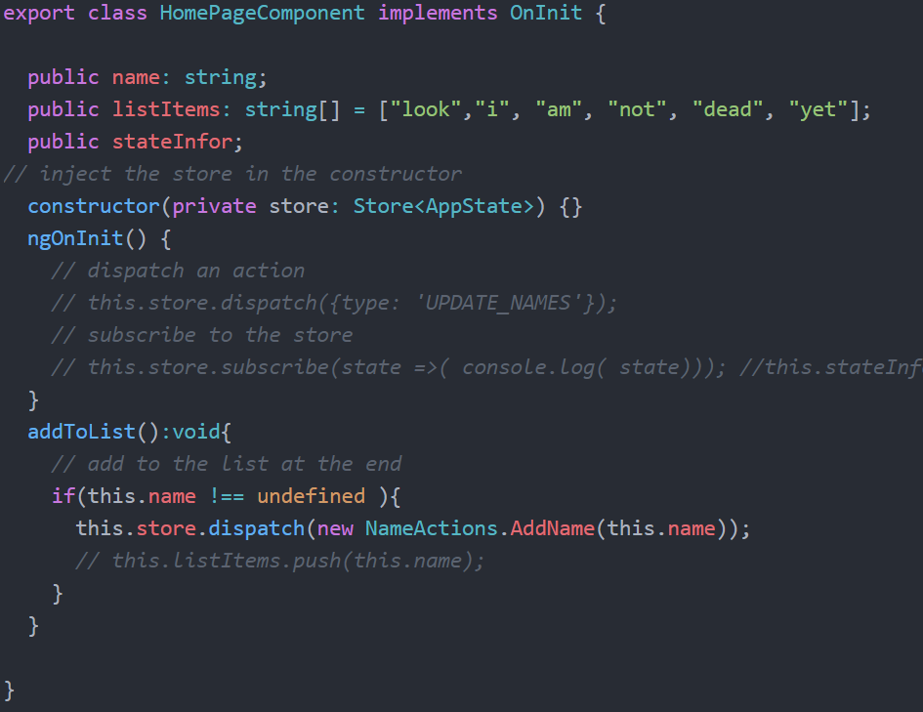
Write to NGRX Store

Slide 11
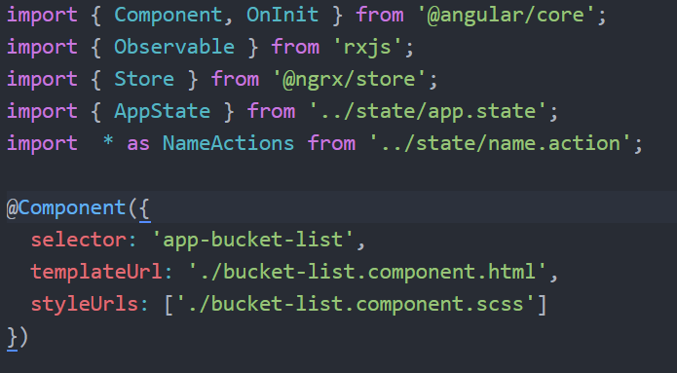
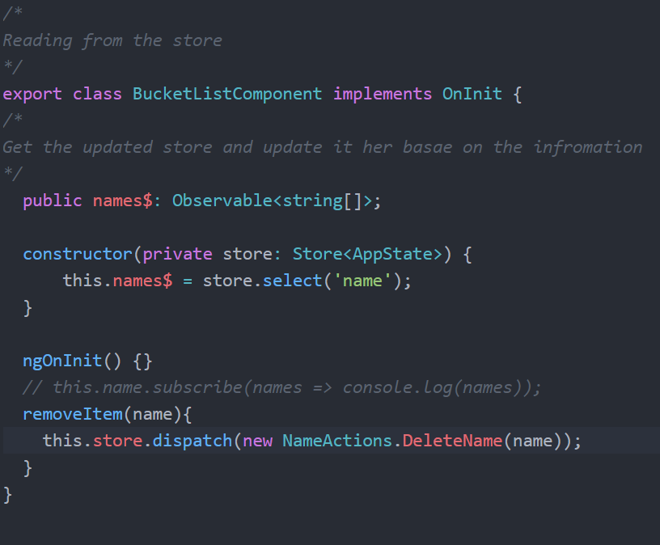
Reading from ngrx store

Slide 12
NGRX with EFFECT
dispatch action
Component
Action
{
Type,
Payload
}
Selector
dispatch action
Effect
Store
Updates state
Reducers
Action
response
{
Type,
Payload
}
request
Service

Slide 13
Source Files
https://coursetro.com/posts/code/151/Angular-Ngrx-Store-Tutorial---Learn-Angular-State-Management
https://medium.com/frontend-fun/angular-ngrx-a-clean-and-clear-introduction-4ed61c89c1fc
https://blog.usejournal.com/redux-angular-style-ngrx-store-b2876280708e
https://mherman.org/blog/authentication-in-angular-with-ngrx/

