Slide 1
Engineering The Allocation of Public Resources
Professor Nick Arnosti
University of Minnesota

Slide 2
Course Overview: Notions of Fairness
Unit 1: Symmetry (Equal Treatment)
Unit 2: Respecting Priorities (No Justified Envy)
Unit 3: Diversity (Representation of Different Groups)
Maximum and Minimum Quotas
Reserved Positions

Slide 3
Examples of Matching with Diversity Goals
Previously: assumed institutions choose top C applicants.
Institutions often care about representation of different groups:
Diversity Visa Lottery
Israeli Gap Year Programs
Chilean Constitutional Assembly
NYC Affordable Housing
H1B Visa Lottery
Indian Civil Service
Brazilian University Admissions
Chilean School Choice

Slide 4
Plan for Today: Maximum Quotas
Diversity visa lottery overview
Top Down Algorithm (practice)
Define goals (desirable properties): maximize selected applicants, priority domination.
Conditions under which Top Down Algorithm achieves these goals

Slide 5
By the end of class, you will be able to…
Calculate the outcome of the Top Down Algorithm on examples.
Given selections, determine whether one priority dominates the other.
Explain what it means for quota categories to be “nested”, and why this matters.

Slide 6
Visa Overview
Family
Employment
Humanitarian
Diversity
Permanent
(“Immigrant”)
(Green Cards)
Business and Leisure
Student
Employment
Temporary
(“Non-Immigrant”)

Slide 7
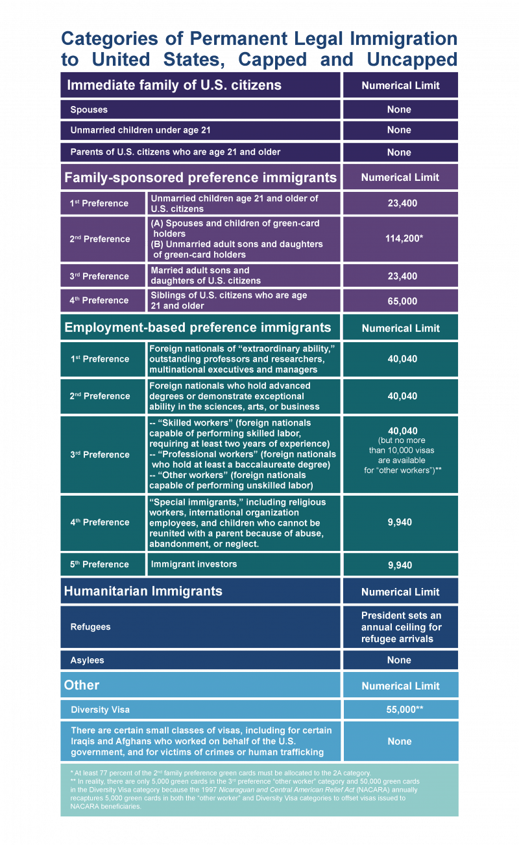
Permanent Visa (Green Card) Categories

Slide 8
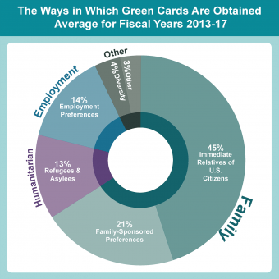
Permanent Visas (Immigrant Visas)
Immediate Family has no Cap
Family-Sponsored Cap of 226,000
Employment-Based Cap of 140,000
Diversity Cap of 55,000
Just over 1 million Green Cards issued each year.
Notes:
https://www.migrationpolicy.org/content/explainer-how-us-legal-immigration-system-works

Slide 9
Diversity Visa Lottery
Eligibility: must be born in a country with few recent immigrants to US.
Maximum Quotas:
Total cap of 55,000.
No country may receive more than 7% of total.
Additional regional caps based on recent immigration patterns.
Lottery:
Each applicant assigned a lottery number that determines priority.

Slide 10
Maximum Quotas Example 1
Quotas:
At most 2 applicants from each country.
At most 3 applicants from each region.
At most 6 applicants in total.
Lottery Order:
Countries of Origin:
Afghanistan
Bhutan
Cameroon
Djibouti.
1 | 2 | 3 | 4 | 5 | 6 | 7 | 8 | 9 | 10 | 11 | 12 | 13 | 14 | 15 | 16
A | B | A | D | B | D | B | D | D | A | C | B | A | D | C | B
1. Which applicants should we select?
2. Compare answers with your neighbor.
3. Put your answer on the whiteboard.

Slide 11
Maximum Quotas Example 1
Quotas:
At most 2 applicants from each country.
At most 3 applicants from each region.
At most 6 applicants in total.
Lottery Order:
Countries of Origin:
Afghanistan
Bhutan
Cameroon
Djibouti.
1 | 2 | 3 | 4 | 5 | 6 | 7 | 8 | 9 | 10 | 11 | 12 | 13 | 14 | 15 | 16
A | B | A | D | B | D | B | D | D | A | C | B | A | D | C | B
Top Down Processing (“Greedy” Selection):
Process applicants in priority order. At each step, allocate a visa to the next applicant unless doing so would violate an upper quota.

Slide 12
Top Down (“Greedy”) Selection Algorithm
Process applicants in priority order. At each step, allocate a visa to the next applicant unless doing so would violate an upper quota (when combined with applicants that have already received visas).
This is a natural algorithm, but is it good?

Slide 13
Goals
Comply with upper quotas.
Select as many applicants as possible.
Choose high priority applicants.
Feasible
Maximize selected applicants
Priority dominate
other feasible selections

Slide 14
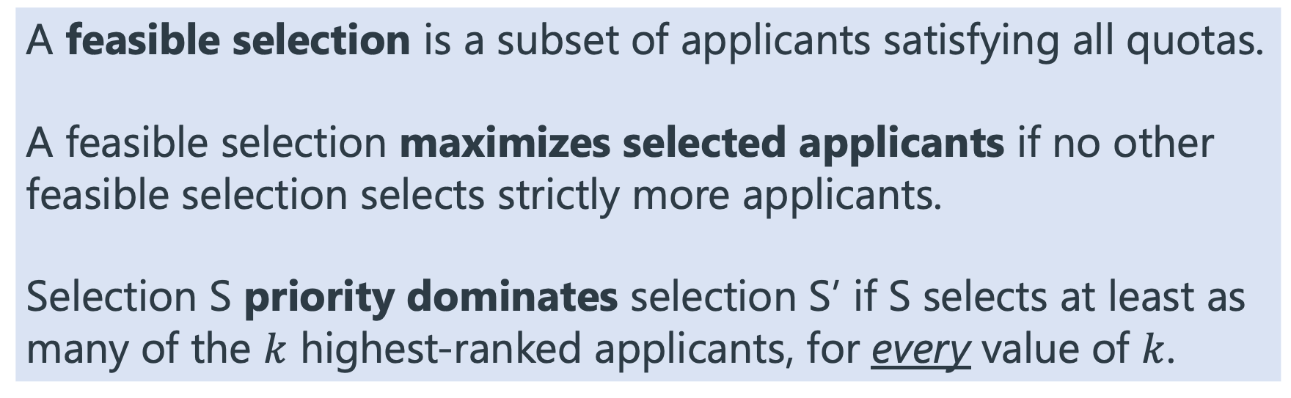
Desirable Properties
A feasible selection is a subset of applicants satisfying all quotas.
A feasible selection maximizes selected applicants if no other feasible selection selects strictly more applicants.
Selection S priority dominates selection S’ if S selects at least as many of the $k$ highest-ranked applicants, for every value of $k$.

Slide 15
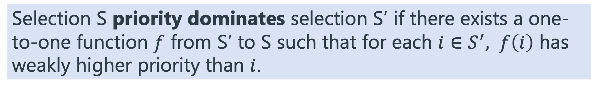
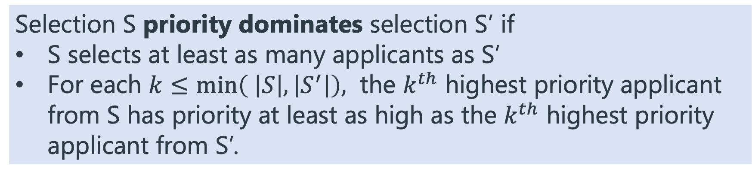
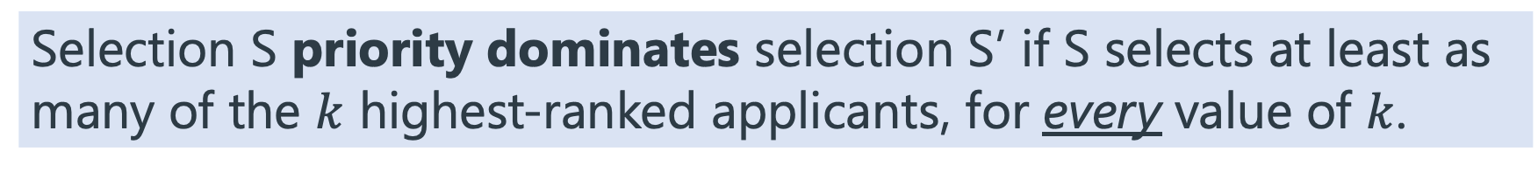
Priority Domination: Equivalent Definitions
Selection S priority dominates selection S’ if S selects at least as many of the $k$ highest-ranked applicants, for every value of $k$.
Selection S priority dominates selection S’ if there exists a one-to-one function $f$ from S’ to S such that for each $i∈S^{′},$ $f\left(i\right)$ has weakly higher priority than $i$.
Selection S priority dominates selection S’ if
S selects at least as many applicants as S’
For each $k≤min\left( \left|S\right|, \left|S^{′}\right|\right),$ the $k^{th}$ highest priority applicant from S has priority at least as high as the $k^{th}$ highest priority applicant from S’.

Slide 16
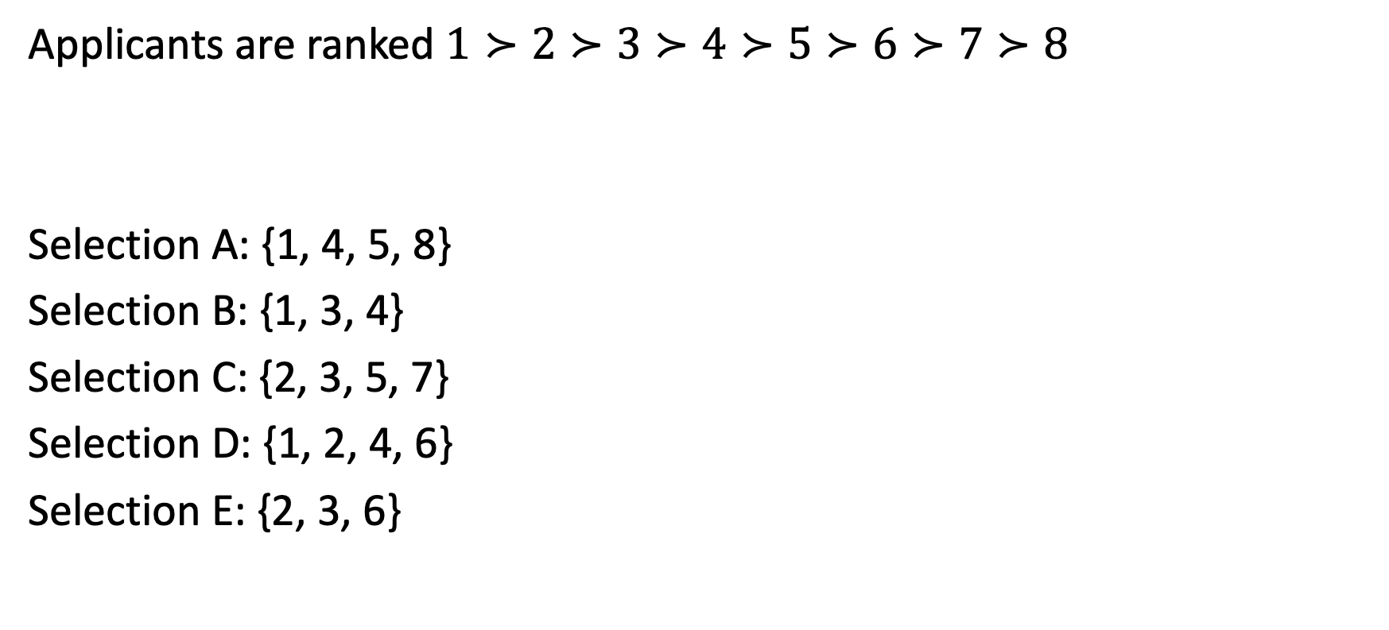
Priority Domination Practice
Applicants are ranked $1≻2≻3≻4≻5≻6≻7≻8$
Selection A: {1, 4, 5, 8}
Selection B: {1, 3, 4}
Selection C: {2, 3, 5, 7}
Selection D: {1, 2, 4, 6}
Selection E: {2, 3, 6}
For each pair of selections, does one priority dominate the other?
A vs B
A vs C
A vs D
A vs E
B vs C
B vs D
B vs E
C vs D
C vs E
D vs E

Slide 17
Priority Domination Practice
Applicants are ranked $1≻2≻3≻4≻5≻6≻7≻8$
Selection A: {1, 4, 5, 8}
Selection B: {1, 3, 4}
Selection C: {2, 3, 5, 7}
Selection D: {1, 2, 4, 6}
Selection E: {2, 3, 6}
For each pair of selections, does one priority dominate the other?
A vs B
A vs C
A vs D
A vs E
B vs C
B vs D
B vs E
C vs D
C vs E
D vs E
D
A
B
C
E

Slide 18
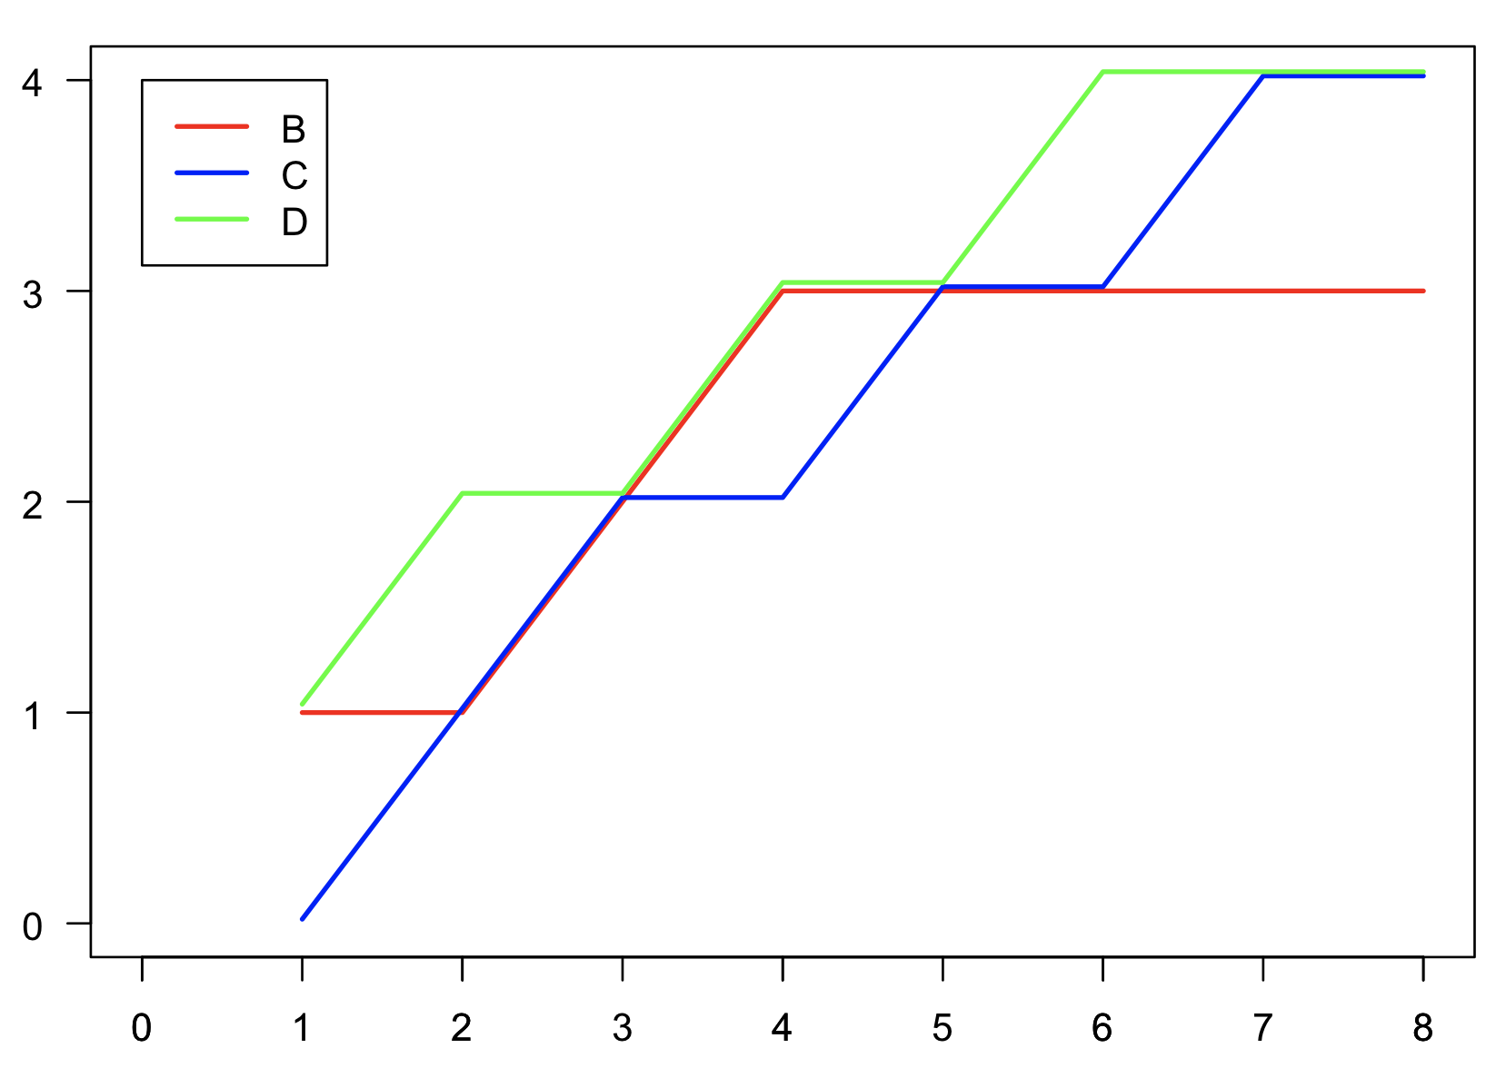
Priority Domination Visualization
B does not dominate C, as it is behind at k = 7 and k = 8.
C does not dominate B, as it is behind at k = 1 and k = 4.
D dominates both B and C.
Top k applicants
Interpretation:
Reasonable people can disagree about whether B or C is better.
Everyone should agree that D is better than B or C.
k

Slide 19
Maximum Quotas Example 1
Quotas:
At most 2 applicants from each country.
At most 3 applicants from each region.
At most 6 applicants in total.
Lottery Order:
Countries of Origin:
Afghanistan
Bhutan
Cameroon
Djibouti.
1 | 2 | 3 | 4 | 5 | 6 | 7 | 8 | 9 | 10 | 11 | 12 | 13 | 14 | 15 | 16
A | B | A | D | B | D | B | D | D | A | C | B | A | D | C | B
Choose a different lottery order (randomly arrange numbers 1-16).
For your lottery order: Does the Greedy algorithm select 6 applicants?
Does its selection priority dominate all others?

Slide 20
Maximum Quotas Example 2
Quotas:
1. No more than four applicants from any one country are selected.
2. No more than three applicants of age 18-35 are selected.
3. No more than three applicants of age 36-55 are selected.
Applicants:
The ages of the applicants from Algeria are 19, 22, 26, 28, 41, 55.
The ages of the applicants from Cameroon are 21, 23, 25, 29, 33, 39.
Will Top Down Processing always find a selection that maximizes selected applicants?
Will Top Down Processing always find a selection that priority dominates all other feasible selections?

Slide 21
What is the difference between these examples?
Quota categories are nested (form a hierarchy) if for any two categories, either one contains the other, or nobody is in both categories.
Example 1: categories are nested.
Example 2: not nested
R1
R2
Y
M
C1
C3
C1
C2
C4
C2

Slide 22
Greedy “works” when categories are nested
Quota categories are nested (form a hierarchy) if for any two categories, either one contains the other, or nobody is in both categories.
Theorem (Maximum Quotas).
The greedy algorithm always finds a feasible selection which is not priority dominated by any other feasible selection.
If categories form a hierarchy, it always finds a selection that maximizes selected applicants and priority dominates any other feasible selection.
When categories do not form a hierarchy, the number of people selected by the greedy algorithm may depend on the processing order!

Slide 23


Summary: Maximum Quotas
Top Down (“Greedy”) Processing:
Process applicants in priority order. Accept each applicant unless this would violate a maximum quota.
 | Hierarchy | In General
Finds Feasible Selection
Maximizes Selected Applicants
Priority Dominates Other Feasible Selections

Slide 24
Study Guide
Concepts
Maximum Quotas
Maximize Selected Applicants
Priority Domination
Nested (hierarchy/laminar)
Facts
If categories are nested, Top Down finds a feasible selection that priority dominates all others.
Algorithms
Top Down (“Greedy”)

Slide 25
Coming Up: Minimum Quotas
Quotas
1. At least one applicant from every country is selected.
2. At least three applicants from each region are selected.
3. At most eight applicants are selected.
Applicants:
4 from Algeria, 5 from Cameroon, 2 from Ecuador, and 6 from Venezuela.
How to find a selection that satisfies these constraints?

Slide 26
References

Slide 27
Engineering The Allocation of Public Resources
Professor Nick Arnosti
University of Minnesota

Slide 28
Recap: Maximum Quotas
Top Down (“Greedy”) Processing:
Process applicants in priority order. Accept each applicant unless doing so would violate a maximum quota (when combined with applicants that have already been accepted).
 | Hierarchy | General Case
Finds Feasible Selection
Maximizes Selected Applicants
Priority Dominates Other Feasible Selections

Slide 29
Plan for Today: Minimum Quotas
Mechinot Gap Year Matching Overview
Mechinot Algorithms 1 and 2 (practice)
Analysis: nested quota categories
Generalized Top Down Algorithm (if categories are not nested)

Slide 30
By the end of class, you will be able to…
Determine selections chosen by Mechinot Algorithms 1 and 2 on examples.
Describe how to make nested categories from non-nested ones.
Describe how the generalized top down algorithm works.

Slide 31
Gap Year Matching in Israel
Matching for the Israeli “Mechinot” Gap-Year Programs: Handling Rich Diversity Requirements (Gonczarowski, Kovalio, Nisan and Romm).
Israelis are required to enlist in the military 2-3 years after high school.
Some institutions (PMAs) offer “gap year” before starting military service.
These mostly focus on educational and volunteering activities.
There are over 50 different PMAs, and these are very heterogeneous: some are religious, some secular, and some mixed; some are co-ed and some (mostly the religious ones) are single-gender; they have different mixes of activities, different focuses of studies, different philosophical and social approaches (from purely religious orthodox to very progressive), and, one may comfortably say, quite different political leanings.

Slide 32
Gap Year Matching in Israel
Matching for the Israeli “Mechinot” Gap-Year Programs: Handling Rich Diversity Requirements (Gonczarowski, Kovalio, Nisan and Romm).
Israeli youth typically graduate from high school at the approximate age of 18 and are then required to enlist in the military for about two and a half years (currently a bit less for women and a bit more for men). There are several institutions that offer high-school graduates a “gap year” before starting their military service, mostly focusing on some combination of educational and volunteering activities.
There are over 50 different PMAs, and these are very heterogeneous: some are religious, some secular, and some mixed; some are co-ed and some (mostly the religious ones) are single-gender; they have dif- ferent mixes of activities, different focuses of studies, different philosophical and social approaches (from purely religious orthodox to very progressive), and, one may comfortably say, quite different political leanings.

Slide 33
Old System
Candidates visit PMAs over a period of months.
Offers made on the spot (or soon after).
Advantage: PMAs can build a balanced cohort by considering who has already accepted when deciding on new offers.
Disadvantages:
PMAs make “exploding offers” (pressure candidates to accept before visiting other PMAS).
PMAs must make offers before seeing all candidates.

Slide 34
New System
Visits spread across months. Offers and matching at coordinated time:
Candidates rank all acceptable PMAs
PMAs rank candidates AND describe target demographics of final cohort.
Each PMA defines a set of “populations” that it cares about (e.g., based on gender, religiousness, city of origin, belonging to certain minority groups). For each such population the PMA is allowed to define a maximum quota as well as minimum target. In addition to ranking the candidates individually, the PMA also specifies set of populations to which each candidate belongs.
First run in January 2018:
35 different programs, 1,760 positions
3,120 candidates
How to use candidate ranking + target demographics to choose among applicants?

Slide 35
Maximum Quotas Example 2
 | Female | Male | Jerusalem | Tel Aviv | Haifa
Minimum | 2 | 2 | 1 | 1 | 1
Maximum | 2 | 2 | 2 | 2 | 2
Category | Max
Female | 2
Male | 2
Jerusalem | 2
Tel Aviv | 2
Female, Jerusalem
Male, Tel Aviv
Female, Tel Aviv
Male, Tel Aviv
Male, Jerusalem
Female, Jerusalem
Male, Jerusalem
Which applicants are chosen by Greedy?
Can you find an ordering where Greedy fails to select 4 applicants?

Slide 36
Proposed Gap Year Matching Algorithms
Algorithm 1
First Pass (Fill Minimum Quotas):
Consider applicants from high to low priority. Accept each applicant who helps fill an unmet minimum quota and does not cause a maximum quota violation.
Second Pass (Top-Down Processing):
Consider remaining applicants from high to low priority. Accept each applicant who does not cause a maximum quota violation.
Algorithm 2
At each step, for each applicant who does not cause maximum quota violations, determine their “score”: the number of unmet minimum quotas that they contribute to.
Add the applicant with the highest score. Break ties using the priority list.

Slide 37
 | Female | Male | Jerusalem | Tel Aviv | Haifa
Minimum | 2 | 2 | 1 | 1 | 1
Maximum | 2 | 2 | 2 | 2 | 2
 | Min | Max
Female | 2 | 2
Male | 2 | 2
Jerusalem | 1 | 2
Tel Aviv | 1 | 2
Haifa | 1 | 2
Which applicants are chosen by Algorithm 1?
Which applicants are chosen by Algorithm 2?
Find an ordering of applicants such that Algorithm 2 fails to find a feasible selection.
Female, Jerusalem
Male, Tel Aviv
Female, Tel Aviv
Male, Tel Aviv
Male, Jerusalem
Female, Haifa
Male, Jerusalem

Slide 38
 | Female | Male | Jerusalem | Tel Aviv | Haifa
Minimum | 2 | 2 | 1 | 1 | 1
Maximum | 2 | 2 | 2 | 2 | 2
Algorithm 2
 | Min |  | Max
Female | 2 |  | 2
Male | 2 |  | 2
Jerusalem | 1 |  | 2
Tel Aviv | 1 |  | 2
Haifa | 1 |  | 2
Which applicants are chosen by Algorithm 1?
Which applicants are chosen by Algorithm 2?
Find an ordering of applicants such that Algorithm 2 fails to find a feasible selection.
I
I
I
I
I
I
I
I
Algorithm 1
Pass 1
Pass 2
Contributes to “Female”, “Jerusalem”
Contributes to “Male”, “Tel Aviv” min
Contributes to “Female” min
Violates “Tel Aviv” max
Contributes to “Male” min
Violates “Female” max
Violates “Male”, “Jerusalem” max
Female, Jerusalem
Male, Tel Aviv
Female, Tel Aviv
Male, Tel Aviv
Male, Jerusalem
Female, Haifa
Male, Jerusalem

Slide 39
Could create cooler animation, but would be a lot of work!
 | Min |  | Max
Female | 2 |  | 2
Male | 2 |  | 2
Jerusalem | 1 |  | 2
Tel Aviv | 1 |  | 2
Haifa | 1 |  | 2
Which applicants are chosen by Algorithm 1?
Which applicants are chosen by Algorithm 2?
Find an ordering of applicants such that Algorithm 2 fails to find a feasible selection.
I
I
I
I
I
I
I
I
Algorithm 2
Female, Jerusalem
Male, Tel Aviv
Female, Tel Aviv
Male, Tel Aviv
Male, Jerusalem
Female, Haifa
Male, Jerusalem
All candidates contribute to 2 min quotas
Candidates 2, 3, 4, 6 contribute to 2 min quotas
Candidate 6 contributes to 2 min quotas
Candidate 3 causes max quota violation. Candidates 4, 5, 7 contribute to 1 min quota
All remaining candidates cause max quota violation.

Slide 40
Proposed solution: eliminate gender minimum quotas.
Could still keep gender maximum quotas, other minimum quotas.

Slide 41
 | Min |  | Max
Female | 0 |  | 2
Male | 0 |  | 2
Jerusalem | 1 |  | 2
Tel Aviv | 1 |  | 2
Haifa | 1 |  | 2
Which applicants are chosen by Algorithm 1?
Which applicants are chosen by Algorithm 2?
Find an ordering of applicants such that Algorithm 2 fails to find a feasible selection.
I
I
I
I
I
I
I
I
Algorithm 1
Pass 1
Pass 2
Female, Jerusalem
Male, Tel Aviv
Female, Tel Aviv
Male, Tel Aviv
Male, Jerusalem
Female, Haifa
Male, Jerusalem
Contributes to “Jerusalem” min
Contributes to “Tel Aviv” min
No contribution to min quota
No contribution to min quota
No contribution to min quota
Contributes to “Haifa” min
No contribution to min quota

Slide 42
 | Female | Male | Jerusalem | Tel Aviv | Haifa
Minimum | 2 | 2 | 1 | 1 | 1
Maximum | 2 | 2 | 2 | 2 | 2
Algorithm 2
 | Min |  | Max
Female | 0 |  | 2
Male | 0 |  | 2
Jerusalem | 1 |  | 2
Tel Aviv | 1 |  | 2
Haifa | 1 |  | 2
Which applicants are chosen by Algorithm 1?
Which applicants are chosen by Algorithm 2?
Find an ordering of applicants such that Algorithm 2 fails to find a feasible selection.
I
I
I
I
I
I
I
I
Algorithm 1
Pass 1
Pass 2
Contributes to “Jerusalem” min
Contributes to “Tel Aviv” min
Violates “female” max
No violations of max quota
Violates “male” max
Contributes to “Haifa” min
Violates “male” max
Female, Jerusalem
Male, Tel Aviv
Female, Tel Aviv
Male, Tel Aviv
Male, Jerusalem
Female, Haifa
Male, Jerusalem

Slide 43
 | Min |  | Max
Female | 0 |  | 2
Male | 0 |  | 2
Jerusalem | 1 |  | 2
Tel Aviv | 1 |  | 2
Haifa | 1 |  | 2
Regardless of whether we have minimum gender quotas, both algorithms fail if ranking is 1 > 3 > …
Both algorithms choose 1 and 3, making it impossible to choose 6 later!
Female, Jerusalem
Male, Tel Aviv
Female, Tel Aviv
Male, Tel Aviv
Male, Jerusalem
Female, Haifa
Male, Jerusalem

Slide 44
Can We Find A Better Algorithm?
Alternative #1 (used for affordable housing allocation in NYC):
Fix order of categories. Attempt to fill mínimum quotas in this order.
Alternative #2 (used for selecting citizens’ assemblies):
Sequentially fill lower quotas that are furthest from being satisfied.
Alternative #3 (used for Chilean constitutional assembly):
Initially ignore lower quotas, then try to satisfy them by replacing some selected candidates with others who were not initially selected.
None of these approaches is guaranteed to find a feasible selection whenever there is one.

Slide 45
Can We Find a Better Algorithm?
Theorem. Determining whether there is a feasible selection is NP-Hard.
(Reductions from Independent Set and Set Cover.)
Consequence: Unlikely that any “simple” (computationally efficient) algorithm can be guaranteed to find a feasible selection whenever one exists.
Potential Solutions:
Use a simple algorithm that might fail to find a feasible selection.
Ensure that categories have special structure (nested).
Use an algorithm that may not be computationally efficient.

Slide 46
Solution #2: Assume Special Structure (Nested)
Quotas:
At most 7 applicants.
At least 3 applicants from each region.
At least 1 applicant from each city
Applicants: ranked 1-16.
Central
North
Jerusalem
Haifa
Tel Aviv
Safed
1 | 2 | 3 | 4 | 5 | 6 | 7 | 8 | 9 | 10 | 11 | 12 | 13 | 14 | 15 | 16
J | T | J | H | T | H | T | H | H | J | S | T | J | H | S | T
What is outcome of algorithm 1? Of algorithm 2?
Find a priority ordering of applicants such that Algorithm 2 does not find a feasible selection.
1 | 2 | 3 | 4 | 5 | 6 | 7 | 8 | 9 | 10 | 11 | 12 | 13 | 14 | 15 | 16
J | T | J | H | T | H | T | H | H | J | S | T | J | H | S | T
Alg 1
Alg 2
1 | 2 | 3 | 4 | 5 | 6 | 7 | 8 | 9 | 10 | 11 | 12 | 13 | 14 | 15 | 16
J | T | J | H | T | H | T | H | H | J | S | T | J | H | S | T

Slide 47
Solution #2: Assume Special Structure (Nested)
Quotas:
At most 7 applicants.
At least 3 applicants from each region.
At least 1 applicant from each city
Applicants: ranked 1-16.
Central
North
Jerusalem
Haifa
Tel Aviv
Safed
1 | 2 | 3 | 4 | 5 | 6 | 7 | 8 | 9 | 10 | 11 | 12 | 13 | 14 | 15 | 16
J | T | J | H | T | H | T | H | H | J | S | T | J | H | S | T
Alg 1
Alg 2
1 | 2 | 3 | 4 | 5 | 6 | 7 | 8 | 9 | 10 | 11 | 12 | 13 | 14 | 15 | 16
J | T | J | H | T | H | T | H | H | J | S | T | J | H | S | T
What is outcome of algorithm 1? Of algorithm 2?
Find a priority ordering of applicants such that Algorithm 2 does not find a feasible selection.

Slide 48
Solution #2: Assume Special Structure
Theorem. If quota categories are nested and there is at least one feasible selection,
Algorithm 1 may fail to find a feasible selection.
Algorithm 2 finds a feasible selection that priority dominates all other feasible selections.

Slide 49
Alternative Algorithm That Works For Hierarchies
A
B
C
Bottom Up Minimums:
Process categories from bottom level up.
At each step, take highest priority applicants needed to satisfy minimums.
D
E
F
Then apply Top Down Processing to fill remaining spots.
Note: Order in which categories in each level are processed does not matter.
Theorem (Minimum + Maximum Quotas). When quota categories form a hierarchy and there is at least one feasible selection:
Bottom Up Minimums finds a feasible selection that priority dominates any other feasible selection. (Equivalent to Algorithm 2)

Slide 50
Creating a Hierarchy
W
M
W
M
C1
W+C1
M+C1
C2
W+C2
M+C2
49
49
49

Slide 51
All Applicants
Not Public HS
Public HS
Public HS
Not Minority
Not Low Inc
Public HS
Minority
Not Low Inc
Public HS + Minority
Public HS +
Low Income
Public HS
Not Minority
Low Income
Public HS
Minority
Low Income
50

Slide 52
Solution #3: use a more complex algorithm
Generalized Top Down Processing:
Process applicants in priority order. When considering an applicant, accept them if and only if it is possible to do so while complying with all quotas.
Nice Properties:
Finds a feasible selection if one exists.
Final selection is never priority dominated by another feasible selection.
Final selection “respects priorities”:
For each applicant who was not selected, including them would require
violating a quota or displacing a higher-priority applicant.
Explainable Affirmative Action
(Arnosti, Bonet, and Sethuraman.)

Slide 53
Application: Citizens’ Assembly
Background about citizens’ assemblies
Traditionally: goal is to simply find a feasible panel.
Reference science paper: do this in a way that is as ”fair” as possible.

Slide 54
Summary
If categories are nested: algorithm 2 finds a feasible selection that priority dominates other feasible selections.
If categories are not nested:
Likely that no simple (polynomial time) algorithm can find a feasible selection. May not be a feasible selection that priority dominates all others.
Options:
Use a simple algorithm and hope it finds a feasible selection.
Use Generalized Top Down Processing.
Use other optimization-based algorithms.
Always feasible, respects priorities, never priority dominated
May be slow, and may not maximize selected applicants

Slide 55
Summary: Maximum + Minimum Quotas
 | Hierarchy | In General (Poly Time) | In General (Exp Time)
Finds Feasible Selection
Maximizes Selected Applicants
Priority Dominates Other Feasible Selections

Slide 56
Study Guide
Algorithms
Mechinot Algorithm 1
Mechinot Algorithm 2
Generalized Top Down Processing
Facts
Both Mechinot Algorithms may fail to find feasible selection (even if one exists)
If categories are nested, Algorithm 1 may fail, but Algorithm 2 finds “best” (priority dominant) feasible selection.
If categories do not form a hierarchy, Finding a feasible selection is NP-Hard (likely impossible for fast algorithm).
Generalized top down processing always finds feasible selection that is not priority dominated.

Slide 57
References
Mechinot Matching….

