Slide 1
Engineering The Allocation of Public Resources
Professor Nick Arnosti
University of Minnesota

Slide 2
Course Overview: Notions of Fairness
Unit 1: Symmetry (Equal Treatment)
Unit 2: Respecting Priorities (No Justified Envy)
Unit 3: Diversity (Representation of Different Groups)
Maximum and Minimum Quotas
Reserved Positions
Last Week
This Week

Slide 3
Minimum Quotas vs Reserved Positions
Key difference is how they handle overlapping categories.
Quotas: individuals contribute to minimum quota for every group they belong to.
If we have minimum quotas of one woman and one minority candidate, a female minority candidate can satisfy both simultaneously.
Reserves: individuals claim one position (reserved for one group they belong to).
If we reserve one position for a woman and another for a minority candidate, a female minority candidate can fill either position (but not both).
Some ambiguity: which position should this candidate fill?

Slide 4
Plan for Mini-Unit on Reserves
Today: Simple case with only two categories of position: “reserved” and “unreserved” (motivated by H1B visa allocation).
Next Class: more complex case with many overlapping categories (motivated by affirmative action in India and elsewhere).

Slide 5
Plan for Today
H1B Visa Overview
Introduction of 4 selection methods used since 2005
First two methods use a single priority list
Next two methods use two priority lists
Calculate outcomes from each method using real data.
How much of a difference does the choice of algorithm make?

Slide 6
By the end of class, you will be able to…
Describe 4 algorithms that have implemented H1B law since 2005.
Say which procedures are better for applicants with advanced degrees.
Calculate the number of successful degree-holders for examples with (i) a given priority order, and (ii) a random priority order.

Slide 7
Visa Overview
Family
Employment
Humanitarian
Diversity
Permanent
(“Immigrant”)
(Green Cards)
Business and Leisure
Student
Employment
Temporary
(“Non-Immigrant”)
H1B, H2B, H2A

Slide 8
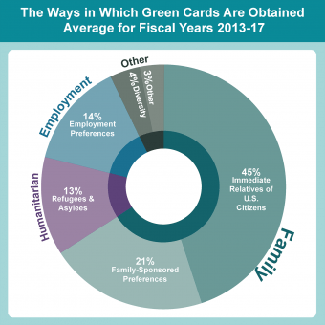
Permanent Visas (Immigrant Visas)
Immediate Family has no Cap
Family-Sponsored Cap of 226,000
Employment-Based Cap of 140,000
Diversity Cap of 55,000
Just over 1 million Green Cards issued each year.
Notes:
https://www.migrationpolicy.org/content/explainer-how-us-legal-immigration-system-works

Slide 9
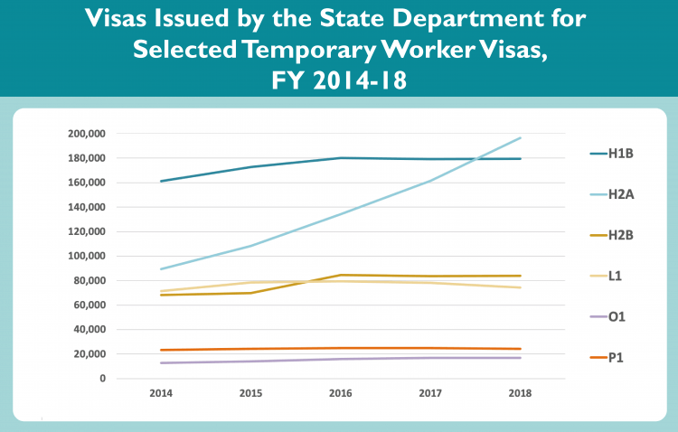
Temporary (“Non-Immigrant”) Employment-Based Visas
Other
H1B
China
India
Other
H2B
Jamaica
Mexico
H2A
Mexico

Slide 10
H1B Visa Program
From USCIS Website:
The H-1B program allows companies and other employers in the United States to temporarily employ foreign workers in occupations that require the theoretical and practical application of a body of highly specialized knowledge and a bachelor’s degree or higher in the specific specialty, or its equivalent.
The H-1B classification has an annual numerical limit (cap) of 65,000 new statuses/visas each fiscal year. An additional 20,000 petitions filed on behalf of beneficiaries with a master’s degree or higher from a U.S. institution of higher education are exempt from the cap.
Additionally, H-1B workers who are petitioned for or employed at an institution of higher education or its affiliated or related nonprofit entities, a nonprofit research organization or a government research organization are not subject to this numerical cap.

Slide 11
H1B Visa History
Pre-2005: cap of 65,000.
FY 2005: introduced exemption for 20,000 advanced degree holders.
FY 2005:
After cap of 65,000 is reached, award additional 20,000 visas to applicants with advanced degrees.
FY 2006-2008:
First 20,000 applicants with advanced degrees don’t count towards 65,000 cap.

Slide 12
Walkthrough Demonstration
Have post-it notes in two different colors (I used gray and green).
Each student takes a post-it note (in my class of 18, 12 gray + 6 green).
I also have post-its: “standard” (gray: 6) and “reserved” (green: 2).
Have students line up. Those with green post-its are eligible for reserved visas.
I start at one end of the line, and simulate the 2005 procedure (hand out post-its of the appropriate color to students, or skip them, and narrate the process). Then I collect the post-its again, and repeat for the 2006 procedure.
After the exercise, students each write their name on their post-it. I collect these, to be used in a demonstration of the two lottery procedures later.

Slide 13
Reserve Example
We have 14 applicants for H1B visas. We can award only 6 visas, but an additional 2 spots are available to applicants with an advanced degree from a US institution. Applicants are numbered by arrival order.
1 | 2 | 3 | 4 | 5 | 6 | 7 | 8 | 9 | 10 | 11 | 12 | 13 | 14
Advanced Degree
No Advanced Degree
Earliest to Apply
Latest to Apply
In 2005, which applicants would receive visas?
In 2006-2008, which applicants would receive visas?
Does either selection priority dominate the other?
Which method selects more applicants with advanced degrees?

Slide 14
Reserve Example
We have 14 applicants for H1B visas. We can award only 6 visas, but an additional 2 spots are available to applicants with an advanced degree from a US institution. Applicants are numbered by arrival order.
1 | 2 | 3 | 4 | 5 | 6 | 7 | 8 | 9 | 10 | 11 | 12 | 13 | 14
Advanced Degree
No Advanced Degree
Earliest to Apply
Latest to Apply
1 | 2 | 3 | 4 | 5 | 6 | 7 | 8 | 9 | 10 | 11 | 12 | 13 | 14
FY 2005
1 | 2 | 3 | 4 | 5 | 6 | 7 | 8 | 9 | 10 | 11 | 12 | 13 | 14
FY 2006-2008

Slide 15
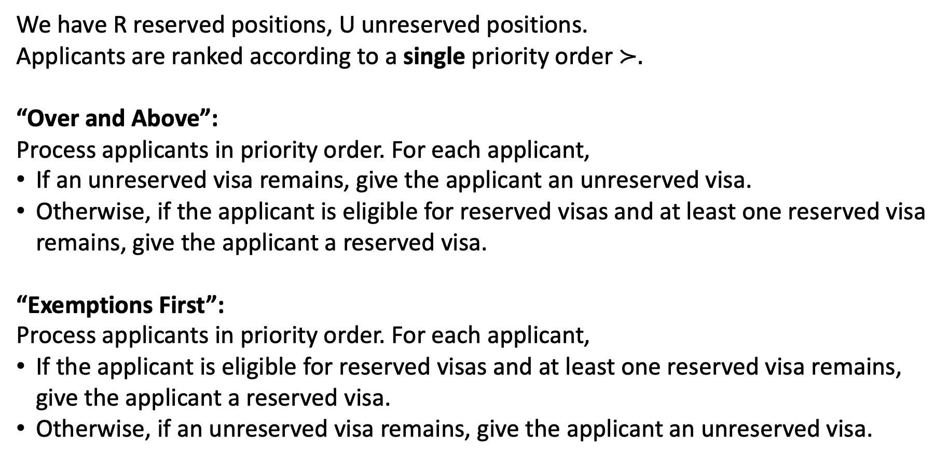
Algorithms Based on One Priority Order
We have R reserved positions, U unreserved positions.
Applicants are ranked according to a single priority order $≻.$
“Over and Above”:
Process applicants in priority order. For each applicant,
If an unreserved visa remains, give the applicant an unreserved visa.
Otherwise, if the applicant is eligible for reserved visas and at least one reserved visa remains, give the applicant a reserved visa.
“Exemptions First”:
Process applicants in priority order. For each applicant,
If the applicant is eligible for reserved visas and at least one reserved visa remains, give the applicant a reserved visa.
Otherwise, if an unreserved visa remains, give the applicant an unreserved visa.
FY 2005 System
(Priority = Arrival Order)
FY 2006-2008 System
(Priority = Arrival Order)

Slide 16
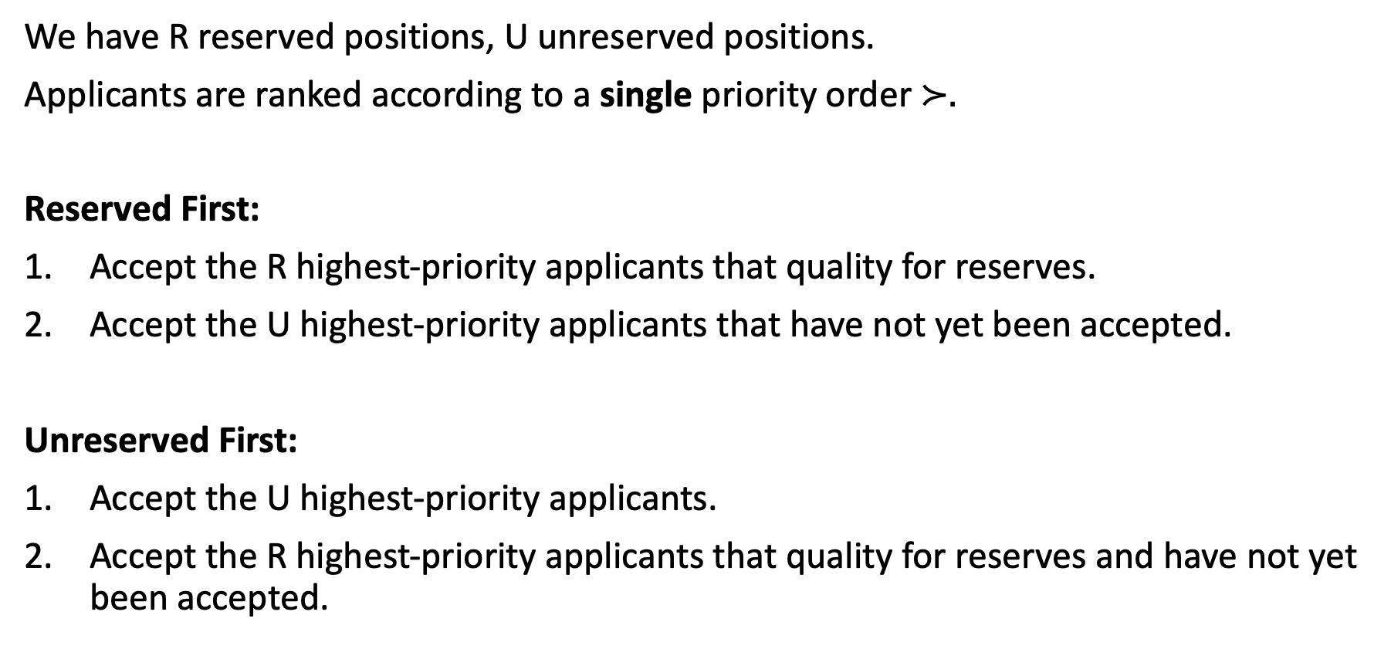
Algorithms Based on Two “Passes”
We have R reserved positions, U unreserved positions.
Applicants are ranked according to a single priority order $≻.$
Reserved First:
Accept the R highest-priority applicants that quality for reserves.
Accept the U highest-priority applicants that have not yet been accepted.
Unreserved First:
Accept the U highest-priority applicants.
Accept the R highest-priority applicants that quality for reserves and have not yet been accepted.

Slide 17
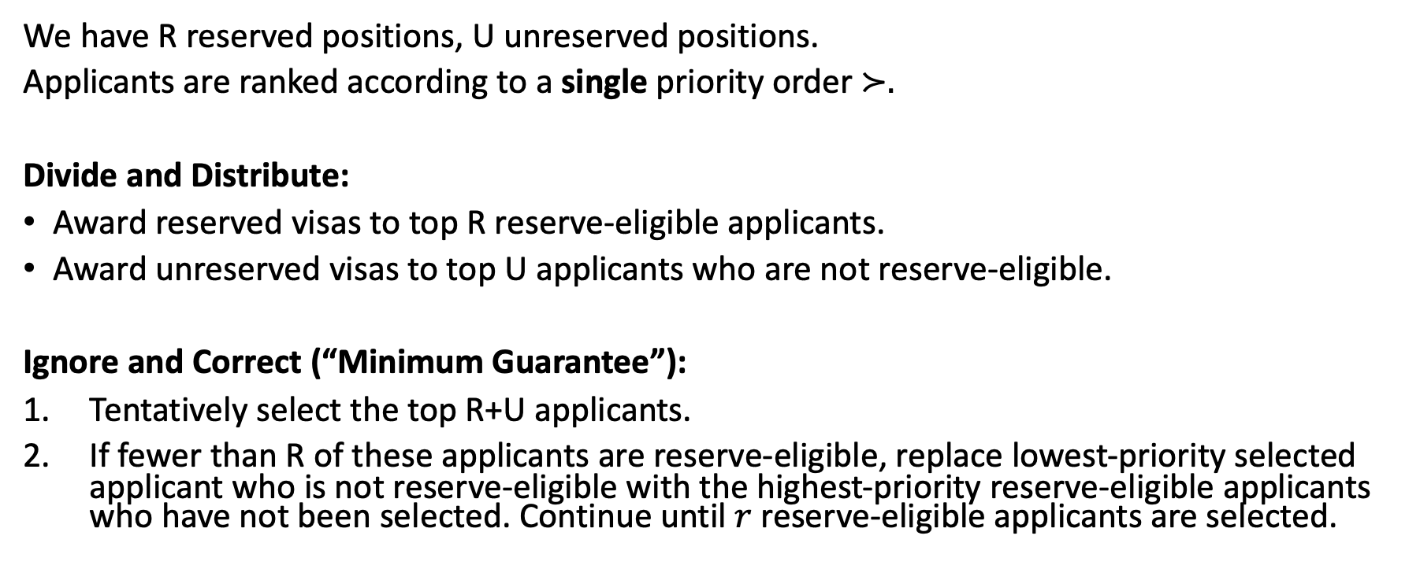
Other Algorithms Using a Single Priority List
We have R reserved positions, U unreserved positions.
Applicants are ranked according to a single priority order $≻.$
Divide and Distribute:
Award reserved visas to top R reserve-eligible applicants.
Award unreserved visas to top U applicants who are not reserve-eligible.
Ignore and Correct (“Minimum Guarantee”):
Tentatively select the top R+U applicants.
If fewer than R of these applicants are reserve-eligible, replace lowest-priority selected applicant who is not reserve-eligible with the highest-priority reserve-eligible applicants who have not been selected. Continue until $r$ reserve-eligible applicants are selected.

Slide 18
Minimum Guarantee
We have R reserved positions, U unreserved positions.
Applicants are ranked according to a single priority order $≻$.
Minimum Guarantee:
Let X be the number of reserve-eligible applicants in the first R+U positions of $≻$.
Accept the $max⁡(X,R)$highest-priority reserve-eligible applicants.
Fill the remaining $R+U− max⁡(X,R)$positions with the highest-priority applicants who are not eligible for reserves.
For any R, U, reserve-eligible applicants $E⊆A$, and priority order $≻$ over $A$,
Applicants Prefer Reserved = Reserve Initiated = Minimum Guarantee
Applicants Prefer Unreserved = Unreserved Initiated = Over and Above.

Slide 19
Compare Exemptions first to Minimum Guarantee:
Award reserved visas to top R reserve-eligible applicants (if there are fewer than R such applicants, they all get reserved visas)
Award unreserved visas to top U applicants that remain.
Point: minimum guarantee is equivalent to exemptions first (all priority orders, all values of R, U)

Slide 20
Comparing Exemptions First to Over and Above
Theorem. For any set of applicants, any priority order, and any R, U:
Exemptions First Reserves result in a selection that priority dominates the selection of Over and Above Reserves.
Over and Above reserves select weakly more reserve-eligible applicants than Exemptions First Reserves.

Slide 21
Priority domination -- is it compelling in this application?
More politically salient goal: select degree holders (or not).
Must comply with law, but how far can you stretch ambiguity?
Seemingly small procedural changes can have big effects!
Usually, this class defines objectives, then procedures to satisfy them. In reality, people usually design (ill-specified) procedures, then leave you guessing at their objectives.

Slide 22
Reform in 2008 (in place for FY 2009)
Concern: 150,000 applications sent by overnight mail arrive on first day of processing.
Solution: any applications in the first five days treated equally (lottery).
How to run the lotteries?

Slide 23
A Common Story: FCFS turns to Lottery
Start with First Come, First Served Reservation System
Increasing volume of applications
This induces a mad scramble for reservations
System replaced by a lottery

Slide 24
H2B Visas

Slide 25
Increasing Volume of Applications
Prior to 2018, OFLC processed applications irrespective of the time of day the application was filed and processed applications based on the day they were filed. On January 1, 2018, OFLC received approximately 4,498 applications covering 81,008 worker positions for April 1 start dates of work, exceeding the semi-annual visa allotment by nearly 250 percent. This was the first time in recent years that applications received within the first day of the filing period exceeded the semi-annual visa allocation.
On June 1, 2018, OFLC announced that it would sequentially assign H-2B applications to analysts based on the calendar date and time on which the applications were received, based on Eastern Time, and measured to the millisecond.

Slide 26
A Mad Scramble
Within the first five minutes of opening the semi-annual H-2B certification process on January 1, 2019, the Department’s network infrastructure supporting OFLC’s electronic filing system experienced more than 22,900 server login attempts, in contrast with only 721 attempts in approximately the same time period for the 2018 filing season. This unprecedented volume of simultaneous system users—30 times the number of users in the previous year—ultimately caused the electronic filing system to become unresponsive and prevented almost all employers from filing H-2B applications

Slide 27
Implementing a Lottery
For these reasons, OFLC has concluded that changes to the procedures under which H-2B applications are assigned to NPC analysts are necessary to promote a more orderly and fair process for all employers seeking access to the H-2B visa program.
New System:
Random Selection Process for Assigning H-2B Applications Received During the Initial Three Days of the Filing Period for the Earliest Start Date of Work.

Slide 28
When Have You Seen This Play Out?

Slide 29

Recreation.gov Permit Lotteries

Slide 30
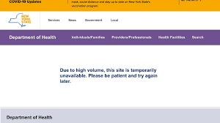
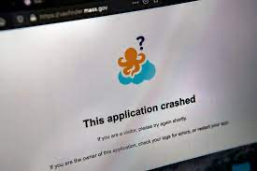
COVID-19 Vaccine Reservations

Slide 31
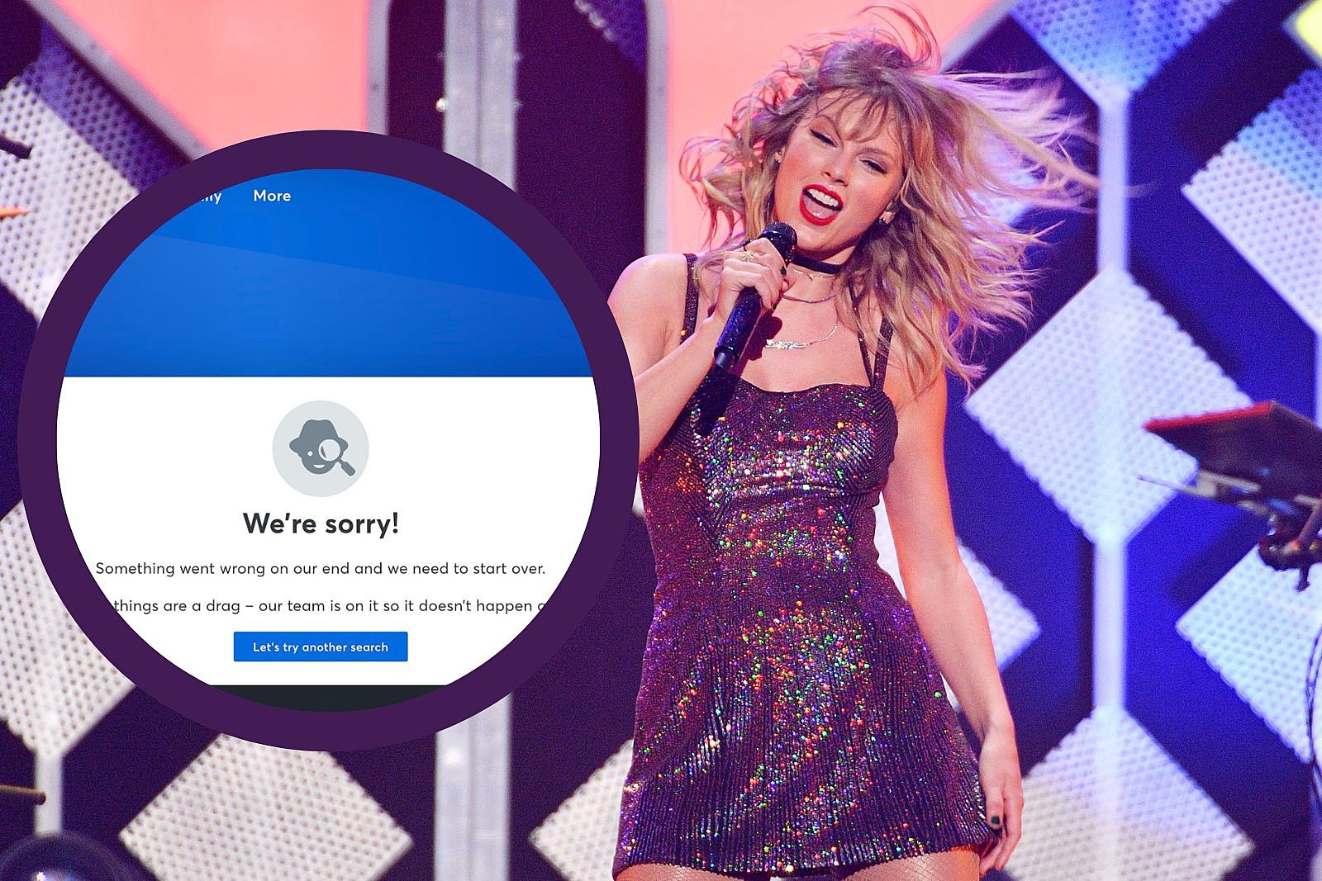

Slide 32
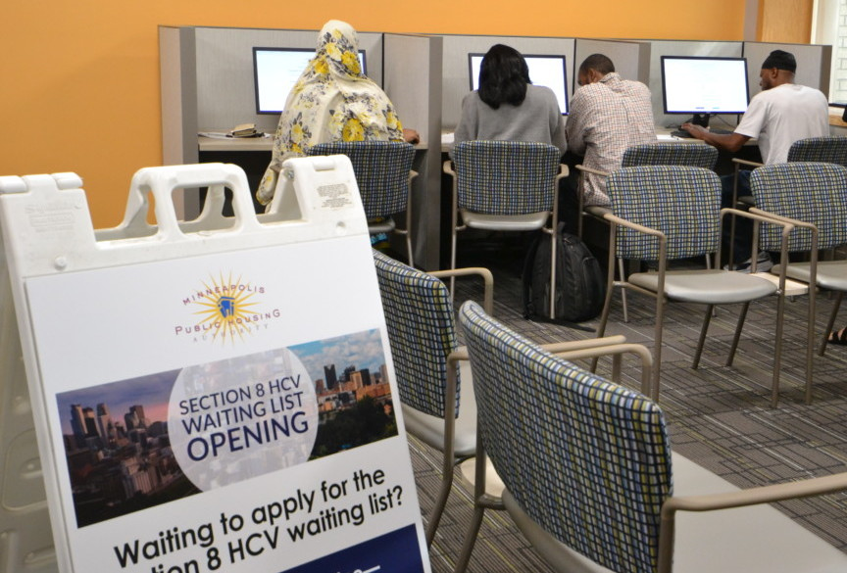
Figured it Out
Three largest housing agencies exceed 45,000 total applications
When the state’s three largest housing authorities opened their waiting lists for applications earlier this month, they knew the demand would be high. For the Metropolitan Council’s Housing and Redevelopment Authority (Metro HRA) and Saint Paul Public Housing Agency, the lists hadn’t been opened for four years. For the Minneapolis Public Housing Authority (MPHA), it had been more than 10 years.
Over the week-long application period, the three agencies received more than 45,000 applications for a total of 33,171 individual applicants when accounting for duplication. Specifically, Metro HRA received more than 17,000, Minneapolis more than 14,000 and St. Paul more than 13,000.
Each agency will place applicants on its waiting list through random lottery. Metro HRA will place 2,000 on its list, Minneapolis 2,000, and St. Paul 3,500.
More than 6,000 applicants—or 13% of applicants—applied for all three lists, which housing officials say indicates what’s at stake for people in need of stable housing in the region combined with the limited resources for housing.
“Opening all three lists at the same time was a great opportunity for regional collaboration,” said Terri Smith, director of the Metro HRA. “The number of people who applied illustrates the tremendous need for affordable housing for low-income families who seek safe, stable housing, in their communities.”

Slide 33
Two-lottery systems
2009-2019:
Award R reserved visas by lottery for reserve-eligible applicants.
Award U unreserved visas by lottery for remaining applicants.
(The second lottery includes losers of the first lottery, as well as applicants who are not reserve-eligible.)
2020:
Award U unreserved visas by lottery for all applicants.
Award R reserved visas by lottery for reserve-eligible applicants who lost the first lottery.
Which system do you expect to select more applicants with advanced degrees? Explain your answer.

Slide 34
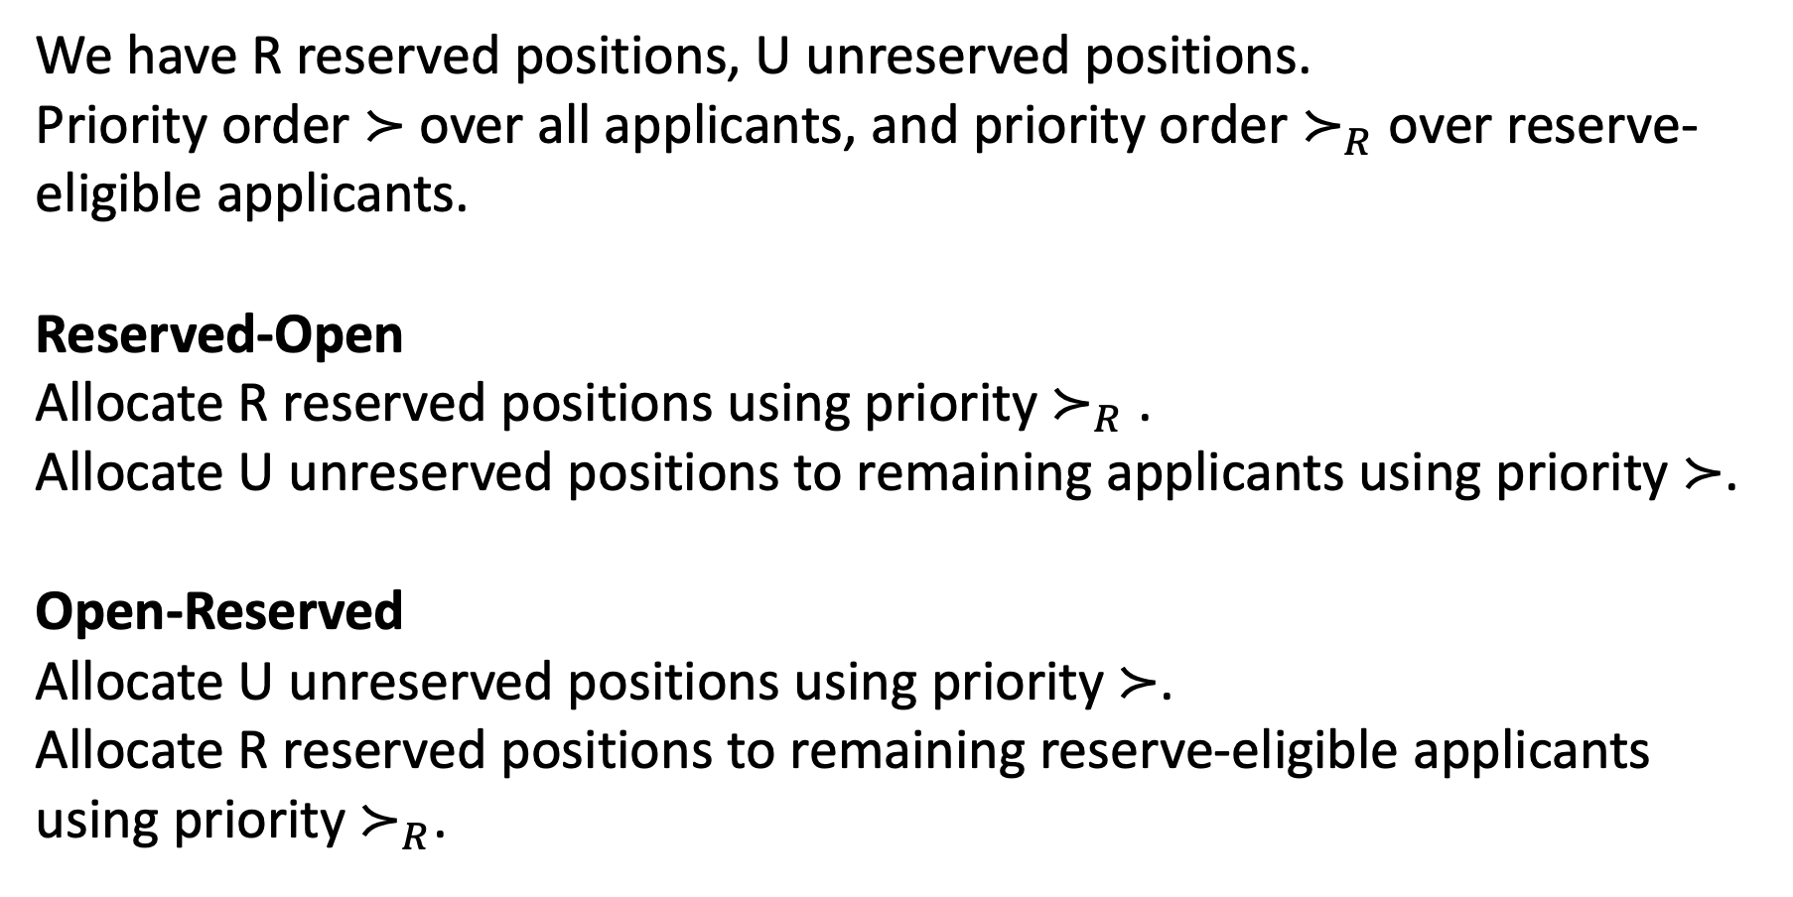
Algorithms Based on Two Priority Lists
We have R reserved positions, U unreserved positions.
Priority order $≻$ over all applicants, and priority order $≻_{R}$ over reserve-eligible applicants.
Reserved-Open
Allocate R reserved positions using priority $≻_{R}$ .
Allocate U unreserved positions to remaining applicants using priority $≻$.
Open-Reserved
Allocate U unreserved positions using priority $≻$.
Allocate R reserved positions to remaining reserve-eligible applicants using priority $≻_{R}$.
FY 2009-2019 System
(Priority = Two Lotteries)
FY 2020 System
(Priority = Two Lotteries)

Slide 35
Group Work:
U = 65,000 unreserved visas.
R = 20,000 reserved visas.
In each scenario, how many degree-holders are expected to be selected under each policy?
Non-Degree-Holders | Degree-Holders | Algorithm | Degree-Holders Selected
111,080 | 87,380 | Exemptions First
 |  | Over and Above
 |  | Reserved-Open
 |  | Open-Reserved
137,017 | 55,900 | Exemptions First
 |  | Over and Above
 |  | Reserved-Open
 |  | Open-Reserved

Slide 36
111,080-87,380 = FY 2017 (last year before statute)
Second scenario = 5 year average (FY 2013-2017)

Slide 37
USCIS Announcement and Analysis
Effective April 1, USCIS will first select H-1B petitions submitted on behalf of all beneficiaries, including those that may be eligible for the advanced degree exemption. USCIS will then select from the remaining eligible petitions, a number projected to reach the advanced degree exemption.
Changing the order in which USCIS counts these allocations will likely increase the number of petitions for beneficiaries with a master’s or higher degree from a U.S. institution of higher education to be selected under the H-1B numerical allocations. Specifically, the change will result in an estimated increase of up to 16% (or 5,340 workers) in the number of selected petitions for H-1B beneficiaries with a master’s degree or higher from a U.S. institution of higher education.

Slide 38
Other Possible Policies
Use lottery to generate single priority order, then use exemptions first.
(or over and above)

Slide 39
Group Work:
U = 65,000 unreserved visas.
R = 20,000 reserved visas.
In each scenario, how many degree-holders are expected to be selected under each policy?
Non-Degree-Holders | Degree-Holders | Algorithm | Degree-Holders Selected
111,080 | 87,380 | Exemptions First | 37,425
 |  | Over and Above | 48,619
 |  | Reserved-Open | 44,542
 |  | Open-Reserved | 48,619
137,017 | 55,900 | Exemptions First | 24,630
 |  | Over and Above | 38,835
 |  | Reserved-Open | 33,495
 |  | Open-Reserved | 38,835

Slide 40
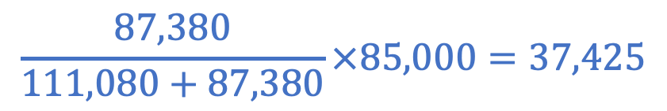

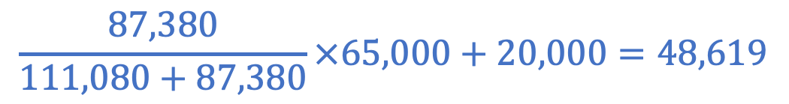
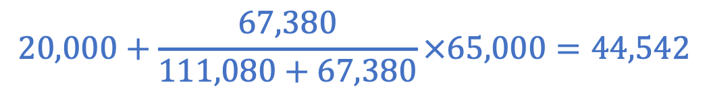
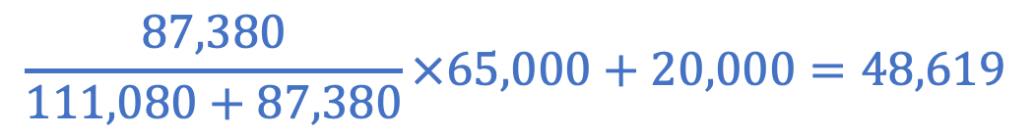
Scenario 1 111,080 Non-Degree-Holders, 87,380 Degree-Holders
We can award 85,000 visas. Degree-Holders Selected:
No reserve:
Exemptions First (20,000 reserved): $37,425$ degree-holders selected.
Over And Above of 20,000:
2 lotteries, reserved first:
2 lotteries, unreserved first:
$$\frac{87,380}{111,080+87,380}×85,000=37,425$$
$$\frac{87,380}{111,080+87,380}×65,000+20,000=48,619$$
$$20,000+\frac{67,380}{111,080+67,380}×65,000=44,542$$
$$\frac{87,380}{111,080+87,380}×65,000+20,000=48,619$$

Slide 41
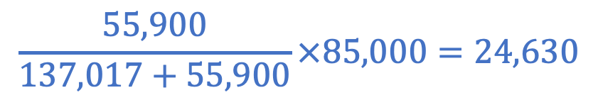

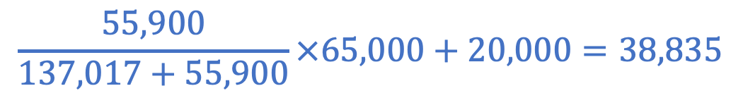
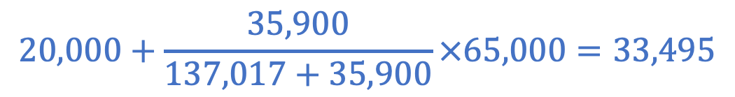
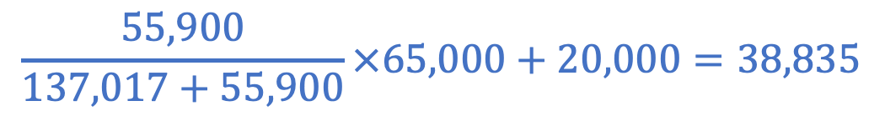
Scenario 2 137,017 Non-Degree-Holders, 55,900 Degree-Holders
We can award 85,000 visas. Degree-Holders Selected:
No reserve:
Exemptions First (20,000 reserved): $24,630$ degree-holders selected.
Over And Above of 20,000:
2 lotteries, reserved first:
2 lotteries, unreserved first:
$$\frac{55,900}{137,017+55,900}×85,000=24,630$$
$$\frac{55,900}{137,017+55,900}×65,000+20,000=38,835$$
$$20,000+\frac{35,900}{137,017+35,900}×65,000=33,495$$
$$\frac{55,900}{137,017+55,900}×65,000+20,000=38,835$$

Slide 42
Study Guide
Algorithms
Exemptions First
Over-and-Above
Reserved-Unreserved
Unreserved-Reserved
Facts
Exemptions First priority dominates Over and Above
Over and Above selects at least as many reserve-eligible applicants as Exemptions First.
Open-Reserved selects at least as many reserve-eligible applicants as Reserved-Open.
Open-Reserved and Over and Above select the same number of reserve-eligible applicants.

Slide 43
I did stuff about how rearranging first U positions won’t affect either one. Make slides to convey this point explicitly.
Minimum Guarantee == Exemptions First (do this in class or first HW)
Real shorthand:
Exemptions First: check first R+U. If among these, at least R are reserve eligible, take top R+U. Otherwise, take first R reserve eligible and first U who are not reserve eligible. Total selected is min(R, reserve-eligible in first U)
Over and Above: give visas to first U, then to next R reserve eligible. Total reserve-eligible who get selected is R + reserve-eligible in first U.
Do more practice (like in next hidden slides).
Exemptions first: take top R reserve eligible, then top U overall.
Connect to previous stuff. We have a hierarchy (reserve-eligible contained in all applicants), so bottom-up minimums algorithm selects something that priority dominates all other feasible. Could do this as HW or in class on Thurs.

Slide 44
Reserve Practice
Group Work:
We have 65,000 unreserved visas, and 20,000 reserved visas.
How many advanced degree applicants receive visas in each case?
Earliest to Apply
Latest to Apply
Policy | # Degree Selected
Exemptions First
Over and Above
Exemptions First
Over and Above
 | First 65k | Next 20k | Rest of List
Degree | 24,600 | 8,700 | 25,000
Non-Degree | 40,400 | 11,300 | 36,300
Degree | 14,200 | 3,100 | 25,000
Non-Degree | 50,800 | 16,900 | 36,300
a)
b)

Slide 45
Reserve Practice
Group Work:
We have 65,000 unreserved visas, and 20,000 reserved visas.
How many advanced degree applicants receive visas in each case?
Earliest to Apply
Latest to Apply
Policy | # Degree Selected
Exemptions First | 33,300
Over and Above | 44,600
Exemptions First | 20,000
Over and Above | 34,200
 | First 65k | Next 20k | Rest of List
Degree | 24,600 | 8,700 | 25,000
Non-Degree | 40,400 | 11,300 | 36,300
Degree | 14,200 | 3,100 | 25,000
Non-Degree | 50,800 | 16,900 | 36,300
a)
b)

Slide 46
Scenario A
Exemptions First:
First 65,000: award 20,000 reserved visas and 45,000 unreserved visas.
This leaves 20,000 unreserved visas, so next 20,000 applicants are selected.
A total of 24,600+8,700 = 33,300 degree holders are selected.
Over and Above:
First 65,000: award 65,000 unreserved visas.
This leaves 20,000 reserved visas, so 20,000 applicants are degree holders.
A total of 24,600+20,00 = 44,600 degree holders are selected.
(24,600
degree holders)
(8,700
degree holders)
(24,600 degree holders)
(20,000
degree holders)

Slide 47
Scenario B
Exemptions First:
First 65,000: award 14,200 reserved visas and 50,800 unreserved visas.
Next 20,000: 3,100 degree holders will get reserved visas. Of the 16,900 non-degree holders, the top 14,200 get unreserved visas.
Rest of list: allocate remaining 2,700 reserved visas.
A total of 20,000 degree holders are selected.
Over and Above:
First 65,000: aaward 65,000 unreserved visas.
This leaves 20,000 reserved visas, so 20,000 applicants are degree holders.
A total of 14,200+20,00 = 34,200 degree holders are selected.
(14,200
degree holders)
(3,100 degree holders)
(2,700 degree holders)
(14,200 degree holders)
(20,000
degree holders)

Slide 48
Lottery Practice
Group Work:
In each scenario, how many degree-holders are expected to be selected under each policy?
Non-Degree-Holders | Degree-Holders | Algorithm | Degree-Holders Selected
111,080 | 87,380 | Exemptions First
 |  | Over and Above
137,017 | 55,900 | Exemptions First
 |  | Over and Above

Slide 49
Lottery Practice
Group Work:
In each scenario, how many degree-holders are expected to be selected under each policy?
Non-Degree-Holders | Degree-Holders | Algorithm | Degree-Holders Selected
111,080 | 87,380 | Exemptions First | 37,425
 |  | Over and Above | 48,619
137,017 | 55,900 | Exemptions First | 24,630
 |  | Over and Above | 38,835

Slide 50
Group Work:
U = 65,000 unreserved visas.
R = 20,000 reserved visas.
In each scenario, how many degree-holders are expected to be selected under each policy?
Non-Degree-Holders | Degree-Holders | Algorithm | Degree-Holders Selected
111,080 | 87,380 | Exemptions First | 37,425
 |  | Over and Above | 48,619
 |  | Reserved-Unreserved | ??
 |  | Unreserved-Reserved | ??
137,017 | 55,900 | Exemptions First | 24,630
 |  | Over and Above | 38,835
 |  | Reserved-Unreserved | ??
 |  | Unreserved-Reserved | ??

Slide 51
Group Work:
U = 65,000 unreserved visas.
R = 20,000 reserved visas.
In each scenario, how many degree-holders are expected to be selected under each policy?
Non-Degree-Holders | Degree-Holders | Algorithm | Degree-Holders Selected
111,080 | 87,380 | Exemptions First | 37,425
 |  | Over and Above | 48,619
 |  | Reserved-Unreserved | 44,542
 |  | Unreserved-Reserved | 48,619
137,017 | 55,900 | Exemptions First | 24,630
 |  | Over and Above | 38,835
 |  | Reserved-Unreserved | 33,495
 |  | Unreserved-Reserved | 38,835

Slide 52
H1B Visas: Changing the Priority Order
Policy Change announced on January 8, 2021:
prioritize applications at higher wage levels.
Durbin (D) and Grassley (R) encouraged Biden administration to follow through.
Concern that some employers abuse the program to bring in low-wage workers.
Aligns with Republicans’ desire to select high-skill immigrants
Aligns with Democrats’ desire for companies to offer higher wages.
Biden administration announced intention to implement this in future years.
Overruled by a judge as against the law:
Aliens who are subject to the numerical limitations of paragraph (1) shall be issued visas (or otherwise provided nonimmigrant status) in the order in which petitions are filed for such visas or status.

Slide 53
Let’s Look at the Law
The total number of aliens who may be issued visas or otherwise provided nonimmigrant status during any fiscal year… may not exceed… 65,000.
Aliens who are subject to the numerical limitations of paragraph (1) shall be issued visas (or otherwise provided nonimmigrant status) in the order in which petitions are filed for such visas or status.
The numerical limitations contained in paragraph (1)(A) shall not apply to any nonimmigrant alien issued a visa or otherwise provided status under section 1101(a)(15)H(i)b of this title who—
is employed (or has received an offer of employment) at an institution of higher education (as defined in section 1001(a) of title 20), or a related or affiliated nonprofit entity;
is employed (or has received an offer of employment) at a nonprofit research organization or a governmental research organization; or
has earned a master’s or higher degree from a United States institution of higher education (as defined in section 1001(a) of title 20), until the number of aliens who are exempted from such numerical limitation during such year exceeds 20,000.

Slide 54
Summary
Allocation systems often start as first come, first served, and switch to lotteries when demand significantly exceeds supply.
Laws and policies are often not precisely specified. Implementation details may be as (or more) important than top-line numbers.
“Exemptions First” implementation often awards many fewer visas to reserve-eligible applicants than “Over and Above” implementation.

Slide 55
Study Guide

Slide 56
References

Slide 57
Warm Up
U = 5 Unreserved positions, R = 3 reserved positions
Priority Order:
1 | 2 | 3 | 4 | 5 | 6 | 7 | 8 | 9 | 10 | 11 | 12 | 13 | 14 | 15 | 16 | 17 | 18 | 19 | 20
Who would be selected under each of the following algorithms?
Exemptions first
Over and above
Reserved-open, with reserve order
Open-reserved, with reserve order
Compare each pair of outcomes. Does one priority dominate the other?
20 | 3 | 16 | 12 | 2 | 9
20 | 3 | 16 | 12 | 2 | 9

Slide 58
Engineering The Allocation of Public Resources
Professor Nick Arnosti
University of Minnesota

Slide 59
Last Class
Since 2005, the law governing H1B visa allocation has not changed.
However, policies implementing the law have changed several times.
Most recent change: swap order of lotteries to increase success rate for applicants with advanced degrees (and decrease success for others).
How consequential are these re-interpretations of the law?

Slide 60
Homework Problem (Fiscal Year 2023)
For Fiscal Year 2023, USCIS received 483,927 applications. Of these, 150,017 were for applicants eligible for the advanced degree exemption.
Recall that the US holds two lotteries: it first holds a lottery for 65,000 visas among all applicants, and then holds a lottery for 20,000 visas among advanced degree holders who did not win the first lottery. Given this policy, how many visas do you expect to be won by advanced degree holders?

Slide 61
Different Ways to Implement H1B Visa Lottery
 | # Successful R-Eligible | R-Eligible Success Rate | R-Ineligible Success Rate
One Lottery, Exemptions First | 26,350 | 17.6% | 17.6%
Two Lotteries, Reserved-Open | 38,217 | 25.5% | 14.0%
Two Lotteries, Open-Reserved | 40,150 | 26.8% | 13.4%
One Lottery, Over and Above | 40,150 | 26.8% | 13.4%
Are there “reasonable” interpretations that match even more R-Eligible candidates? Fewer?

Slide 62
Plan for Today
Introduce a model of reserves, with multiple reserve categories. (H1B setting is a special case.)
Define desirable properties (non-wasteful, respect priorities, maximize selected applicants, priority dominant)
What are most “extreme” allowable policies?

Slide 63
Multiple Overlapping Reserve Categories
Often, many different target populations:
In Chile, school seats are reserved for low-income students, high-achieving students, and students with disabilities.
In Brazil, University seats are reserved for public high school attendees who are low income and/or ethnic minorities.
In India, civil service positions are reserved for members of specific castes, women, and people with disabilities.
In New York, apartments are reserved for applicants with disabilities, residents of the community, and city employees.

Slide 64
Important Questions
Should we count a woman with a disability towards both objectives, or only one?
If only one, which one?
If we cannot fill all reserves, can unfilled positions go to other applicants?
(Quota vs Reserve)
(Precedence Algorithm? “Smart” Reserves?)
(Hard vs Soft Reserves)

Slide 65
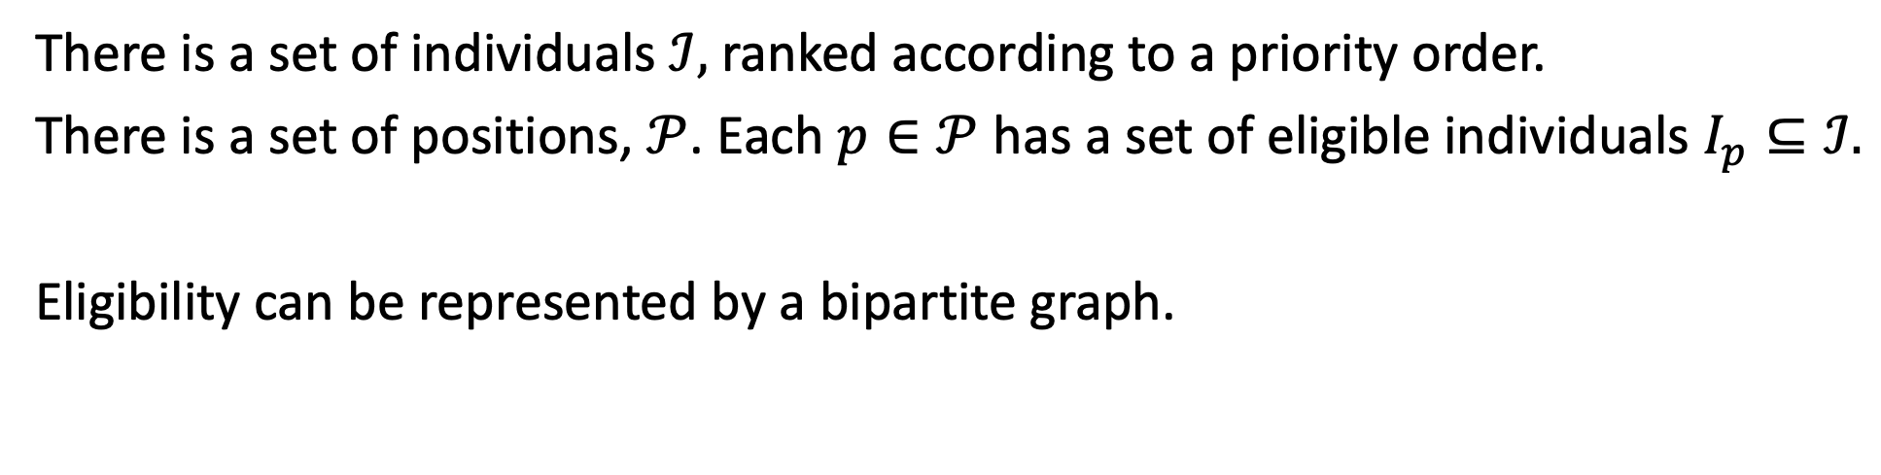
A General Model of Reserves
There is a set of individuals $ℐ,$ ranked according to a priority order.
There is a set of positions, $𝒫$. Each $p∈𝒫$ has a set of eligible individuals $I_{p}⊆ℐ.$
Eligibility can be represented by a bipartite graph.
Individuals
Positions
1
A
2
B
3
C
4

Slide 66
Example 1: H1B Visas
Some positions are unreserved (everyone is eligible)
Other positions are reserved (only applicants with advanced degrees from US institutions are eligible).
In this example, position U1 is available to anyone, positions R1 and R2 are reserved, and individuals 2 and 4 are reserve eligible.
Individuals
Positions
1
U 1
2
R1
3
R2
4
65

Slide 67
Example 2: Overlapping Reserve Categories
We have three positions. One is reserved for a woman, and one is reserved for a person with a disability.
There are 4 applicants. Applicant priority and eligibility are as follows:
1
O
2
D, W
W
D
W
3
D
4

Slide 68
Goals (Informal)
Match a lot of people
Match high priority people
Improve this

Slide 69
Goals (Informal)
Respect spirit of affirmative action (applicants are never harmed by declaring reserve eligibility). Related to elimination of justified envy – distinct properties, but seem similar. Should I just go with elimination of justified envy (for matching), since it is familiar?
Maximize reserve utilization: a reserved seat should only go to an ineligible candidate if absolutely necessary.
Select applicants with priority as high as posible.
#2 assumes soft reserves – I should just assume hard reserves and say maximize selected applicants

Slide 70
Formal Definitions
A matching M is a subset of the edges of G, in which there is at most one edge involving each individual and position.
A matching is wasteful if there is an unassigned individual, and an unassigned position for which that applicant is eligible.
(Otherwise, it is non-wasteful.)
An individual has justified envy if they are not assigned, and are eligible for a position assigned to a lower-priority applicant.
A matching respects priorities if no applicant has justified envy.

Slide 71
Precedence Algorithms
Choose a “precedence order” (ranking of positions).
In precedence order, positions choose applicants:
Choose highest priority eligible individual who has not yet been chosen.
If all eligible individuals have been chosen, the position goes unfilled.
These generalize algorithms from last class:
Over and Above: unreserved positions have highest precedence.
Exemptions First/Minimum Guarantee: reserved positions have highest precedence.

Slide 72
Axiomatic Approach
These definitions specific to H1B setting
We have R reserved positions and U unreserved positions.
We have a single priority ranking of all applicants.
An allocation assigns each applicant to a reserved position, an unreserved position, or no position.
An allocation is feasible if at most U are assigned to unreserved positions, at most R are assigned to reserved positions, and only eligible applicants are assigned to reserved positions.
An applicant who is not assigned has justified envy if they are eligible for a position assigned to a lower-priority applicant. An allocation respects priorities if no applicant has justified envy.
An allocation is wasteful if there is an unassigned applicant, and an unassigned position for which that applicant is eligible. (Otherwise, it is non-wasteful.)

Slide 73
Practice with these Concepts
We have 13 applicants for H1B visas. We can award only 6 visas, but an additional 2 spots are available to applicants with an advanced degree from a US institution.
1 | 2 | 3 | 4 | 5 | 6 | 7 | 8 | 9 | 10 | 11 | 12 | 13
Advanced Degree
No Advanced Degree
Earliest to Apply
Latest to Apply
1 | 2 | 3 | 4 | 5 | 6 | 7 | 8 | 9 | 10 | 11 | 12 | 13
Group Work:
Which allocations are feasible, non-wasteful, and respect priorities?
1 | 2 | 3 | 4 | 5 | 6 | 7 | 8 | 9 | 10 | 11 | 12 | 13
1 | 2 | 3 | 4 | 5 | 6 | 7 | 8 | 9 | 10 | 11 | 12 | 13
1 | 2 | 3 | 4 | 5 | 6 | 7 | 8 | 9 | 10 | 11 | 12 | 13

Slide 74
Reserve Example
What is the outcome of Minimum Guarantee?
Non-wasteful
What is the outcome of Over-and-Above?
Non-wasteful
1 | 2 | 3 | 4 | 5 | 6 | 7 | 8 | 9 | 10 | 11 | 12 | 13
1 | 2 | 3 | 4 | 5 | 6 | 7 | 8 | 9 | 10 | 11 | 12 | 13
1 | 2 | 3 | 4 | 5 | 6 | 7 | 8 | 9 | 10 | 11 | 12 | 13
Better for all applicants!
Do we have the right definition of wasteful?

Slide 75
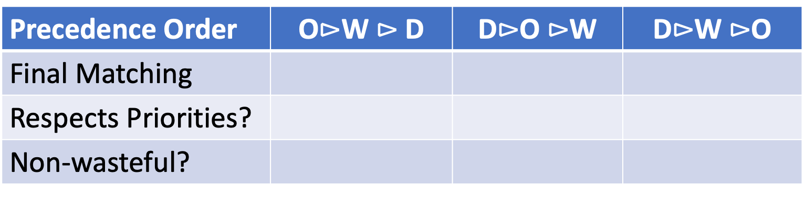
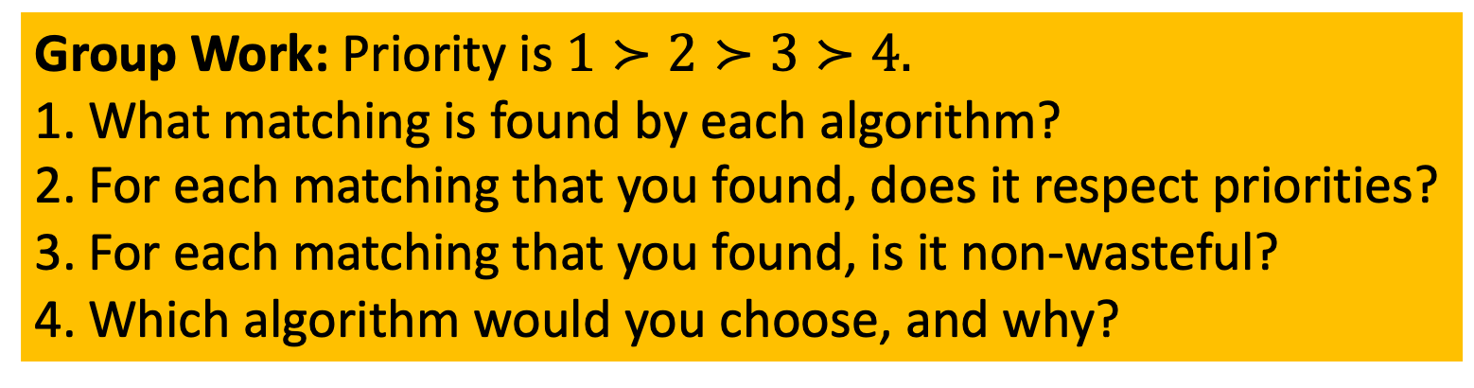
Precedence Algorithms Practice
Precedence Order | O$⊳$W $⊳$D | D$⊳$O $⊳$W | D$⊳$W $⊳$O
Final Matching
Respects Priorities?
Non-wasteful?
1
O
Group Work: Priority is $1≻2≻3≻4.$
What matching is found by each algorithm?
For each matching that you found, does it respect priorities?
For each matching that you found, is it non-wasteful?
Which algorithm would you choose, and why?
2
W
3
D
4

Slide 76

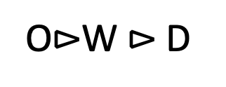

Precedence Algorithms (Outcomes)
O$⊳$W $⊳$D
D$⊳$O$⊳$W
D$⊳$W$⊳$O
1
1
1
1
O
O
O
O
2
2
2
2
W
W
W
W
3
3
3
3
D
D
D
D
4
4
4
4

Slide 77

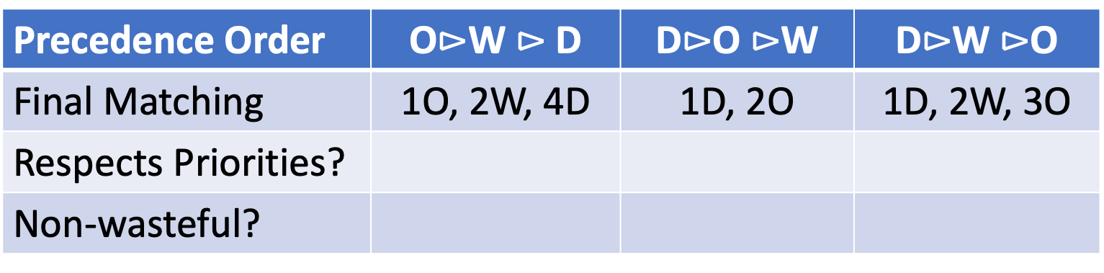
Precedence Algorithms (Solution)
Precedence Order | O$⊳$W $⊳$D | D$⊳$O $⊳$W | D$⊳$W $⊳$O
Final Matching | 1O, 2W, 4D | 1D, 2O | 1D, 2W, 3O
Respects Priorities?
Non-wasteful?
1
O
Group Work: Priority is $1≻2≻3≻4.$
What matching is found by each algorithm?
For each matching that you found, does it respect priorities?
For each matching that you found, is it non-wasteful?
Which algorithm would you choose, and why?
2
W
3
D
4

Slide 78
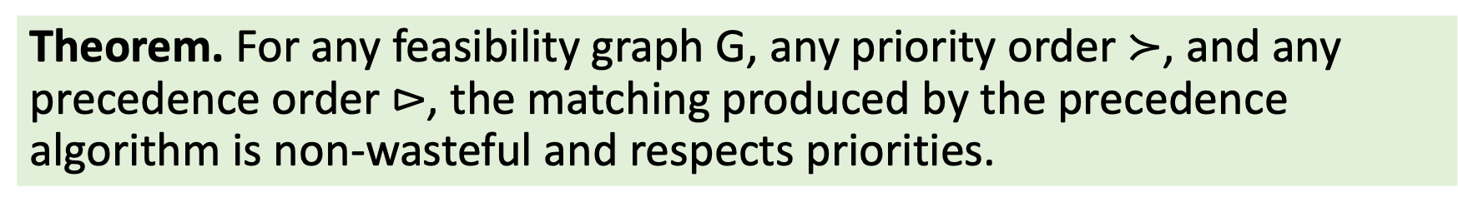
Precedence Algorithm Guarantees
Theorem. For any feasibility graph G, any priority order $≻$, and any precedence order $⊳$, the matching produced by the precedence algorithm is non-wasteful and respects priorities.
Proof sketch: One way to find this matching is as follows.
Positions rank eligible individuals based on priority.
Individuals “rank” eligible positions based on precedence order.
Run DA (individual-proposing or position-proposing; in this case, they lead to same outcome)
The result follows, as we know that the outcome of DA is non-wasteful and respects priorities.

Slide 79
Something seems off…
Is {1D, 2O} non-wasteful?
According to our definition, yes. But we could classify 1 and 2 differently, and then select both of them as well as 3 or 4.
Does {1O, 2W, 4D} respect priorities?
According to our definition, yes: 3’s envy of 4 is not justified because 3 is not eligible for the D position. But we chose to assign 1 to the only position 3 was eligible for. If we assign 1 to D we can select 1, 2, and 3.
For school choice, re-assigning 1 and 2 would mean placing them in less-preferred schools. In this case, they don’t care how they are classified!

Slide 80
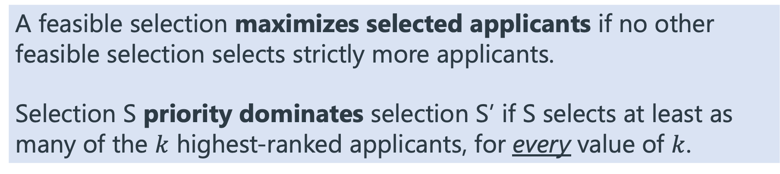
(Recall) Desirable Properties: Quotas
A feasible selection is a subset of applicants satisfying all quotas.
A feasible selection maximizes selected applicants if no other feasible selection selects strictly more applicants.
Selection S priority dominates selection S’ if S selects at least as many of the $k$ highest-ranked applicants, for every value of $k$.

Slide 81
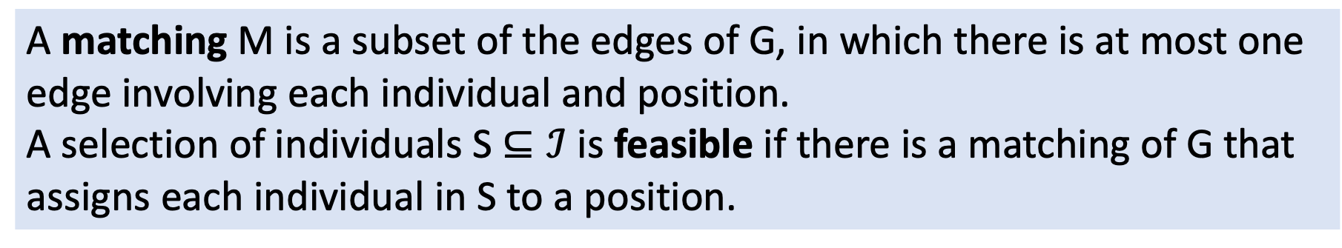
New Desirable Properties: Reserves
A matching M is a subset of the edges of G, in which there is at most one edge involving each individual and position.
A selection of individuals S $⊆ℐ$ is feasible if there is a matching of G that assigns each individual in S to a position.
A feasible selection maximizes selected applicants if no other feasible selection selects strictly more applicants.
Selection S priority dominates selection S’ if S selects at least as many of the $k$ highest-ranked applicants, for every value of $k$.

Slide 82
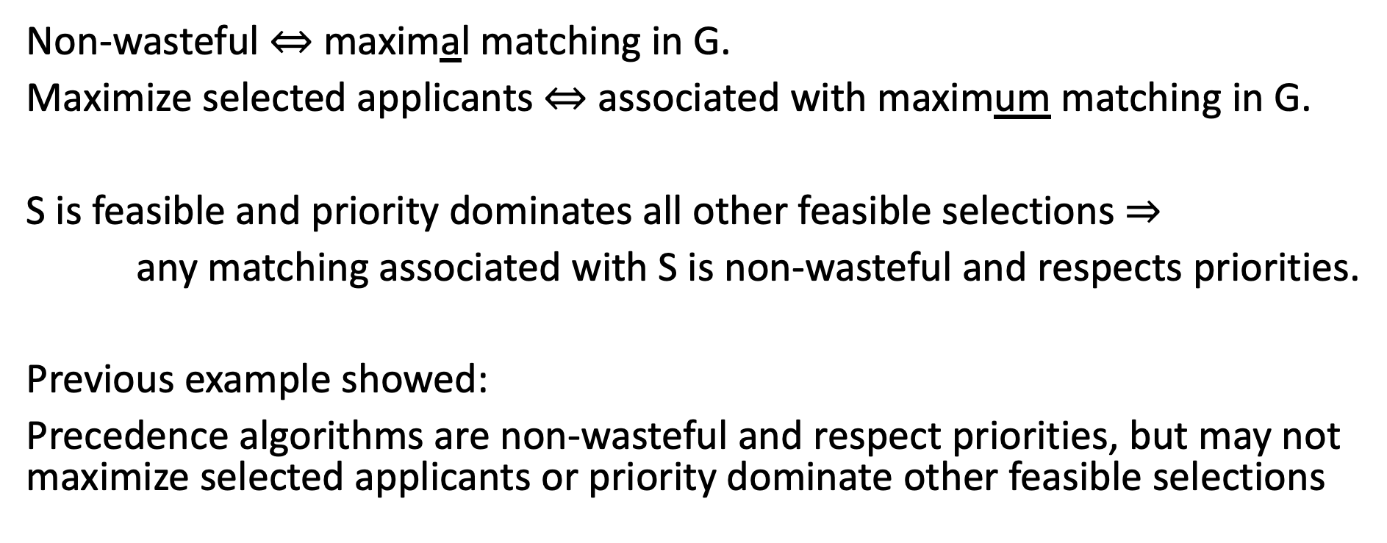
These are Stronger Requirements!
Non-wasteful $⇔$ maximal matching in G.
Maximize selected applicants $⇔$ associated with maximum matching in G.
S is feasible and priority dominates all other feasible selections $⇒$
any matching associated with S is non-wasteful and respects priorities.
Previous example showed:
Precedence algorithms are non-wasteful and respect priorities, but may not maximize selected applicants or priority dominate other feasible selections

Slide 83
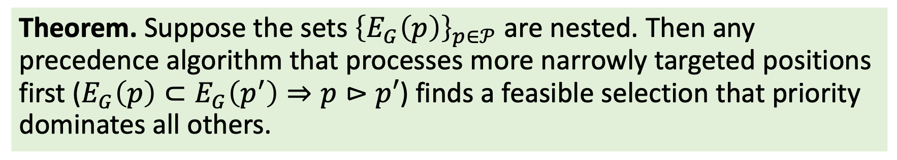
What if Reserves Have Special Structure?
Let $E_{G}\left(p\right)$ denote applicants who are eligible for position $p$.
Theorem. Suppose the sets ${\left\{E_{G}\left(p\right)\right\}}_{p∈𝒫}$ are nested. Then any precedence algorithm that processes more narrowly targeted positions first ($E_{G}\left(p\right)⊂E_{G}\left(p^{′}\right)⇒p⊳p′$) finds a feasible selection that priority dominates all others.
Implication: in H1B setting, there are two types of position.
Reserved positions are more narrowly targeted than unreserved ones.
Thus, filling reserved positions first (“Exemptions First”/”Minimum Guarantee”) priority dominates any other feasible selection.

Slide 84
Identities of Selected Applicants
Previous result considered number and priority of selected applicants, but not their identity (i.e. how many advanced degree holders selected).
Might be best to put this in first class (even if I can’t define appropriate axioms until second class).

Slide 85
Maximizing (or minimizing) successful degree holders
Not just number of students, actually identity of students (due to RP). Is this important?
Exemptions First is feasible, non-wasteful, and respects priorities.
Over and Above is feasible, non-wasteful, and respects priorities.
Theorem. (Pathak, Rees-Jones, Sonmez)
Among feasible non-wasteful allocations that respect priorities,
Exemptions first selects the fewest reserve-eligible applicants, and the most candidates who are not reserve-eligible.
Over and Above selects the most reserve-eligible applicants, and the fewest candidates who are not reserve-eligible.
These results hold for a single fixed priority order.
Changing how priorities are determined could have a big effect.

Slide 86
Finding “Good” Matchings in General
If eligibility requirements do not induce a matroid, can we still maximize selected applicants? Priority dominate other selections?
Yes! But we need a cleverer algorithm.
Maximum cardinality bipartite matching is a special case of the assignment problem, and can be solved by the Hungarian algorithm.
(Also can be formulated as maximum flow problem, and solved by Edmonds-Karp algorithm, Dinitz’s algorithm, Hopcroft-Karp algorithm.)
(Also can be formulated as an integer linear program, which is totally unimodular and thus can be solved by dropping integrality constraints.)

Slide 87

Minimum Cost Assignment Problem
For every individual $i$ and position $p$, there is a cost $c\left(i,p\right).$
We wish to assign individuals to positions to minimize total cost.
https://en.wikipedia.org/wiki/Assignment_problem
https://en.wikipedia.org/wiki/Hungarian_algorithm

Slide 88
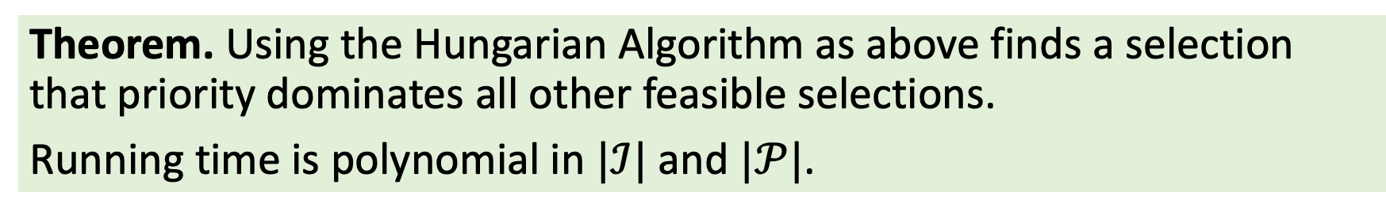
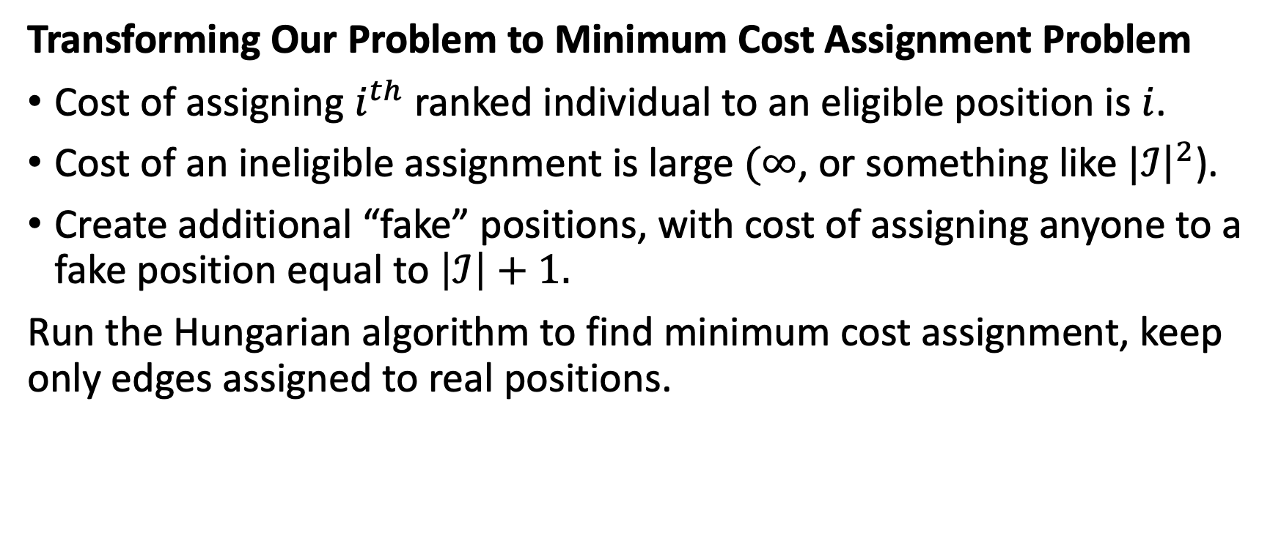
Using The Hungarian Algorithm (“Smart Reserves”)
Transforming Our Problem to Minimum Cost Assignment Problem
Cost of assigning $i^{th}$ ranked individual to an eligible position is $i$.
Cost of an ineligible assignment is large $(∞$, or something like $|ℐ{\left.​\right|}^{2}$).
Create additional “fake” positions, with cost of assigning anyone to a fake position equal to $\left|ℐ\right|+1.$
Run the Hungarian algorithm to find minimum cost assignment, keep only edges assigned to real positions.
Theorem. Using the Hungarian Algorithm as above finds a selection that priority dominates all other feasible selections.
Running time is polynomial in $|ℐ|$ and $|𝒫|$.

Slide 89
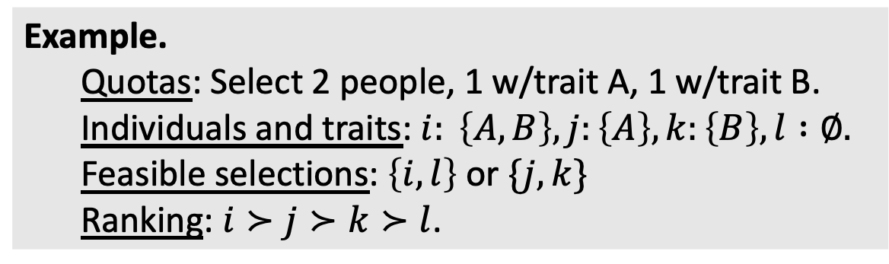
Quotas vs Reserves
Quotas:
Nested categories: greedy algorithm finds priority dominant selection.
In general: might not be any priority dominant selection.
Reserves:
Nested categories: greedy algorithm finds priority dominant selection.
In general: Hungarian algorithm finds priority dominant selection.
Example.
Quotas: Select 2 people, 1 w/trait A, 1 w/trait B.
Individuals and traits: $i: \left\{A,B\right\}, j:\left\{A\right\}, k:\left\{B\right\}, l :∅.$
Feasible selections: $\left\{i,l\right\}$ or $\{j,k\}$
Ranking: $i≻j≻k≻l$.

Slide 90
Quotas vs Reserves
Kurata et al work is relevant for comparison – I should read it more carefully (basically, shows that problems arise with quotas, not reserves)
Commonality: MATROIDS (similar results for each)

Slide 91
Matroids

Slide 92
Smart Reserves for Vaccine Allocation

Slide 93
Vaccine Scheduling
Three inefficiencies of FCFS:
Does not select highest priority.
May not maximize total vaccinations.
Turns into race: lots of time spent refreshing browser.
https://nickarnosti.com/blog/schedulingvaccines/
Monday Morning (2)
Monday Afternoon (2)
Tuesday Morning (2)
Tuesday Afternoon (2)
Wednesday Morning
Wednesday Afternoon
Thursday Morning
Thursday Afternoon

Slide 94
‘De-Reserving’ Positions
What if we are willing to fill a reserved position with someone who is ineligible, rather than leaving it vacant?
Discuss contexts where de-reserving is and is not allowed.
References include Aygun-Turhan, Arnosti-Bonet-Sethuraman, others…

Slide 95
Study Guide
COMPLETE THIS

Slide 96
Unit Review
Concepts
Maximum and Minimum Quotas
Reserves
Hierarchy
Maximize Selected Applicants
Priority Domination
Respect Spirit of Affirmative Action
Algorithms
Jefferson/D’Hondt
Chilean Assembly Algorithm
Israeli Mechinot Alg 1 & 2
Generalized Top-Down Algorithm
Minimum Guarantee
Over and Above
2SM Algorithm in India
Smart Reserves
Individually: write 2-3 concepts/algorithms that you don’t feel confident about.
In pairs: try to explain the concepts or algorithms that you listed to each other.
As a table: reach consensus on topics that you have questions about. Write these topics on the board.

Slide 97
Coming Up
In Unit 2, we introduced the Deferred Acceptance algorithm in settings where schools had a strict ranking of students.
In Unit 3, we studied more complex algorithms for selecting among applicants. However, we only addressed cases with identical items.
Next up: combine these ideas! Study a variant of Deferred Acceptance for settings where schools use complex algorithms to select students.

