Slide 1
Engineering Systems for Allocating Public Goods

Slide 2
Coming Up
Midterm #2
Available Thurs 3/21, Noon – Mon 3/25, Noon
Optional Extra Credit:
Due Wed 3/20
Class Project
First submission due 4/10
Final submission due 4/24

Slide 3
Class Project
Goal: Document and Assess a Real-World Allocation Problem
Rules/procedures must be clearly specified.
Write for a broad(ish) audience.
More complete instructions posted to Canvas soon. Start brainstorming!

Slide 4
Past Projects
Lung Allocation
Affordable housing in NYC and Singapore
Allocating Marijuana Retail Licenses in Washington State
Road Space Rationing in Beijing
On allocation of online advertising
The allocation Process of Florida's Hunt Permits
Clinic scheduling allocation
Permit lotteries for Mount Whitney climbers
Indian Premier League Players’ Auction
Dormitory allocation at the University of Minnesota
Parking spaces at the University of Minnesota
Course scheduling

Slide 5
Today’s Class in Context
Unit 2: Deferred Acceptance (schools have strict ranking of students).
Unit 3: Complex algorithms to select applicants (one school/type of position).
Today: Deferred Acceptance + complex algorithms to select applicants.

Slide 6
School Choice in Chile
Priorities by independent lotteries
Some seats reserved for children from disadvantaged backgrounds.
Some seats reserved for children with special needs

Slide 7
Plan For Today
Stable matching with choice functions
Matching with contracts (college scholarships)

Slide 8
Choice Functions

Slide 9
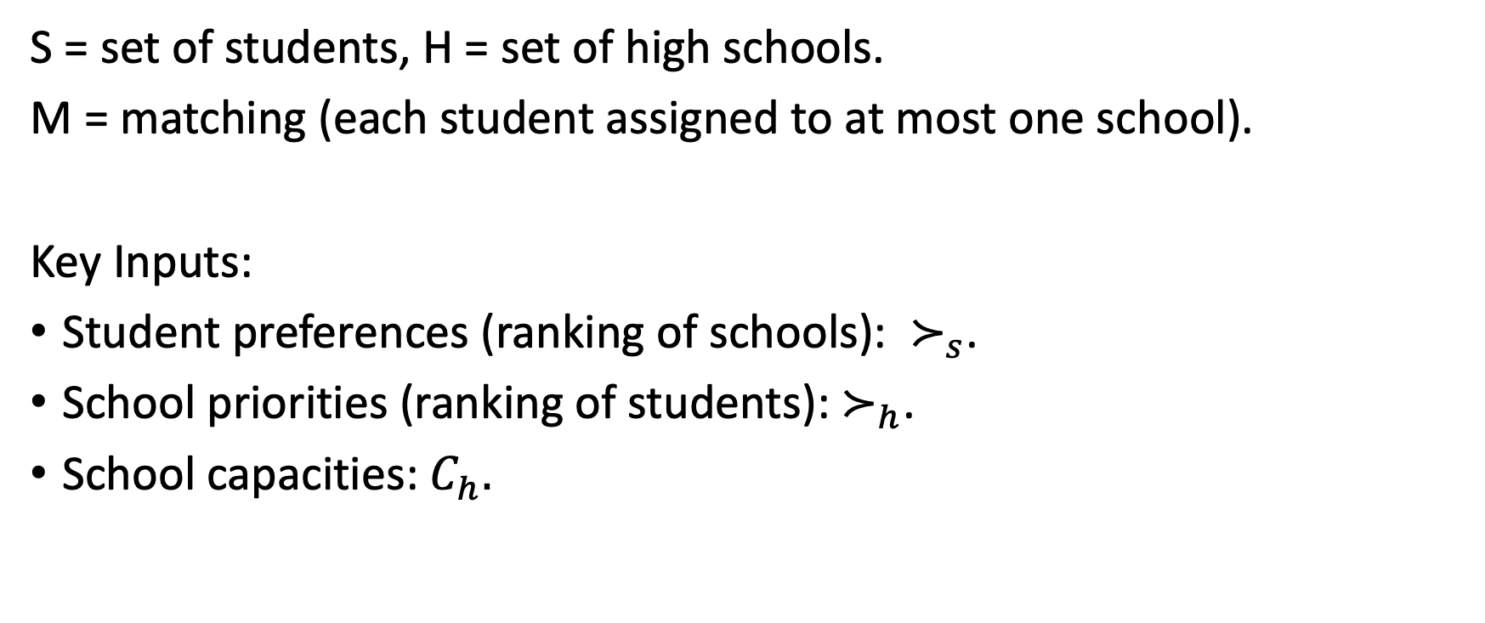
Traditional Stable Matching
S = set of students, H = set of high schools.
M = matching (each student assigned to at most one school).
Key Inputs:
Student preferences (ranking of schools): $≻_{s}$.
School priorities (ranking of students): $≻_{h}$.
School capacities: $C_{h}.$

Slide 10

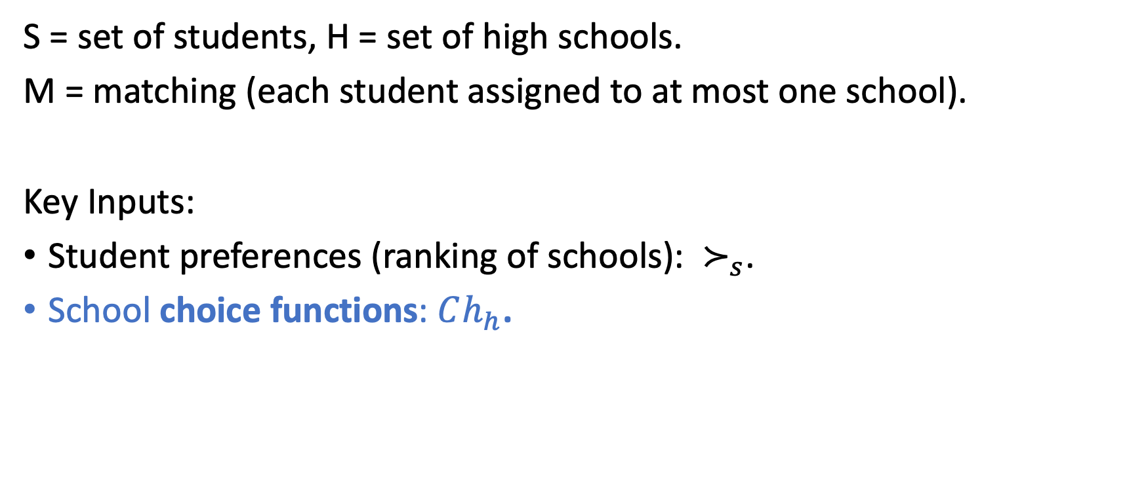
A More General Model
S = set of students, H = set of high schools.
M = matching (each student assigned to at most one school).
Key Inputs:
Student preferences (ranking of schools): $≻_{s}$.
School choice functions: $Ch_{h}$.
For each possible set of applicants $A⊆S$,
$Ch_{h}\left(A\right)⊆A$ says who school $h$would select.

Slide 11
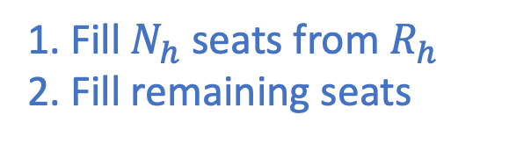
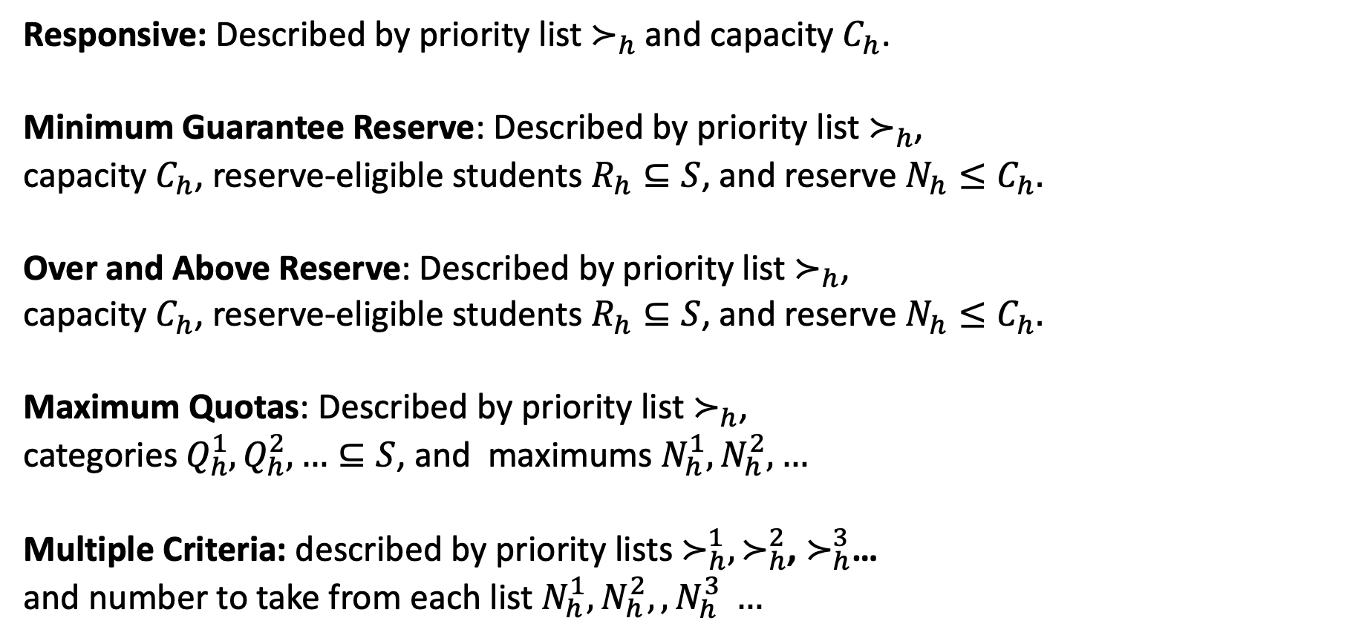
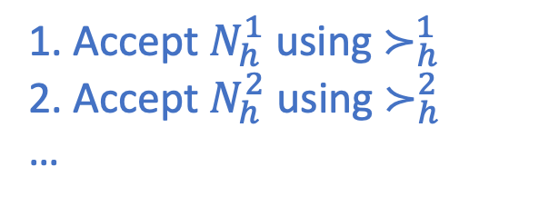
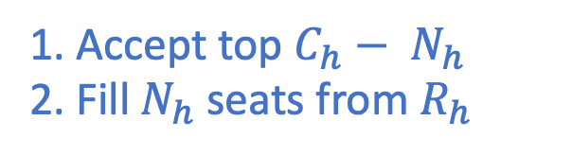
Choice Function Examples
Responsive: Described by priority list $≻_{h}$ and capacity $C_{h}$.
Minimum Guarantee Reserve: Described by priority list $≻_{h}$,
capacity $C_{h}$, reserve-eligible students $R_{h}⊆S$, and reserve $N_{h}≤C_{h}.$
Over and Above Reserve: Described by priority list $≻_{h}$,
capacity $C_{h}$, reserve-eligible students $R_{h}⊆S$, and reserve $N_{h}≤C_{h}.$
Maximum Quotas: Described by priority list $≻_{h}$,
categories $Q_{h}^{1},Q_{h}^{2},…⊆S$, and maximums $N_{h}^{1}, N_{h}^{2}, …$
Multiple Criteria: described by priority lists $≻_{h}^{1},≻_{h}^{2}$, $≻_{h}^{3}$…
and number to take from each list $N_{h}^{1}, N_{h}^{2},, N_{h}^{3} …$
1. Fill $N_{h}$ seats from $R_{h}$
2. Fill remaining seats
1. Accept top $C_{h}− N_{h}$
2. Fill $N_{h}$ seats from $R_{h}$
Top-Down Algorithm
(Accept if possible)
1. Accept $N_{h}^{1}$ using $≻_{h}^{1}$
2. Accept $N_{h}^{2}$ using $≻_{h}^{2}$
…

Slide 12
Can We Still Use Student-Proposing DA?

Slide 13
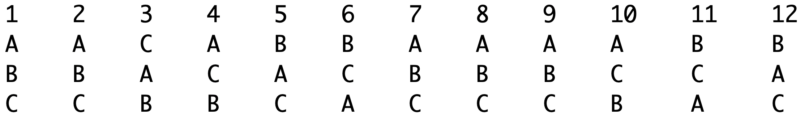
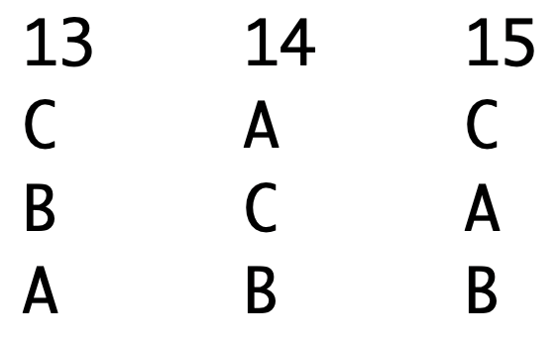
Example
3 Schools. Each has 4 seats.
School A has a minimum guarantee of 2 for low-income students.
Priority Ranking: 7, 15, 11, 2, 9, 10, 13, 1, 8, 14, 12, 6, 4, 3, 5
School B has a minimum guarantee of 1 for special-needs students.
Priority Ranking: 8, 7, 4, 12, 11, 3, 9, 10, 14, 5, 2, 13, 6, 15, 1
School C admits strictly based on its priority rankings.
Priority Ranking: 12, 13, 8, 2, 1, 11, 14, 9, 6, 10, 4, 15, 3, 5, 7
Student Preferences:

Slide 14
Example
3 Schools. Each has 4 seats.
School A has an over and above reserve of 2 for low-income students.
Priority Ranking: 7, 15, 11, 2, 9, 10, 13, 1, 8, 14, 12, 6, 4, 3, 5
School B has an over and above reserve of 1 for special-needs students.
Priority Ranking: 8, 7, 4, 12, 11, 3, 9, 10, 14, 5, 2, 13, 6, 15, 1
School C admits strictly based on its priority rankings.
Priority Ranking: 12, 13, 8, 2, 1, 11, 14, 9, 6, 10, 4, 15, 3, 5, 7
Student Preferences:
13

Slide 15
Example
3 Schools. Each has 4 seats.
School A has an over and above reserve of 2 for low-income students.
Priority Ranking: 7, 15, 11, 2, 9, 10, 13, 1, 8, 14, 12, 6, 4, 3, 5
School B has an over and above reserve of 1 for special-needs students.
Priority Ranking: 8, 7, 4, 12, 11, 3, 9, 10, 14, 5, 2, 13, 6, 15, 1
School C has minimum guarantees of 2 special needs students, 1 low-income student, and uses smart reserves.
Priority Ranking: 12, 13, 8, 2, 1, 11, 14, 9, 6, 4, 10, 15, 3, 5, 7
Student Preferences:

Slide 16
Example
2 Schools. Each has 2 seats.
School A has a maximum quota of 1 special needs student, a maximum quota of 1 high-income student, and uses top-down processing.
Priority Ranking: 1 (H), 2 (H+ S), 3 (S), 4, 5
School B admits the two highest priority students.
Priority Ranking: 5, 3, 1, 2, 4
Student Preferences:
1 | 2 | 3 | 4 | 5
B | A | A | A | B
A | B | B | B | A

Slide 17
Example
2 Schools. Each has 2 seats.
School A has a maximum quota of 1 special needs student, a maximum quota of 1 high-income student, and uses top-down processing.
Priority Ranking: 1 (H), 2 (H+ S), 3 (S), 4, 5
School B admits the two highest priority students.
Priority Ranking: 5, 3, 1, 2, 4
Student Preferences:
1 | 2 | 3 | 4 | 5
B | A | A | A | B
A | B | B | B | A
1 | 2 | 3 | 4 | 5
B | A | A | A | B
A | B | B | B | A
Which outcome (if either) would you call stable?
(I) Rejections are final
(II) Rejections can revert

Slide 18
Example
2 Schools. Each has 2 seats.
School A has a maximum quota of 1 special needs student, a maximum quota of 1 high-income student, and uses top-down processing.
Priority Ranking: 1 (H), 2 (H+ S), 3 (S), 4, 5
School B admits the two highest priority students.
Priority Ranking: 5, 3, 1, 2, 4
School A prefers {1, 3}, and 3 prefers A.
School B prefers {1, 5}, and 1 prefers B.
1 | 2 | 3 | 4 | 5
B | A | A | A | B
A | B | B | B | A
1 | 2 | 3 | 4 | 5
B | A | A | A | B
A | B | B | B | A
(I) Rejections are final
(II) Rejections can revert

Slide 19
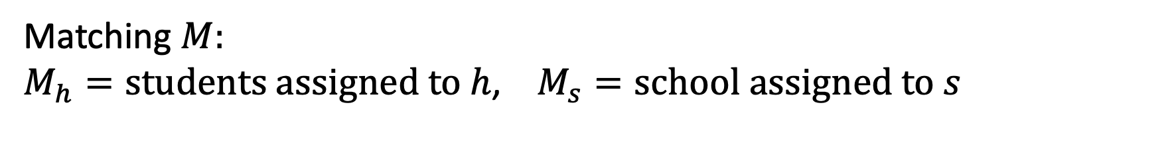
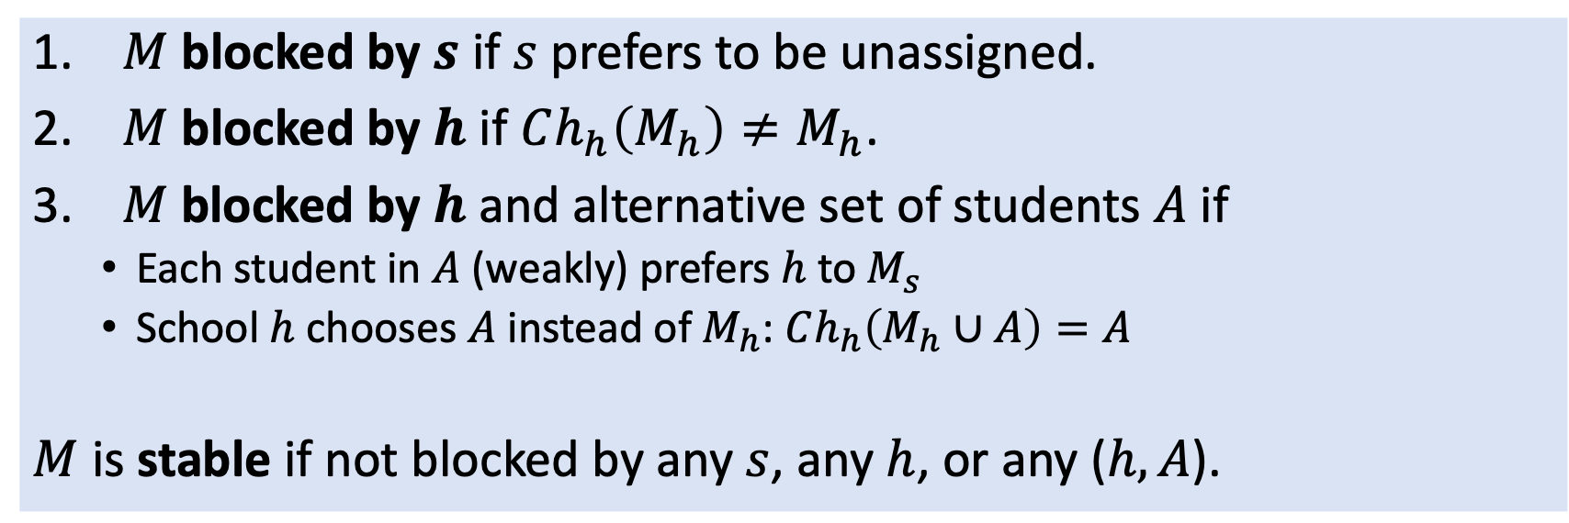
Generalized Definition of Stability
Matching $M:$
$M_{h}=students assigned to h$, $M_{s}=school assigned to s$
$M$ blocked by $s$ if $s$ prefers to be unassigned.
$M$ blocked by $h$ if $Ch_{h}\left(M_{h}\right)≠M_{h}$.
$M$blocked by $h$ and alternative set of students $A$ if
Each student in $A$ (weakly) prefers $h$ to $M_{s}$
School $h$ chooses $A$ instead of $M_{h}$: $Ch_{h}\left(M_{h}∪A\right)=A$
$M$ is stable if not blocked by any $s$, any $h$, or any ($h, A$).

Slide 20
Important Questions
Recall: couples broke all of the nice properties of stable matchings.
Is the same true of choice functions with reserves and quotas?
Do generalized stable matchings (GSM) exist?
If so,
How can we find a GSM?
Can we find a GSM with a truthful mechanism?
Is there a student-optimal GSM?
Do all GSMs match the same set of students?

Slide 21
Generalized Deferred Acceptance
Repeat the following steps:
Unassigned students propose to favorite school that has not rejected them.
Schools apply choice functions to set of students that have proposed to them, reject any students not chosen.
Stop when every unassigned student has proposed to all listed schools.

Slide 22
Example
3 Schools. Each has 4 seats.
School A has a maximum quota of 1 special needs student, and a maximum quota of 2 students who are not low income.
School B has a maximum quota of 2 low income students.
School C admits strictly based on its priority rankings.
Student Preferences:

Slide 23
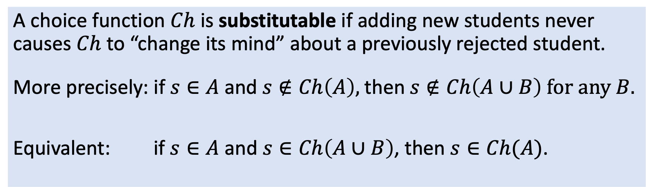
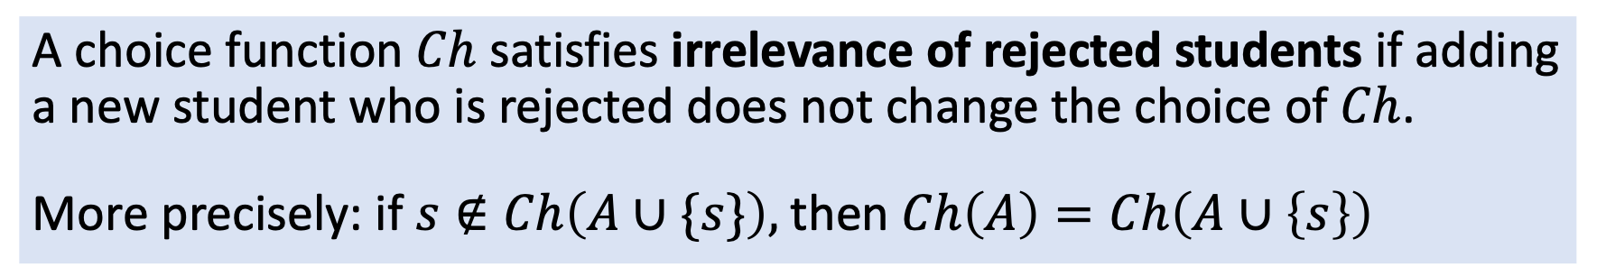
Important Properties: Substitutability and Irrelevance of Rejected Students
A choice function $Ch$ satisfies irrelevance of rejected students if adding a new student who is rejected does not change the choice of $Ch$.
More precisely: if $s∉Ch\left(A∪\{s\}\right),$then$Ch\left(A\right)=Ch\left(A∪\left\{s\right\}\right)$
A choice function $Ch$ is substitutable if adding new students never causes $Ch$ to “change its mind” about a previously rejected student.
More precisely: if $s∈A$and$s∉Ch\left(A\right),$then$s∉Ch\left(A∪B\right) for any B.$
Equivalent: if $s∈A$ and $s∈Ch\left(A∪B\right)$, then $s∈Ch(A)$.
Rejected from small set $⇒$ rejected from bigger set
Accepted from big set $⇒$ accepted from smaller set

Slide 24
Violation of IRS
Does SCI algorithm satisfy IRS? NO.
Have 1 SC-O spot, 1 SC-W spot. Applicants as follows:
SC
SC
SC-W
W
Algorithm tentatively takes {1,2}, then swaps 2 for 4, takes {1,4}.
If 2 did not apply, algorithm would take {1,3}.
(This also shows the algorithm is not substitutable – adding 2 helps 4.)

Slide 25
Good News!
Theorem. If every school’s choice function is substitutable and satisfies irrelevance of rejected students, then
There exists a stable matching.
There exists a student-optimal stable matching.
The generalized DA algorithm finds it.
Group Work
Does a minimum guarantee choice rule always satisfy IRS?
Is it always substitutable?
Does a maximum quota choice rule always satisfy IRS?
Is it always substitutable?
Yes
Yes
Yes
If quota categories form a hierarchy, Yes
No

Slide 26
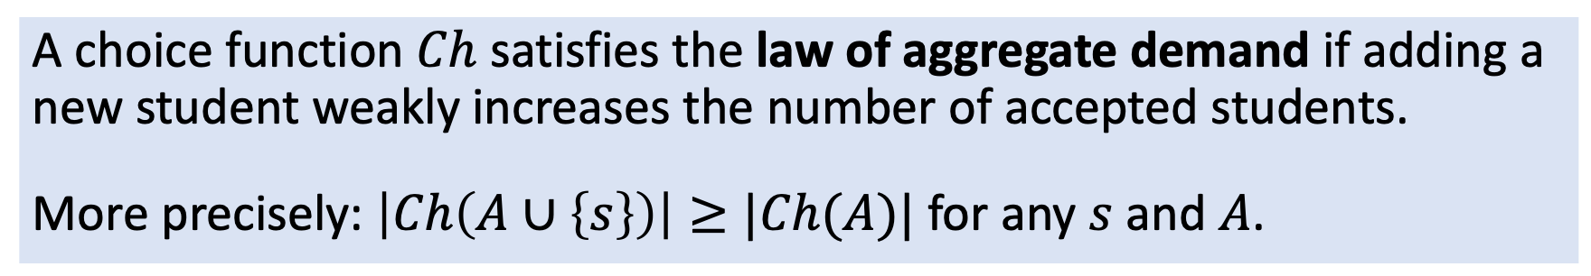
Is Deferred Acceptance Truthful?
A choice function $Ch$ satisfies the law of aggregate demand if adding a new student weakly increases the number of accepted students.
More precisely: $\left|Ch\left(A∪\left\{s\right\}\right)\right|≥|Ch(A)|$ for any $s$ and $A$.
Theorem. If every school’s choice function is substitutable and satisfies the law of aggregate demand, then
Every choice function satisfies irrelevance of rejected students.
The set of assigned students is the same for every stable matching.
The generalized DA algorithm is truthful.

Slide 27
What if Choice Functions are Not Substitutable?
Stable matchings may not exist!
We can choose among several different algorithms, none of which is ideal.
Option 1: every student who proposed to the school.
Concern: students may get multiple acceptances.
Option 2: students who proposed and have not been rejected.
Concern: outcome may depend on order of rejections,
may not be stable.
Option 3: students who didn’t get another school that they prefer.
Concern: circular (ambiguous) definition.

Slide 28
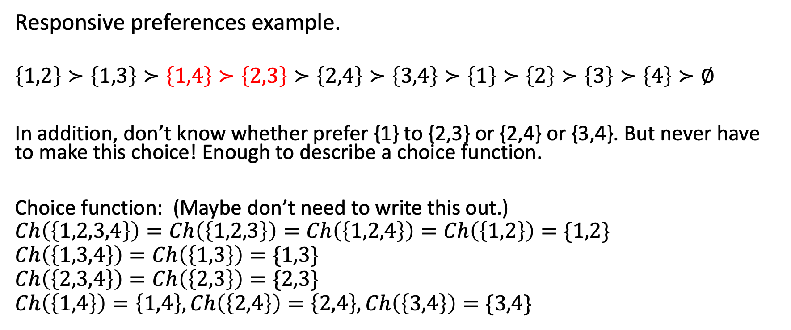
Responsive preferences example.
$$\left\{1,2\right\}≻\left\{1,3\right\}≻\left\{1,4\right\}≻\left\{2,3\right\}≻\left\{2,4\right\}≻\left\{3,4\right\}≻\left\{1\right\}≻\left\{2\right\}≻\left\{3\right\}≻\left\{4\right\}≻∅$$
In addition, don’t know whether prefer {1} to {2,3} or {2,4} or {3,4}. But never have to make this choice! Enough to describe a choice function.
Choice function: (Maybe don’t need to write this out.)
$$Ch\left(\left\{1,2,3,4\right\}\right)=Ch\left(\left\{1,2,3\right\}\right)=Ch\left(\left\{1,2,4\right\}\right)=Ch\left(\left\{1,2\right\}\right)=\{1,2\}$$
$$Ch\left(\left\{1,3,4\right\}\right)=Ch\left(\left\{1,3\right\}\right)=\{1,3\}$$
$$Ch\left(\left\{2,3,4\right\}\right)=Ch\left(\left\{2,3\right\}\right)=\{2,3\}$$
$$Ch\left(\left\{1,4\right\}\right)=\left\{1,4\right\}, Ch\left(\left\{2,4\right\}\right)=\left\{2,4\right\}, Ch\left(\left\{3,4\right\}\right)=\{3,4\}$$

Slide 29
Connect population monotonicity and substitutability. (Are they different?)
Mention law of aggregate demand? (Doesn’t hold in “skill coverage” example – adding an agent can cause you to hire fewer.)
Is LAD needed for Hatfield-Milgrom results? (See Sonmez note.)

Slide 30
Ranking over subsets of agents induces a choice function. (Note that there are more rankings than choice functions.
With responsive choice functions, I know perfectly well who I choose, even though I don’t know whether the school prefers {1,4} or {2,3}.

Slide 31
Examples
Include two examples of choice functions. One substitutable, one not. Perhaps first two below. Ask, what is the difference?
Perhaps quota vs minimum guarantee reserve.
Which of the following choice functions are substitutable?
A residency program wishes to have an even number of residents. It has a ranking of all residents, and takes even number (up to 10).
A board of directors wishes to have at least one male and at least one female. Implement as 3 seats, with minimum guarantee of one female and one male (have a hierarchy). Can be soft reserves (i.e. if no women, take three men). No need to “break up” into separate programs.
Overlapping quotas. Minority women allow admission of majority men.
Instead of woman and man above, could be medical specialties: want at least one person in each specialty…
Over and above reserves (since others are more like minimum guarantee reserves).
Reserves with different priority orders (as in pandemic rationing).
Company hiring. Two skill sets needed. Candidate 1 has {A, B}, Candidate 2 has {A}, Candidate 3 has {B}. If can only hire for one skill, will take it. Prioritize maximizing number of skills covered. Subject to that, prioritize minimizing labor costs. (This is like overlapping quotas, but is substitutable because they prefer to get away with as few workers as possible. Could add another candidate with skill B.)

Slide 32
Break

Slide 33
Matching With Contracts

Slide 34
Should we use DA for College Admissions?
Advantage: coordinated offers (colleges don’t need to guess yield).
Challenge: student choices depend on financial aid offers.

Slide 35
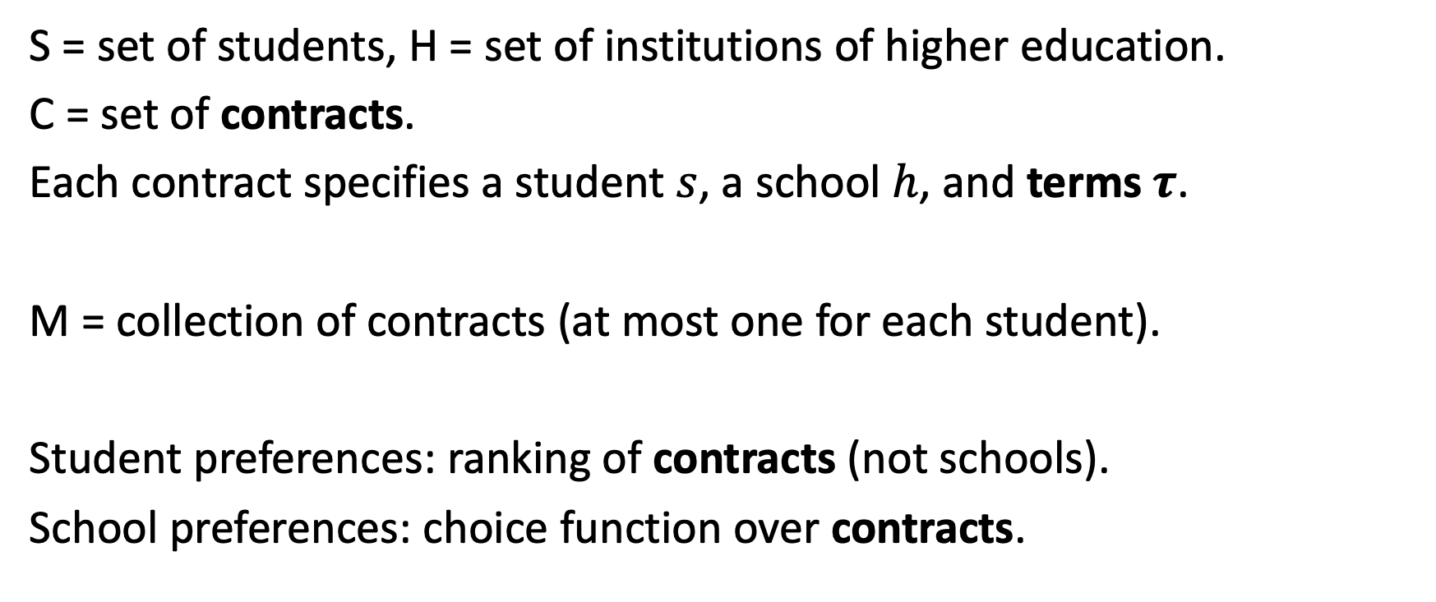
Matching with Contracts Model
S = set of students, H = set of institutions of higher education.
C = set of contracts.
Each contract specifies a student $s$, a school $h$, and terms $τ$.
M = collection of contracts (at most one for each student).
Student preferences: ranking of contracts (not schools).
School preferences: choice function over contracts.

Slide 36
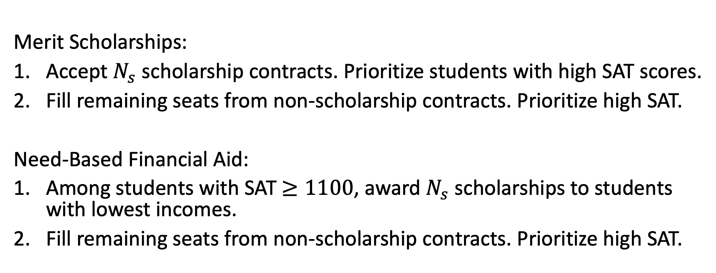
Example: Choice Functions Over Contracts
Merit Scholarships:
Accept $N_{s}$ scholarship contracts. Prioritize students with high SAT scores.
Fill remaining seats from non-scholarship contracts. Prioritize high SAT.
Need-Based Financial Aid:
Among students with SAT $≥1100$, award $N_{s}$ scholarships to students with lowest incomes.
Fill remaining seats from non-scholarship contracts. Prioritize high SAT.

Slide 37
Generalizing the Definition of Stability

Slide 38
Cumulative Offers Mechanism (Super generalized Deferred Acceptance)

Slide 39
More Good News!
Theorem. In the matching with contracts model, if every choice function is substitutable and satisfies irrelevance of rejected contracts:
There exists a stable matching.
There exists a student-optimal stable matching.
The generalized DA algorithm finds it.
If every choice function also satisfies the law of aggregate demand,
The set of assigned students is the same for every stable matching.
The generalized DA algorithm is truthful.

Slide 40
Application: US Military Branch of Choice Matching

Slide 41
Summary
Deferred Acceptance can be generalized to settings involving contracts and complex school choice functions.
Key requirement: choice functions should be substitutable.

Slide 42
Study Guide
Concepts
Choice Function
Generalized Stability
Irrelevance of Rejected Students
Substitutability
Law of Aggregate Demand
Algorithms
Generalized Deferred Acceptance

Slide 43
Coming Up
Concept Check 11 due tomorrow night.
Midterm 2 available next Thursday

Slide 44
College Admissions Reform
Should we use DA for College Admissions? This would mean
Getting colleges to coordinate on a timeline.
Getting students to rank the colleges they apply to.
Getting colleges to define more explicit choice functions.
Which of these steps seem most challenging? Why?
What benefits do you think could emerge from this change?

Slide 45
Which Choice Functions are Substitutable?
Showing that a choice function is not substitutable is straightforward:
find an example where adding a new applicant benefits another applicant.
Showing that a choice function is substitutable seems harder.
However, many choice functions sequentially apply “simple” choice functions.
Minimum Guarantee
Choose R highest-priority reserve-eligible candidates
Choose U highest-priority remaining candidates
Over and Above
Choose U highest-priority candidates
Choose R highest-priority remaining reserve-eligible candidates
2SM: 4 simple choice functions applied sequentially.

Slide 46
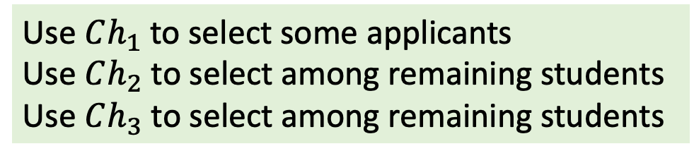
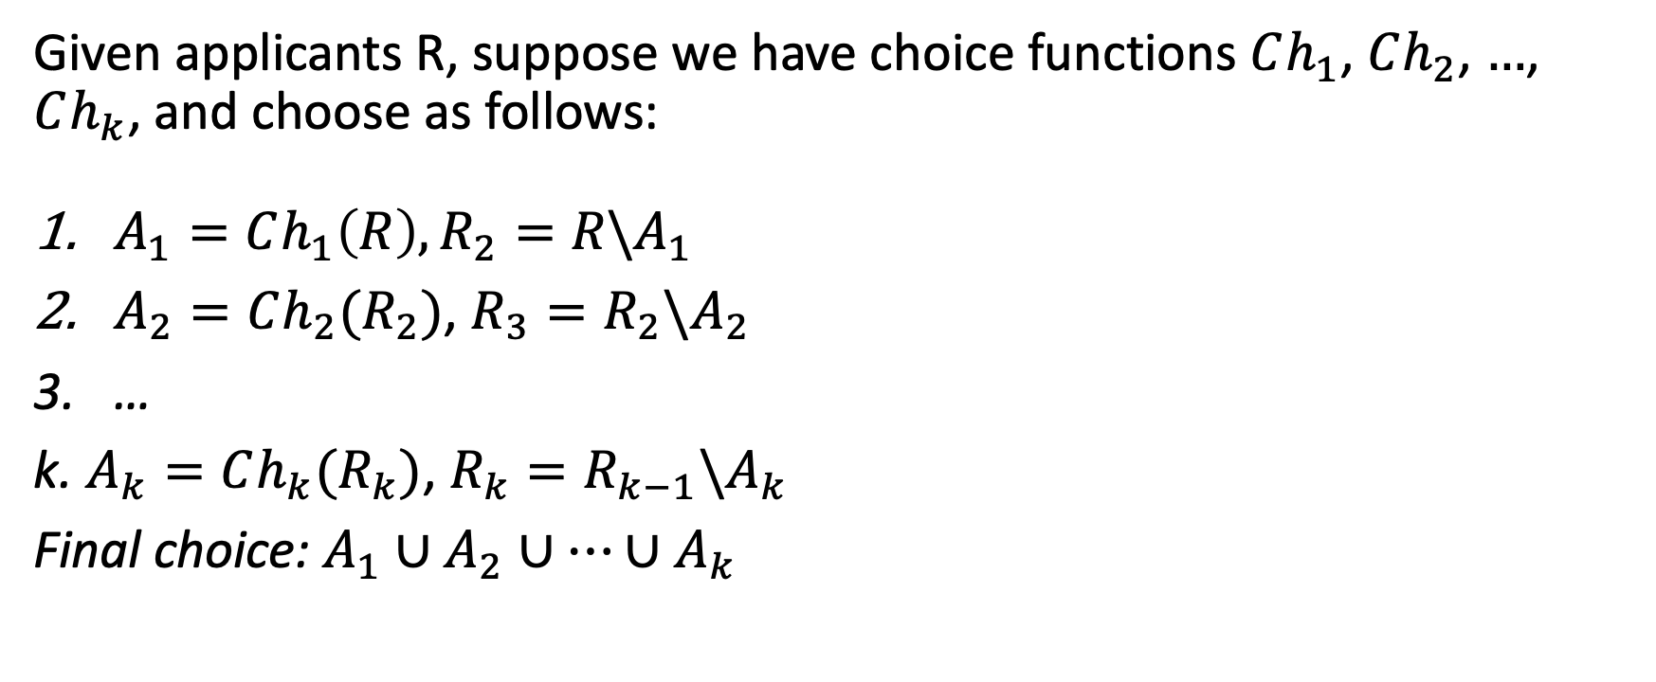
Composing Substitutable Choice Functions
Given applicants R, suppose we have choice functions $Ch_{1}$, $Ch_{2}$, $…$, $Ch_{k}$, and choose as follows:
$A_{1}=Ch_{1}\left(R\right), R_{2}=R\backslash A_{1}$
$A_{2}=Ch_{2}(R_{2})$, $R_{3}=R_{2}{\backslash A}_{2}$
…
k. $A_{k}=Ch_{k}(R_{k})$, $R_{k}=R_{k−1}{\backslash A}_{k}$
Final choice: $A_{1}∪A_{2}∪⋯∪A_{k}$
Use $Ch_{1}$ to select some applicants
Use $Ch_{2}$ to select among remaining students
Use $Ch_{3}$ to select among remaining students
Tentatively accept anyone chosen at any step.
Theorem. If each choice function is substitutable, so is the composite choice function.
If each choice function is itself substitutable, then the composition is substitutable. (Easy to prove – include proof.)
Be wary – sometimes, the choice function in step 2 depends on the outcome of step 1. Then you need to be careful. (Bertan has a paper related to this.)

Slide 47


Incorrect HW Answer
Can Any Student Benefit From Misreporting?
All school choice functions are both substitutable and satisfy the irrelevance of rejected students. This means the GDA algorithm will produce a student optimal stable matching.
Meaning the system is truthful and you cannot improve your outcome by misreporting your preferences.

Slide 48
Good News!
Theorem. If every school’s choice function is substitutable and satisfies irrelevance of rejected students, then
There exists a stable matching.
There exists a student-optimal stable matching.
The generalized DA algorithm finds it.
Theorem. If every school’s choice function is substitutable and satisfies the law of aggregate demand, then
Every choice function satisfies irrelevance of rejected students.
The set of assigned students is the same for every stable matching.
The generalized DA algorithm is truthful.

Slide 49
Engineering Systems for Allocating Public Goods

Slide 50
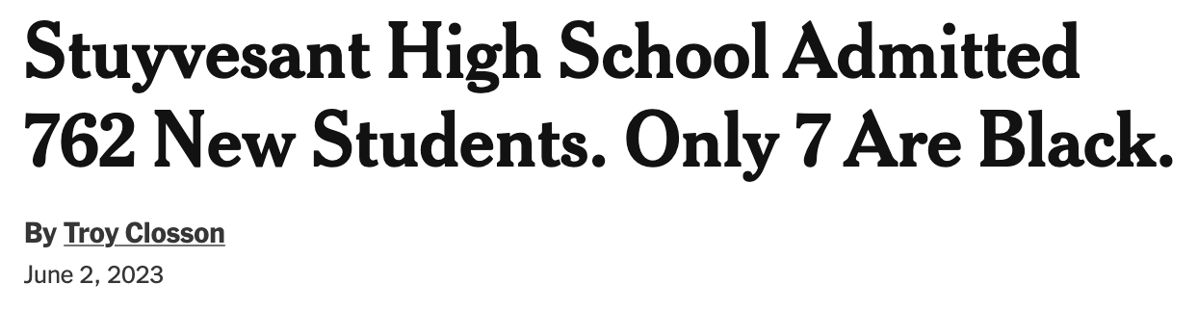

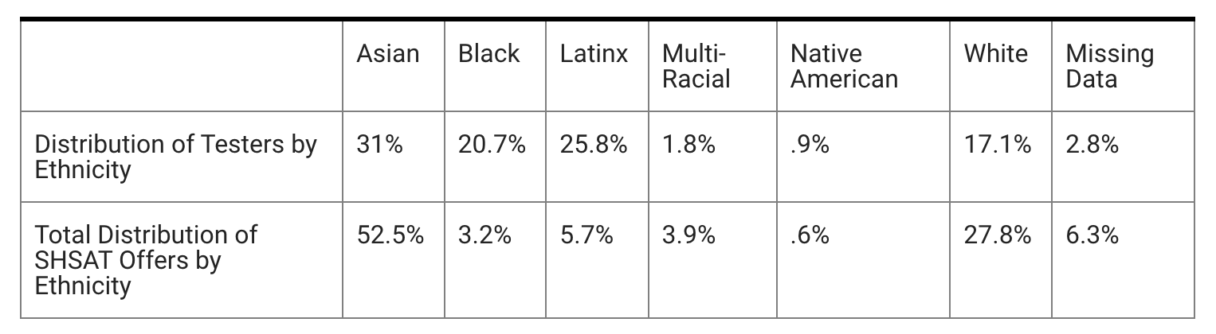
NYC Specialized High Schools
8 schools admit based solely on “Specialized High Schools Admissions Test” (SHSAT)
Each year, ~28,000 students take this test. There are ~5,000 spots across all 8 schools.
Source: https://www.nbcnewyork.com/news/local/nearly-half-of-nyc-students-who-took-shsat-were-black-or-latinx-only-9-got-an-offer/3737289/
20% Reserved

Slide 51
Discovery Program
20% of seats at each specialized high school reserved for “disadvantaged” students.
Eligibility criteria:
Attend high-poverty public school or live in a high-poverty area (if not attending public school).
Satisfy one of the following:
Qualify for free or reduced lunch
English language learner new to NYC
Family receives welfare or SNAP benefits
Child is in foster care.
3. Score “just below” SHSAT cutoff.
Why include both criteria?

Slide 52
https://www.schools.nyc.gov/enrollment/enroll-grade-by-grade/specialized-high-schools/discovery-programs
Students must attend a high-poverty public school or live in a high-poverty area if the student attends a non-public school or is homeschooled:
Public school students (including district schools and charter schools) must attend a school whose Economic Need Index (ENI) is 60% or higher. Read more about the ENI on page 4 of Diversity in New York City Public Schools. To see each public school’s ENI percentage, visitSchool Performance Dashboard (includes district schools and charter schools).
Students who currently attend a non-public school (private or parochial school) or are currently homeschooled must live in a high-poverty area. A high-poverty area is one where, per the US Census’s most recent American Community Survey, at least 60% of families in the student’s home census tract live below the poverty line. For further information, please visit, data.census.gov.
Students must be certified as disadvantaged, which means that they must attend a high-poverty public school (see details above) or live in a high-poverty area (see details above) and meet at least one of the following requirements:
The family receives assistance from the Human Resources Administration (welfare or SNAP benefits).
The child is in foster care, is a ward of the state, or is a Student in Temporary Housing as defined by McKinney-Vento.
The child is an English Language Learner or a former English Language Learner within the previous two (2) school years and enrolled in a DOE school for the first time within the last four years.
The family earns less than or equal to the reduced-price lunch income threshold (based on household size) in the USDA Food and Nutrition Service Income Eligibility Guidelines table below (https://www.fns.usda.gov/cn/fr-020923).

Slide 53
Discovery Algorithm: Example
Student 1 has highest score, student 15 lowest.
Students in orange are “disadvantaged.”
1 | 2 | 3 | 4 | 5 | 6 | 7 | 8 | 9 | 10 | 11 | 12 | 13 | 14 | 15
A | A | A | B | A | A | B | A | C | C | A | B | C | A | C
B | C | C | C | B | B | C | C | B | B | B | C | A | B | A
3 Schools. Each has:
2 open seats
1 discover seat
Final Outcome:
1 | 2 | 3 | 4 | 5 | 6 | 7 | 8 | 9 | 10 | 11 | 12 | 13 | 14 | 15
A | A | A | B | A | A | B | A | C | C | A | B | C | A | C
B | C | C | C | B | B | C | C | B | B | B | C | A | B | A
Who might be justifiably upset?

Slide 54
Discovery Algorithm
Run serial dictatorship (in score order) for “open” seats.
Among disadvantaged students who have not yet been assigned and have scores below final assigned student, run serial dictatorship for “discovery” seats.

Slide 55
Concern
Justified Envy! (Unfair)
Getting a higher exam score could hurt disadvantaged students.
Could fill Discover seats with higher-scoring students.

Slide 56
School | 2024 Cutoff
Stuyvesant High School | 561
High School For Mathematics, Science And Engineering At City College (HSMSE) | 542
Staten Island Technical High School | 519
The Bronx High School of Science | 526
Queens High School For The Sciences At York College | 524
High School Of American Studies At Lehman College | 514
Brooklyn Technical High School | 507
The Brooklyn Latin School | 492
Source: https://www.schools.nyc.gov/enrollment/enroll-grade-by-grade/specialized-high-schools
Only students with scores < 492 eligible for the Discover program.

Slide 57
Alternative Proposals
Student-proposing DA. Schools use minimum guarantee reserves.
Student-proposing DA. Schools use over and above reserves.
Student 1 has highest score, student 15 lowest.
Students in orange are “disadvantaged.”
1 | 2 | 3 | 4 | 5 | 6 | 7 | 8 | 9 | 10 | 11 | 12 | 13 | 14 | 15
A | A | A | B | A | A | B | A | C | C | A | B | C | A | C
B | C | C | C | B | B | C | C | B | B | B | C | A | B | A
3 Schools. Each has:
2 open seats
1 discover seat
What is the outcome under proposal #1?
What is the outcome under proposal #2?
Which proposal is better for disadvantaged students?

Slide 58
Minimum Guarantee Reserves:
1 | 2 | 3 | 4 | 5 | 6 | 7 | 8 | 9 | 10 | 11 | 12 | 13 | 14 | 15
A | A | A | B | A | A | B | A | C | C | A | B | C | A | C
B | C | C | C | B | B | C | C | B | B | B | C | A | B | A
Compared to original Discovery Algorithm, fewer disadvantaged students selected. Should we switch?
Over and Above Reserves:
1 | 2 | 3 | 4 | 5 | 6 | 7 | 8 | 9 | 10 | 11 | 12 | 13 | 14 | 15
A | A | A | B | A | A | B | A | C | C | A | B | C | A | C
B | C | C | C | B | B | C | C | B | B | B | C | A | B | A

Slide 59
What if some students don’t want to participate in Discover program?
Requires 3 weeks of summer school.
Admission very likely but not guaranteed.

Slide 60
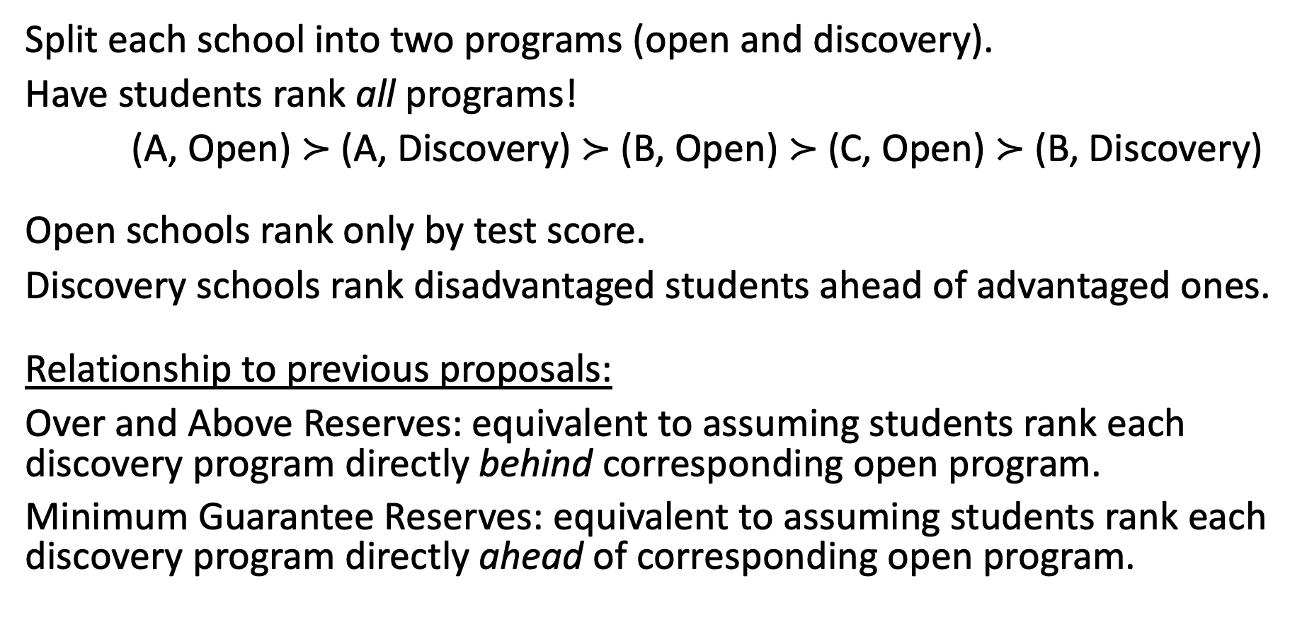
Alternative Proposal
Split each school into two programs (open and discovery).
Have students rank all programs!
(A, Open) $≻$ (A, Discovery) $≻$ (B, Open) $≻$ (C, Open) $≻$ (B, Discovery)
Open schools rank only by test score.
Discovery schools rank disadvantaged students ahead of advantaged ones.
Relationship to previous proposals:
Over and Above Reserves: equivalent to assuming students rank each discovery program directly behind corresponding open program.
Minimum Guarantee Reserves: equivalent to assuming students rank each discovery program directly ahead of corresponding open program.

Slide 61
US Military Branch of Choice Matching
Originally: serial dictatorship, OML
Then: “auction” (branch of choice, BRADSO)
Then: “matching” (talent based branching, TBB)
Then: “matching with contracts”

Slide 62
System Before 2006
Order of Merit List Ranking (1 is best)
1 | 2 | 3 | 4 | 5 | 6 | 7 | 8 | 9 | 10 | 11 | 12 | 13 | 14 | 15
A | A | B | A | B | A | C | A | C | A | B | B | A | C | A
B | C | A | B | C | C | A | B | B | B | C | A | C | A | B
C | B | C | C | A | B | B | C | A | C | A | C | B | B | C
Each branch has
5 positions

Slide 63
BRADSO
BRanch of choice
Active
Duty
Service
Obligation

Slide 64
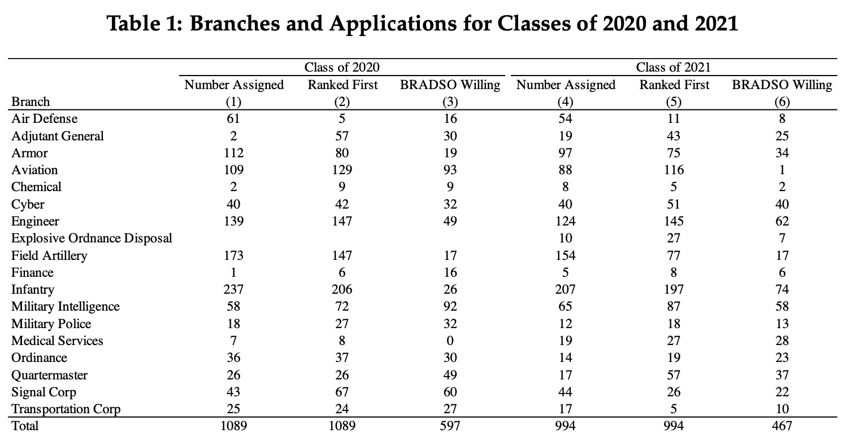

Slide 65


2006-2019 Mechanism
Inputs:
Order of merit list $π$
Number of open positions $q_{b}^{O}$ and BRADSO positions $q_{b}^{B}$ for each branch $b$
Cadets rank branches + indicate willingness to serve an extended term.
Algorithm:
For each branch $b$, construct “modified ranking” $π_{b}$ as follows:
First: All cadets who are willing to serve an extended term for $b$ (in OML order)
Then: All remaining cadets (in OML order)
For each branch $b$, construct choice function as follows:
Take $q_{b}^{O}$ applicants that are highest on OML list $π$
Among remaining applicants, take $q_{b}^{B}$ that are highest on modified ranking $π_{b}$
Determine Branches. Run student proposing DA using branch choice functions above.
Determine Terms. Assign extended term to any cadet that was assigned to $b$ and was (i) willing to serve an extended term for branch$b$, but (ii) not among the $q_{b}^{O}$ highest-priority applicants assigned to $b$. (Remaining cadets assigned standard term.)

Slide 66
2006 Mechanism (Example)
Order of Merit List Ranking (1 is best)
1 | 2 | 3 | 4 | 5 | 6 | 7 | 8 | 9 | 10 | 11 | 12 | 13 | 14 | 15
A | A | B | A | B | A | C | A | C | A | B | B | A | C | A
B | C | A | B | C | C | A | B | B | B | C | A | C | A | B
C | B | C | C | A | B | B | C | A | C | A | C | B | B | C
Each branch has
3 regular positions
2 branch of choice positions
Modified Rankings for BoC positions:
At A: 1 > 3 > 4 > 6 > 13 > 2 > 5 > 7 > 8 > 9 > 10 > 11 > 12 > 14 > 15
At B: 1 > 3 > 5 > 11 > 2 > 4 > 6 > 7 > 8 > 9 > 10 > 12 > 13 > 14 > 15
At C: 9 > 13 > 14 > 1 > 2 > 3 > 4 > 5 > 6 > 7 > 8 > 10 > 11 > 12 > 15
Is this mechanism truthful?
What does “truthful” mean?
1 | 2 | 3 | 4 | 5 | 6 | 7 | 8 | 9 | 10 | 11 | 12 | 13 | 14 | 15
A | A | B | A | B | A | C | A | C | A | B | B | A | C | A
B | C | A | B | C | C | A | B | B | B | C | A | C | A | B
C | B | C | C | A | B | B | C | A | C | A | C | B | B | C
Standard terms
Extended terms
Do an example that allows us to see differences.
A > B > C, {A}
A > B > C, {}
B > C > A, {B, C}

Slide 67
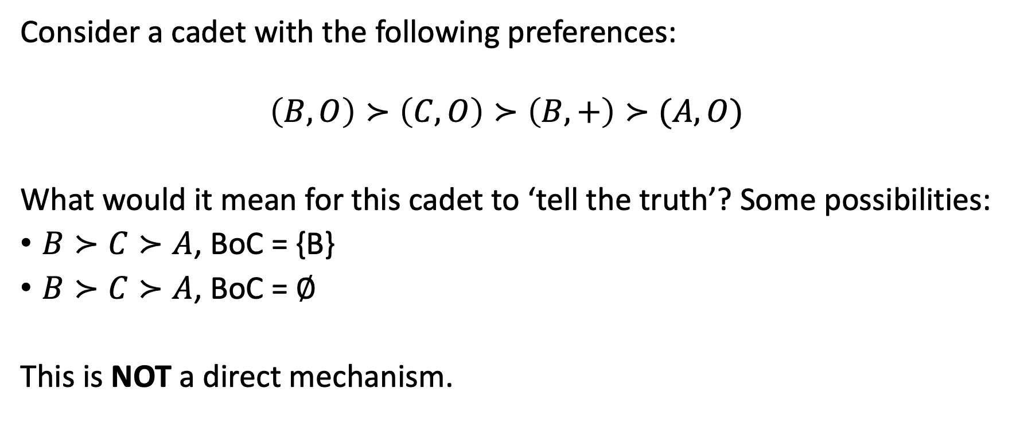
Challenges Defining Truthfulness
Consider a cadet with the following preferences:
$$\left(B, O\right)≻\left(C, O\right)≻\left(B, +\right)≻(A, O)$$
What would it mean for this cadet to ‘tell the truth’? Some possibilities:
$B≻C≻A$, BoC = {B}
$B≻C≻A$, BoC = $∅$
This is NOT a direct mechanism.

Slide 68
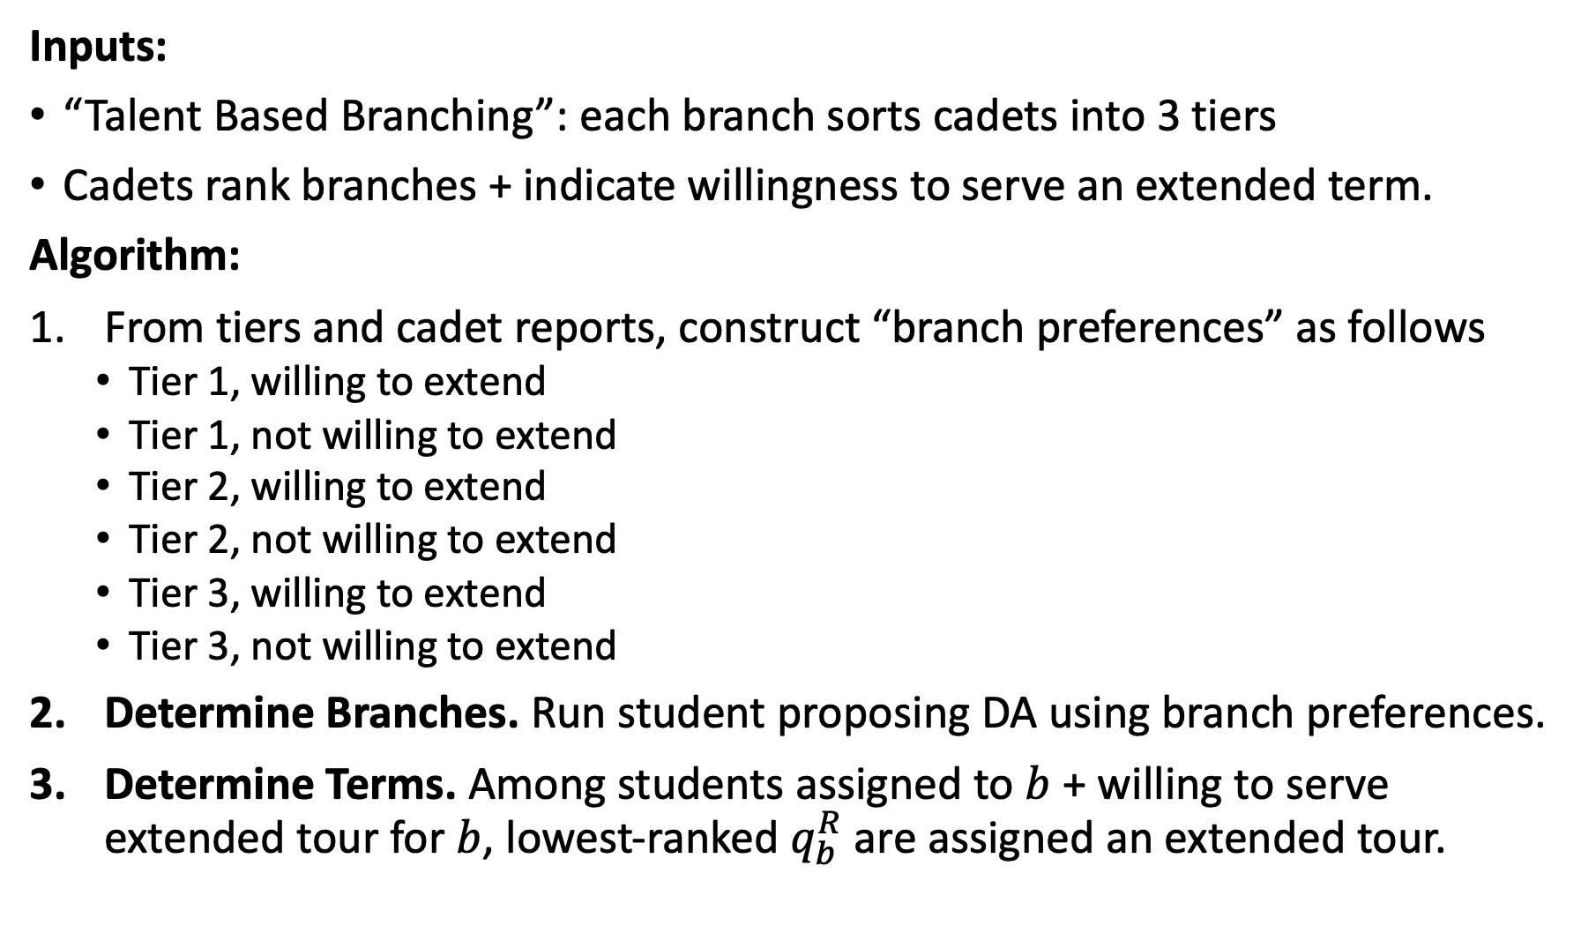
2020 Mechanism
Inputs:
“Talent Based Branching”: each branch sorts cadets into 3 tiers
Cadets rank branches + indicate willingness to serve an extended term.
Algorithm:
From tiers and cadet reports, construct “branch preferences” as follows
Tier 1, willing to extend
Tier 1, not willing to extend
Tier 2, willing to extend
Tier 2, not willing to extend
Tier 3, willing to extend
Tier 3, not willing to extend
Determine Branches. Run student proposing DA using branch preferences.
Determine Terms. Among students assigned to $b$ + willing to serve extended tour for $b$, lowest-ranked $q_{b}^{R}$ are assigned an extended tour.

Slide 69
2020 Mechanism (Example)
Order of Merit List Ranking (1 is best)
1 | 2 | 3 | 4 | 5 | 6 | 7 | 8 | 9 | 10 | 11 | 12 | 13 | 14 | 15
A | A | B | A | B | A | C | A | C | A | B | B | A | C | A
B | C | A | B | C | C | A | B | B | B | C | A | C | A | B
C | B | C | C | A | B | B | C | A | C | A | C | B | B | C
Each branch has
3 regular positions
2 branch of choice positions
If branches all put 1-5 in Tier 1, 6-10 in Tier 2, and 11-15 in Tier 3, branch “preferences” are:
At A: 1 > 3 > 4 > 2 > 5 > 6 > 7 > 8 > 9 > 10 > 13 > 11 > 12 > 14 > 15
At B: 1 > 3 > 5 > 2 > 4 > 6 > 7 > 8 > 9 > 10 > 11 > 12 > 13 > 14 > 15
At C: 1 > 2 > 3 > 4 > 5 > 9 > 6 > 7 > 8 > 10 > 13 > 15 > 11 > 12 > 15
1 | 2 | 3 | 4 | 5 | 6 | 7 | 8 | 9 | 10 | 11 | 12 | 13 | 14 | 15
A | A | B | A | B | A | C | A | C | A | B | B | A | C | A
B | C | A | B | C | C | A | B | B | B | C | A | C | A | B
C | B | C | C | A | B | B | C | A | C | A | C | B | B | C
Standard terms
Extended terms

Slide 70
What if few cadets indicate BRADSO willingness?
Non-wastefulness

Slide 71
Price Responsiveness Functions

Slide 72
Desirable Axioms
Individual Rationality (no cadet assigned an unacceptable contract)
Nonwastefulness (no cadet unassigned if a branch they applied to has any empty positions)
No justified envy (no cadet should envy the assignment of a lower-ranked cadet)
Complies with price responsiveness policy (which specifies how much priority can improve by accepting longer service).
Truthful (cadets can never benefit from misreporting preferences).

Slide 73
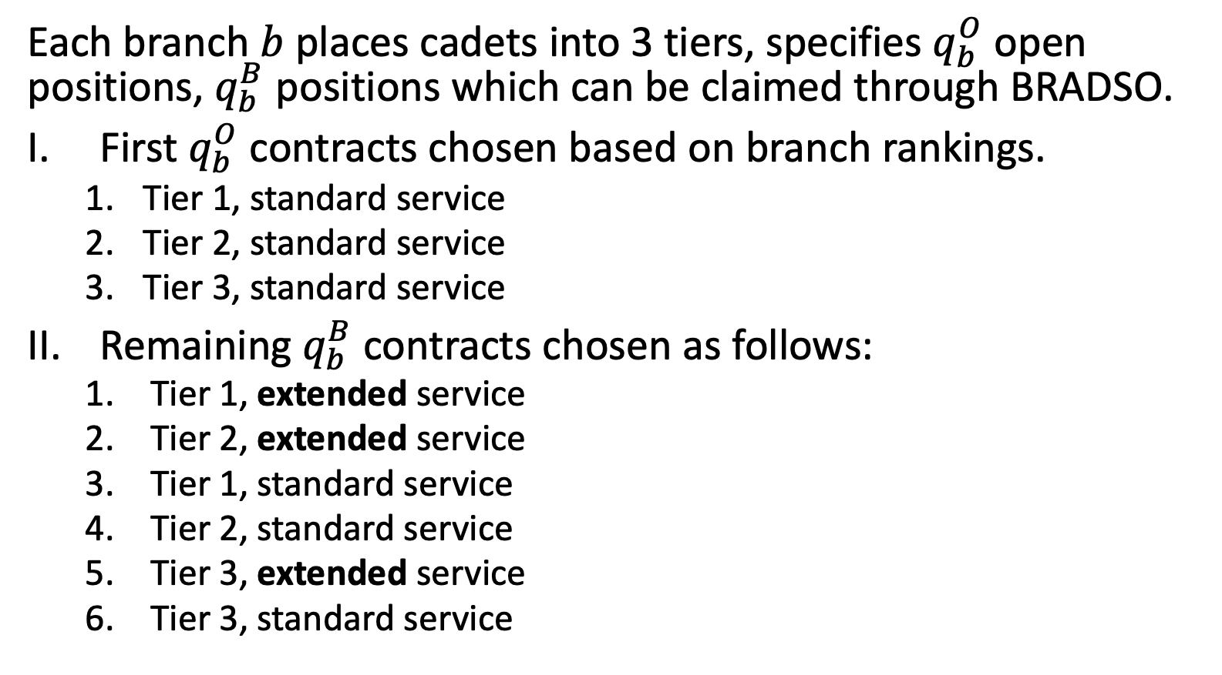
System in Place Since 2021
Each branch $b$ places cadets into 3 tiers, specifies $q_{b}^{O}$ open positions, $q_{b}^{B}$ positions which can be claimed through BRADSO.
First $q_{b}^{O}$ contracts chosen based on branch rankings.
Tier 1, standard service
Tier 2, standard service
Tier 3, standard service
Remaining $q_{b}^{B}$ contracts chosen as follows:
Tier 1, extended service
Tier 2, extended service
Tier 1, standard service
Tier 2, standard service
Tier 3, extended service
Tier 3, standard service
Ties broken by OML
Have cadets rank (branch, term) pairs.
Run cadet-proposing DA, with branch choice functions as described.

Slide 74
Matching With Contracts

Slide 75
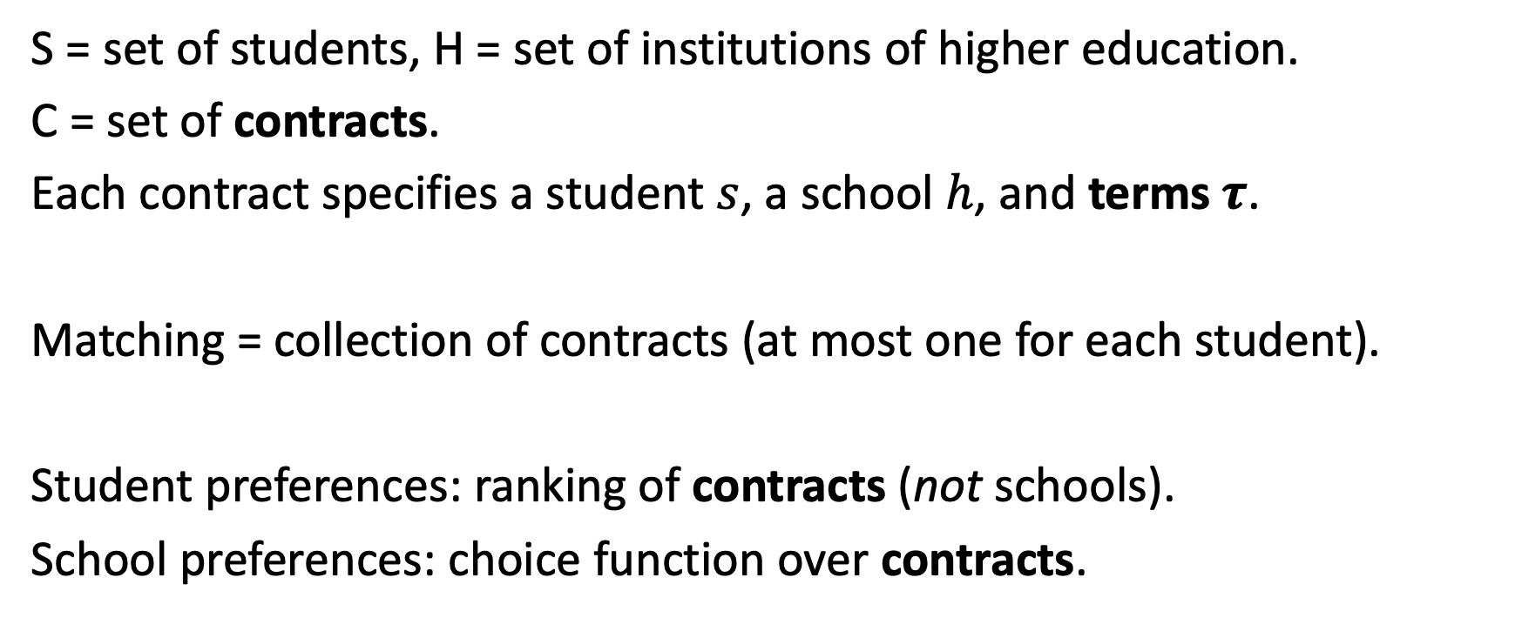
Matching with Contracts Model
S = set of students, H = set of institutions of higher education.
C = set of contracts.
Each contract specifies a student $s$, a school $h$, and terms $τ$.
Matching = collection of contracts (at most one for each student).
Student preferences: ranking of contracts (not schools).
School preferences: choice function over contracts.

Slide 76
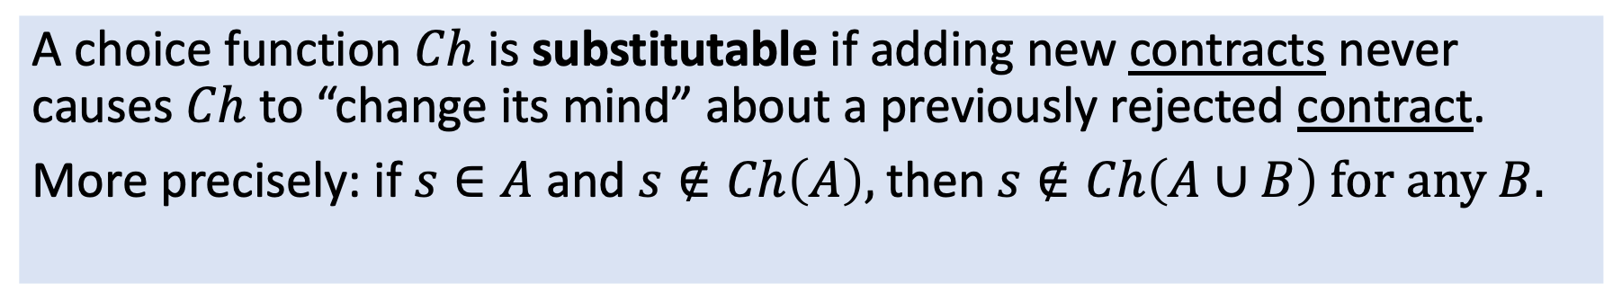
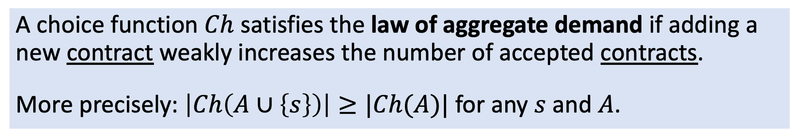
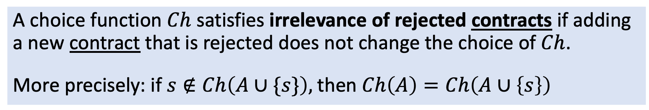
Important Properties
A choice function $Ch$ satisfies irrelevance of rejected contracts if adding a new contract that is rejected does not change the choice of $Ch$.
More precisely: if $s∉Ch\left(A∪\{s\}\right),$then$Ch\left(A\right)=Ch\left(A∪\left\{s\right\}\right)$
A choice function $Ch$ is substitutable if adding new contracts never causes $Ch$ to “change its mind” about a previously rejected contract.
More precisely: if $s∈A$and$s∉Ch\left(A\right),$then$s∉Ch\left(A∪B\right) for any B.$
Rejected from small set $⇒$ rejected from bigger set
A choice function $Ch$ satisfies the law of aggregate demand if adding a new contract weakly increases the number of accepted contracts.
More precisely: $\left|Ch\left(A∪\left\{s\right\}\right)\right|≥|Ch(A)|$ for any $s$ and $A$.

Slide 77
More Good News!
Theorem. In the matching with contracts model, if every choice function is substitutable and satisfies irrelevance of rejected contracts:
There exists a stable matching.
There exists a student-optimal stable matching.
The generalized DA algorithm finds it.
If every choice function also satisfies the law of aggregate demand,
The set of assigned students is the same for every stable matching.
The generalized DA algorithm is truthful.

Slide 78
Example: Choice Functions Over Contracts
Merit Scholarships:
Accept $N_{s}$ scholarship contracts. Prioritize students with high SAT scores.
Fill remaining seats from non-scholarship contracts. Prioritize high SAT.
Need-Based Financial Aid:
Among students with SAT $≥1100$, award $N_{s}$ scholarships to students with lowest incomes.
Fill remaining seats from non-scholarship contracts. Prioritize high SAT.

Slide 79
Summary
Deferred Acceptance can be generalized to settings involving contracts and complex school choice functions.
Key requirement: choice functions should be substitutable and satisfy irrelevance of rejected contracts and the law of aggregate demand.

Slide 80
Review: Algorithms and Concepts
Algorithms
Discovery Algorithm
Minimum Guarantee
Over and Above
Freedom to Choose Algorithm
2006 USMA
2020 USMA
2021 USMA
Properties
Respects Improvements
Nonwasteful

