Slide 1
Affirmative Action in India
Engineering The Allocation of Public Resources
Professor Nick Arnosti
University of Minnesota

Slide 2
A Motivating Example
Who should we select?
SC
SC, W
W
Example:
One position reserved for a woman
One position reserved for SC
One open position
There are over 2000 cases at the Supreme Court and State High Courts on implementation of the reservations policy!

Slide 3
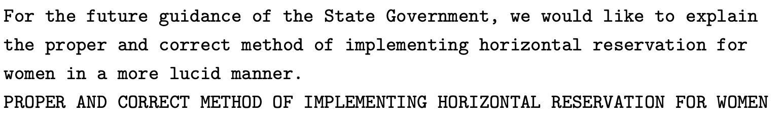
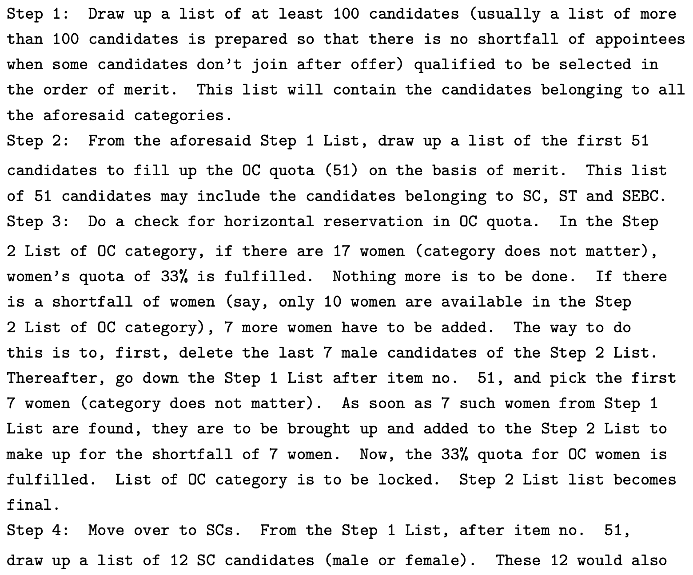
Tamannaben Ashokbhai Desai (2020)

Slide 4
Tamannaben Ashokbhai Desai (2020)

Slide 5
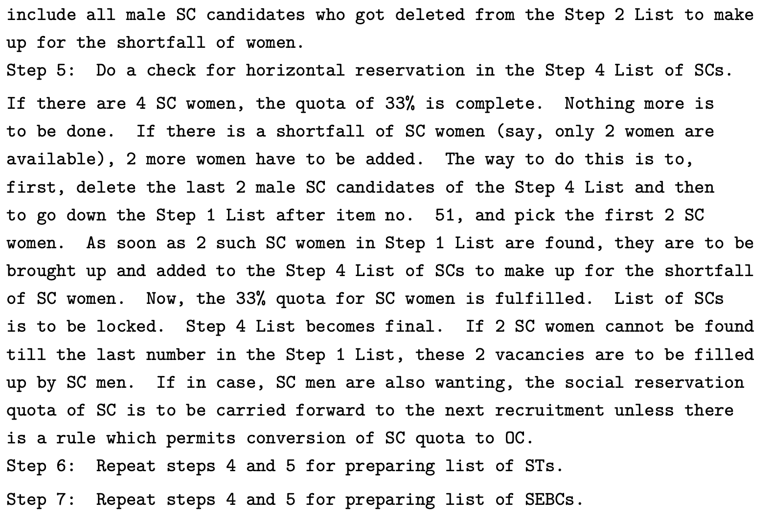
Tamannaben Ashokbhai Desai (2020)

Slide 6
Tamannaben Ashokbhai Desai (2020)

Slide 7
Tamannaben Ashokbhai Desai (2020)
This is amazing!
Can you imagine a US Court writing this opinion?
Our goal: make this more ‘lucid’ (understand this algorithm)

Slide 8
Affirmative Action for Government Positions in India
Reservations for Following Groups:
Scheduled Castes (SC)
Scheduled Tribes (ST)
Other Backwards Classes (OBC)
People With Disabilities (D)
Women (W)
Do these categories form a hierarchy?
NO!
New last year:
“Economically weaker section” (EWS)
We will ignore this today.

Slide 9
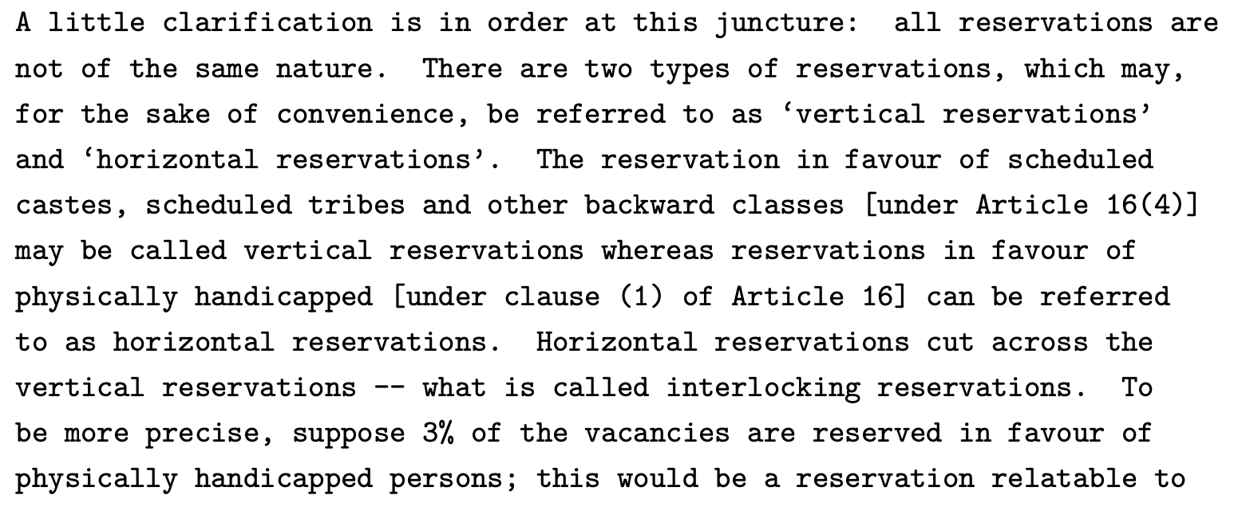
Affirmative Action for Government Positions in India
Reservations for Following Groups:
Scheduled Castes (SC)
Scheduled Tribes (ST)
Other Backwards Classes (OBC)
People With Disabilities (D)
Women (W)
Indra Sawhney (1992)

Slide 10
Two Types of Reservations
'Vertical’ Categories: SC, ST, OBC
These are disjoint categories (nobody belongs to 2 of them).
'Horizontal’ Categories: W, D
These overlap with each other, and with vertical categories.

Slide 11
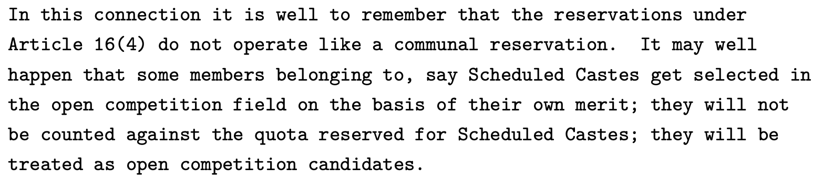
More Detail on ‘Vertical Reservations’
Indra Sawhney (1992)
We rank candidates on the basis of civil service exams.
Which algorithm more accurately implements the intention described above?
Exemptions First
Over and Above

Slide 12
Vertical Reservations Algorithm
Generalizing “Over and Above” to non-intersecting reserve categories:
Open-Reserved Algorithm:
Fill open positions.
Fill vertical reservations from remaining applicants.

Slide 13


Vertical Reservations Practice
$∅$
$OBC$
$∅$
SC
$∅$
OBC
$∅$
$∅$
ST
$∅$
$∅$
$OBC$
$∅$
SC
$∅$
OBC
$∅$
$∅$
ST
$∅$
5 open positions
3 spots reserved for OBC
1 spot reserved for SC
1 spot reserved for ST
Which applicants should be selected?

Slide 14
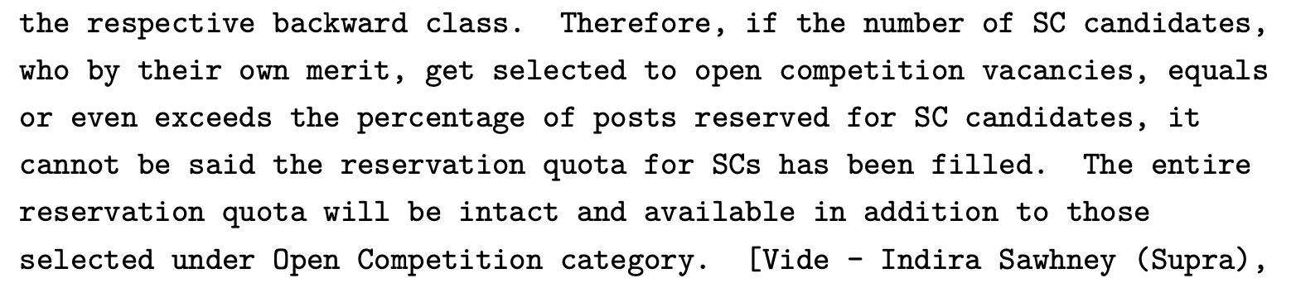
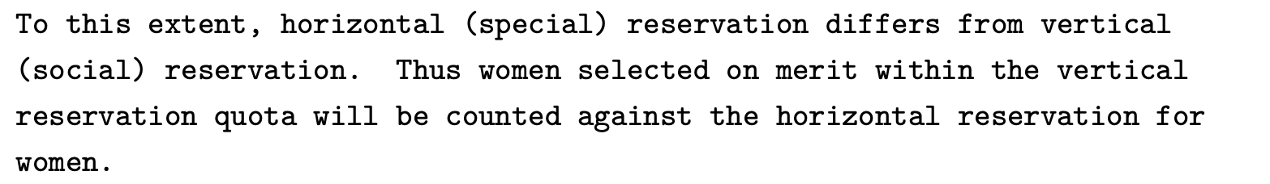
Difference Between Vertical and Horizontal
Rajesh Kumar Daria (2007):

Slide 15
Difference Between Vertical and Horizontal
Vertical = Over and Above
Horizontal = Exemptions First

Slide 16
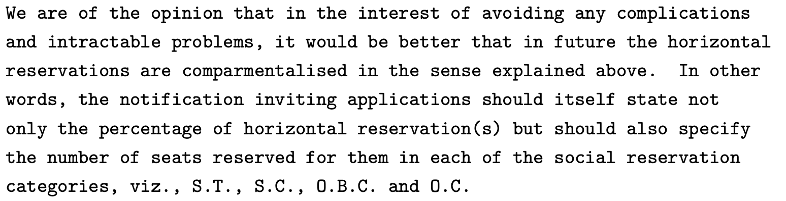
Interaction Between Horizontal and Vertical
Indra Sawhney (1992):
 | SC (15%) | ST (7.5%) | OBC (27%) | Open (50.5%)
Women (33.3%) | SC-W | ST-W | OBC-W | O-W
Open (66.7%) | SC-O | ST-O | OBC-O | O-O
 | SC (15%) | ST (7.5%) | OBC (27%) | Open (50.5%)
Women (33.3%)
Open (66.7%)
Anil Kumar Gupta (1995)

Slide 17
Interaction Between Horizontal and Vertical
Indra Sawhney (1992):
 | SC (15%) | ST (7.5%) | OBC (27%) | Open (50.5%)
Women (33.3%) | SC-W | ST-W | OBC-W | O-W
Open (66.7%) | SC-O | ST-O | OBC-O | O-O
 | SC (15%) | ST (7.5%) | OBC (27%) | Open (50.5%)
Women (33.3%)
Open (66.7%)
 | SC (15%) | ST (7.5%) | OBC (27%) | Open (50.5%)
Women (33.3%) | 5% | 2.5% | 9% | 16.8%
Open (66.7%) | 10% | 5% | 18% | 33.7%
Anil Kumar Gupta (1995)

Slide 18
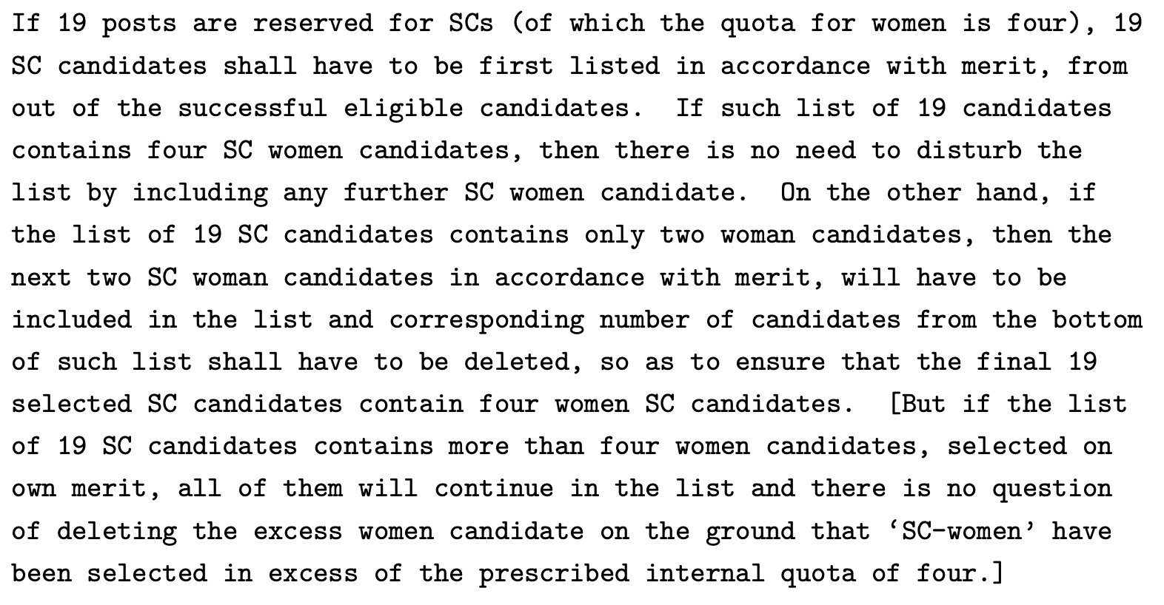
Rajesh Kumar Daria (2007):

Slide 19
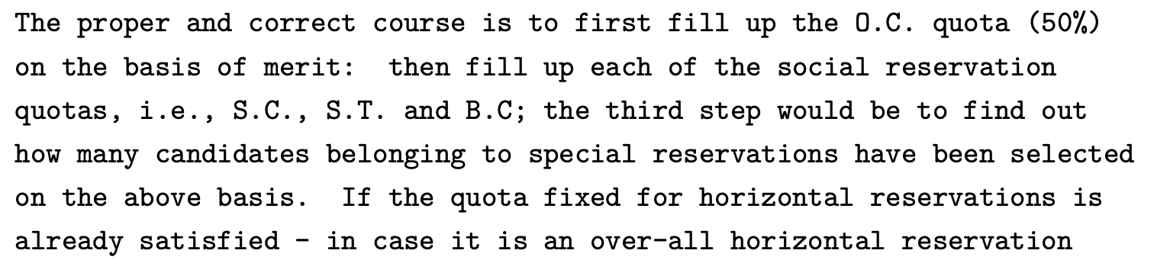
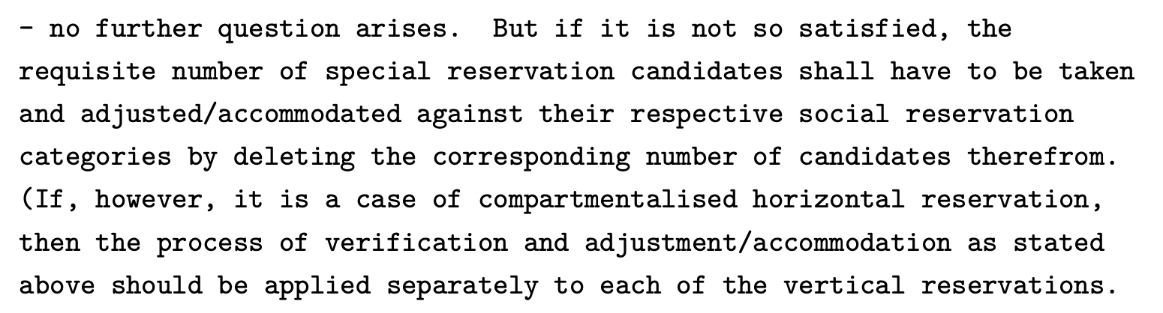
Anil Kumar Gupta (1995)

Slide 20
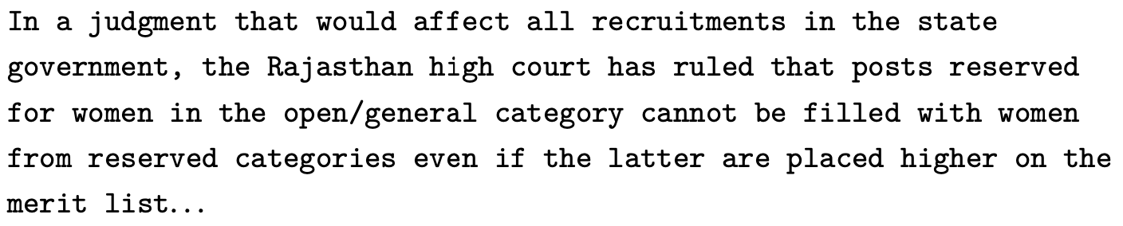
Adding Horizontal Reservations
Somewhat similar to Chilean approach:
initially ignore gender constraint, fix if needed.
Procedure in Place Until Recently (SCI Algorithm):
Apply Open-Reserved algorithm (ignore horizontal reservations)
In each category of positions, enforce horizontal reservations:
In open category: replace bottom scoring non-women with top-scoring women who remain among those not in any vertical category.
In each vertical category: replace bottom scoring non-women with top-scoring women who remain among those in that vertical category.

Slide 21
 | SC (2) | OBC (2) | Open (2)
Women (3) | SC-W (1) | OBC-W (1) | O-W (1)
Open (3) | SC-O (1) | OBC-O (1) | O-O (1)
SC
OBC, W
SC
SC, W
W
OBC
OBC, W
SCI Algorithm (high-level summary)
Select as if there were no W reservations.
Make swaps to ensure that W reservations are met.
Initial Selection:
Open seats: 1, 2
OBC seats: 4, 9
SC seats: 3, 5
How to correct?
Should 4 get “moved” to O-W?
Should 6 get SC-W seat or O-W seat?
Choices made by SCI algorithm:
Already allocated candidates don’t get moved.
In the second stage SC-W candidates can only be swapped into SC-W spots. Only W who are not SC, ST, OBC can be swapped into O-W spots.

Slide 22
Causing Problems in our Motivating Example
SC
SC, W
W
1 O-O position
1 O-W position
1 SC-O position
Who does SCI algorithm select?
A: Step 1: 1,2 take open seats, 3 takes SC seat
Step 2: 2 swapped for 5.
Applicant 4 has justified envy!

Slide 23
The 2SM Algorithm with one horizontal category
Fill Open Positions Using Exemptions First Rule
First allocate open seats with horizontal reservation.
Then allocate open seats with no horizontal reservation.
Fill Vertical Positions Using Exemptions First Rule
Then allocate vertical reservation seats with horizontal reservation.
Then allocate vertical reservation seats with no horizontal reservation.

Slide 24
Practice with this Algorithm

Slide 25
 | SC (2) | ST (2) | OBC (3) | Open (3)
Women (4) | SC-W (1) | ST-W (1) | OBC-W (1) | O-W (1)
Open (6) | SC-O (1) | ST-O (1) | OBC-O (2) | O-O (2)
ST, W
SC, W
W
OBC, W
OBC
SC, W
SC
SC, W
ST
SC
SC
OBC
OBC, W
W

Slide 26
 | SC (2) | ST (2) | OBC (3) | Open (3)
Women (4) | SC-W (1) | ST-W (1) | OBC-W (1) | O-W (1)
Open (6) | SC-O (1) | ST-O (1) | OBC-O (2) | O-O (2)
ST, W
SC, W
W
OBC, W
OBC
SC, W
SC
O-W
O-O
O-O
OBC-W
OBC-O
SC-W
SC-O
SC, W
ST
SC
SC
OBC
OBC, W
W
ST
OBC-O

Slide 27
Recap
Process reserved positions first.
“Horizontal Reservations” = “Exemptions First”
“Vertical Reservations” = “Over and Above”
Dealing with overlap between horizontal and vertical:
Process general positions first.
 | SC (15%) | ST (7.5%) | OBC (27%) | Open (50.5%)
Women (33.3%) | 5% | 2.5% | 9% | 16.8%
Open (66.7%) | 10% | 5% | 18% | 33.7%

Slide 28
Recap: Vertical + Horizontal Reservations
Process reserved positions first.
“Horizontal Reservations” = “Minimum Guarantee”
“Vertical Reservations” = “Over and Above”
Dealing with overlap between horizontal and vertical:
Process general positions first.
 | SC (15%) | ST (7.5%) | OBC (27%) | Open (50.5%)
Women (33.3%) | 5% | 2.5% | 9% | 16.8%
Open (66.7%) | 10% | 5% | 18% | 33.7%

Slide 29
The 2SM Algorithm with one horizontal category
First allocate open seats with horizontal reservation.
Then allocate open seats with no horizontal reservation.
Then allocate vertical reservation seats with horizontal reservation.
Then allocate vertical reservation seats with no horizontal reservation.

Slide 30
2SM Algorithm with multiple horizontal categories
First allocate open seats with horizontal reservation:
Allocate simultaneously using smart reserves.
Then allocate open seats with no horizontal reservation.
Then allocate vertical reservation seats with horizontal reservation.
Allocate simultaneously using smart reserves.
Then allocate vertical reservation seats with no horizontal reservation.

Slide 31
The 2SM Algorithm with multiple horizontal category
First allocate open seats with horizontal reservation.
Then allocate open seats with no horizontal reservation.
Then allocate vertical reservation seats with horizontal reservation.
Then allocate vertical reservation seats with no horizontal reservation.

Slide 32
Economically Weaker Sections
2019 Constitutional Amendment reserves 10% of seats for EWS.
This is a vertical reservation.
Members of SC, ST, OBC declared ineligible for EWS reserves.
If we apply 2SM algorithm, may not respect spirit of affirmative action!

