Slide 1
Affordable Housing in New York City
Engineering The Allocation of Public Resources
Professor Nick Arnosti
University of Minnesota

Slide 2
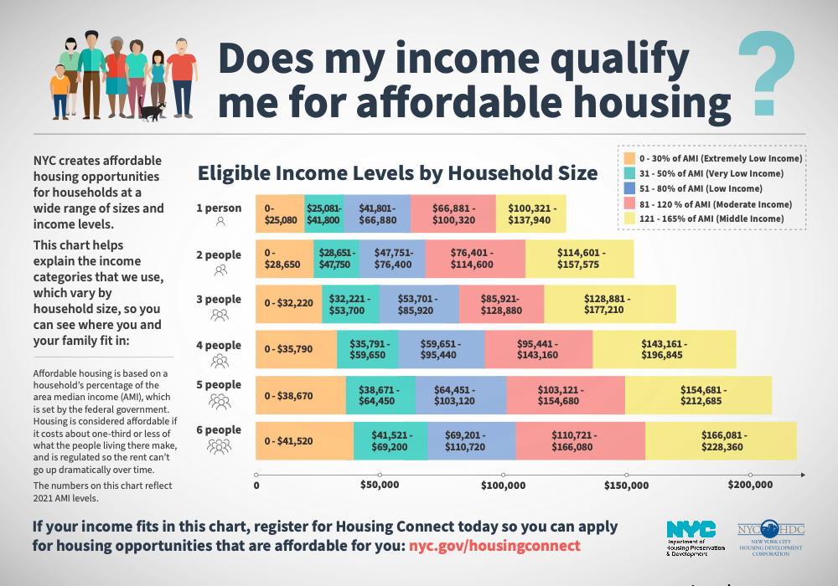
How many households in each income level?
How many apartments marketed to each income level?

Slide 3
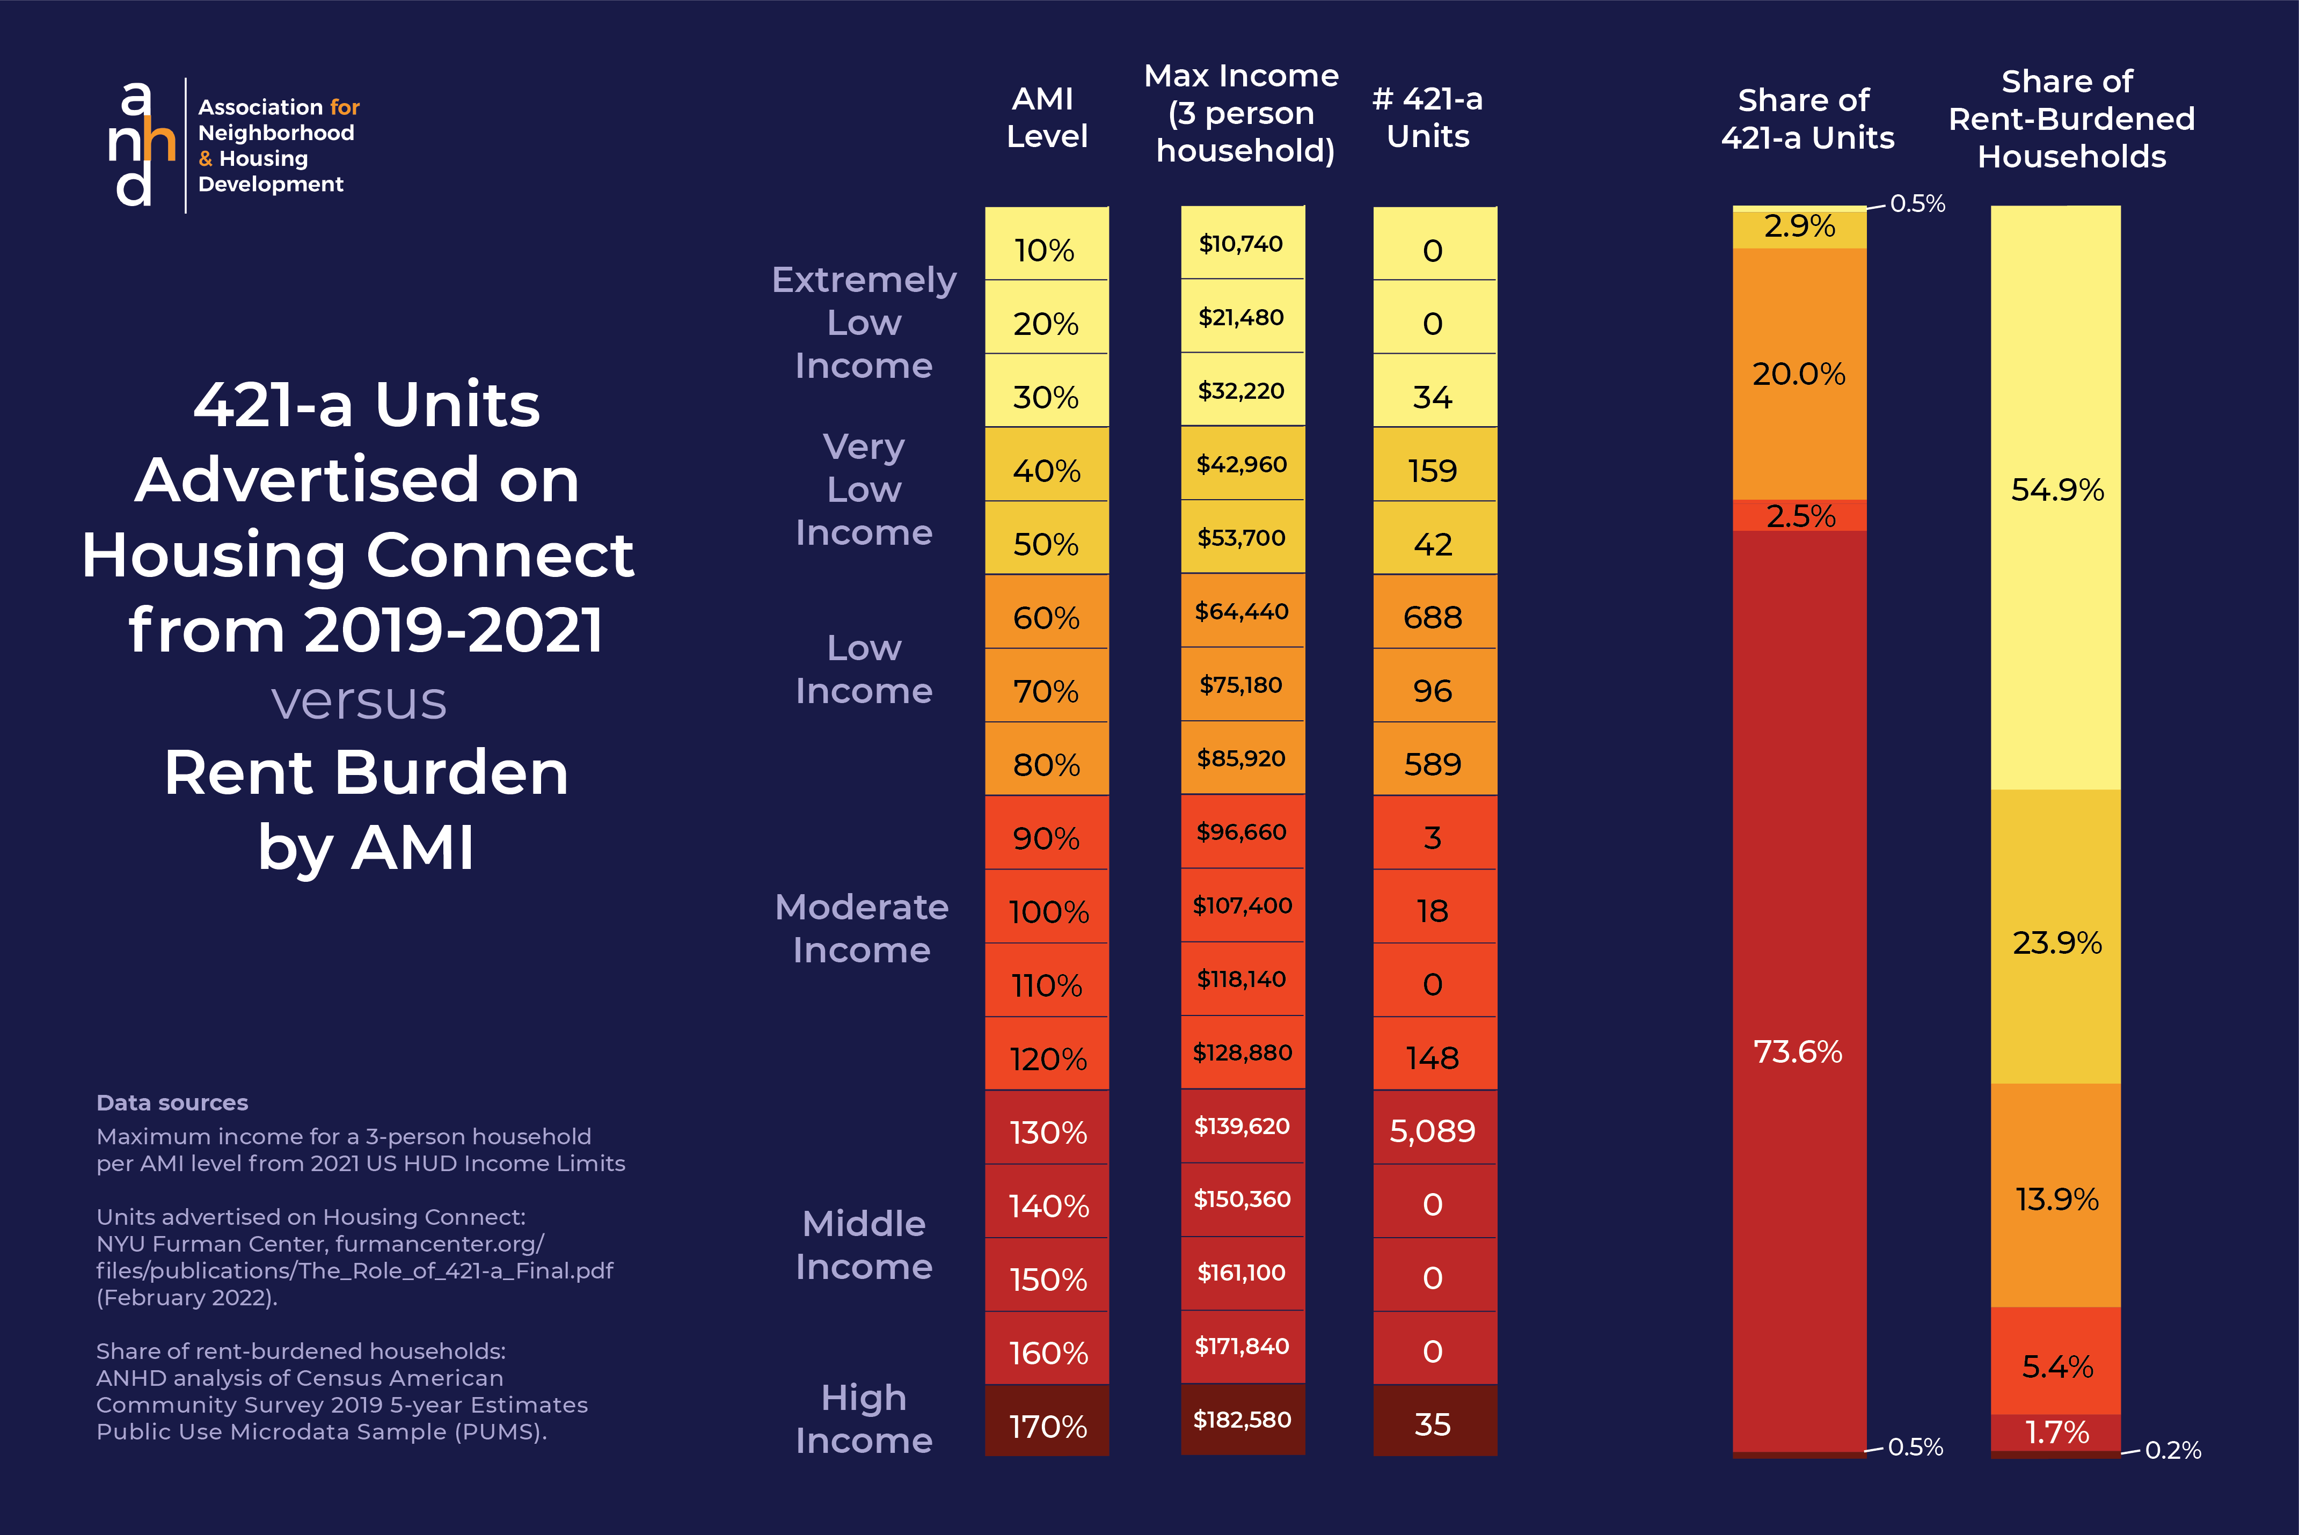

Slide 4
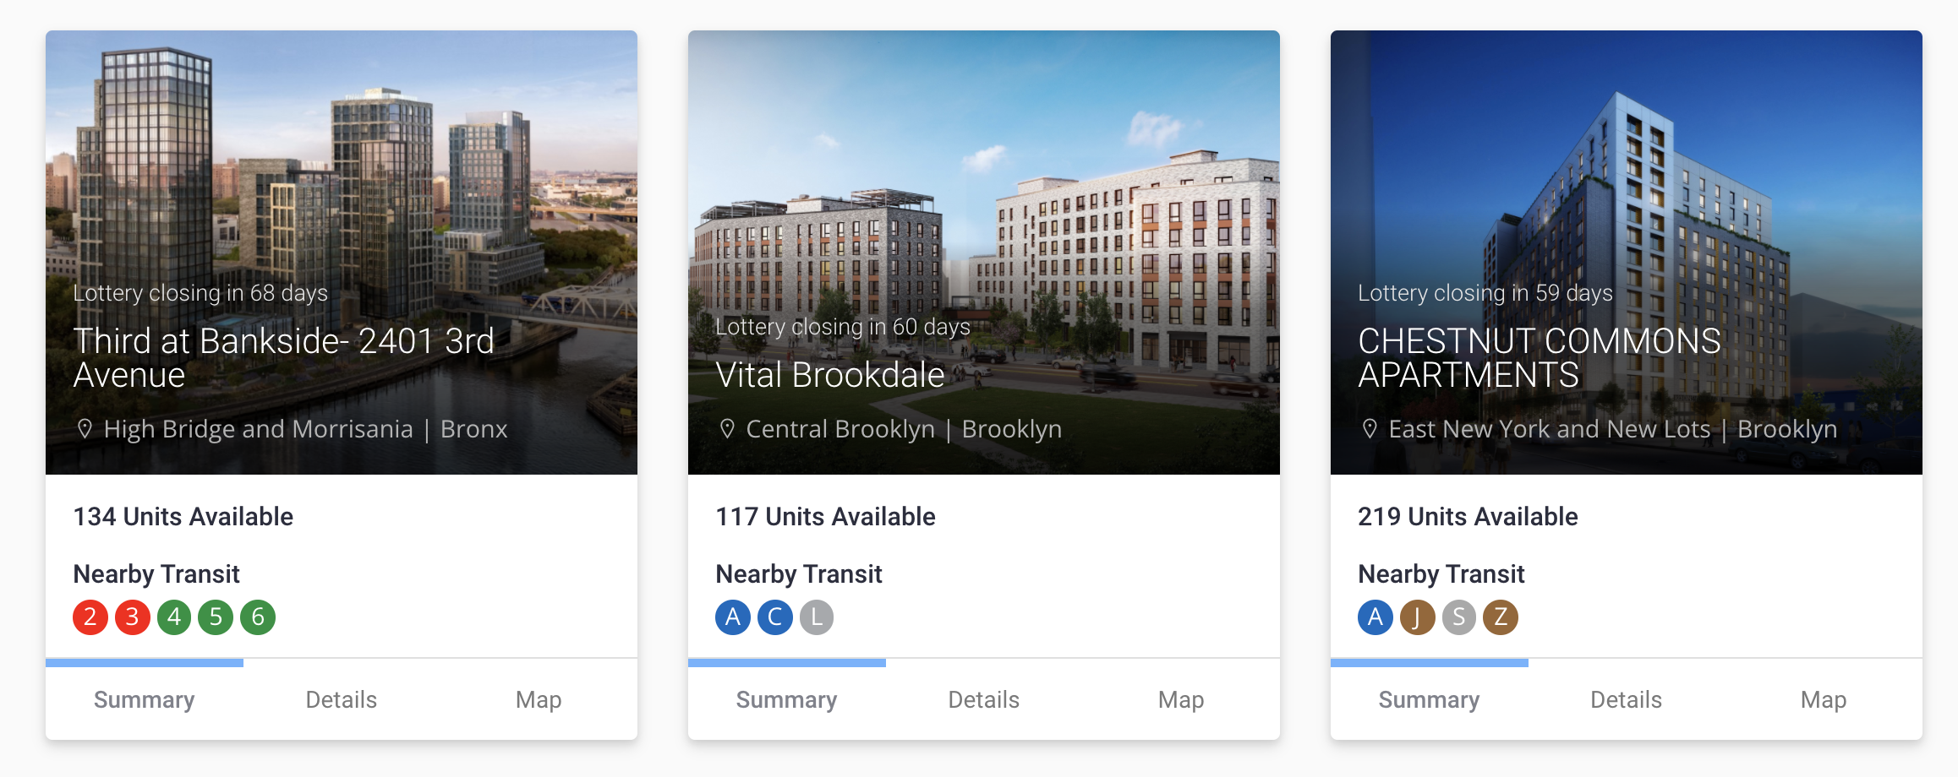
New York Affordable Housing Lotteries
Inclusionary Zoning (80/20):
Units in new buildings offered at “affordable” rates through HousingConnect.
7,857 new units in 2018.
People can apply for as many buildings as they wish.
After Applications Close:
The city places applicants in a random order.
Developers screen and place applicants.

Slide 5
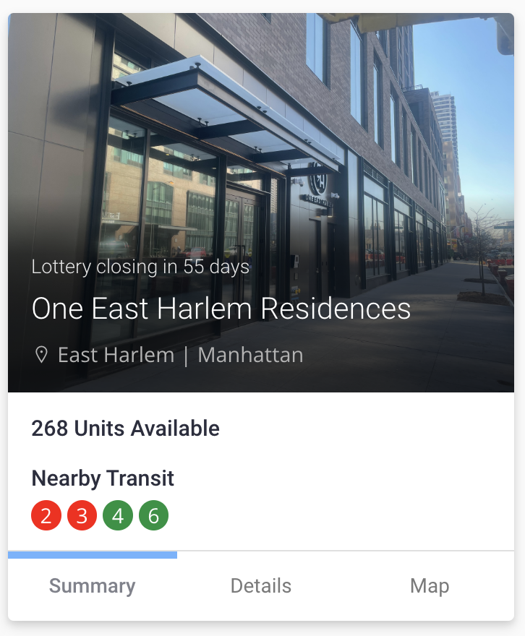
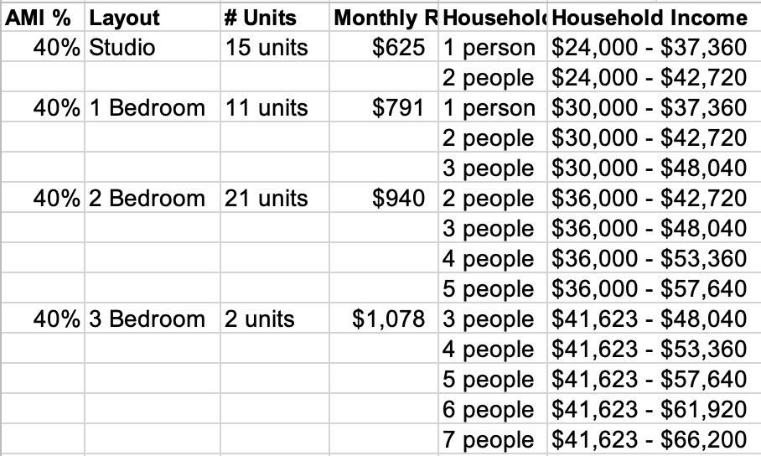
Unit Types Eligibility Criteria
# bedrooms household size
AMI target household income

Slide 6
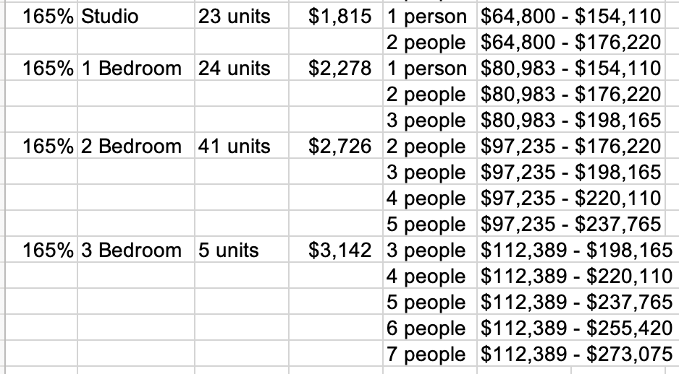

Slide 7
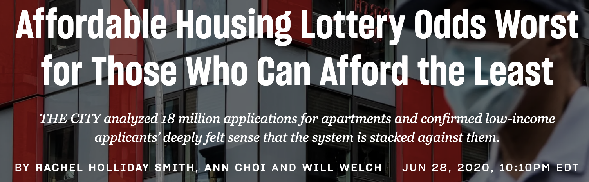

Slide 8
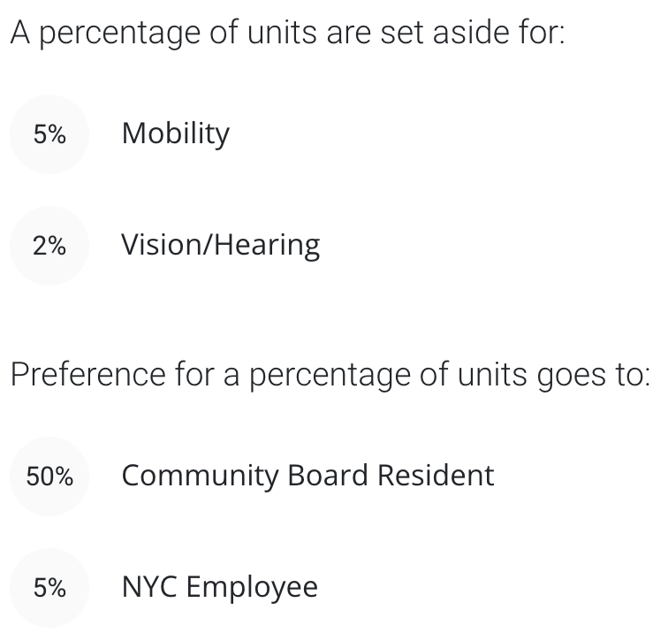

Slide 9
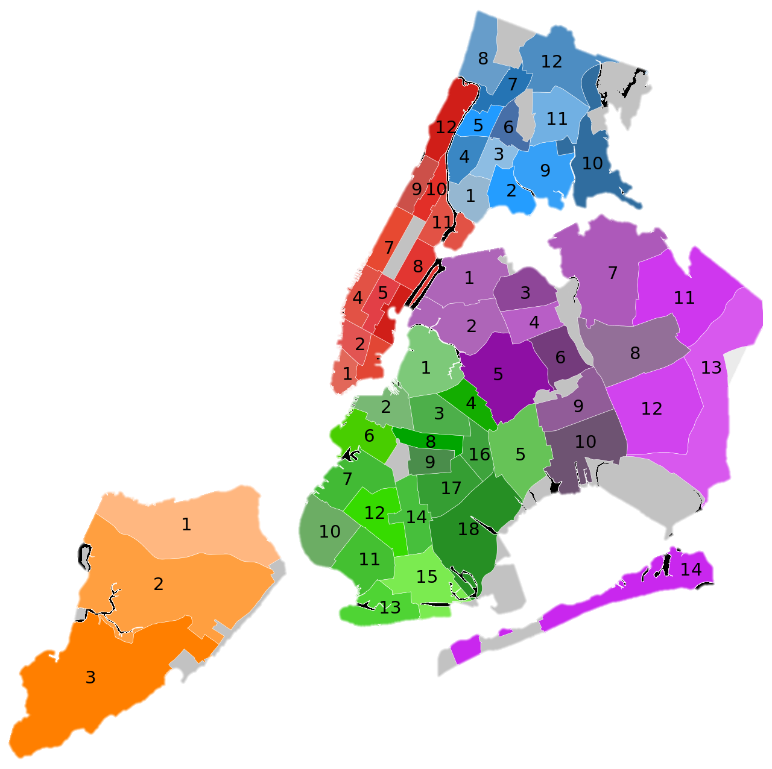
Community Preference Policy
Community Preference is a longstanding NYC policy that reserves 50% of units in most subsidized affordable housing developments for residents of the local Community District.
Lawsuit!
Plaintiffs claim that the policy has racially discriminatory impacts and perpetuates the harmful legacy of segregation.
Learn more at nickarnosti.com/blog
NYC has 59 Community Districts

Slide 10
Quick Recap
Units have different #bedrooms, AMI targets.
“Preferences” (quotas) for people with disabilities, community residents, and city employees.
Lottery numbers, household size and income for each applicant.
How do they handle this all?

Slide 11
NYC Developer Screening Algorithm
Order applicants by log number.
Satisfy preferences:
Applicants eligible for disability preference considered in log order until 7% of units have been allocated.
Applicants eligible for community preference considered in log order until 50% of units filled with people from community district.
Applicants eligible for municipal employee preference considered in log order until 5% of units filled with municipal employees.
Remaining applicants considered in log order until all units filled.
Details:
Granting someone with multiple preferences a unit counts against each preference’s goal.
If household is eligible for multiple available unit types, it chooses which to claim.

Slide 12
What are consequences of using this algorithm?
My claim:
More than 50% of low income units go to community residents.
Less than 50% of middle income units go to community residents.

Slide 13

A Simple Example
Assume:
All units have same number of bedrooms.
Two non-overlapping target income ranges.
No disability or municipal employee preferences
All applicants are eligible and will accept.
$≥2$ from
community
15 applicants:
No CP Policy
With CP Policy
Applicants | CP | Not CP
Low Income | 4 | 8
Middle Income | 1 | 2
Success Probability | CP | Not CP
Low Income | 16.7% | 16.7%
Middle Income | 66.7% | 66.7%
Success Probability | CP | Not CP
Low Income | 40.5% | 4.8%
Middle Income | 69.5% | 65.2%
2 units
2 units

Slide 14

Another Simple Example
Assume:
All units have same number of bedrooms.
Two non-overlapping target income ranges.
No disability or municipal employee preferences
All applicants are eligible and will accept.
$≥$50 from
community
1000 applicants:
20% from community district
90% low income
Income and community preference are independent.
100 units
50 low income
50 middle income
 | CP | Not CP
Low Income | 180 | 720
Middle Income | 20 | 80

Slide 15
Outcomes from different policies
Applicant Counts
 | CP | Not CP
Low Income | 180 | 720
Middle Income | 20 | 80
No Community Preference
50% Community Preference
 | CP | Not CP
Low Income | 18 | 72
Middle Income | 2 | 8
 | CP | Not CP
Low Income | 45 | 45
Middle Income | 5 | 5
No Income Targeting
 | CP | Not CP
Low Income | 10 | 40
Middle Income | 10 | 40
 | CP | Not CP
Low Income | 45 | 5
Middle Income | 10 | 40
50% Low Income
50% Middle Income

Slide 16
The effect of community preference
No Community Preference
50% Community Preference
Community members get
90% of low-income seats
20% of middle income seats
(same as without CP policy!)
 | CP | Not CP
Low Income | 10 | 40
Middle Income | 10 | 40
 | CP | Not CP
Low Income | 45 | 5
Middle Income | 10 | 40
The city does NOT reserve 50% of each type of unit for community members.
Community members (like other applicants) are mostly low income.
They claim most low-income units.
Few low-income units left for applicants from outside the community.

Slide 17
Why is this happening? (more detail)
Community Preference
Satisfied
 | CP | Not CP
Low Income | 45 | 0
Middle Income | 5 | 0
 | CP | Not CP
Low Income | 45 | 5
Middle Income | 10 | 40
 | CP | Not CP
Low Income | 45 | 5
Middle Income | 5 | 0
 | CP | Not CP
Low Income | 45 | 5
Middle Income | 5 | 20
First pass: take top 50 community residents.
50/200 = 25%
Second pass:
Fill remaining units
5/720 = 0.7%
50/100 = 50%
Low Income Units Fill
Middle Income Units Fill
Challenge: Explain to person #6 why they were not selected.

Slide 18
Is this actually happening?
This is a stylized example with made-up numbers.
Same qualitative conclusions should hold if:
Fewer than 50% of applicants qualify for community preference, and
competition is fiercest for low-income units.

Slide 19
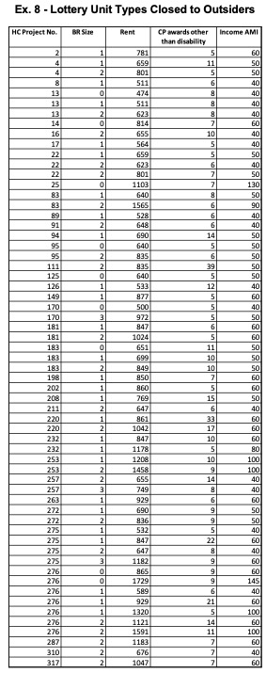

Beveridge’s Analysis: types with $≥5$units to insiders, 0 to outsiders.
Mostly very low-income units!

Slide 20
Inevitable consequence of stated policies? NO.
 | CP | Not CP
Low Income | 45 | 5
Middle Income | 10 | 40
At least 50 community members.
At most 50 low income.
At most 50 middle income.
Conclusion:
Processing algorithm is not carefully considered, but has a large effect!
 | CP | Not CP
Low Income | 10 | 40
Middle Income | 40 | 10
 | CP | Not CP
Low Income | 30 | 20
Middle Income | 20 | 30
(If total # applicants doubled.)

Slide 21
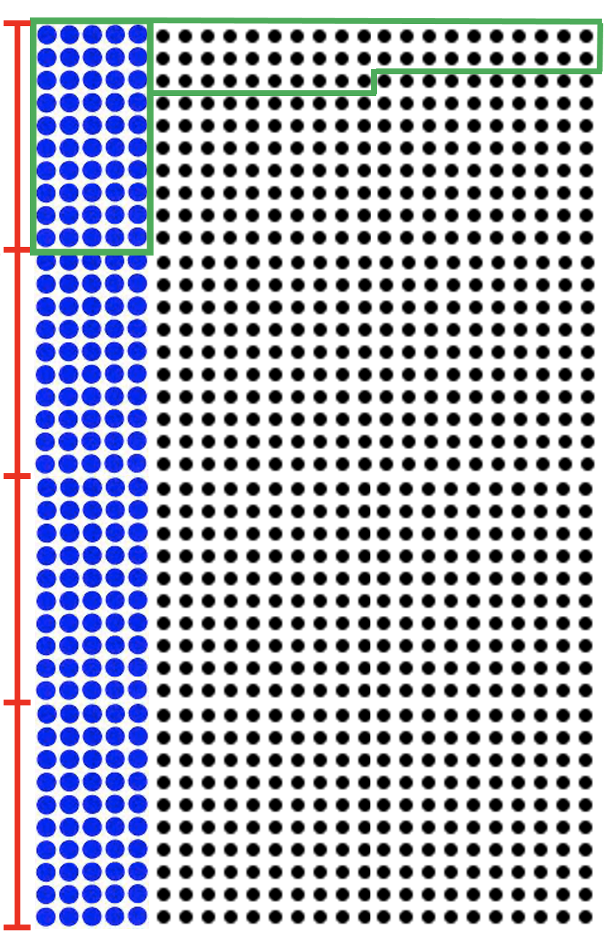
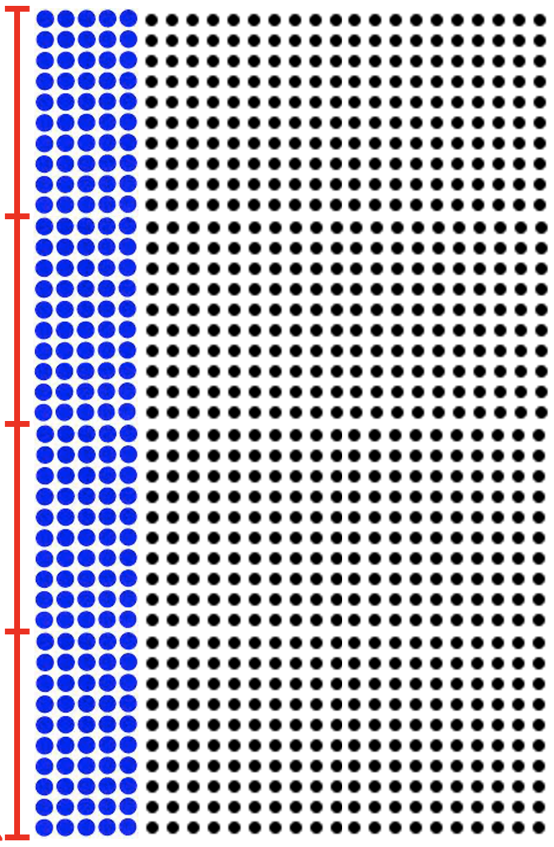
NYC Community Preference
0
Each applicant is given a 'log number’
The city processes applicants in increasing order of log number (lower is better), allocating units to residents of the community district.
Once 50% of units have been allocated in this way, the city processes all remaining applicants in increasing order of log number.
0.25
0.5
0.75
Hypothetical: 100 units, 1000 applicants (200 from Community District)
1

