Slide 1
Chile’s Constitutional Assembly Election
Engineering The Allocation of Public Resources
Professor Nick Arnosti
University of Minnesota

Slide 2
Pre-Class Homework
Next class, we will dive into the election for Chile's Constitutional Assembly. There are several key facts to know. First, each candidate is associated with a 'list' (you can think of this as representing a political affiliation). Ideally, each list would have a number of candidates selected that is proportional to its total vote share. That is, a list whose candidates earned 1/3 of all votes cast should ideally win 1/3 of the available seats.
The data for Chile's District 5 is given in this spreadsheet:
https://docs.google.com/spreadsheets/d/1POHHyJUrgcuw8PSj2cxgqECtMl7N7ueoz4l1KmPHS4E/edit?usp=sharing
Question 1. Use this data to determine the total number of votes received by each list.
Question 2. Given the vote totals calculated above, we must now determine the number of seats won by each list. There are several methods for doing this. The method used by Chile is the Jefferson/D'Hondt method, which can be read about here: https://en.wikipedia.org/wiki/D%27Hondt_method
(This page also lists many other countries that use this method for elections, and includes several examples.)
Chile's District 5 has a total of 6 seats. Apply the Jefferson/D'Hondt method to the data from the previous question to determine the number of seats won by each list.
Question 3. Once we have determined the number of seats won by each list, we now must determine the identity of the individual winning candidates. If a list earns k seats, we start by trying to select the top k candidates who ran as part of the list. If we do this, what are the IDs of the 6 elected candidates? Do we select 3 men and 3 women? (In the Gender column, H = 'Hombre' = Man, and M = 'Mujer' = Woman.)

Slide 3
Today’s Class in Context

Slide 4
Plan for Today: Chilean Constitutional Assembly
Simplified Chilean Algorithm
Jefferson/D’Hondt Method
Swapping rule
Full Chilean Algorithm
2 stage Jefferson/D’Hondt (list and party)
Modified swapping rule

Slide 5
By the end of class, you will be able to…

Slide 6
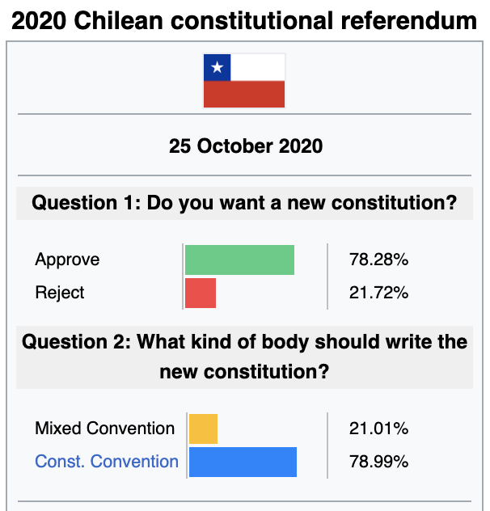
Chilean Constitutional Assembly of 2021: Timeline
October 2019: large-scale riots and protests
October 2020: constitutional referendum
May 2021: constitutional assembly election
Sources: https://en.wikipedia.org/wiki/2020_Chilean_constitutional_referendum
https://en.wikipedia.org/wiki/2021_Chilean_Constitutional_Convention_election

Slide 7
Elections for “Chamber of Deputies”
A total of 155 seats, divided across 28 districts (3-8 seats each).
Proportional representation of political coalitions (“lists”).
Lists and districts are not nested categories. But they create nested categories by having independent elections across districts.
D1
D2
D1
D2
L1
L1+D1
L1+D2
L2
L2+D1
L2+D2
6
6
6

Slide 8
Chilean Constitutional Assembly: Quotas
Purpose: elect 155 representatives to draft a new constitution.
Aim to ensure representation of
How did they do this?
Pre-determined # representatives from each of 28 districts. Outcomes independent across districts.
Create non-geographical “district” for indigenous tribes (17 representatives)
Each list must have equal number of male and female candidates. Elected representatives from each district must be gender balanced.
Representation of lists and parties determined by vote shares.
Present in every Chilean election
Political coalitions (list+party)
Indigenous people
Each district
Each gender
New to this election

Slide 9
Quotas
District 1: lower = upper = 6.
District 1 + W: lower = 1, upper = 2
District 1 + M: lower = 1, upper = 2

Slide 10
Step 1: Determine Votes For Each List
District 5 results (6 seats)
Lista | Votes
WD | 58516
YQ | 37401
YB | 36743
XP | 35030
WB | 23800
WI | 23564
XA | 10481
Total | 225535

Slide 11
Step 2: Determine Representatives for Each List
District 5 results (6 seats)
Lista | Votes | Vote Share | Ideal # Representatives
WD | 58516 | 25.9% | 1.56
YQ | 37401 | 16.6% | 0.99
YB | 36743 | 16.3% | 0.98
XP | 35030 | 15.5% | 0.93
WB | 23800 | 10.6% | 0.63
WI | 23564 | 10.4% | 0.63
XA | 10481 | 4.6% | 0.28
Total | 225535 | 100% | 6
Challenge: cannot assign fractional representatives!
Proportional reasoning: “This feels like a task I could give to my 6th graders”

Slide 12
Step 2: Determine # Representatives for Each List using Jefferson D’Hondt Method
District 5 results (6 seats)
If there were 8 seats:
How many seats would each list win?
How many votes would list XA need in order to win one of these 8 seats? (Votes for other lists stay the same.)
Lista | Seat 1 | Seat 2 | Seat 3
WD | 58516 | 29258 | 19505
YQ | 37401 | 18701 | 12467
YB | 36743 | 18372 | 12248
XP | 35030 | 17515 | 11677
WB | 23800 | 11900 | 7933
WI | 23564 | 11782 | 7855
XA | 10481 | 5241 | 3494
Equivalent way to think about it:
Look at lowest bolded total: 23,800
Lists get 1 seat for each 23,800 votes (round DOWN).
Note: because of rounding, it benefits lists to combine.

Slide 13
Step 2: Determine # Representatives for Each List using Jefferson D’Hondt Method
District 5 results (6 seats)
If there were 8 seats:
How many seats would each list win?
How many votes would list XA need in order to win one of these 8 seats? (Votes for other lists stay the same.)
Lista | Seat 1 | Seat 2 | Seat 3
WD | 58516 | 29258 | 19505
YQ | 37401 | 18701 | 12467
YB | 36743 | 18372 | 12248
XP | 35030 | 17515 | 11677
WB | 23800 | 11900 | 7933
WI | 23564 | 11782 | 7855
XA | 10481 | 5241 | 3494
Answers:
Next two seats would go to WI and WD.
XA would need at least 19,505 votes to win a seat.
Equivalent way to think about it:
Look at lowest bolded total: 23,800
Lists get 1 seat for each 23,800 votes (round DOWN).
Note: because of rounding, it benefits lists to combine.

Slide 14
Step 3: Determine Tentative Winners
ID | Genero | Lista | Partido | Votos
160 | M | WD | IND160 | 22489
189 | M | YQ | CONVER. | 13393
185 | H | YB | PS | 12545
161 | H | WD | IND161 | 11066
192 | H | YQ | PCCH | 10076
182 | M | YB | PDC | 8259
180 | H | XP | RN | 8005
173 | M | XA | PEV | 7433
175 | M | XP | UDI | 7009
163 | H | WD | IND163 | 6362
181 | M | XP | RN | 6283
153 | M | WB | IND153 | 6141
Select candidates with most votes to represent their list.
Lista | Seats Won
WD | 2
YQ | 1
YB | 1
XP | 1
WB | 1
WI | 0
XA | 0
If tentative winners are gender balanced (difference in men and women is at most 1), we are done!

Slide 15
Step 1: Determine Votes For Each List
Practice: Data from District 3
Step 2: Determine # Representatives for Each List using Jefferson D’Hondt Method
Lista | Votos
ZZ | 31466
ZN | 25993
YQ | 22924
XP | 21247
YB | 14845
L | 13161
ZR | 10651
ID123 | 7745
ID122 | 4476
ID121 | 2782
District 3 has 4 seats. How many go to each list?
Answer: 1 seat each to ZZ, ZN, YQ, XP.

Slide 16
Step 3: Determine Tentative Winners
ID | Genero | Lista | Partido | Votos
115 | M | ZZ | IND | 19736
104 | M | ZN | IND | 10252
100 | M | YQ | PCCH | 9519
123 | M | ID123 | IND | 7745
105 | H | ZN | IND | 6454
82 | M | L | IND | 6081
89 | H | XP | UDI | 5441
86 | M | XP | RN | 5163
96 | M | YB | PS | 4924
110 | H | ZR | PTR | 4564
120 | H | ZZ | IND | 4487
122 | H | ID122 | IND | 4476
106 | M | ZN | IND | 4242
117 | M | ZZ | IND | 4148
99 | H | YQ | FREVS | 3946
1 seat each to ZZ, ZN, YQ, XP.
Tentative selection includes:
3 women (M)
1 man (H)
We must replace 1 woman with a man. Which one?

Slide 17
Step 4: Ensure Gender Parity
Must swap 1 woman for a man from the same list.
Which would you swap? Why?
Come up with counter-argument.
Swap YQ
Swap ZN
Swap ZZ
ID | Genero | Lista | Votos
115 | M | ZZ | 19736
104 | M | ZN | 10252
100 | M | YQ | 9519
123 | M | ID123 | 7745
105 | H | ZN | 6454
82 | M | L | 6081
89 | H | XP | 5441
86 | M | XP | 5163
96 | M | YB | 4924
110 | H | ZR | 4564
120 | H | ZZ | 4487
122 | H | ID122 | 4476
106 | M | ZN | 4242
117 | M | ZZ | 4148
99 | H | YQ | 3946
ID | Genero | Lista | Votos
115 | M | ZZ | 19736
104 | M | ZN | 10252
100 | M | YQ | 9519
123 | M | ID123 | 7745
105 | H | ZN | 6454
82 | M | L | 6081
89 | H | XP | 5441
86 | M | XP | 5163
96 | M | YB | 4924
110 | H | ZR | 4564
120 | H | ZZ | 4487
122 | H | ID122 | 4476
106 | M | ZN | 4242
117 | M | ZZ | 4148
99 | H | YQ | 3946
ID | Genero | Lista | Votos
115 | M | ZZ | 19736
104 | M | ZN | 10252
100 | M | YQ | 9519
123 | M | ID123 | 7745
105 | H | ZN | 6454
82 | M | L | 6081
89 | H | XP | 5441
86 | M | XP | 5163
96 | M | YB | 4924
110 | H | ZR | 4564
120 | H | ZZ | 4487
122 | H | ID122 | 4476
106 | M | ZN | 4242
117 | M | ZZ | 4148
99 | H | YQ | 3946

Slide 18
Many Possible Principles
Swap out woman with fewest votes
Swap in man with most votes
Swap pair for whom difference in votes is smallest
Chile swapped out the ‘majority gender’ candidate with fewest votes.

Slide 19
Relationship to Priority Dominance
Who thought we should swap YQ? Swap ZN?
Neither of the resulting selections priority dominates the other.
Who thought we should swap ZZ?
This selection is priority dominated by the selection from ZN swap.

Slide 20
Simplified Chilean Algorithm
Determine vote totals for each list.
Determine number of representatives for each list according to Jefferson/D’Hondt method.
Determine preliminary winners by selecting top candidates from each list.
While gender parity is not satisfied,
Identify elected ‘majority gender’ candidate with fewest votes.
Replace this candidate with highest non-elected candidate from the same list and opposite gender. (If no such candidate exists, candidate from ‘a’ is safe: continue.)
Gender Parity: #Men and #Women differ by at most 1
Algorithm description. (Include fact that swapping lowest may be infeasible if list won lots of seats.)
Note: each list required to have equal number of male and female.
Note: this algorithm respects priorities (equivalent to Generalized Top-Down with quotas on Lists and Gender).
How comfortable do you feel with this?

Slide 21
Break

Slide 22
Practice: District 7
ID | Genero | Lista | Partido | Votos
299 | H | YQ | CONVER | 43490
280 | H | XP | UDI | 21520
328 | M | ZN | IND328 | 18949
288 | H | YB | PL | 17783
330 | M | ZN | IND330 | 15073
276 | H | XP | RN | 13774
331 | H | ZN | IND331 | 12611
301 | H | YQ | PCCH | 12185
278 | H | XP | UDI | 12079
303 | H | YQ | RD | 9760
329 | H | ZN | IND329 | 9074
279 | M | XP | UDI | 7813
298 | M | YQ | COMUNES | 6649
312 | M | YV | IND312 | 6155
283 | M | YB | PDC | 5935
274 | H | XG | PH | 5676
Lista | Votos
D | 9892
XG | 5676
XP | 71164
YB | 45751
YI | 8685
YQ | 79305
YT | 12178
YV | 21040
ZB | 5621
ZN | 67319
ZR | 4681
District 7 has 7 seats.
How many seats go to each list?
Who was elected?

Slide 23
District 7 Seats Won By List
ID | Genero | Lista | Partido | Votos
299 | H | YQ | CONVER | 43490
280 | H | XP | UDI | 21520
328 | M | ZN | IND328 | 18949
288 | H | YB | PL | 17783
330 | M | ZN | IND330 | 15073
276 | H | XP | RN | 13774
331 | H | ZN | IND331 | 12611
301 | H | YQ | PCCH | 12185
278 | H | XP | UDI | 12079
303 | H | YQ | RD | 9760
329 | H | ZN | IND329 | 9074
279 | M | XP | UDI | 7813
298 | M | YQ | COMUNES | 6649
312 | M | YV | IND312 | 6155
283 | M | YB | PDC | 5935
274 | H | XG | PH | 5676
Lista | Seat 1 | Seat 2 | Seat 3
D | 9892 | 4946 | 3297
XG | 5676 | 2838 | 1892
XP | 71164 | 35582 | 23721
YB | 45751 | 22876 | 15250
YI | 8685 | 4343 | 2895
YQ | 79305 | 39653 | 26435
YT | 12178 | 6089 | 4059
YV | 21040 | 10520 | 7013
ZB | 5621 | 2811 | 1874
ZN | 67319 | 33660 | 22440
ZR | 4681 | 2341 | 1560
District 7 has 7 seats.
How many seats go to each list?
Who was elected?

Slide 24
District 7 Election Results
ID | Genero | Lista | Partido | Votos
299 | H | YQ | CONVER | 43490
280 | H | XP | UDI | 21520
328 | M | ZN | IND328 | 18949
288 | H | YB | PL | 17783
330 | M | ZN | IND330 | 15073
276 | H | XP | RN | 13774
331 | H | ZN | IND331 | 12611
301 | H | YQ | PCCH | 12185
278 | H | XP | UDI | 12079
303 | H | YQ | RD | 9760
329 | H | ZN | IND329 | 9074
279 | M | XP | UDI | 7813
298 | M | YQ | COMUNES | 6649
312 | M | YV | IND312 | 6155
283 | M | YB | PDC | 5935
274 | H | XG | PH | 5676
ID | Genero | Lista | Partido | Votos
287 | M | YB | PPD | 5292
332 | M | ZN | IND332 | 5195
275 | M | XP | RN | 5126
282 | H | XP | EVOPOLI | 4976
286 | H | YB | PS | 4747
285 | M | YB | PS | 4260
306 | M | YT | IND306 | 4221
284 | H | YB | PDC | 4187
289 | M | YB | PL | 3547
281 | M | XP | EVOPOLI | 3087
315 | H | YV | IND315 | 2805
277 | M | XP | RN | 2789
314 | M | YV | IND314 | 2749
313 | H | YV | IND313 | 2602
302 | M | YQ | RD | 2596
307 | H | YT | IND307 | 2542

Slide 25
What I Hope You Got
(Outcome of Simplified Chilean Algorithm)
Seat allocation: 2 seats for XP, YQ, ZN, 1 for YB
Initial selection
Gender parity correction
ID | Genero | Lista | Partido | Votos
299 | H | YQ | CONVER | 43490
280 | H | XP | UDI | 21520
328 | M | ZN | IND328 | 18949
288 | H | YB | PL | 17783
330 | M | ZN | IND330 | 15073
276 | H | XP | RN | 13774
331 | H | ZN | IND331 | 12611
301 | H | YQ | PCCH | 12185
278 | H | XP | UDI | 12079
303 | H | YQ | RD | 9760
329 | H | ZN | IND329 | 9074
279 | M | XP | UDI | 7813
298 | M | YQ | COMUNES | 6649
ID | Genero | Lista | Partido | Votos
299 | H | YQ | CONVER | 43490
280 | H | XP | UDI | 21520
328 | M | ZN | IND328 | 18949
288 | H | YB | PL | 17783
330 | M | ZN | IND330 | 15073
276 | H | XP | RN | 13774
331 | H | ZN | IND331 | 12611
301 | H | YQ | PCCH | 12185
278 | H | XP | UDI | 12079
303 | H | YQ | RD | 9760
329 | H | ZN | IND329 | 9074
279 | M | XP | UDI | 7813
298 | M | YQ | COMUNES | 6649

Slide 26
A New Twist: Incorporating Political Parties
The actual Chilean method runs Jefferson/D’Hondt at TWO stages:
First to determine allocation of seats to lists,
Next within each list to determine allocation of seats to parties.
Partido | Numero de Candidatos | Votos
CONVER | 1 | 43490
RD | 2 | 12356
PCCH | 1 | 12185
COMUNES | 1 | 6649
FREVS | 2 | 2414
IGUALDAD | 1 | 2211
List YQ won 2 seats.
Jefferson/D’Hondt would give both to CONVER,
but they only had one candidate.
Note: a second candidate from CONVER could have “won” with no votes!
Instead, next seat goes to RD.
When swapped, this seat stays within RD.

Slide 27
The Actual Chilean Algorithm
Each list/party cannot win more seats than it has candidates!
Run Jefferson/D’Hondt to determine seats for each list.
Within lists, run Jefferson/D’Hondt to determine seats for each party. Each independent candidate (party = IND) treated as a party of one.
Use list and party quotas to determine initial allocation.
Correct initial allocation to ensure gender parity.
Try to replace selected ‘majority gender’ candidate with fewest votes with opposite-gender candidate from same party who is not currently selected.
Try to replace selected ‘majority gender’ candidate with fewest votes with opposite-gender candidate from same list who is not currently selected.
If no such candidate exists, move on to next-lowest vote-getter among selected ‘majority gender’ candidates and repeat.

Slide 28
Outcome of Full Chilean Algorithm
Allocate seats to lists: 2 seats for XP, YQ, ZN, 1 for YB
Allocate seats to parties:
YQ seats go to CONVER and RD
XP seats go to UDI and RN
ZN seats go to IND328 and IND330
YB seat goes to PL
Determine initial selection.
Perform swaps to ensure gender parity.
Swap candidate 303 for 302.
Initial Selection from Step 3
ID | Genero | Lista | Partido | Votos
299 | H | YQ | CONVER | 43490
280 | H | XP | UDI | 21520
328 | M | ZN | IND328 | 18949
288 | H | YB | PL | 17783
330 | M | ZN | IND330 | 15073
276 | H | XP | RN | 13774
331 | H | ZN | IND331 | 12611
301 | H | YQ | PCCH | 12185
278 | H | XP | UDI | 12079
303 | H | YQ | RD | 9760
329 | H | ZN | IND329 | 9074
279 | M | XP | UDI | 7813
298 | M | YQ | COMUNES | 6649

Slide 29
Is this a good method for electing an assembly?
Hard to say. What are the properties we wish to satisfy?
One seemingly undesirable property:
5 candidates did not need any votes to get elected!

Slide 30
An Interesting Connection to “Explainability”
Theorem. The simplified Chilean algorithm is equivalent to applying the generalized top-down processing algorithm with gender and list quotas.
Interpretation (from my paper):
Simplified Chilean algorithm is explainable.
Full Chilean algorithm is not explainable.

Slide 31
Local vs Global Methods
Local: independent elections in each district.
Global: assign seats to lists in proportion to national vote totals.
In the United States:
Hyper-local elections (1 seat per congressional district).
Result: ‘gerrymandering’ to produce disproportional representation.
In Chile:
List XA (“green party”) received ~4% of national vote, but won 0 seats. A global method would award this list 5 seats.
Local methods ensure gender parity in each district, but may not ensure overall parity.

Slide 32
Chilean Constitutional Assembly Timeline
October 2020
78% vote to draft new constitution.
79% vote for new elected assembly.
May 2021
Assembly elected.
Establishment conservative list won only 37 seats.
Many independents elected.
7 women replaced by men.
5 men replaced by women.
September 2022
Proposed constitution rejected 62%-38%
May 2023
New assembly (will be) elected.
New process.

Slide 33
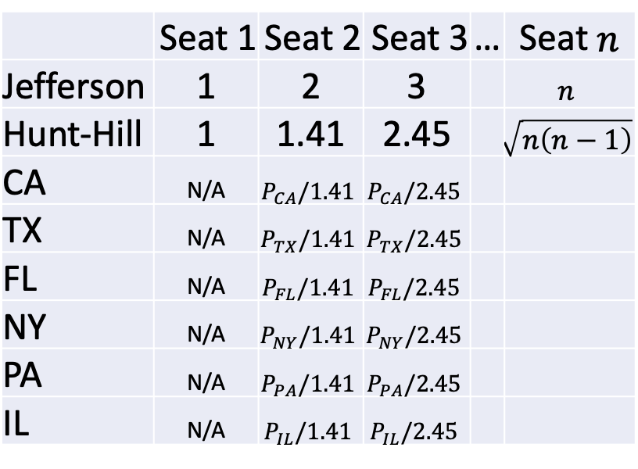
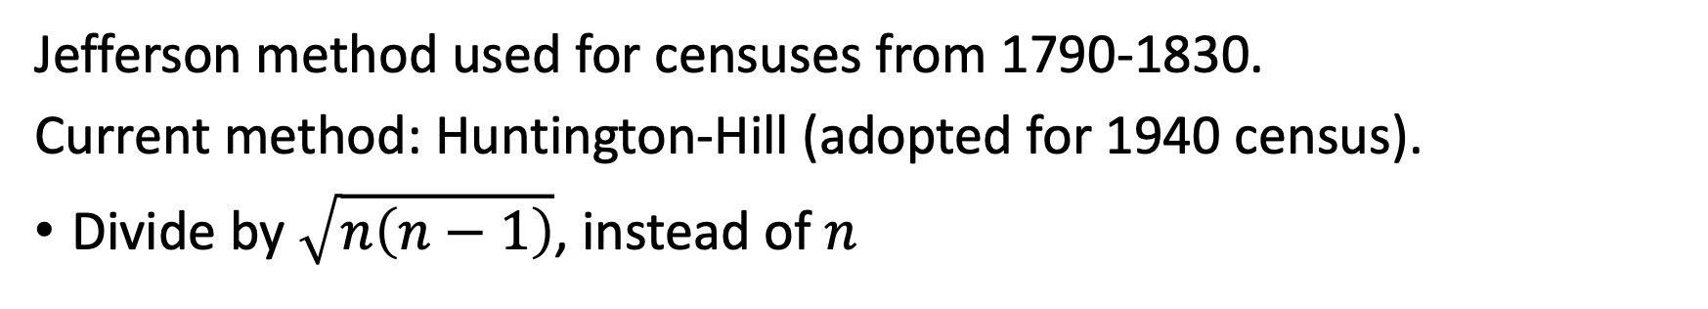
Apportionment for US Congress: History
Jefferson method used for censuses from 1790-1830.
Current method: Huntington-Hill (adopted for 1940 census).
Divide by $\sqrt{n\left(n−1\right)}$, instead of $n$
(Guarantee 1 seat/state)
 | Seat 1 | Seat 2 | Seat 3 | … | Seat $n$
Jefferson | 1 | 2 | 3 |  | $$n$$
Hunt-Hill | 1 | 1.41 | 2.45 |  | $$\sqrt{n\left(n−1\right)}$$
CA | N/A | $$P_{CA}/1.41$$ | $$P_{CA}/2.45$$
TX | N/A | $$P_{TX}/1.41$$ | $$P_{TX}/2.45$$
FL | N/A | $$P_{FL}/1.41$$ | $$P_{FL}/2.45$$
NY | N/A | $$P_{NY}/1.41$$ | $$P_{NY}/2.45$$
PA | N/A | $$P_{PA}/1.41$$ | $$P_{PA}/2.45$$
IL | N/A | $$P_{IL}/1.41$$ | $$P_{IL}/2.45$$
Extra Credit (spreadsheet on Canvas):
Minnesota currently has 8 house seats.
How many would we have if the US still used the Jefferson method?

Slide 34
Summary

Slide 35
Study Guide

Slide 36
Practice: District 7 Results
In District 7, YQ wins 2 seats.
These seats go to CONVER and RD.
Then initial allocation is infeasible (5 men out of 7 seats)
RD swapped with woman of same PARTY (not just LIST)

Slide 37
Practice: District 8 Results
In District 8, YQ wins 3 seats.
Two of these seats go to RD (would be 3 seats if there were 3 candidates).
This shows that someone could be elected with 0 votes!

Slide 38
Warm Up
A | B | C
130 | 140 | 124
118 | 85 | 80
111 | 33 | 18
23 | 14 | 14
There are 12 candidates from three lists (A, B, C) competing for 4 seats (2 of each gender).
Vote totals and genders are shown in the table.
When using the Jefferson/D’Hondt method, how many seats does each list receive?
Identify two reasonable sets of winning candidates. Give a pro and a con for each.
2 | 1 | 3
4 | 6 | 7
5 | 8 | 10
9 | 11 | 12

Slide 39
Greedy Acceptance
Actual Algorithm
A (2) | B (1) | C (1)
130 | 140 | 124
118 | 85 | 80
111 | 33 | 18
23 | 14 | 13
A (2) | B (1) | C (1)
130 | 140 | 124
118 | 85 | 80
111 | 33 | 18
23 | 14 | 13
A (2) | B (1) | C (1)
130 | 140 | 124
118 | 85 | 80
111 | 33 | 18
23 | 14 | 13
Replace man with fewest votes.
Select woman with most votes.
Swap pair with smallest vote difference.

Slide 40
A (2) | B (1) | C (1)
130 | 140 | 124
118 | 85 | 80
111 | 33 | 18
23 | 14 | 13
A (2) | B (1) | C (1)
130 | 140 | 124
118 | 85 | 80
111 | 33 | 18
23 | 14 | 13
Greedy Acceptance
Infeasible
No Affirmative Action
Actual Algorithm
A (2) | B (1) | C (1)
130 | 140 | 124
118 | 85 | 80
111 | 33 | 18
23 | 14 | 13
A (2) | B (1) | C (1)
130 | 140 | 124
118 | 85 | 80
111 | 33 | 18
23 | 14 | 13
Greedy Rejection
Add Highest Vote-Getting Minority/
Maximize Minimum Vote-Getter
Maximize Total Votes
Bonus Points
(add 45 to all female totals)

Slide 41
Different Algorithms
Default + Correction
Objective-Oriented
Greedy (One Pass)
Replace elected majority gender with fewest votes
Replace elected majority gender with minority gender who loses fewest votes.
Add most popular losing minority gender.
Respect Priorities
Maximize Total Votes of Elected Candidates
Maximize Minimum Votes of any Elected Candidate
Reject so long as we remain feasible.
Accept so long as we remain feasible
Same constraints, same priorities, but different algorithms.

Slide 42
Proportional Reasoning: “This feels like a task I could give to my 6th graders”
 | A | B | C
 | 130 | 140 | 124
 | 118 | 85 | 80
 | 111 | 33 | 18
 | 23 | 14 | 14
Total | 382 | 272 | 236
% | 42.9 | 30.6 | 26.5
Seats | 1.72 | 1.22 | 1.06
‘A’ received 43% of the vote, so it should receive 43% of the seats!
Problem: how to round?

