Slide 1
Engineering The Allocation of Public Resources
Professor Nick Arnosti
University of Minnesota

Slide 2
Plan for Today: Maximum Quotas
Sample Content (Abbreviated)
Diversity visa lottery overview
Top Down Algorithm (practice)
Define goals (desirable properties): maximize selected applicants, priority domination.
Conditions under which Top Down Algorithm achieves these goals
Course Overview
Topics
Students
Pedagogy

Slide 3
By the end of lecture, you will be able to…
Describe constraints governing allocation of diversity visas
Calculate the outcome of the Top Down Algorithm.
Determine whether one selection priority dominates another.
Explain what it means for quota categories to be “nested”, and why this matters.

Slide 4
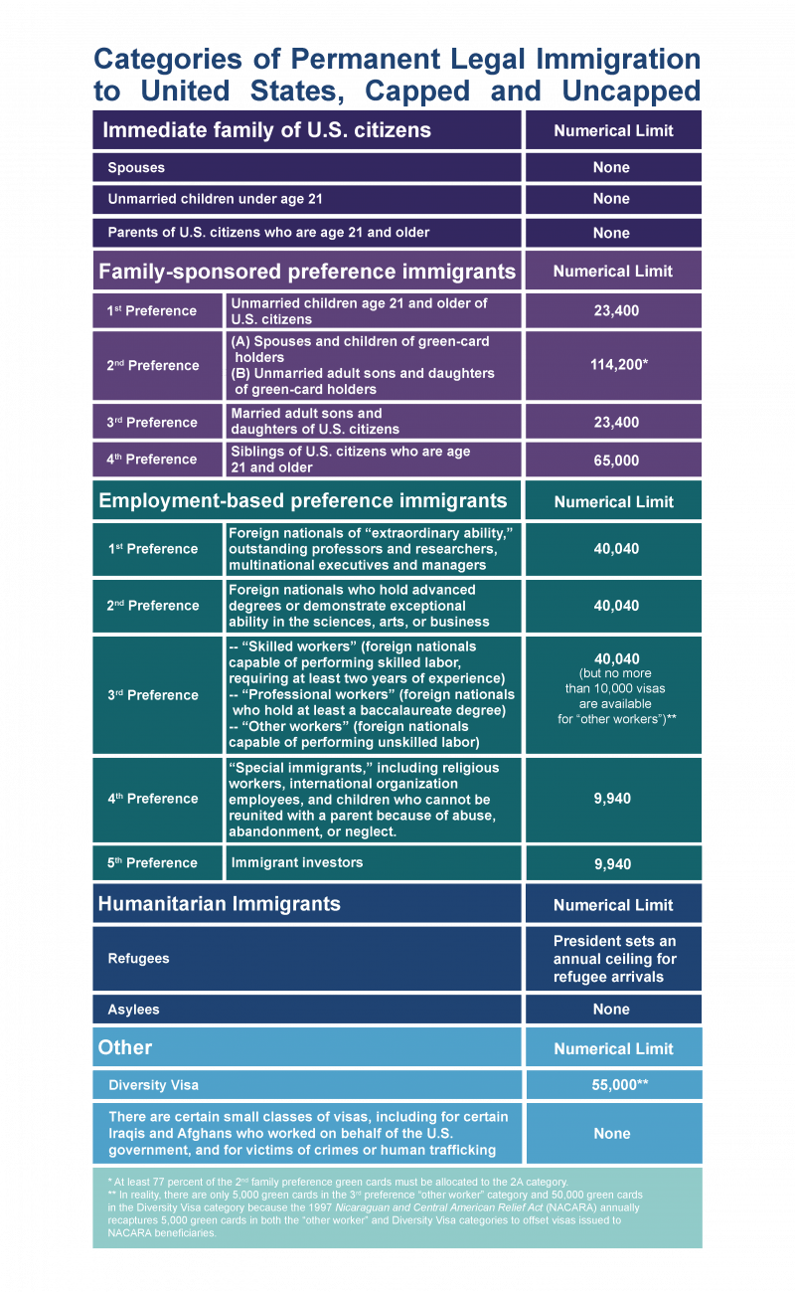
Permanent Visa (Green Card) Categories

Slide 5
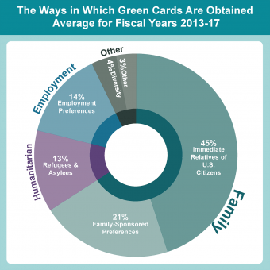
Permanent Visas (Immigrant Visas)
Immediate Family has no Cap
Family-Sponsored Cap of 226,000
Employment-Based Cap of 140,000
Diversity Cap of 55,000
Just over 1 million Green Cards issued each year.
Notes:
https://www.migrationpolicy.org/content/explainer-how-us-legal-immigration-system-works

Slide 6
Diversity Visa Lottery
Eligibility: must be born in a country with few recent immigrants to US.
Maximum Quotas:
Total cap of 55,000.
No country may receive more than 7% of total.
Additional regional caps based on recent immigration patterns.
Lottery:
Each applicant assigned a lottery number that determines priority.

Slide 7
Maximum Quotas Example 1
Quotas:
At most 2 applicants from each country.
At most 3 applicants from each region.
At most 6 applicants in total.
Priority Order:
Country of Origin:
Afghanistan
Bhutan
Cameroon
Djibouti.
Region:
Asia
Africa
1 | 2 | 3 | 4 | 5 | 6 | 7 | 8 | 9 | 10 | 11 | 12
A | B | A | D | B | D | B | D | D | A | C | B
1. Which applicants should we select?
2. Compare answers with your neighbor.
3. Put your answer on the whiteboard.

Slide 8
Maximum Quotas Example 1
Quotas:
At most 2 applicants from each country.
At most 3 applicants from each region.
At most 6 applicants in total.
Priority Order:
Country of Origin:
Afghanistan
Bhutan
Cameroon
Djibouti.
Region:
Asia
Africa
1 | 2 | 3 | 4 | 5 | 6 | 7 | 8 | 9 | 10 | 11 | 12
A | B | A | D | B | D | B | D | D | A | C | B
1. Which applicants should we select?
2. Compare answers with your neighbor.
3. Put your answer on the whiteboard.

Slide 9
Top Down (“Greedy”) Selection Algorithm
Process applicants in priority order. At each step, allocate a visa to the next applicant unless doing so would violate an upper quota (when combined with applicants that have already received visas).
This is a natural algorithm, but is it good?

Slide 10
Goals
Comply with upper quotas.
Select as many applicants as possible.
Choose high priority applicants.
Feasible
Maximize selected applicants
Priority dominate
other feasible selections

Slide 11
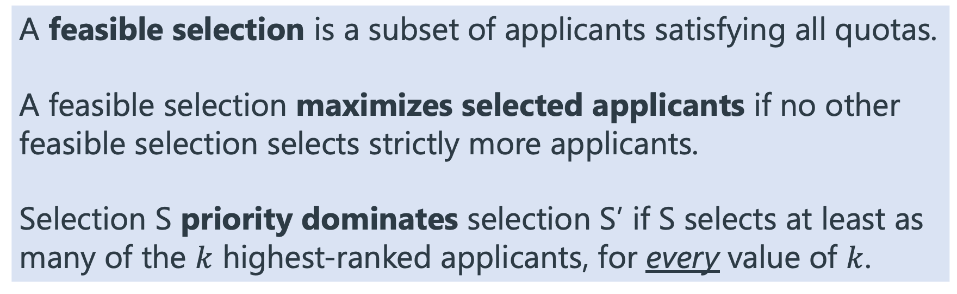
Desirable Properties
A feasible selection is a subset of applicants satisfying all quotas.
A feasible selection maximizes selected applicants if no other feasible selection selects strictly more applicants.
Selection S priority dominates selection S’ if S selects at least as many of the $k$ highest-ranked applicants, for every value of $k$.

Slide 12
Maximum Quotas Example 1
Quotas:
At most 2 applicants from each country.
At most 3 applicants from each region.
At most 6 applicants in total.
Priority Order:
Country of Origin:
Afghanistan
Bhutan
Cameroon
Djibouti.
Region:
Asia
Africa
1 | 2 | 3 | 4 | 5 | 6 | 7 | 8 | 9 | 10 | 11 | 12
A | B | A | D | B | D | B | D | D | A | C | B
Choose a different priority order. For your order, does the Greedy algorithm select 6 applicants?
Find a priority order such that Greedy does not select 6 applicants.

Slide 13
Maximum Quotas Example 2
Quotas:
At most 2 applicants from each country.
At most 3 applicants from each age group.
At most 6 applicants in total.
Priority Order:
Country of Origin:
Afghanistan
Bhutan
Cameroon
Djibouti.
Age Group:
Young
Middle Aged
1 | 2 | 3 | 4 | 5 | 6 | 7 | 8 | 9 | 10 | 11 | 12
A | B | A | D | B | A | B | D | D | A | D | B
How many applicants are selected by the greedy algorithm?
Is there a feasible selection that accepts more applicants?

Slide 14
What is the difference between these examples?
Quota categories are nested (laminar) if for any two categories, either one contains the other, or nobody is in both categories.
Example 1: categories are nested.
Example 2: not nested
R1
R2
Y
M
C1
C1
C3
C2
C3
C2
C4
C4

Slide 15
Greedy “works” when categories are nested
Quota categories are nested (laminar) if for any two categories, either one contains the other, or nobody is in both categories.
Theorem (Maximum Quotas).
The greedy algorithm always finds a feasible selection which is not priority dominated by any other feasible selection.
If categories are nested, it always finds a selection that maximizes selected applicants and priority dominates any other feasible selection.
When categories are not nested, the number of people selected by the greedy algorithm may depend on the processing order!

Slide 16
Engineering The Allocation of Public Resources
Professor Nick Arnosti
University of Minnesota

Slide 17
Content Overview
Matching Foundations
Serial Dictatorship, Top Trading Cycles, Deferred Acceptance
School choice, residency matching, board game swaps
Diversity and Affirmative Action
Quotas, reserves
Visa allocation, Indian Civil Service, Brazilian University Admissions…
Dynamic Matching
Cycles, chains, lotteries, waiting lists
Organ allocation, housing allocation
Algorithms for Affirmative Action
Informs Transactions on Education

Slide 18
Student Body
~20 students
Officially offered at masters level
Most students are Seniors in ISyE
Several PhD students, several sophomores/juniors
Students in Econ, CS, Stats, BME, Civil…

Slide 19
Pedagogical Principles
Minimize: notation, proofs
Incorporate: examples
Keep: definitions, theorem statements
Frequent homework (2x/week), quick (instant) feedback

Slide 20
Questions?
nickarnosti.com
arnosti@umn.edu

